Slide 1

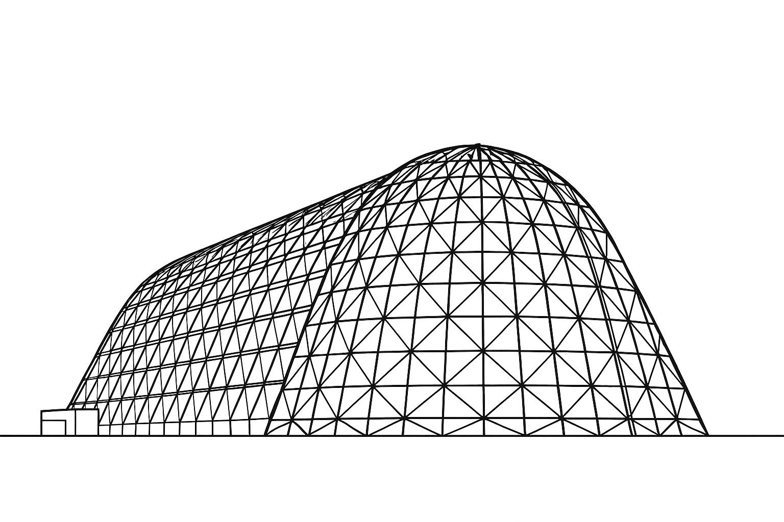

Simcenter Systems Simulation for Space Sytems Design and Electrified Rocket Development
TFAWS 2025 Interdisciplinary 2 Technical Session
Presented by: Darren Nunes
Siemens DI SW
Thermal & Fluids Analysis Workshop 2025
NASA Ames Research Center
San Jose, CA
August 4-7, 2025

Slide 2
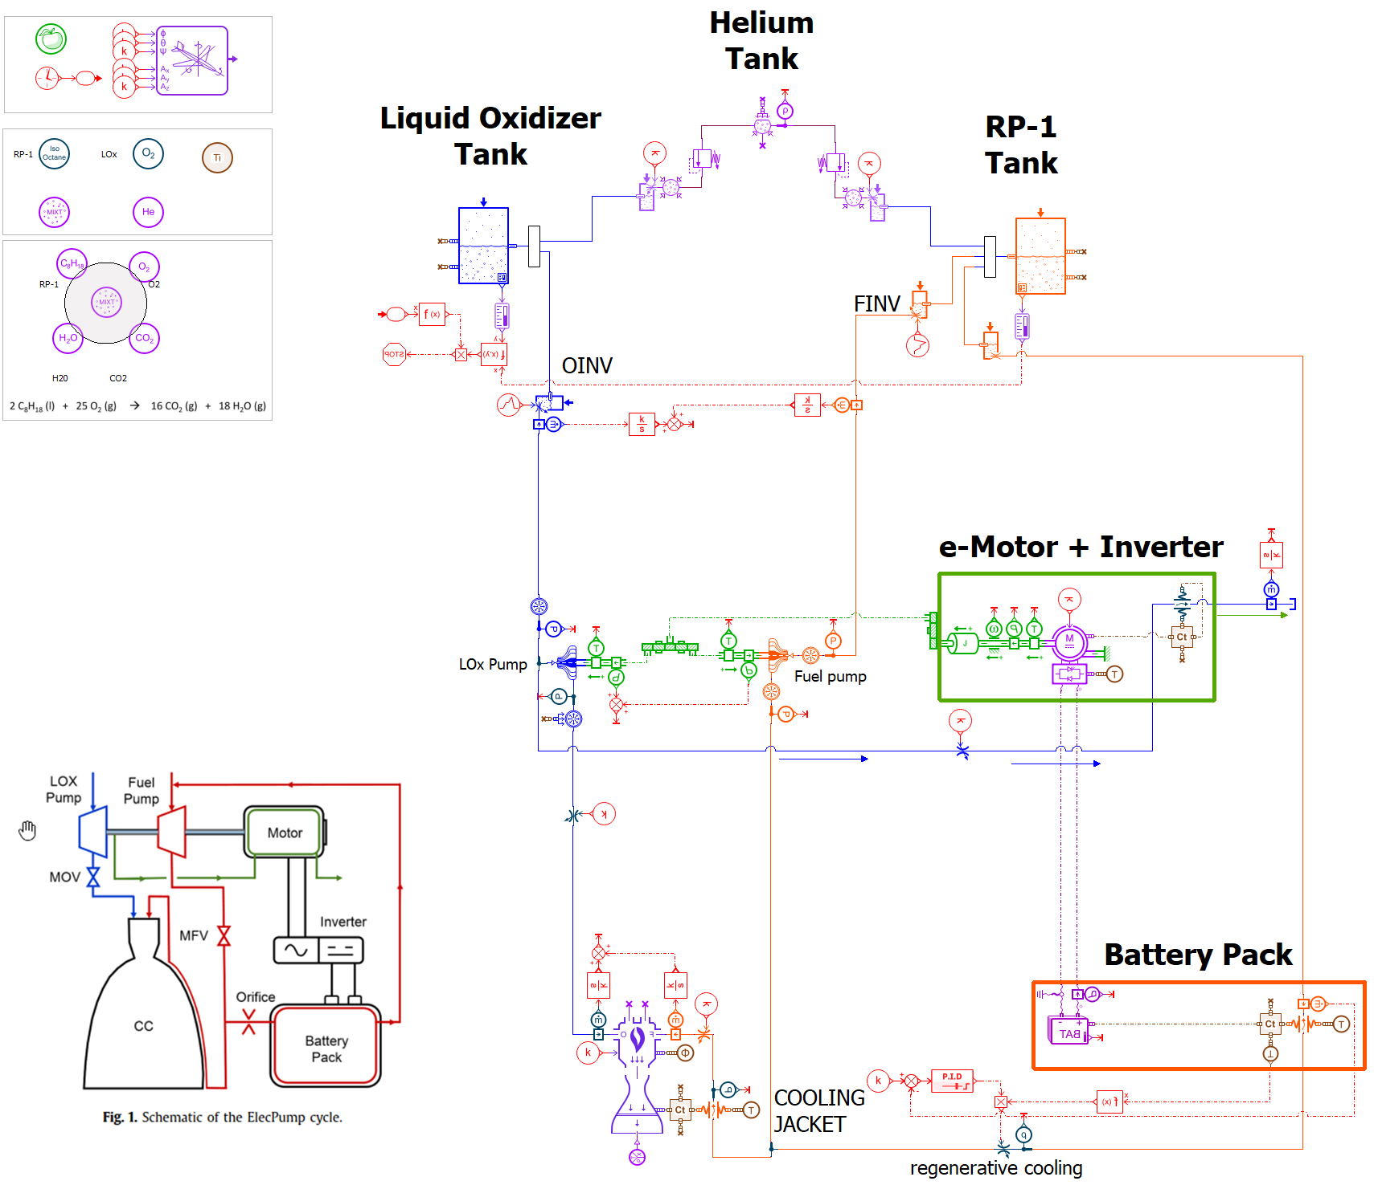
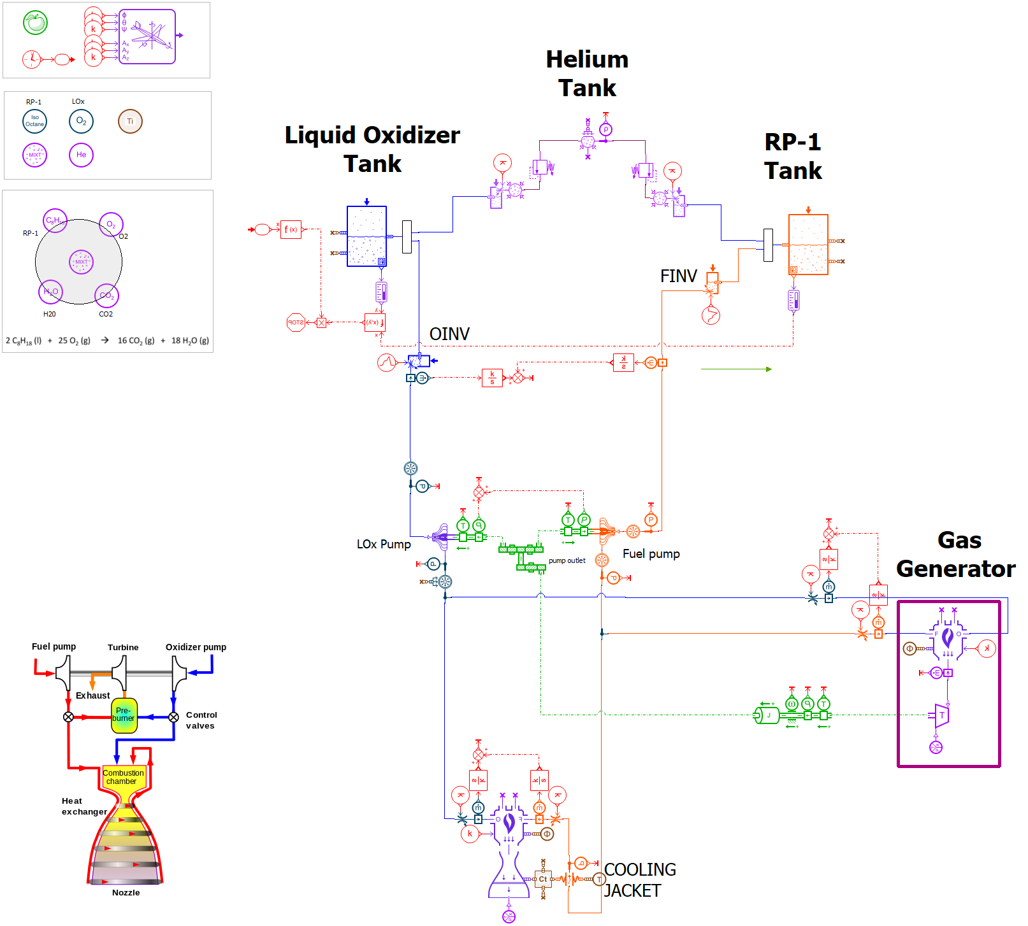

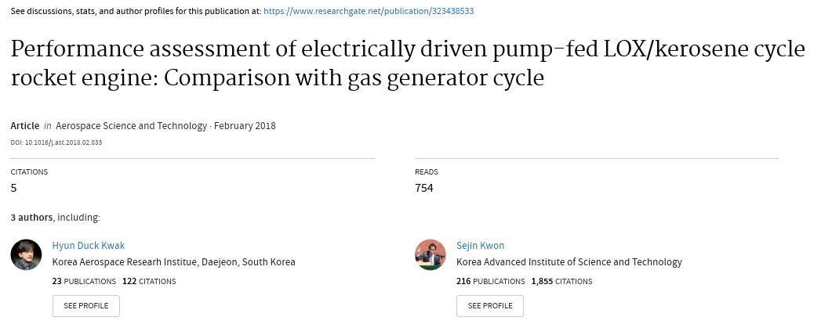
Architecture Trade-Off (Lox / RP-1 Rocket Engine)
#1 Electric driven pump-fed
#2 Gas Generator

Slide 3
Architecture Trade-Off (Lox / RP-1 Rocket Engine)
#1 Electric driven pump-fed
#2 Gas Generator

Slide 4

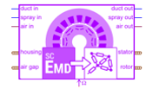





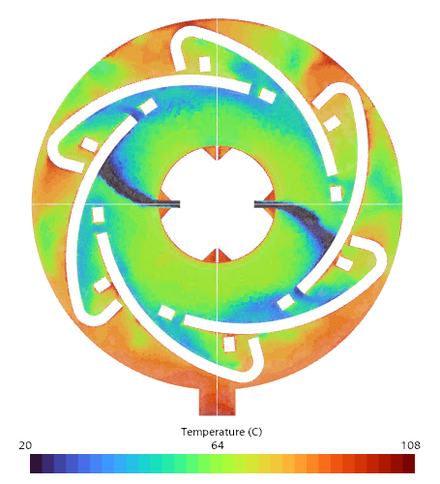

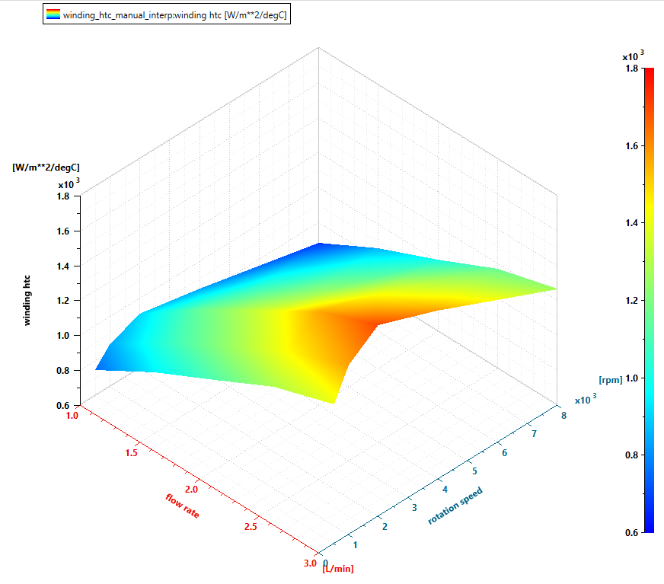
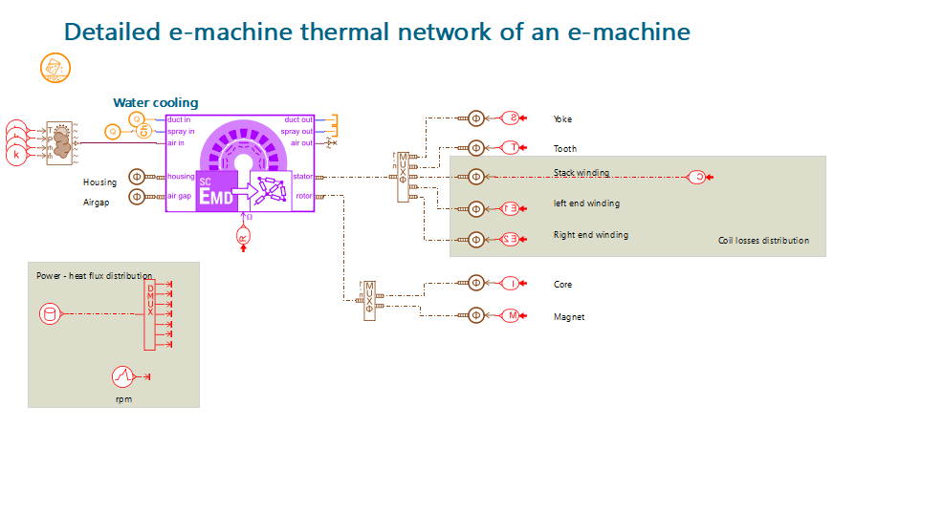
Simcenter E-machine Development Workflow
Requirements capture into model
Analysis & Export of detailed E-Motor design model
E-Motor thermal system simulation with imported detailed LPTN model
Thermal model integration into the system and full vehicle model
Updated analysis & Export of detailed E-Motor design model using CFD results
Coherent E-Motor cooling high-fidelity CFD simulation
Update Motor LPTN model with High-Fidelity Oil Cooling performance map
TEAMCENTER

Slide 5



Simcenter E-machine Development Workflow
Requirements capture into model
Analysis & Export of detailed E-Motor design model
E-Motor thermal system simulation with imported detailed LPTN model
Thermal model integration into the system and full vehicle model
Updated analysis & Export of detailed E-Motor design model using CFD results
Coherent E-Motor cooling high-fidelity CFD simulation
Update Motor LPTN model with High-Fidelity Oil Cooling performance map

Slide 6
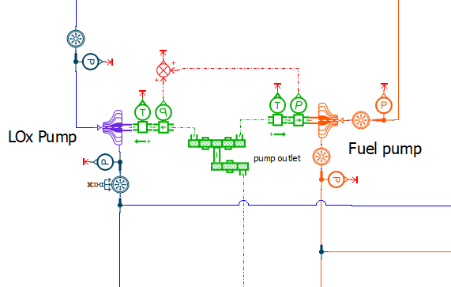
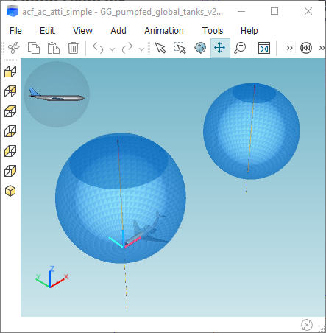
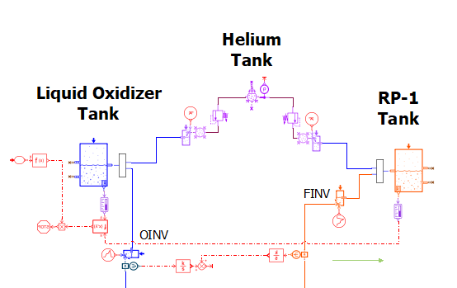
Requirements – Fluid Pumps and Tanks
Pumps Lox-Fuel
Power densities 20 - 15 kW/kg
Efficiences 0.66 - 0.61
Outlet Pressure 5.06– 6.82 MPaA
Inlet Pressure 0.4 – 0.25 MPaA
Mixture ratio = 2.45
Pump characteristic based on Suter curves
Tanks
Spherical shape
Aluminium alloy and INCONEL 718 material
Helium tank Pressure = 27 MPaA
Thin-walled theory used to compute solid mass
Ullage safety factor applied
Initial fluid quantity adapted to burning time (300 or 1200 sec)

Slide 7
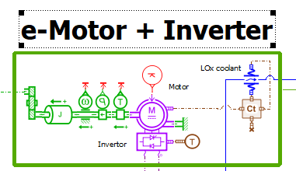
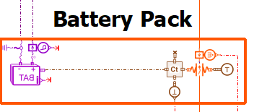
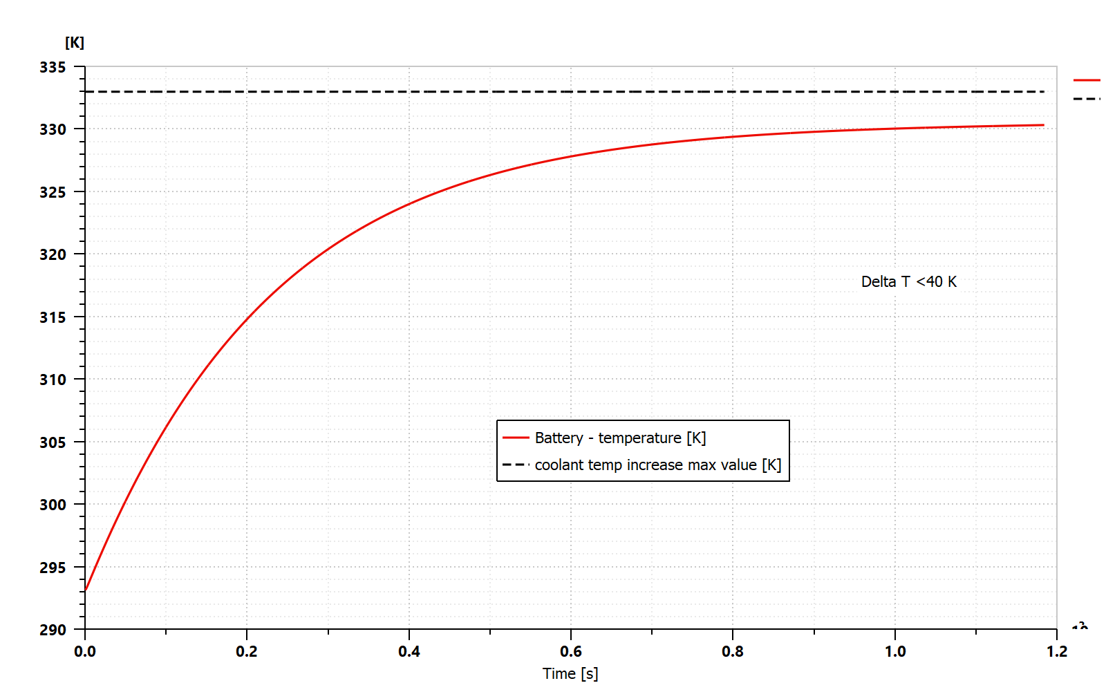
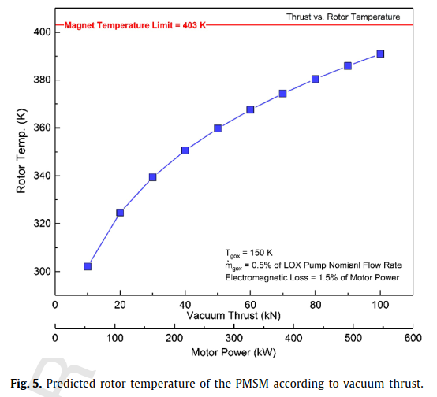
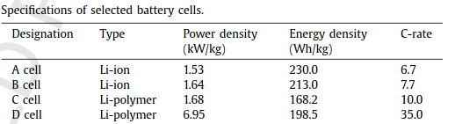
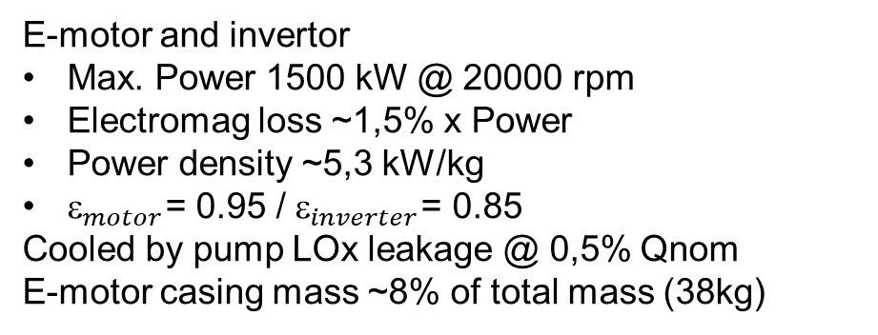
Requirements – Electric Pack
E-motor and invertor
Max. Power 1500 kW @ 20000 rpm
Electromag loss ~1,5% x Power
Power density ~5,3 kW/kg
$_{motor}$= 0.95 / $_{inverter}$= 0.85
Cooled by pump LOx leakage @ 0,5% Qnom
E-motor casing mass ~8% of total mass (38kg)
Battery
Lithium Polymer cell chemistry (D cell)
Cooled by Fuel Battery mass casing ~8% of total mass (38kg)
Max. coolant temperature increase = 40 K
To match this requirement, 2% of fuel nominal flow was used to cool down battery pack
RP-1 coolant

Slide 8
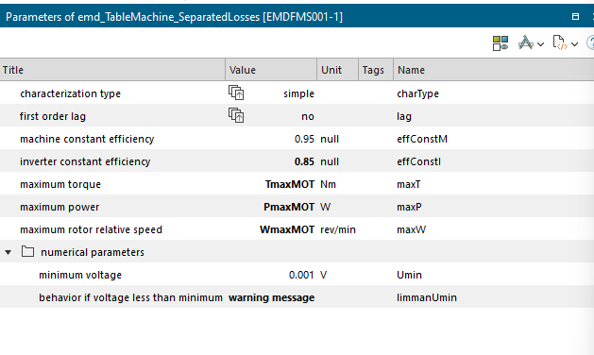
Requirements - Motor
E-motor and invertor
Max. Power 1500 kW @ 20000 rpm
Electromag loss ~1,5% x Power
Power density ~5,3 kW/kg
$_{motor}$= 0.95 / $_{inverter}$= 0.85
Cooled by pump LOx leakage @ 0,5% Qnom
E-motor casing mass ~8% of total mass (38kg)
E-motor and invertor
Continuous torque: 80 Nm
Max Torque: 99.2
Max Power: ~ 356047 W (356 kW)
Max Rotor Relative Speed: 44200 rev/min

Slide 9
Simcenter E-machine Development Workflow – Systems
Requirements capture into model
Analysis & Export of detailed E-Motor design model
E-Motor thermal system simulation with imported detailed LPTN model
Thermal model integration into the system and full vehicle model
Updated analysis & Export of detailed E-Motor design model using CFD results
Coherent E-Motor cooling high-fidelity CFD simulation
Update Motor LPTN model with High-Fidelity Oil Cooling performance map

Slide 10
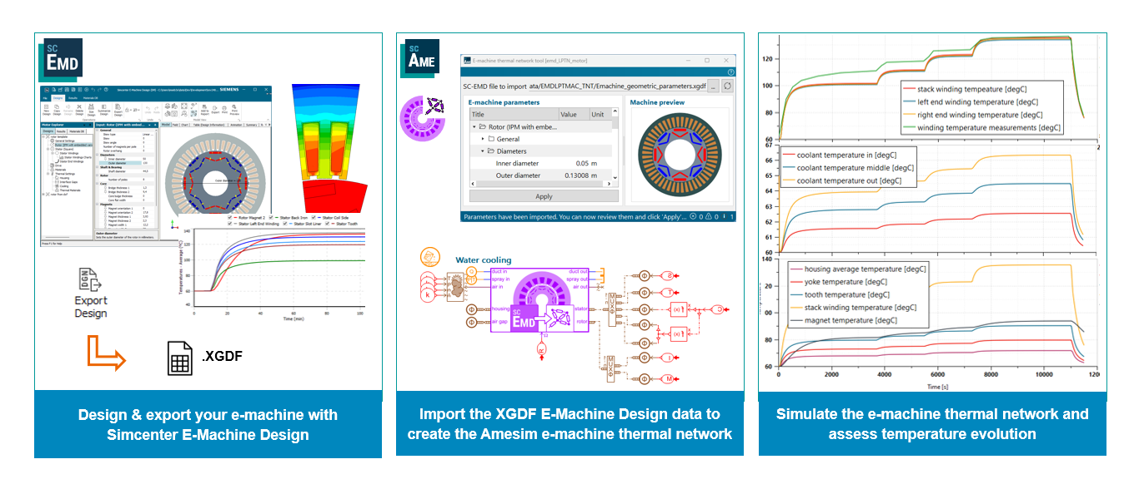
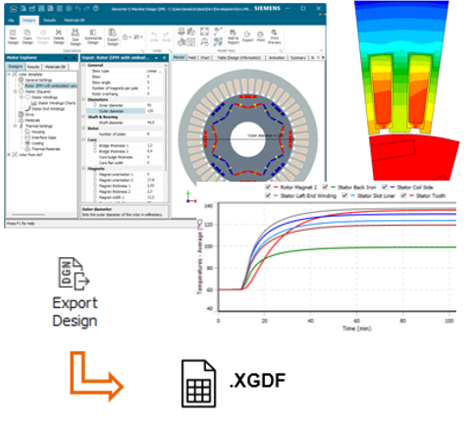
Simcenter E-machine Development Workflow – Thermal Network
Design & export e-machine
Assess machine temperature evolution for various drive cycles
Import high fidelity oil cooling performance map

Slide 11
Simcenter E-machine Development Workflow – Systems
Requirements capture into model
Analysis & Export of detailed E-Motor design model
E-Motor thermal system simulation with imported detailed LPTN model
Thermal model integration into the system and full vehicle model
Updated analysis & Export of detailed E-Motor design model using CFD results
Coherent E-Motor cooling high-fidelity CFD simulation
Update Motor LPTN model with High-Fidelity Oil Cooling performance map

Slide 12
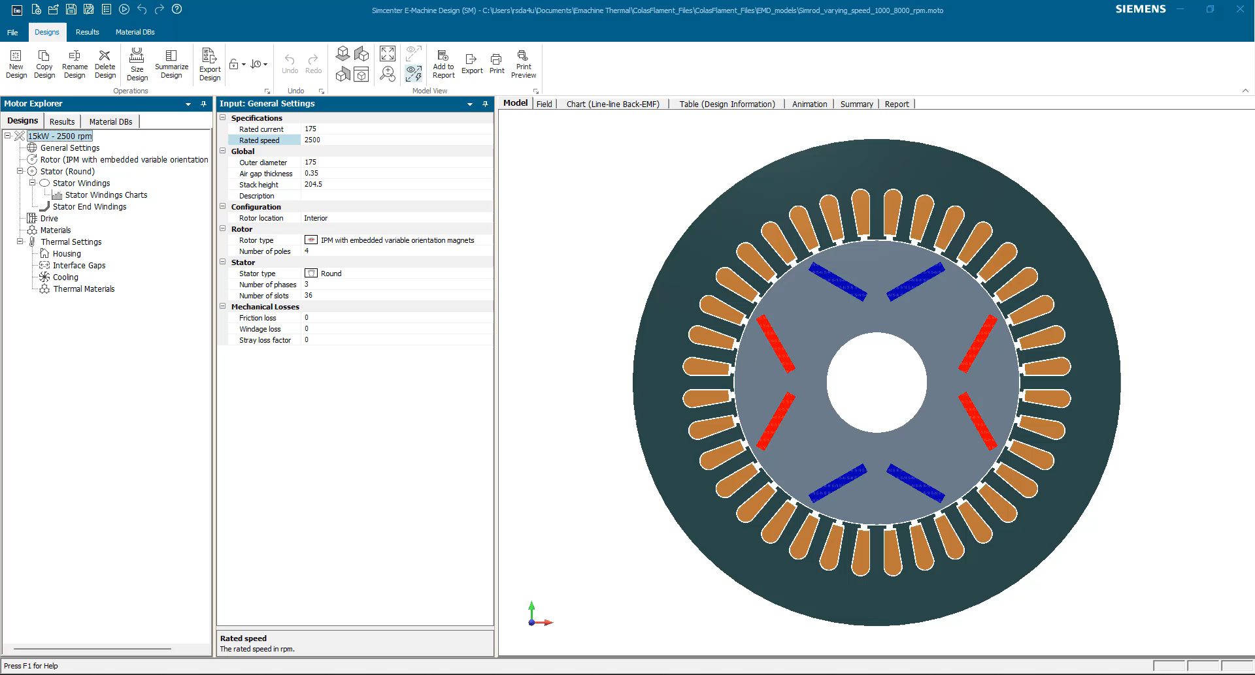
Analysis of detailed E-Motor design model

Slide 13
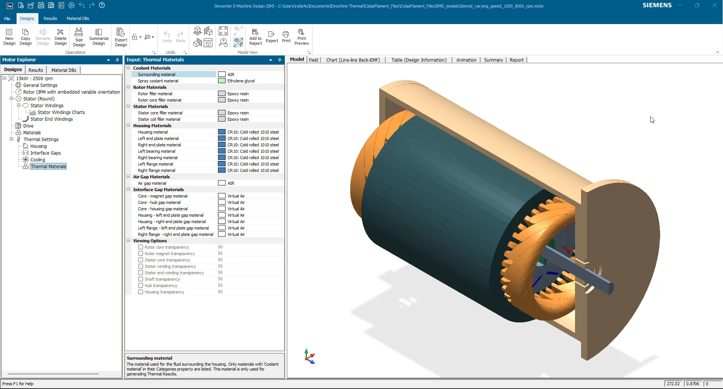
Export of detailed E-Motor design model

Slide 14

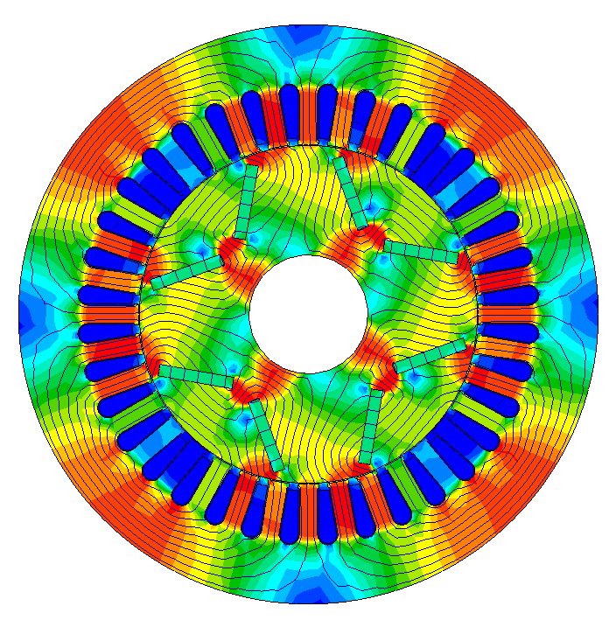
Analysis & Export of detailed E-Motor design model
Analysis of detailed E-Motor design model
Benefit summary
Efficient and precise component sizing to meet desired targets and requirements.
Analyze the impact of drive configurations and control strategies on vehicle performance.
Significantly reduced development time and costs.
Masses, Heat losses, Forces
Unrestricted | © Siemens 2024 | E-Machine Development & Thermal Management | Siemens Digital Industries Software

Slide 15
Simcenter E-machine Development Workflow – Systems
Requirements capture into model
Analysis & Export of detailed E-Motor design model
E-Motor thermal system simulation with imported detailed LPTN model
Thermal model integration into the system and full vehicle model
Updated analysis & Export of detailed E-Motor design model using CFD results
Coherent E-Motor cooling high-fidelity CFD simulation
Update Motor LPTN model with High-Fidelity Oil Cooling performance map

Slide 16
E-Motor thermal system with imported detailed LPTN model - Import

Slide 17
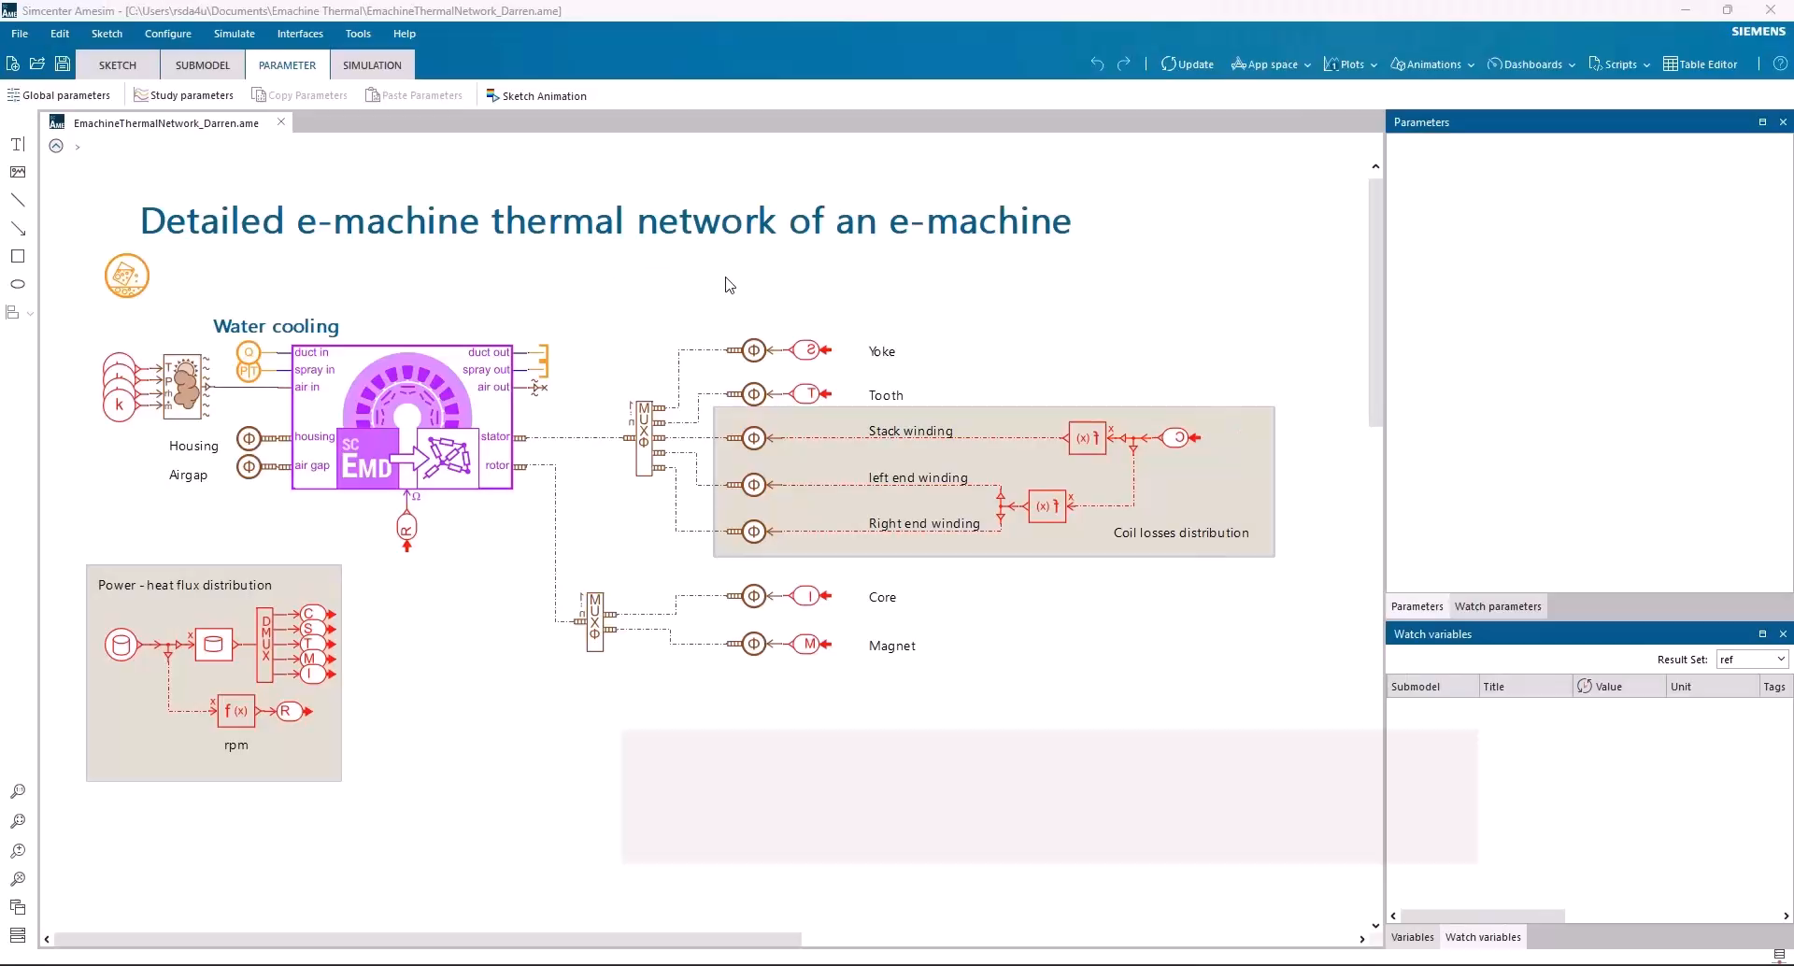
E-Motor thermal simulation with imported detailed LPTN model Import of the e-machine design & Edit

Slide 18
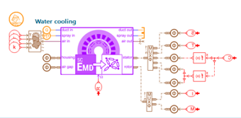
E-motor Thermal System Simulation with Imported LPTN Model
Benefit summary
Seamless and detailed thermal architecture and pre-sizing
Automated creation of a detailed LPTN model
Easy to modify manually and add cooling effects, change materials

Slide 19
Simcenter E-machine Development Workflow – Systems
Requirements capture into model
Analysis & Export of detailed E-Motor design model
E-Motor thermal system simulation with imported detailed LPTN model
Thermal model integration into the system and full vehicle model
Updated analysis & Export of detailed E-Motor design model using CFD results
Coherent E-Motor cooling high-fidelity CFD simulation
Update Motor LPTN model with High-Fidelity Oil Cooling performance map

Slide 20
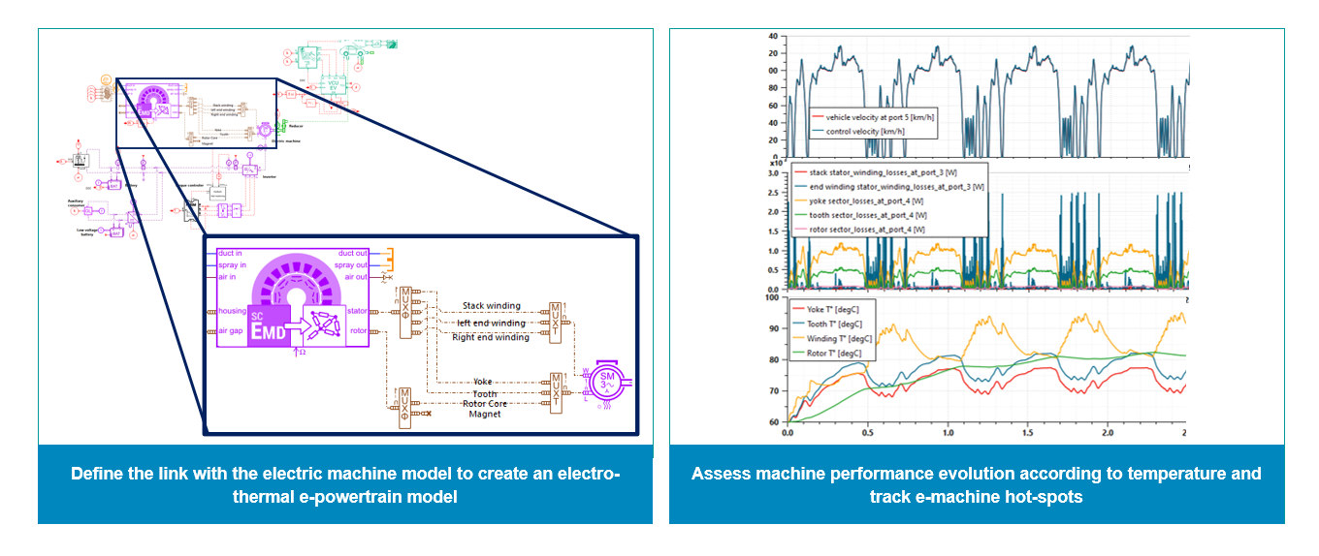
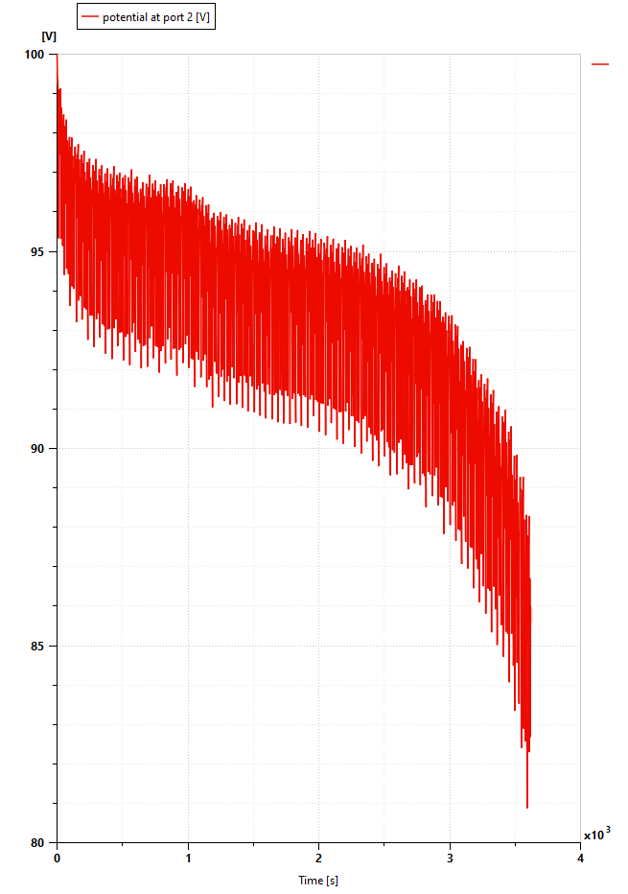
Thermal model integration into the system model
Now that oil cooling heat transfer performance has been tabulated over the operating range of the E-Motor and oil/cooling system, we embed this high-fidelity map into the imported LPTN
We can verify the component design and cooling architecture change impact on design & vehicle requirements
High fidelity direct oil cooling HTC map

Slide 21
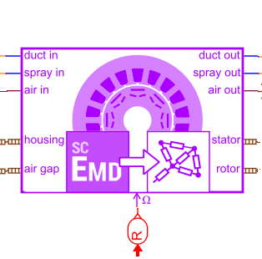
Thermal model integration (LPTN) into the system model
Benefit summary
“Thermal management design choices are directly articulated and arbitrated at the system level with the required confidence”

Slide 22
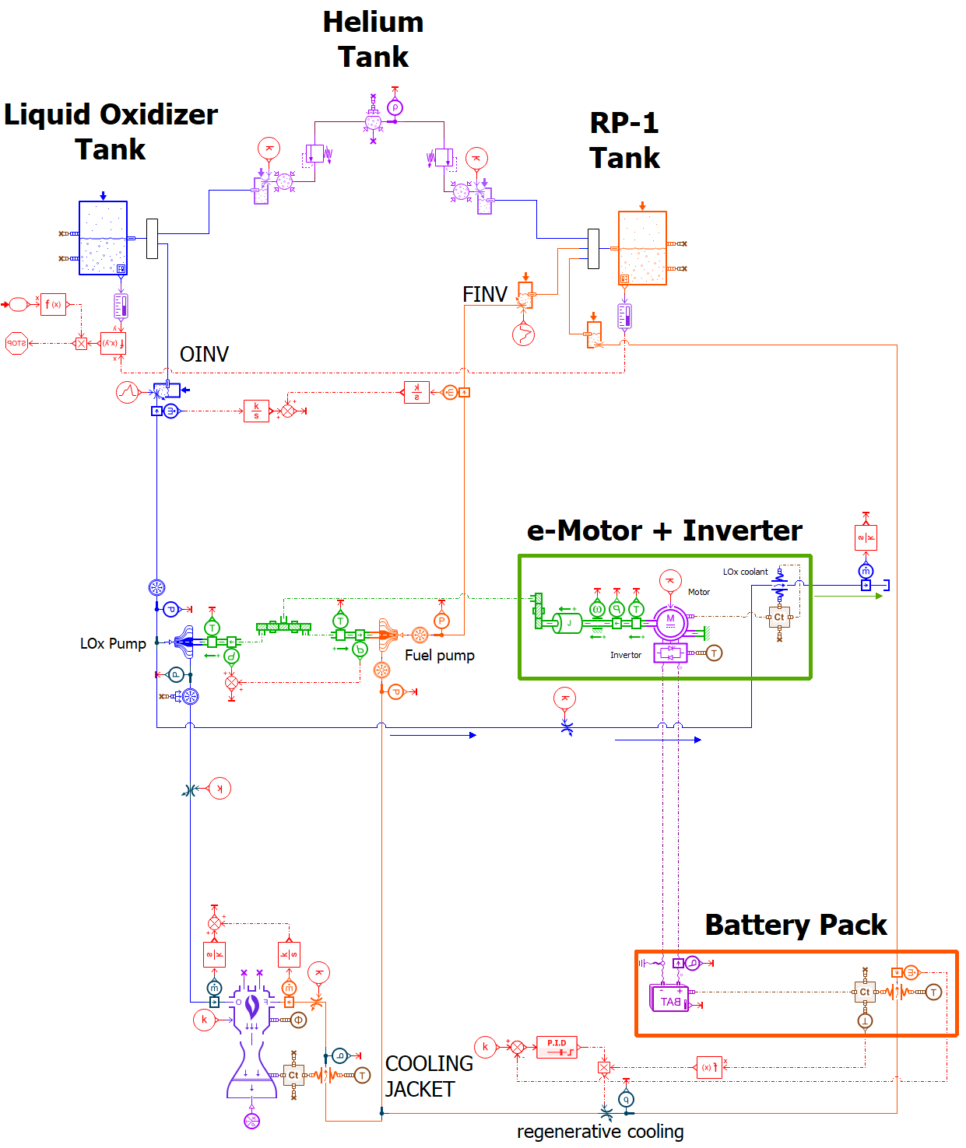
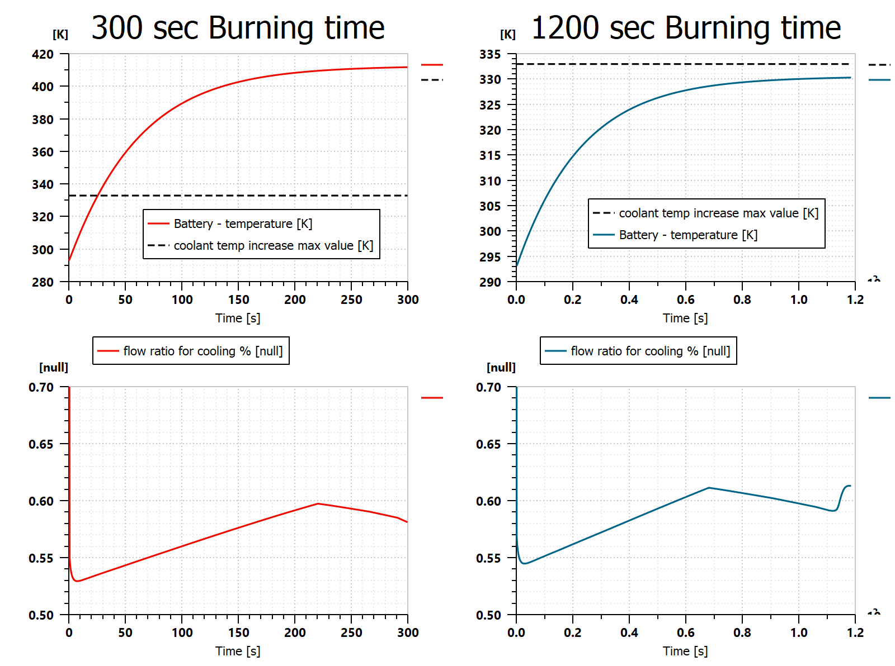
Conclusion
The Digital Thread allows E-Drive stakeholders to keep consistency between requirements & sizing, components design, integration and testing.
Fast turn-around time thanks to automation of models transfer
(~ 6 months → 1 month)
Integration of high-fidelity direct oil cooling simulation into advanced E-Motor design LPTN
Leverage benefit of high-fidelity simulations into a dynamic simulation of the mass & power budget balance
( ~ sim time reduces from 1000+ hrs to seconds)
Increasing model fidelity will help to refine design of electric machine and capture physical interactions between:
electric machine
2 ϕ thermal cooling system
cryogenic feeding pump and lines
Notes:
Notes : simulation will help to refine cooling strategy of emotor targeting 0,5% of nominal pump LOX flows is not enough to limit deltaT increase to 40 K for 300 sec burning configuration. Control might be requested here to adapt required amount of flow….

Slide 23
Contact
Darren Nunes
Senior Simcenter Solutions Consultant
Siemens Digital Industries Software
Darren.nunes@siemens.com

