Slide 1

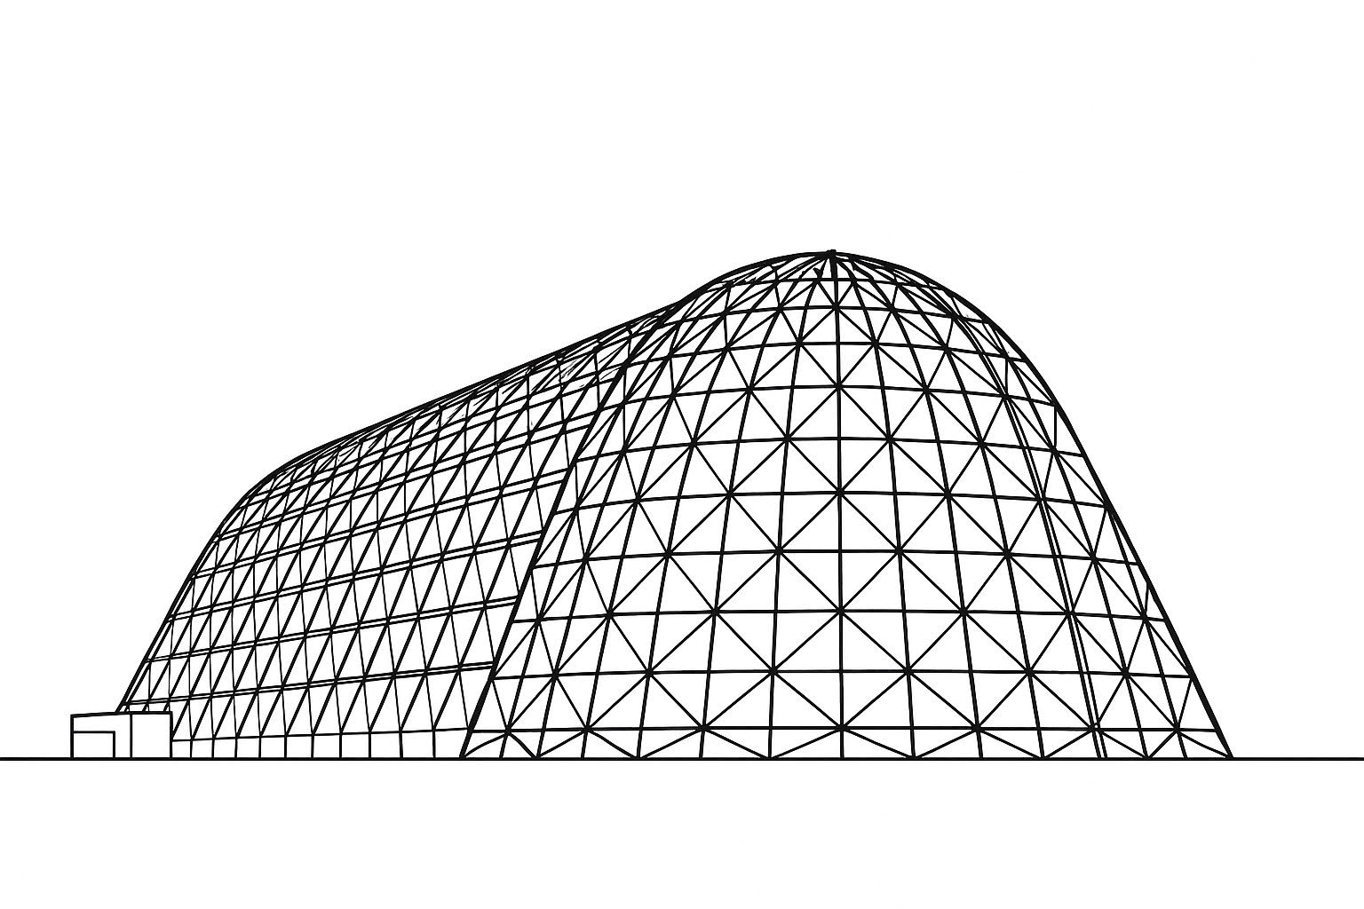

Thermal Modeling of an ESPA-Class Satellite with OHP and DSABR Architecture: A Comparative Study Using Thermal Desktop and ThermQuik
TFAWS 2025 Interdisciplinary Technical Session
Presented by: Dr. Kevin R. Anderson
Calif. State Polytechnic Univ., Pomona
Kevin R. Anderson
Calif. State Polytechnic University, Pomona
George DeMoulin, Ariel Gatti, Alyssa Vu Ingenium Technical Services, Inc.
Thermal & Fluids Analysis Workshop 2025
NASA Ames Research Center
San Jose, CA
August 4-7, 2025

Slide 2
Agenda
What is ThermQuik?
Key capabilities
ThermQuik Model Development
Structure of a ThermQuik model
ThermQuik: Project Phases
Demo case: ESPA Class DSABR Satellite
Future development

Slide 3
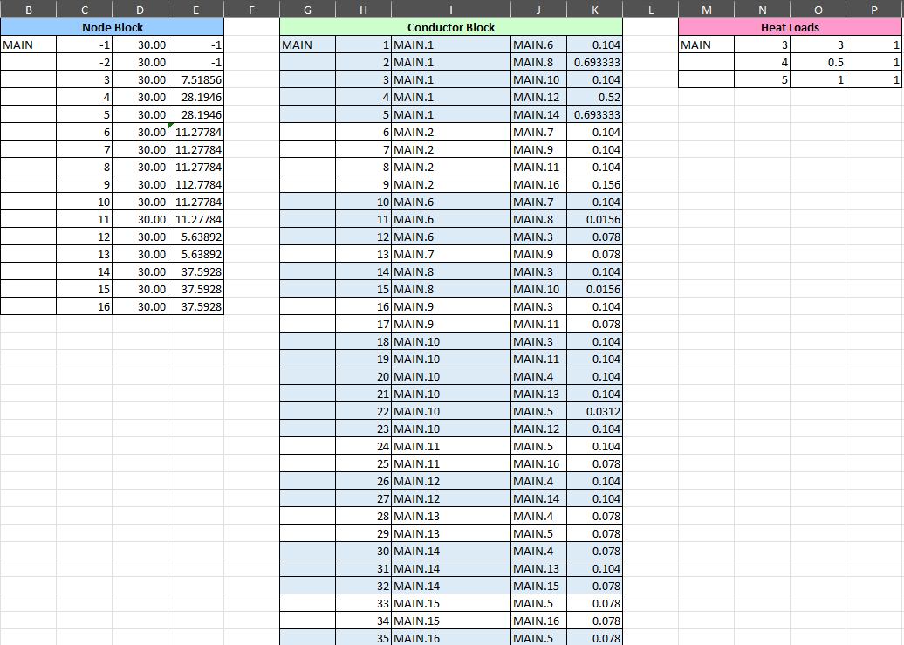
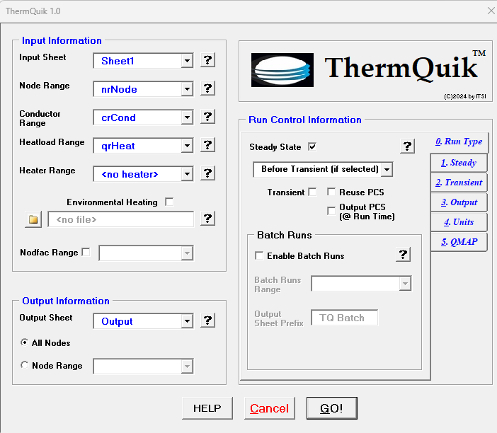
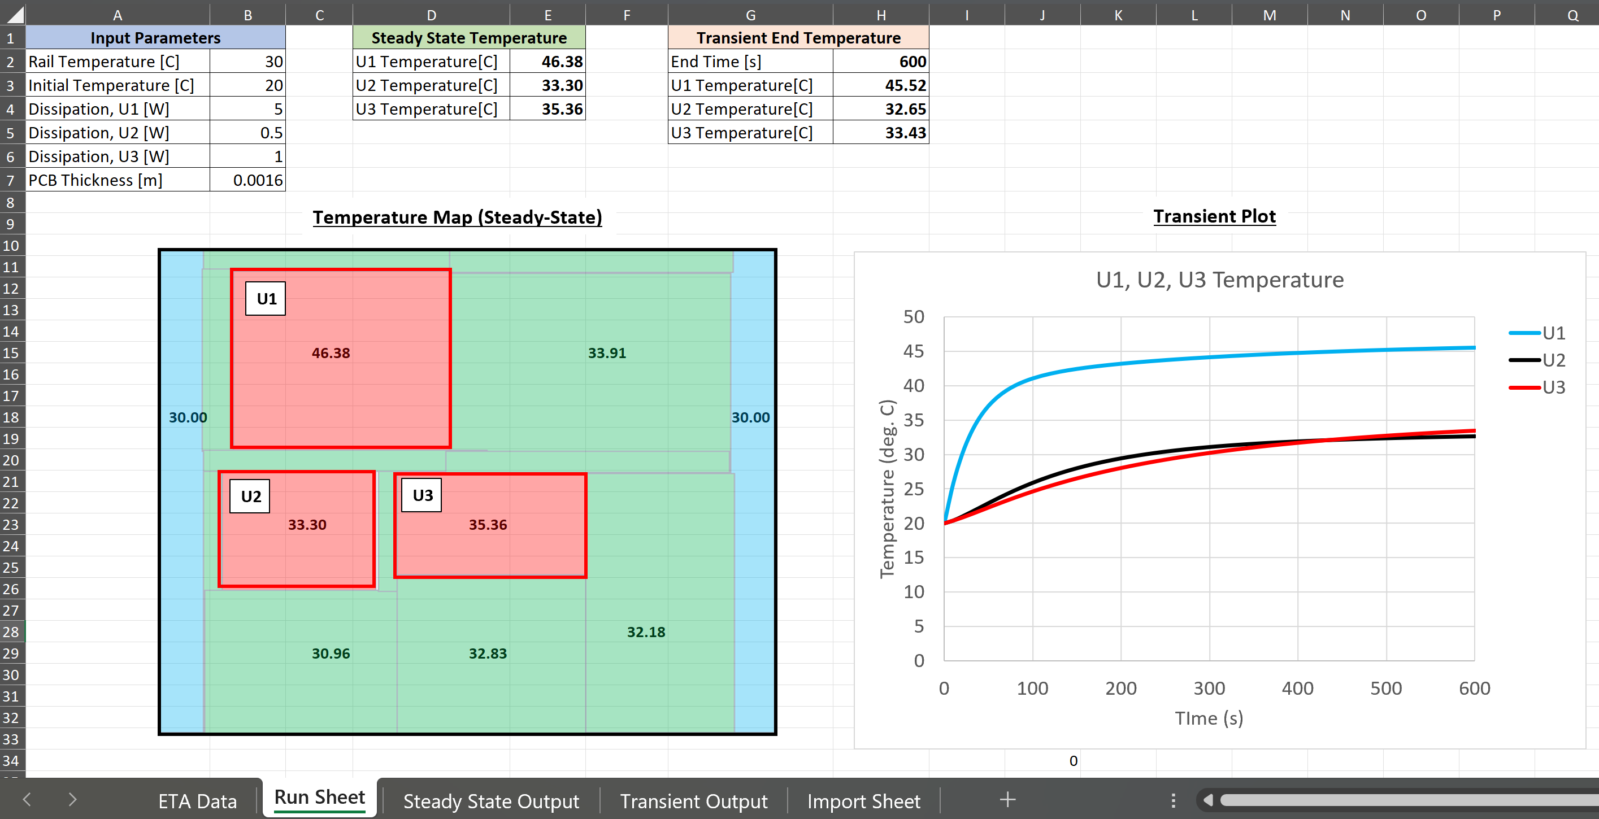
What is ThermQuik?
Excel-based thermal analyzer that enables a wide spectrum of thermal analysis options ranging from Back-Of-The-Envelope calculations to spacecraft analysis
Thermal analyzer capable of solving lumped-parameter networks requiring steady state and/or transient conditions
Excel-based thermal analyzer with SINDA-like network definition inputs utilizing node/conductor blocks and submodel definition
Ability to implement time-varying heat loads and heaters
A tool that bridges the gap between full-feature commercial analyzers and paper and pencil
Is 100% integrated with EXCEL in the Office365 environment.
Includes a Thermal Desktop model translator
Build and Run Thermal Model in Excel
Postprocess and Analyze Results, in Excel

Slide 4
Key Capabilities of ThermQuik
Steady-state
Newton-Raphson solution of First Law of Thermodynamics
Transient
One explicit and two implicit solution methods
Static and time dependent heat loads
User-defined arrays
Environmental heating
User-defined in ThermQuik or imported from TD
Heaters
User-defined heaters for steady-state or transient cases
Batch runs
Allows sequential, multiple runs of a thermal network for parametrized cases
Pre-processor reuse
Save and reuse preprocessed networks
Considerable time savings when dealing with large thermal networks
Thermal Desktop model translator
Translates the TD *.inp files into ThermQuik node, conductor, heatload, heater, and symbols block
Other analyzer importers could be implemented in the future based on user feedback

Slide 5
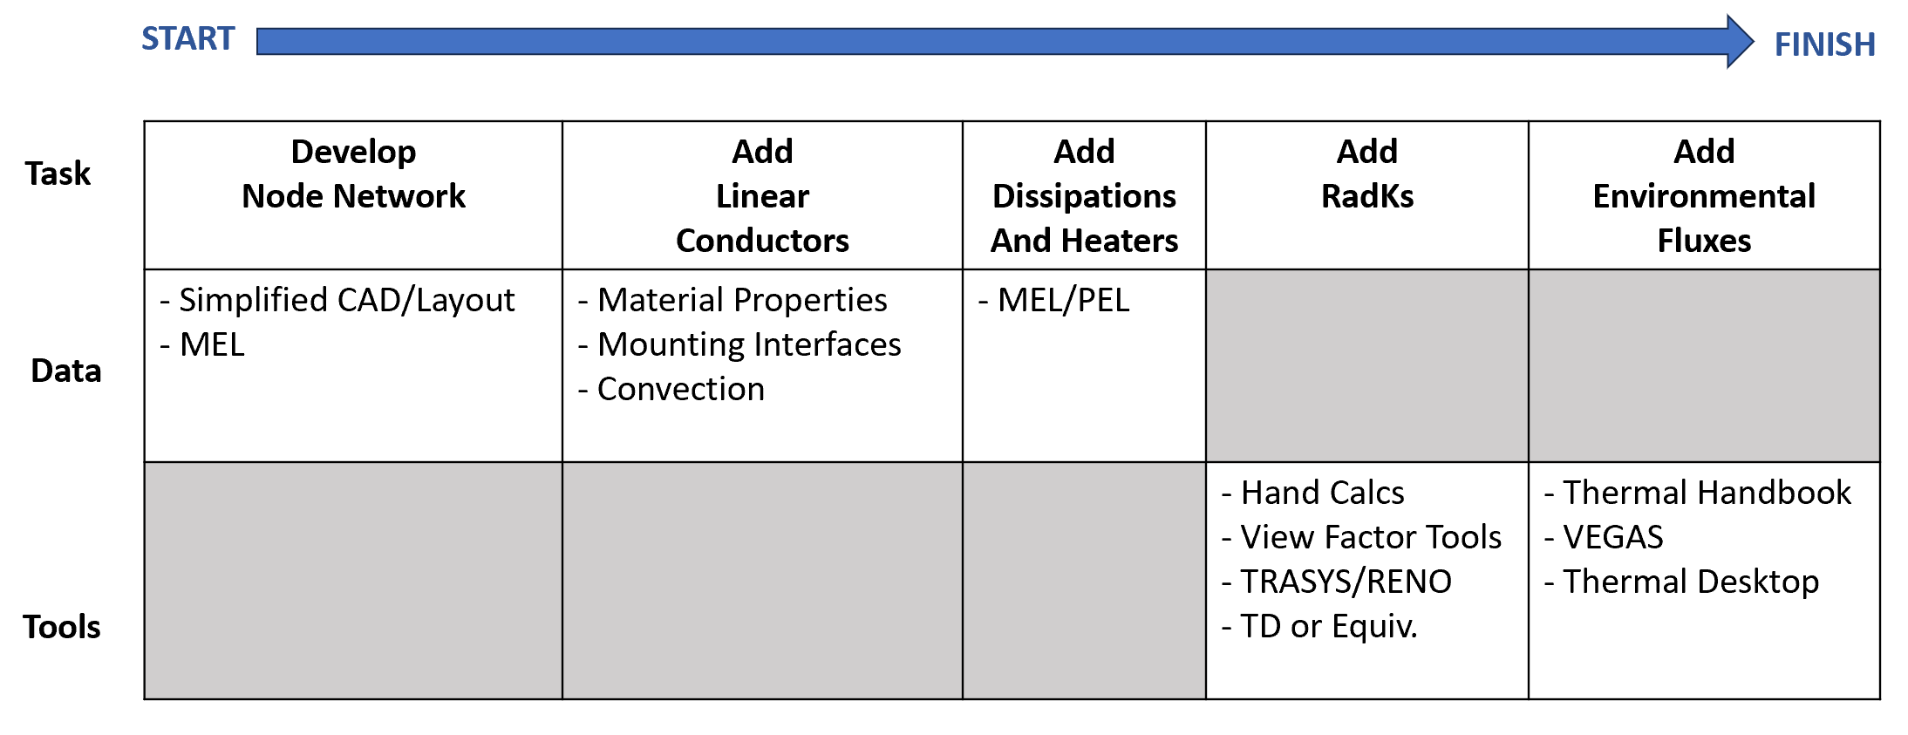
ThermQuik Model Development

Slide 6
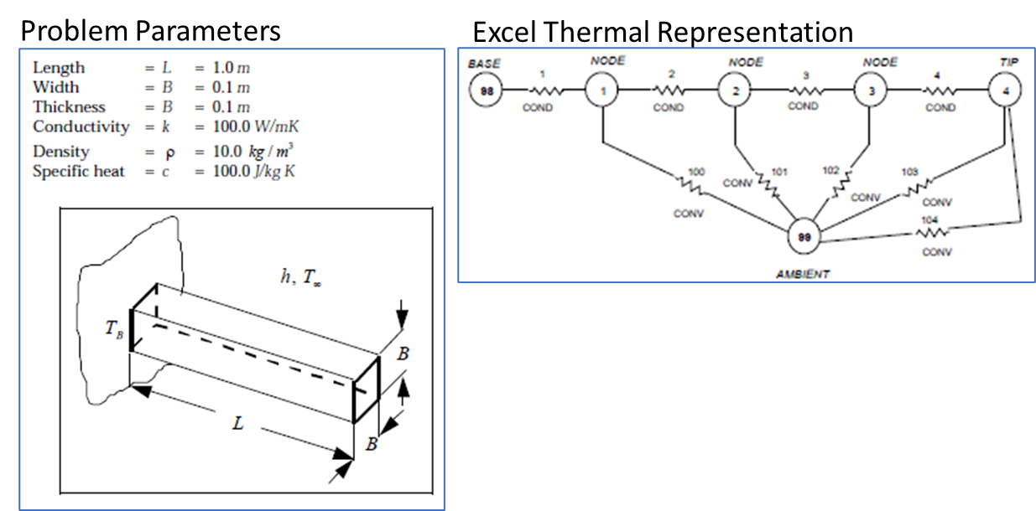
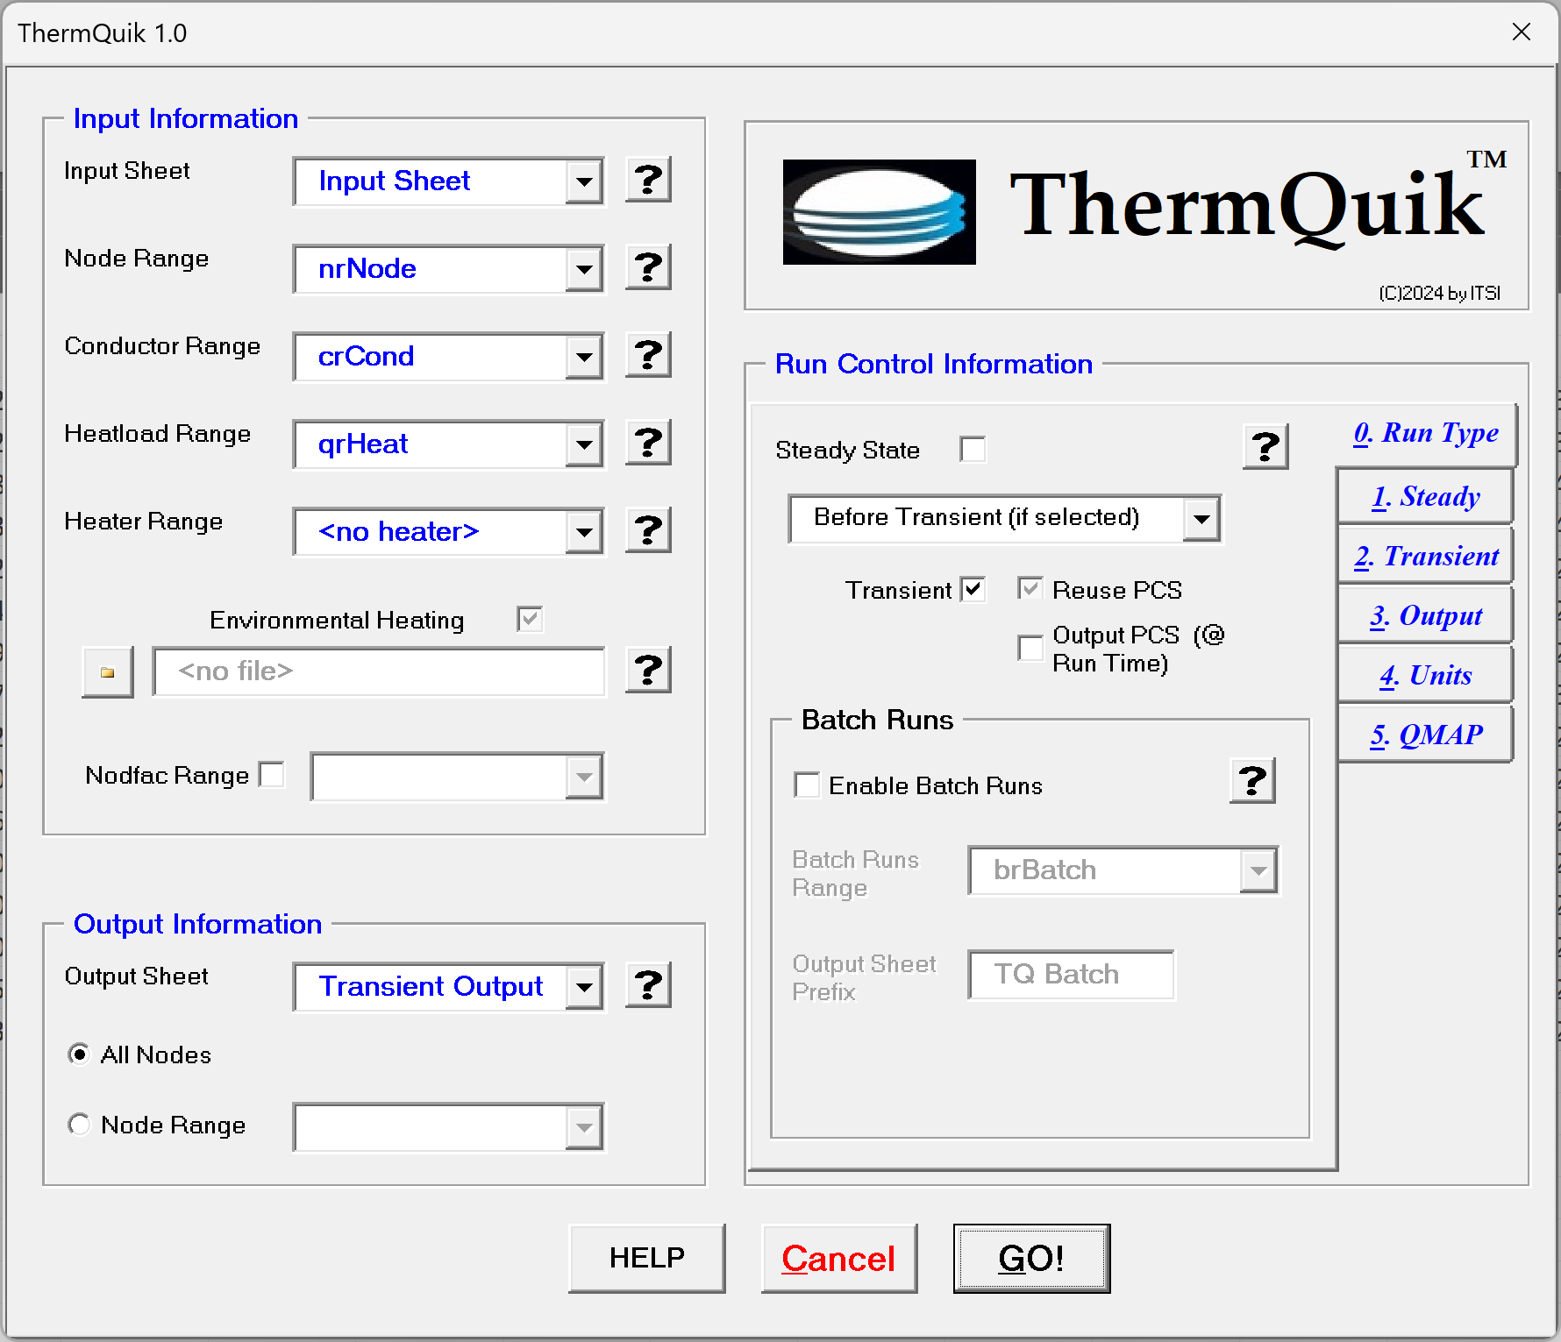
Structure of a ThermQuik Model
Thermal network representation of a rectangular fin with convection
ThermQuik Main Input Screen
Excel Thermal Representation

Slide 7
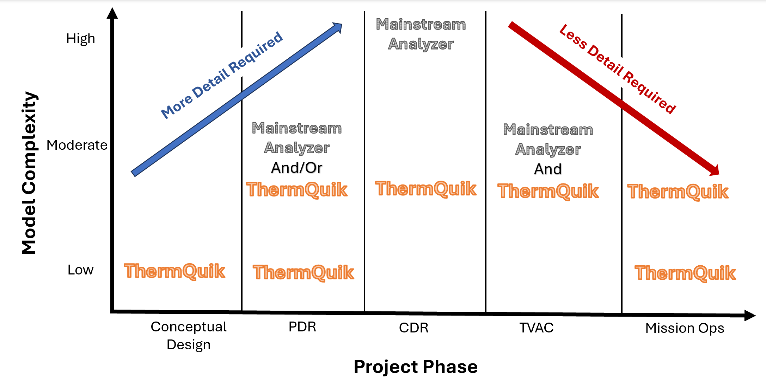
ThermQuik: Project Phases

Slide 8
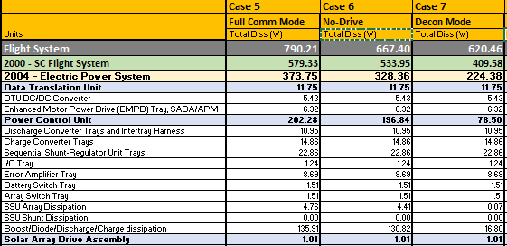
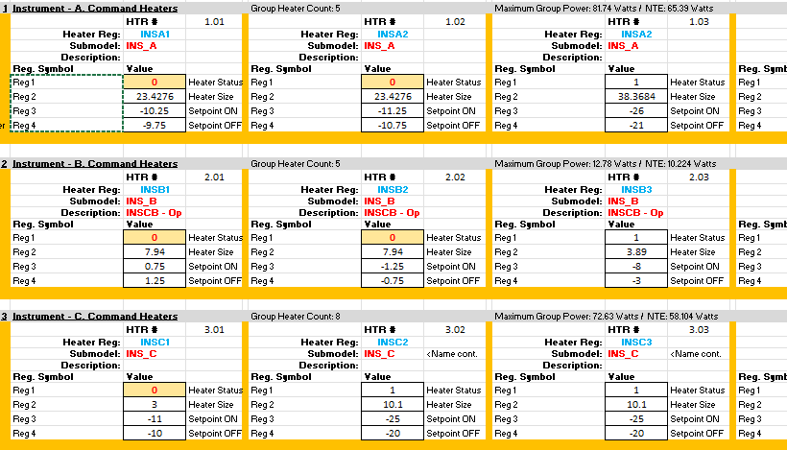
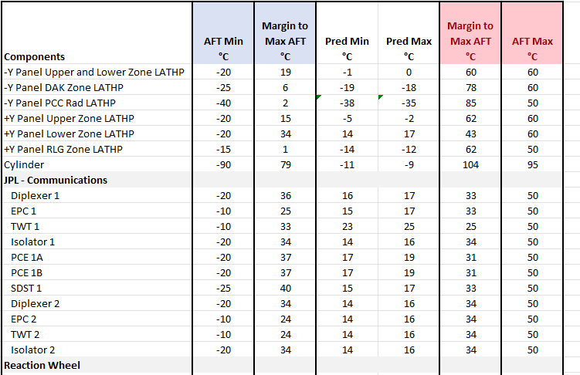
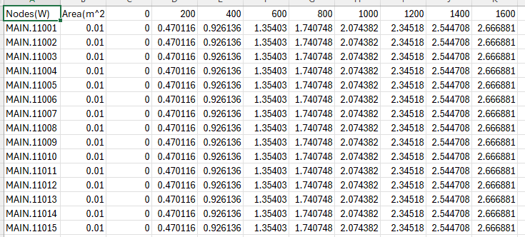
ThermQuik: SC Analysis Platform
Most input/output can be self-contained in one WORKBOOK!!
At present, environmental heating is input from a separate Excel workbook to minimize S/C workbook size – easier/quicker to save file.
Power Definition
Sheet: SC_Pow
Node
Definition
Conductor
Definition
S/C Requirements
Heater
Definition
Thermal Network
Payload Definition
Sheet: SC_Heater
Sheet: SC_Def
Summaries
Environmental Heating Definition
Case 1
Case 2
. . .
Case N
Sheet: SC_Env
Reports
Read-in from external Excel file
Temperatures
EXCEL Environment

Slide 9
Test Case of Thermal Desktop to ThermQuik
The model detailed in the paper below was used as a testcase of importing a ThermalDesktop model into ThermQuik
“Thermal Analysis of an ESPA-Class Host Satellite Using Oscillating Heat Pipes (OHP’s) & Deployable Solar Array Backed Radiator (DSABR)” by A. E. Deravanessian, K. R. Anderson, Calif. State Polytechnic Univ. at Pomona/Mechanical Engineering, AIAA SciTech Conference January 3-4, 2022, San Diego, CA, USA

Slide 10
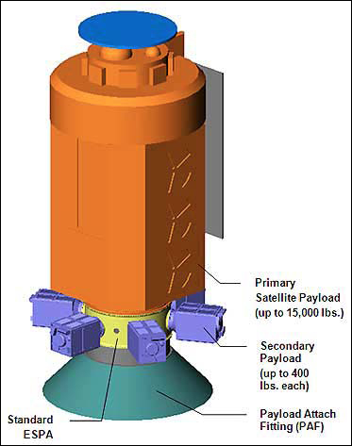
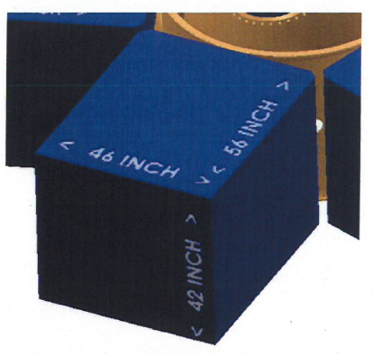
ESPA Spacecraft
Evolved Expendable Launch Vehicle (EELV) Secondary Payload Adapter (ESPA) created in 2000’s for DoD secondary payload launches.
ESPA Rings accommodate ESPA Standard and Grande.
ESPA-Class satellite fit within allotted dimensions.
Carried to LEO, then jettisoned. Have opportunity to continue orbit raising.
Serve as a template for small-sat manufacturing and launches.
(ESPA Grande Dimensions)
http://www.milsatmagazine.com/story.php?number=797849281
https://www.csaengineering.com/products-services/espa/
CF. Deravanessian, Alexander, and Kevin R. Anderson. "Thermal analysis of an ESPA class host satellite using oscillating heat pipes and deployable solar array backed radiator." In AIAA SCITECH 2022 Forum, p. 1910. 2022.

Slide 11
Deployable Solar-Array Backed Radiators (DSABR) Technology
Deployable Solar Array and Radiators are prevalent among larger spacecraft, however add cost and complexity to the design.
DSABR combines the two deployable technologies into one stacked package, increasing solar array and radiator area, scaling power collection and dissipation by up to 100% (in the case evaluated, increased scaling can allow for higher percentages.)
CF. Deravanessian, Alexander, and Kevin R. Anderson. "Thermal analysis of an ESPA class host satellite using oscillating heat pipes and deployable solar array backed radiator." In AIAA SCITECH 2022 Forum, p. 1910. 2022.

Slide 12
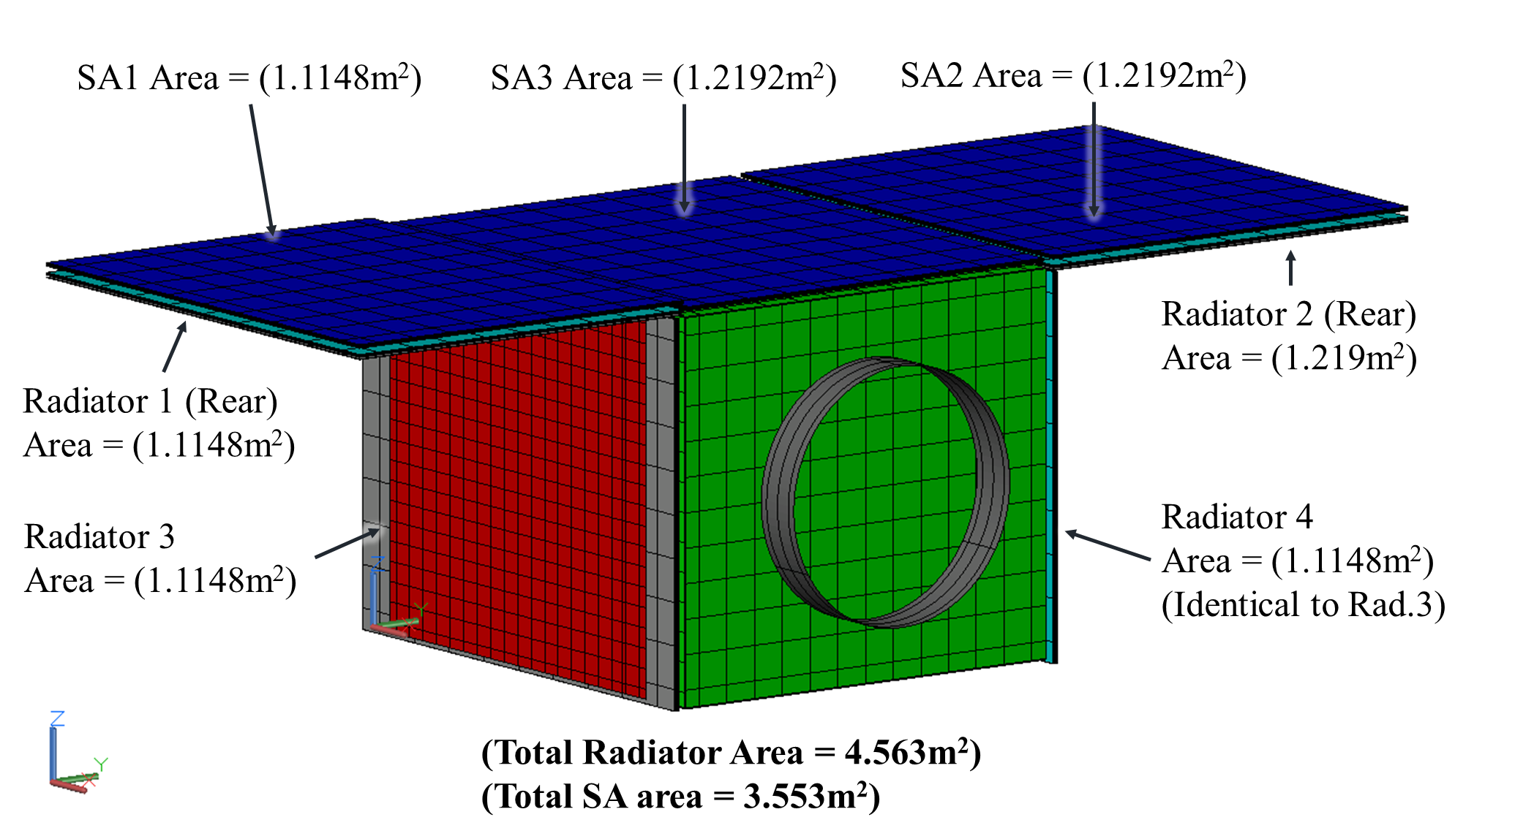
Solar Array and Radiators
Radiator area of spacecraft with similar geometry is limited to ~2.23 m³. DSABR more than doubles area to 4.56 m³.
“Daisy-chaining” modular DSABR arrays allows for scalability for the user’s requirements (similar to that of Orbital ATK’s ESPA implementation)
CF. Deravanessian, Alexander, and Kevin R. Anderson. "Thermal analysis of an ESPA class host satellite using oscillating heat pipes and deployable solar array backed radiator." In AIAA SCITECH 2022 Forum, p. 1910. 2022.

Slide 13
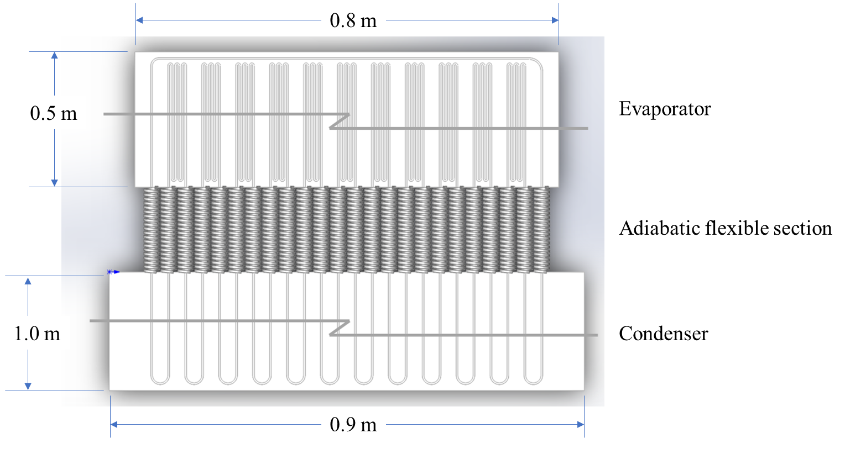
OHP Network Design
High thermal conductivity makes OHP’s a prime selection for heat transport from high dissipating components.
OHP evaporators are located at high dissipating component interfaces.
OHP condensers are located at radiator surfaces.
OHP’s have a flexible section, for DSABR deployment.
Takurou Diamaru’s publicly available OHP model was modified by JPL cohorts to meet system requirements.
Feature | Value
Number of Turns | 240
Heating Section Length (mm) | 2000
Cooling Section Length (mm) | 4000
Heating Plate Width (mm) | 800
Turn Radius (mm) | 1
Width of Plate (mm) | 900
Length of Plate (mm) | 1500
Thickness of Plate (mm) | 3.8
Heat Input (W) | 500
Cold Temperature (°C) | -10
CF. Deravanessian, Alexander, and Kevin R. Anderson. "Thermal analysis of an ESPA class host satellite using oscillating heat pipes and deployable solar array backed radiator." In AIAA SCITECH 2022 Forum, p. 1910. 2022.

Slide 14
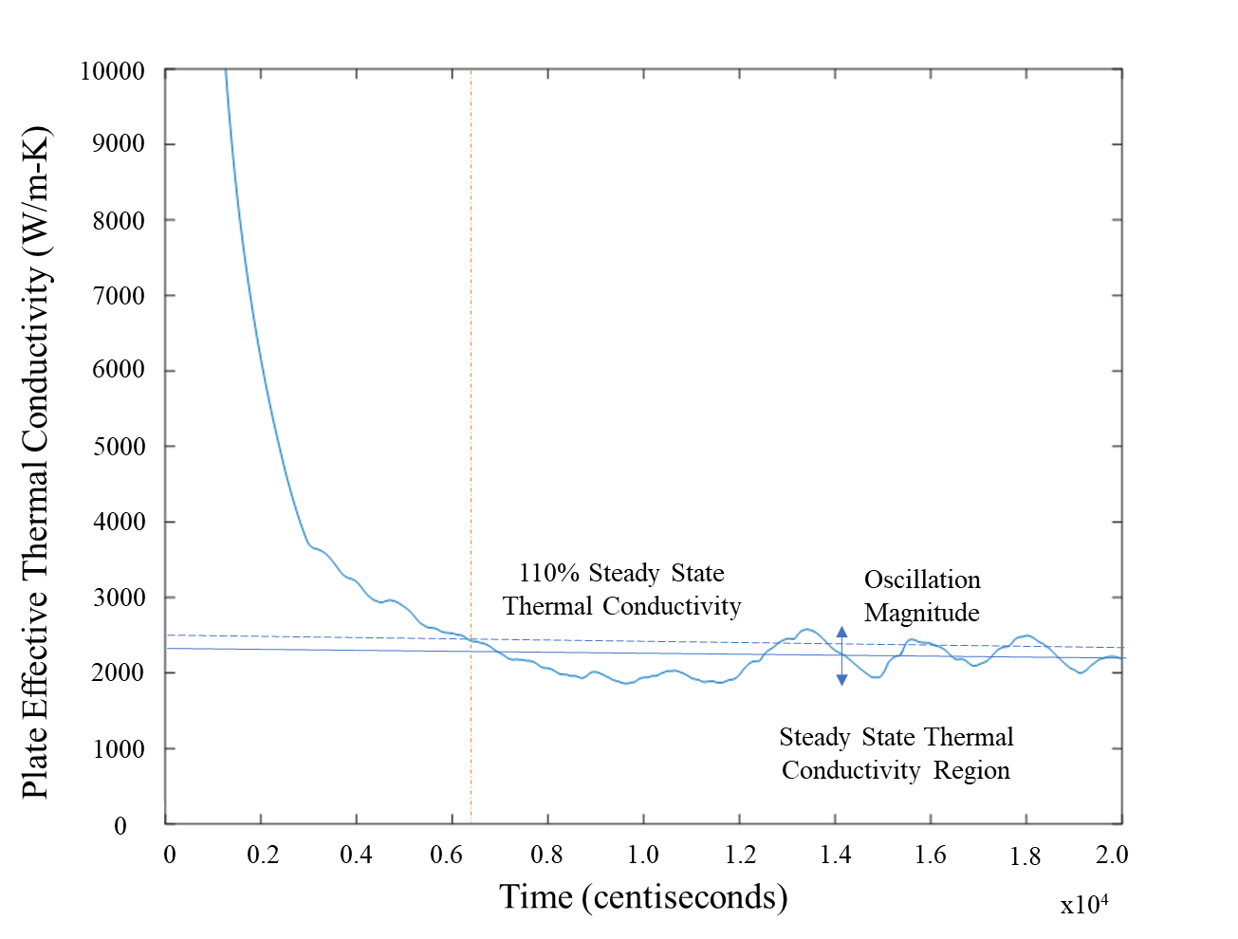
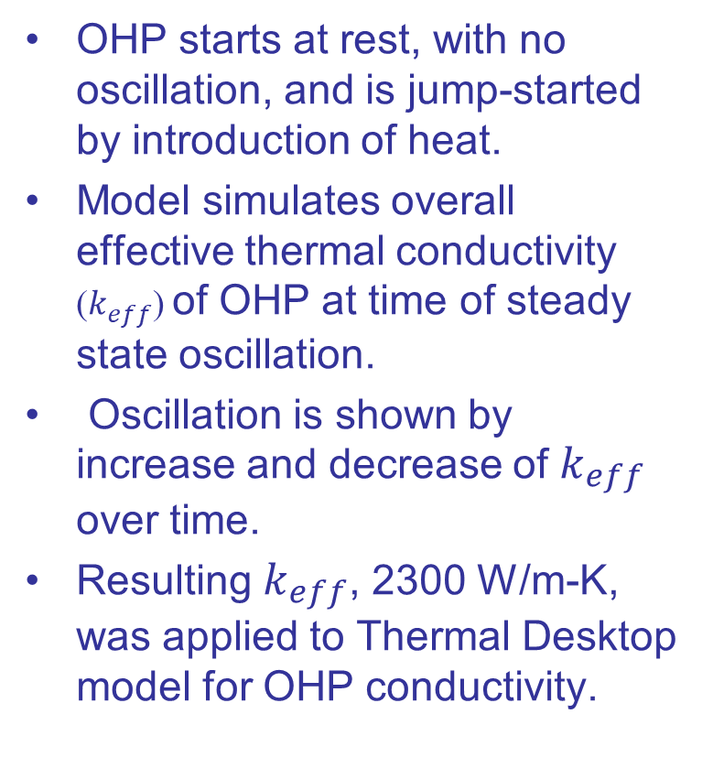

OHP Performance
OHP starts at rest, with no oscillation, and is jump-started by introduction of heat.
Model simulates overall effective thermal conductivity ($k_{eff}$) of OHP at time of steady state oscillation.
Oscillation is shown by increase and decrease of $k_{eff}$ over time.
Resulting $k_{eff}$, 2300 W/m-K, was applied to Thermal Desktop model for OHP conductivity.
Solid Blue Line - $k_{eff}$
Solid Blue Horizontal Line – Averaged value of $k_{eff}$ (2300 W/m-K)
Dashed Horizontal Line – Averaged 110% steady state $k_{eff}$ (2500 W/m-K)
Solid Vertical Line – Time at which 110% steady state is achieved
CF. Deravanessian, Alexander, and Kevin R. Anderson. "Thermal analysis of an ESPA class host satellite using oscillating heat pipes and deployable solar array backed radiator." In AIAA SCITECH 2022 Forum, p. 1910. 2022.

Slide 15
Evaporator and Condenser Temperature Max/Mins
Simulation Case | Hottest Condenser Temperature (°C) | Coldest Condenser Temperature (°C) | Hottest Evaporator Temperature (°C) | Coldest Evaporator Temperature (°C)
Sun Synchronous Beta 0 | 48 | -82 | 79 | -82
Sun Synchronous Beta 15 | 48 | -82 | 79 | -82
Sun Synchronous Beta 30 | 48 | -82 | 79 | -82
Sun Synchronous Beta 45 | 45 | -60 | 73 | -55
Sun Synchronous Beta 60 | 43 | -57 | 69 | -52
Sun Synchronous Beta 75 | 38 | 0 | 66 | 53
Sun Synchronous Beta 90 | 36 | 30 | 66 | 56
Nadir Beta 0 | 45 | -67 | 70 | -65
Nadir Beta 15 | 45 | -67 | 70 | -65
Nadir Beta 30 | 40 | -67 | 68 | -65
Nadir Beta 45 | 25 | --64 | 45 | -63
Nadir Beta 60 | 10 | -60 | 28 | -60
Nadir Beta 75 | -7 | -60 | 0 | -60
Nadir Beta 90 | -34 | -69 | -32 | -69
CF. Deravanessian, Alexander, and Kevin R. Anderson. "Thermal analysis of an ESPA class host satellite using oscillating heat pipes and deployable solar array backed radiator." In AIAA SCITECH 2022 Forum, p. 1910. 2022.

Slide 16
ThermQuik Modeling
The Thermal Desktop model was imported into ThermQuik, as follows:
Reduced the nodal subdivision on thin panels, from 3 to 1 in the thin dimension
The main purpose of this was to raise CSGMIN (it went from ~0.001 to ~0.15)
Doing this alone brought the total node count from ~12K to ~6.5K
Replaced the temperature dependent properties with constant averages

Slide 17
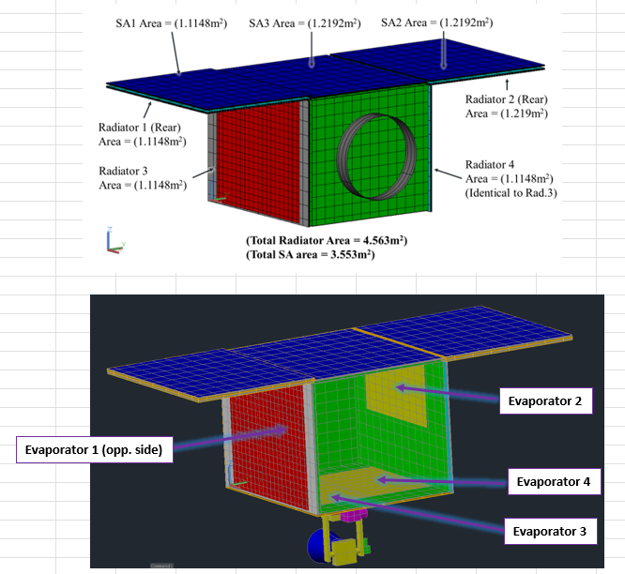
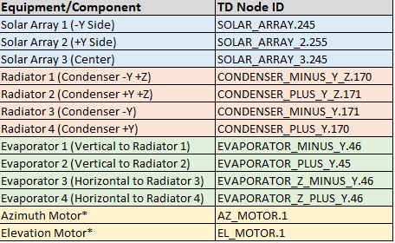
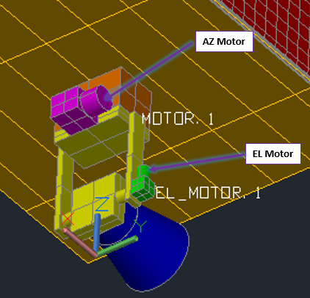
ThermQuik / Thermal Desktop Comparison
ESPA-Class Satellite with Deployable OHP Radiators
Nodes for ThermQuik-TD Comparison

Slide 18
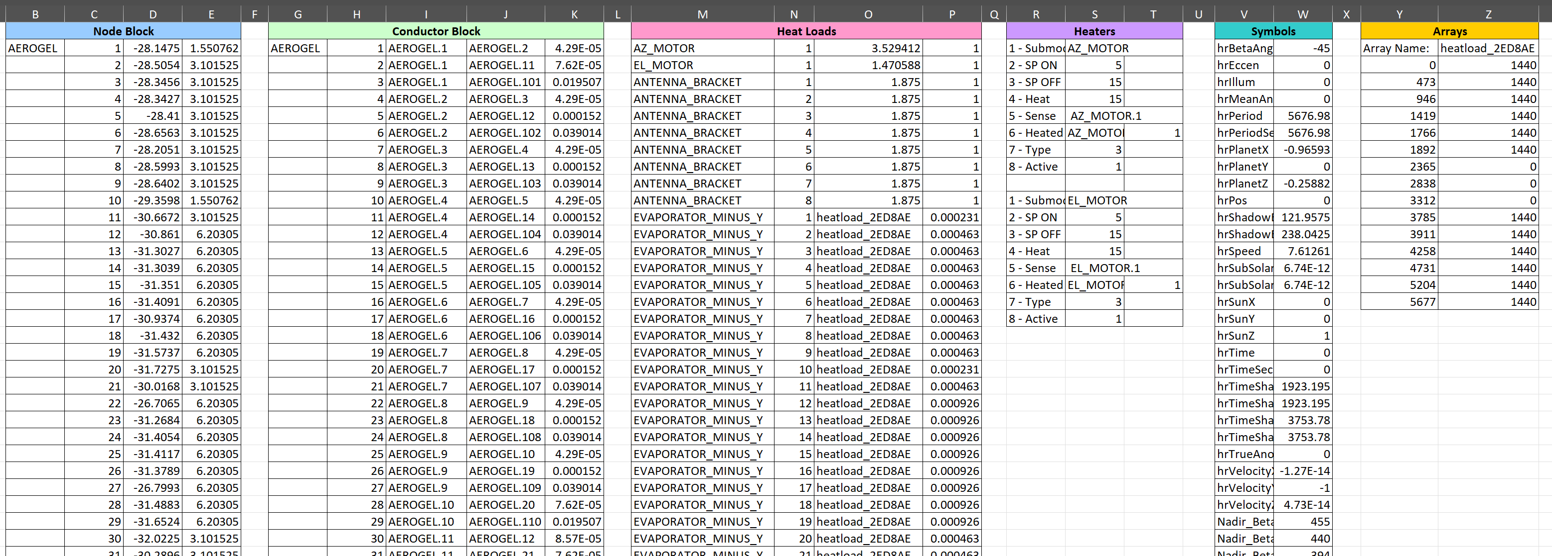
ThermQuik Model Translator
The ThermQuik Model Translator generates a ThermQuik model in Excel using the .inp file from the Thermal Desktop model.
ThermQuik Excel Worksheet (Partial View) after Running Model Translator

Slide 19
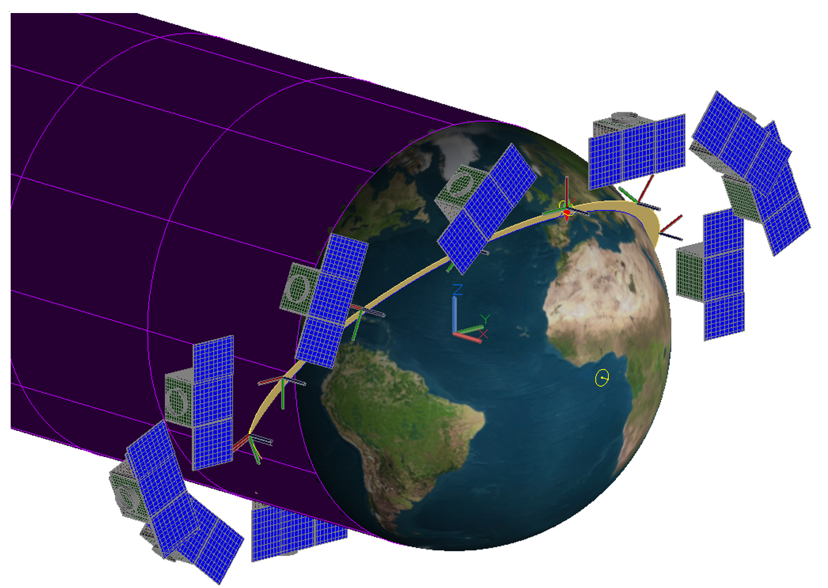
Sun Sync, β = 45°: Steady State Results
The orbit chosen for the comparative study was Sun-synchronous, with 45° Beta Angle
For Steady State, the temperatures predicted by ThermQuik are within 0.4°C of the Thermal Desktop solution
SuncSync Orbit with β = 45°
Steady State Results: ThermQuik vs. Thermal Desktop

Slide 20
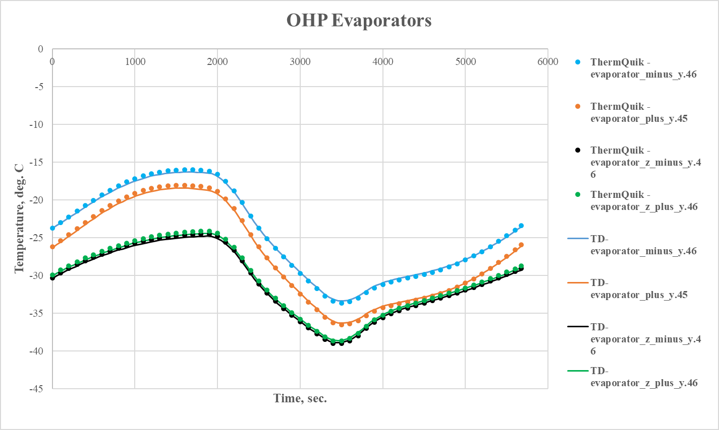
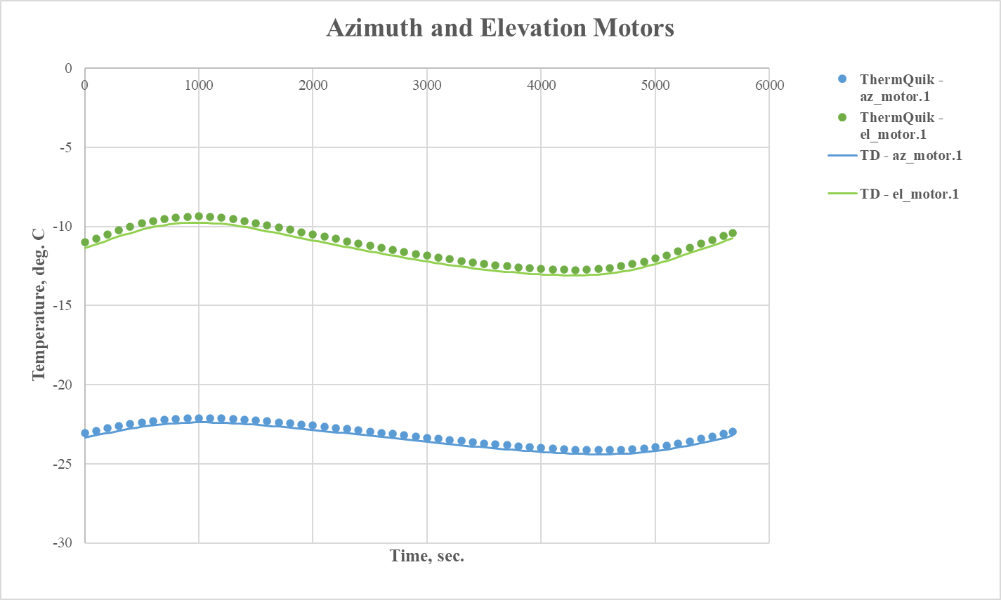
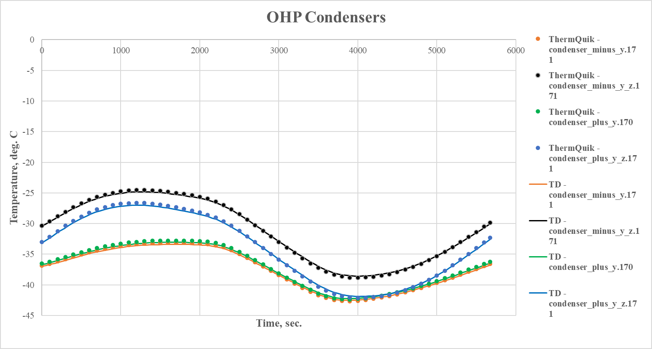
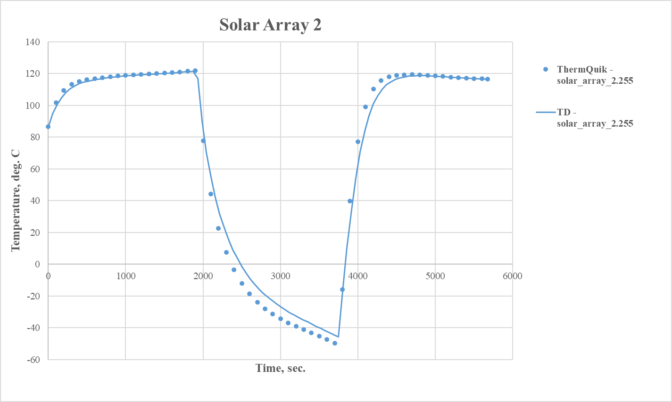
Sun Sync, β = 45°: Transient Results
In each plot, the ThermQuik results are dots and the Thermal Desktop results are solid lines
Very close agreement except for the Solar Array
ThermQuik results use the CNQUIK solution routine
More discussion on next slide

Slide 21
Discussion of Results
For Steady State, ThermQuik matched TD within 0.4°C
For Transient, ThermQuik matched TD within 0.5°C except for on the Solar Arrays (shown right)
For the Solar Arrays, ThermQuik tends to lead the TD solution when there are sharp changes in temperature with time
This suggest the need to further develop the transient numerical methods in ThermQuik, but a more accurate solution in these regions may be obtained by using a smaller time step or tuning the solution control parameters
Transient Results for Solar Array

Slide 22
Future Development of ThermQuik
Implement temperature dependent conductances
Further development of transient numerical methods
Improved post-processing
Improved heat-flow diagnostics
Implement Radiation interchange factor (Bij) calculations
Improvements to ThermQuik are driven by user feedback

Slide 23
CONTACT
Kevin R. Anderson
Calif. State Polytechnic University, Pomona
kranderson1@cpp.edu
George DeMoulin, Areial Gatti, Alyssa Vu
Ingenium Technical Services, Inc.
support@thermquik.com

