Slide 1

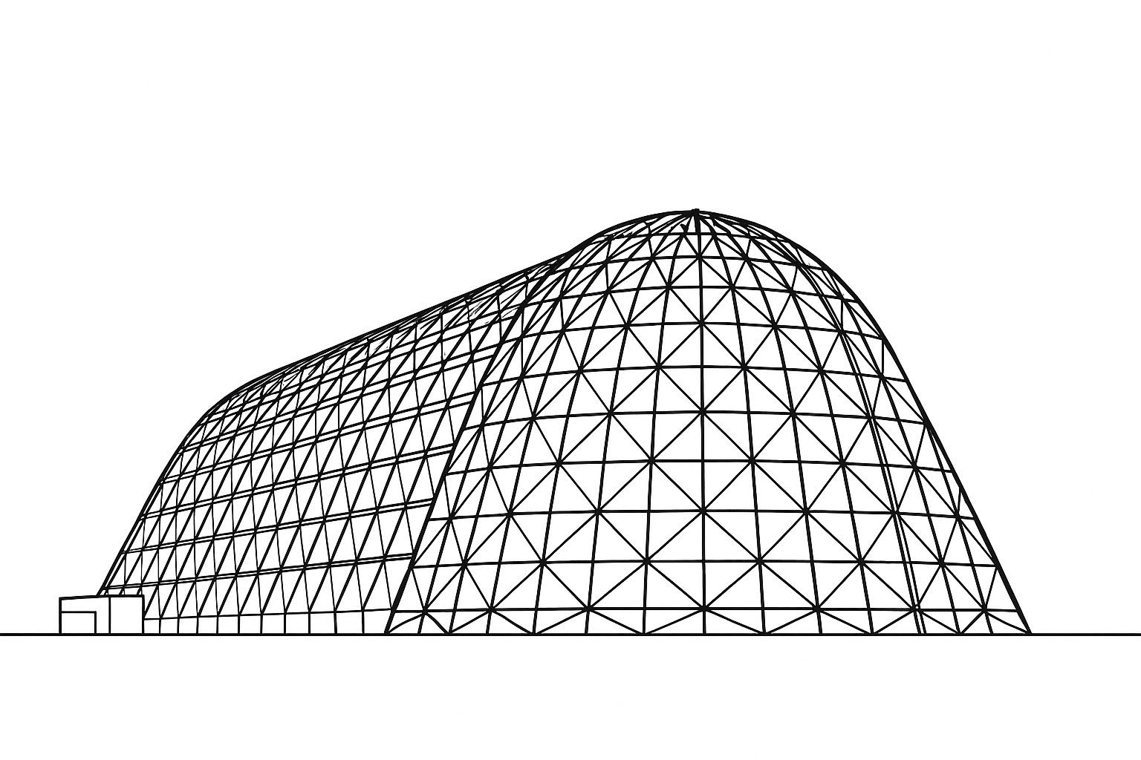

Thermal Performance Evaluation of IPEX via Dynamic Modeling with Thermal Desktop and SINDA
TFAWS 2025 Interdisciplinary Thermal Technical Session
Presented by: Dr. Kevin R. Anderson, Jet Propulsion Laboratory, California Institute of Technology
Kevin R. Anderson, Jet Propulsion Laboratory, California Institute of Technology
James Egbert, Melissa Young, NASA KSC
Thermal & Fluids Analysis Workshop 2025
NASA Ames Research Center
San Jose, CA
August 4-7, 2025

Slide 2
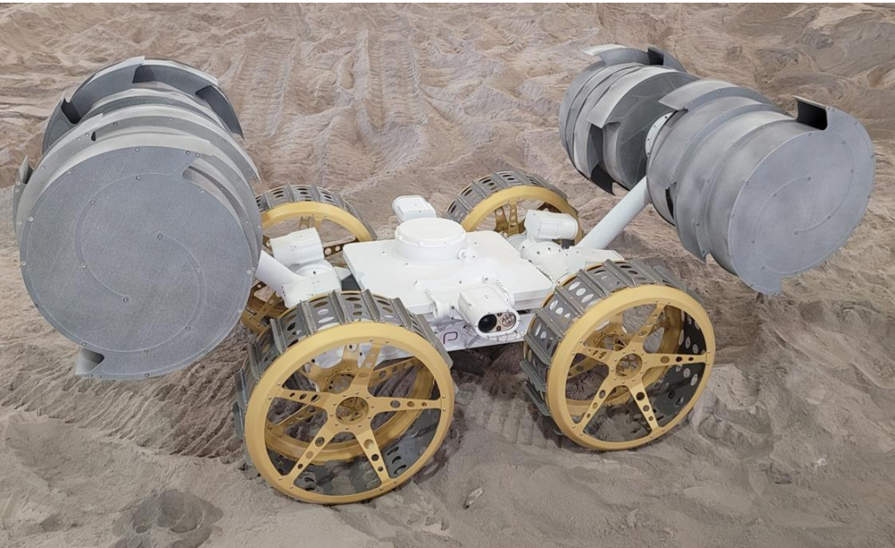
IPEx Background
The primary goal of NASA’s ISRU Pilot Excavator (IPEx) project is to dig up lunar soil, known as regolith, and transport it across the Moon’s surface.
This process is designed to enable the extraction of vital resources, such as hydrogen, oxygen, and water, which are essential for life support systems [1].
[2]

Slide 3
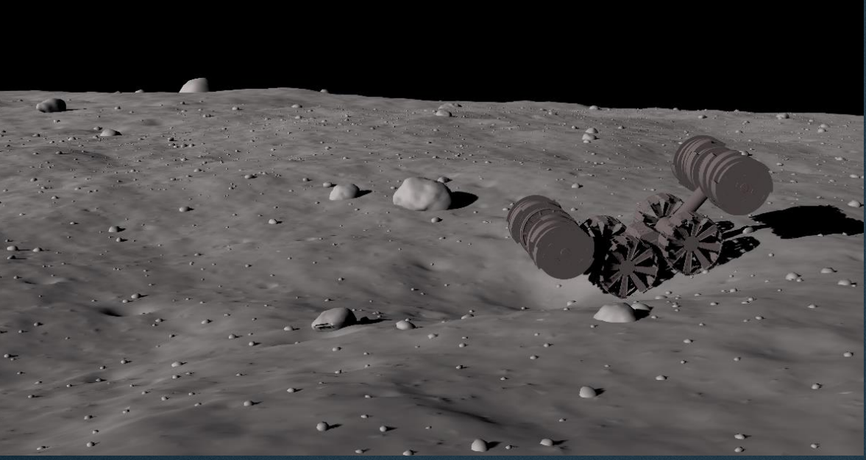
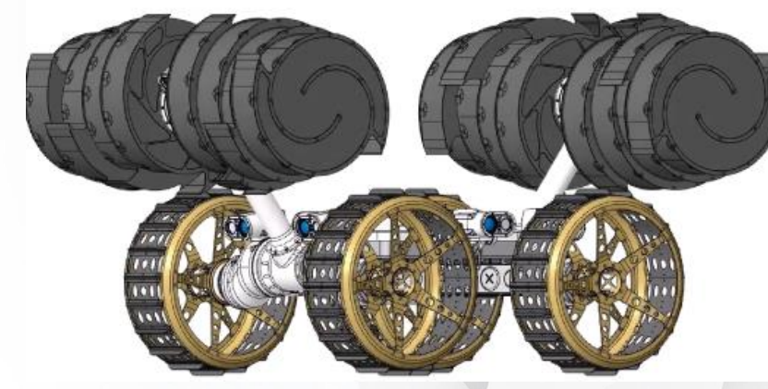
IPEx Background
The ISRU Pilot Excavator (IPEx) is a groundbreaking robotic system designed by NASA to revolutionize lunar excavation. Functioning as both a bulldozer and a dump truck, IPEx is engineered to efficiently mine and transport lunar regolith, the loose rocky material on the Moon’s surface, which is crucial for future lunar missions and In-Situ Resource Utilization (ISRU) processes. This dual capability makes IPEx an indispensable tool for sustainable lunar exploration [1].
[2]
[2]

Slide 4
IPEx Background
The development of IPEx incorporates modern tools and algorithms to enhance its functionality and reliability. Some of the IPEx subsystems include:
Camera and Dust Mitigation System
This system includes cameras, lenses, wiring, and lighting used for navigation and orientation during the mission. It helps the equipment move autonomously and safely by using visual cues. To protect the equipment from dust, it features electro-dynamic dust shields to maintain clear visuals and protect sensitive equipment [1].
Mobility System
The Mobility System supports other systems and provides the necessary equipment to move across the lunar surface. Its main parts include the structure, wheels, and devices that control the wheels [1].
Thermal Control System
The Thermal Control System (TCS) ensures that the equipment remains within safe temperature ranges during travel and while on the Moon. Its key components include a radiator with a cover and motor, phase change material (PCM), heat spreaders, heater strips, an enclosure for electronics, and multi-layer insulation (MLI) [1].

Slide 5
IPEx Background
Regolith Delivery System
The Regolith Delivery System (RDS) is designed to collect lunar soil, known as regolith. It uses rotating bucket drums on each side of the excavator, which are lifted by arms to gather and transport the soil. This system includes motors for both the bucket drums and the arms, as well as the bucket drums, arms, and their respective motors [1].
IPEx employs innovative excavation tools known as bucket drums, which are hollow cylinders equipped with scoops that dig and collect regolith. These drums rotate in opposite directions, reducing reaction forces and enabling the lightweight robotic system to operate effectively in the Moon’s reduced gravity environment.
The system is designed to excavate up to 10,000 kg of regolith. This is a significant improvement over previous missions that have collected tens of kilograms. This capability is essential for future ISRU operations, which aim to extract resources such as oxygen from the lunar regolith to support sustained human presence on the Moon [1].

Slide 6
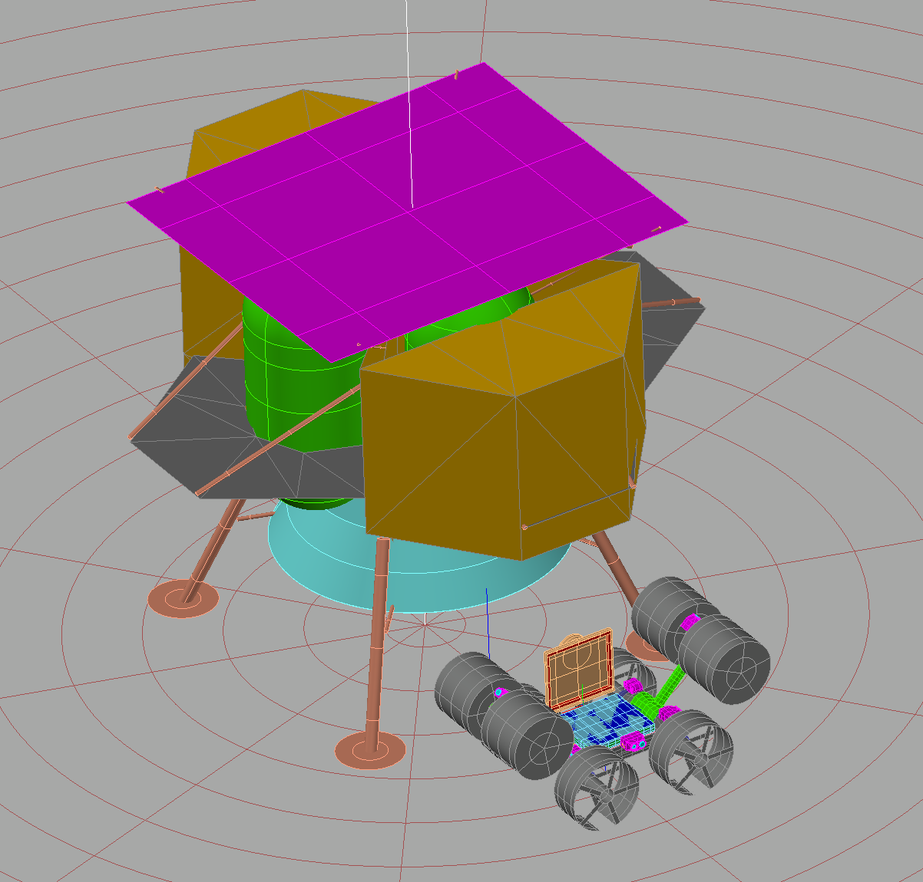
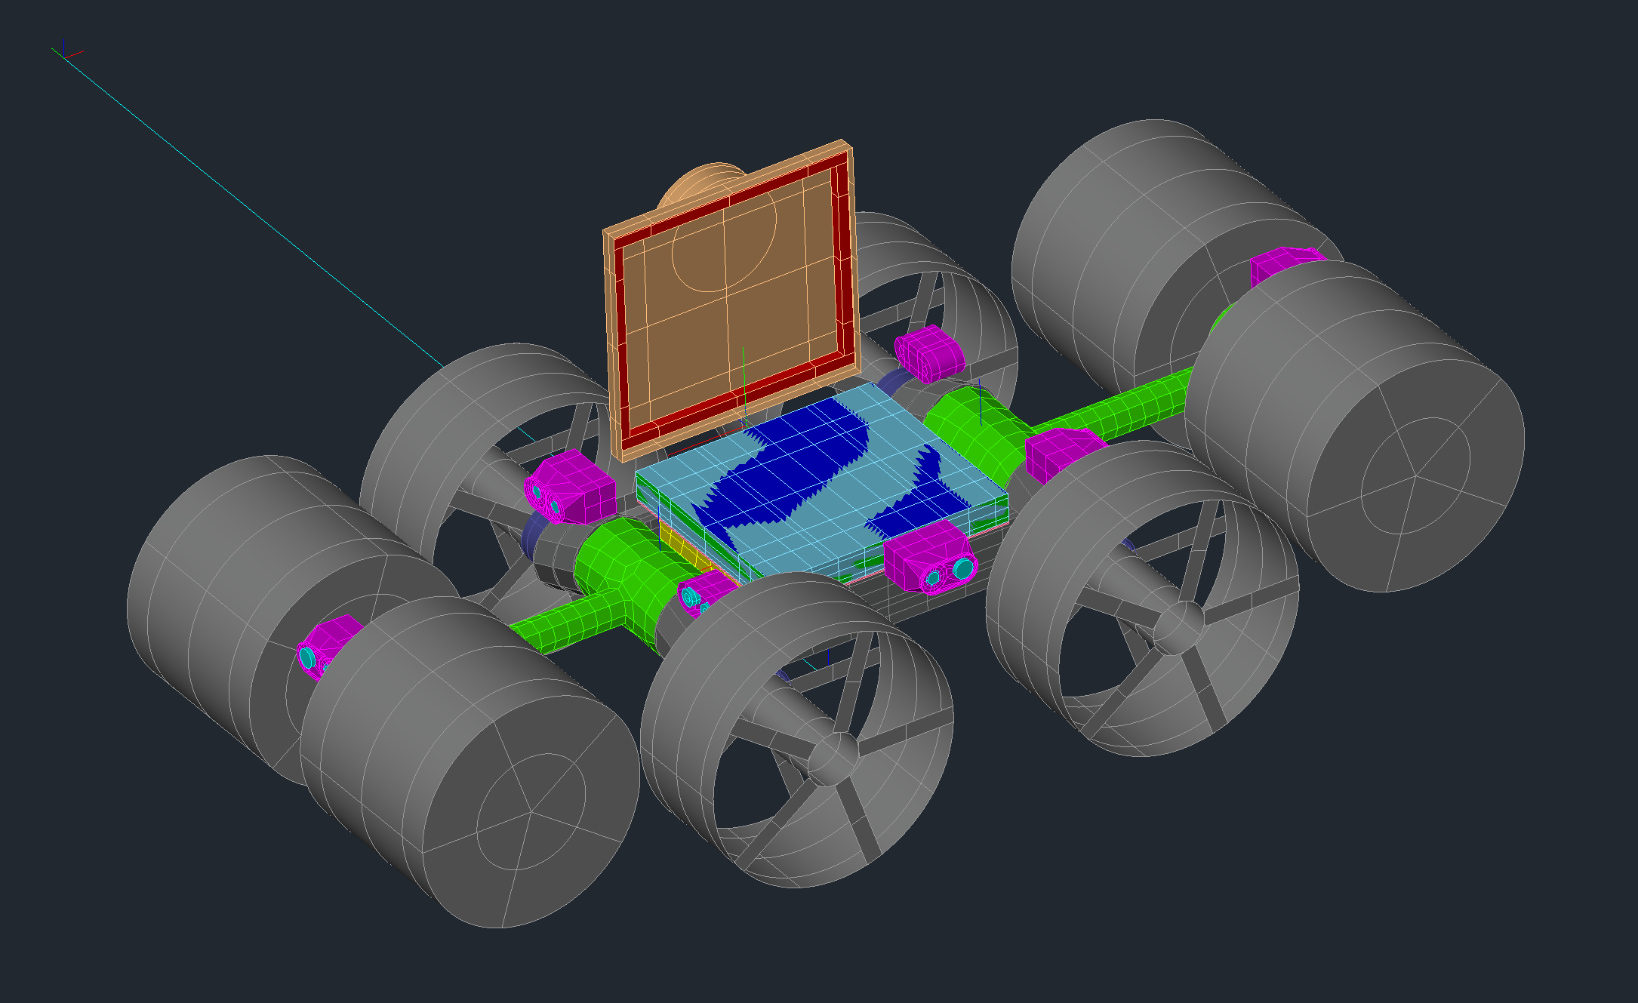
IPEx Thermal Desktop Model
REGOLITH
IPEx PCM Cover Articulator
LANDER
IPEx Vehicle Articulator
IPEx Arm Articulator (2 PLCS.)
IPEx

Slide 7
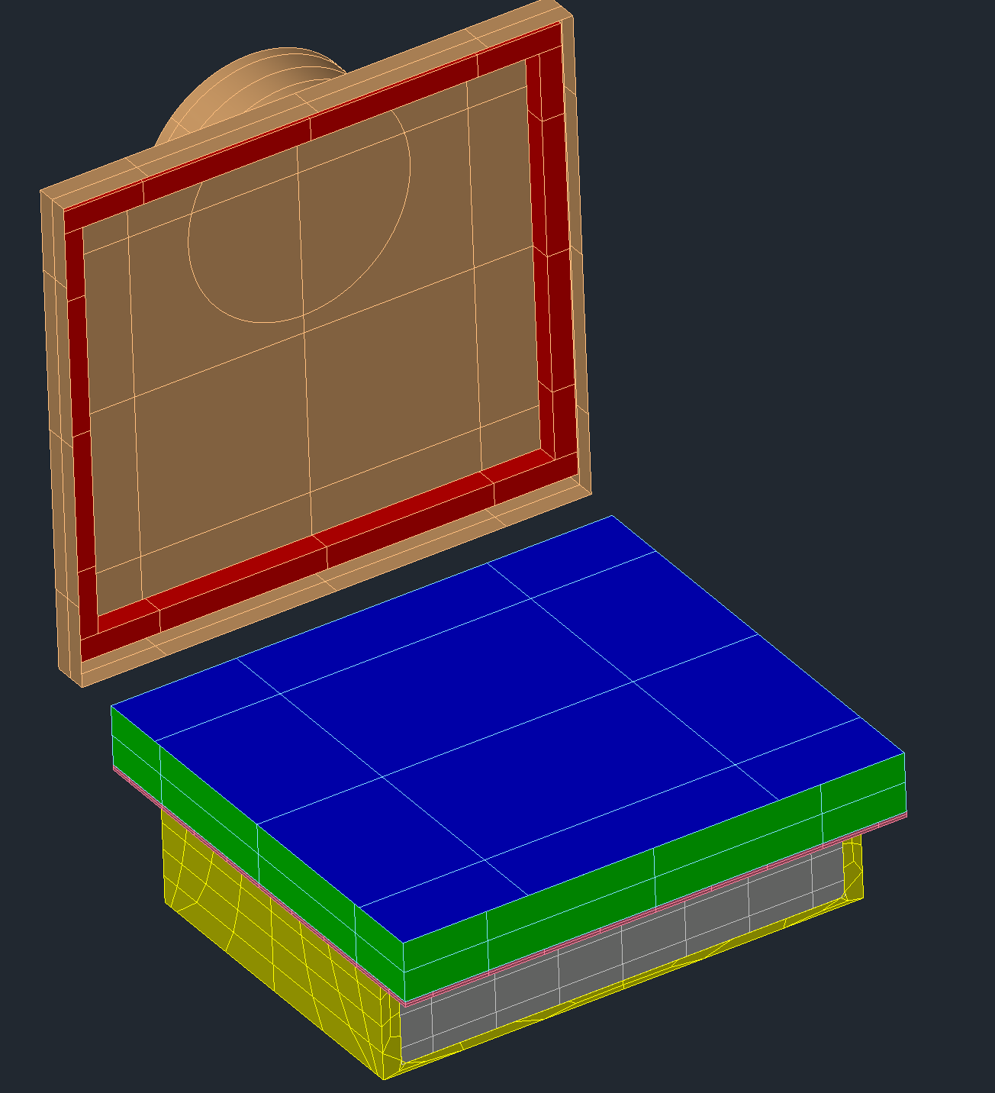
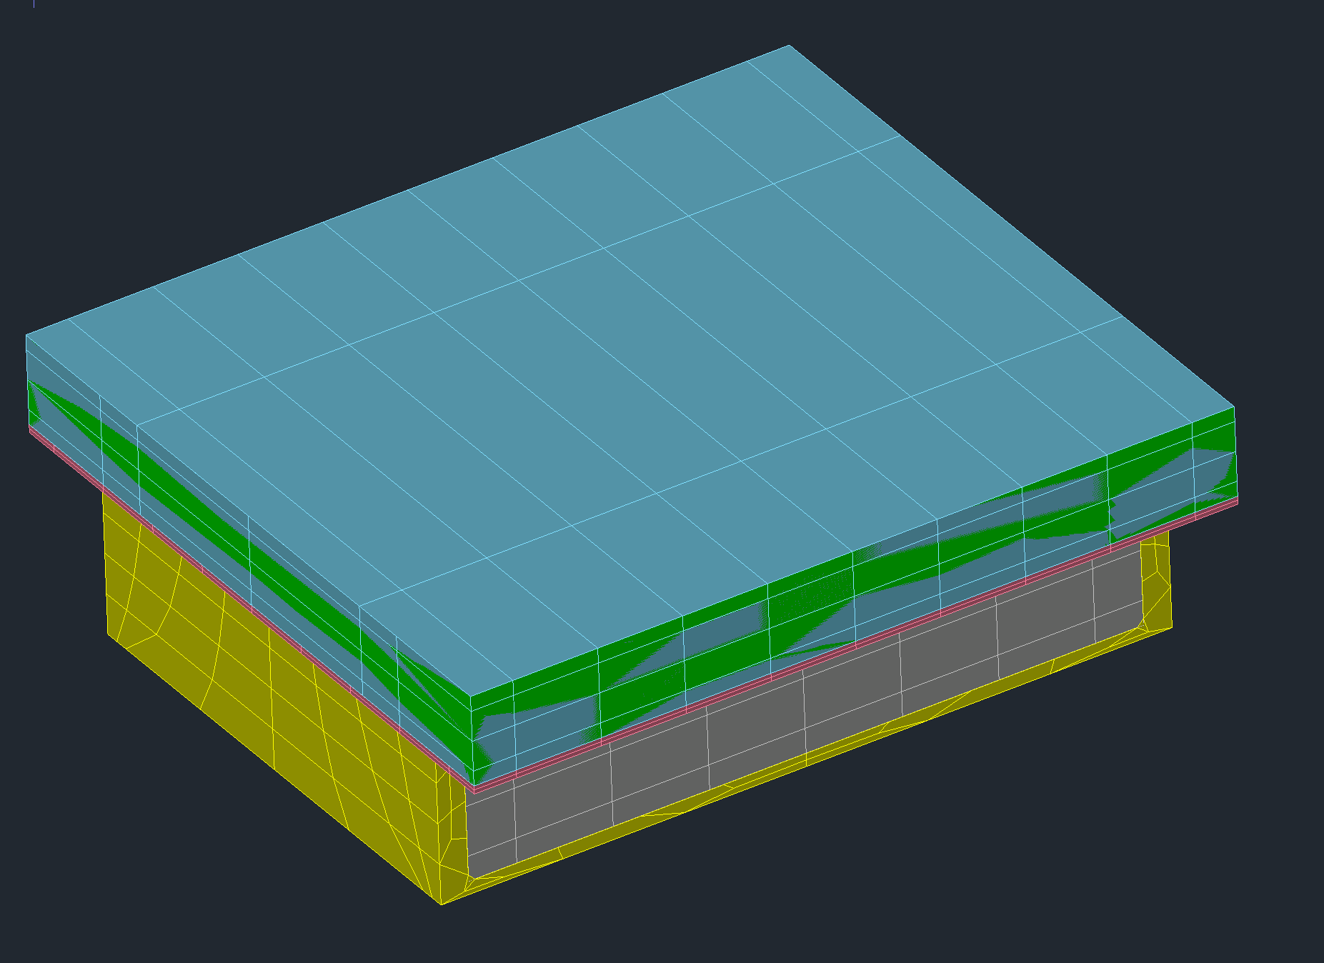
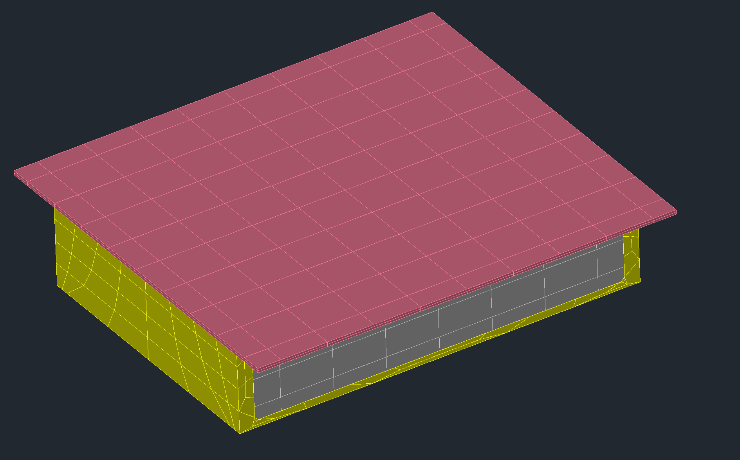
IPEx Thermal Desktop Model
PCM:
N-Eicosane
k_{x} = 8.4 W/m-K
k_{y}/k_{v} = 2
k_{z}/k_{w} = 6.9
Solid specific heat
2210 J/kg-K
Liquid specific heat
2630 J/kg-K
Heat of fusion
244,000 J/kg
Melting point
36.6 °C
PCM
RADIATOR COVER
PCM RADIATOR
SPREADER PLATE
AVIONICS

Slide 8
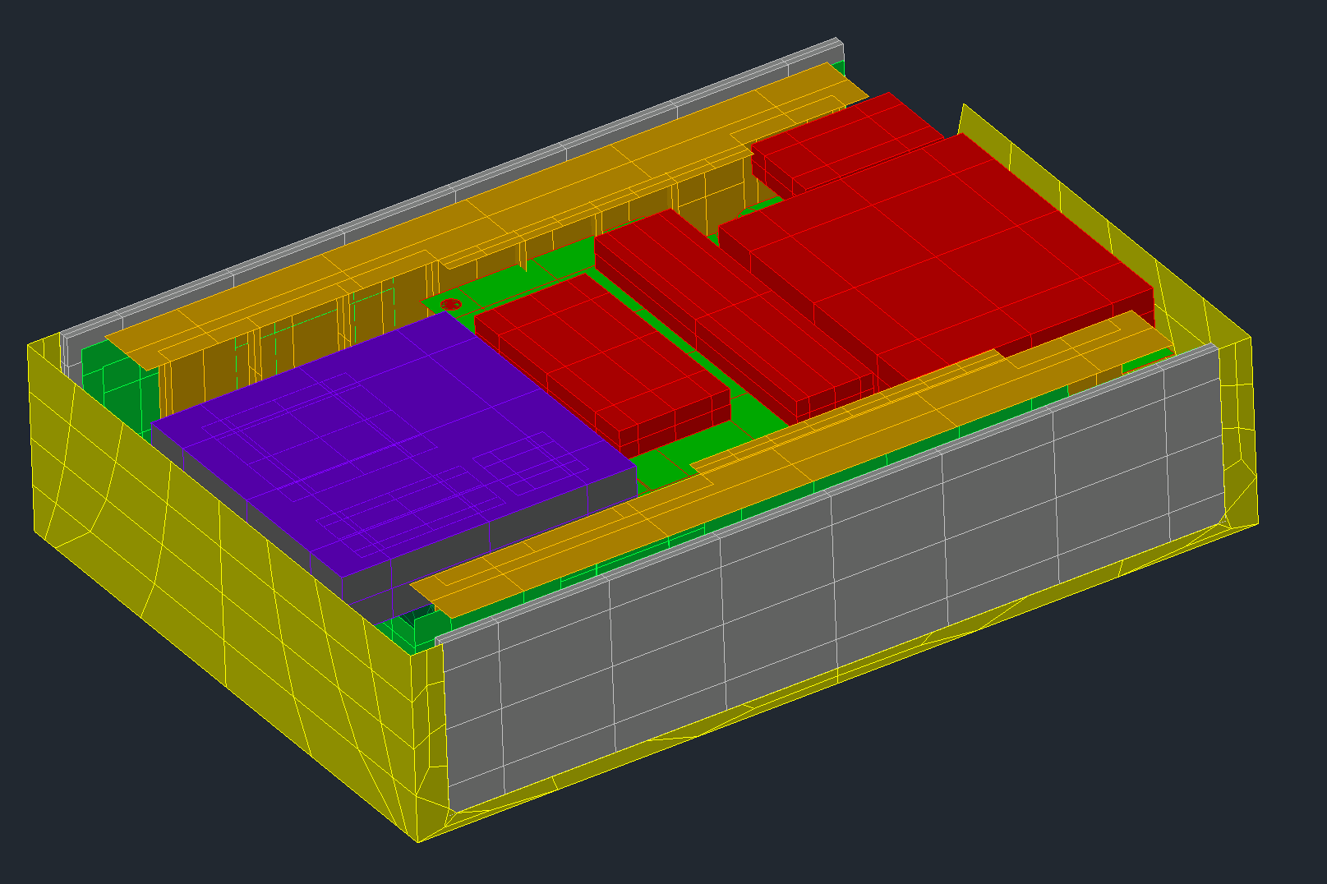
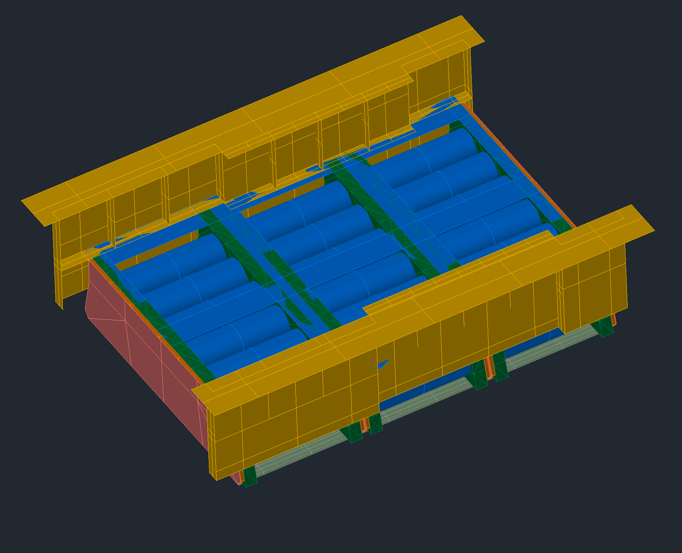
IPEx Thermal Desktop Model
AVIONICS
BOARDS
WIRELESS
CHARGER
BATTERY MODEL PER JSC
XREF INTO IPEx MODEL

Slide 9
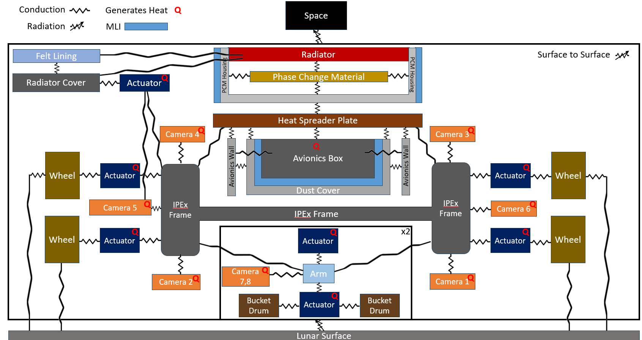
IPEx Thermal Model Heat Flow Paths

Slide 10
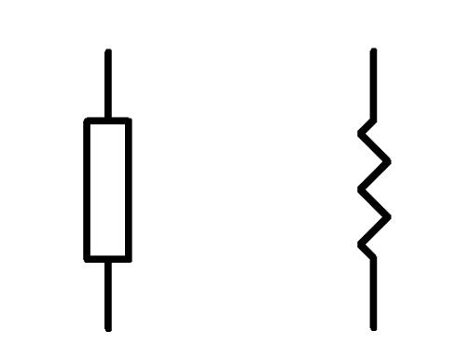








Avionics Thermal Model Heat Flow Paths
SIDE VIEW
SPREADER PLATE
IPEX_AVNX_BRD
AVNX_BRKTS
IPEX_WRLS_CHRG
AVNX_BRKTS
IPEX_MCC_PCB
IPEX_MCC_PCB
AVNX WALL
ICON_PCB
Battery Model
ICON_PCB
DUST COVER
FRONT VIEW
SPREADER PLATE
SOM BOARD
IPEX_RADIO
IPEX_DCDC_CNV1&3
NETWORK SWITCH
CORE BOARD
IPEX_WRLS_CHRG
EDS Board

Slide 11
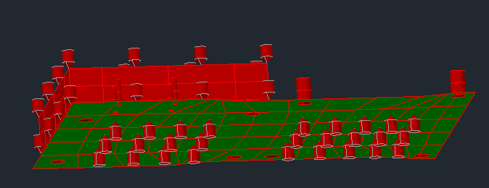
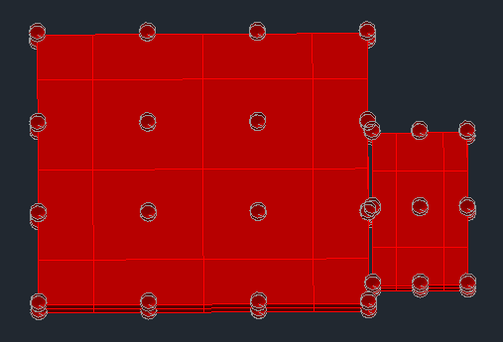

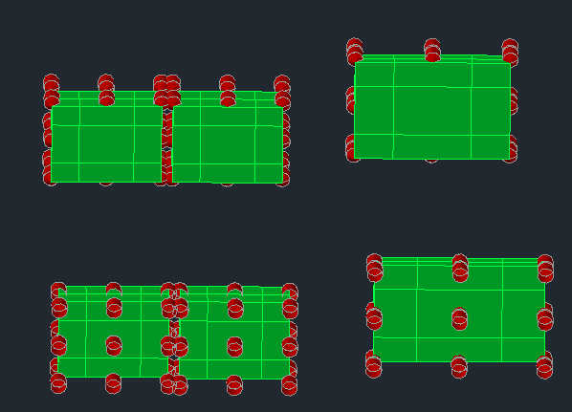
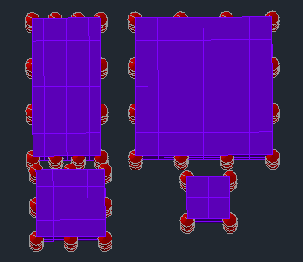
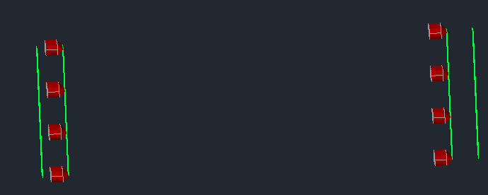
Avionics Heat Loads
IPEX_AVNX_BRD
IPEX_RADIO
SOM BOARD [Q1]
SOM BOARD [Q1]
IPEX_RADIO [Q2]
NETWORK SWITCH [Q16]
CORE BOARD [Q17]
IPEX_DCDC_CNV1&3
IPEX_MCC_PCB
IPEX_WRLS_CHRG [Q6]
MC 5A x 2
MCC 10A
MCC 10A
[Q14,15]
[Q13]
[Q12]
…CNV1 [Q3]
…CNV3 [Q4]
MC 5A x 3
IPEX_ICON_PCBS [Q18 & 19]
MC 10A
MCC 10A
[Q8,9,10]
[Q11]
[Q7]

Slide 12
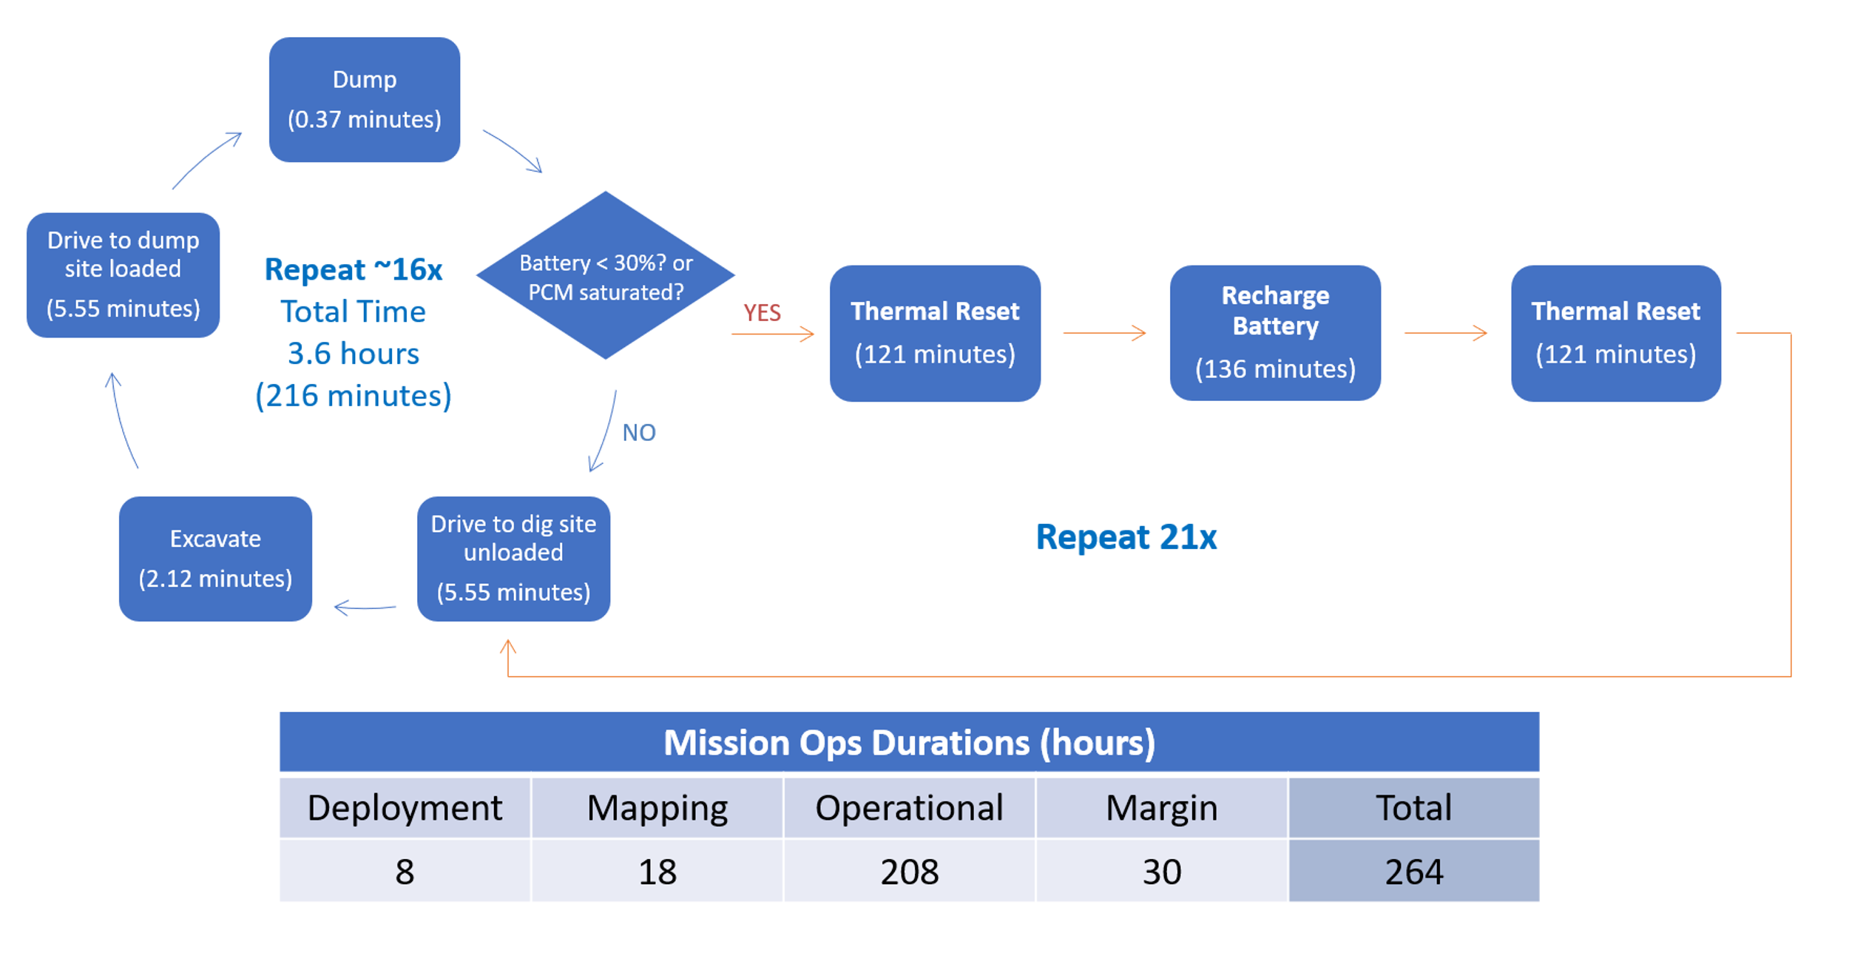
IPEx Con-Ops

Slide 13
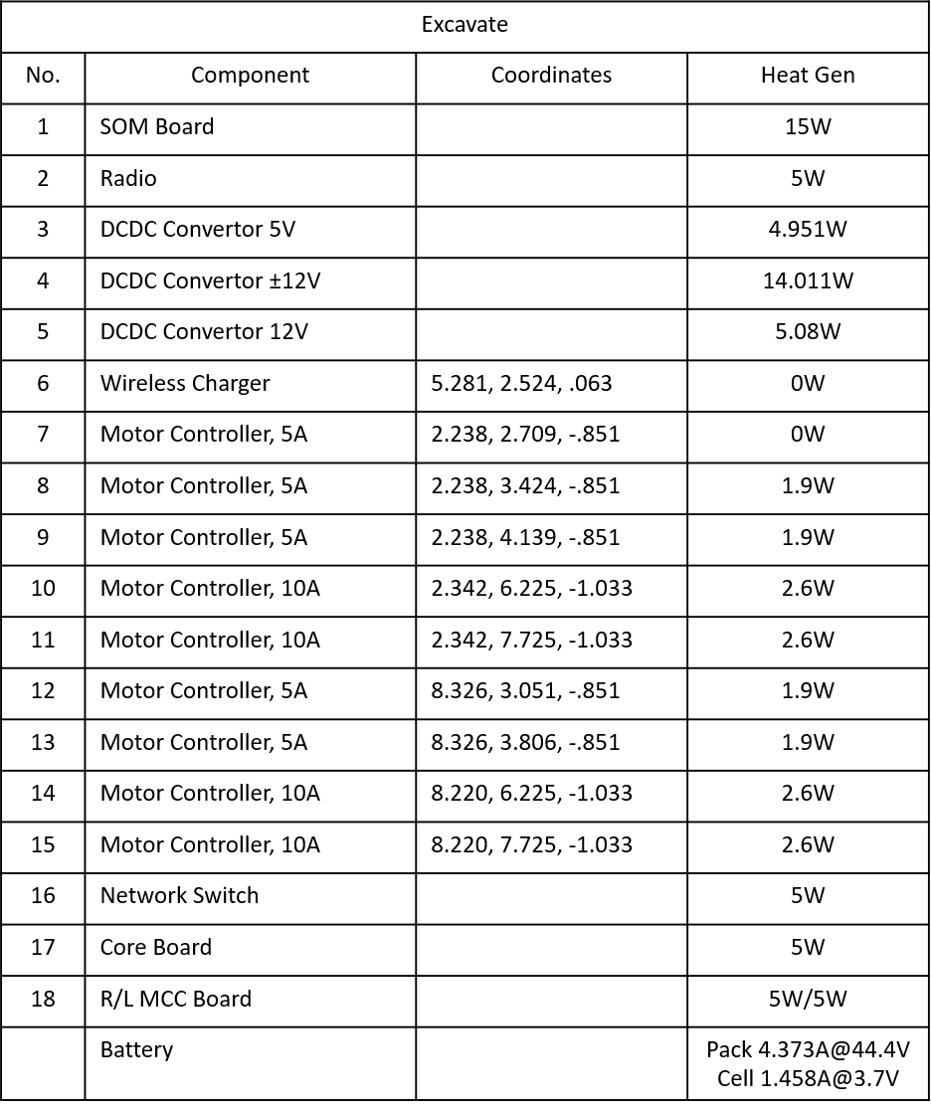
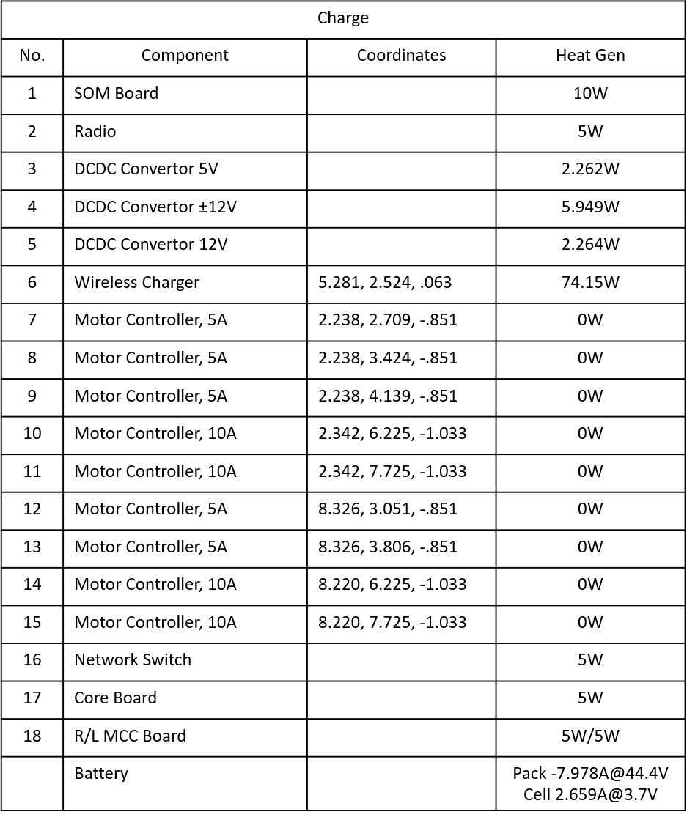
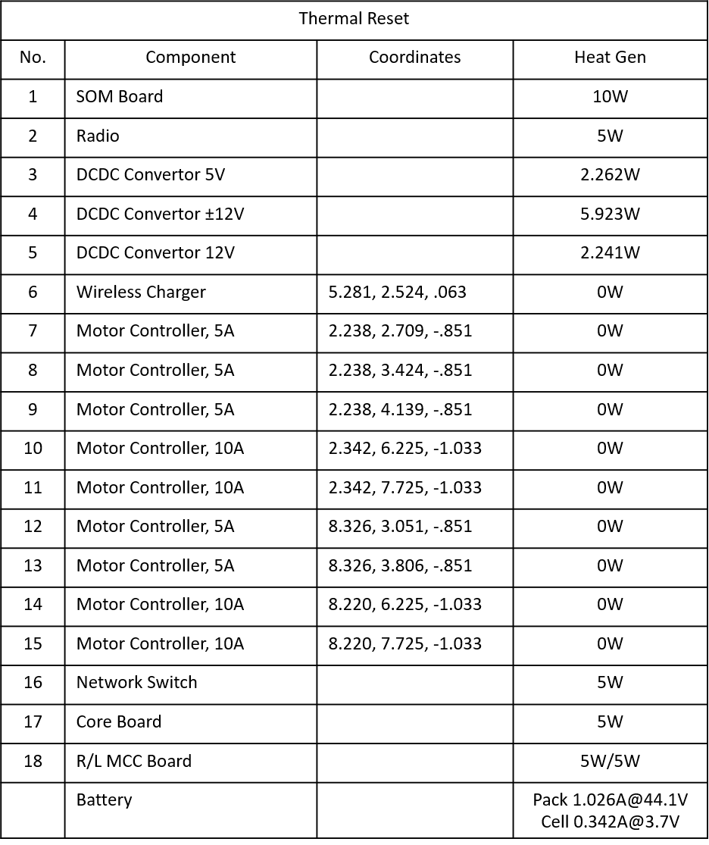
Con-Ops Heat Loads

Slide 14
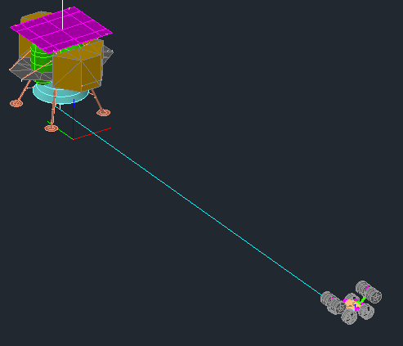
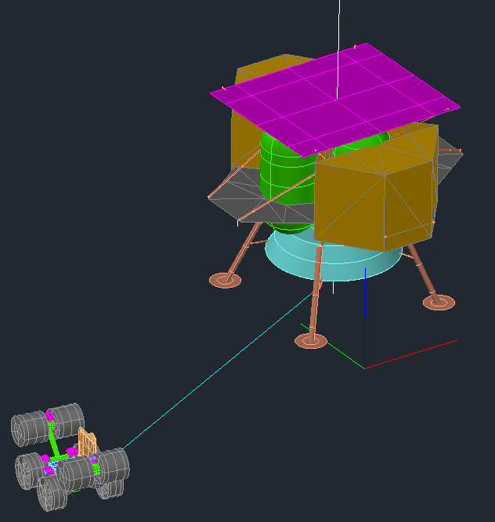
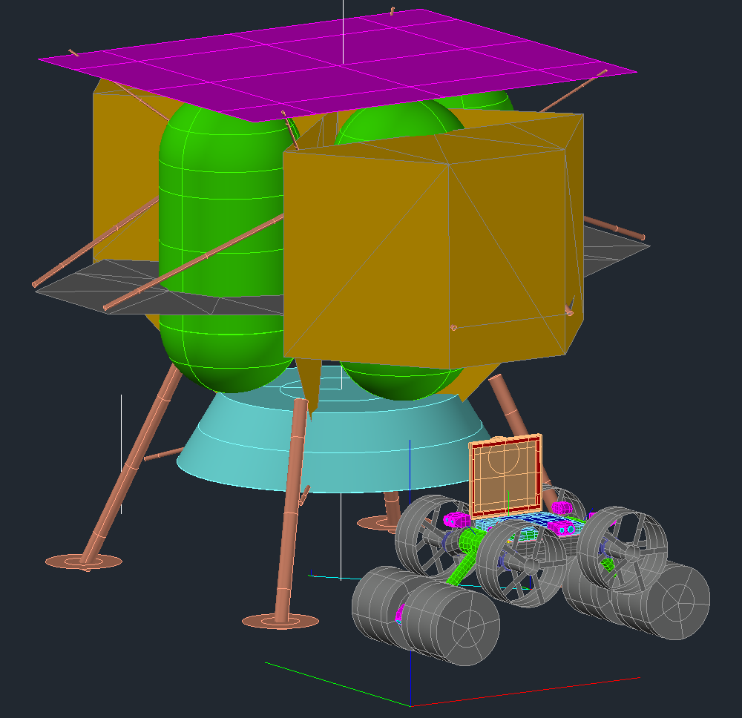
Articulator Maneuvering Mode Positions
y
Lander
Excav
x
T.R.
IPEx
IPEx
Charging: X=0, Y=-1.5, Yaw=0, Arms = -45°
Thermal Reset:
X=-4
Y=-2
Yaw=Changes
Arms = 0°
Chrg.
IPEx
Excavation: X=0, Y=-11.386, Yaw=180, Arms = 45°

Slide 15
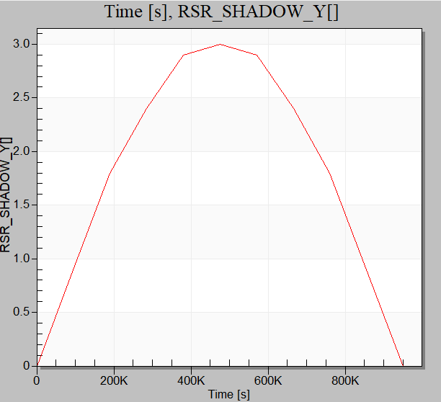
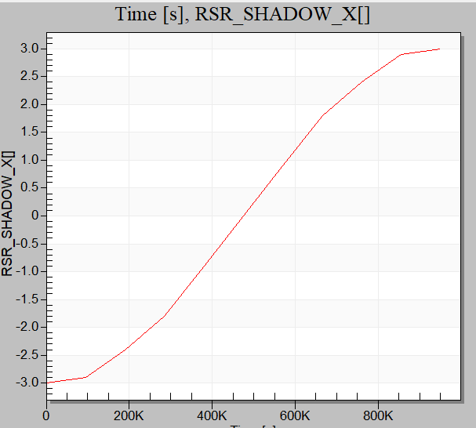
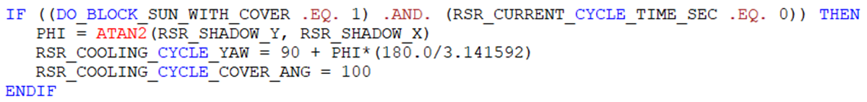
Articulator Maneuvering Thermal Reset in Sun
y
Φ
Lander
-x
x
IPEx
RSR_YAW

Slide 16
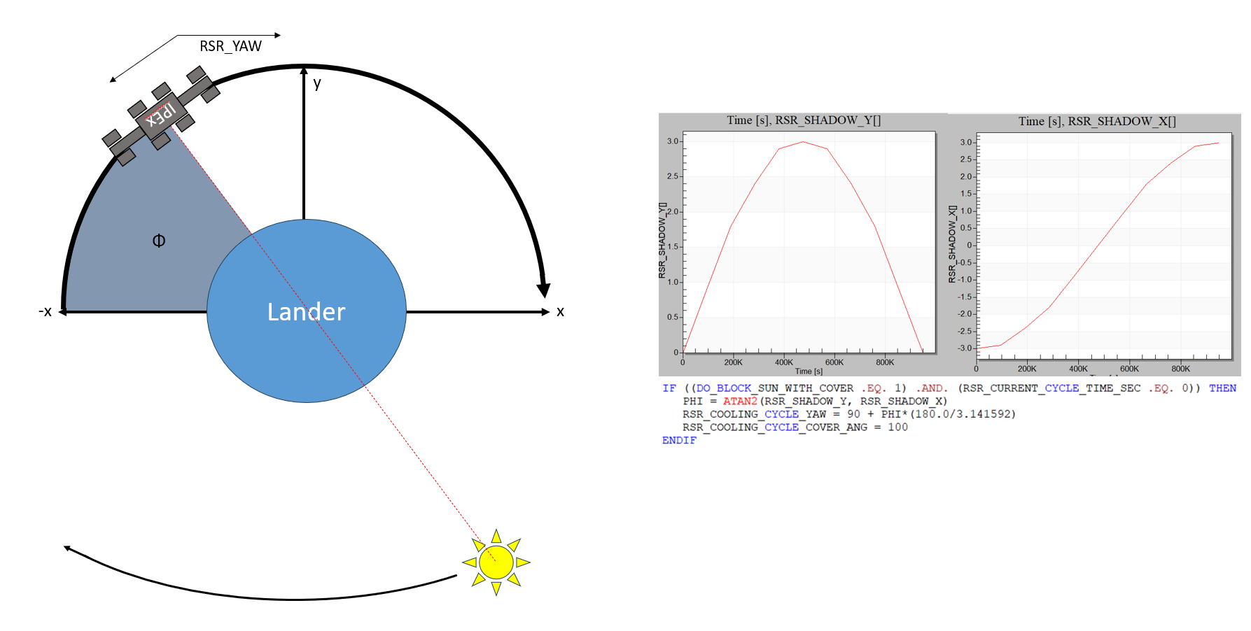
Articulator Maneuvering Thermal Reset in Shade

Slide 17
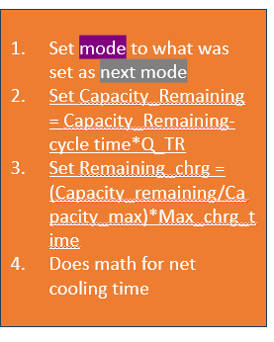
Logic Flowchart
Start
Mode = Excavation (Ex)
Mode = Charging (Ch)
Mode = Thermal Reset (TR)
Set excavation X, Y, yaw, cover angle
Run heating rates
Set excavation power/heat loads
Set charging X, Y, yaw, cover angle
Run heating rates
Set charging power/heat loads
Set cooling X, Y, yaw, cover angle
f(cool in shade or not)
Run heating rates
Set cooling power/heat loads
If
If
Y
Batt > AFT
Set mode to TR
Set next mode to Ch
Does math for aborted cycles & net excav time
Batt > AFT
If
Y
Set mode to TR
Set Current_Chrg (s)
PCM < Melt – 0.5 AND
BATT < AFT-5
Set mode to what was set as next mode
Does math for net cooling time
If
Y
N
N
Current_Chrg < Remaining_Chrg
Y
Set next mode to Charging
Set Remaining_Chrg to (Max_Chrg-Current_Chrg)
Add 1 to aborted chrg cycles
Exceed max Ex time && Batt < AFT
Set mode to TR
Set next mode to Ch
Does math for completed cycles & net excav time
Y
N
N
Set next mode to Ex
Set Remaining_Chrg=Max_Chrg
Set Current_Chrg=0
Does math for net charging time
Add 1 to aborted chrg cycles
Set mode to TR
Set next mode to Ch
Does math for completed cycles & net excav time
Cycle_Time> Remaining_Chrg && Batt < AFT
Y
Set mode to Ex
Set Remaining_Chrg=Max_Chrg
Set Current_Chrg=0
Does math for net charging time
Add 1 to completed chrg cycles
N
Set mode to TR
Set next mode to Ex
Set Remaining_Chrg=Max_Chrg
Set Current_Chrg=0
Does math for net charging time
Add 1 to completed chrg cycles

Slide 18
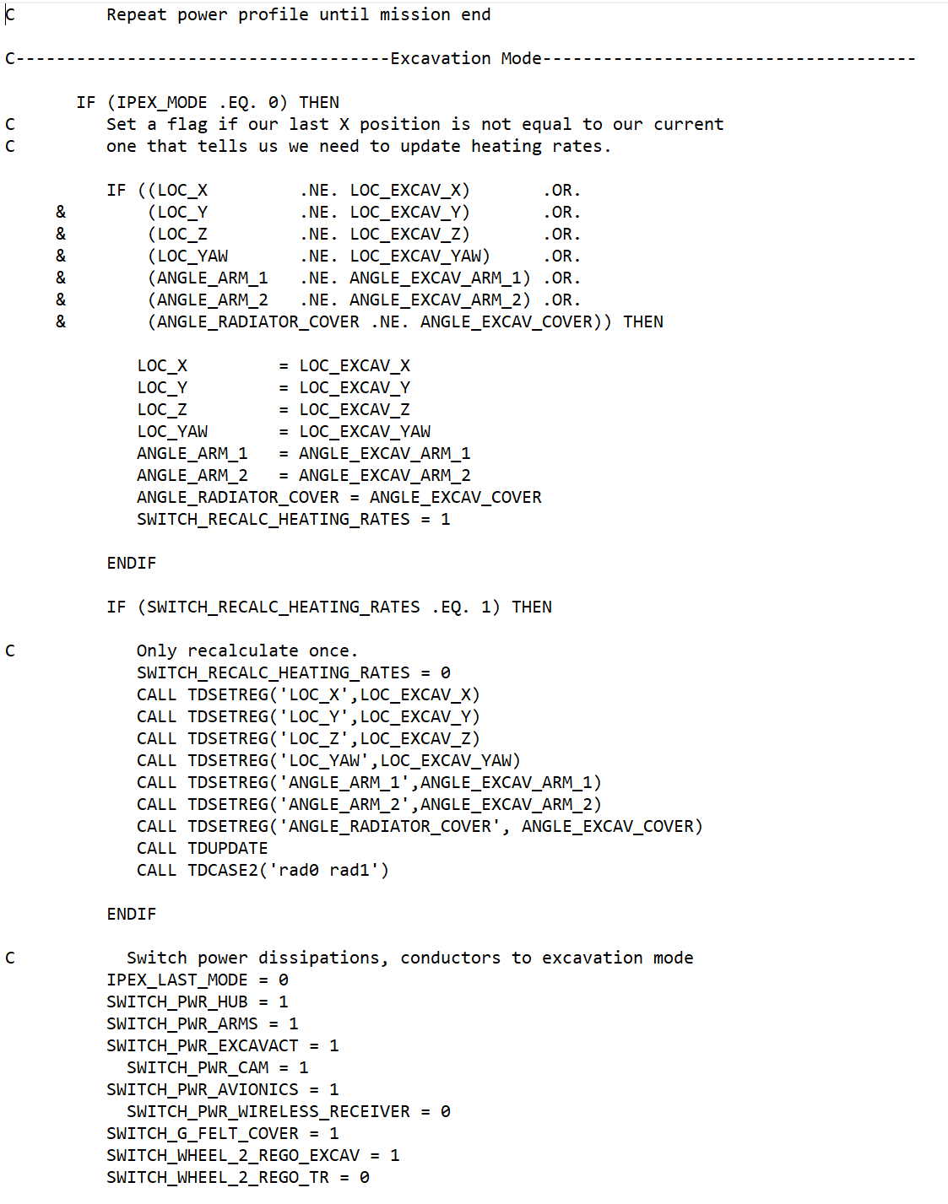
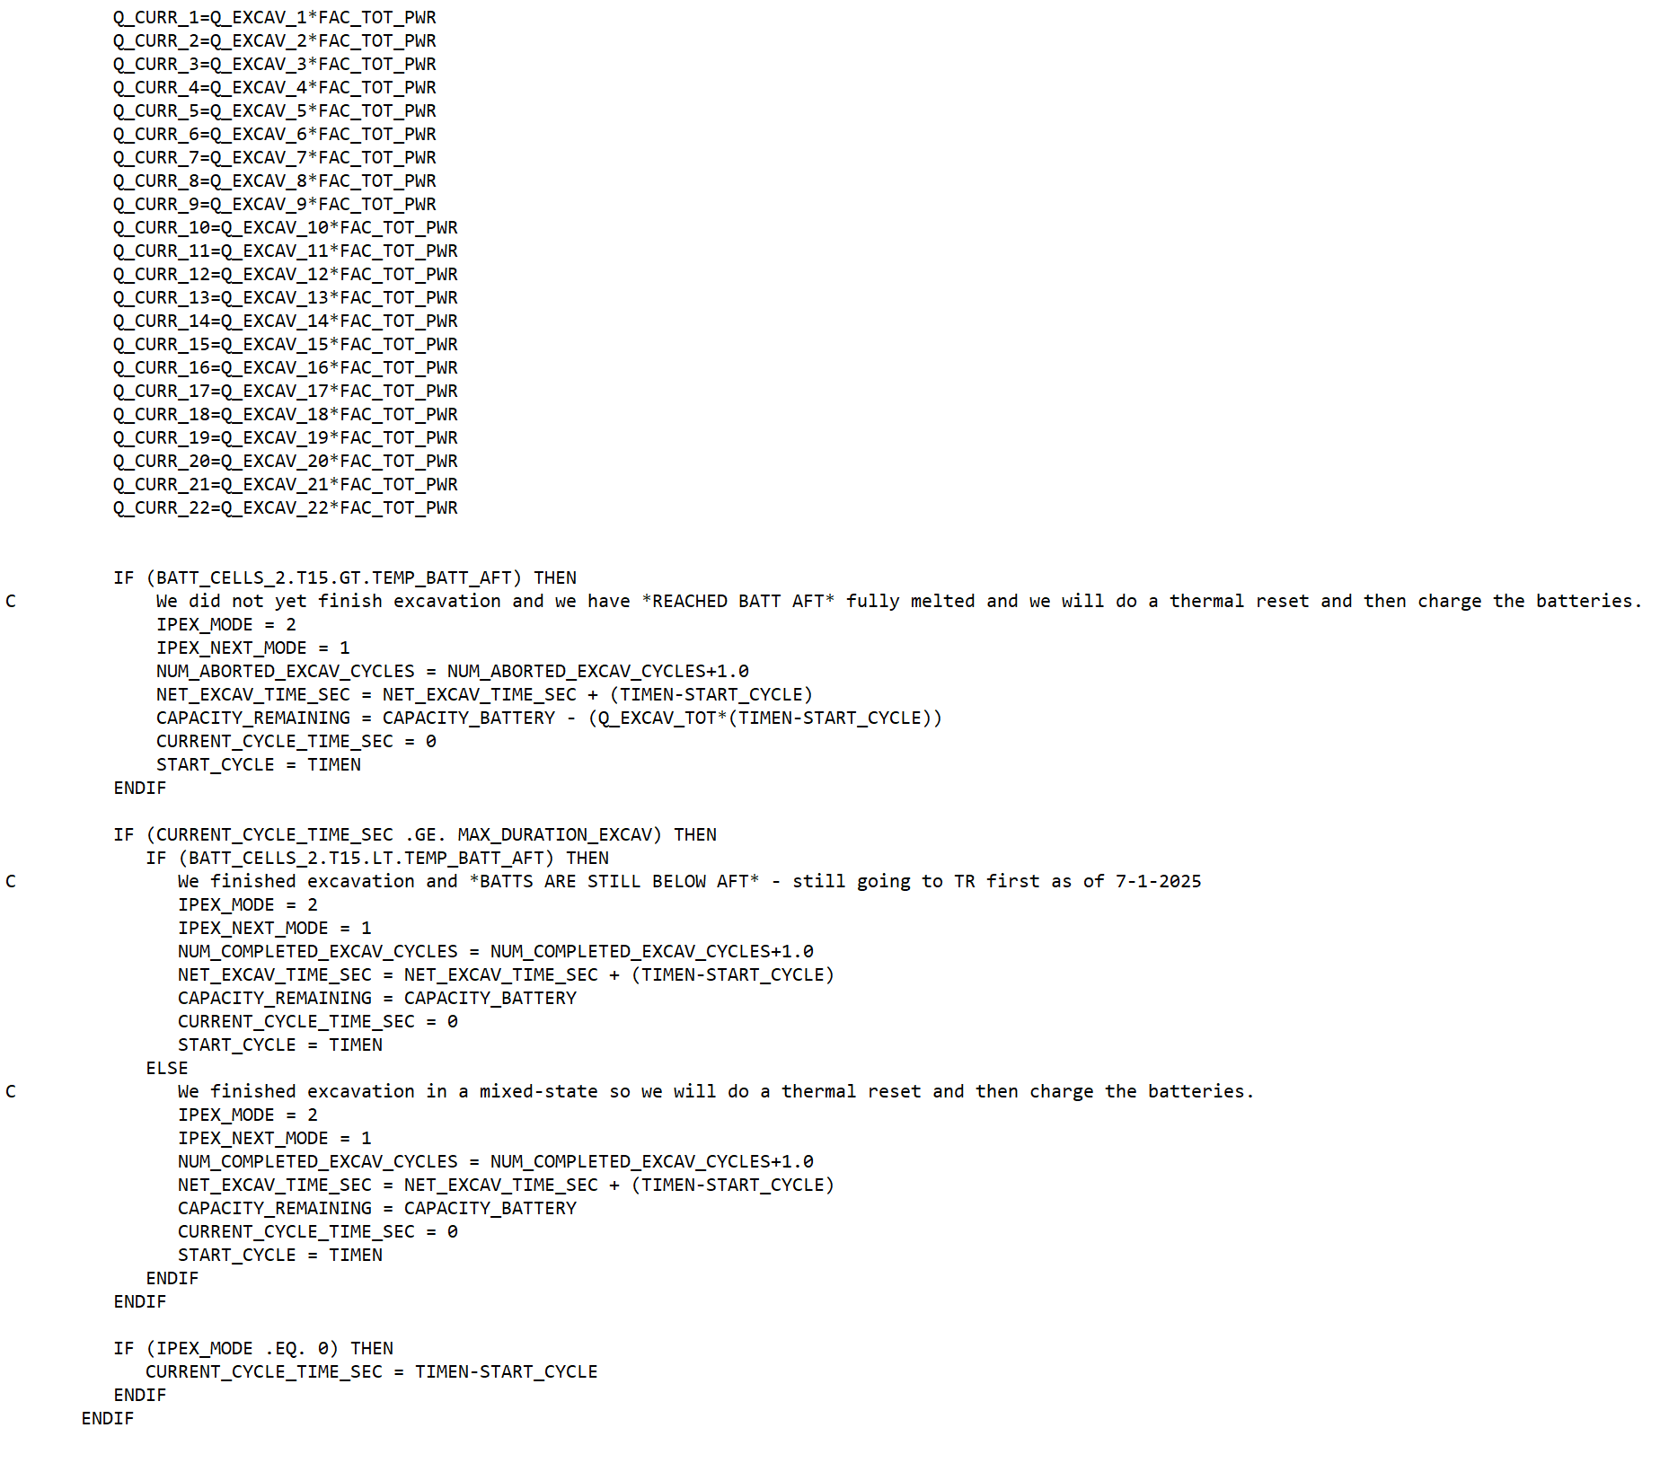
SINDA VARIABLES 2
SINDA SUBROUTINES UTILIZED

Slide 19
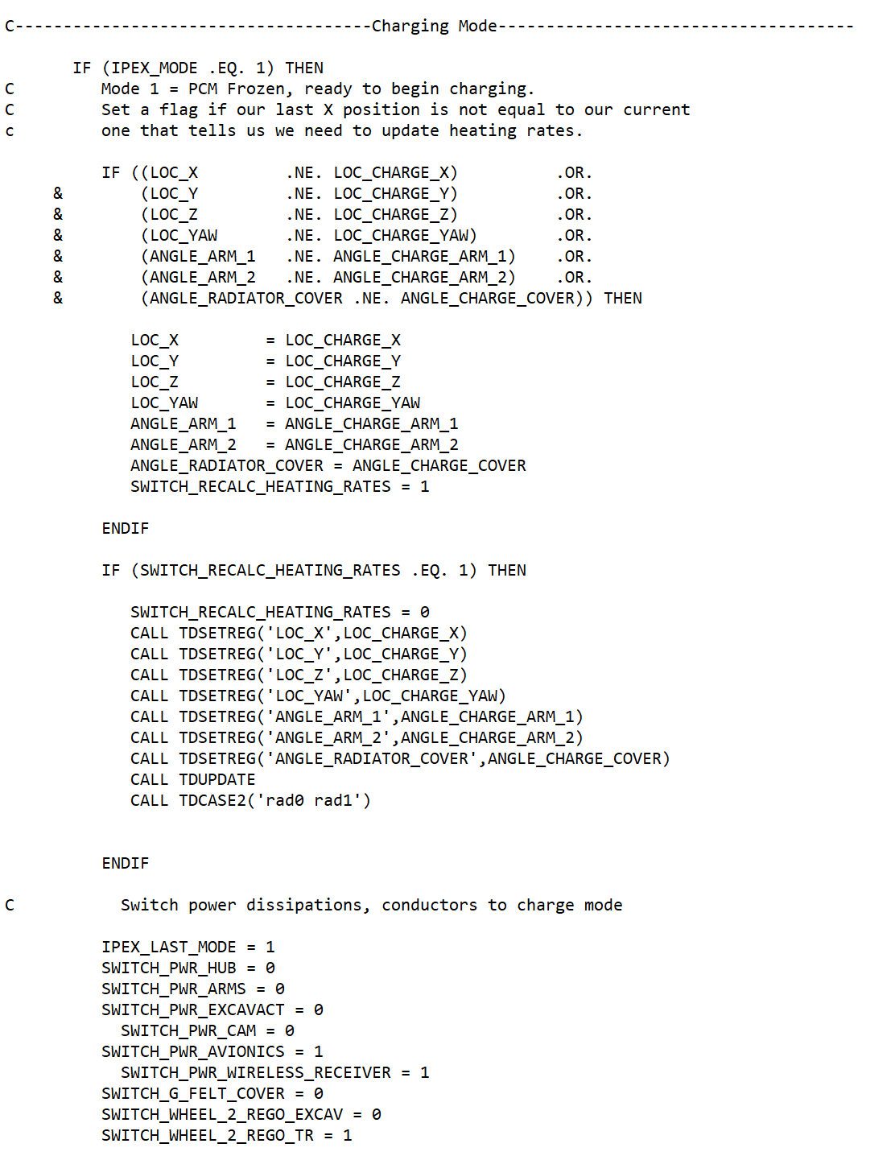
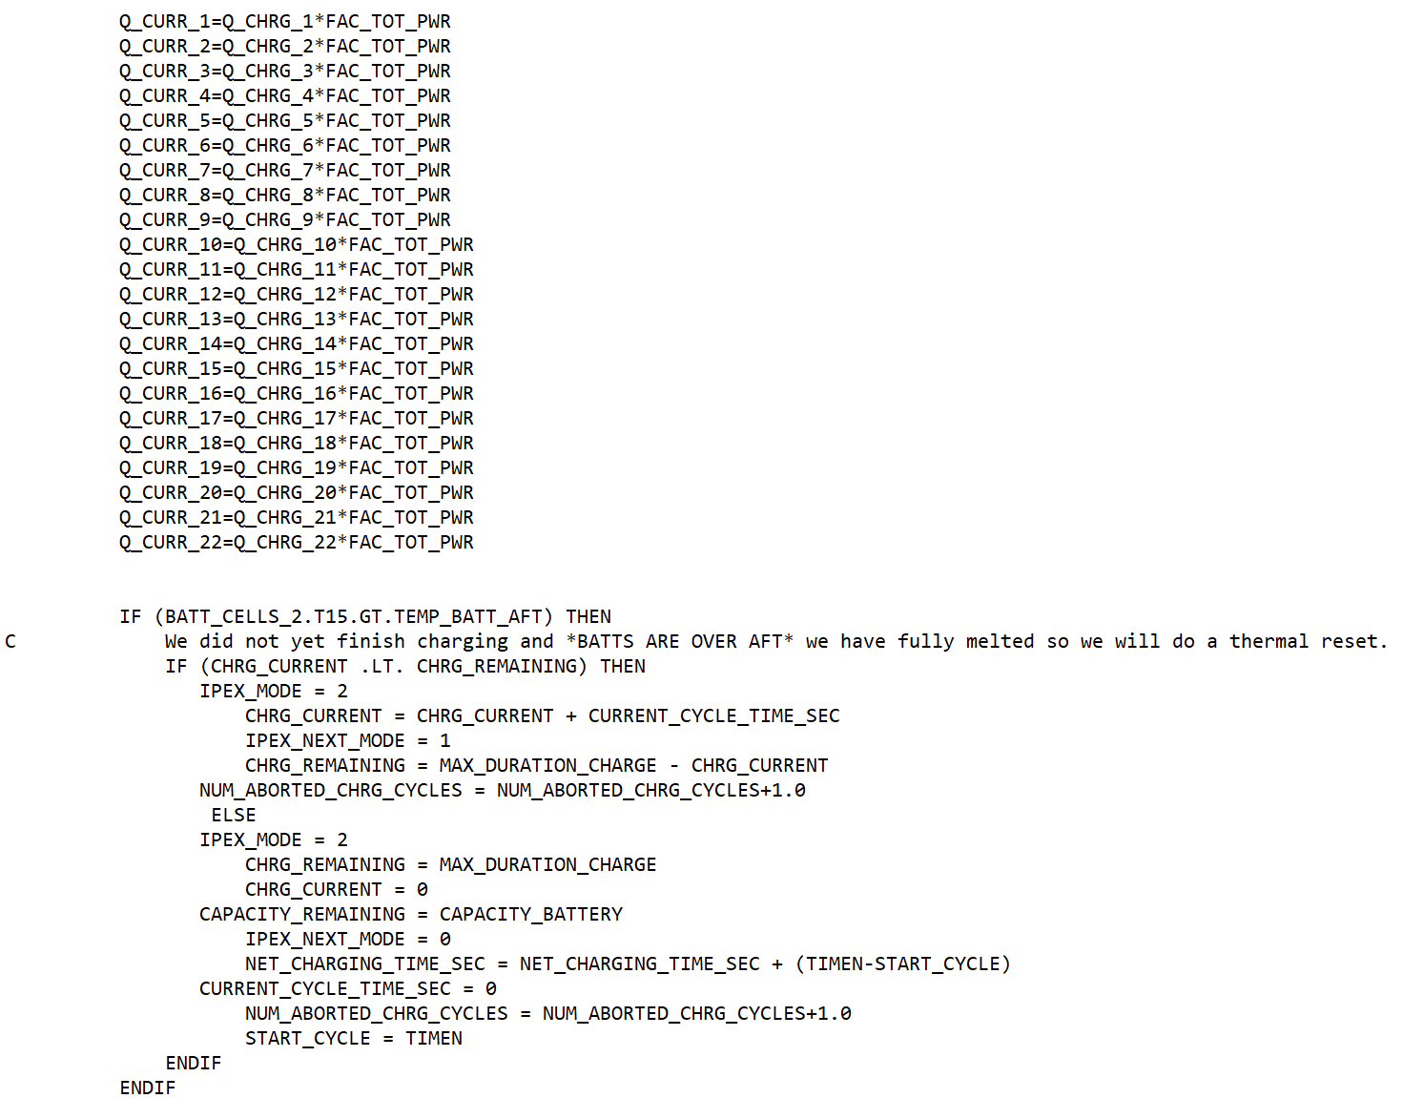
SINDA VARIABLES 2

Slide 20
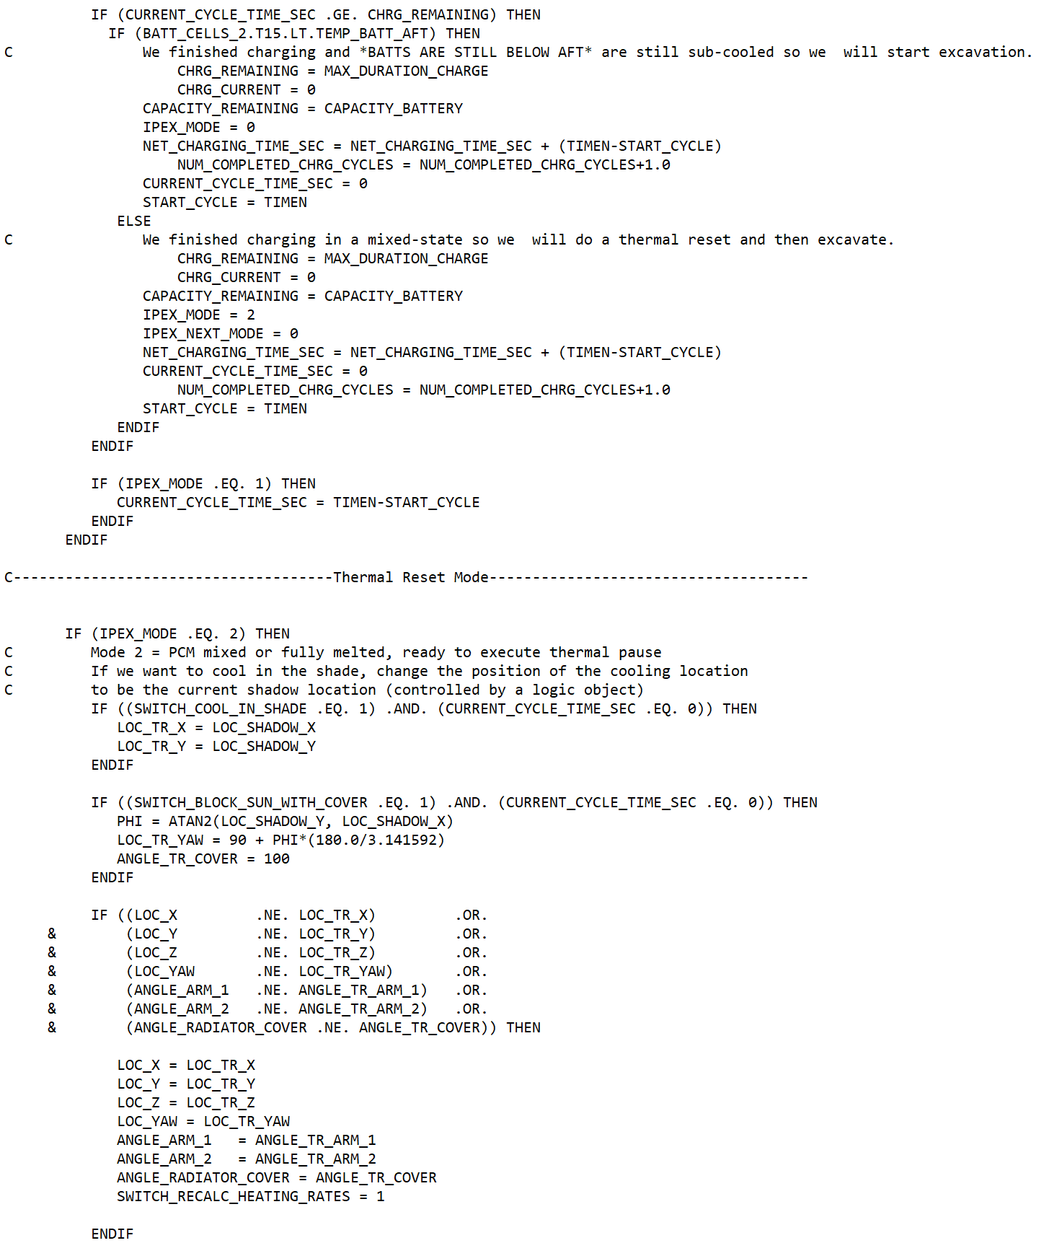
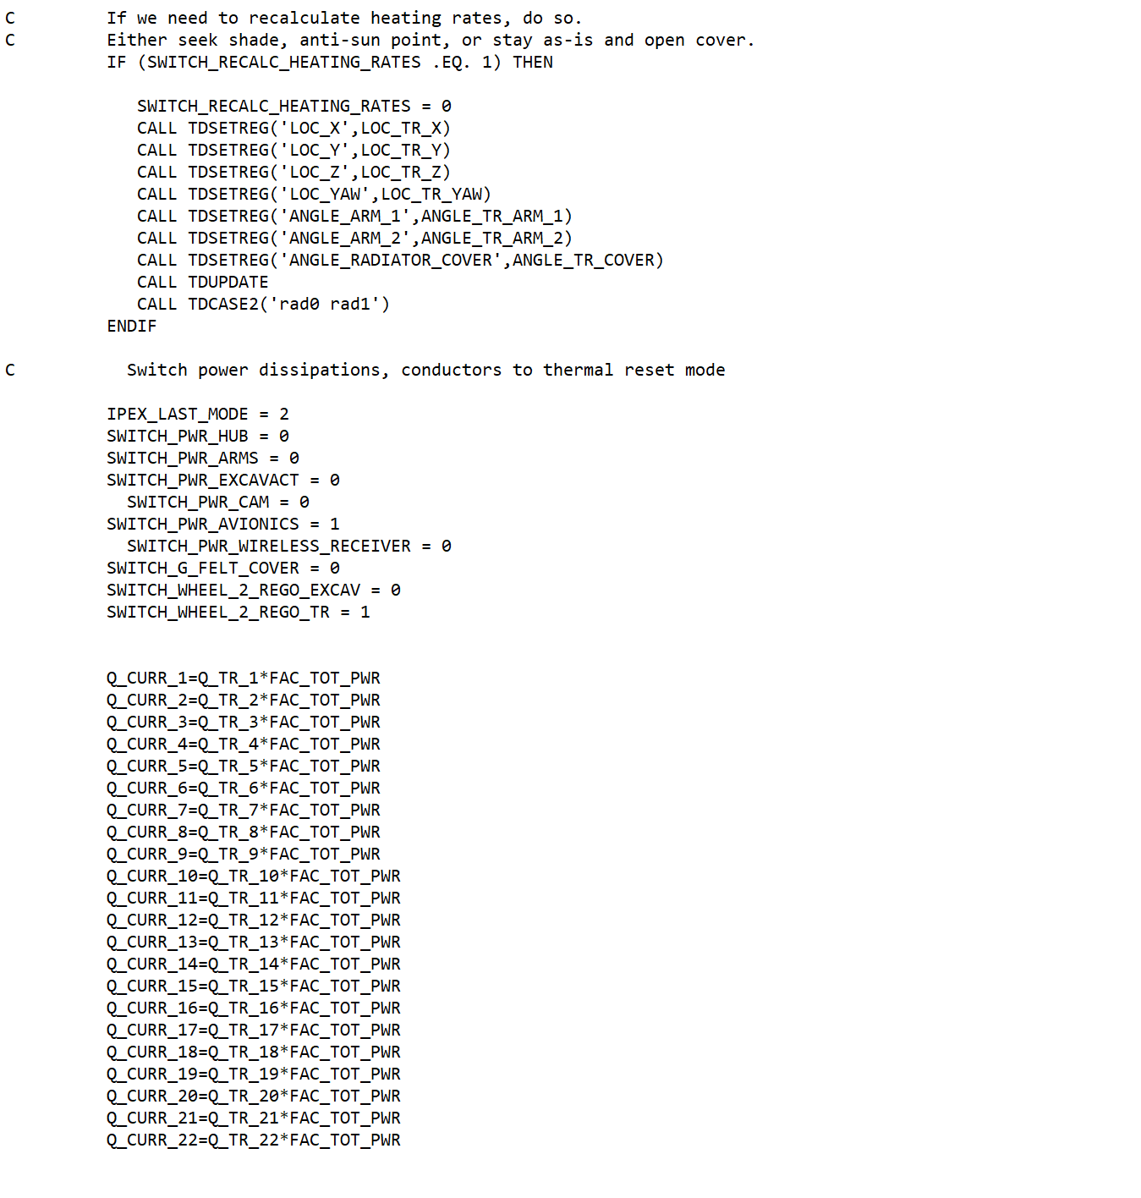
SINDA VARIABLES 2

Slide 21
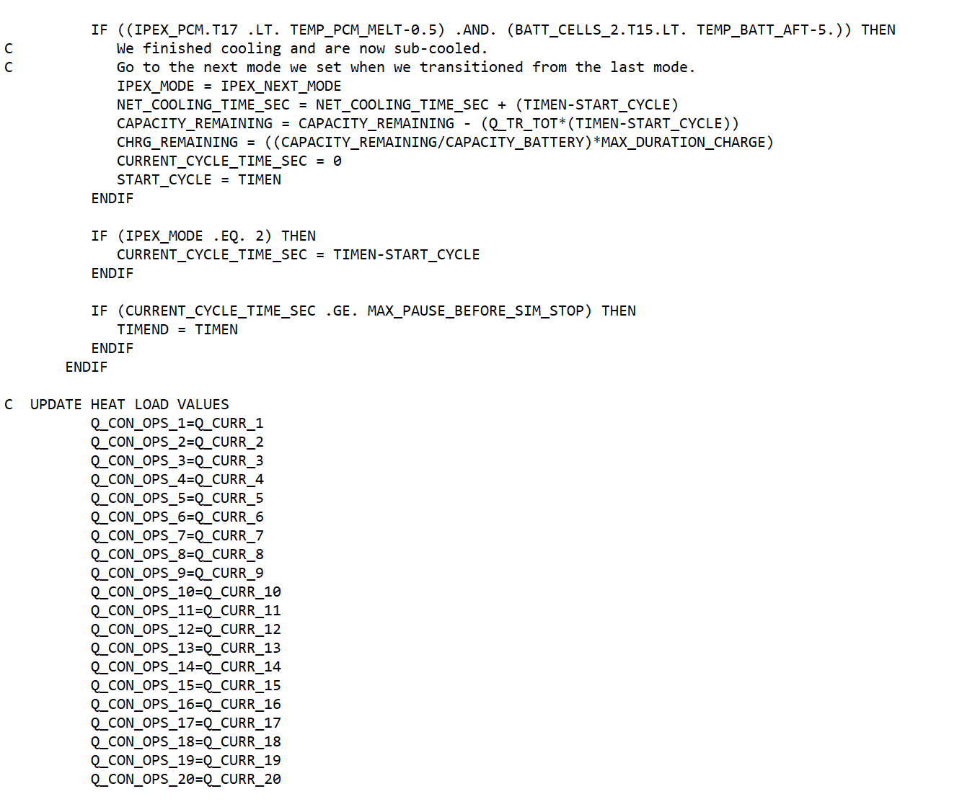
SINDA VARIABLES 2

Slide 22
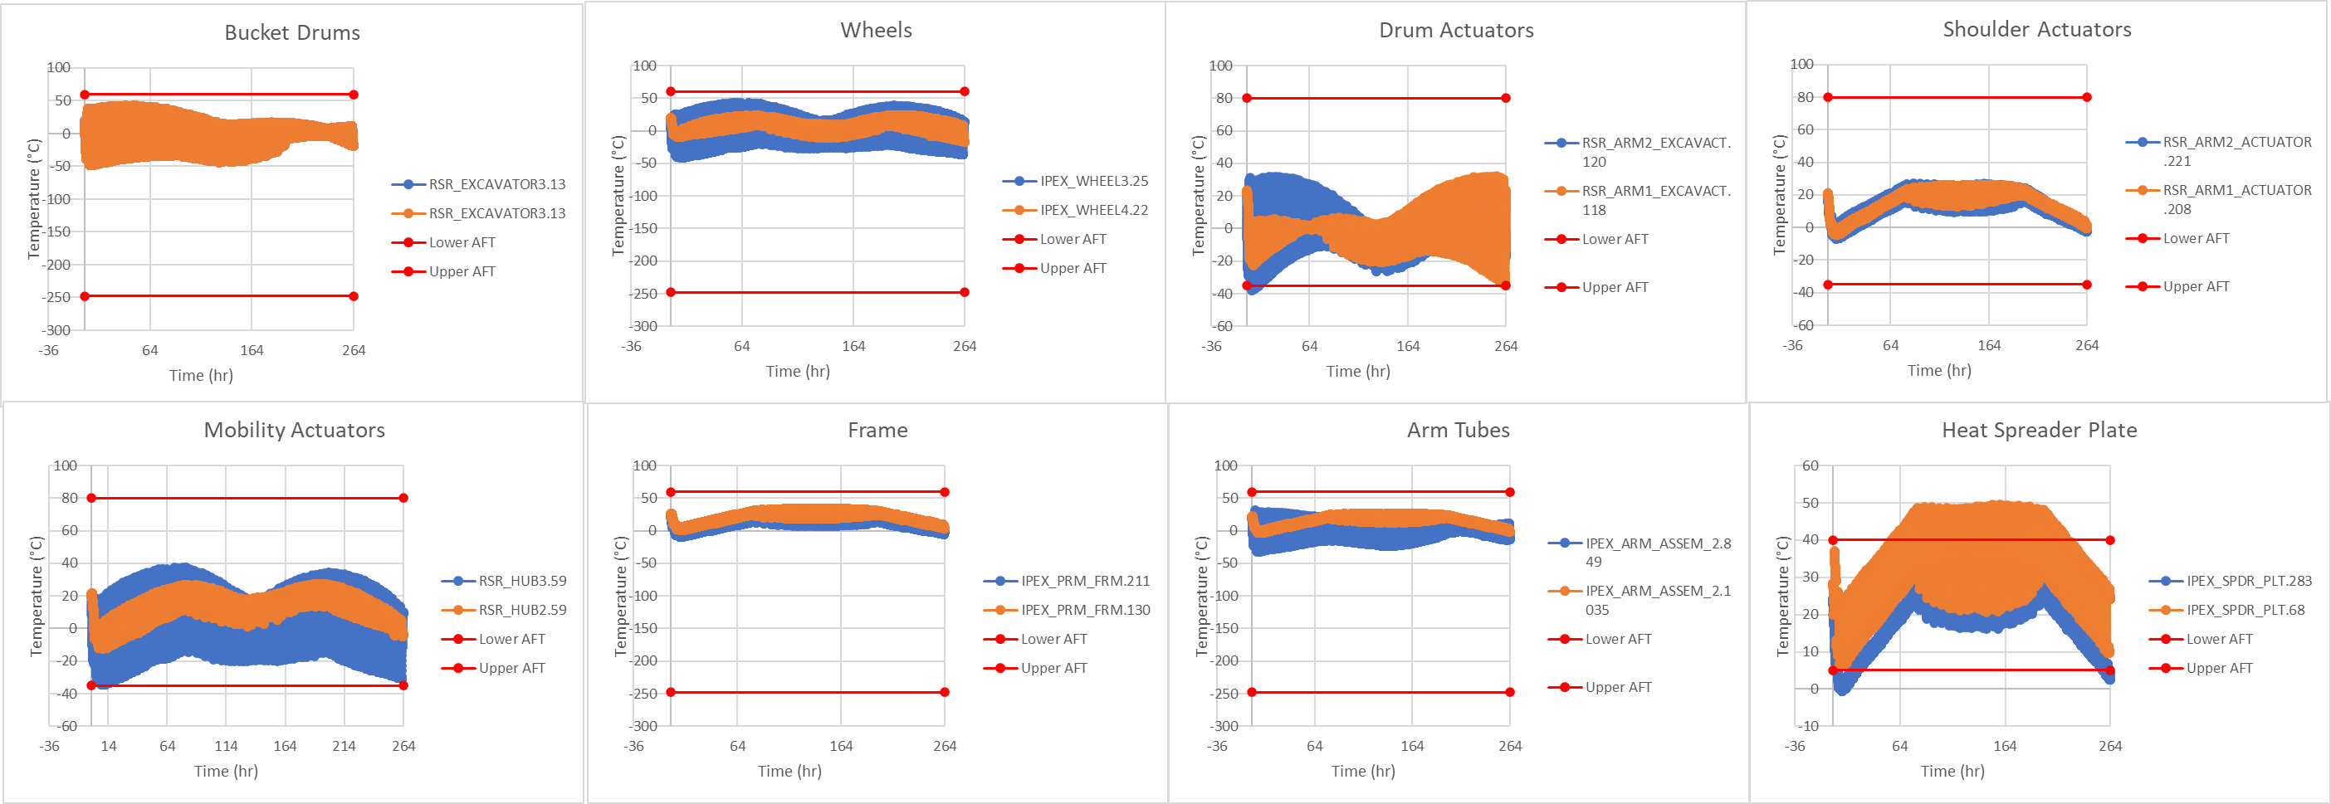
Typical Results

Slide 23
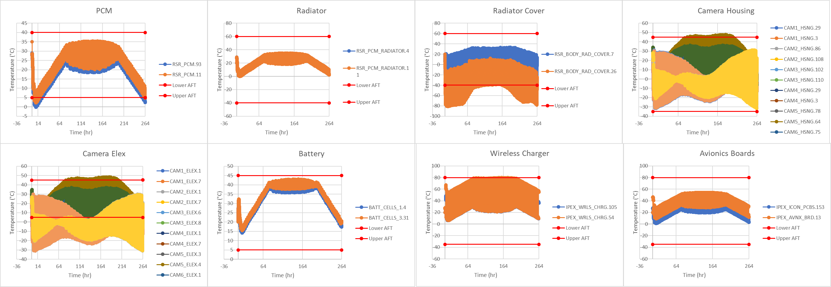
Typical Results

Slide 24
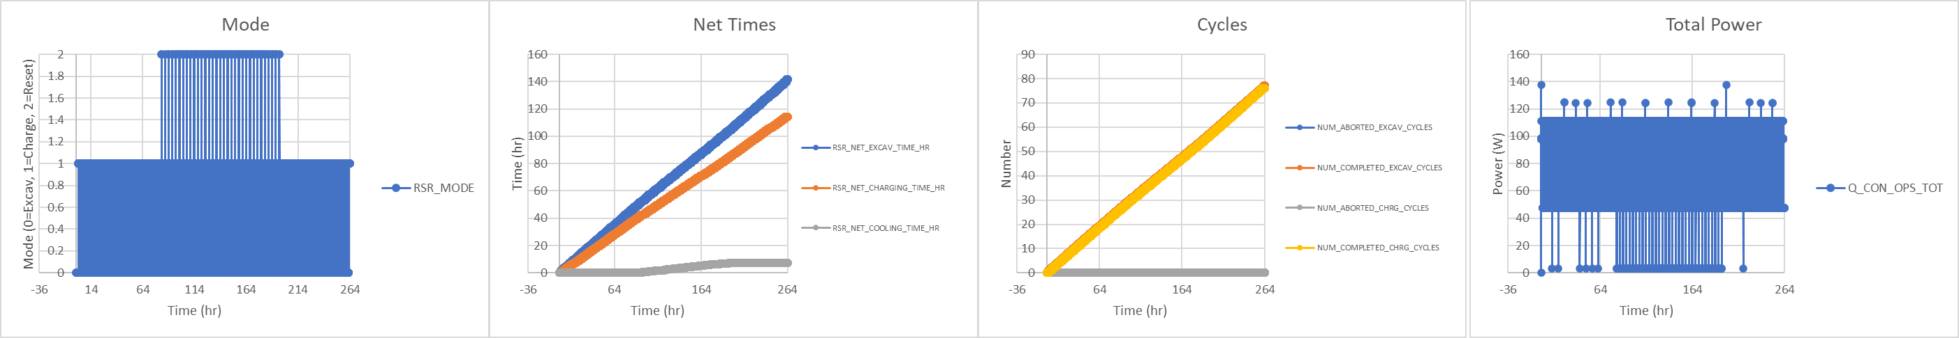
Typical Results

Slide 25
References
[1] ISRU Pilot Excavator – NASA https://www.nasa.gov/isru-pilot-excavator/
[2] NASA In-Situ Resource Utilization (ISRU) Pilot Excavator (IPEX) Digital Twin Autonomy Challenge for Universities 2024 Machine-Ground Interaction Consortium Meeting (MaGIC) Authors: Rob Mueller, Jason Schuler– NASA Kennedy Space Center; Eric Reiners - Caterpillar

