Slide 1

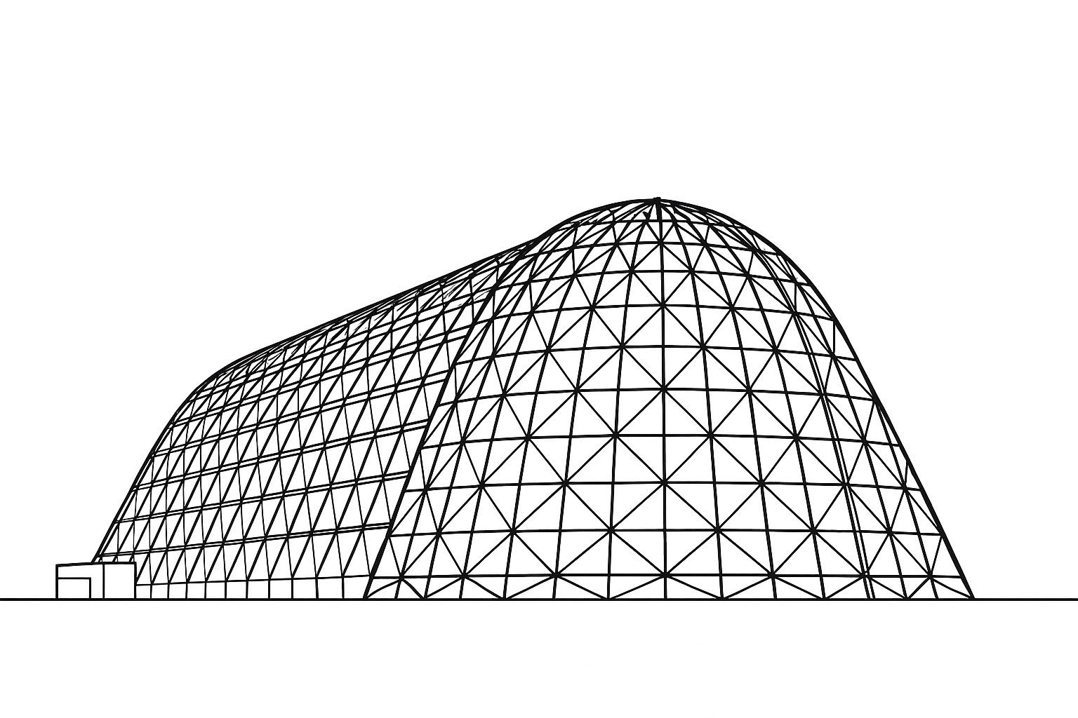


Thermal Effects of Scene-Based, Lunar Alignment for a Hyperspectral Earth Observation Telescope in Low Earth Orbit
TFAWS 2025 Interdisciplinary Technical Session
Presented by: Geneva Vandervinne
Thermal & Fluids Analysis Workshop 2025
NASA Ames Research Center
San Jose, CA
August 4-7, 2025

Slide 2

Outline
Motivation
Mission Overview
Auto-alignment Introduction
Model Setup
Assumptions
Alignment Maneuver
Mesh, Contacts & Radiation Environment
Case Sets
Results
Temperature Profiles
Optical Displacements
Conclusions

Slide 3
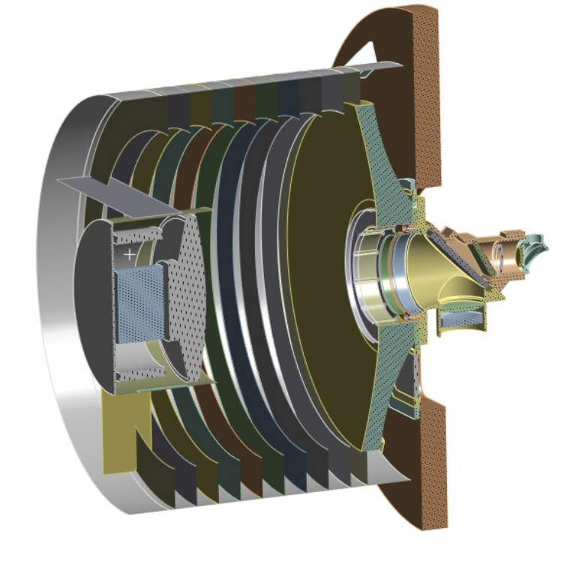
Motivation – Mission Overview
Hyperspectral, EO payload
LEO, SSO
Cassegrain-style optical system
Fine-adjust mechanism for alignment operations on the secondary mirror

Slide 4
Motivation – Lunar Alignment
Goal is automatic, scene-based alignment using fine adjust mechanism to position the secondary mirror.
Scene-based alignment using targets on the surface of the Earth is an option, but well-defined features and contrast is required. The Moon is an ideal target for alignment (large, bright, well-defined edge). Requires a spacecraft pointing maneuver.
Challenge: Imaging does not occur in the same thermal environment as alignment.

Slide 5
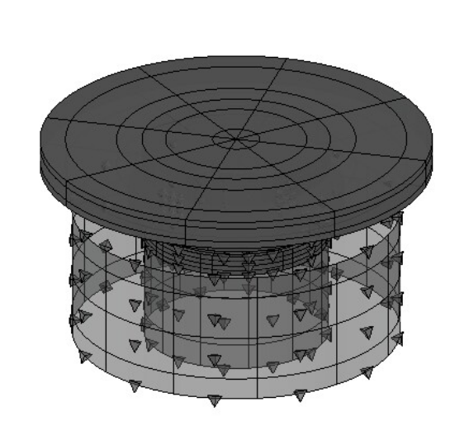
Model Setup – Assumptions
Fine adjust mechanism planned to be actively heated for temperature control (detailed design TBD). Mechanism held at constant temperature for this analysis.
Nominal hot operating conditions are considered. One nominal cold case is included to check for significant changes.

Slide 6
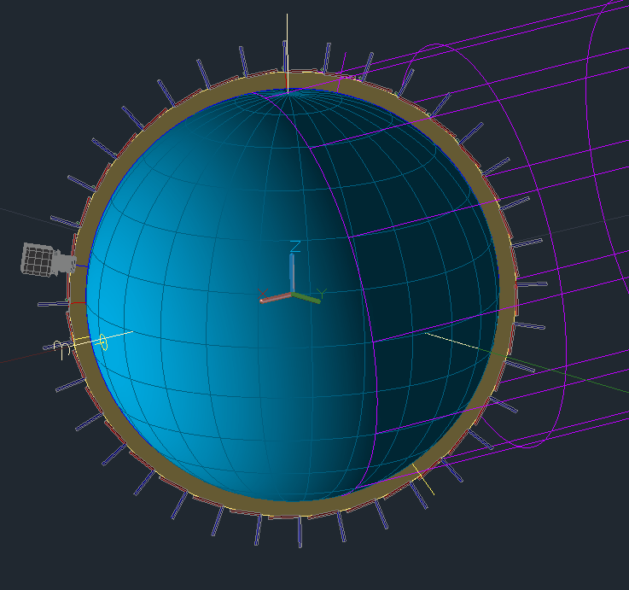
Model Setup – Alignment Maneuver
Simplification: Payload is assumed to rotate 180 degrees to be zenith-facing for a period of ~16 minutes.
Alignment is assumed to take 3-5 minutes.
Slew rate of 1 deg/s is assumed.
Margin of ~5 minutes added to account for position stabilization, etc.

Slide 7
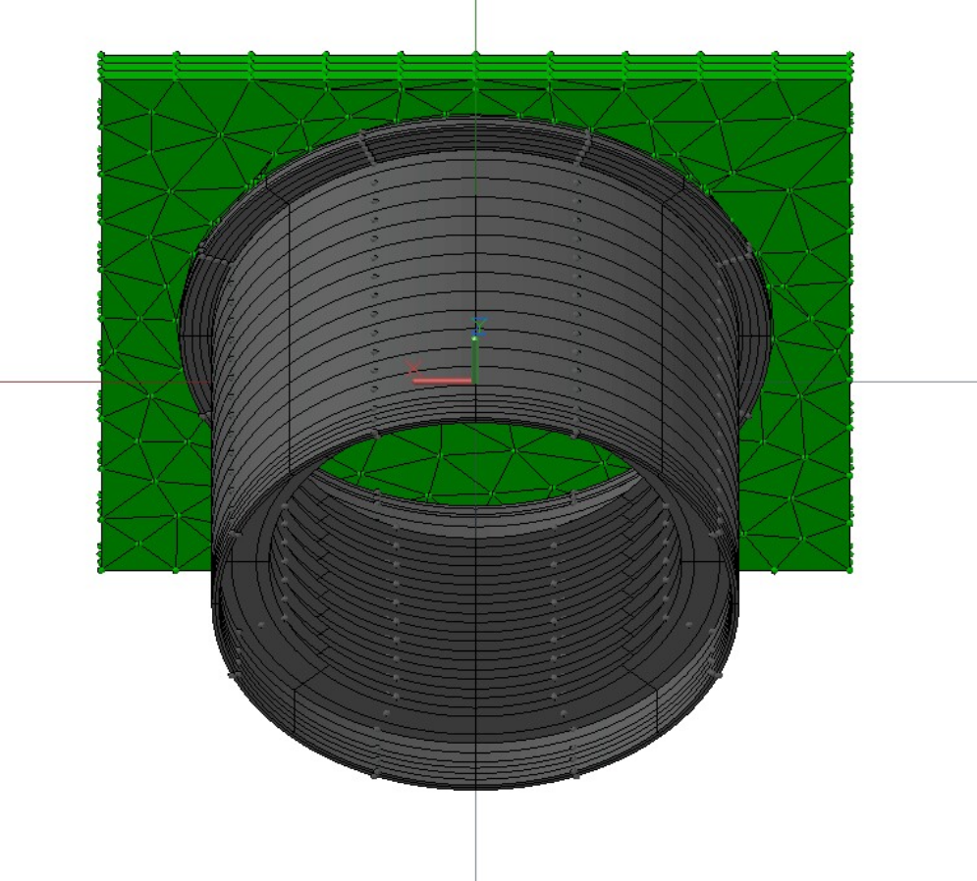
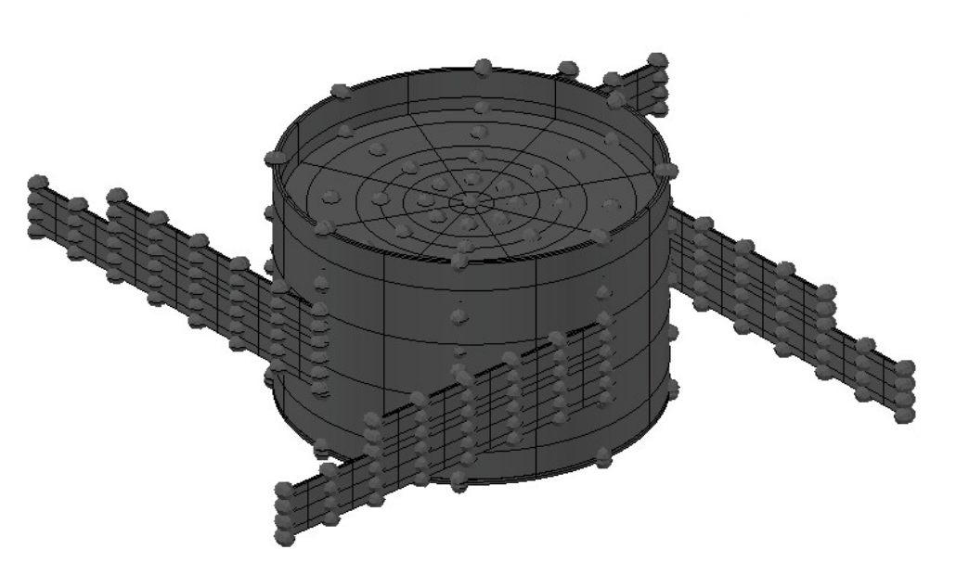
Model Setup – Mesh

Slide 8
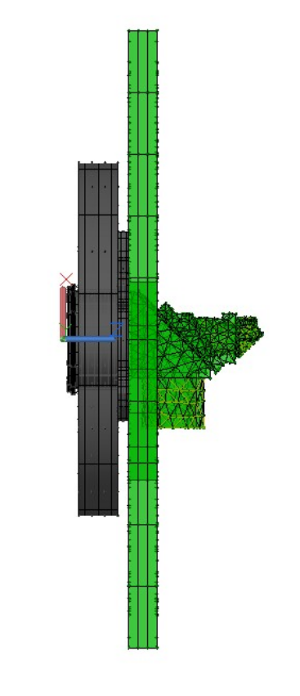
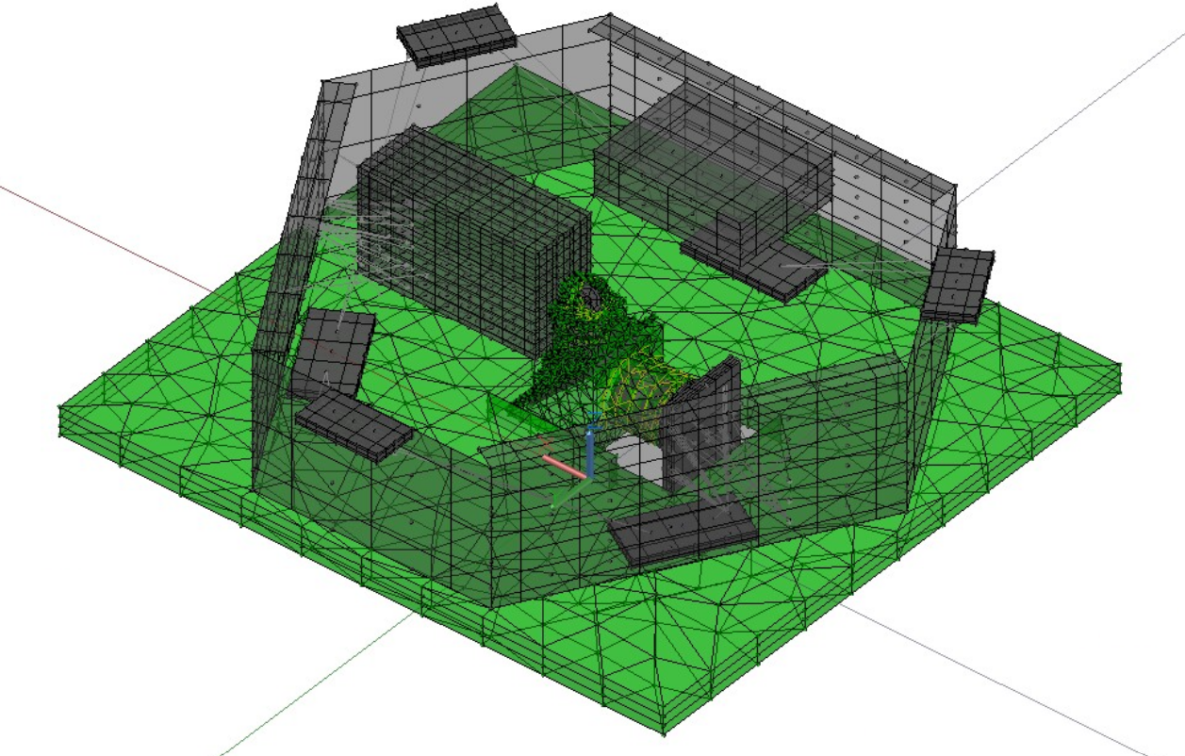
Model Setup – Mesh

Slide 9
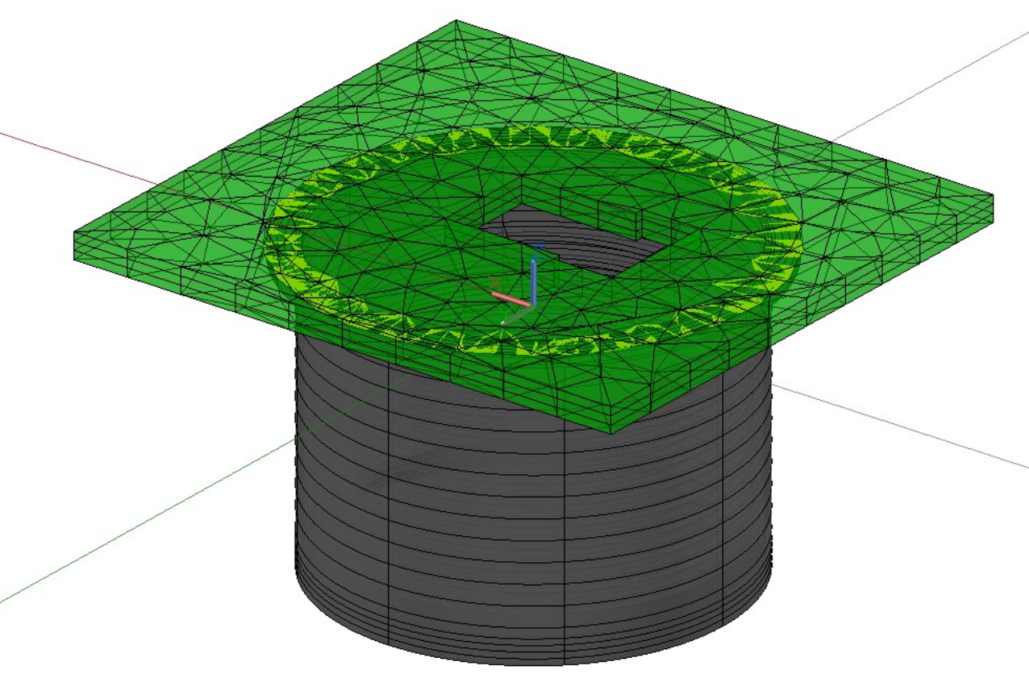
Model Setup – Contacts
Spacecraft bus is represented by a simple aluminum box. Radiative heat transfer only assumed between payload and bus.
Merged nodes used for composite shapes whenever possible.
Simple shapes replaced with conductor elements where practicable.
Bolted connections represented by face or node contactor elements.

Slide 10
Model Setup – Radiation
Parameter | Nominal Hot Case Value | Nominal Cold Case Value
Solar Radiation | 1367 W/m2 | 1367 W/m2
Earth IR | 237 W/m2 | 225 W/m2
Albedo | 0.24 | 0.2
Bus Temperature | 20 C | -20 C

Slide 11
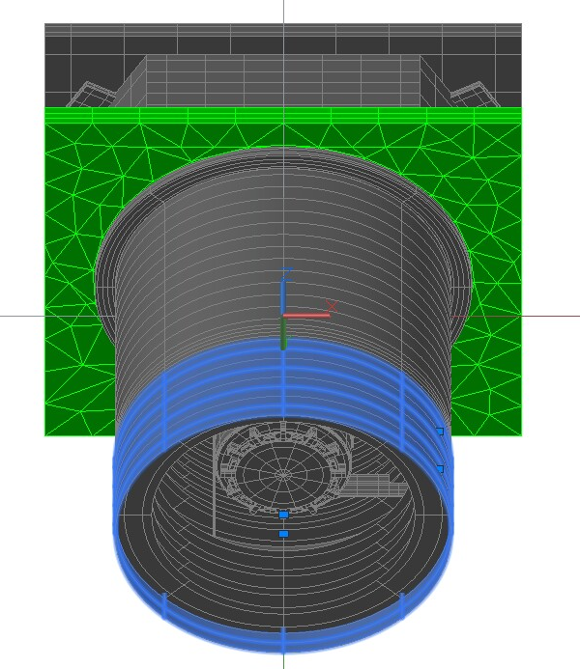
Analysis – Case Sets
Alignment maneuver position
Immediately after eclipse entry
Middle of eclipse
Immediately before eclipse exit
Nominal hot or cold conditions
Baffle extension inclusion
Number of alignment passes
1 (assumed nominal)
3 (assumed less frequent)

Slide 12
Analysis – Case Sets
Analysis Section | Duration | Description
Setup | 22,857 s (four orbits) | Steady state analysis at starting position, followed by transient. Nominal (nadir-facing) operation.
Alignment | 5,714 s (one orbit), for nominal cases 17,143 s (three orbits), for worst cases (assume alignment requires multiple passes) | Transient analysis initialized from final Setup case time. Nominal operation, satellite rotates 180 degrees to zenith-facing for six orbital “positions” (~16 minutes).
Post-Alignment | 28,571 (five orbits) | Transient analysis initialized from final Alignment case time. Nominal operation. Goal is to ensure return to quasi-steady-state within a relatively short time.

Slide 13
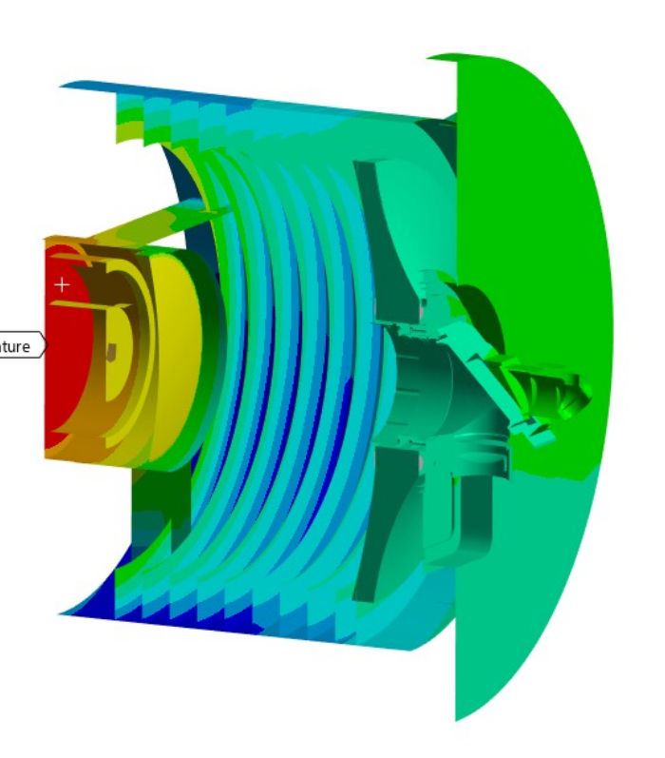
Analysis – Structural
The following time steps were mapped to the structural mesh:
Four approximately equally spaced points in Setup transient analysis final orbit (eclipse entry/exit, middle of sunlit portion, middle of eclipse)
Two points in the middle of the alignment maneuver
Temperature profiles were imported into ANSYS Mechanical and set up as “stepped” Static Structural analyses.

Slide 14
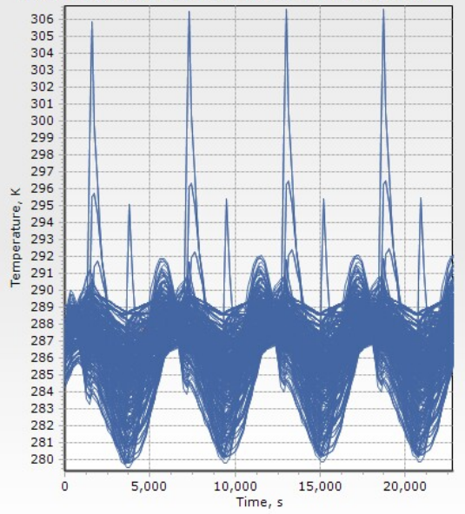
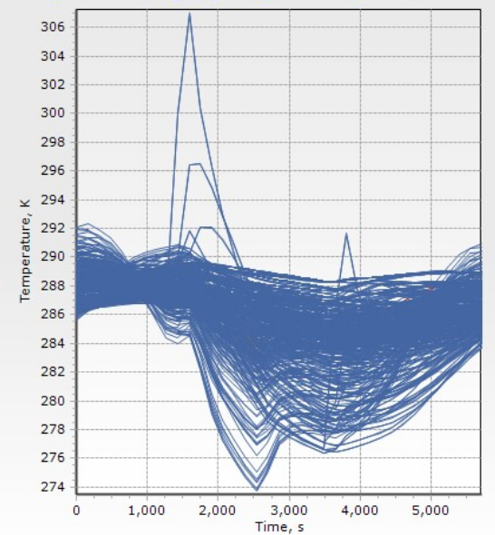
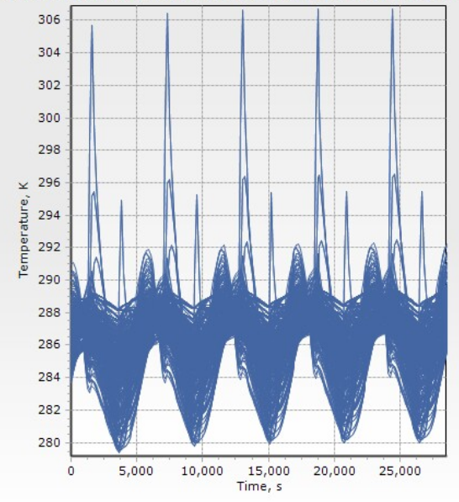
Results - Temperature
Setup
Alignment
Post-Align

Slide 15
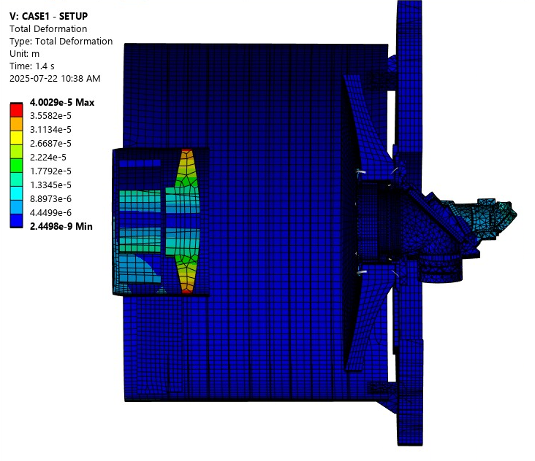
Results - Displacement
Displacement profiles for optical surfaces were exported from ANSYS Mechanical for further analysis by the Controls team.
Secondary mirror displacements were focused on. System performance is sensitive to these.
Change in position during normal operations, as well as during the alignment maneuver, were assessed.

Slide 16
Conclusions
Most component temperatures appear to return to quasi-steady-state after 3-5 orbits following an alignment maneuver.
Optical conclusions,
Extended baffle reduces temperature variation, improving results.
In quasi-steady-state operation, the system passively stays in focus.
Difference between alignment in eclipse and quasi-steady-state is in despace only and ranges from 1.5-2.5 um. This displacement is considered correctable.
Variation of despace position during alignment is relatively small (1.5-1.9 nm/s).
Based on this analysis, the lunar alignment approach appears feasible. This analysis will be revisited and validated with testing as the overall design maturity increases.

Slide 17


Questions
THANK YOU!
geneva.vandervinne@wyvern.space

