Slide 1

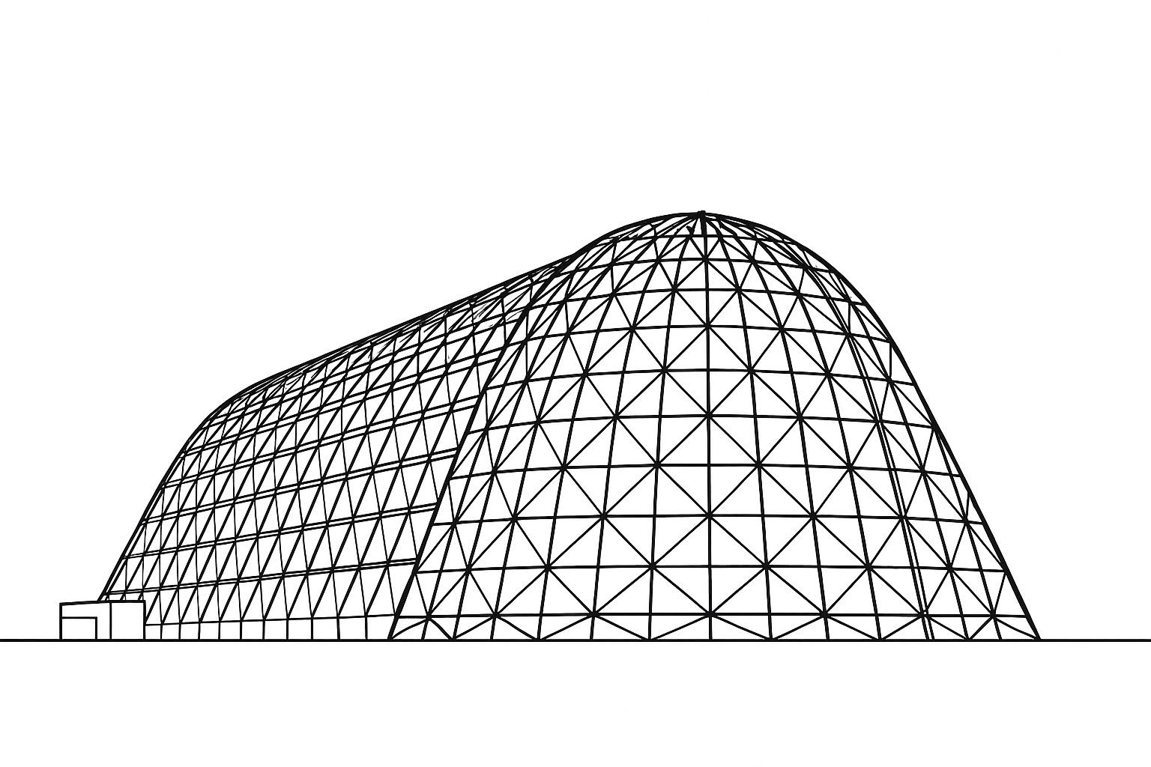

Harnessing Thermoacoustic Power with Bi-Directional Turbines: A Path to Efficient Energy Conversion
TFAWS 2025 Interdisciplinary Technical Session
Presented by: Luis A. Rodriguez¹
Co-Authors: Mark P. Wernet¹, Ronald J. Leibach1,Terry V. Reid¹, Corey T. Mays²
Affiliation: ¹ NASA Glenn Research Center, Cleveland, Ohio; ² The Ohio State University, Columbus, Ohio
Thermal & Fluids Analysis Workshop 2025
NASA Ames Research Center
San Jose, CA
August 4-7, 2025

Slide 2
Agenda
Thermoacoustic Background and Need
Thermoacoustic Traveling Wave Concepts
In-house System and Previous Results
Bi-directional Turbine Background
Base Turbine CFD Study and Results
In-house Turbine Testing and Results
Summary

Slide 3
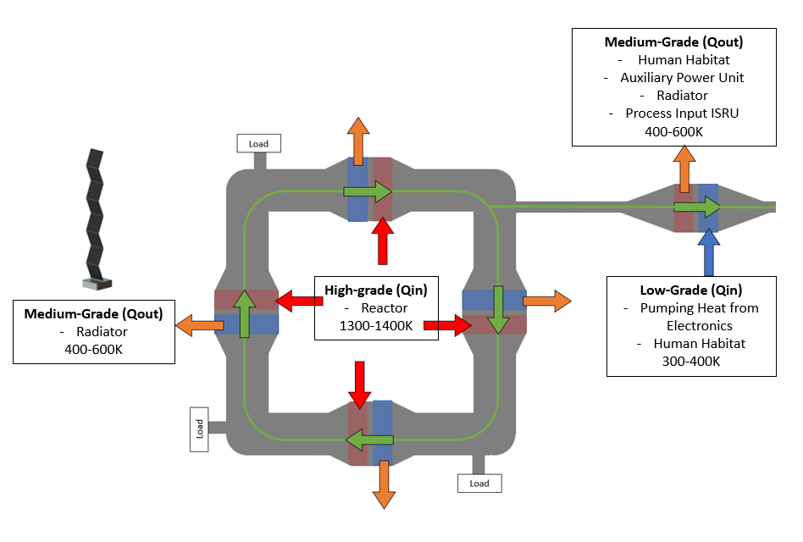
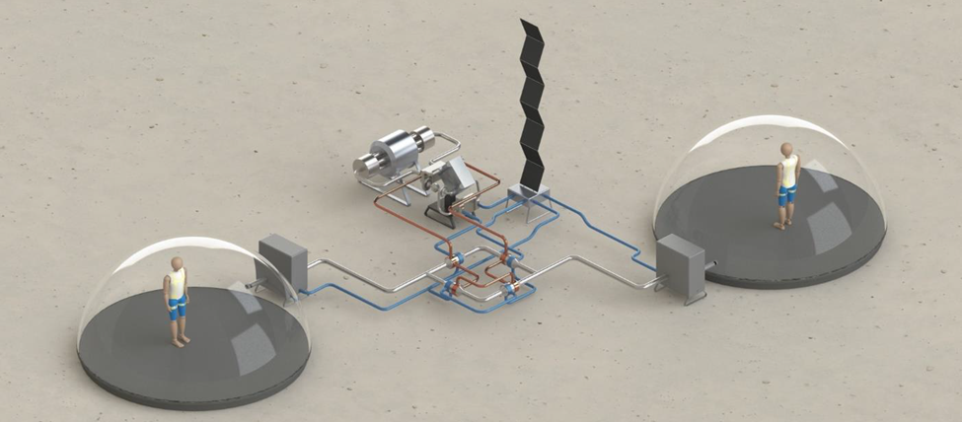
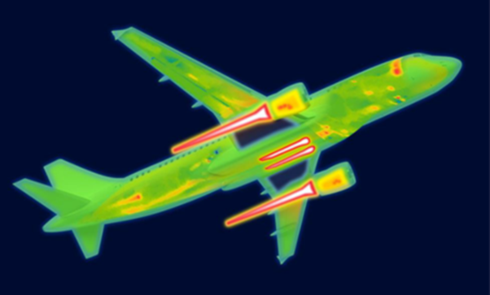
Thermoacoustic Background and Need
Electric Aircraft
Space
Thermal Management Technology | Disadvantage
Ram air HX | Adds weight, aircraft drag, displaces fuel capacity
Convective skin cooling HX | Adds weight, drag, and requires liquid pumping losses
Sinking heat into fuel | Limited thermal capacity due to coking and volume
Sinking heat into lubricating oil | Limited thermal capacity, Low delta T adds HX mass
Active cooling | Reduces propulsive efficiency, Adds weight and maintenance
Phase change cooling | Limited thermal capacity, Adds weight
Heat Pipe, Pumped Multiphase | Does not increase Exergy which impacts mass and efficiency
Waste Heat: 200 KW to 6 MW
(VTOL, General Aviation, Small Turboprop, Regional Turboprops/Turbofans, and Single Aisle)
(Rodriguez, 2025)
Notes:
After,Thermoacoustics has the advantage of, of handling high grade heat loads, having no moving parts, gravity independent, and potentially being imbedded into infrastructure.

Slide 4
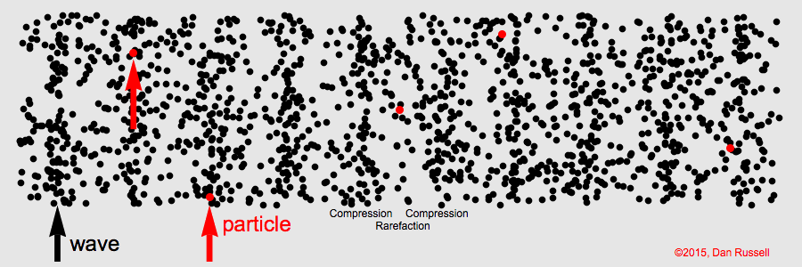




Traveling Wave Concepts
Aeronautics
Local Skin Heating
Thrust Augmentation
Fuel Preheating
Space
Human Habitat
ISRU Process Input
Auxiliary Power Unit
(Rodriguez, 2025)
Heat Sink Temperature
Low $\dot{Q}$ Out
Engine
High $\dot{Q}$ Out
Heat Pump
Linear Motor
Reservoir
(Russell, 2015)
Low $\dot{Q}$ In
High $\dot{Q}$ In
Sources of High-Grade Wasted Heat
Sources of Low-Grade Heat

Slide 5
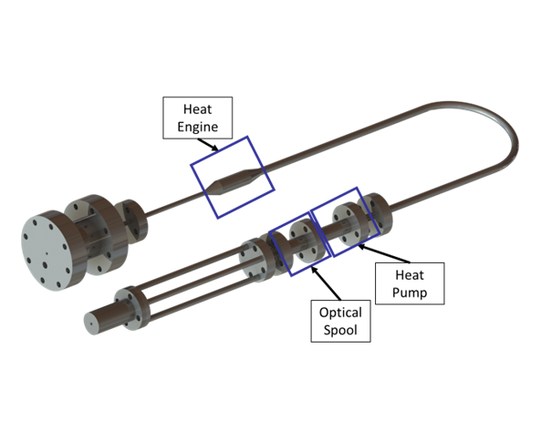
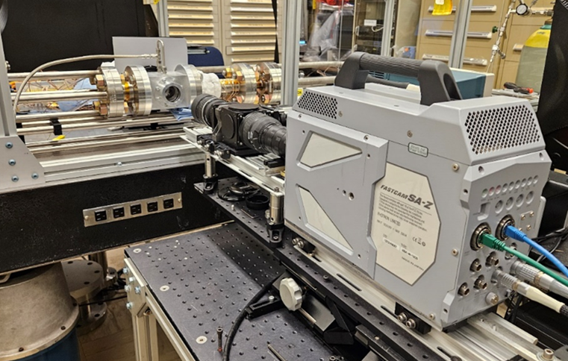
In-House System
(Rodriguez, 2025)
Self Aligned Focusing Schlieren System
(Rodriguez, 2025)

Slide 6
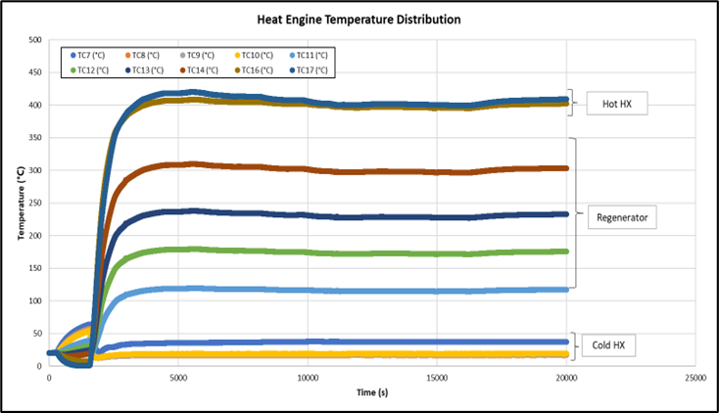
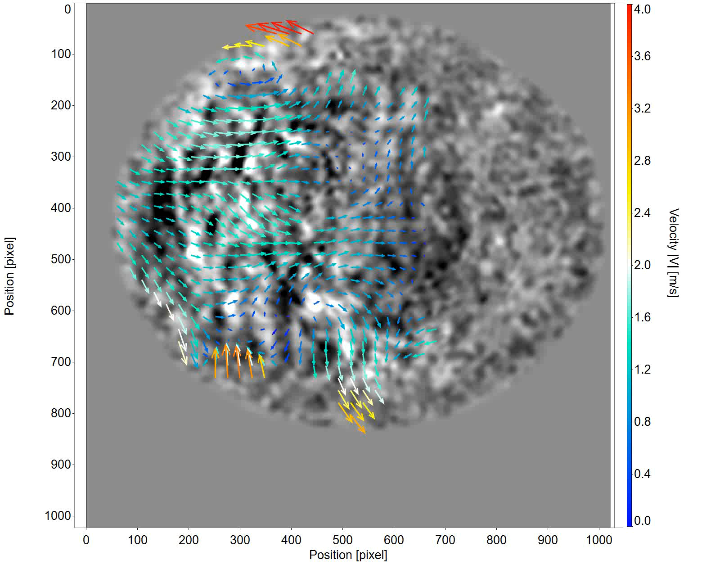
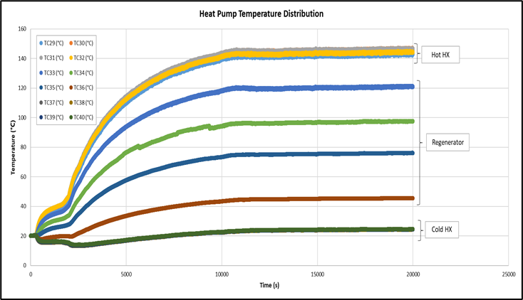
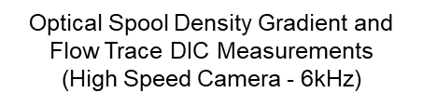
Previous Work
(Rodriguez, 2025)
Δ Temperature (⁰C)
391.89
Δ Temperature (⁰C)
124.59

Slide 7
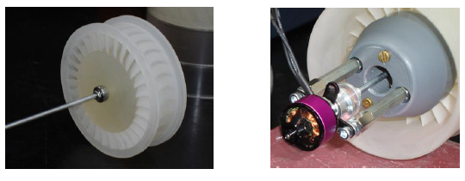
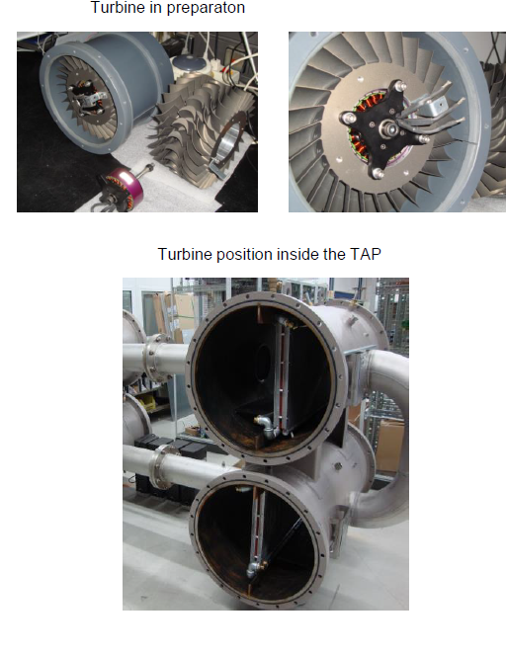
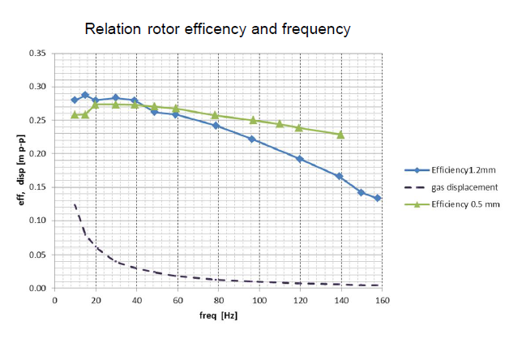
Previous Bi-directional Turbine Testing
Axial Impulse Turbine (Rotor Diameter 72 mm)
High Power Axial Impulse Turbine
(Rotor Diameter 200 mm)
(de Blok, 2014)
(de Blok, 2014)
100 KW TAP Rig
Rotor Diameter: 200 mm
Rotational Speed: 2700 RPM
Power: 2KW
Efficiency in air at 0.8MPa of this axial bi-directional
turbine is measured to be 80%
Notes:
SLA Printed. Used Brushless DC motor

Slide 8
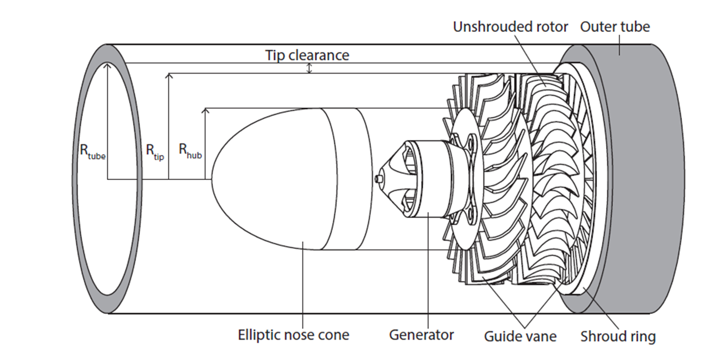
Turbine Operating Principles
Generated acoustic pressure energy flows through the guide vanes and is converted to kinetic within the turbine.
As a result of symmetry, the turbine will experience a torque in the same rotational direction, independent of the incoming axial flow.
Mechanical power produced by the turbine can then be converted to electricity by connecting shaft to a generator.
Goal is to generate 10We!
(Timmer, 2020)
Notes:
In low power RPS applications : Small RPS could be used to enable a long-life network of small distributed stations that monitor and transmit science data on lunar or planetary surfaces. https://ntrs.nasa.gov/api/citations/20190001555/downloads/20190001555.pdf

Slide 9
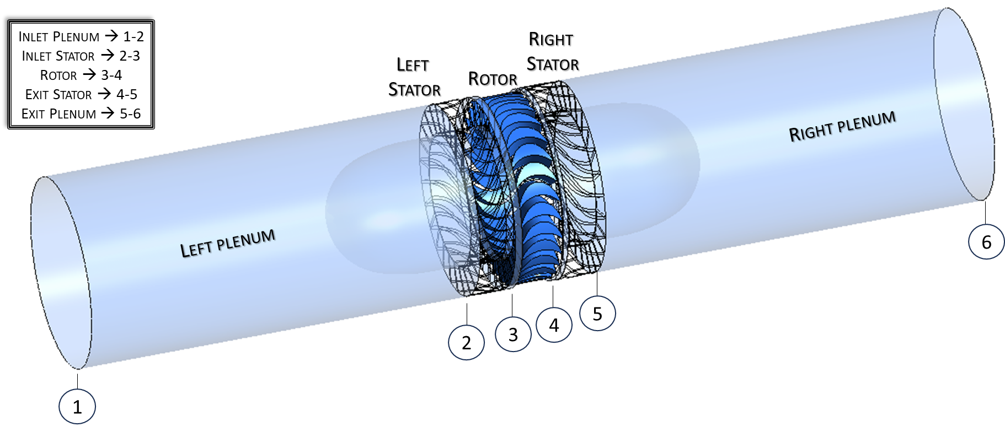
Base Turbine CFD Study- Ansys Fluent
Flow in the model is in a single direction.
Inlet pressure amplitude for all cases is 1,000 Pa.
Temperatures are taken at the points in the image above.

Slide 10
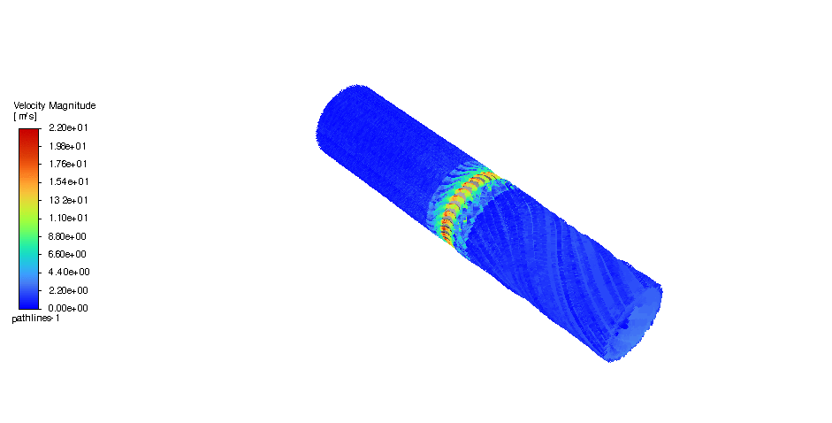
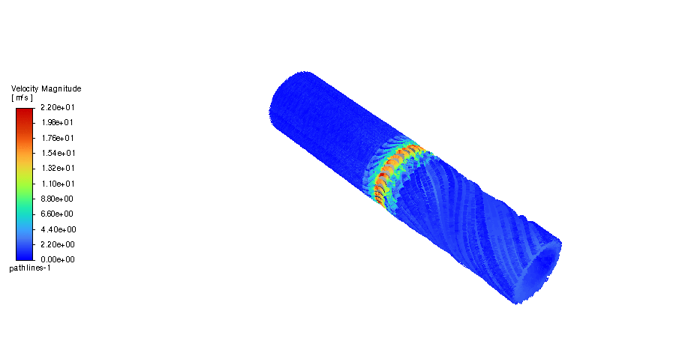
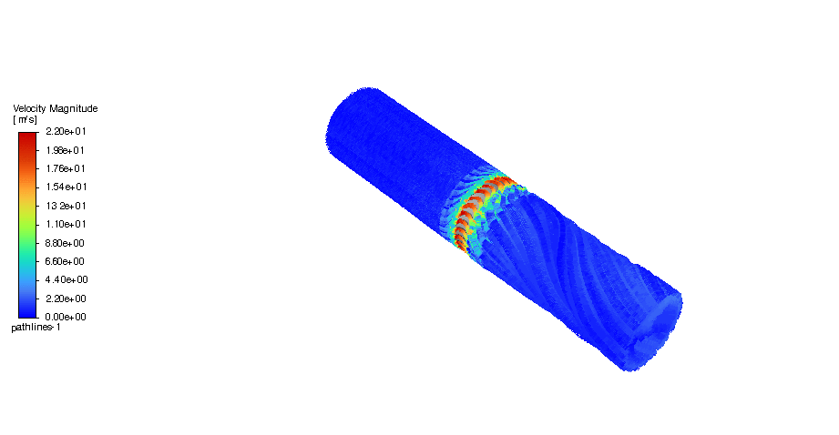
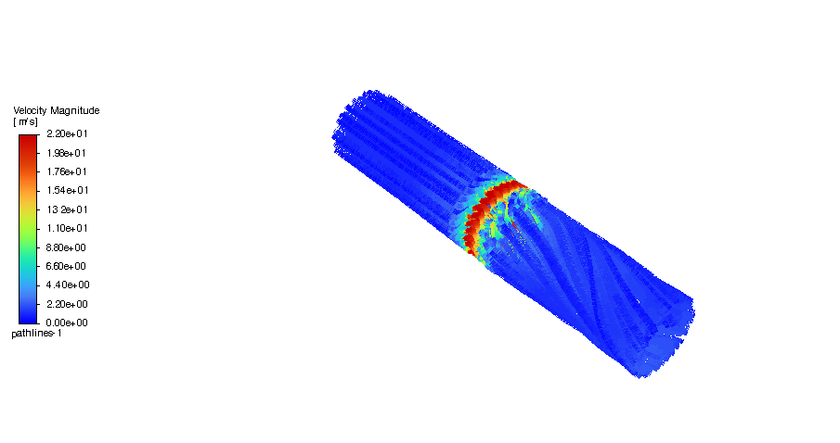
Power and RPM Results
Pow₂₋₅ = 22.01 watts
Pow₂₋₅ = 28.92 watts
Case 1.5 – 21.67 Hz (1,300 RPM)
Case 2 – 30 Hz (1,800 RPM)
Pow₂₋₅ = 8.80 watts
Pow₂₋₅ = 7.16 watts
Case 3 – 55 Hz (3,300 RPM)
Case 4 – 80 Hz (4,800 RPM)

Slide 11
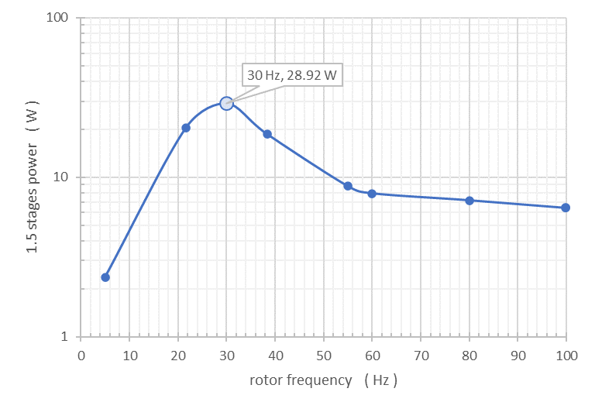
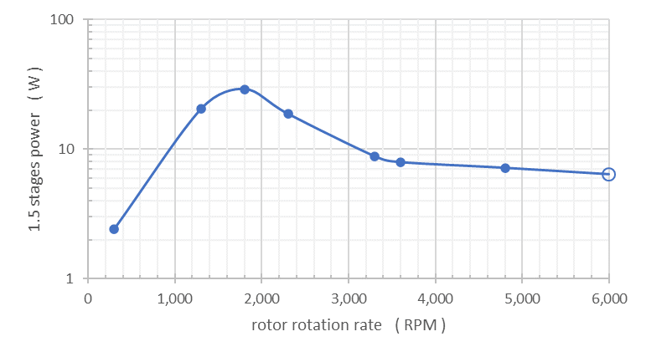

Additional Power and RPM Results
Power was calculated for each case run.
For the device being assembled, power output is critical. In this instance, book-keeping includes the inlet stator (2), through the rotor, to the exit stator (5).
$$Power={\dot{m}C}_{p}\left(T_{T2}−T_{T5}\right)$$
φ = 1
Notes:
This Equation gives the rate of energy extracted from the fluid due to the temperature drop across the turbine.

Slide 12
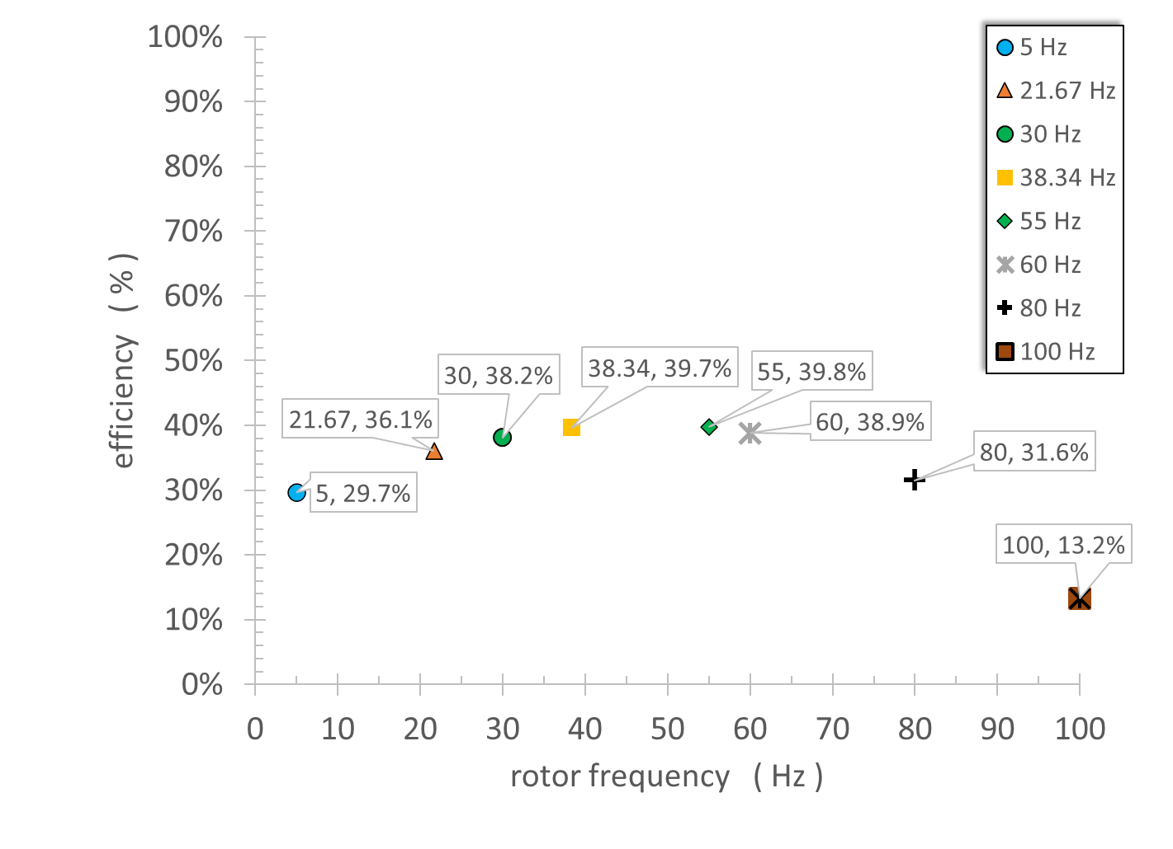
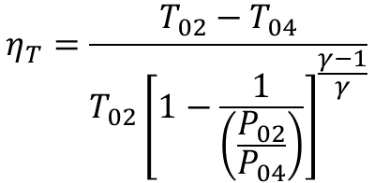
Turbine Efficiency
Efficiency is usually defined as
  desired output/required input.
The higher the efficiency is, the more bang for your buck you are getting regarding supplied input. Using the total-to-total efficiency equation from the textbook Gas Turbine Theory (H. Cohen, G.F.C Rogers, and H.I.H. Saravanamuttoo, 1991).
$$η_{T}=\frac{T_{02}−T_{04}}{T_{02}{\left[1−\frac{1}{\left(\frac{P_{02}}{P_{04}}\right)}\right]}^{\frac{γ−1}{γ}}}$$

Slide 13
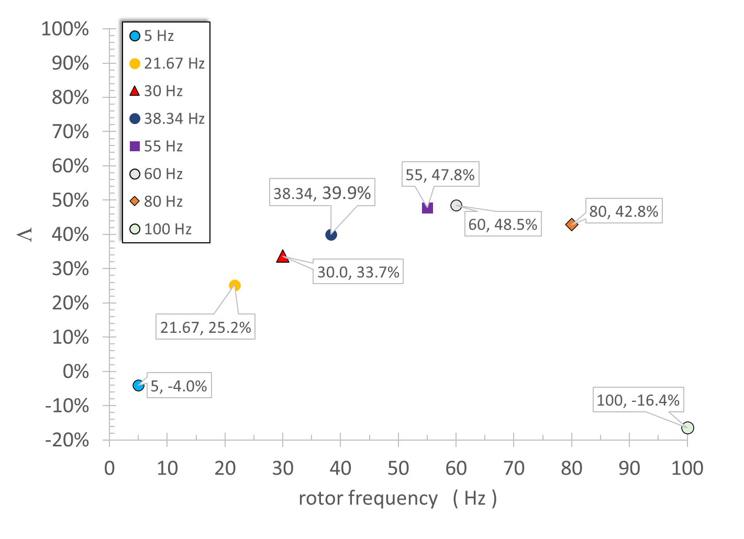
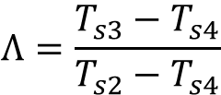
Degree of Reaction
The Reaction (L) is defined as the ratio of the enthalpy drop across the rotor versus the enthalpy drop over the stage. This can be rephrased as the fraction of expansion across a stage that occurs in the rotor. In this case, the stage is defined as the stator and the rotor (not including the second stator). Since the specific heat is being held constant, the ratio is defined using static temperatures.
Stages having 50% of expansion occurring in the rotor is typically desired. If the rate of expansion is equally shared between the stator and the rotor rows, this can reduce the tendency of boundary layer separation from the blade surface, which will help avoiding large stagnation pressure losses.
Reaction rates less than 50% suggests that expansion rate is not equally shared between the rotor and the stage. It suggests that higher rates of expansion are occurring in the stator. If reaction rates are low at mid span, they will be even lower near the hub. Reaction rates < 0 suggests recompression in the rotor, which is undesirable and would contribute to aerodynamic losses.
$$Λ=\frac{T_{s3}−T_{s4}}{T_{s2}−T_{s4}}$$

Slide 14
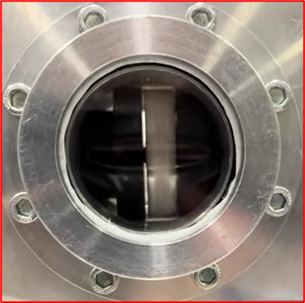
In-House Testing
Self Aligned Focusing Schlieren System
Experimental Test (Sans Motor)

Slide 15
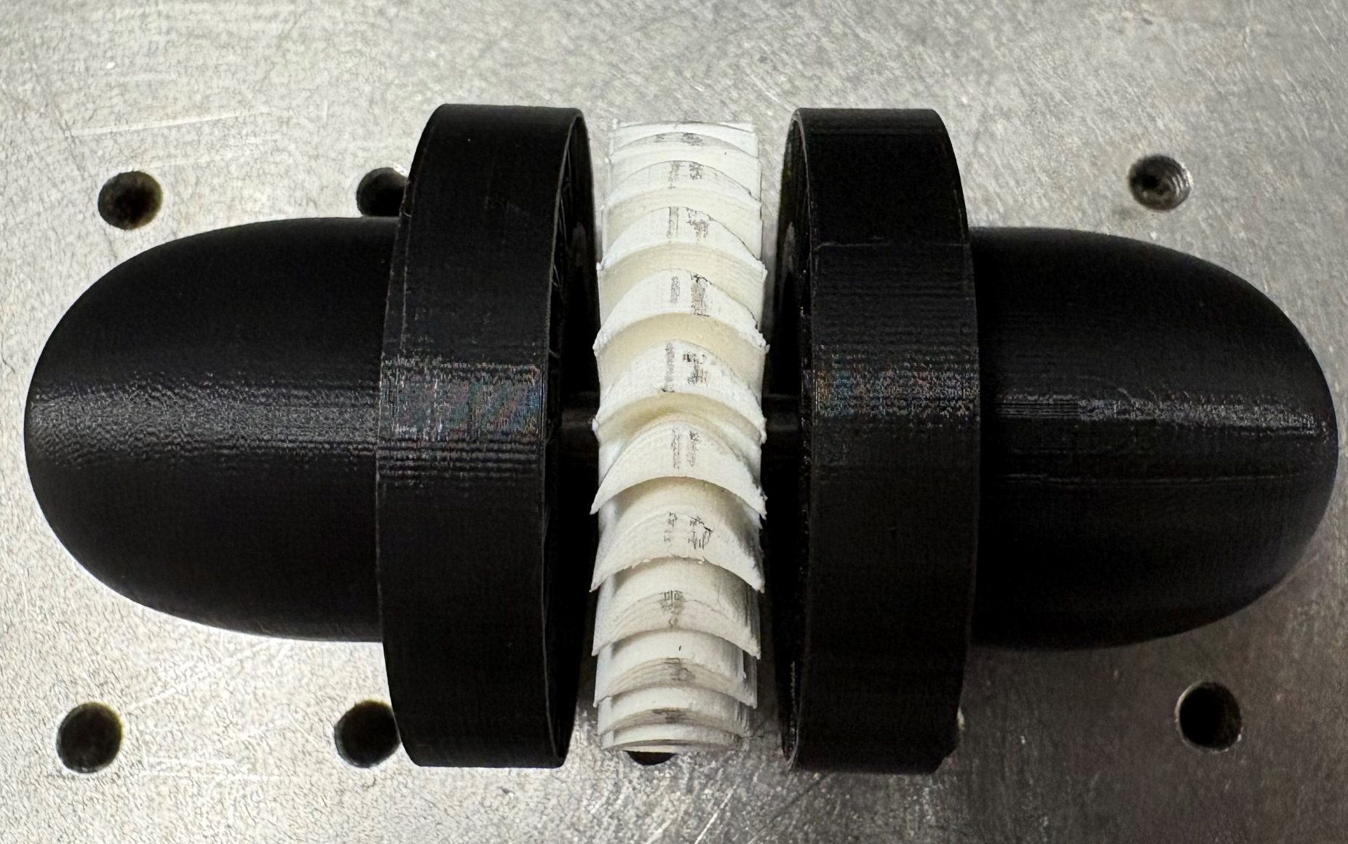
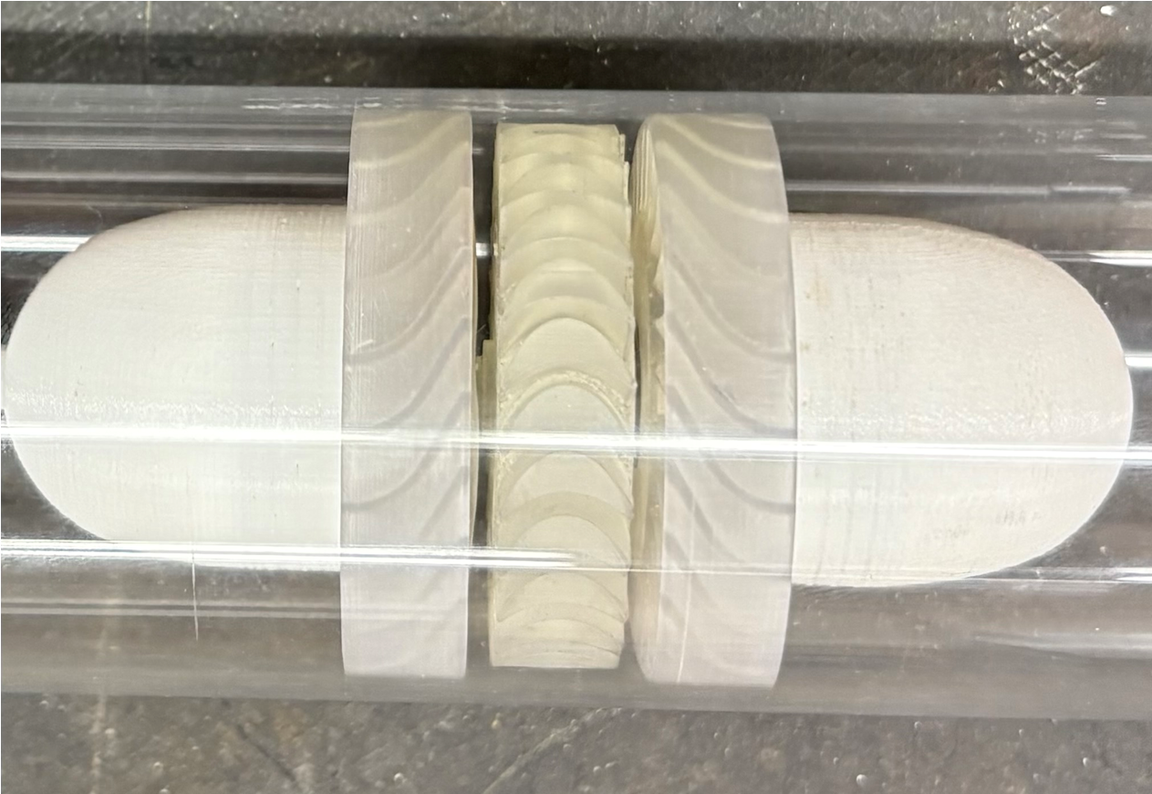
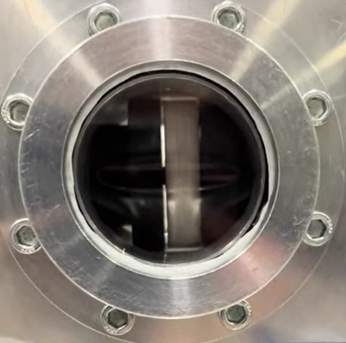
Turbine Prototypes and Results
Optimized Design
Printer: Ultimaker 3
Material: PLA
(1296 RPM)
Printer: Formlabs Form 3L
Material: Clear Resin V4
(2117 RPM)
φ = 1
Notes:
Form labs SLA (Stereolithography) printer -a 3D printing technology that uses a laser or light projector to cure liquid photopolymer resin, building parts layer by layer
Ultimaker dual-extrusion Fused Filament Fabrication (FFF)

Slide 16
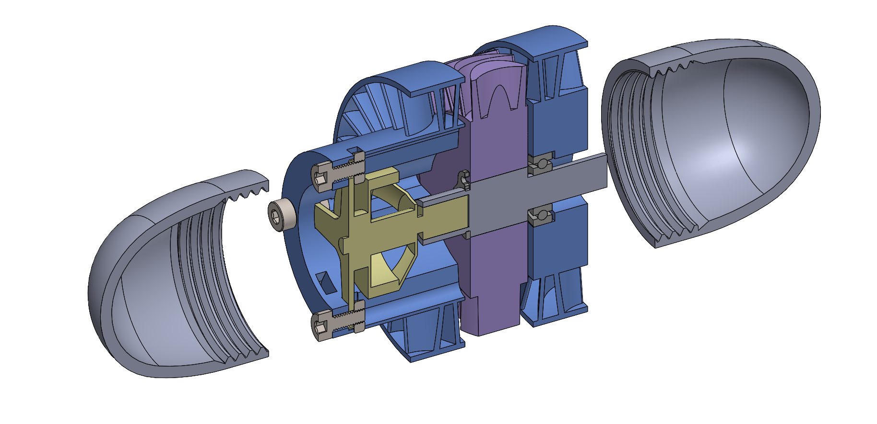
Summary
Preliminary CFD analysis used to define baseline bi-directional turbine geometry.
Demonstrated rotating bi-directional turbine and increased RPM.
Next steps are to attach rotating generator to produce ~10We.
Turbine CAD with Motor

Slide 17
Questions
luis.a.rodriguez@nasa.gov

Slide 18
Acknowledgments
Don Fong, Casey Theman, Frank Lam, Frank Gaspare, and David Hausser for their immense support and resources throughout this research.
This work was sponsored by the Advanced Air Transportation Technologies project/Advanced Engine Cycles sub-project.

