Slide 1



Thermo-Elastic Antenna Depointing Analysis Workflow Jean-Frédéric Ruel, Donya Mohammadshahi, Joel Gagnon, Dr. Christian Semler Maya HTT (Canada)
TFAWS Interdisciplinary Paper Session
Presented By
Joel Gagnon
Thermal & Fluids Analysis Workshop TFAWS 2025 August 4-7, 2024
Host: NASA Ames Research Center
San Jose, CA

Slide 2
Agenda
Introduction
Overview of Thermo-Elastic Depointing Workflow
Thermal Analysis of Spacecraft in Orbit using GPU ray tracing
Structural Simulation setup for Antenna analysis
Results of Thermo-elastic distortion Simulation
Opportunities for Automation & Conclusions

Slide 3
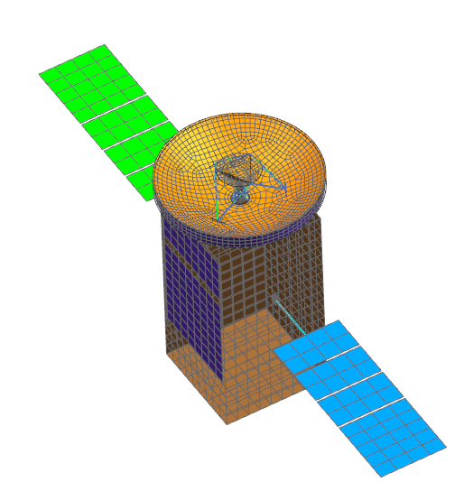
Introduction
Importance of Thermo-Elastic Simulations
Temperature effects cause antennas to distort their shape
This leads to RF signals to deviate from their design point
Current Challenges
Multi-Disciplinary analysis workflows can be inefficient
This leads to loss of productivity or added risk from delaying analysis until later in design cycle

Slide 4
Introduction
Why improve on thermo-elastic simulation workflows?
Efficiently passing data between thermal and structural teams helps drive efficient engineering analysis
Simplifying the process for multi-disciplinary analysis earlier on in the design cycle allows engineers to catch potential problems earlier on
Obtaining precise results of thermal-induced distortions allows for better Radio Frequency performance predictions
Objectives
Provide methodology and template for thermal and structural analysts
Investigate opportunities for further automation to improve workflow

Slide 5
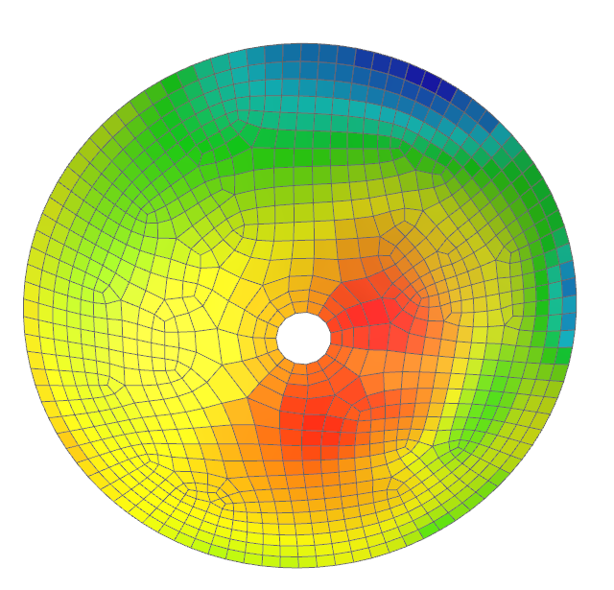
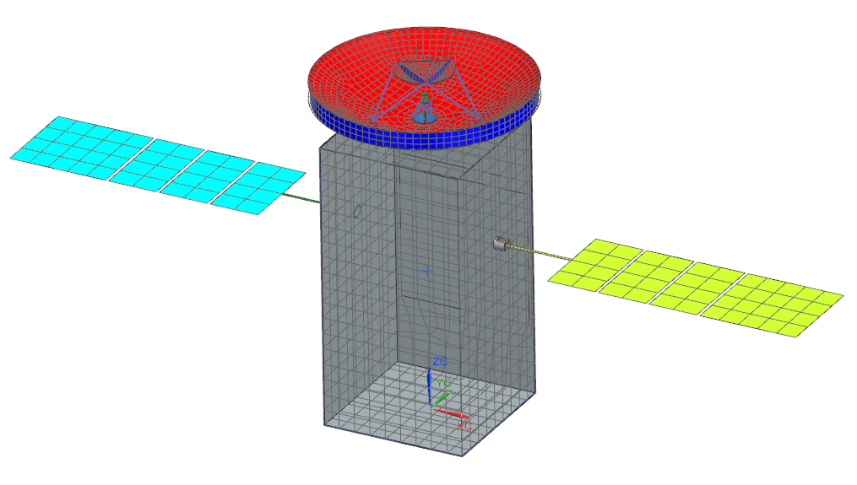
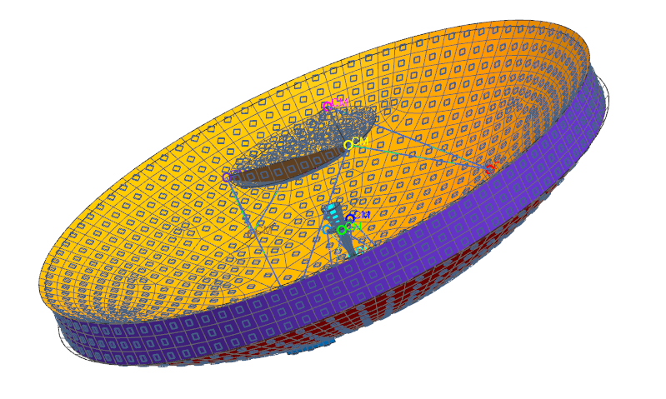
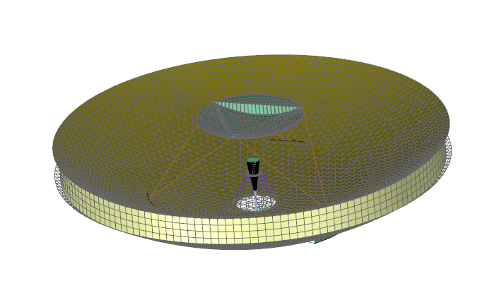
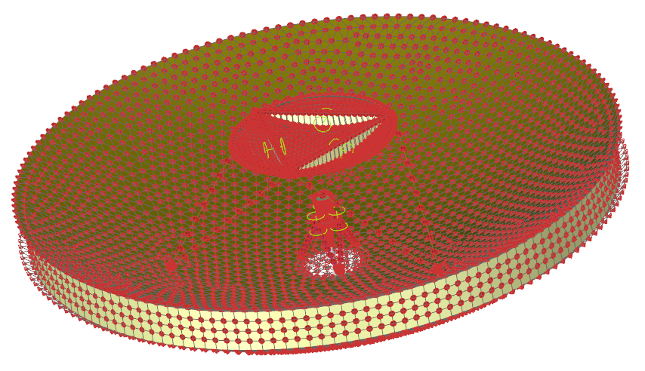
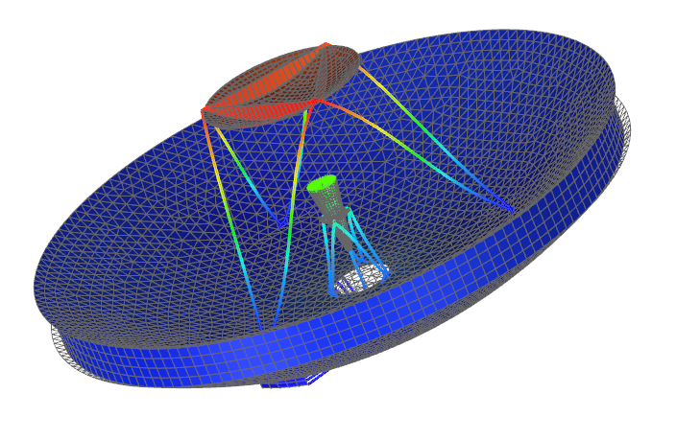
Thermo-Elastic Workflow Overview in Simcenter 3D
Simcenter 3D
FEM
SIM
Space Systems Thermal (SST)
Solve
Thermal Association Zones
NX CAD
Mapping
Thermo-Elastic
Simcenter 3D Nastran
Thermal Target Zones
Deformation
Notes:
What to mention?
All done in one User Interface in Simcenter 3D
Can choose to only map certain components. Ex. We do thermal analysis with entire bus, but only map the antenna.
Thermal and structural workflows can be done in parallel except for final thermo-elastic deformation which takes thermal results as input
Association zones and thermal target zones must match
Can all be done within simcenter 3D interface, making for a streamlined workflow, easy for a multi-disciplinary analyst or two teams to perform the loop
Mention: Why we can’t or don’t want to do it in SC3D Multiphysics
Orbital heating not available?
Typically structural mesh much larger, will lead to very slow thermal solve?

Slide 6
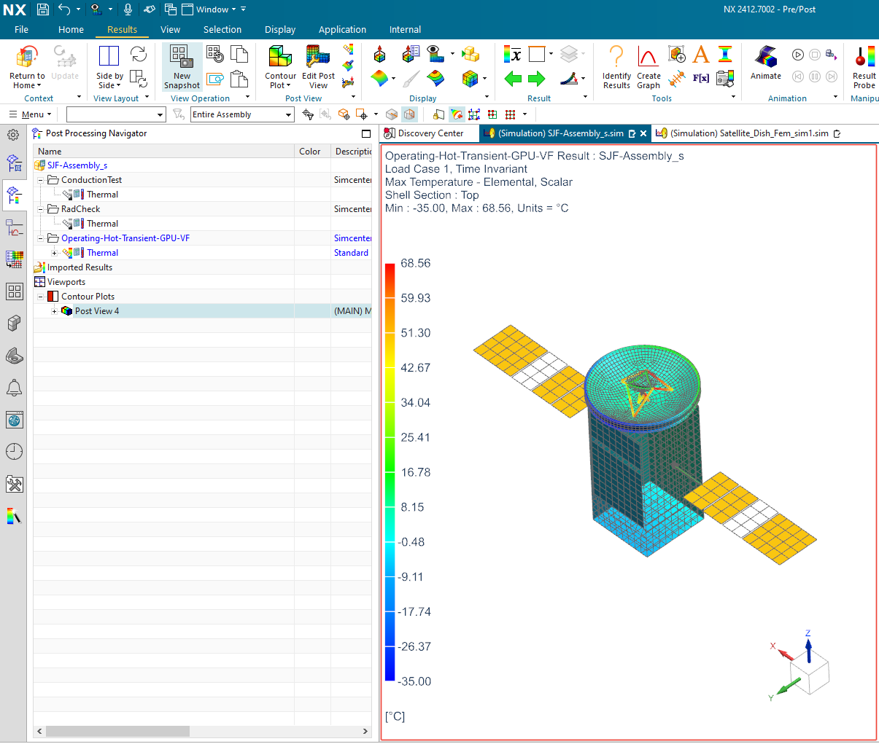
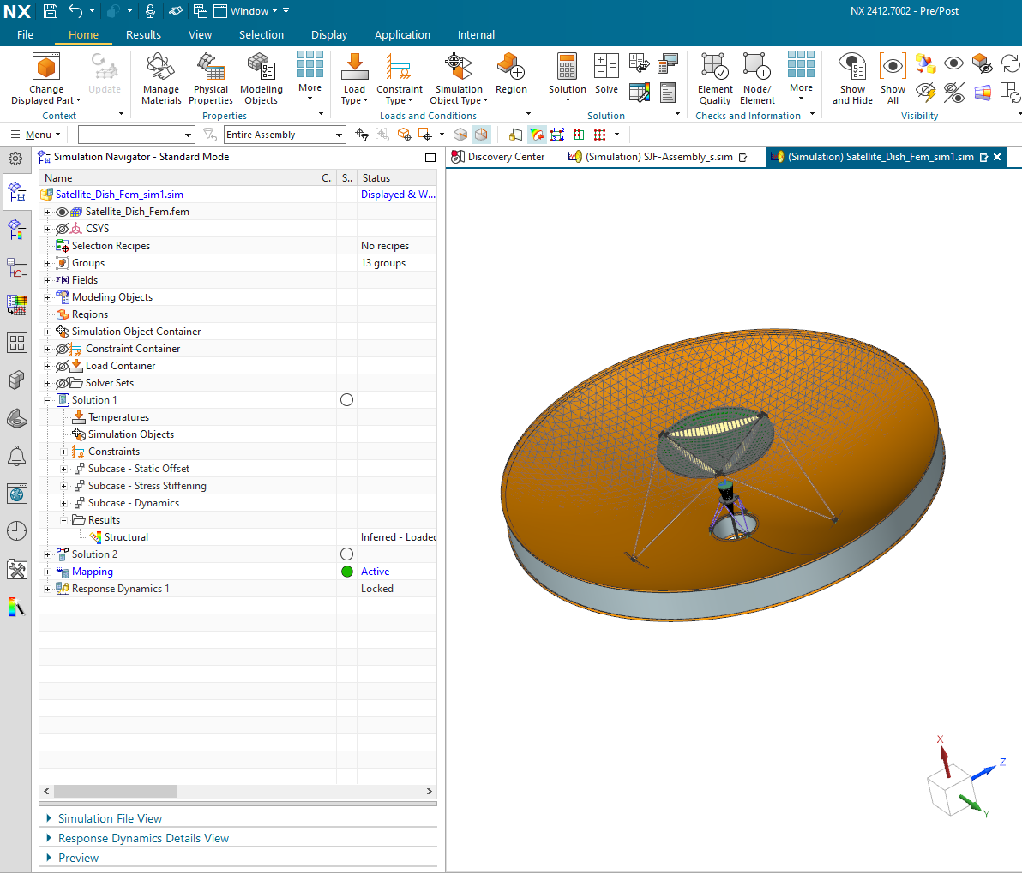
Thermo-Elastic Workflow Overview in Simcenter 3D
All steps can be accomplished in a single user interface (Simcenter 3D). This includes pre-processing, simulation, post-processing for both thermal and structural simulations.
Notes:
What to mention?
All done in one User Interface in Simcenter 3D
Can choose to only map certain components. Ex. We do thermal analysis with entire bus, but only map the antenna.
Thermal and structural workflows can be done in parallel except for final thermo-elastic deformation which takes thermal results as input
Association zones and thermal target zones must match
Can all be done within simcenter 3D interface, making for a streamlined workflow, easy for a multi-disciplinary analyst or two teams to perform the loop
Mention: Why we can’t or don’t want to do it in SC3D Multiphysics
Orbital heating not available?
Typically structural mesh much larger, will lead to very slow thermal solve?

Slide 7
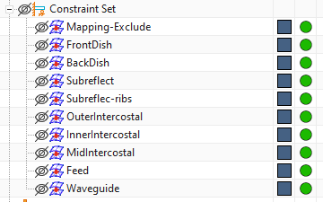
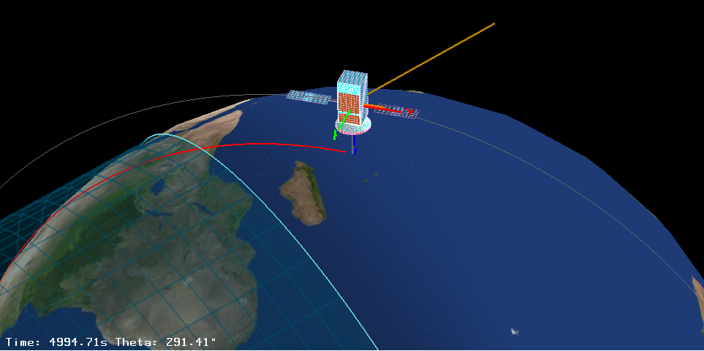
Thermal Analysis Setup – Spacecraft in Orbit
Thermal Finite Element Model:
Antenna, spacecraft bus, Solar Arrays
3,700 elements
Thermal Simulation:
Mapping:
Create Thermal Association Zones for antenna components
Orbital Heating:
LEO, 45° inclination
Computation method: GPU Ray Tracing
Solution:
TMG Solver
Transient, 60s timesteps, periodic convergence
Orbit Visualizer
Notes:
Things to mention:
GPU ray tracing
Orbital Visualizer?
Anything else?
Reflector ~3m
GPU: NVIDIA Quadro P2000
Warning: 0D elements are not supported by GPU view factors and GPU ray tracing radiation calculation methods

Slide 8
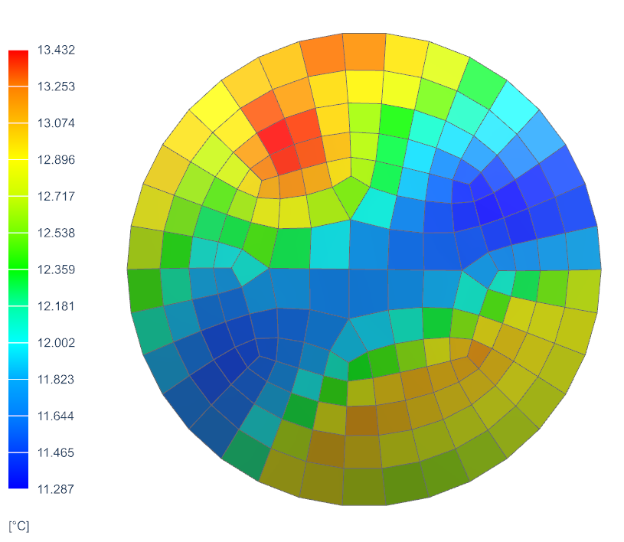
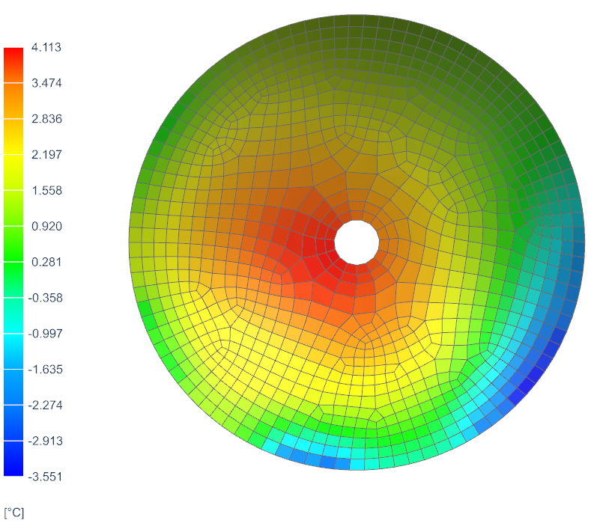
Thermal Analysis Results – Spacecraft in Orbit
Temperature Profiles
Solver Details:
Orbital Heating – 15,000 Rays/Element
View Factors – 1,769,658
Graphics Card - Quadro P2000
View Factors Solve Time – 4 min 59 sec
Total Solve Time – 13 min 28 sec
Sub-Reflector @ t=35 mins
Thermal Simulation Results:
Temperature distribution vs. time obtained
Component | Min Temp (°C) | Max Temp (°C)
Sub-Reflector | 2.9 | 16.7
Front Reflector | -3.9 | 7.2
Feed | 42.0 | 55.3
Front Reflector @ t=62 mins
Notes:
Things to mention:
GPU ray tracing
Orbital Visualizer?
Anything else?
Reflector ~3m
GPU: NVIDIA Quadro P2000
Warning: 0D elements are not supported by GPU view factors and GPU ray tracing radiation calculation methods

Slide 9
Structural Analysis – Antenna Setup
Structural Finite Element Model:
Antenna only (feed, reflector, sub-reflector)
14,700 elements
Structural Simulation:
Mapping Solution:
Create Thermal Target Zones for antenna components
Import temperatures from thermal_results.bun files
Thermo-Elastic Solution:
Create Temperature Loads from .dat files
generated from structural mapping solution
SOL 101 Linear Statics Solver

Slide 10
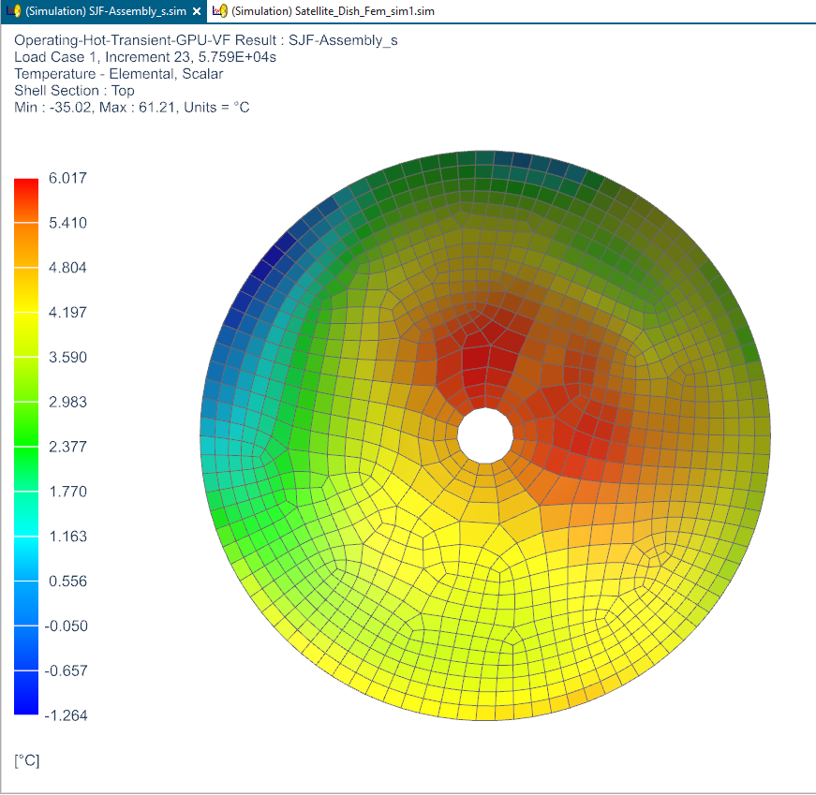
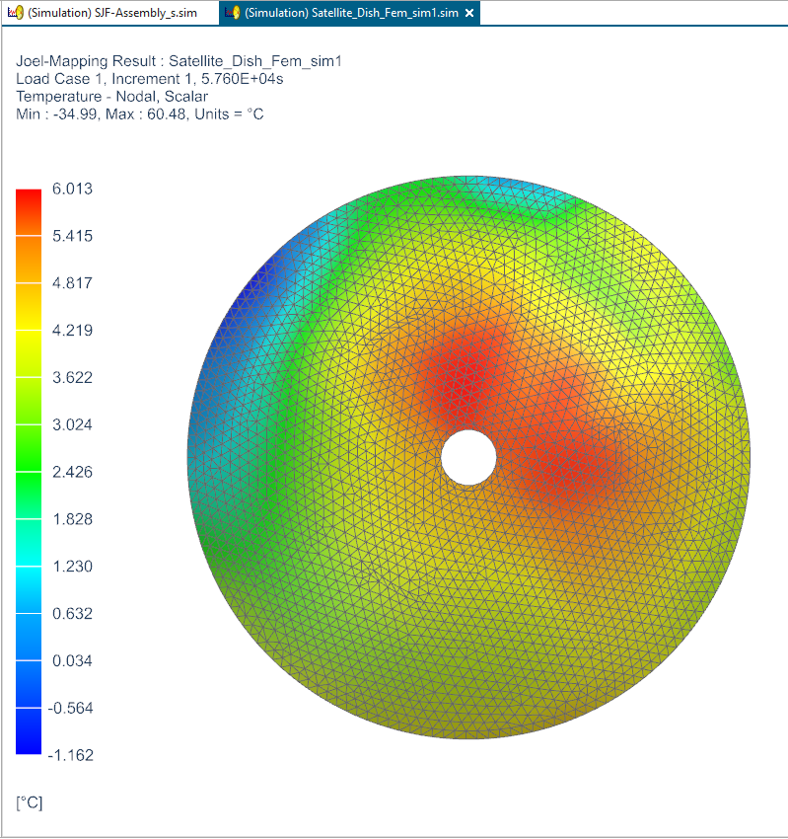
Mapping Solution
Results
Can verify that the mapping was done successfully by checking temperature contours
Thermal to structural mapping

Slide 11
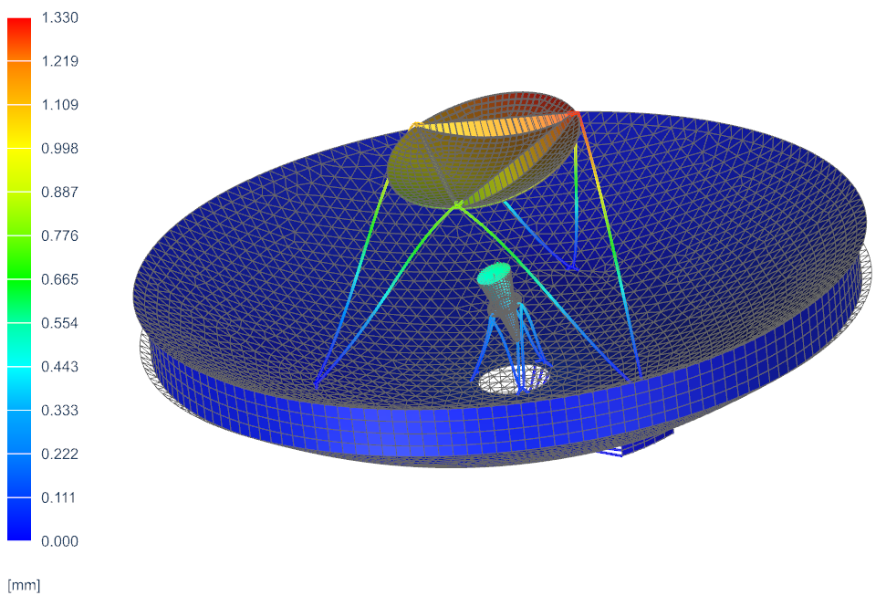
Thermo-Elastic Solution
Results
Max deviation: 1.33 mm on sub reflector shell/ribs
Max feed angular deviation: ~0.07°
Both occur @ ~35 mins, coinciding with entering into first eclipse
Nodal displacement @ t=35 mins

Slide 12
Opportunities for Workflow Optimization
Automation of workflow and selection of worst-case scenarios
Using Scripts to analyze entire spacecraft lifetime
Identification extreme temperatures and max gradient cases for each component
Risk of missing highest deviation cases
Automate post-processing tasks
Demonstrated in Simcenter 3D by Thales Alenia Space
Reduced “human tasks” by 50%
Thermomechanical Process Automation on a Spacecraft Antenna (ESTEW 2018)
Notes:
https://www.mayahtt.com/blog/cubesat-design-thermal-modelling-and-system-power-budget-analysis/

Slide 13

Opportunities for Workflow Optimization
Automation of workflow and selection of worst-case scenarios
Using HEEDS to optimize workflow
MayaHTT is looking at demonstrating a workflow for efficient mapping for multiple cases
Similar to a workflow previously shared:
Cubesat design optimization: a detailed thermal model coupled with system power budget analysis.
Cubesat optimization using HEEDS
Notes:
https://www.mayahtt.com/blog/cubesat-design-thermal-modelling-and-system-power-budget-analysis/

Slide 14
Conclusion
Summary
Workflow allows for results from a full spacecraft thermal solution to be mapped to an antenna structural model
Association/Target zones between models allow for precise mapping
Advantages
Simcenter 3D allows for a single User Interface for multi-physics simulation
Streamlined process reduces time and errors associated with data exchange between thermal and structural models
Ease of process allows for verification of depointing earlier in the design process leading to fewer surprises in RF performance

Slide 15


Thank You! Any Questions?
Speaker Info
Joel Gagnon
joel.gagnon@mayahtt.com
Book a Discovery Call
GPU-based radiation calculations
TFAWS 2025 – August 4-7, 2025 / © Copyright 2025 Maya HTT, Ltd. All rights reserved. Permission to make digital or hard copies of this work for the conference proceedings use is granted without fee provided that the copies are not made or distributed for profit or commercial advantage and that copies bear this notice.
Notes:
https://www.mayahtt.com/blog/the-race-to-develop-spacecraft-faster-without-compromise/

Slide 17
BACKUP SLIDES

Slide 18




Maya HTT
Recognised Siemens Partner
for Simulation
Global Support & Services Presence
Digital Transformation
& AI Services Projects
Software Modules Authored for
Siemens Digital Industries Software
Product Lifecycle Management
Design
Automation & Optimization
Simulation
2000+
30+
Software Development & Custom Applications
Manufacturing
Industrial IoT & Applied AI
Notes:
Modified from: https://mayahtt-my.sharepoint.com/:p:/p/talia_mcgourdji/EWSeb5_lGsRDoHz6_uHs4hgBtjvH5bG5UifnOFQCvKuA_g?email=joel.gagnon%40mayahtt.com&e=AALFLF

