Slide 1

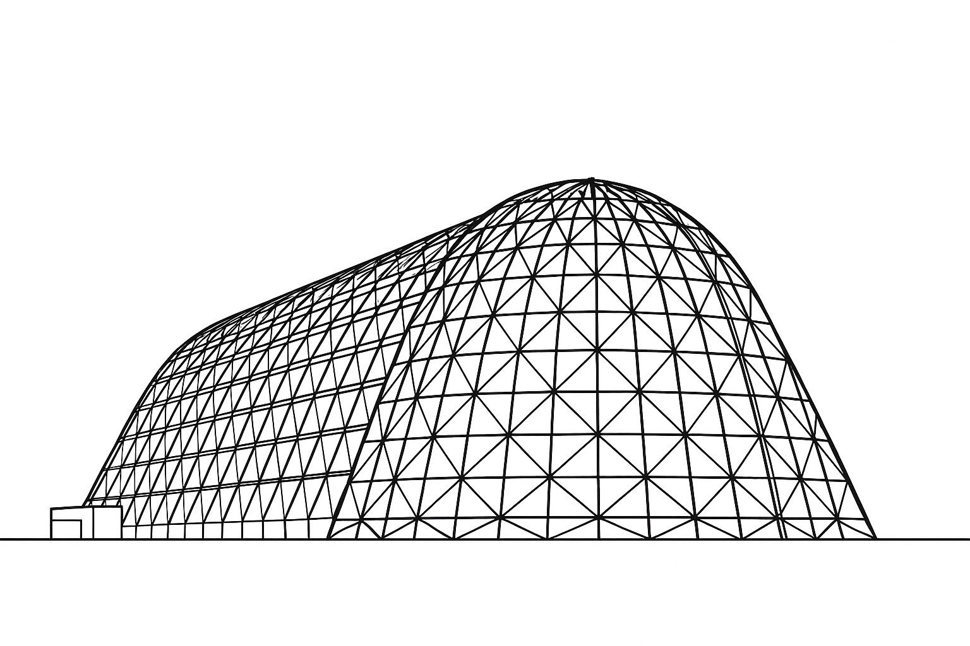

Characterization of Lunar Thermal Environments: Regional and Terrain Effects on Sink Temperature
TFAWS 2025 Interdisciplinary Technical Session
Presented by: Will Grier
Will Grier (LaRC-D206), will.j.grier@nasa.gov
Lisa Erickson (JSC-EC611), lisa.erickson@nasa.gov
Will Birmingham (MSFC-EV34), william.j.birmingham@nasa.gov
Thermal & Fluids Analysis Workshop 2025
NASA Ames Research Center
San Jose, CA
August 4-7, 2025

Slide 2
Outline
Study Purpose
LUMENATE Overview
  Description and Products
Lunar Surface Thermal Environment
Flux Cube Sink Temperature Method
Simple Lunar Terrain Model
  Methods and Results
Detailed Lunar Terrain Model
  Methods and Results
Thermal Impacts of Dust Coverage
Methods to Predict Lunar Surface Temperature
Findings and Remarks
References

Slide 3
Study Purpose
  Introduce the LUnar and Mars ENvironments Analysis Team (LUMENATE) and relevant products:
  Thermal insights for NESC cold tolerant electronics for Lunar applications report
  Detailed terrain modeling for Artemis III Human Landing System (HLS) extravehicular activities (EVAs)
Investigate differences between Lunar surface temperatures and the environmental sink temperatures of a representative asset at various regional locations on the Lunar surface
  Demonstrate using the flux cube method to gather sink temperatures across a range of optical properties
  Use generated optical property ratio plots to infer thermal impacts from dust deposition on asset surfaces
Compare Lunar surface temperature and environmental sink temperature predictions between thermal models using simple and detailed terrain models
  Highlight discrepancies between simplified flat plane and detailed terrain models for South Pole regions where low solar elevation angles and terrain features significantly impact thermal conditions

Slide 4
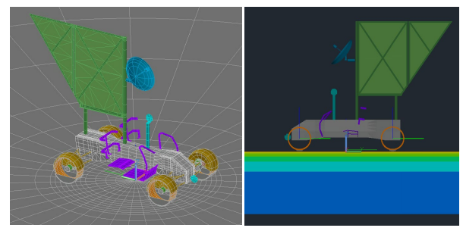

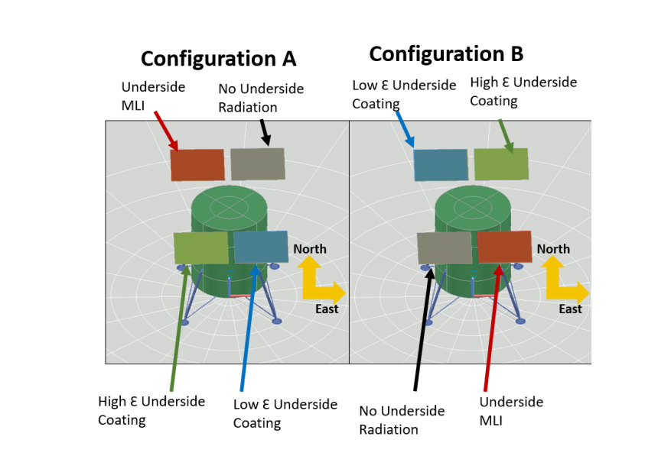
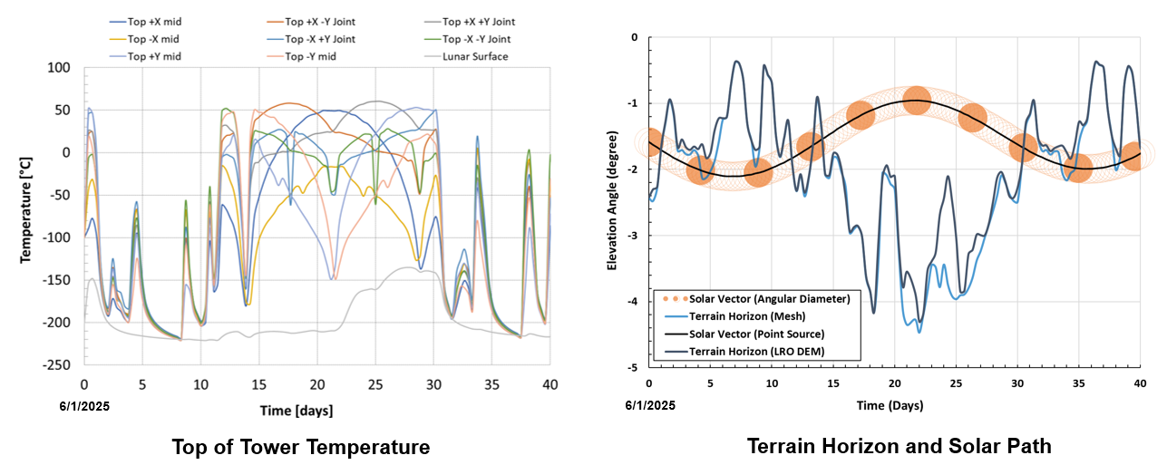
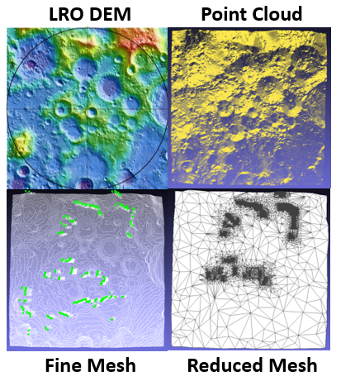
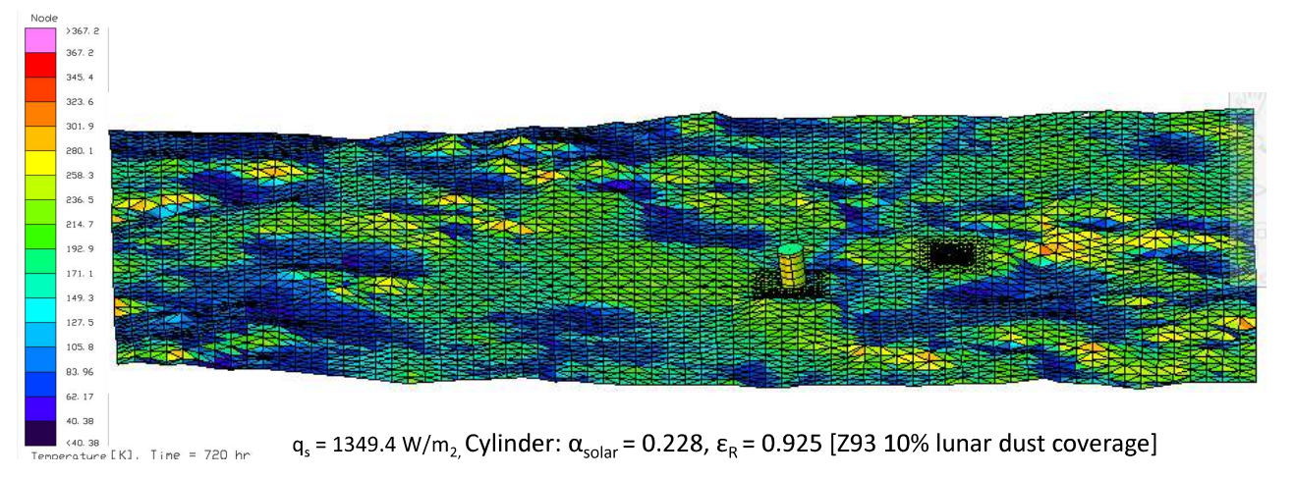
LUnar and Mars ENvironments Analysis Team (LUMENATE)
The LUMENATE team delivers Lunar and Martian thermal environmental modeling expertise to NASA and industry:
  Develop guidance documentation and reference models for performing Lunar and Martian environmental thermal analysis
  Address environmental knowledge gaps identified during system development efforts and missions
  Create and improve advanced environmental thermal analysis techniques that support diverse missions and systems
Current duties include:
  Update the Lunar Thermal Analysis Guidebook (LTAG)^{[1]}
  Develop a Mars Thermal Analysis Guidebook (MTAG)
  Develop novel thermal analysis capability for Artemis III and beyond surface missions to inform EVA planning
Thermal Sensitivity of LTV Wheels, Will Birmingham (MSFC-EV34)^{[3]}
Lunar Latitude and Terrain Radiator Sensitivity, Will Birmingham (MSFC-EV34)^{[4]}
Lunar Surface 3D Terrain Modeling, Lisa Erickson (JSC-EC611)^{[2]}
Tall Tower Lunar Thermal Analysis, Will Grier (LaRC-D206)^{[5]}

Slide 5
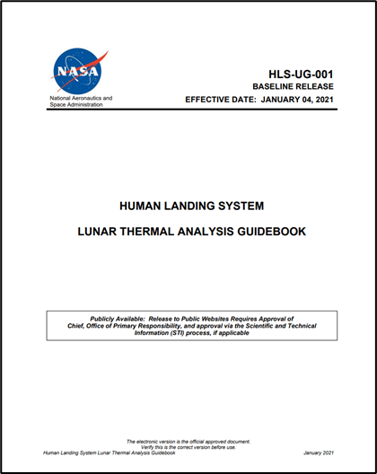
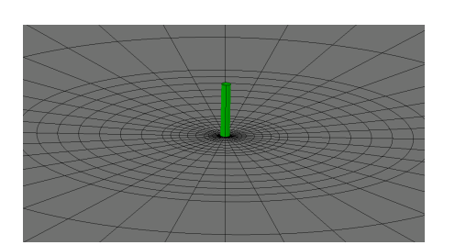
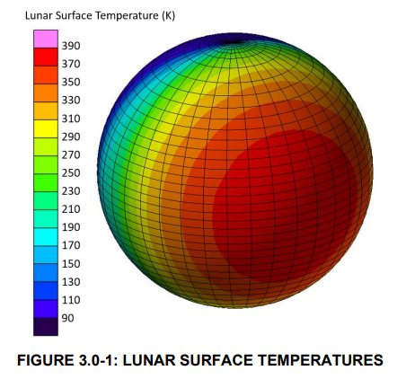
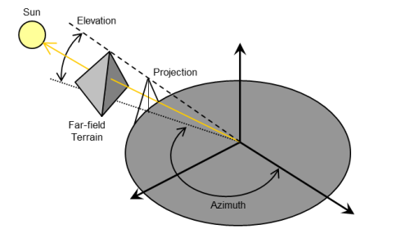
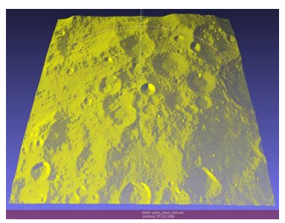
Lunar Thermal Modeling Capability
The current version of the HLS Lunar Thermal Analysis Guidebook and associated NESC Academy tutorial videos provide guidance on developing simplified and mission site specific Lunar surface thermal models^{[1][6]:}
  HLS-UG-001 Lunar Thermal Analysis Guidebook Baseline_STI.pdf
  Lunar Thermal Analysis Guidebook, Part 1 | NESC Academy Online
  Lunar Thermal Analysis Guidebook, Part 2 | NESC Academy Online
  Lunar Thermal Analysis Guidebook, Part 3 | NESC Academy Online
HLS-UG-001 Lunar Thermal Analysis Guidebook^{[1]}
Simplified Flat Plane Surface Model^{[1]}
Lunar Surface Temperatures^{[1]}
Far Field Terrain Impacts^{[1]}
Detailed Site-Specific Terrain Mesh^{[1]}

Slide 6
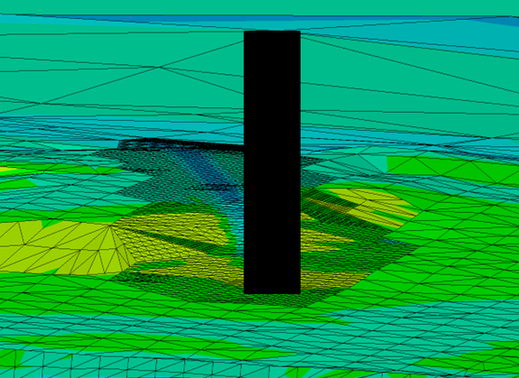
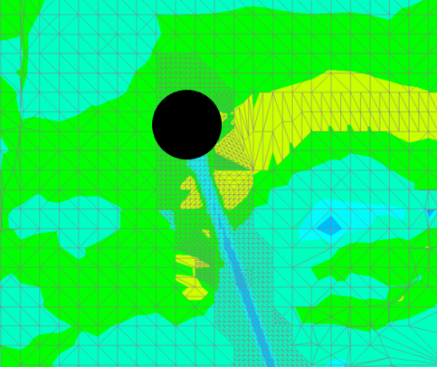
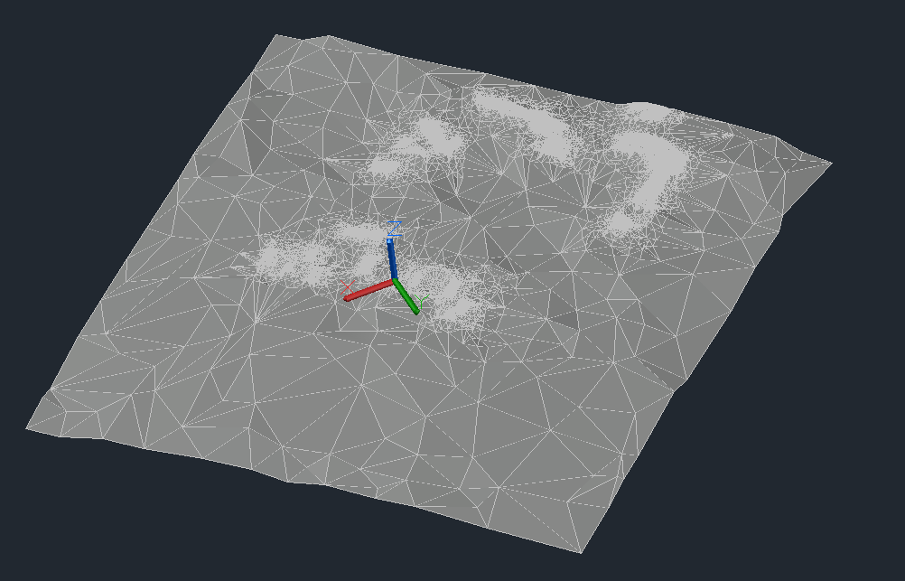
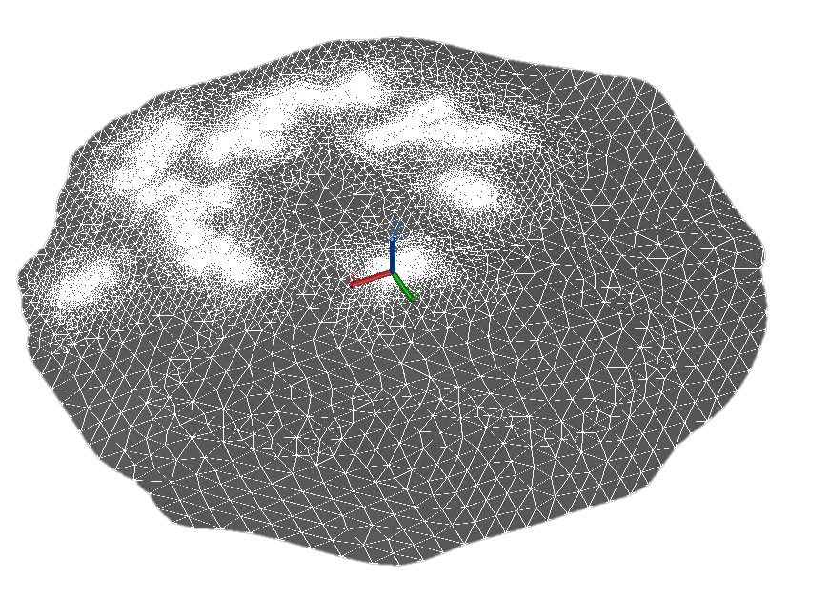
LUMENATE Detailed Terrain Thermal Model Updates
Codifying a publicly releasable process to build Lunar thermal models that include site specific near-field terrain, far field terrain horizon, solar path, and regolith properties
  Automated lunar surface point cloud simplification and generation (includes horizon points)
  Process for obtaining solar vector and flux data for use in ANSYS Thermal Desktop (TD)
  Verify surface temperature and illumination vs satellite data and detailed illumination models
Lays groundwork for Lunar surface “weather reports” for Artemis EVA operations
  Captures shadows and hot spots generated from detailed terrain features and surface assets
  Used to predict suit temperatures to assist with EVA traverse planning
    Identification of thermal keep out zones and EVA start and end times
    Accurate temperature timeline prediction
Lander Shadow on Lunar Surface (side view)
Automated Lunar Terrain Mesh with Horizon
Lander Shadow on Lunar Surface (top view)
Manually Meshed Lunar Terrain with Horizon^{[5]}

Slide 7
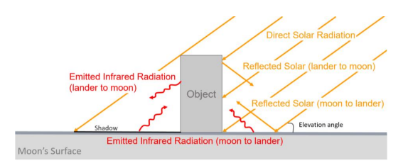
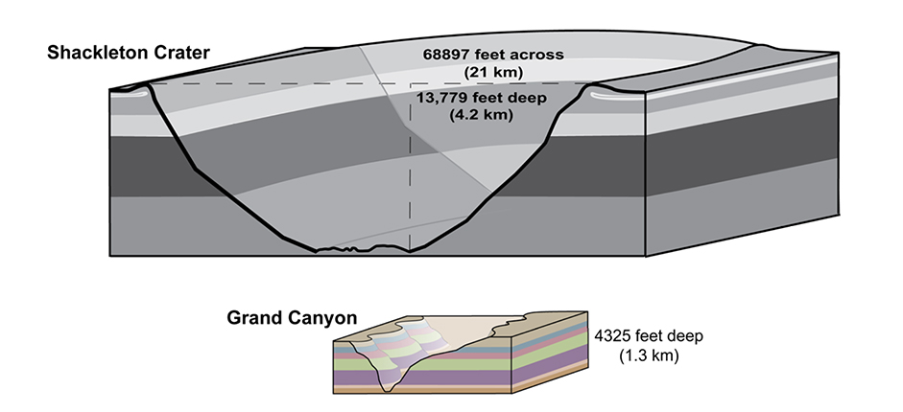
Lunar Surface Thermal Environment
The Lunar surface thermal environment is complex and significantly more extreme than Earth's in both magnitude and variation due to the following characteristics^{[1]}:
  Regolith thermophysical and optical properties
    Low thermal inertia, high IR emissivity, high solar absorptivity
  Lack of an atmosphere
    Radiation dominant heat exchange, unobstructed incident solar flux
  Rotational period
    ~29 Earth days with ~14.5-day nighttime duration
  Axial tilt to the ecliptic plane
    1.54º, complex solar illumination environment at the poles
  Complex and location dependent topology
    Deep craters and high peaks
Accurately identifying worst case thermal environments for assets on the Lunar surface requires knowledge of the specific mission location:
  Maximum incident solar elevation angle
    Latitude and local ground slope dependent
  View factor to surface
    Nearby terrain topology, vehicle integration, height above surface
  Regional regolith thermophysical and optical properties
Radiation Exchange on Lunar Surface^{[1]}
Shackleton Crater vs Grand Canyon^{[7]}

Slide 8
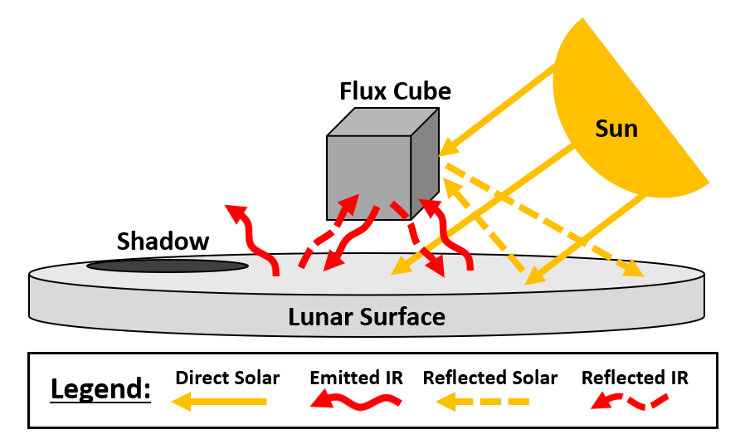


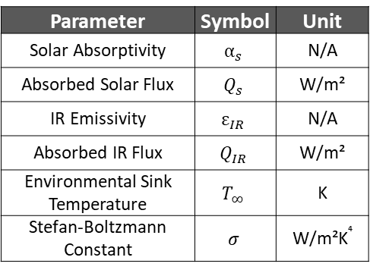



Environmental Sink Temperature
Definitions:
  Environmental Sink Temperature: The effective temperature of the surrounding environment that acts as a thermal sink for radiative heat transfer from a surface. Represents a complex radiation environment as a single equivalent temperature.^{[8]}
  α/ε Ratio (Alpha-to-Epsilon Ratio): The ratio of solar absorptivity to infrared emissivity. A low α/ε ratio surface absorbs little solar energy and emits most absorbed heat. A high α/ε ratio indicates high solar absorption with poor IR heat rejection capability.
Process:
  Flux cube optical properties are set to $α_{s}$=1 & $ε_{IR}$=1 in the Thermal Desktop (TD) model^{[11]}
  Incident solar flux and TSINK are obtained via TD.hra files and the TSINK post processing routine respectively
  Incident IR flux is then back calculated using the formulas below
  Incident solar and IR fluxes can then be used with any optical property ratio to obtain the flux cube sink temperature
Thermal Radiation Exchange, Lunar Surface
Environmental Sink Temperature Calculation^{[9,10]}
$$0=α_{s}Q_{s}+ε_{IR}Q_{IR}−ε_{IR}σT_{∞}^{4}$$
Parameter | Symbol | Unit
Solar Absorptivity | $$α_{s}$$ | N/A
Absorbed Solar Flux | $$Q_{s}$$ | W/m²
IR Emissivity | $$ε_{IR}$$ | N/A
Absorbed IR Flux | $$Q_{IR}$$ | W/m²
Environmental Sink Temperature | $$T_{∞}$$ | K
Stefan-Boltzmann Constant | $$σ$$ | W/m²K⁴
$$T_{∞}={\left(\frac{1}{σ}\left(\frac{α_{s}}{ε_{IR}}Q_{s}+Q_{IR}\right)\right)}^{0.25}$$
$${Q_{s}=\frac{ε_{IR}}{α_{s}}(σT}_{∞}^{4}−Q_{IR})$$
$${Q_{IR}= (σT}_{∞}^{4}−\frac{α_{s}}{ε_{IR}}Q_{S})$$
Notes:
IR Emissivity ($ε_{IR}$): The fraction of infrared energy that is emitted from a surface relative to a perfect blackbody at the same temperature, ranging from 0 to 1. IR absorptivity is equivalent to IR emissivity at the same temperature and radiation wavelength (per Kirchhoff’s Law). A surface with high IR emissivity will absorb most incident infrared energy and emit most of that absorbed infrared energy.
Solar Absorptivity ($α_{s}$): The fraction of incident solar energy absorbed by a surface, ranging from 0 to 1. A surface with high solar absorptivity absorbs most incoming solar energy, and low absorptivity indicates high solar reflectance.

Slide 9
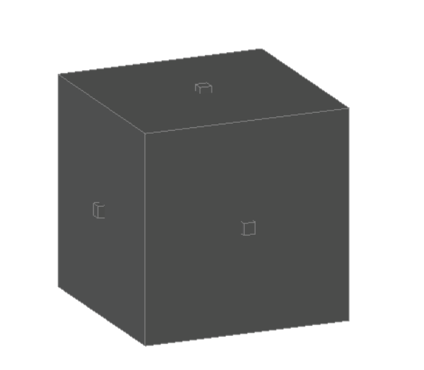
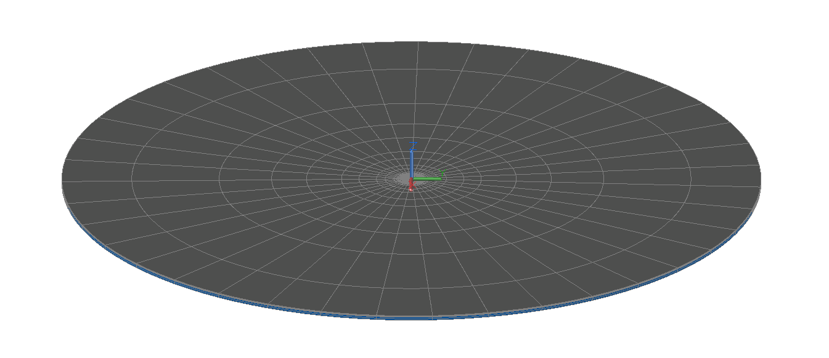
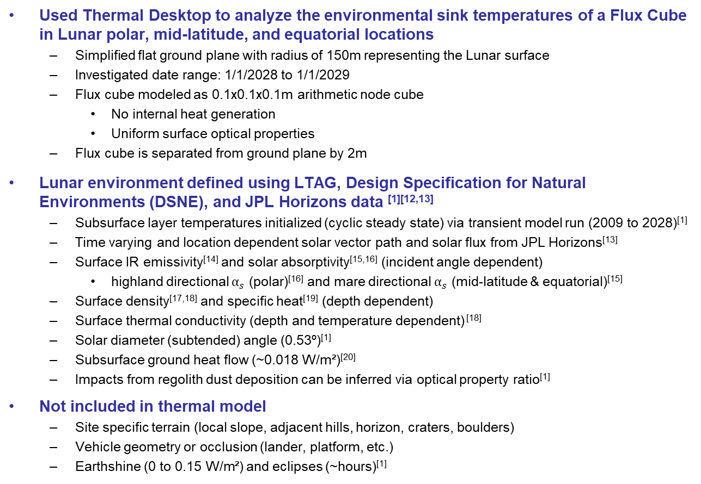
Simple Ground Plane Model Overview & Assumptions
Used Thermal Desktop to analyze the environmental sink temperatures of a Flux Cube in Lunar polar, mid-latitude, and equatorial locations
  Simplified flat ground plane with radius of 150m representing the Lunar surface
  Investigated date range: 1/1/2028 to 1/1/2029
  Flux cube modeled as 0.1x0.1x0.1m arithmetic node cube
    No internal heat generation
    Uniform surface optical properties
  Flux cube is separated from ground plane by 2m
Lunar environment defined using LTAG, Design Specification for Natural Environments (DSNE), and JPL Horizons data ^{[1][12,13]}
  Subsurface layer temperatures initialized (cyclic steady state) via transient model run (2009 to 2028)^{[1]}
  Time varying and location dependent solar vector path and solar flux from JPL Horizons^{[13]}
  Surface IR emissivity^{[14]} and solar absorptivity^{[15,16]} (incident angle dependent)
    highland directional $α_{s}$ (polar)^{[16]} and mare directional $α_{s}$ (mid-latitude & equatorial)^{[15]}
  Surface density^{[17,18]} and specific heat^{[19]} (depth dependent)
  Surface thermal conductivity (depth and temperature dependent) ^{[18]}
  Solar diameter (subtended) angle (0.53º)^{[1]}
  Subsurface ground heat flow (~0.018 W/m²)^{[20]}
  Impacts from regolith dust deposition can be inferred via optical property ratio^{[1]}
Not included in thermal model
  Site specific terrain (local slope, adjacent hills, horizon, craters, boulders)
  Vehicle geometry or occlusion (lander, platform, etc.)
  Earthshine (0 to 0.15 W/m²) and eclipses (~hours)^{[1]}
Analyzed Locations
Location | Latitude | Longitude
Polar | -89.46752° | -138.012788°
Mid-Latitude | +45° | 0°
Equatorial | 0° | 0°
Arithmetic Node Flux Cube
Flat Ground Plane, Lunar Surface
Notes:
Will and Warren

Slide 10
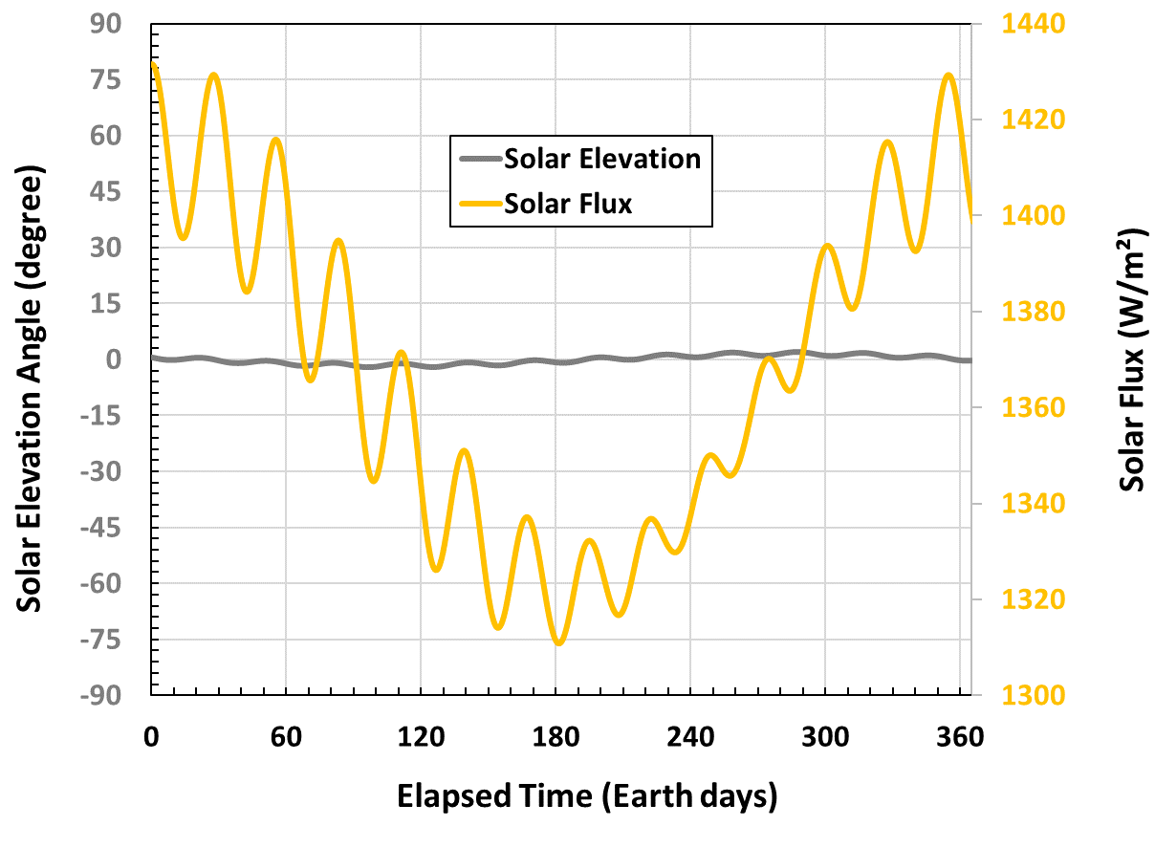
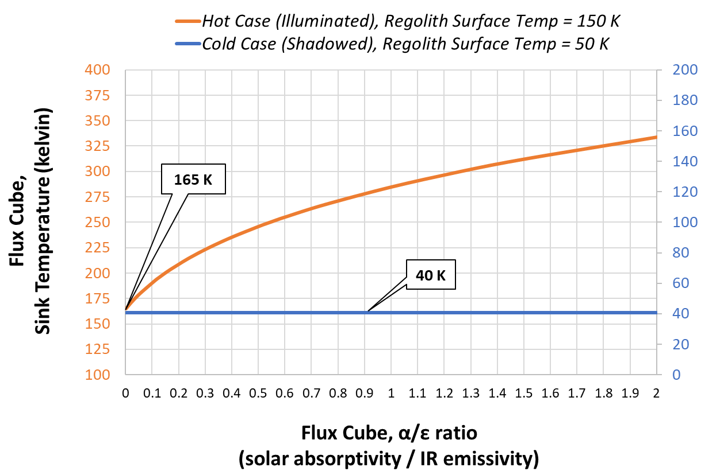
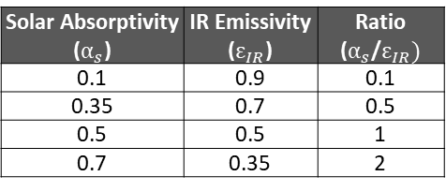
Location: South Pole (89.5ºS)
At the poles, the solar elevation angle remains low with the sun circling close to the horizon; This creates a low solar incident angle relative to the terrain, resulting in relatively cool ground temperatures despite direct sunlight
The flux cube’s side faces receive solar illumination, the bottom face receives some IR and reflected solar heat from the lunar surface, and the top face predominantly radiates to deep space with minimal solar input
Solar Absorptivity ($α_{s}$) | IR Emissivity ($ε_{IR}$) | Ratio ($α_{s}$/$ε_{IR})$
0.1 | 0.9 | 0.1
0.35 | 0.7 | 0.5
0.5 | 0.5 | 1
0.7 | 0.35 | 2
Solar Elevation Angle & Flux vs Time
Sink Temperature vs α/ε Ratio
Note: Environmental sink temperature vs. optical property ratio trends were derived from analysis timesteps selected based on peak sink temperatures (hot and cold) values.
Notes:
Will and Warren

Slide 11
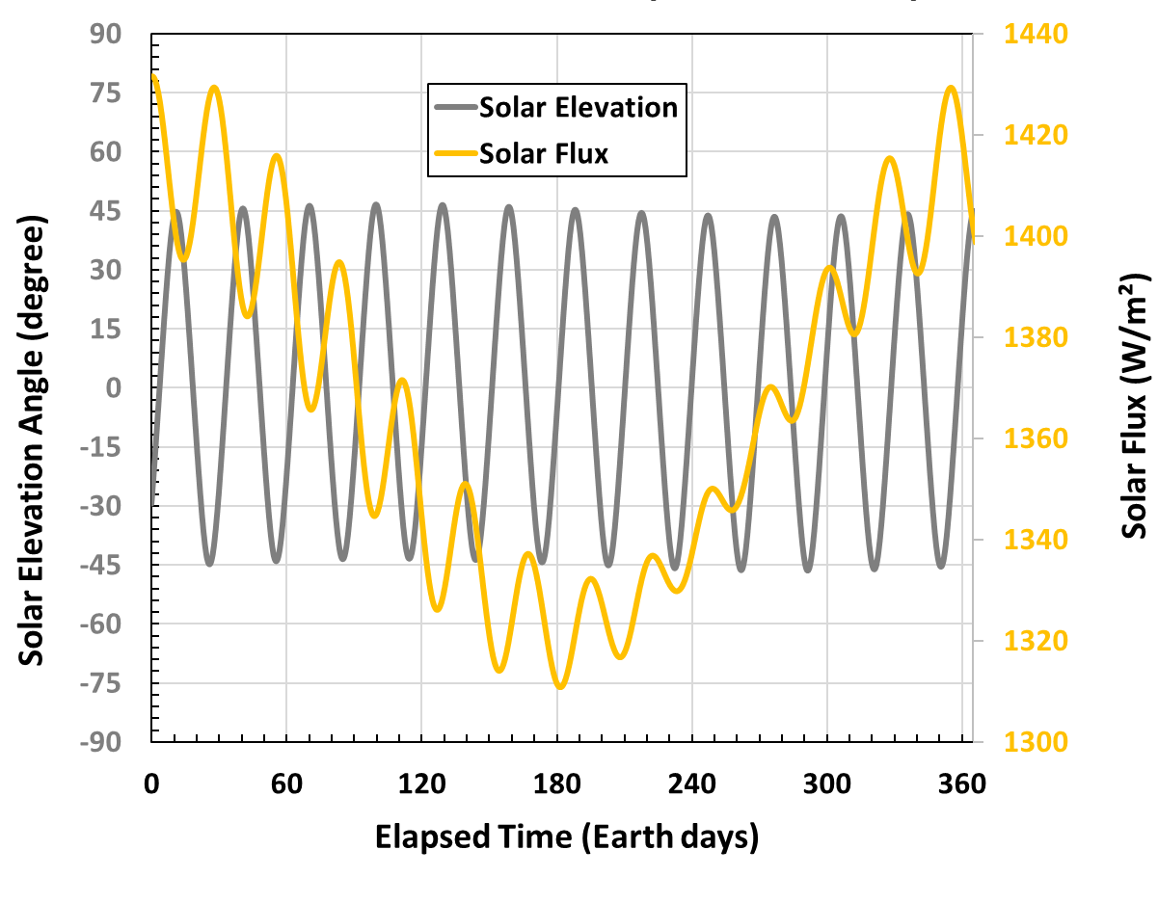
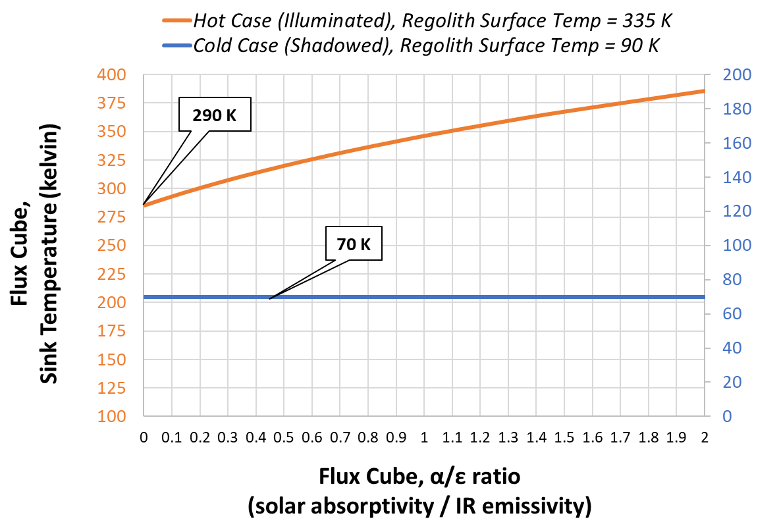
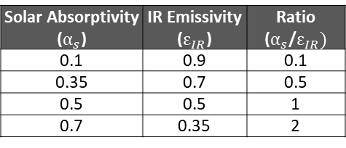
Location: Mid-Latitude (45ºN)
At mid-latitudes, the solar elevation angle varies throughout the day with the sun arcing higher across the sky than at the poles generating relatively higher surface temperatures
The flux cube’s side faces receive alternating periods of direct and indirect solar illumination, the bottom face receives heat from a hotter Lunar surface, and the top face periodically receives indirect sunlight
Solar Absorptivity ($α_{s}$) | IR Emissivity ($ε_{IR}$) | Ratio ($α_{s}$/$ε_{IR})$
0.1 | 0.9 | 0.1
0.35 | 0.7 | 0.5
0.5 | 0.5 | 1
0.7 | 0.35 | 2
Solar Elevation Angle & Flux vs Time
Sink Temperature vs α/ε Ratio
Note: Environmental sink temperature vs. optical property ratio trends were derived from analysis timesteps selected based on peak sink temperatures (hot and cold) values.
Notes:
Will and Warren

Slide 12
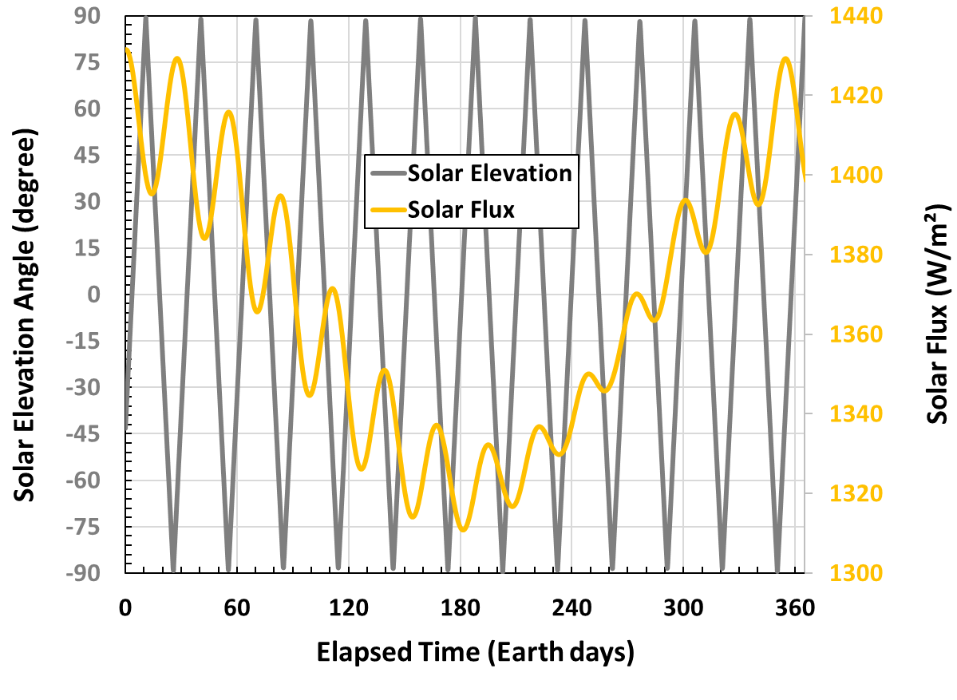
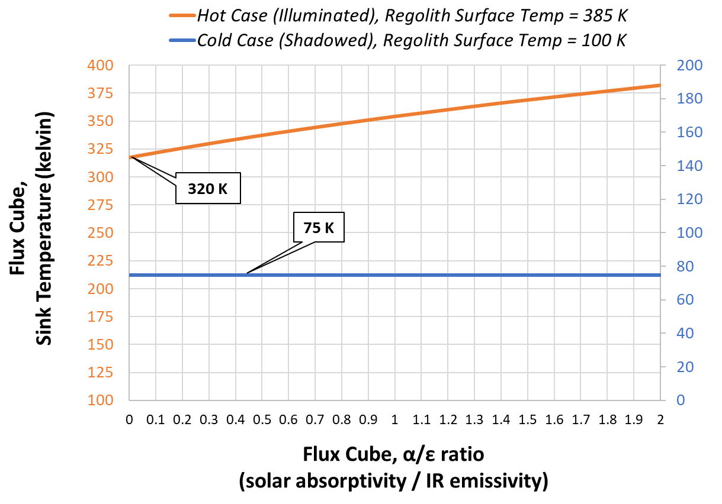
Location: Equatorial (0ºN)
At the lunar equator, the solar path reaches zenith during local noon with near-perpendicular solar incident angles relative to the terrain thus generating high Lunar surface temperatures
The flux cube’s side faces receive directional solar illumination as the sun moves overhead, the bottom face exchanges heat with a surface that reaches high peak temperatures, and the top face receives maximum solar input during lunar noon
Solar Absorptivity ($α_{s}$) | IR Emissivity ($ε_{IR}$) | Ratio ($α_{s}$/$ε_{IR})$
0.1 | 0.9 | 0.1
0.35 | 0.7 | 0.5
0.5 | 0.5 | 1
0.7 | 0.35 | 2
Solar Elevation Angle & Flux vs Time
Sink Temperature vs α/ε Ratio
Note: Environmental sink temperature vs. optical property ratio trends were derived from analysis timesteps selected based on peak sink temperatures (hot and cold) values.
Notes:
Will and Warren

Slide 13
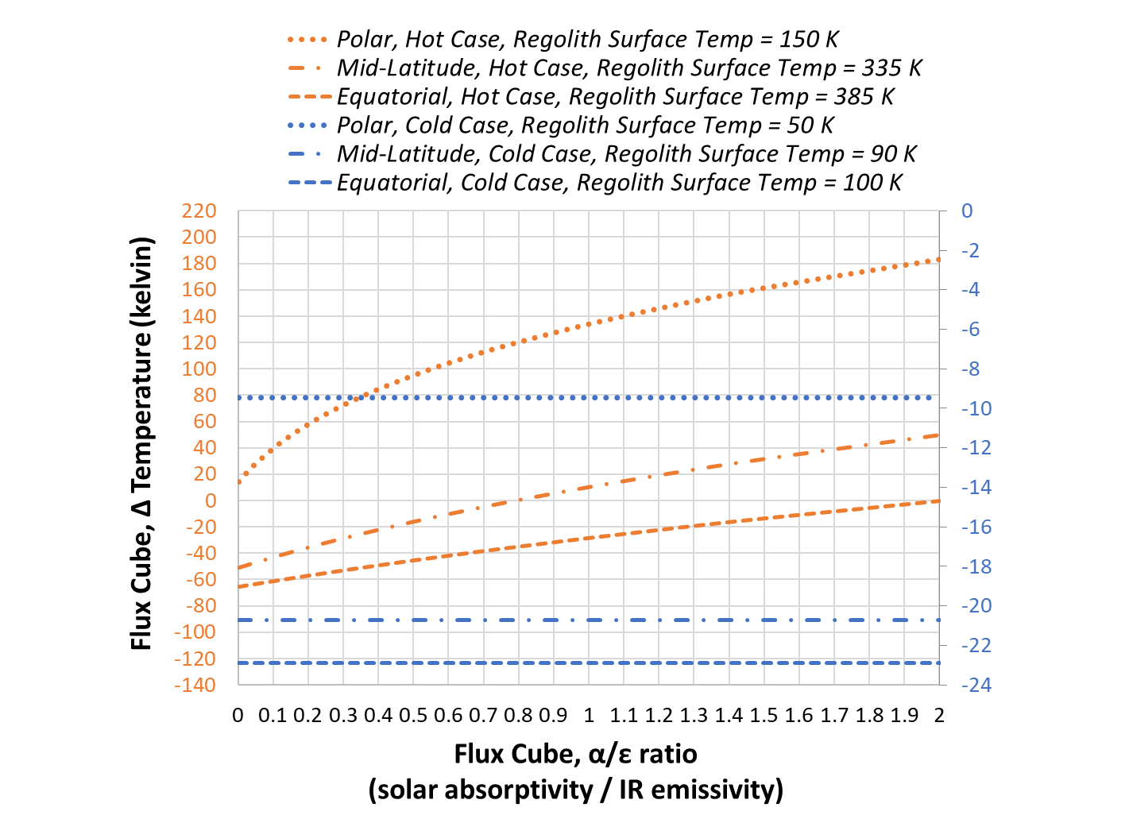
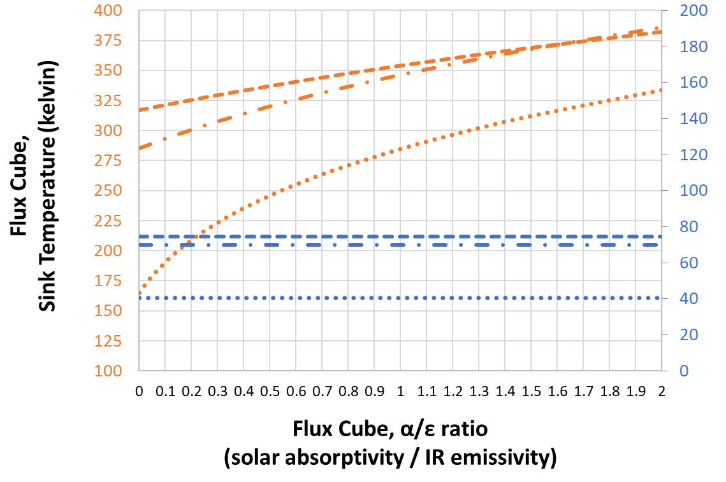

Results: Flat Ground Plane
Sink temperature is almost never equivalent to regolith surface temperature
  Hot case (illuminated, daytime); equatorial = hottest region:
    Sink temperature increases (↑) with decreasing (↓) latitude
  Cold case (shadowed, nighttime); polar = coldest region
    Sink temperature decreases (↓) with increasing (↑) latitude
Flat Ground Plane, Regional Sink Temperature vs α/ε Ratio
Flat Ground Plane, Regional ∆T vs α/ε Ratio
$$∆T=T_{sink}−T_{regolith}$$
Note: Environmental sink temperature vs. optical property ratio trends were derived from analysis timesteps selected based on peak sink temperatures (hot and cold) values.

Slide 14
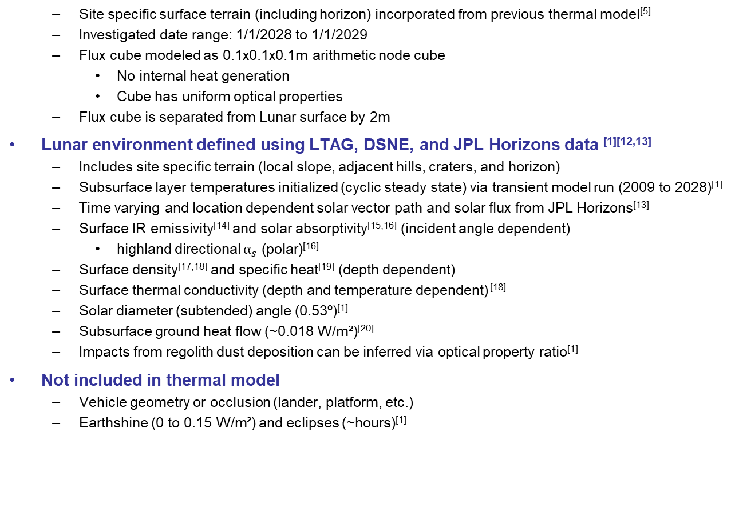
Detailed Terrain Model Overview & Assumptions
Used Thermal Desktop to analyze environmental sink temperatures of a Flux Cube at the Shackleton Connecting Ridge (latitude = -89.46752º, longitude = -138.012788º, elevation = 1938 m)
  Site specific surface terrain (including horizon) incorporated from previous thermal model^{[5]}
  Investigated date range: 1/1/2028 to 1/1/2029
  Flux cube modeled as 0.1x0.1x0.1m arithmetic node cube
    No internal heat generation
    Cube has uniform optical properties
  Flux cube is separated from Lunar surface by 2m
Lunar environment defined using LTAG, DSNE, and JPL Horizons data ^{[1][12,13]}
  Includes site specific terrain (local slope, adjacent hills, craters, and horizon)
  Subsurface layer temperatures initialized (cyclic steady state) via transient model run (2009 to 2028)^{[1]}
  Time varying and location dependent solar vector path and solar flux from JPL Horizons^{[13]}
  Surface IR emissivity^{[14]} and solar absorptivity^{[15,16]} (incident angle dependent)
    highland directional $α_{s}$ (polar)^{[16]}
  Surface density^{[17,18]} and specific heat^{[19]} (depth dependent)
  Surface thermal conductivity (depth and temperature dependent) ^{[18]}
  Solar diameter (subtended) angle (0.53º)^{[1]}
  Subsurface ground heat flow (~0.018 W/m²)^{[20]}
  Impacts from regolith dust deposition can be inferred via optical property ratio^{[1]}
Not included in thermal model
  Vehicle geometry or occlusion (lander, platform, etc.)
  Earthshine (0 to 0.15 W/m²) and eclipses (~hours)^{[1]}
Manually Generated Detailed Terrain Mesh^{[5]}
Site Terrain Generation Process^{[5]}

Slide 15
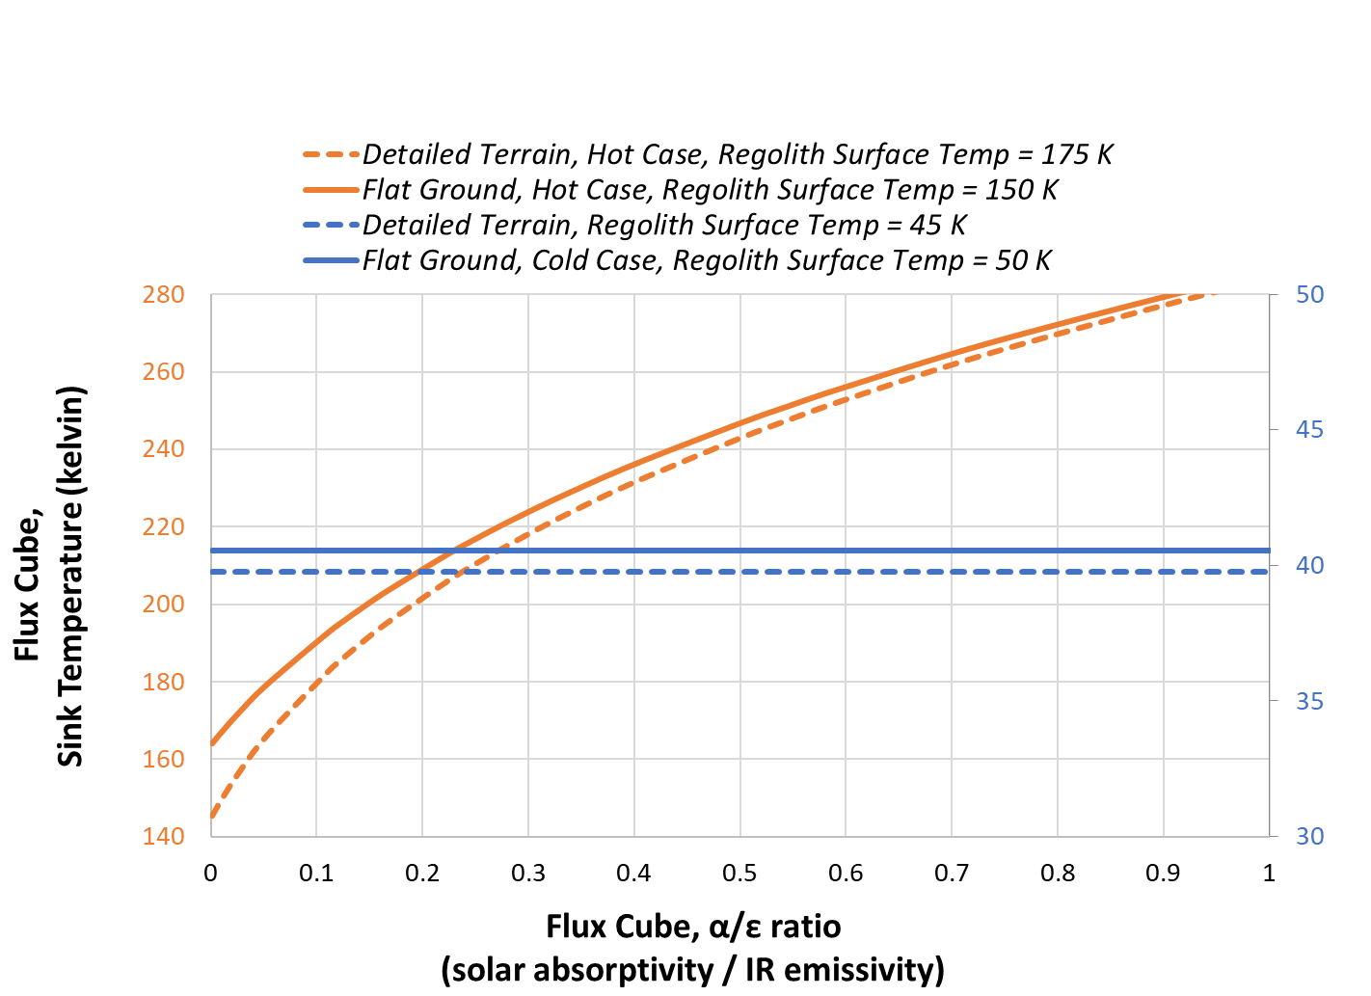
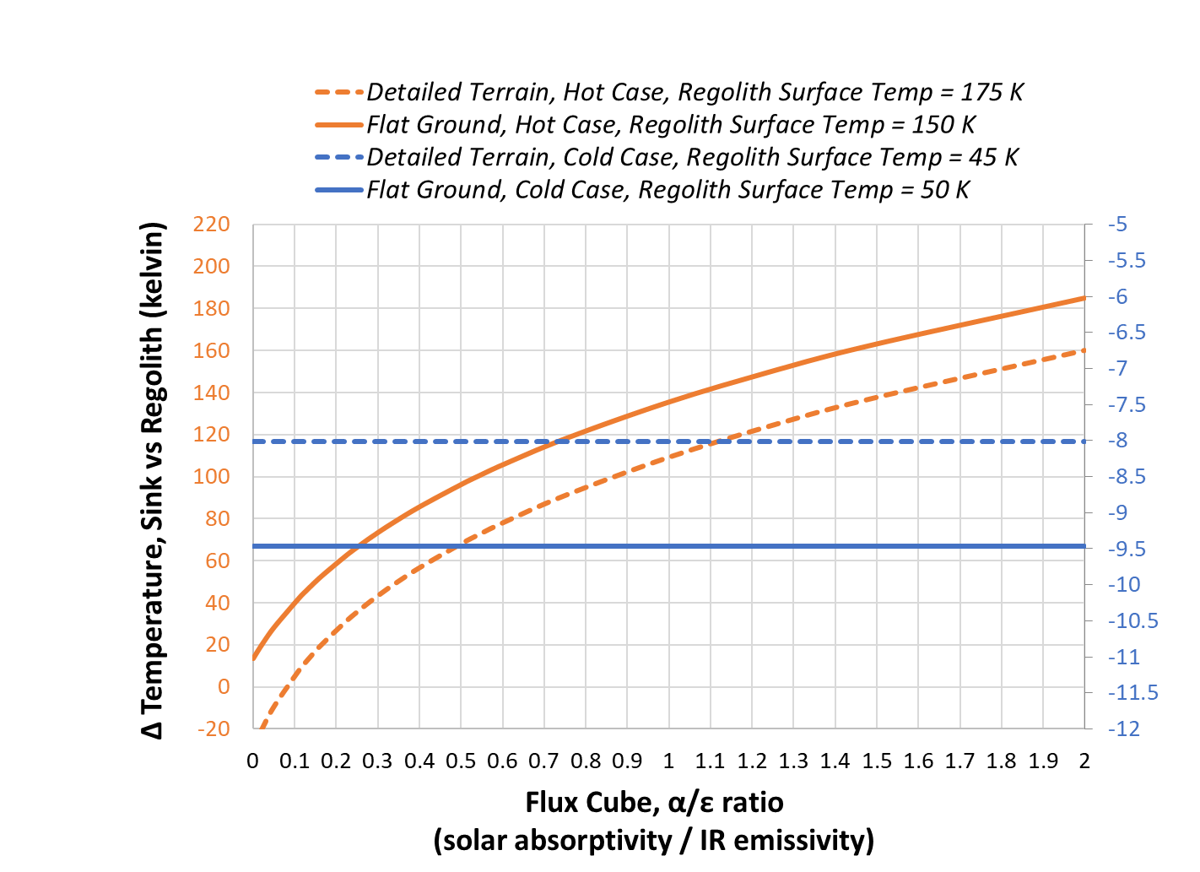

Comparison: Polar, Simplified vs Detailed Surface Model
Sink temperature curves differ between detailed terrain and simple flat plane models (with stated assumptions)
  Difference magnitude can vary widely depending on surface site of interest and asset vehicle integration and orientation
Sink temperature is still almost never equivalent to regolith surface temperature
Flat Ground Plane Model
Detailed Terrain Model^{[5]}
Sink Temperature vs α/ε Ratio & Terrain Model
∆ Sink Temperature vs α/ε Ratio & Terrain Model
$$∆T=T_{sink}−T_{regolith}$$
Note: Environmental sink temperature vs. optical property ratio trends were derived from analysis timesteps selected based on peak sink temperatures (hot and cold) values.

Slide 16
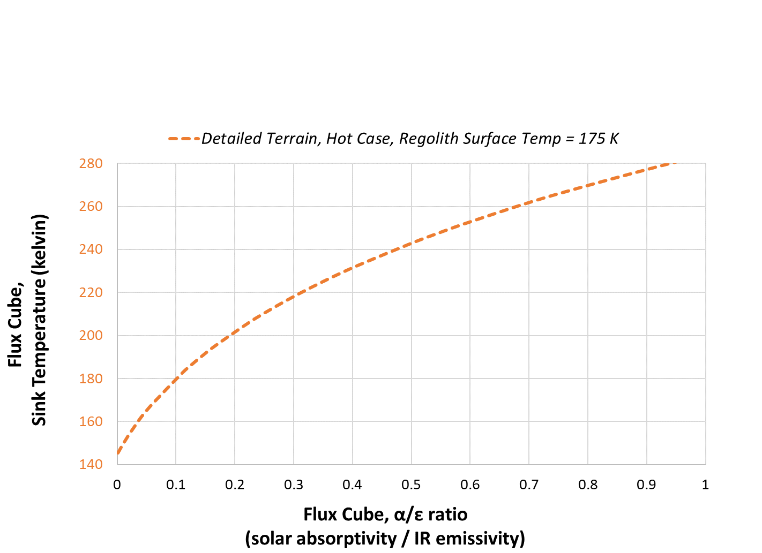
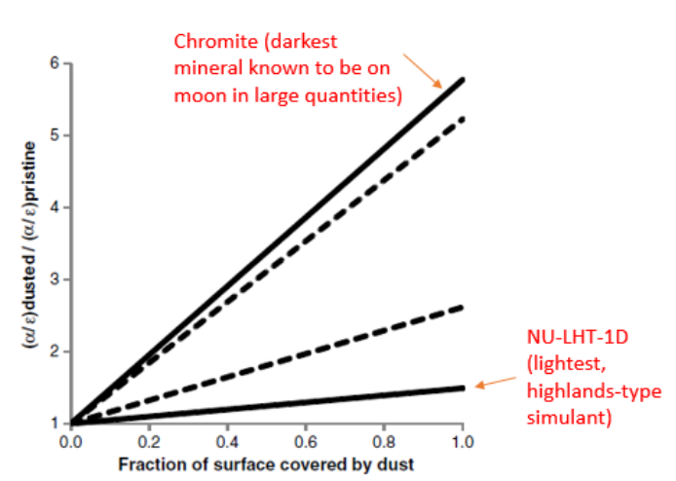
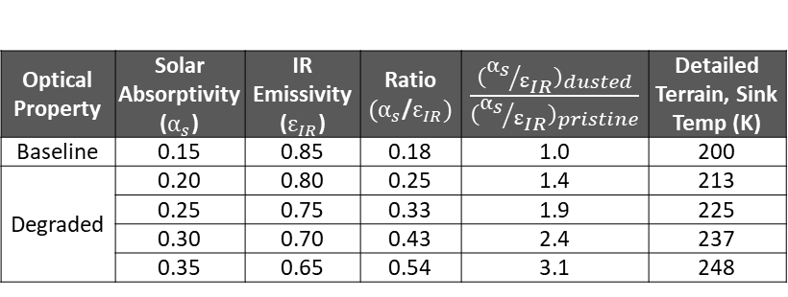
Accounting for Lunar Dust Impacts
Regolith dust deposition onto asset surfaces can be inferred by applying optical property ratio factors that are derived from experimental test data
  Factors correspond to percent dust coverage for different surface treatments and regional regolith compositions
Dust deposition effectively increases the sink temperature thus limiting heat rejection capability which may result in higher temperatures during the day and longer nighttime survival durations
  See Will Birmingham’s “Lunar South Pole Terrain Effects on Radiators” paper for a more detailed analysis on the thermal effects of terrain and dust deposition for radiators
Dusted Surface Optical Property Factors
Optical Property | Solar Absorptivity ($α_{s}$) | IR Emissivity ($ε_{IR}$) | Ratio ${(α}_{s}$/$ε_{IR})$ | $\frac{({α_{s}}/{ε_{IR}})_{dusted}}{({α_{s}}/{ε_{IR}})_{pristine}}$ | Detailed Terrain, Sink Temp (K)
Baseline | 0.15 | 0.85 | 0.18 | 1.0 | 200
Degraded | 0.20 | 0.80 | 0.25 | 1.4 | 213
 | 0.25 | 0.75 | 0.33 | 1.9 | 225
 | 0.30 | 0.70 | 0.43 | 2.4 | 237
 | 0.35 | 0.65 | 0.54 | 3.1 | 248
Polar, Sink Temperature vs α/ε Ratio
Varying Optical Properties of Typical Radiator Materials vs Dust Deposition for Regional Simulants^{[1]}

Slide 17
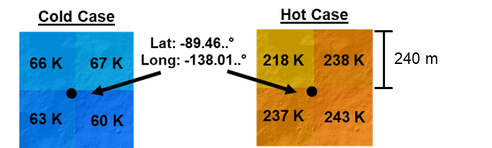
Method Comparison: Predicting Surface Temperature
For polar locations, flat ground plane models do not accurately capture worst case hot environment due to the relationship between local terrain slope, solar elevation angle, and incident angle regolith optical properties
  240 meters per pixel resolution of LRO satellite derived bolometric surface temperature data limits its utility for areas of extreme topology
For mid-latitude and equatorial regions, a flat ground plane model will capture worst case hot and cold conditions within 7 K (assuming the site of interest is relatively flat)
Lunar Location | Terrain Model Type | Latitude | Longitude | Maximum Regolith Surface Temperature (kelvin) |  |  |  |  | Minimum Regolith Surface Temperature (kelvin)
 |  |  |  | Model Predicted | DSNE Regional Mean^{[12]} | DSNE Regional 1σ^{[12]} | **LTAG Section 5.2.2^{[1]} | ***LRO Data @ Lat, Long | Model Predicted | DSNE Regional Mean^{[12]} | DSNE Regional 1σ^{[12]} | ***LRO Data @ Lat, Long
Polar | Ground Plane | -89.46752° | -138.012788° | 160 | *182 (@ 85°S) | *224 (@ 85°S) | 119 | 237 | 50 | *61 (@ 85°S) | *41 (@ 85°S) | 63
Polar | Detailed Terrain | -89.46752° | -138.012788° | 185 |  |  |  |  | 47
Mid-Latitude | Ground Plane | +45° | 0° | 354 | 350 | 357 | 359 | 355 | 91 | 89 | 83 | 93
Equatorial | Ground Plane | 0° | 0° | 387 | 391 | 394 | 392 | 394 | 98 | 96 | 94 | 99
LRO Data @ Lat, Long:
*Polar mean and 1σ worst case hot and cold values as listed in DSNE; originally obtained via LRO Diviner flight data for 85º Latitude locations
**For mid-latitude and equatorial locations, daytime surface temperatures can be approximated via analytical expressions based on an energy balance
***Values were obtained via LROC WebView, LRO Diviner data was overlayed onto a digital elevation map of the Lunar surface. LRO Diviner bolometric Lunar surface temperature data has a spatial resolution of 240 meters per pixel and temperature value error of ±5ºC. For polar regions where terrain topology is extreme and the solar vector stays near the horizon, the relatively low spatial data resolution of the Diviner instrument can reduce its utility for estimating surface temperatures.^{[21-25]}

Slide 18
Findings and Remarks
Regolith surface temperatures are not the effective thermal environment that assets near or on the surface will experience, asset sink temperature is almost never equivalent to regolith surface temperature
  Accurately identifying the worst-case thermal environments for assets on the Lunar surface requires knowledge of the specific mission location (terrain features, regolith properties, solar elevation angle) and vehicle integration (e.g., reflections or occlusion from the environment)
  Asset temperatures can be much hotter or colder than Lunar surface temperatures
For polar locations, flat ground plane models do not accurately capture worst case hot surface temperature due to the relationship between local terrain slope, solar elevation angle, and incident angle regolith optical properties
  240 meters per pixel resolution of LRO satellite derived bolometric surface temperature data limits its accuracy for areas of extreme topology
For mid-latitude and equatorial regions, a flat ground plane model can capture worst case hot and cold surface temperatures within ±7 K (assuming the site of interest is relatively flat)
The thermal impacts of regolith dust deposition onto asset surfaces can be inferred by applying optical property ratio factors that are derived from experimental test data
  Factors correspond to percent dust coverage for different surface treatments and regional regolith compositions

Slide 19
References
[1] B. D. Hamill, R. G. Schunk, and L. R. Erickson, “Human Landing System Lunar Thermal Analysis Guidebook,” Jan. 2021, Available: https://ntrs.nasa.gov/citations/20210010030
[2] C. Gomez, B. Hamill, G. Schunk, and L. Erickson, “Lunar Surface 3D Terrain Modeling,” Sep. 06, 2022. Available: https://ntrs.nasa.gov/citations/20220013302
[3] W. Birmingham, “Thermal Sensitivity Study of Lunar Terrain Vehicle Wheels.” Accessed: Jun. 12, 2025. [Online]. Available: https://ntrs.nasa.gov/api/citations/20240006096/downloads/Thermal%20Sensitivity%20of%20LTV%20Wheels%20V4.pdf
[4] W. Birmingham, G. Schunk, and B. Evans, “Lunar Latitude and Terrain Radiator Sensitivity Study,” 2024. [Online]. Available: https://ntrs.nasa.gov/api/citations/20240010276/downloads/Lunar_Latitude_and_Terrain_Radiator_Sensitivity_V2.pdf
[5] W. Grier, A. Stark, R. Wiggins, and R. Amundsen, “Thermoplastic Space Point Design (TSPD) Tall Tower Lunar Thermal Analysis,” Nasa.gov, Aug. 26, 2024. https://ntrs.nasa.gov/citations/20240009936
[6] “Lunar Thermal Analysis Guidebook, Part 1,2,3 | NESC Academy Online,” nescacademy.nasa.gov. https://nescacademy.nasa.gov/video/43723e634fe44646aef30b745640ad4d1d
[7] “Lunar Surface Geology,” Usra.edu, 2025. https://www.lpi.usra.edu/exploration/training/illustrations/lunarGeology/ (accessed Jun. 12, 2025).
[8] A. Juhasz, “An Analysis and Procedure for Determining Space Environmental Sink Temperatures With Selected Computational Results,” 2001. Available: https://ntrs.nasa.gov/api/citations/20010014168/downloads/20010014168.pdf
[9] L. Carrillo, N. Jsc, D. Farner, J. Engineering, and C. Preston, “NASA-TFAWS Short Course ISS Payload Thermal Environments,” 2015. Accessed: Jul. 01, 2025. [Online]. Available: https://tfaws.nasa.gov/wp-content/uploads/TFAWS2015-SC-ISS-Payload-Thermal-Design.pdf
[10] L. Erickson, B. Barnes, C. Sladek, “Thermal Analysis for EVA Twighlight Scenario on a Flat Plane,” JETS-JE33-23-TLSS-DOC-00031, June 8, 2023.
[11] R. Henson, G. Laubach, J. Iovine, G. Lucas, “A Routine (FLXCAL) to Determine EVA Cube Fluxes using SINDA Temperatures,” June 20, 2003.
[12] F. B. Leahy, “SLS-SPEC-159, Cross-Program Design Specification for Natural Environments (DSNE),” Oct. 2021. Available: https://ntrs.nasa.gov/citations/20210024522
[13] “Horizons System,” Available: https://ssd.jpl.nasa.gov/horizons/
[14]T.-Y. Park, J.-J. Lee, J.-H. Kim, and H.-U. Oh, “Preliminary Thermal Design and Analysis of Lunar Lander for Night Survival,” International Journal of Aerospace Engineering, vol. 2018, pp. 1–13, Oct. 2018, doi: https://doi.org/10.1155/2018/4236396.
[15] J. Feng, M. A. Siegler, and P. O. Hayne, “New Constraints on Thermal and Dielectric Properties of Lunar Regolith from LRO Diviner and CE‐2 Microwave Radiometer,” Journal of Geophysical Research: Planets, vol. 125, no. 1, Jan. 2020, doi: https://doi.org/10.1029/2019je006130
[16] E. J. Foote, D. A. Paige, M. K. Shepard, J. R. Johnson, and S. Biggar, “The bidirectional and directional hemispheric reflectance of Apollo 11 and 16 soils: Laboratory and Diviner measurements,” Icarus, vol. 336, p. 113456, Jan. 2020, doi: 10.1016/j.icarus.2019.113456.
[17] A. R. Vasavada et al., “Lunar equatorial surface temperatures and regolith properties from the Diviner Lunar Radiometer Experiment,” Journal of Geophysical Research: Planets, vol. 117, no. E12, p. n/a-n/a, Apr. 2012, doi: https://doi.org/10.1029/2011je003987.
[18] P. O. Hayne et al., “Global Regolith Thermophysical Properties of the Moon From the Diviner Lunar Radiometer Experiment,” Journal of Geophysical Research: Planets, vol. 122, no. 12, pp. 2371–2400, Dec. 2017, doi: https://doi.org/10.1002/2017je005387.
[19] R. Woods‐Robinson, M. A. Siegler, and D. A. Paige, “A Model for the Thermophysical Properties of Lunar Regolith at Low Temperatures,” Journal of Geophysical Research: Planets, vol. 124, no. 7, pp. 1989–2011, Jul. 2019, doi: https://doi.org/10.1029/2019je005955
[20] L. Erickson, C. Gomez, B. Hamill, and G. Schunk, “Lunar Thermal Analysis Guidebook: Thermo-physical and Optical Properties of Lunar Regolith.” Available: https://ntrs.nasa.gov/api/citations/20220013412
[21] “Lunar Reconnaissance Orbiter - NASA Science,” Available: https://science.nasa.gov/mission/lro/
[22] “Lunar Orbital Data Explorer - Data Set Browser,” ode.rsl.wustl.edu. https://ode.rsl.wustl.edu/moon/datasets
[23] “QuickMap,” quickmap.lroc.asu.edu. Available: https://quickmap.lroc.asu.edu
[24] T. M. Powell et al., “High‐Resolution Nighttime Temperature and Rock Abundance Mapping of the Moon Using the Diviner Lunar Radiometer Experiment With a Model for Topographic Removal,” Journal Of Geophysical Research: Planets, vol. 128, no. 2, Feb. 2023, doi: https://doi.org/10.1029/2022je007532.
[25 ] J. P. Williams et al., “Seasonal Polar Temperatures on the Moon,” JGR Planets, vol. 124, no. 10, pp. 2505–2521, Oct. 2019, doi: https://doi.org/10.1029/2019je006028.
‌

