Slide 1

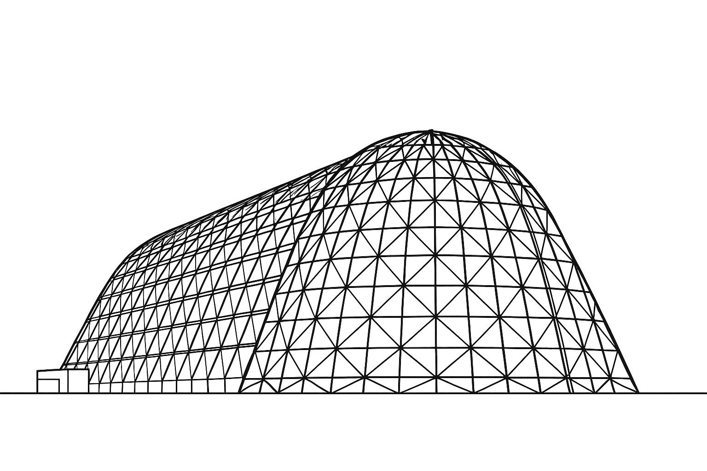

Thermal Systems Engineering for Nuclear Electric Propulsion (NEP) High Temperature Radiators
TFAWS 2025 Interdisciplinary Technical Session
Presented by: Will Grier
Will Grier (LaRC-D206), Amanda Stark (LaRC-D206), Diego Perea (LaRC-D206, Intern, San Diego State University), Tai Valdés (LaRC-D312, Intern, Pennsylvania State University), Malay Shah (KSC-NEL60), Sarah Czerwien (GRC-LTT0, HX5), William Machemer (Analytical Mechanics Associates [AMA]), Andrew McMahon (LaRC-D208)
Thermal & Fluids Analysis Workshop 2025
NASA Ames Research Center
San Jose, CA
August 4-7, 2025
LaRC: NASA Langley Research Center
KSC: NASA Kennedy Space Center
GRC: NASA Glenn Research Center
D206: Structural and Thermal Systems Branch, D312: Structural Mechanics and Concepts Branch, NEL60: Advanced Engineering Development Branch, LTT0: Thermal Systems and Transport Processes Branch, D208: Engineering Integration Branch

Slide 2

Outline
Nuclear Electric Propulsion (NEP) Introduction
Project Overview
State of the Art (SoA) Comparison
Target Application
  Thermal Environments Modeling
System Definition Diagrams
  External Interfaces
  Installation and Commissioning Options
  Internal Interfaces
  Functional Flows
Thermal Performance Trades
  Key Performance Parameter
  Technology Selections
  Thermal Model Development
Future Work
References

Slide 3
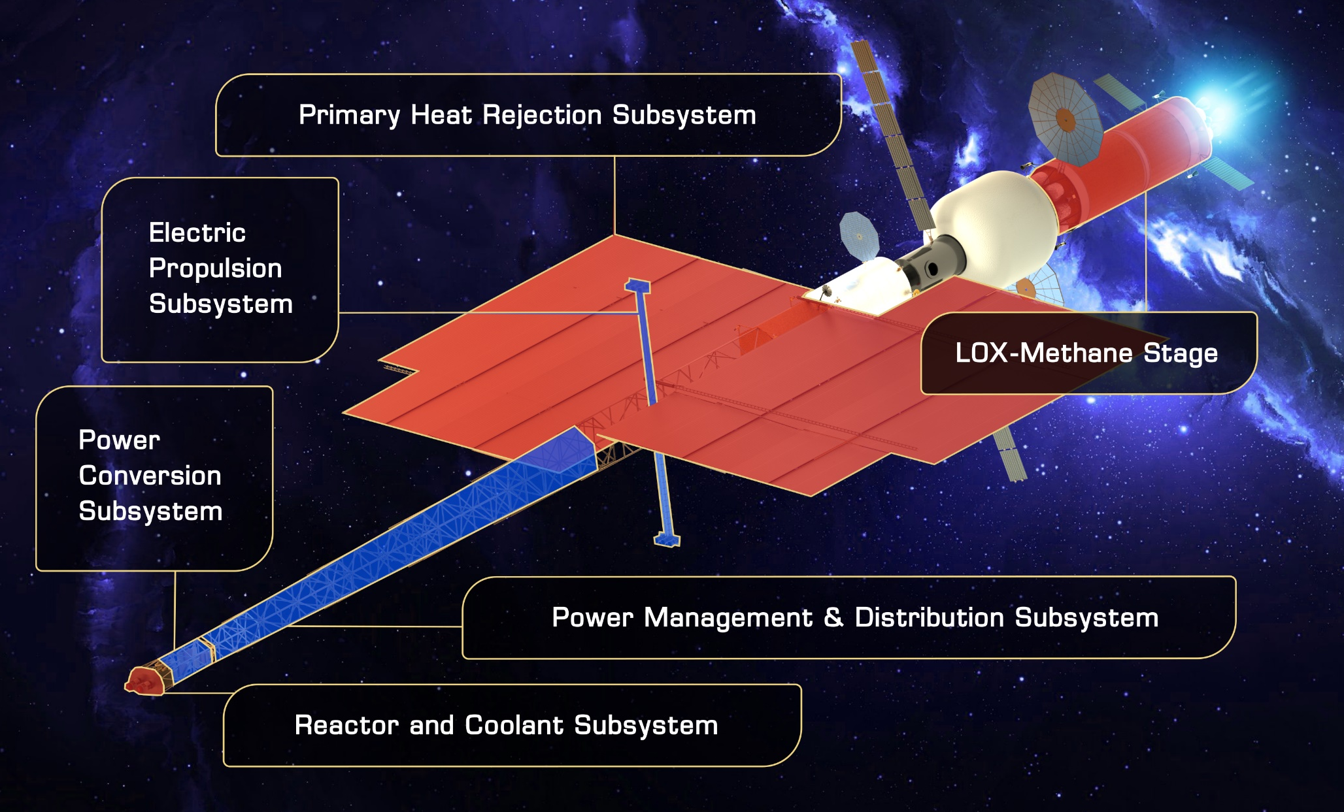
Hybrid NEP/Chemical Vehicle
NASA is challenged to develop nuclear propulsion spacecraft for human-rated and cargo Mars missions in the next decade (late 2030s)
Nuclear Electric Propulsion (NEP) has been considered for more than six decades based on fuel efficiencies 10 to 20 times greater than what is currently achievable with conventional propulsion^{[1]}
  Nuclear propulsion vehicles also enable expanded cis-lunar mobility, sustained Mars presence, and deep space exploration
A Hybrid NEP/Chemical system contains five technology elements^{[1,2]}:
  Reactor and Coolant Subsystem
  Power Conversion Subsystem
  Power Management & Distribution Subsystem
  Electric Propulsion Subsystem
  Primary Heat Rejection Subsystem
  Chemical Stage (LOX-Methane) is not considered a critical technology element, but rather as an engineering development item
Note: The NEP System of Spacecraft shown is an artist's rendition of the crewed version with one EPS propellant stage. The vehicle configuration and number of elements changes throughout the Mars Opposition Class mission. One possible set of subsystem placements is shown and is subject to change.

Slide 4
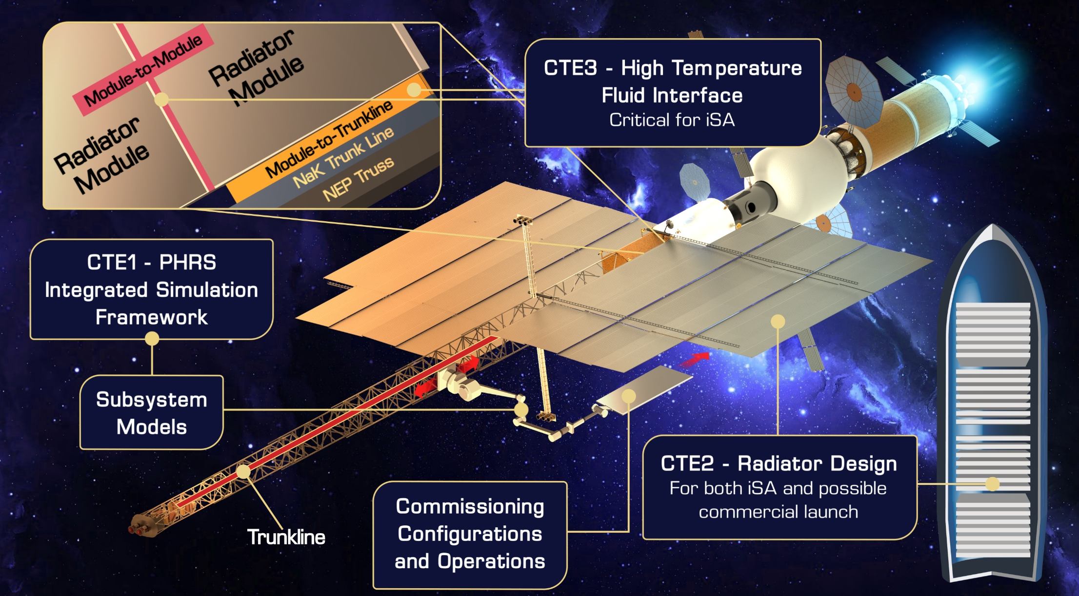
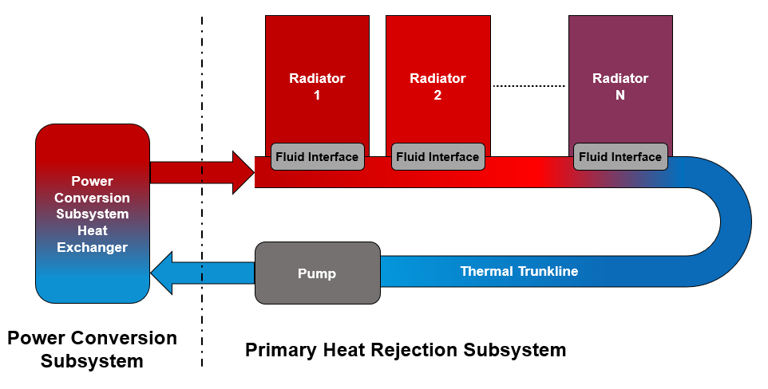
Modular Assembled Radiators for NEP VehicLes (MARVL)
Need, Goal, Objectives (NGO)
Nuclear Electric Propulsion (NEP) contains five key elements; The Primary Heat Rejection Subsystem (PHRS) is the largest and most massive element due to the large amount of reactor waste heat:
  Surface area >3,000 m² and 40-60% of total NEP dry mass^{[1,3]}
  The use of in-Space Assembly (iSA) in designing NEP modular radiators enables the “planar Bi-Wing” configuration and 25% to 65% mass savings
Need | Large-scale in-space radiator technology that meets launch vehicle constraints, reduces system mass, improves system performance, reduces risk, and provides future mission planners flexibility in NEP architecture design
Goal | Design and analyze a lightweight PHRS targeting an NEP capability
Objective | Define and evaluate a set of PHRS installation and commissioning concepts | Build an integrated simulation to predict and analyze system behavior in relevant environments | Define and analyze a representative modular high-temperature radiator unit design | Define and analyze a high-temperature fluid interface design
Cross-agency team: LaRC, GRC, KSC, MSFC
MARVL System of Interest (SOI)
MARVL Critical Technology Elements (CTE)

Slide 5
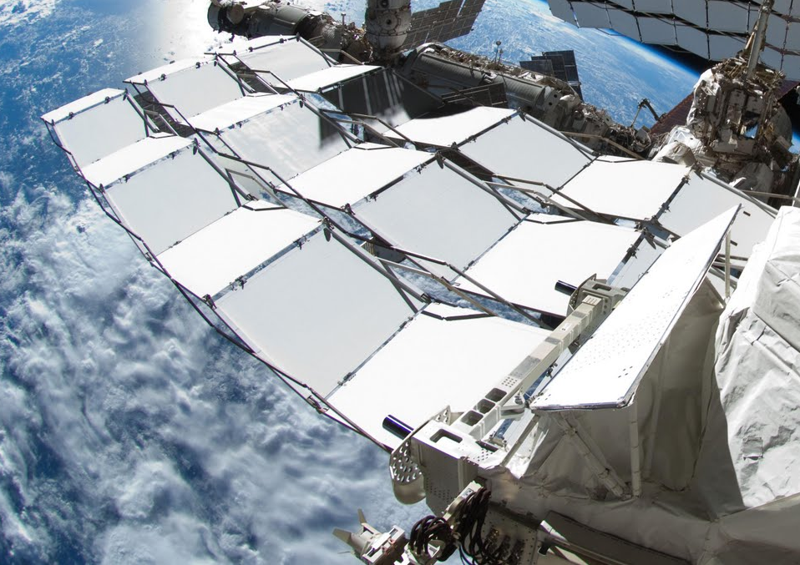
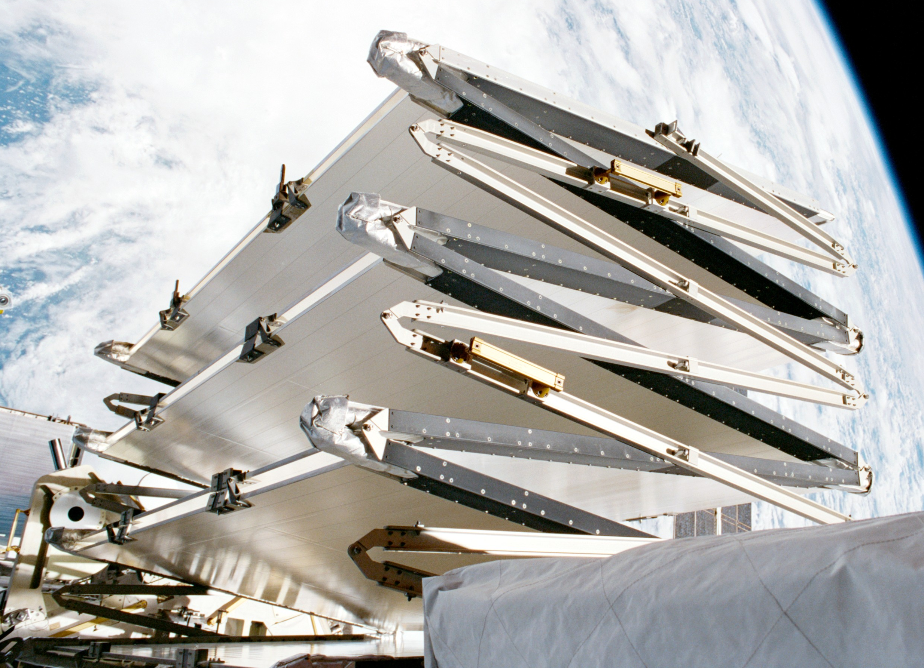
State of the Art Comparison - ISS Radiators
The International Space Station (ISS) Active Thermal Control System (ATCS) radiator arrays, with their Orbital Replacement Unit (ORU) interfaces, are the most relevant state of the art in terms of size and commissioning approach
  ISS radiator arrays were launched in several segments, robotically assembled on orbit, then remotely deployed
  However, ISS radiators do not meet NEP PHRS requirements
System Characteristics: ISS Radiators vs MARVL PHRS
System/ Characteristic | ISS Radiator Arrays | MARVL PHRS
Commissioning Method | Robotically Installed & Deployed ^{[5]} | Robotically Installed & Deployed or Fully Assembled
Surface Area | ~1300 m² ^{[5]} | >3000 m² ^{[1]}
Launch Vehicle(s) | ~5 Space Shuttles ^{[5]} | TBD
Thermal Working Fluid | Anhydrous Ammonia ^{[5]} | Liquid Metal NaK ^{[1]}
Fluid Temp. | ~270 K to 290 K ^{[6]} | ~330 K to 550 K ^{[1,4]}
Effective Radiation Temp. | ~285 K ^{[6]} | ~400 K ^{[3]}
Areal Density | ~7.0 kg/m² ^{[7]} | <4.5 kg/m² ^{[1,4]}
Heat Rejection | ~125 kWth ^{[5]} | ~4 MWth ^{[1,4]}
Design Environment(s) | LEO ~400 km altitude ISS Interfaces | Mars Opposition Class Mission NEP/Chem Vehicle Interfaces
Photo Credit: NASA

Slide 6
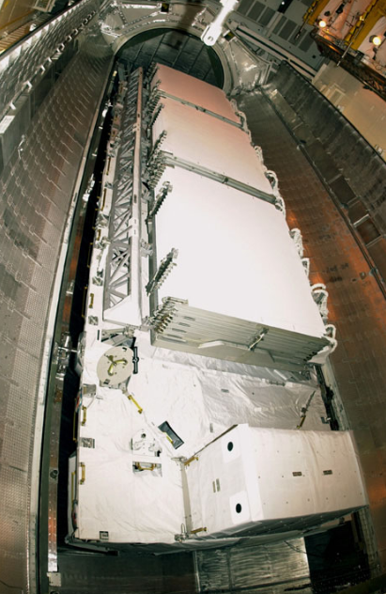
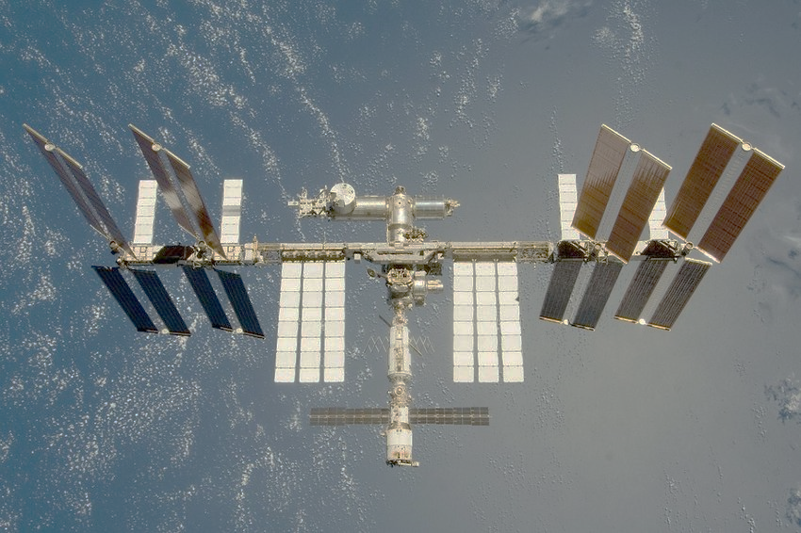
State of the Art Comparison - ISS Radiators
Photovoltaic Thermal Control System (PTCS) Radiators^{[5]}
External Active Thermal Control System (EATCS) Radiators^{[5]}
ISS, Deployed Radiator Arrays
EATCS Stowed in Space Shuttle
ISS Radiators Deployed In-Orbit
Photo Credit: NASA

Slide 7
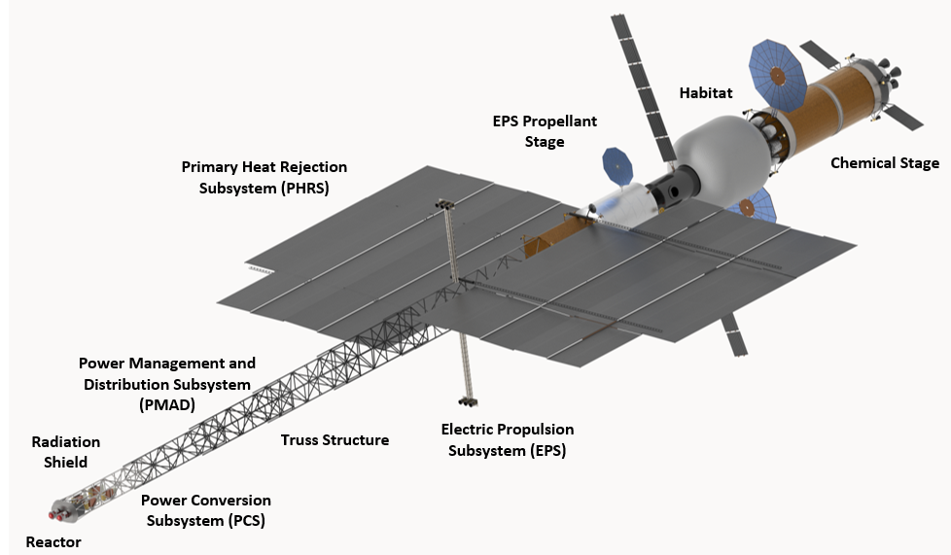
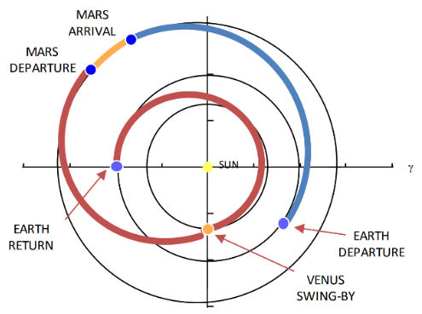
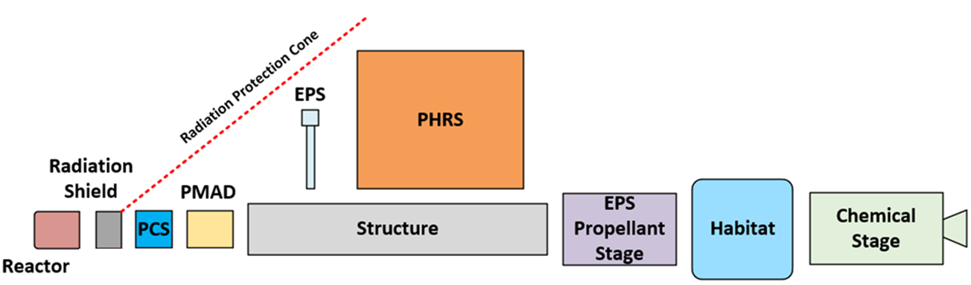
Target Application - Enveloping Mars Mission
Crewed mars missions involve many mission phases and locations each with differing environments
The target application for technology development is a Crewed NEP Mars Opposition Class Mission^{[1]}:
  Crew departure date: 2039
  Total mission duration: ~3 years
System integration and loads: with hybrid NEP/chemical vehicle (NEP for cruise phases & chemical stage to enter/exit gravity wells)
Possible locations: Low Earth Orbit (LEO), Near Rectilinear Halo Orbit (NRHO), Lunar Distant High Earth Orbit (LDHEO), Interplanetary, Mars Orbit, Venus Flyby
Relevant environments: thermal, vacuum, Micro Meteoroid and Orbital Debris (MMOD), radiation, launch loads, in-space loads, microgravity
Opposition Class Mars Mission^{[8]}
Hyrbid NEP/Chemical Vehicle
Note: The NEP System of Spacecraft shown is an artist's rendition of the crewed version with one EPS propellant stage. The vehicle configuration and number of elements changes throughout the Mars Opposition Class mission. One possible set of subsystem placements is shown and is subject to change.

Slide 8
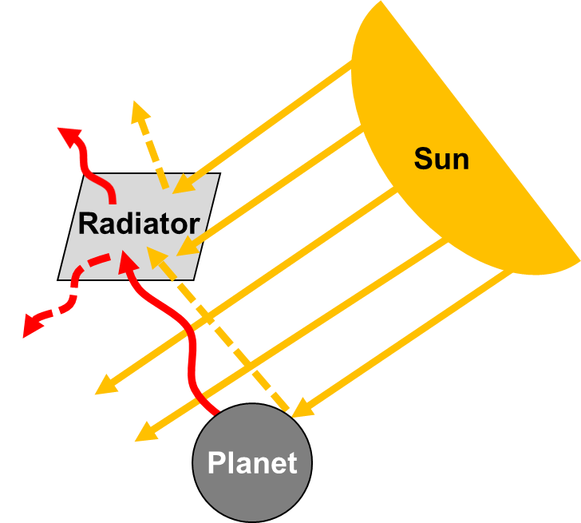
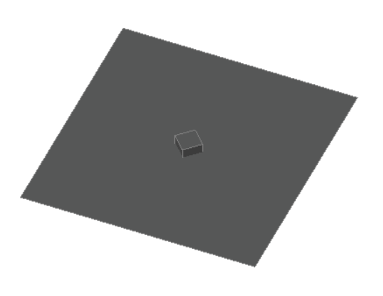
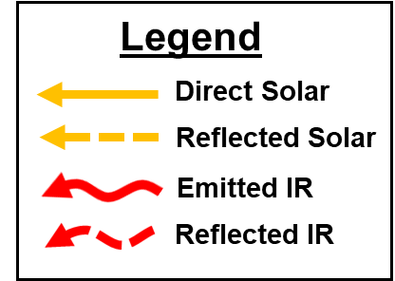
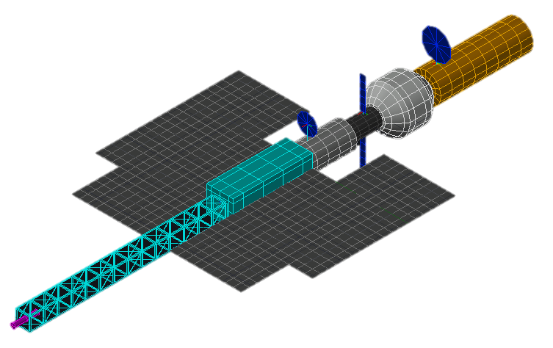
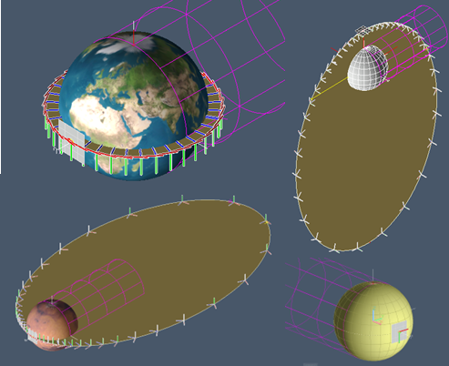


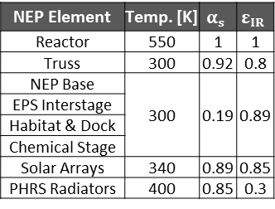
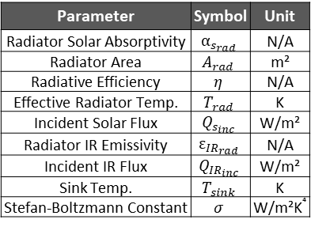
Enveloping Mission - Thermal Environment Modeling
Developed reduced order models in ANSYS Thermal Desktop (TD) to define orbital cases and investigate PHRS heat rejection capability relative to sink temperature vs orbit period
  Results inform operations (pointing and orientation requirements), thermal constraints, orbit selections, sensitivities to adjacent vehicle elements, and radiator optical property sensitivities
  “Thermal Considerations for 2039 Opposition Class Nuclear Electric Propulsion/Chemical Propulsion Crewed Mars Mission” presentation/paper by Tai Valdés includes details on orbit definitions, environmental parameters, and plate model results^{[9]}
Thermal Radiation Exchange
TD Plate Model^{[9]}
TD Representative Full Vehicle Model
TD Orbital Environments^{[9]}
LEO
NRHO
Sink Temp. & Heat Rejection Capability Calculations^{[10-14]}
$$T_{sink}={\left(\frac{1}{σ}\left(\frac{α_{s_{rad}}}{ε_{{IR}_{rad}}}Q_{s_{inc}}+Q_{{IR}_{inc}}\right)\right)}^{0.25}$$
Parameter | Symbol | Unit
Radiator Solar Absorptivity | $$α_{s_{rad}}$$ | N/A
Radiator Area | $$A_{rad}$$ | m²
Radiative Efficiency | $$η$$ | N/A
Effective Radiator Temp. | $$T_{rad}$$ | K
Incident Solar Flux | $$Q_{s_{inc}}$$ | W/m²
Radiator IR Emissivity | $$ε_{{IR}_{rad}}$$ | N/A
Incident IR Flux | $$Q_{{IR}_{inc}}$$ | W/m²
Sink Temp. | $$T_{sink}$$ | K
Stefan-Boltzmann Constant | $$σ$$ | W/m²K⁴
NEP Element | Temp. [K] | $$α_{s}$$ | $$ε_{IR}$$
Reactor | 550 | 1 | 1
Truss | 300 | 0.92 | 0.8
NEP Base | 300 | 0.19 | 0.89
EPS Interstage
Habitat & Dock
Chemical Stage
Solar Arrays | 340 | 0.89 | 0.85
PHRS Radiators | 400 | 0.85 | 0.3
$$Heat Rejection Capability \left[\%\right]=$$
$$\left(\frac{A_{rad}ησε_{{IR}_{rad}}}{A_{rad}ησε_{{IR}_{rad}}}\right)\left(\frac{\left(T_{rad}^{4}−T_{sink}^{4}\right)}{\left(T_{rad}^{4}\right)}\right)∗100$$
Mars Orbit
Venus Flyby

Slide 9
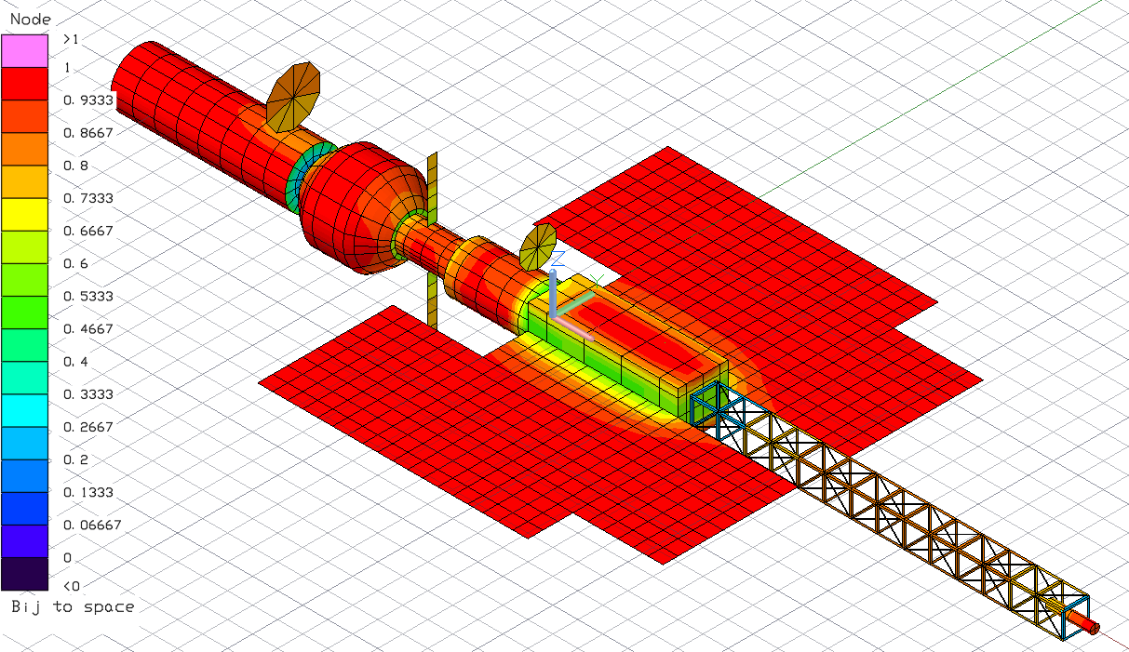

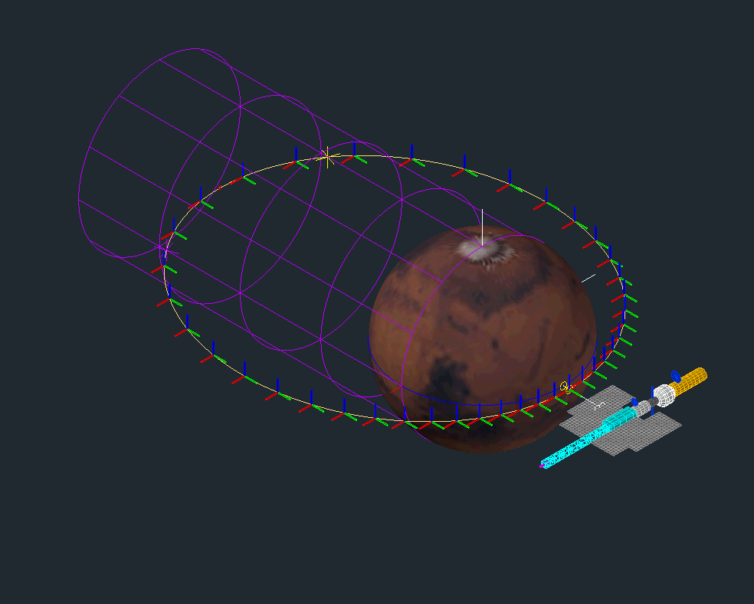
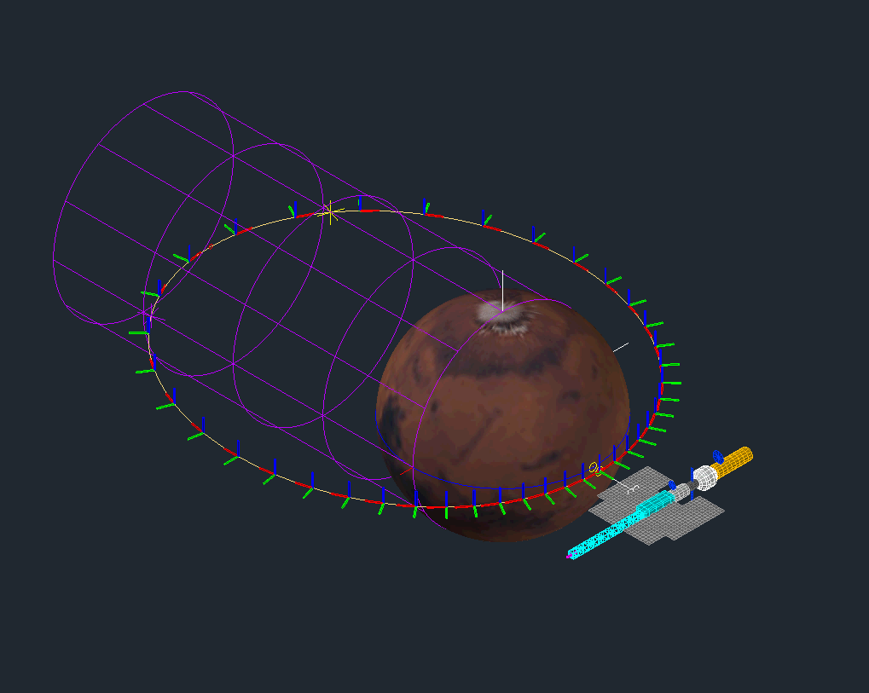
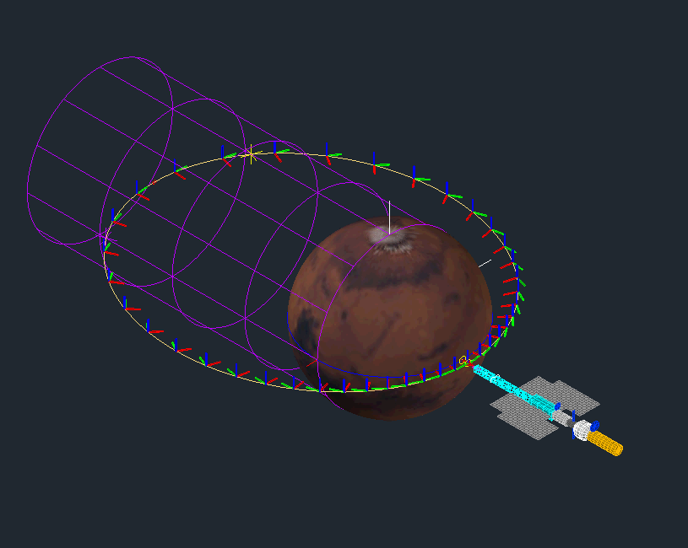
Reduced Order Full Vehicle Model - Key Findings
Radiator edge to Sun orientation is the most ideal in all mission locations when the reactor and PCS are online
  Face to Sun orientation is ideal when radiators are exposed to space prior to reactor/PCS startup
Regardless of orientation (R2VV or R2P), heat rejection capability predictions are within 8% relative to the plate model for all analyzed orbits
Radiator wings experience elevated sink temperatures near adjacent spacecraft elements
TD, View Factor to Space
Example Orbits: Heat Rejection Capability vs Time
LEO 500km (Edge to Sun, Horizontal), Cold, Beta = 0º
LEO 500km (Edge to Sun, Horizontal), Hot, Beta = 52º
TD Full Vehicle Model: Orientation Examples
Edge to Sun (Plate Model Orientation)
Edge to Sun & Reactor to Velocity Vector (R2VV)
Edge to Sun & Reactor to Planet (R2P)
Mars 1-Sol (Edge to Sun, Horizontal), Hot, Beta = 90º

Slide 10
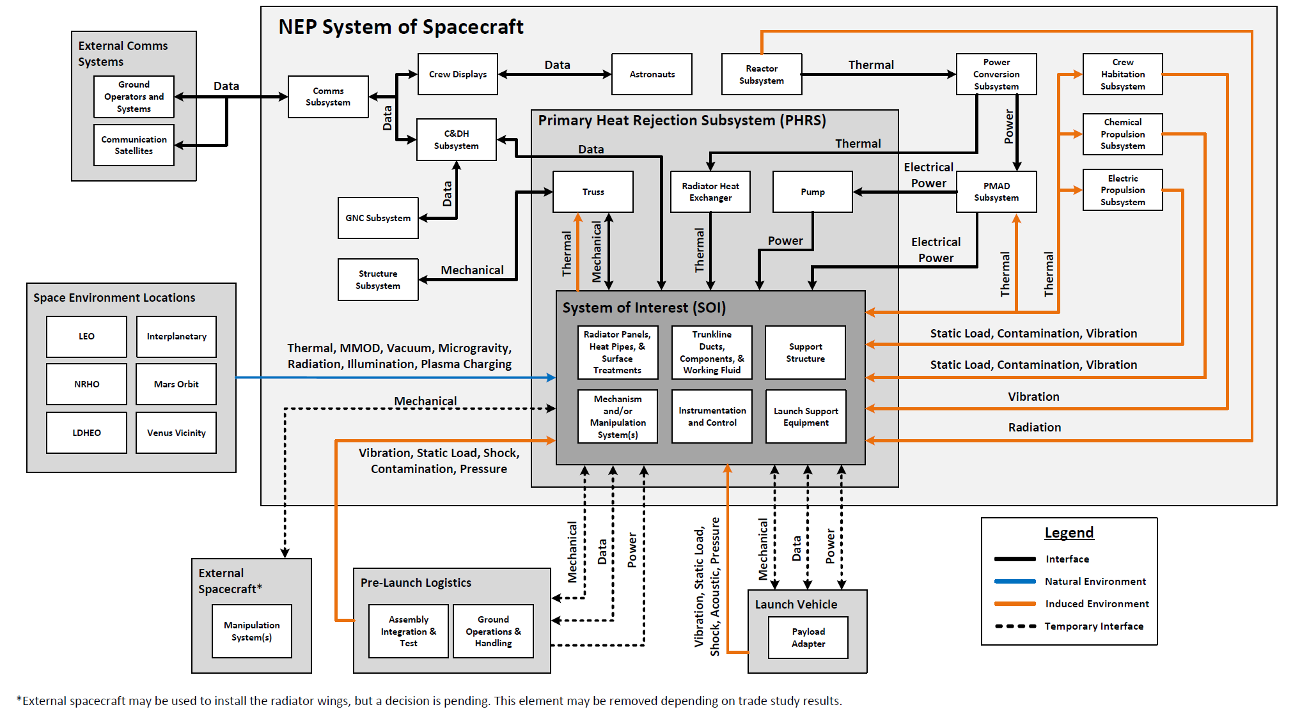
System of Interest (SOI) - External Interfaces

Slide 11
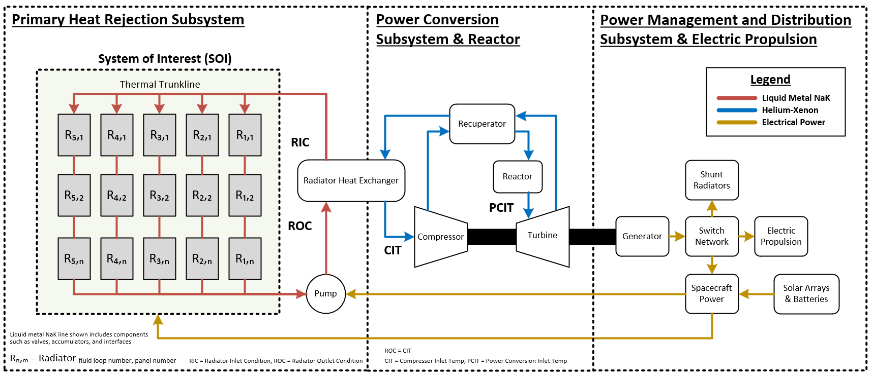
NEP Power System

Slide 12
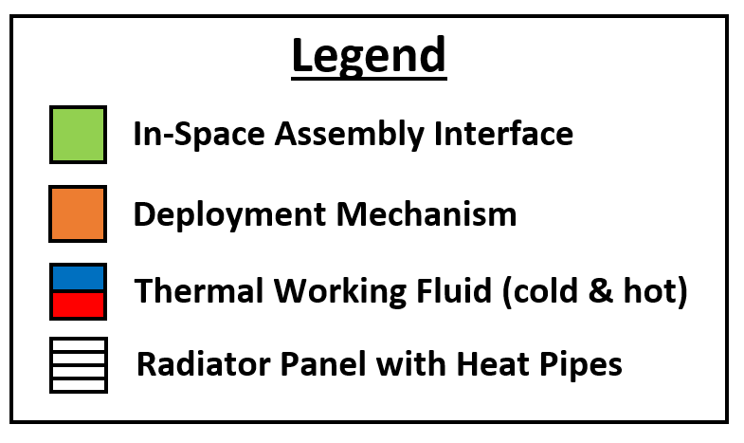
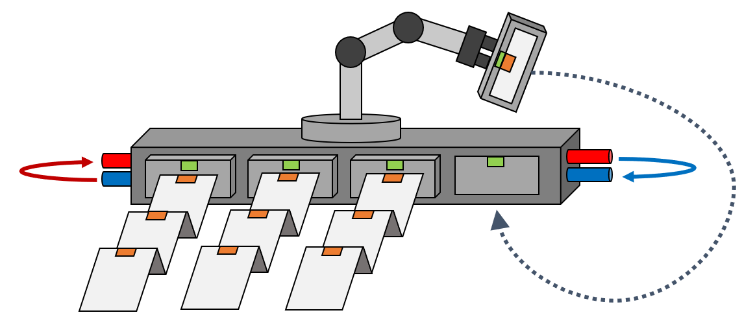
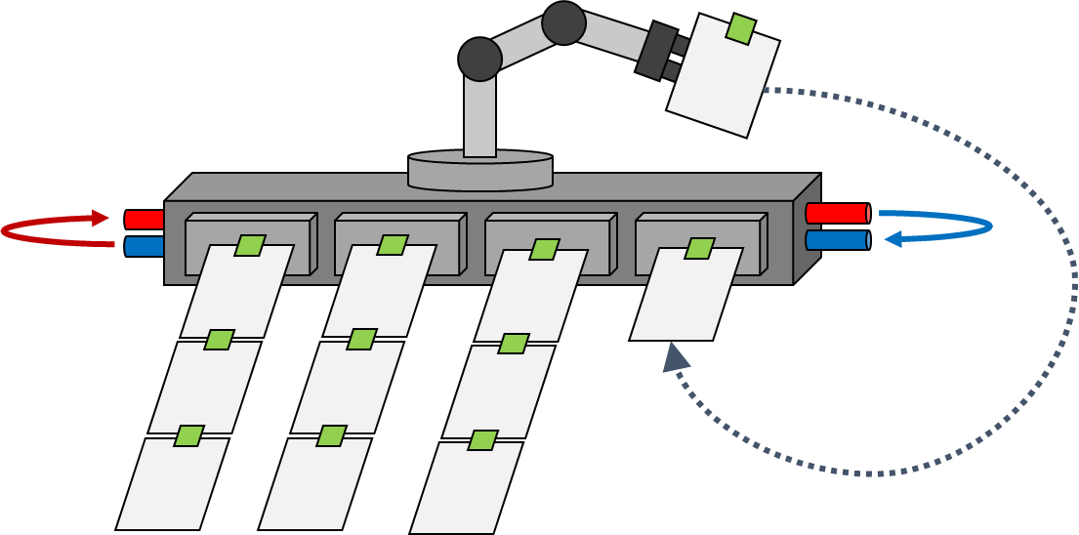
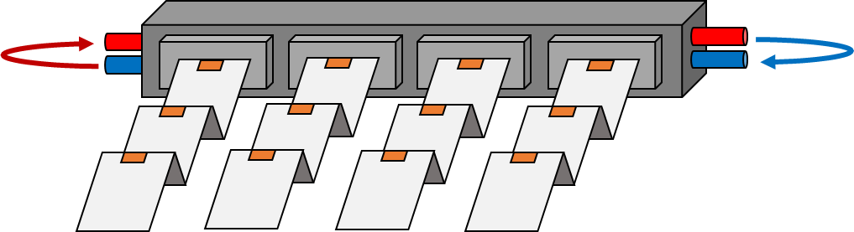
Installation and Commissioning Concepts
Definitions:
  Installation: incremental assembly/deployment of the PHRS radiators prior to reactor startup
  Commissioning: achievement of an operational PHRS in-line with reactor startup
Full Deployment
Hybrid
Full Assembly
Single-launch, co-manifested with the rest of the NEP power system
Constrained from a launch vehicle mass capability to orbit standpoint
Limited subsystem design flexibility and extensibility
Robotically assembled/installed units which are then deployed
Exploring hard mounted and mobile robotic agents
Requires multiple launches
Enables architectural flexibility and extensibility
Radiator units are robotically assembled into configuration
Exploring hard mounted and mobile robotic agents
Requires multiple launches
Enables architectural flexibility and extensibility

Slide 13
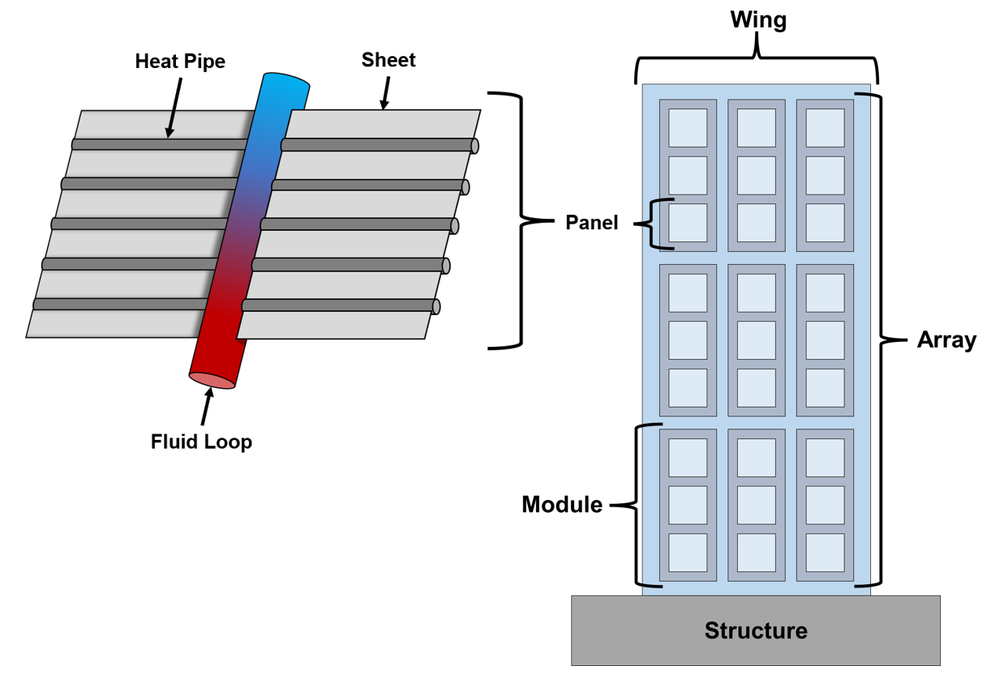
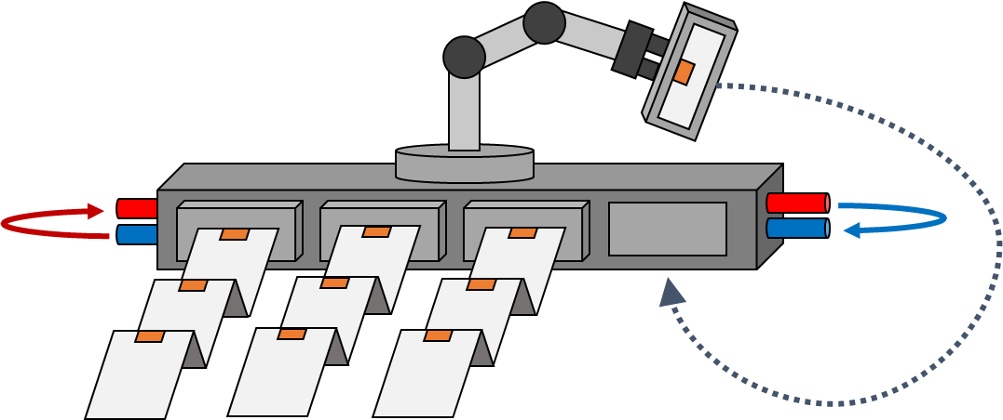
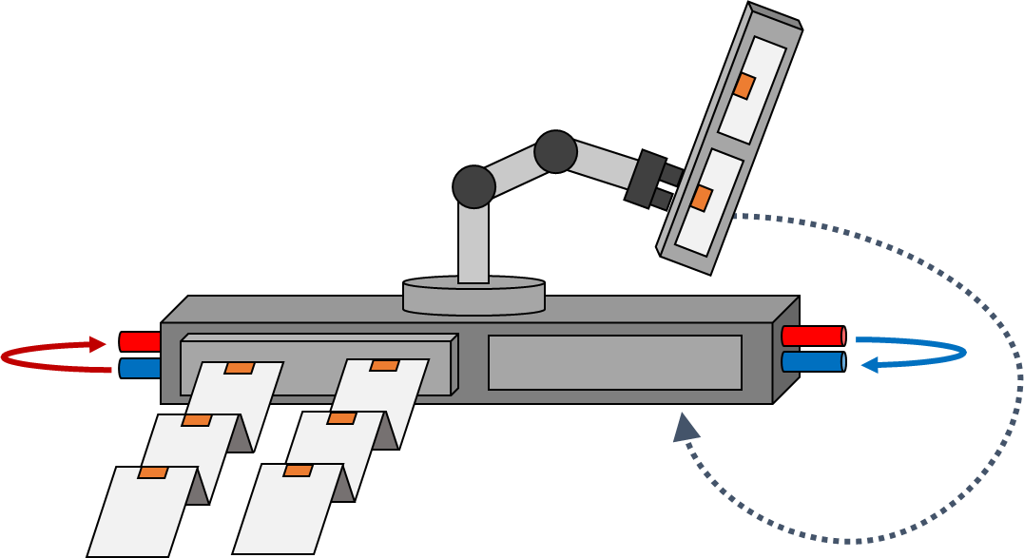
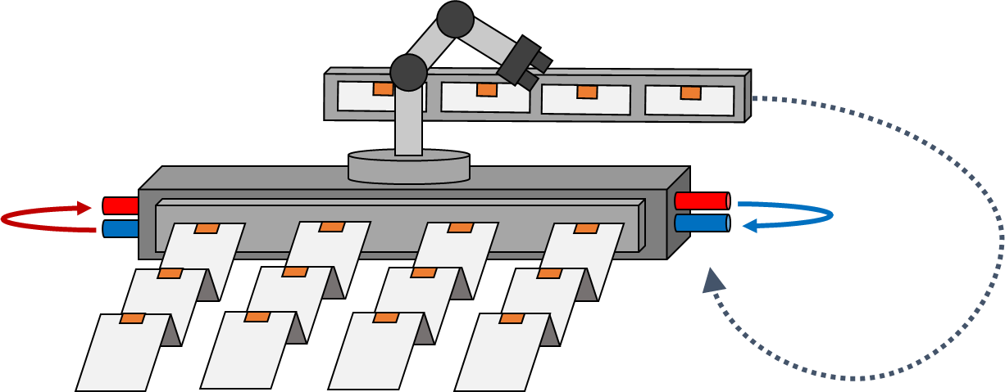
Radiator Unit Options
Radiator Unit: a modularized collection of radiative heat rejection surfaces to include structural supports, fluid loop(s) to each panel or module, surface treatments, heat pipes, and panel sheet materials
  Pending trade studies, a radiator unit may be a panel, a module, array, or wing
Radiator Unit Terminology
In-Space Assembled Unit Options
Radiator Panel
Radiator Module
Radiator Wing
Radiator Array

Slide 14
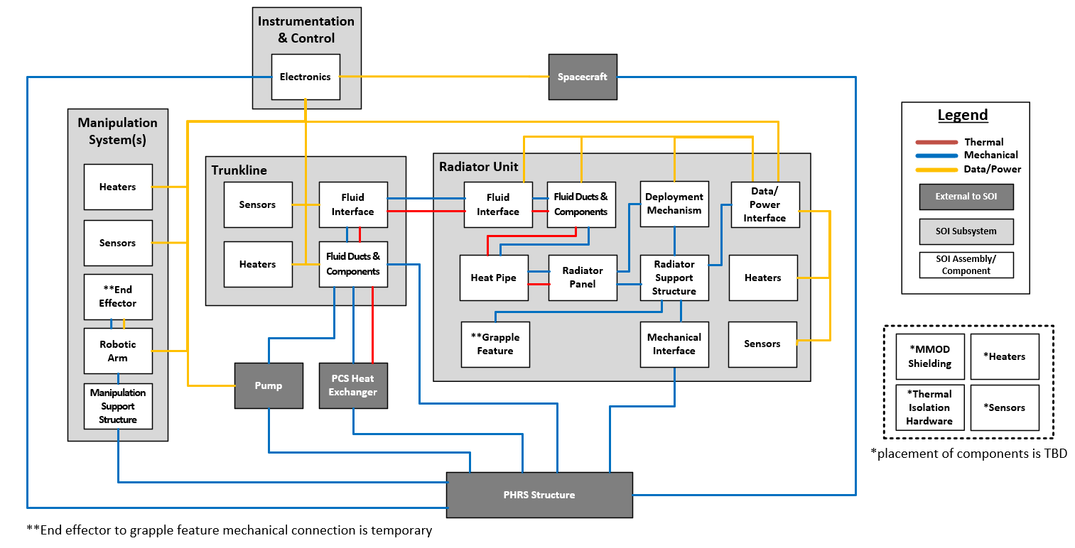
Hybrid Concept - SOI Internal Interfaces

Slide 15
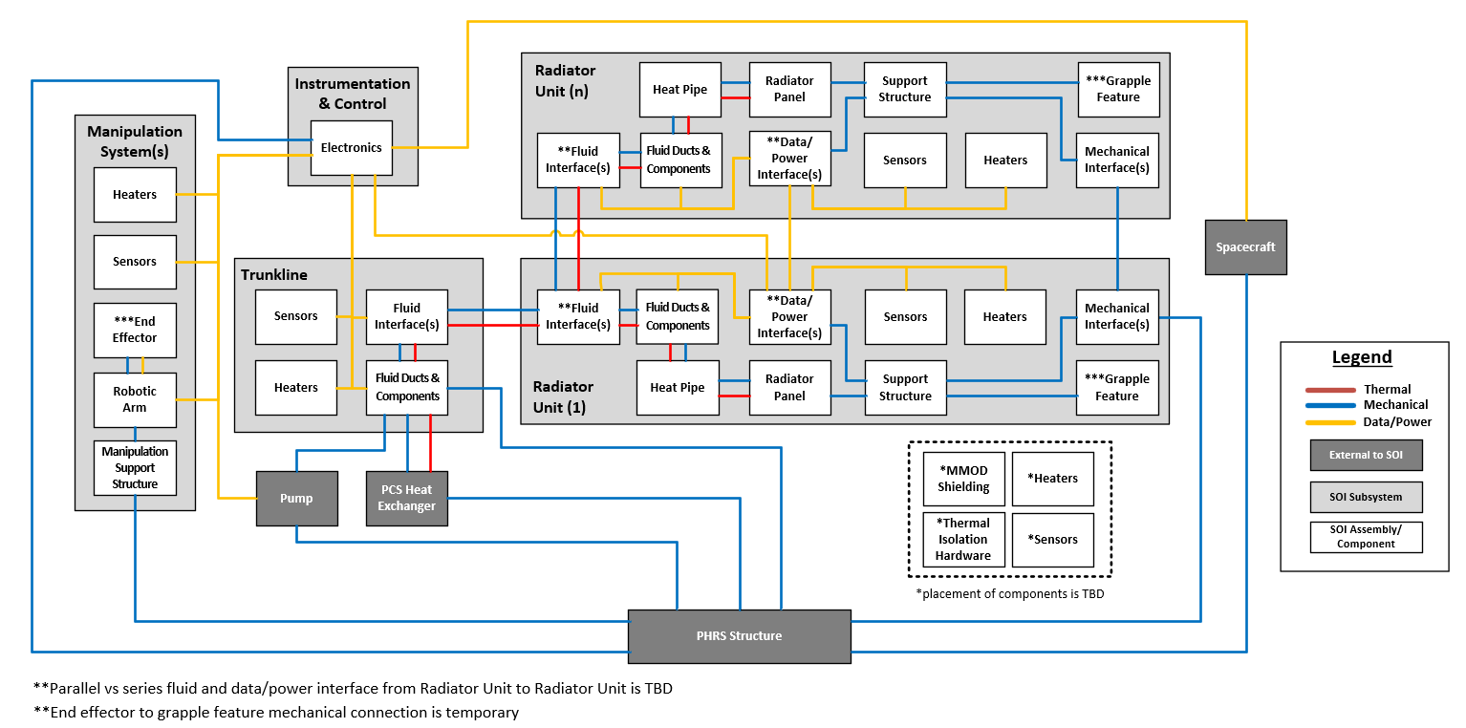
Full Assembly Concept - SOI Internal Interfaces
*

Slide 16
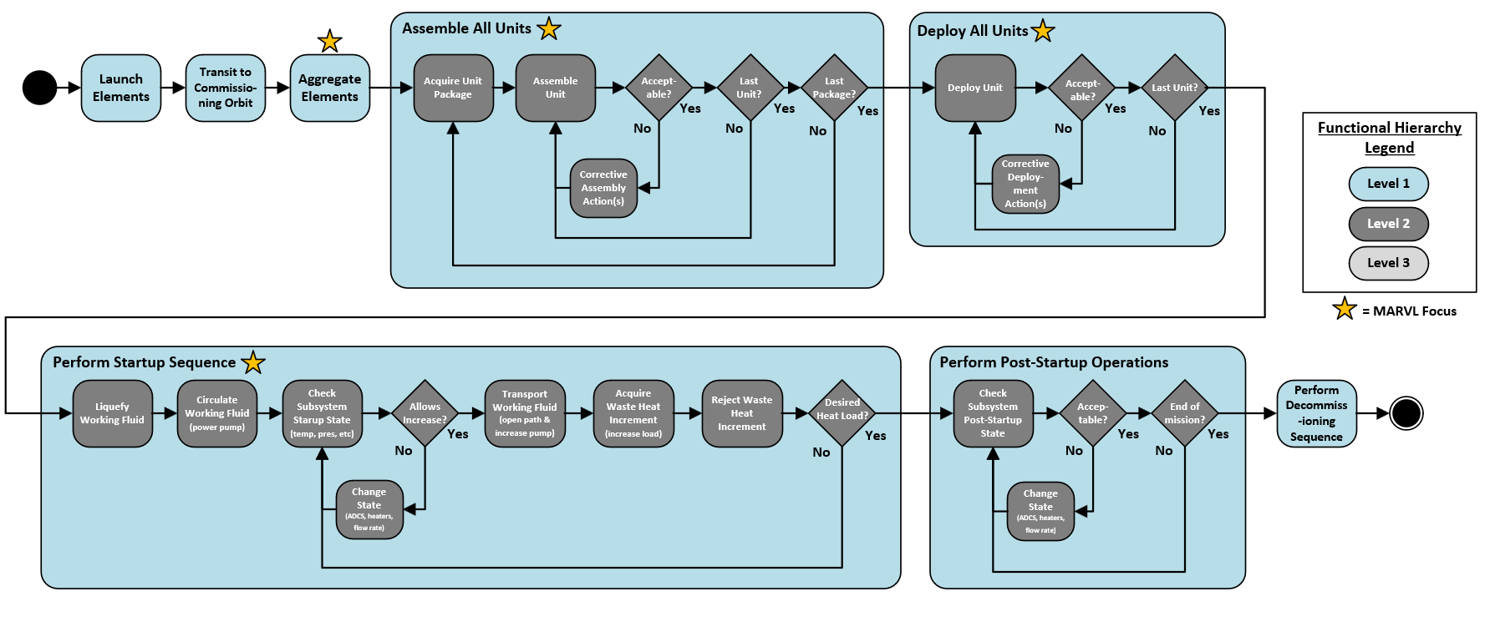
Initial Functional Flow Diagram
Not included in Full-Assembly Option
= MARVL focus area

Slide 17
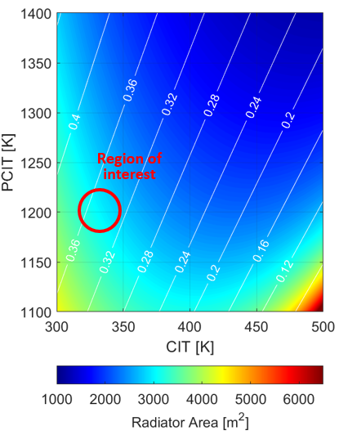
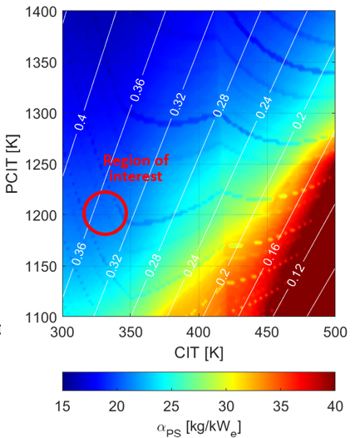
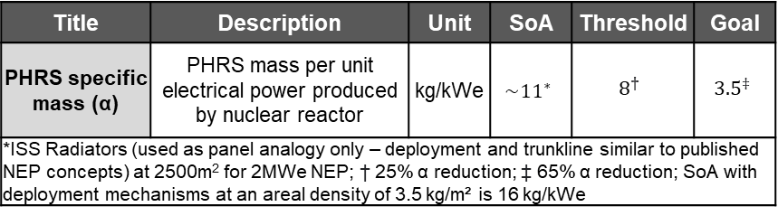
MARVL Key Performance Parameter (KPP)
Specific mass per unit power produced by the reactor (kg/kWe) is a measure of NEP architecture feasibility
  13 to 24 kg/kWe for the nuclear power system (includes the 5 NEP technical elements) represents mission closure
MARVL’s Key Performance Parameter (KPP) is defined at the PHRS level; the radiators cannot be designed independent of the PCS
  Minimizing overall NEP specific mass is a complex non-linear relationship between radiator area, power conversion efficiency, working fluid temperatures, heat pipe operating limits, and technology readiness (with respect to environments and system integration)
Increasing radiator operating temperature does not result in overall system mass improvement
  Reduces surface area at the cost of decreasing PCS cycle efficiency, thus requiring more heat to be rejected
  Requires high temperature (≥1400 K) reactor and turbine
  Requires developing new heat pipe technologies (next slide)
PCS Inlet and Outlet Temperatures vs Radiator Area (left) and Power System Specific Mass (right)
MARVL Key Performance Parameter (KPP)
Title | Description | Unit | SoA | Threshold | Goal
PHRS specific mass (α) | PHRS mass per unit electrical power produced by nuclear reactor | kg/kWe | $${\sim 11}^{∗}$$ | $$8^{†}$$ | $${3.5}^{‡}$$
*ISS Radiators (used as panel analogy only – deployment and trunkline similar to published NEP concepts) at 2500m² for 2MWe NEP; † 25% α reduction; ‡ 65% α reduction; SoA with deployment mechanisms at an areal density of 3.5 kg/m² is 16 kg/kWe
The main lever to achieve improved overall system mass from a radiator design perspective is decreasing areal density (kg/m²)
Note: Plots were obtained via the AMA NEP-SIM model^{[4]}, Plots assume 2 MW_{e} NEP producing 4 MW_{th,} the white lines in displayed plots represent PCS efficiency, CIT: Compressor Inlet Temperature, PCIT: Power Conversation Inlet Temperature

Slide 18
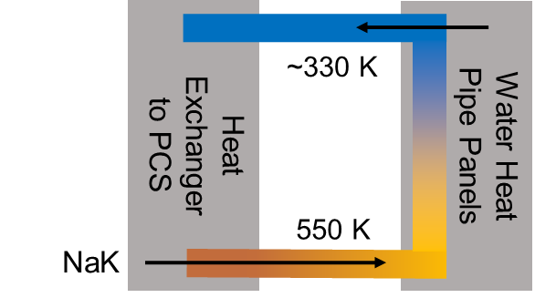
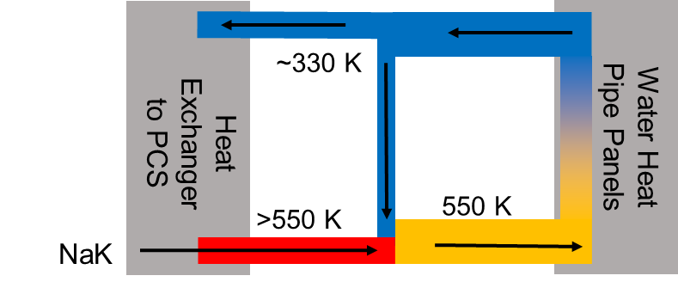
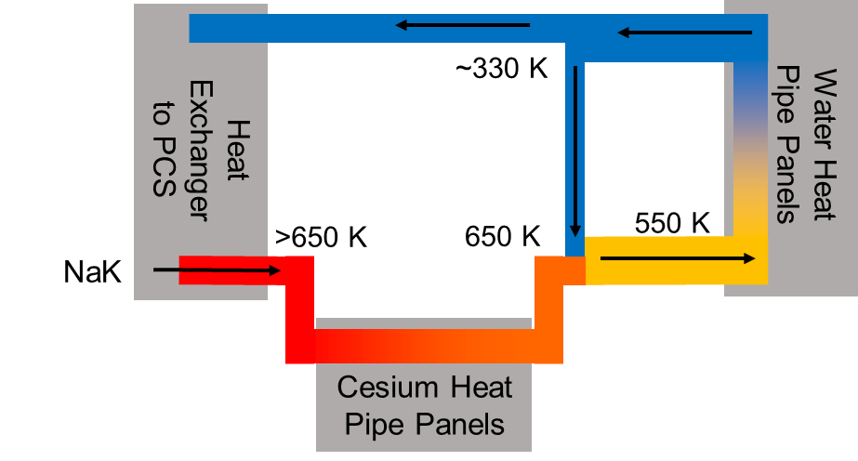
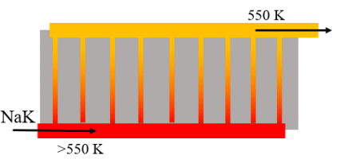
Thermal Trunkline Routing and Heat Pipe Options
Maximum Radiator Inlet Temperature (RIT) is limited by heat pipe technology
  Water heat pipes operate at ≤ 550 K; high Technology Readiness Level (TRL)
  Low TRL heat pipes required for higher temperatures
    Cesium heat pipes for >650 K; low TRL
    Intermediate temperature heat pipes for 550 K to 650 K; very low TRL and compatibility concerns
Working fluid re-circulation can be used to increase RIT without higher temperature heat pipes, but with drawbacks:
  Increased fluid mass flow rate which decreases fluid residence time (less efficient heat transfer)
  Additional fluid duct and associated component masses
Another option is radiator embedded pumped fluid loops (~5% mass improvement over water-based heat pipes)
  MMOD shielding mass required to mitigate risk of external fluid leakage over ~3000 m² of radiator area obviates any mass improvements
Limited Inlet Temperature^{[3]}
Re-Circulation^{[3]}
Cesium Heat Pipes, Re-Circulation
Pumped NaK Loops^{[3]}

Slide 19
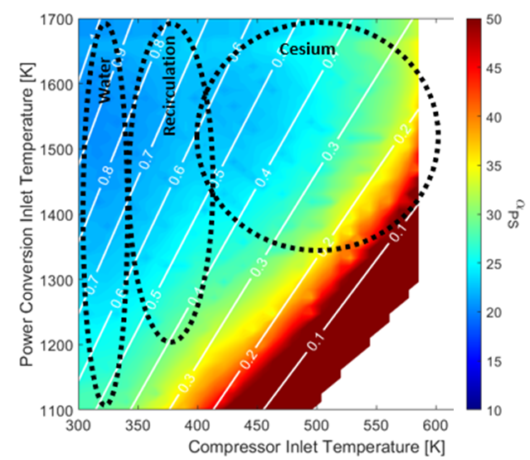
Technology and State Property Selection
Limiting the radiator inlet temperature to ≤ 550 K was selected as it minimizes overall NEP system mass and avoids concerns with low TRL heat pipe technology
For an NEP power system producing ~2 MWe (four 500 kWe units) and ~4 MWth total:
  PCIT of 1200 K due to temperature limits concerns for high TRL PCS turbine materials
    Can be increased to 1400 K while still employing water-based heat pipes
  Minimum overall system mass occurs at CIT of ~330 K
  Maximum titanium-water heat pipe temperature is 550 K
  Maximum working fluid pressure is ~500 kPa
  Effective average radiator temperature is 400 K
  PCS efficiency of ~34%
  Radiator area of ~3000 m²
Power System Alpha: PCIT vs CIT
Limited Inlet Temperature^{[3]}
Region of interest
Note: Plots were obtained via the AMA NEP-SIM model^{[4]}, the white lines in displayed plots represent PCS efficiency, efficiency lines on slide 18 are more accurate than those displayed on this slide

Slide 20
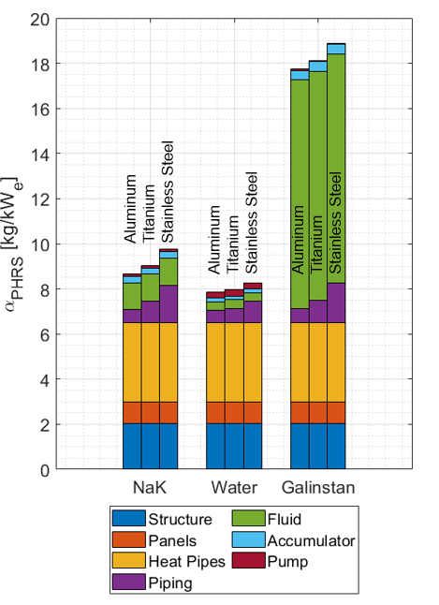
Pumped Thermal Working Fluid Selection
Systems analysis models were used to predict PHRS specific mass for three working fluid candidates (NaK, Water, and Galinstan)
Galinstan has a wider liquid operating temperature range than NaK, but performs very poorly due to its low specific heat capacity
Water results in lower specific mass than NaK by ~1 kg/kW_{e}, but with other concerns:
  Requires high pressure ~7 MPa to remain liquid
  Positive coefficient of thermal expansion when freezing is a major concern for closed cycle fluid loops
NaK was selected as the working fluid due to its low kg/kW_{e}, reasonable liquid operating temperature range, and radiation compatibility
Working Fluid vs Overall PHRS Specific Mass
Working Fluid Properties
Parameter | NaK | Water | Galinstan
Density (kg/m³) | ~900 | ~1000 | ~6000
Specific Heat (J/kg*K) | ~1000 | ~4000 | ~300
Viscosity (kg/m*s) | ~7x10⁻⁴ | ~9x10⁻⁴ | ~2x10⁻³
Note: Plot was generated via the AMA NEP-SIM model^{[4]}

Slide 21
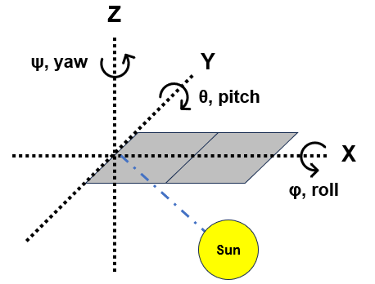
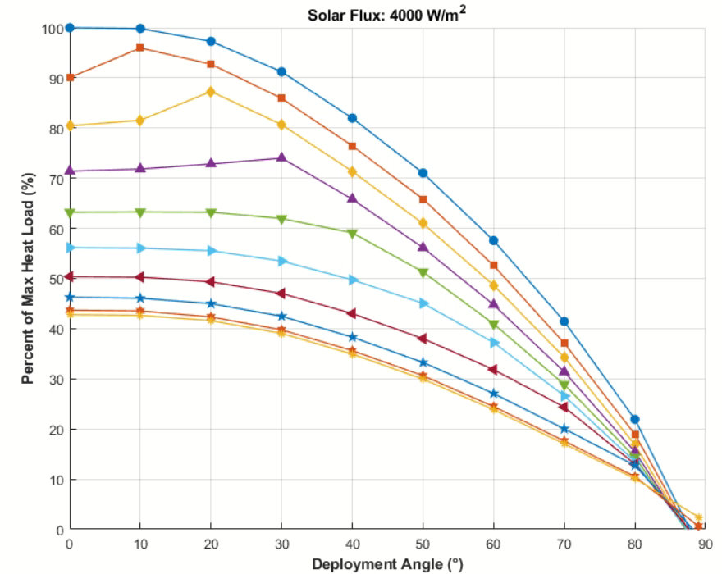

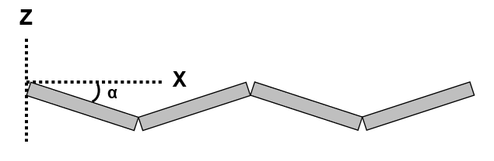
Solar Pitch & Radiator Deployment Angle Sensitivities
Heat rejection capability for a constant radiator area with varying solar flux and solar pitch & deployment angles
  Absorbed solar flux obtained from thermal desktop, neglecting albedo and planetary IR
  0º is fully deployed and 90º is packaged
  Solar pitch angle < 20º and deployment angle < 20º deemed acceptable
    ISS radiators were deployed with a ~20º angle between panels^{[6]}
Investigation Values
Panel Length | 1 m
Panel Width | 2 m
Panel Count | 8
Radiation Temperature (eff) | 400 K
IR Emissivity | 0.85
Solar Absorptivity | 0.3
Fin Effectiveness | 0.85
Bi-Wing Heat Rejection Capability (relative to theoretical max @ Tsink = 0 K)
Solar Pitch Angle
α = Deployment Angle
φ = Solar Roll Angle
θ = Solar Pitch Angle
ψ = Solar Yaw Angle

Slide 22
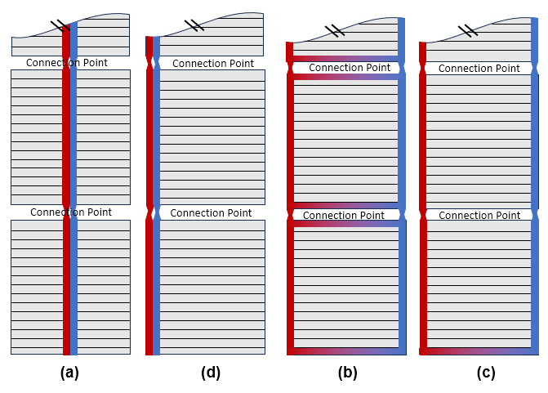
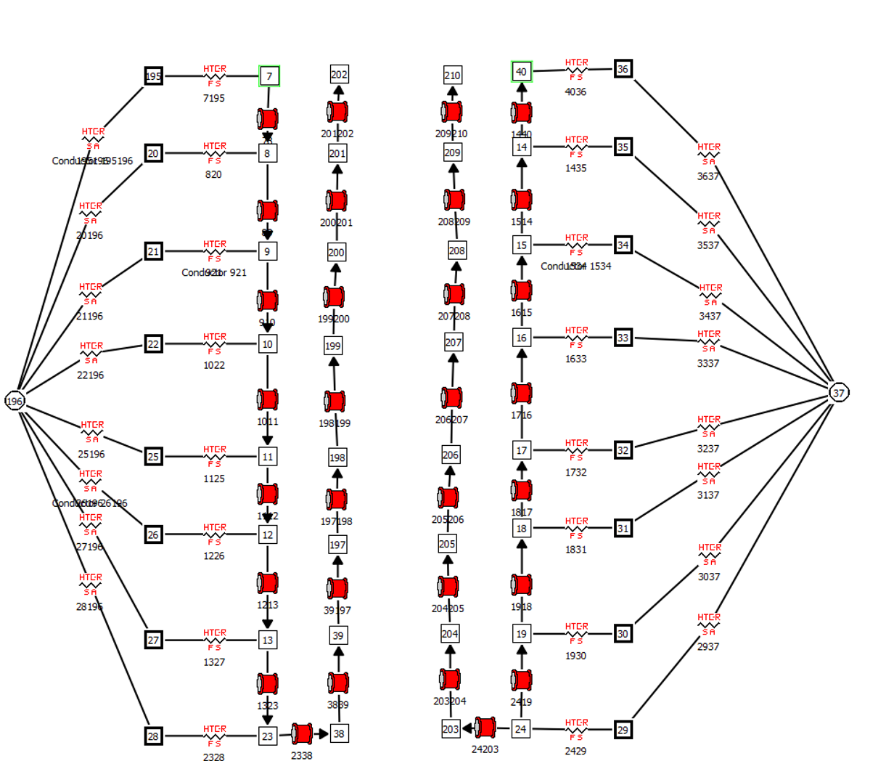





Integrated Thermal Model Development
Performing integrated radiator unit and fluid loop design trades with developed thermal models
  Simulating thermal performance of the radiator and fluid loops across operational conditions, both online and offline reactor states, space thermal environments, freeze/thaw cycles, and thermal limit constraints
  Building and refining models to investigate state properties, thermal resistances, and component selection/placement
  Integration and definition of deployment mechanisms and in-space assembly interfaces is ongoing concurrently
Initial Candidate Fluid Loop Concepts
Thermal Nodal Network Model^{[15]}
Radiator Panel TD Model
  The Generalized Fluid System Simulation Program (GFSSP) is a general-purpose computer program for analyzing steady state and time-dependent flowrates, pressures, temperatures, and concentrations in a complex flow network
Developed based on models generated for the 2nd Generation Radiator Demonstration Unit (RDU) technology^{[16]}

Slide 23





Initial Radiator Unit Thermal Results
Identified options for further analysis
  Considerations include thermal performance (coupling between hot and cold lines), redundancy, total pipe length/mass, fluid pressure drop, compatibility with deployment mechanisms and/or in-space assembly interfaces, thermal contact resistances
Title / Element | Option 1 | Option 2 | Option 3 | Option 4
Initial Layout Sketch
TD Model (Based on 2nd Gen. Radiator Demo Unit)
Radiator ΔT, along fluid loop length [K] | Hot = 13 Cold = 14 | Hot = 23 Cold = 25 | Hot = 24 Cold = 26 | Hot = 25 Cold = 28
Heat Rejected [kW_{th}] | Hot = 14.6 Cold = 16.2 | Hot = 13.9 Cold = 15.2 | Hot = 14.0 Cold = 15.6 | Hot = 14.0 Cold = 15.0
Red and Orange = HOT trunkline
Blue and Green = COLD trunkline
Note: Hot Case Sink Temperature = 290 K, Cold Case Sink Temperature = 6.2 K

Slide 24

Future Work
Define Baseline Radiator Unit Design
  Establish a baseline radiator unit with detailed specifications for thermal, mechanical, structural, and power/data interfaces, including potential hardware mockups for validation.
Model Environmental and Structural Survivability
  Develop comprehensive environmental and structural load models to assess radiator and fluid loop survivability under MMOD, launch, and in-space loading scenarios, including thruster-induced loads and commissioning operations. Ensure pressure vessel integrity with appropriate factors of safety.
Further Develop Integrated Thermal Models
  Simulate thermal performance of the radiator and fluid loops across operational conditions—both online and offline reactor states—considering various orientations relative to planetary bodies, freeze/thaw cycles, and mission thermal constraints.
Simulate Radiator Installation and Commissioning
  Analyze kinematics and dynamics of radiator deployment and in-space assembly, accounting for robotics placement, radiator package handling, and installation and commissioning sequences.
Define and Assess Fluid Interfaces
  Determine the form, fit, and function of fluid interfaces aligned with thermal loop requirements; identify components (e.g., seals), assess NaK material compatibility, and produce iterative mockups for functional testing.

Slide 25
References
[1] A. Martin, "SNP-PLAN-0043 Space Nuclear Propulsion (SNP) Technology Maturation Plan for High Power Nuclear Electric Propulsion - DRAFT," NASA Marshall Space Flight Center, Huntsville, 2023.
[2] “Nuclear Electric Propulsion Technology Could Make Missions to Mars Faster - NASA,” NASA, Jan. 10, 2025. https://www.nasa.gov/centers-and-facilities/langley/nuclear-electric-propulsion-technology-could-make-missions-to-mars-faster/
[3] W. Machemer, M. Duchek, and D. Nikitaev, “Considerations for Radiator Design in Multi- Megawatt Nuclear Electric Propulsion Applications.” Available: https://ntrs.nasa.gov/api/citations/20220019167/
[4] M. E. Duchek, W. Machemer, C. Harnack, M. Clark, A. Pensado and K. Palomares, "Key Performance Parameters for MW-Class NEP Elements and Their Interfaces," AIAA ASCEND, Nevada, 2022.
[5] Boeing, "Active Thermal Control System (ATCS) Overview“
[6] J. A. Oren and H. R. Howell, “Space Station Heat Rejection Subsystem Radiator Assembly Design and Development,” SAE Transactions, vol. 104, pp. 1086–1095, 1995, doi: https://doi.org/10.2307/44612020.
[7] W. K. Alan, M. L. Fleming, and A. Y. Lee, “Design and Performance of Space Station Photovoltaic Radiators,” SAE Transactions, vol. 102, pp. 1018–1026, 1993, doi: https://doi.org/10.2307/44740054.
[8] B. Mattfeld, C. Stromgren, H. Shyface, D. Komar, W. Cirillo, and K. Goodliff, “Trades Between Opposition and Conjunction Class Trajectories for Early Human Missions to Mars,” Available: https://ntrs.nasa.gov/api/citations/20150001240/downloads/20150001240.pdf
[9] T. Valdés, A. Stark, W. Grier, “Thermal Considerations for 2039 Opposition Class Nuclear Electric Propulsion/Chemical Propulsion Crewed Mars Mission,” NASA TFAWS 2025, August 4, 2025
[10] A. Juhasz, “An Analysis and Procedure for Determining Space Environmental Sink Temperatures With Selected Computational Results,” 2001. Available: https://ntrs.nasa.gov/api/citations/20010014168/downloads/20010014168.pdf
[11] L. Carrillo, N. Jsc, D. Farner, J. Engineering, and C. Preston, “NASA-TFAWS Short Course ISS Payload Thermal Environments,” 2015. Accessed: Jul. 01, 2025. [Online]. Available: https://tfaws.nasa.gov/wp-content/uploads/TFAWS2015-SC-ISS-Payload-Thermal-Design.pdf
[12] L. Erickson, B. Barnes, C. Sladek, “Thermal Analysis for EVA Twighlight Scenario on a Flat Plane,” JETS-JE33-23-TLSS-DOC-00031, June 8, 2023.
[13] R. Henson, G. Laubach, J. Iovine, G. Lucas, “A Routine (FLXCAL) to Determine EVA Cube Fluxes using SINDA Temperatures,” June 20, 2003.
[14] D. Pietro, “Radiator Sizing for Venus Flyby,” May 29, 2022.
[15] “Generalized Fluid System Simulation Program (GFSSP), Version 702 (Educational Version)(MFS-32929-1) | NASA Software Catalog,” Nasa.gov, 2025. https://software.nasa.gov/software/MFS-32929
[16] Ellis, David. “Summary of the Manufacture, Testing and Model Validation of a Full-Scale Radiator for Fission Surface Power Applications - NASA Technical Reports Server (NTRS).” NASA, NASA, ntrs.nasa.gov/citations/20110012006.

Slide 26
Backup

Slide 27

Initial Sub-Functional Flow Diagram #1

Slide 28

Initial Sub-Functional Flow Diagram #2

Slide 29

Initial Sub-Functional Flow Diagram #3

