Slide 1



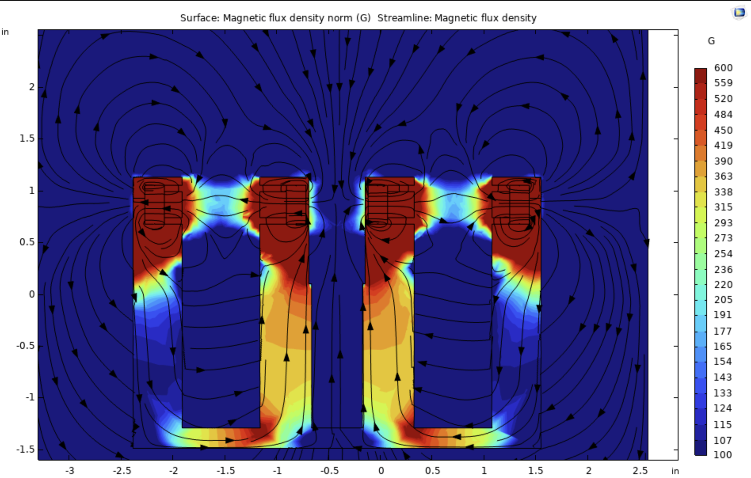
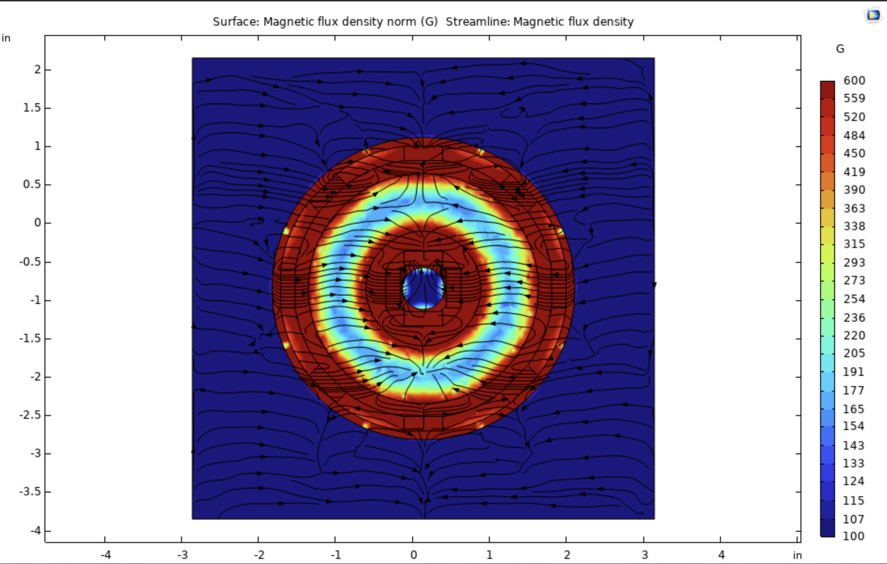
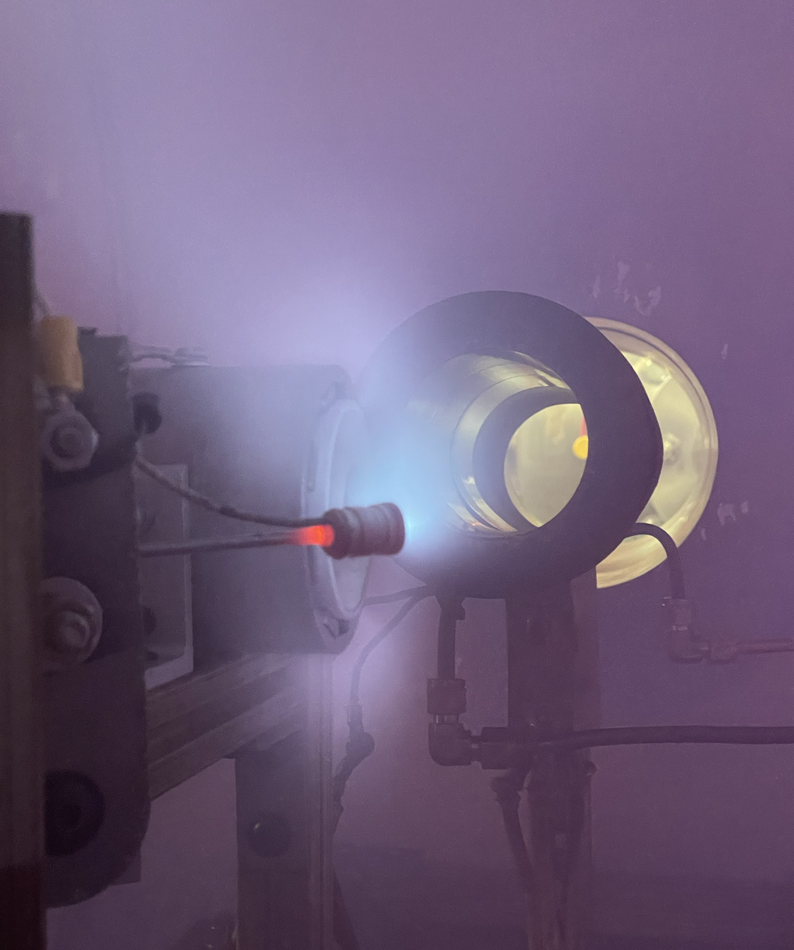
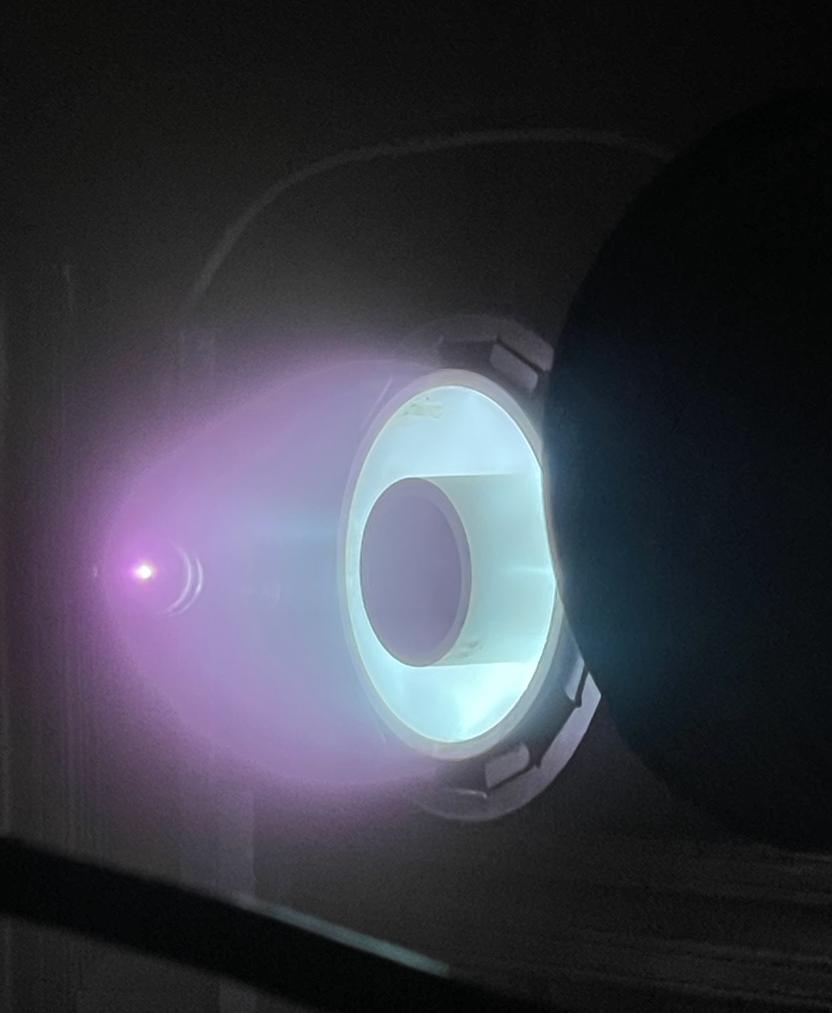
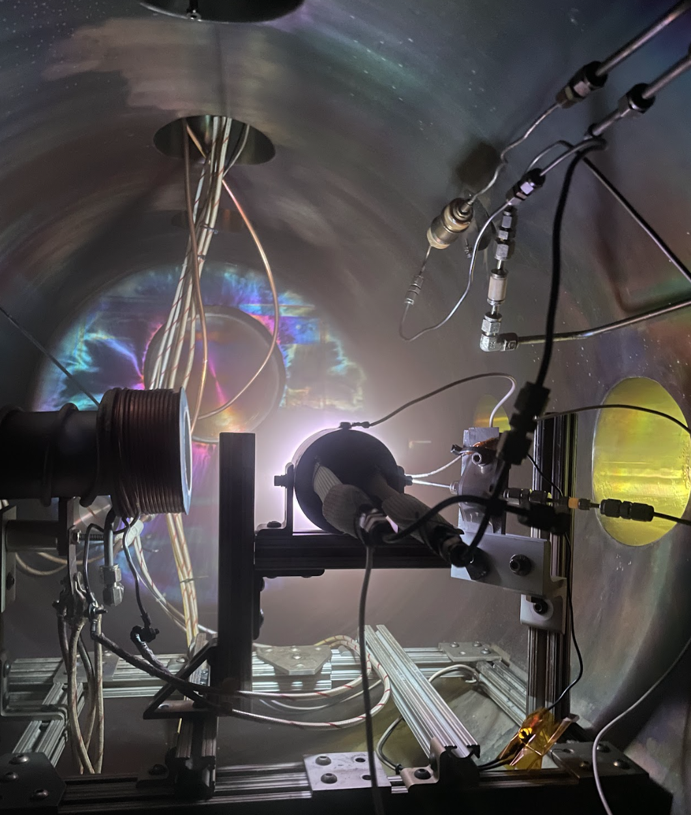
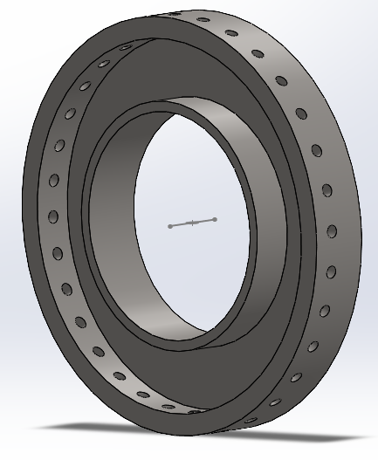
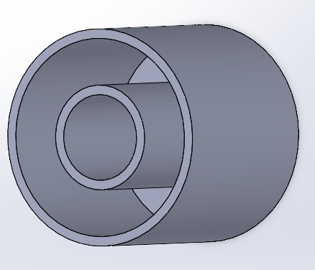
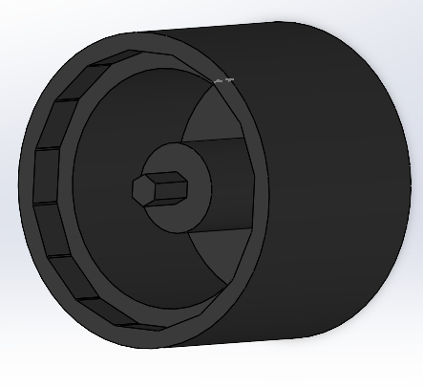
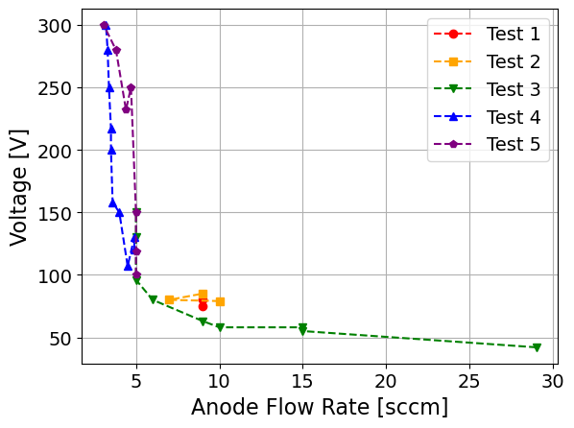
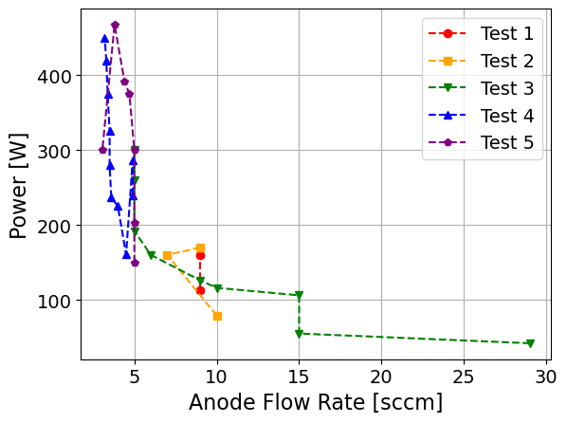
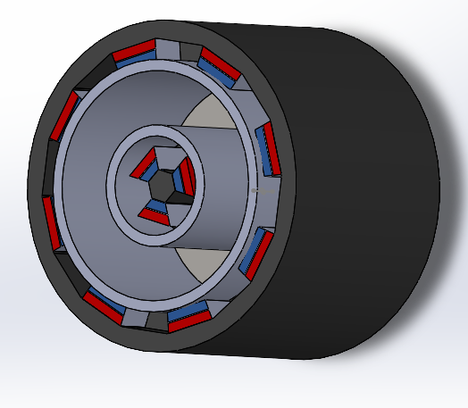
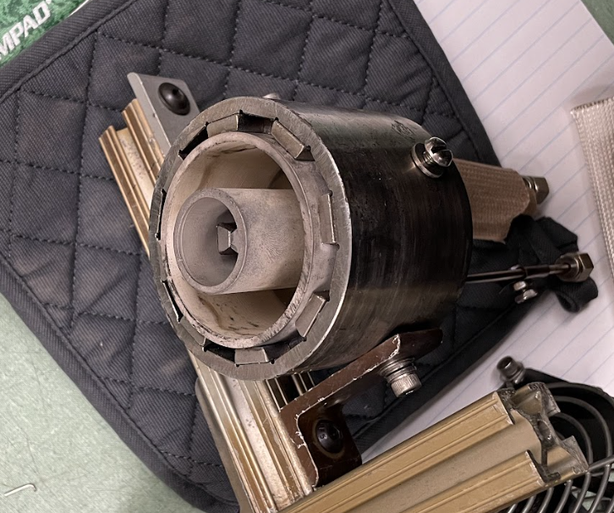
Hall Effect Thruster Design and Testing
TFAWS 2025 Interdisciplinary Technical Session
I. Eramov* and P. Papadopoulos*
*San Jose State University, **TU Delft
Introduction
Thermal and Magnetic Simulation
The Hall-effect thruster (HET) is a type of electric space propulsion system that utilizes a magnetic field to trap electrons and generate a Hall current, which ionizes and accelerates a noble gas. Noble gas serves as the propellant, specifically in this project, the thruster is designed for xenon. Originally developed during the Cold War and later refined using Soviet research in the 1990s, HETs are now widely used for satellite station-keeping, orbital insertion, and deorbiting missions.
This design project focused on developing a compact Hall-effect thruster suitable for CubeSat integration. The primary objective was to create a functional prototype capable of sustained ignition in a vacuum environment and achieving a power of 500 Watts at a voltage of 300 Volts.
The final prototype incorporates custom-machined components, a boron nitride discharge channel, a stainless steel anode, samarium cobalt magnets, and a heatless lanthanum hexaboride cathode [1]. The system was tested at the NASA Jet Propulsion Laboratory (JPL) with the assistance of Dr. Dan M. Goebel and successfully demonstrated stable plasma discharge during multiple vacuum chamber tests.
Thermal Testing
To validate structural integrity, the thruster underwent thermal cycling in a furnace from 36°C to 218°C, with 5°C increments. This procedure simulated the thermal environment during the plasma discharge. The structure demonstrated thermal resistance and maintained its integrity throughout heating. The test also confirmed that the design incorporated appropriate tolerances for thermal expansion.
Magnetic Testing
Magnetic field simulation was performed in COMSOL Multiphysics to verify the polarity, strength, and orientation of the samarium cobalt magnets.
Design and Materials
The HET was designed with modular components to meet CubeSat-scale constraints, withstand thermal loads from the plasma generation process, and satisfy key operational performance.
Given the dimensional constraints of a standard CubeSat, the final prototype has major dimensions of 61 mm in length and 76.2 mm in diameter, with a total mass of 1247 grams.
The thruster’s performance targets are established to generate 30 mN of thrust with continuous operation for 300 seconds. To achieve this, the thruster was optimized to operate at 500 W, with two main electrical configurations: 1) 300 V supplied to the anode with 1.66 A, and 2) 250 V supplied with 2 A current.
These conditions lead to the internal temperature of the discharge channel exceeds 500 K, posing a risk of damaging the magnets. To mitigate this, the design uses thermally resistant materials and allows for protecting the sensitive parts. Additionally, the mechanical tolerances were taken into account due to thermal expansion.
The HET was modeled in SOLIDWORKS, presented in Figs. 1-4, based on these constraints. Key components include:
Anode – A ring with 32 x 0.1-inch azimuthal holes, made of 304 stainless steel alloy. It functions as both a uniform gas distributor and the positive electrode.
Cathode – Positioned externally. It emits electrons for ionization and beam neutralization. The cathode is a heaterless design made of lanthanum hexaboride.
Discharge channel – Constructed from boron nitride. It contains the xenon plasms and electrically insulates the magnet housing while protecting the magnets from heat and erosion.
Magnetic housing – The structural casing of the HET. It is made from 1018 steel, provides mechanical integrity, and mounts the internal assembly.
Magnets – Samarium cobalt permanent magnets create a magnetic flux of 200-300 gauss to trap electrons and confine plasma.
Fig. 6. Side view of magnetic field
Fig. 7. Top view of magnetic field
The simulation, shown in Figs. 6 and 7, targeted a field strength between 200 and 350 G, which is optimal for electron confinement and Hall current generation.
Vacuum Chamber Testing
Testing Facility
Vacuum testing was conducted at NASA JPL using a cryogenically pumped vacuum chamber capable of reaching 10⁻⁵ Torr. The HET was mounted to a test stand, connected to a xenon mass flow rate controller, and powered via an external high-voltage supply.
Testing
Five vacuum chamber tests were conducted over two days (Figs. 8-10), with iterative hardware adjustments between each run.
Test 1. Ignition occurred, but the magnetic field was too strong (~1000G), preventing electron flow into the discharge channel.
Test 2. Half of the magnets were removed. However, the thruster was not properly sealed, leading to a plasma leak through gaps in the structure.
Test 3. The feed lines are properly insulated, the HET achieved its first successful ignition. At a xenon flow rate of 30 sccm, the power draw exceeded 300 W. The voltage instability led to an early shutdown.
Test 4. Ignition occurred at the flow rate of 4.9 sccm. The HET maintained a stable burn at 300 V and 450 W for over 30 minutes.
Test 5. Peak power output of 500 W at 250 V was reached. The test ended earlier due to thermal stress that caused cracking in the discharge channel.
Fig. 8. Test 2
Fig. 9. Test 4
Fig. 10 Test 4 back view
Fig. 1. Anode
Fig. 2. Discharge channel
Fig. 3. Magnetic housing
The HET fully assembled is presented in Figs. 4 and 5. Its modular design facilitated iterative assembly and tuning during testing.
Magnets
Magnetic housing
Discharge channel
Fig. 11. Voltage vs. anode flow rate
Fig. 12. Power vs. anode flow rate
Key Results
Vacuum chamber testing confirmed the functionality of the designed HET. The system achieved stable plasma discharge during multiple runs, including a continuous 30-minute burn. The final test reached a peak output of 500 W and validated the prototype as a promising candidate for a CubeSat electric propulsion system.
Xenon supply
References
Fig. 4. CAD of full assembly
Fig. 5. HET fully assembled
[1] Conversano, R. W., Goebel, D. M., Hofer, R. R., Matlock, T. S., and Wirz, R. E., “Development and Initial Testing of a Magnetically Shielded Miniature Hall Thruster,” IEEE Transactions on Plasma Science, Vol. 43, 2015, pp. 103-117.

