Slide 1
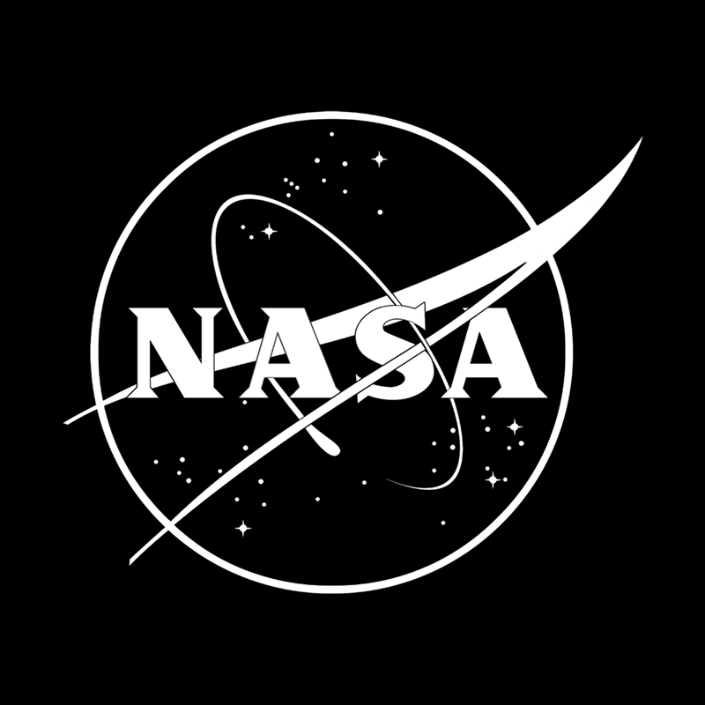
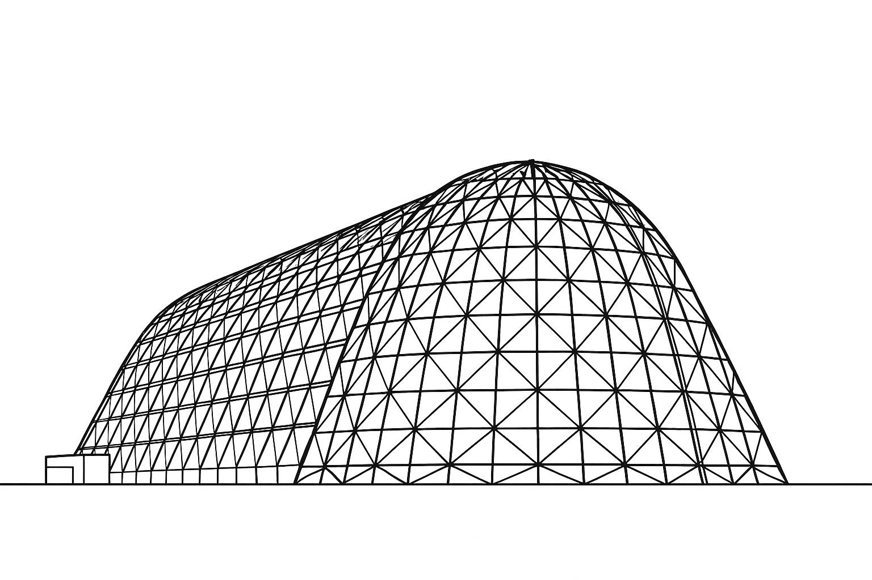
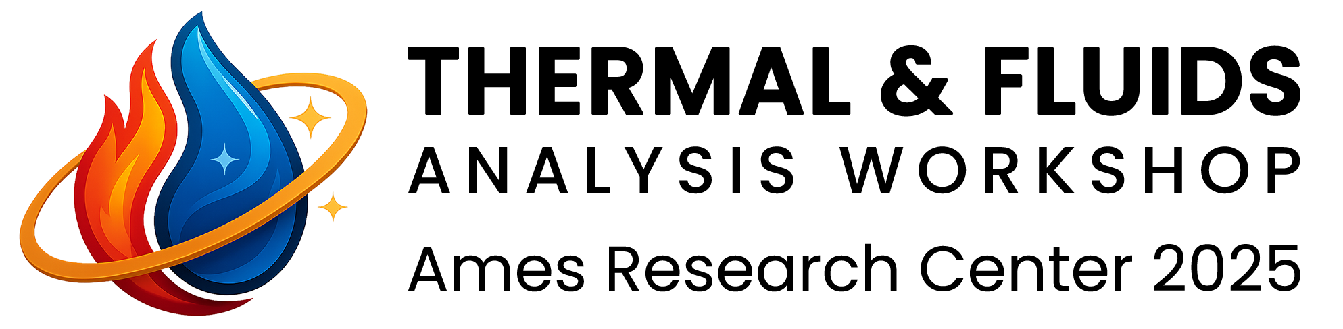


Mitigation of Superheated Vapor Formation in Cryogenic Coolant Loops of Thermal Vacuum Chambers using Passive Flow Strategies
TFAWS 2025 Thermal Control and Protection
Technical Session
Presented by: Vinay N Panda
Team Members -
A Al-Bahlawan of Astrostructures Ltd. a.albahlawan@astrostructures.com
T Teschner of Cranfield University Tom.Teschner@cranfield.ac.uk
Thermal & Fluids Analysis Workshop 2025
NASA Ames Research Center
San Jose, CA
August 4-7, 2025
Notes:
Hi everyone, I am Vinay and I will be presenting about the industrial challenge of superheating of liquid nitrogen within a thermal vacuum chamber, and some research we have undertaken to address it.

Slide 2
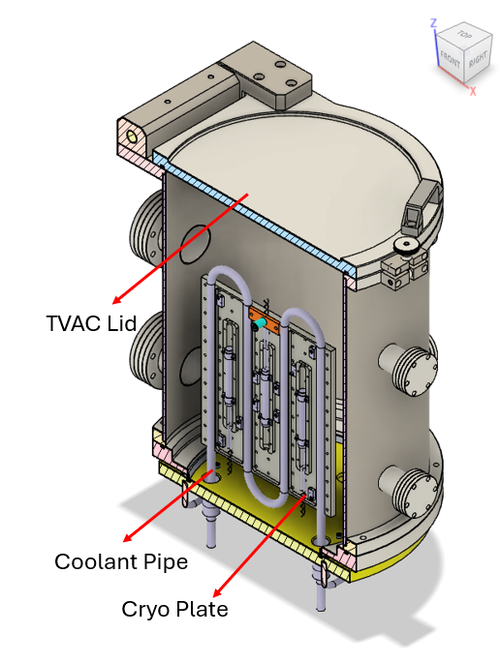
Background & Motivation
Thermal Vacuum Chambers (TVAC) test deep space heat-sink conditions for space vehicles
Commonly used coolant is Liquid Nitrogen (LN2), as opposed to hydrogen or helium
Both single and multiphase systems of LN2 are used for experimental testing
The Challenge: Buildup of superheated Gaseous Nitrogen (GN2) in the two-phase system, lowering heat transfer, local thermal imbalance in the chamber and wasting expensive LN2
Figure 1: Sectional View of a Thermal Vacuum Chamber
Notes:
The figure we see on the right is a thermal vacuum chamber, which is used for testing satellites for very cold environment of space
One of the coolant used for this purpose in liquid nitrogen. Using liquid nitrogen is expensive and the superheating of gaseous nitrogen within the TVAC causes local temperature imbalances which would impact the testing of space hardware within the chamber, so this research focuses on optimising the operation of the TVAC to minimise buildup of superheated gaseous nitrogen and the minimsation of imbalances.

Slide 3
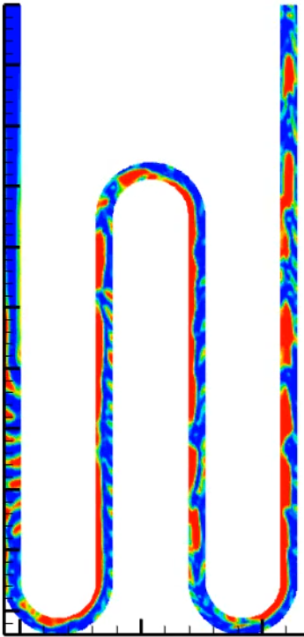
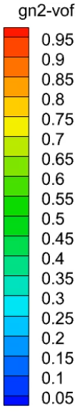
Aims & Objectives
The Challenge: Buildup of superheated Gaseous Nitrogen (GN2) in the two-phase system, lowering heat transfer, local thermal imbalance in the chamber and wasting expensive LN2
Existing Strategies: High flow rates, phase separators
Strategies:
Varying Flow Rates
Introducing dimples in the channel
Subcooling the coolant
Enforcing capillary flow
Performance measure - %volume of coolant loop occupied by high-quality superheated GN2 – lower percentage indicates better performance
Figure 2: Production of superheated GN2 during operation
Notes:
So far, research focus has been mostly on flow patterns to enhance heat transfer, not on mitigation of GN2 prevention.
The Industrial partner of this research, Astrostructures, indicate that mitigation of GN2 formation in the coolant pipe is of commercial interest, to mitigate the thermal imbalance and also optimising the usage of liquid nitrogen per run.
We developed some strategies for this research, and we will discuss 4 of them here - Right off the bat, we focused on mass flow rate, then we tinkered with the design of the channel, introducing surface bumps/dimples in it to break up the thermal boundary layer.
We also looked at subcooling the coolant to proactively inhibit formation of superheated gaseous nitrogen. Lastly, we looked at reducing pipe diameter and inducing capillary flow.

Slide 4
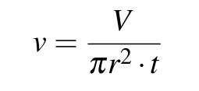
Simulation Setup
Turbulence: k-ω SST
Multiphase: Explicit Volume Fraction (VOF) used to track flow patterns of both phases (LN2 and GN2)
Material of fluid (at initial calculation) – Liquid Nitrogen
Verification of simulation setup through a Grid Convergence Study.
High quality superheated GN2 is defined as regions where volume fraction of GN2 is higher than 0.50.
Flow Rate Calculation
Difficult to calculate during manual operation
Operational Duration driven calculation using limited volume (V) of the Dewar Flask, the pipe (radius r) over operational desired duration (t), the velocity at inlet (v) is given by:
[1]. Ashwindran SN, Azizuddin AA. Design of small thermal vacuum chamber for 125 U CubeSat satellite. IOP Conference Series: Materials Science and Engineering. 2019 Jan;469:012108.
Notes:
For the setup of our CFD simulations, we used the k-ω SST model as it can handle adverse pressure gradients, which we estimated to be present in the dimpled geometry
The Explicit Volume Fraction (VOF) method used to track complex interface between both phases (LN2 and GN2), critical for simulating surface tension in bubble dynamics This also enabled us to quantify the performance due to presence of volume fractions.
We calculated the flow rate through a duration based approach - a typical 2000L volume of Dewar Flask to be emptied in 48 hours of operation. And now we discuss the different strategies and what results we got from them.

Slide 5
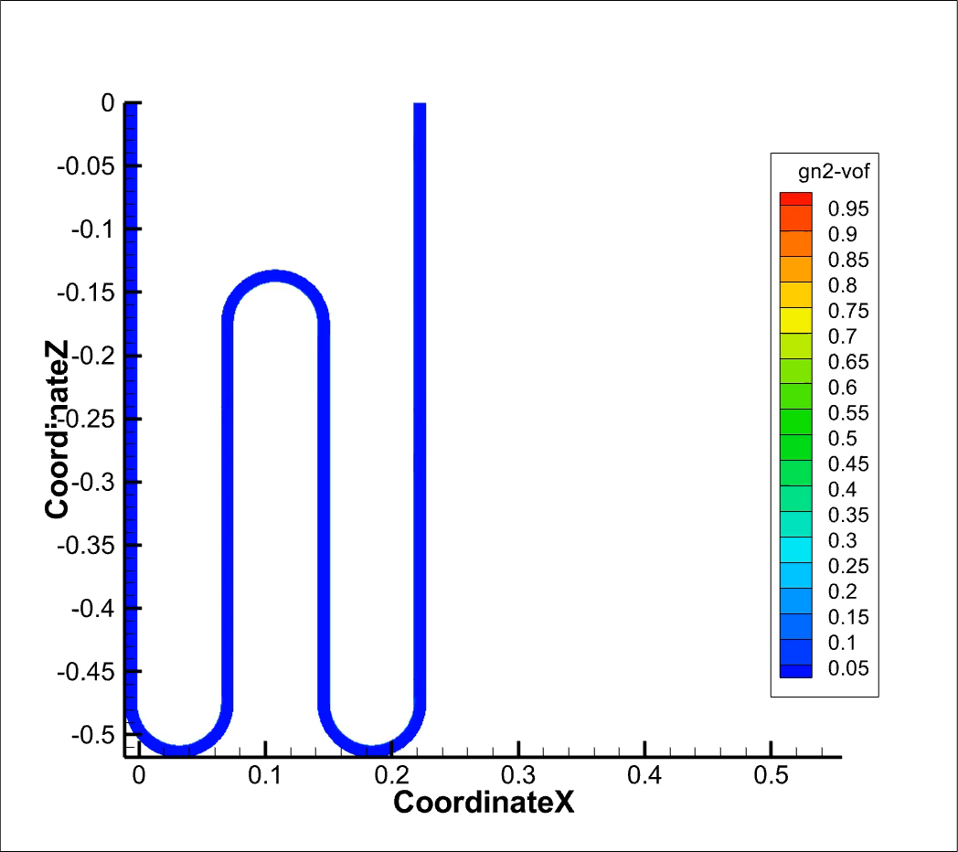
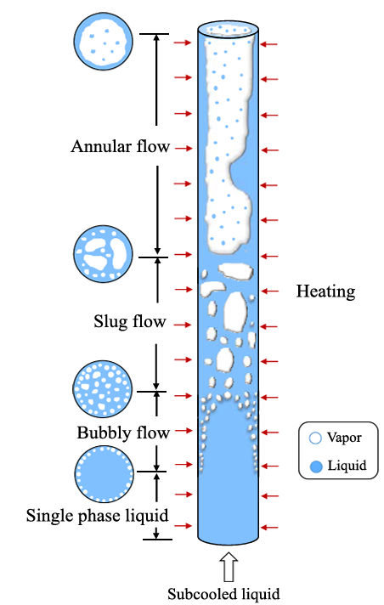
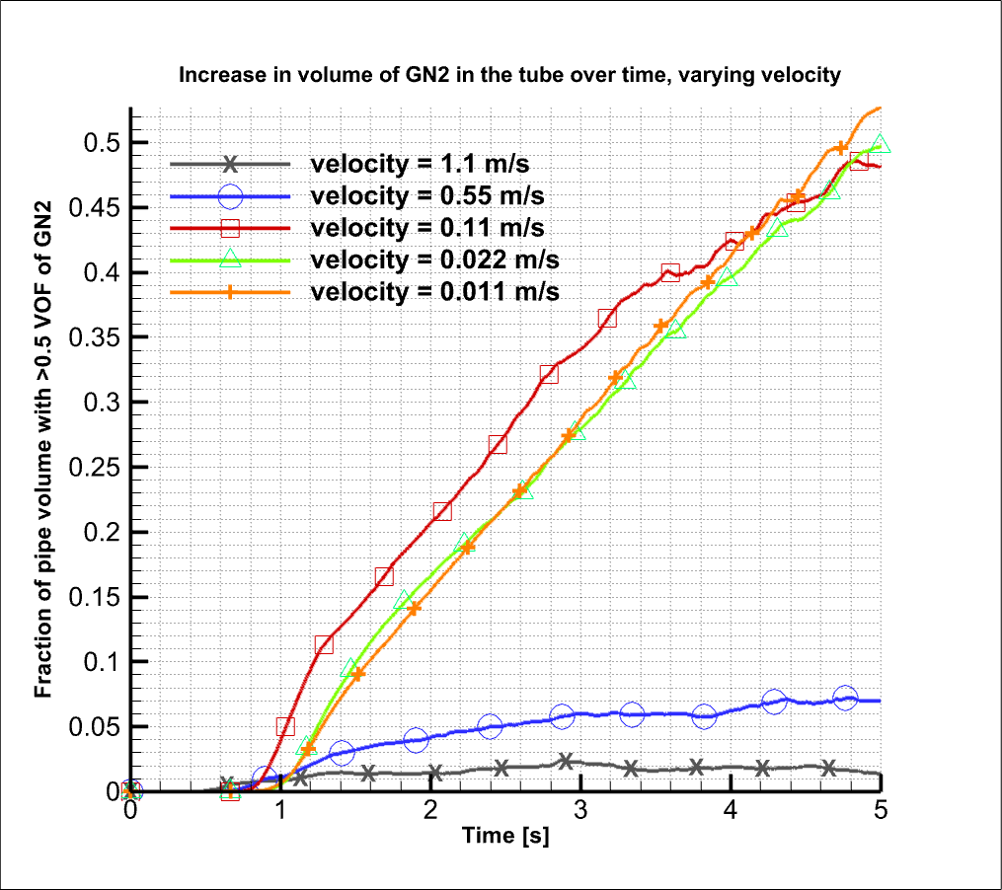
Strategy 1: Varying Flow Rate
Regime 3
Regime 3
Laminar/Transitional Flows
Regime 2
Regime 2
Rapid boiling in laminar flow
Turbulent Flows
Regime 1
Regime 1
Figure 3: GN2 formation at 0.11 m/s
Figure 4: Flow Boiling Regimes [2]
Figure 5: Multiple Flow Rates and effect on GN2
formation
Increasing the flow rate would enable the superheated vapour to be removed faster from the loop, but would cause the stored LN2 to be depleted faster
[2] Setoodeh H, Shabestary AM, Ding W, Lucas D, Hampel U. CFD-modelling of boiling in a heated pipe including flow pattern transition. Applied Thermal Engi neering. 2022 Mar;204:117962.
Notes:
Laminar flows, at the lower flow rates, involve different regimes of GN2 formation – steep at first, tapered later, identifying with different flow boiling regimes.
Turbulent Flows, at higher flow rates,, which we see at the bottom of the graph, ensure uniform mixing of thermal energy and can remove the boiling mass before it superheats, lower GN2 formation – which is our objective.
Unfortunately, we also ensure quicker depletion of Dewar Flask in high flow rates.

Slide 6
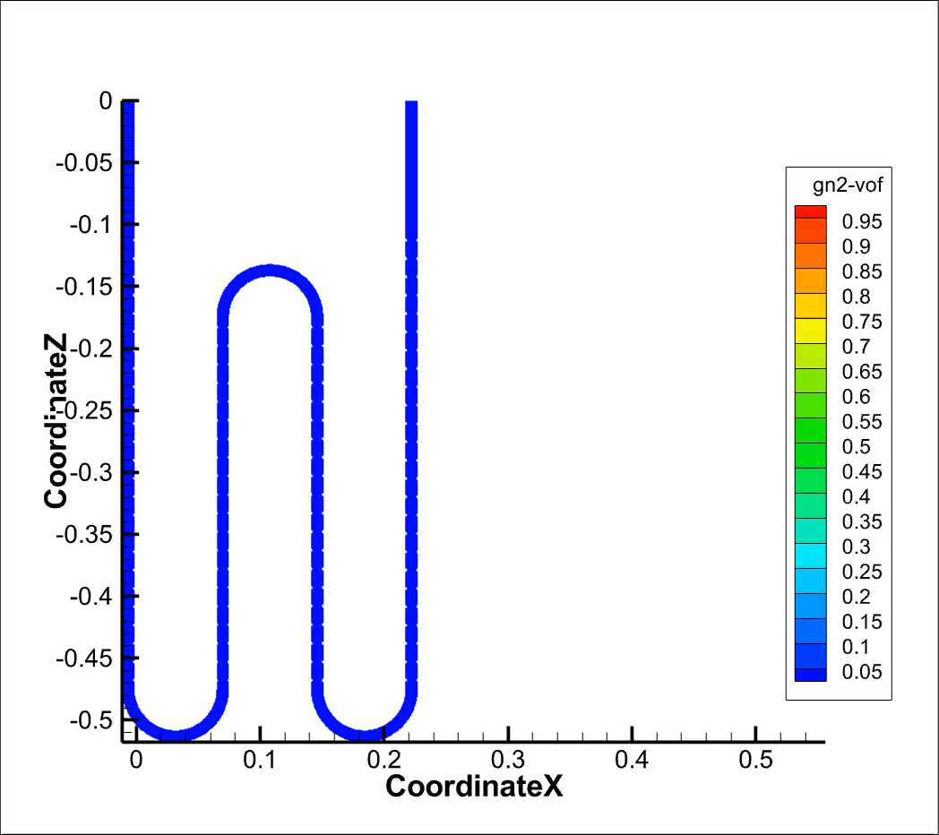
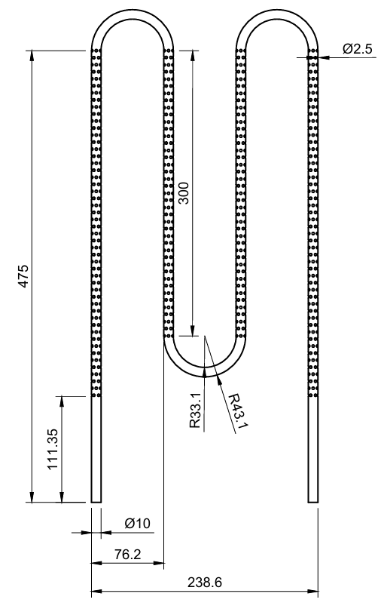
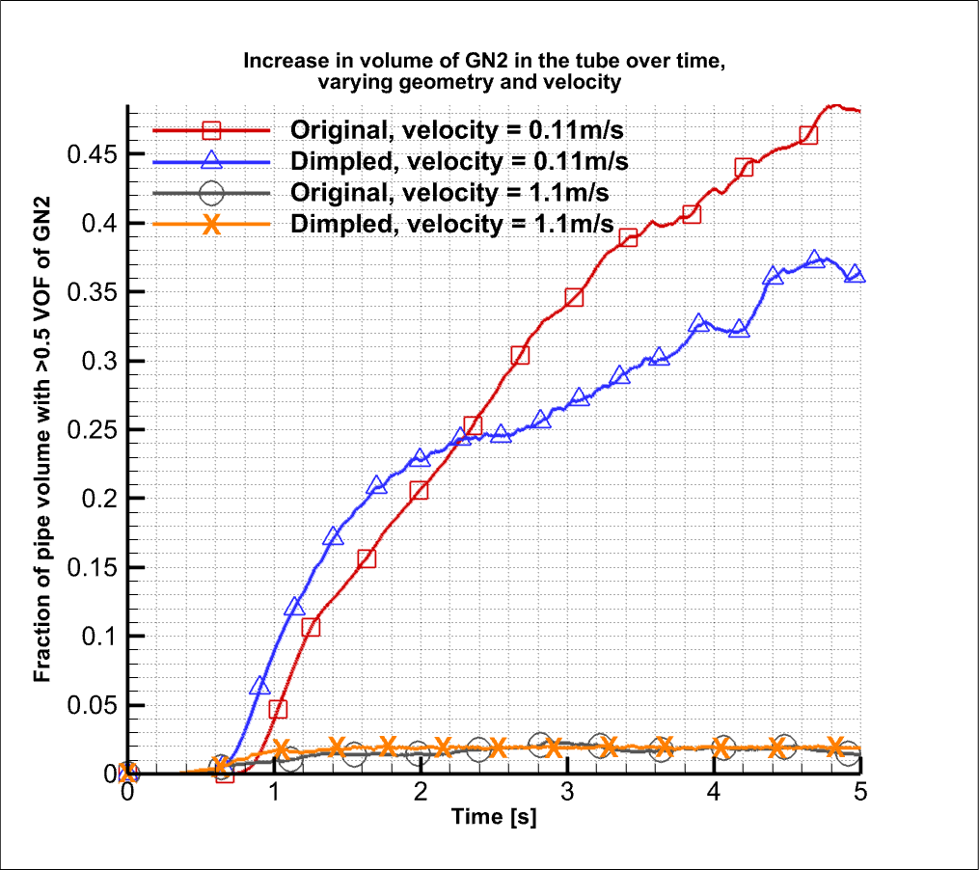
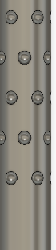
Strategy 2: Dimples in Coolant Pipe
Axisymmetric placement
Figure 7: Dimpled Pipe Geometry
Figure 6: GN2 formation at 0.11 m/s in dimpled geometry
Figure 8: Effect of Dimpled Geometry on Gn2 formation
Dimples enhance turbulent mixing even in laminar/transitional regime, but they introduce manufacturing complexity
Notes:
Moving on the strategy of introducing surface dimples. Dimples enhance mixing even in laminar/transitional regime, breaking the thermal boundary layer. Similar performance to regular pipe for turbulent flows
The dimples, as we see in the centre figure, provide a larger surface area for bubble nucleation sites, which enables convective heat transfer through multi-longitudinal vortices along the length of the channel.
We see the growth of the volume fraction of superheated gaseous nitrogen taper off, due to enhanced heat transfer and flow disruptions dries out liquid film near the walls, inhibiting further GN2 formation

Slide 7
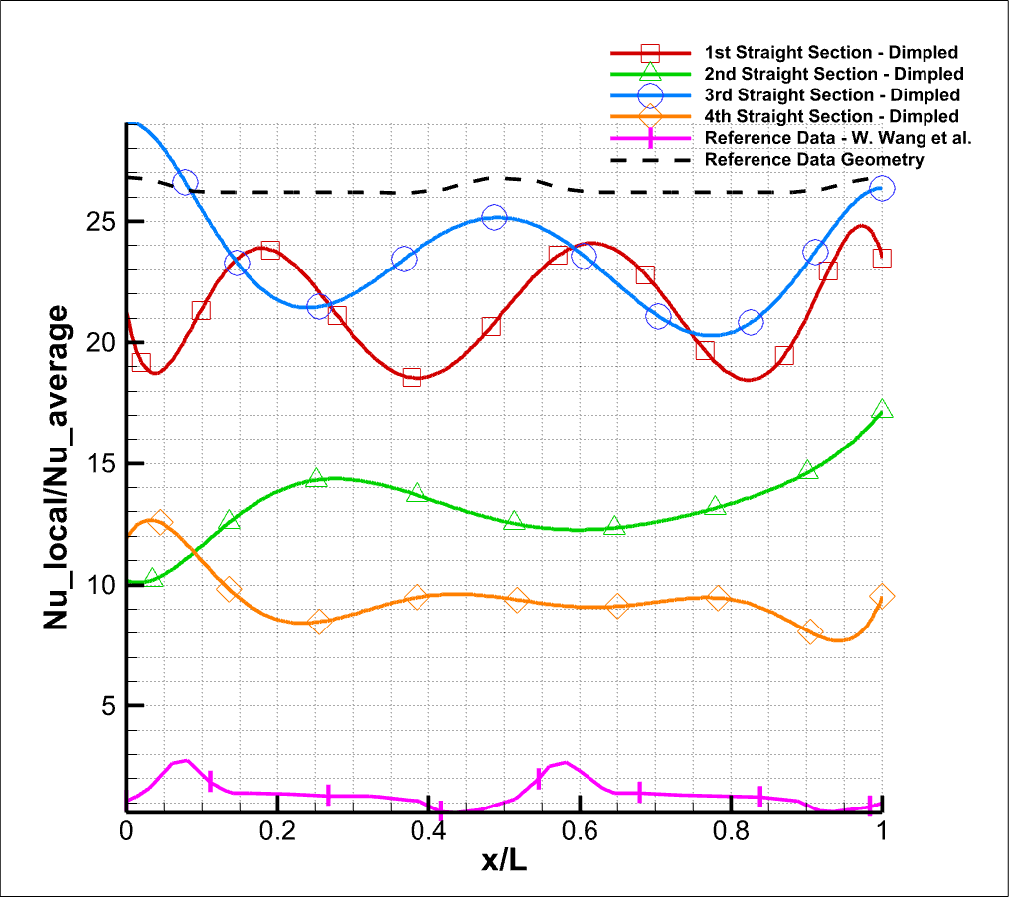
Dimples in Coolant Pipe: Heat Transfer Analysis
Figure 9: Local Nusselt Number analysis over dimples, against reference [3]
Figure 10: Dimpled Pipe Geometry
The dimples cause an increase in heat transfer due to better flow mixing larger surface area for bubble nucleation sites, but display oscillatory behaviour across bends.
Notes:
Now, we want to see if the heat transfer performance of our dimple design is comparable to circular corrugations studied in literature
Looking at the red plot, we see that the Local Nusselt number value decreases due to adverse pressure gradient before the first dimple , then increasing with flow separation induced recirculation till reattachment point is reached, where it decreases due to adverse pressure gradient.
We note that Significantly higher Nusselt values than reference due to improved breaking of thermal boundary layer by asymmetric dimples. The reference values are provided along only one section of a similarly bent channel.
Further straight sections have limited disruptive effect on the turbulence generation due to buildup of GN2 volume, as the perimeter walls approach dryout.

Slide 8

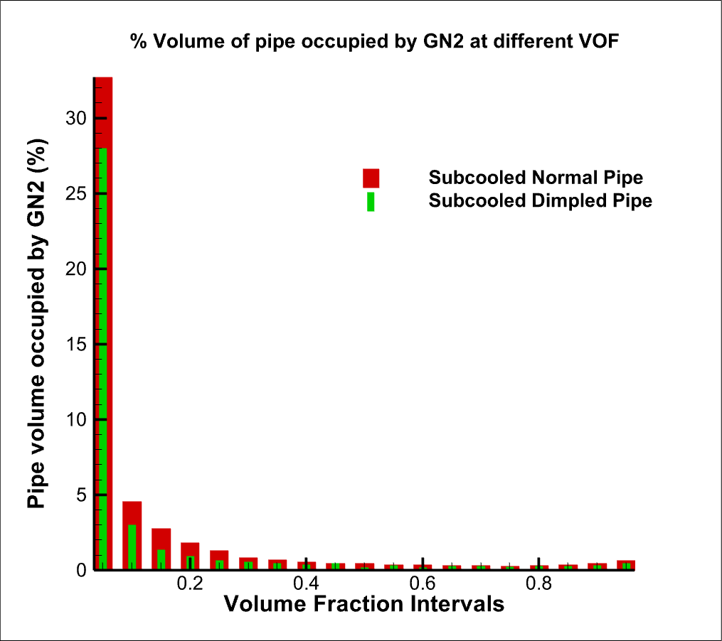
Strategy 3: Subcooling the Coolant
Figure 11: GN2 formation at 2K subcooling below 77.2K
Figure 12: GN2 formation at different vapour fractions
Decreasing the inlet temperature of LN2 by 2K massively reduces the superheated vapor buildup in the system, but needs upfront investment on cryocooling.
Notes:
Finally, we study the effect of restricting the flow to essentially capillary flow. The higher velocity in the smaller channels (due to fixed flow rate) removes boiling mass, in equilibrium with rate of phase transition – essentially having the same effect as the turbulent flows we saw earlier.
We observe that Churn/annular flow is dominant in the smaller pipe, mitigating further formation of GN2. It is likely that smaller pipes than this will continue this trend, but this is an area for further research.

Slide 9
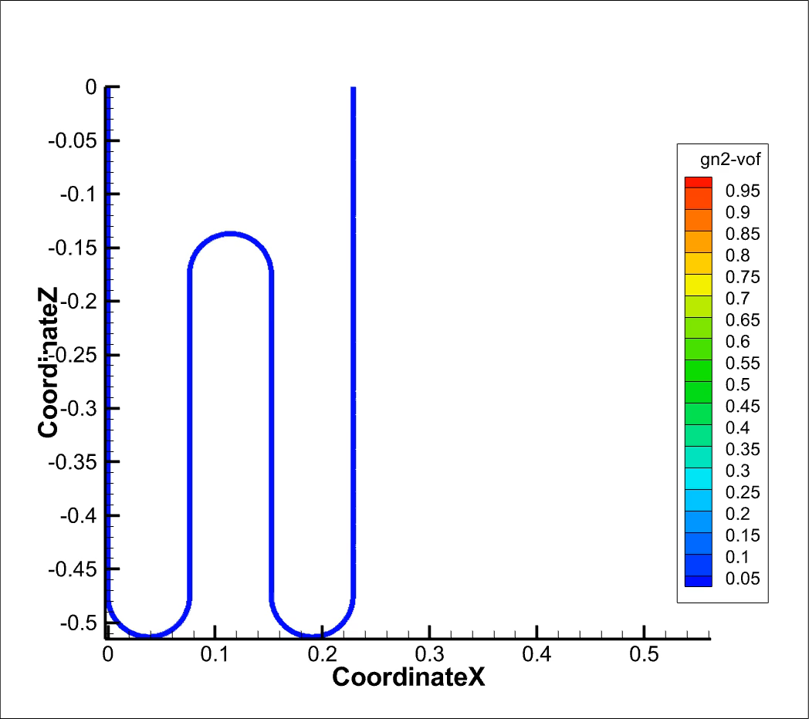
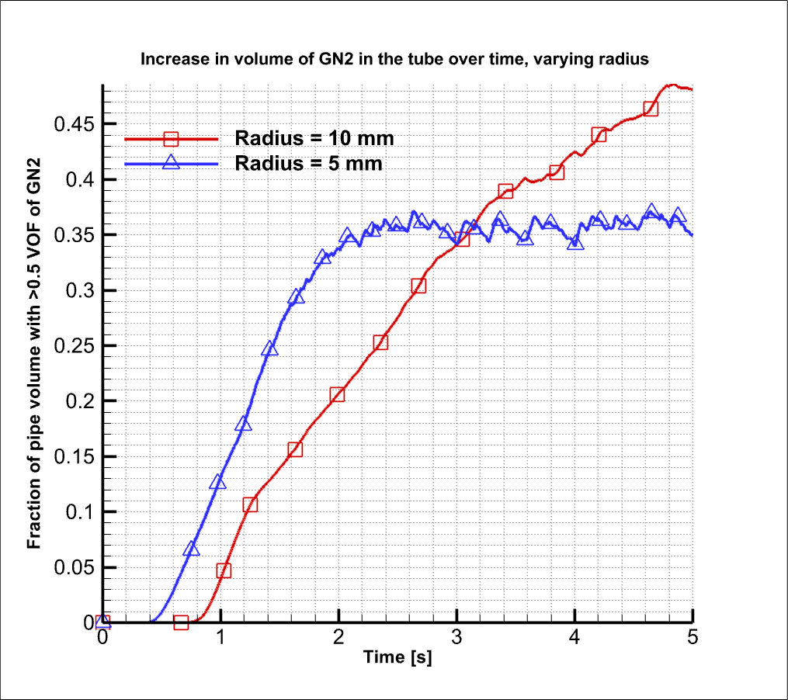
Strategy 4: Decreasing Area of Cross Section
Figure 13: GN2 formation in 5mm diameter pipe
Figure 14: Multiple Radii and their effect on GN2 formation
Decreasing the pipe diameter causes annular flow in the system, but due to the increased velocity, the vapor buildup can be mitigated.
Heat transfer effects to be analysed
Notes:
Finally, we study the effect of restricting the flow to essentially capillary flow. The higher velocity in the smaller channels (due to fixed flow rate) removes boiling mass, in equilibrium with rate of phase transition – essentially having the same effect as the turbulent flows we saw earlier.
We observe that Churn/annular flow is dominant in the smaller pipe, mitigating further formation of GN2. It is likely that smaller pipes than this will continue this trend, but this is an area for further research.

Slide 10
Concluding Remarks
Strategy 1: Higher velocities at the inlet mitigate GN2 formation
Strategy 2: Using dimples enhances heat transfer and mitigates GN2 formation
Strategy 3: Subcooling the coolant significantly reduces GN2 formation.
Strategy 4: Decreasing pipe radius reduces GN2 formation
Future Scope
Validation of results in experimental facilities
Further parametric analysis of dimpled geometry
Heat load could be varied
Recirculation strategy

Slide 11
Thank you
I am Vinay, and I will be delighted to take further questions at vn16panda@gmail.com.
This research was done in collaboration with Astrostructures ltd (Astrostructures.com) and conducted at Cranfield University (cranfield.ac.uk).

