Slide 1

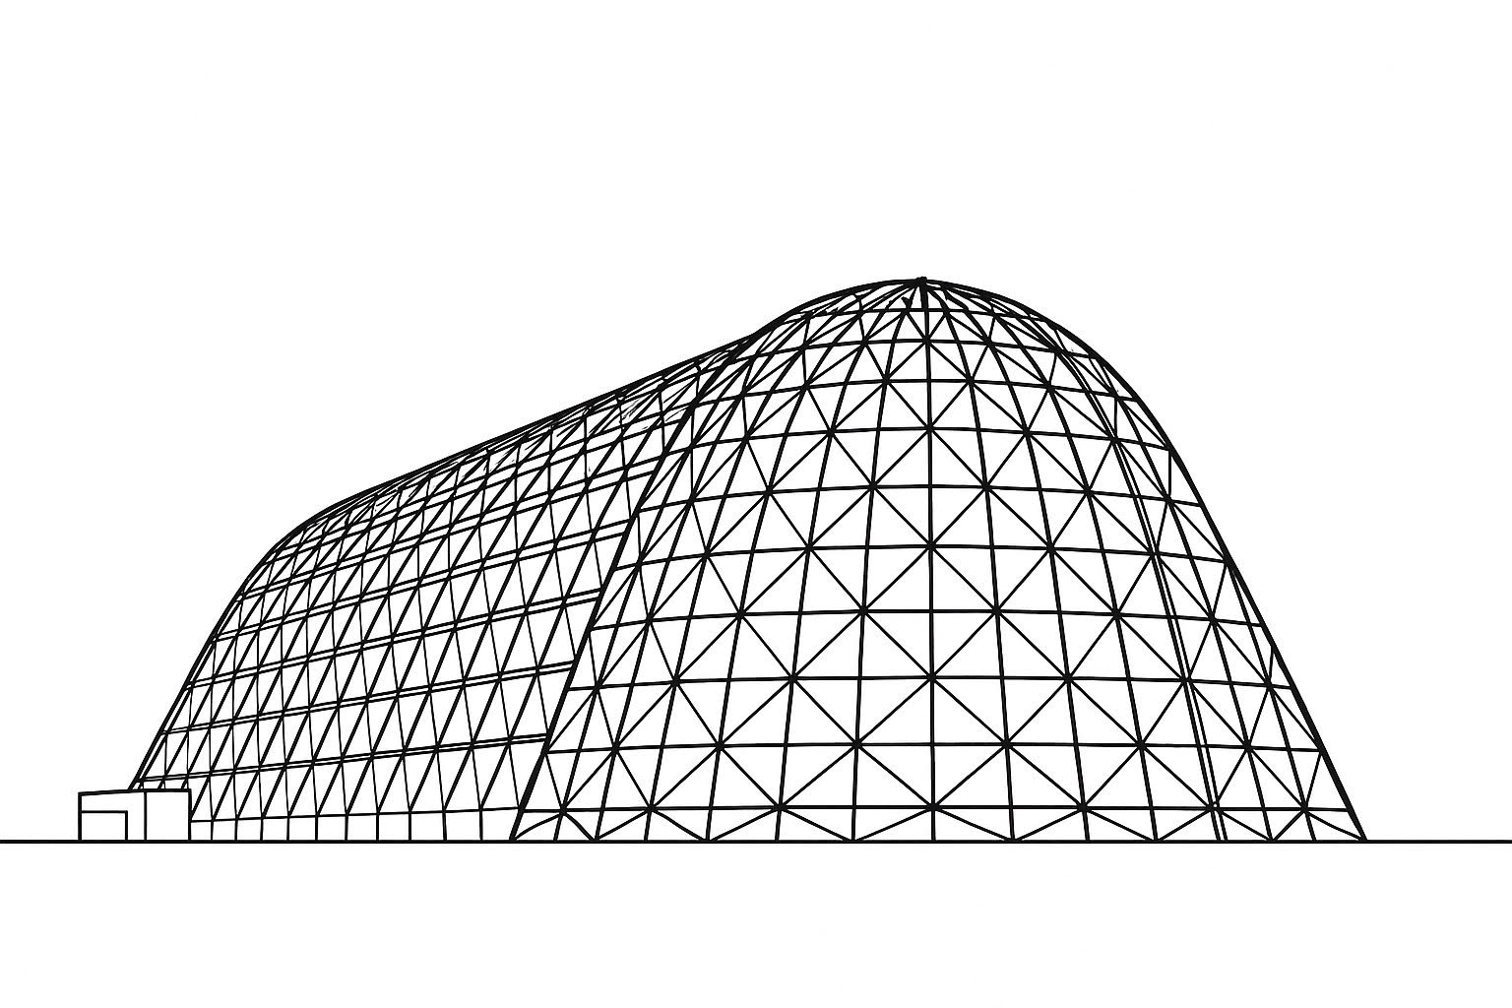

CATS-Vac Comparative Analysis of Thermal Straps in Vacuum
TFAWS 2025 Passive Thermal Technical Session
Presented by: Heather Grimes
Heather Grimes
Mackenzie Byrnes
Amentum NASA MSFC
Thermal & Fluids Analysis Workshop 2025
NASA Ames Research Center
San Jose, CA
August 4-7, 2025

Slide 2
Outline
Introduction
Overview
Strap Specifications
Test Matrix
Hand Calculations
Test Procedure
Bench Top Testing
TVAC Testing
Thermal Analysis
Iterative Improvements
Strap Characterization and Results
Next Steps

Slide 3
Introduction
Thermal straps are critical for efficient heat transfer and thermal management in space applications.
This test campaign aims to advance NASA’s thermal design and analysis capabilities by thermal vacuum testing and analyzing various thermal strap designs.
The results of this study will expand the capabilities in the Hub for Innovative Thermal Technology Maturation and Prototyping (HI-TTeMP) laboratory which will improve developmental thermal testing efficiency and support a wide variety of projects, including HLS.
Motivation:
Developmental testing in the HI‑TTeMP lab often requires rapid, iterative test designs, making it impractical to wait on commercial thermal straps with long lead times and high costs.
Thermal straps are frequently fabricated in‑house using readily available, cost‑effective materials; however, accurate strap performance values are not known.
Characterizing the performance of these convenient in‑house straps ensures reliable test setups without sacrificing schedule or budget.

Slide 4
Overview
Phase 1: Testing and characterizing straps used in current tests in the HI-TTeMP Lab, in addition to inexpensive, non-thermal specific COTS straps.
Phase 2: Exploring and characterizing new attachment methods that could be used in future thermal tests.

Slide 5
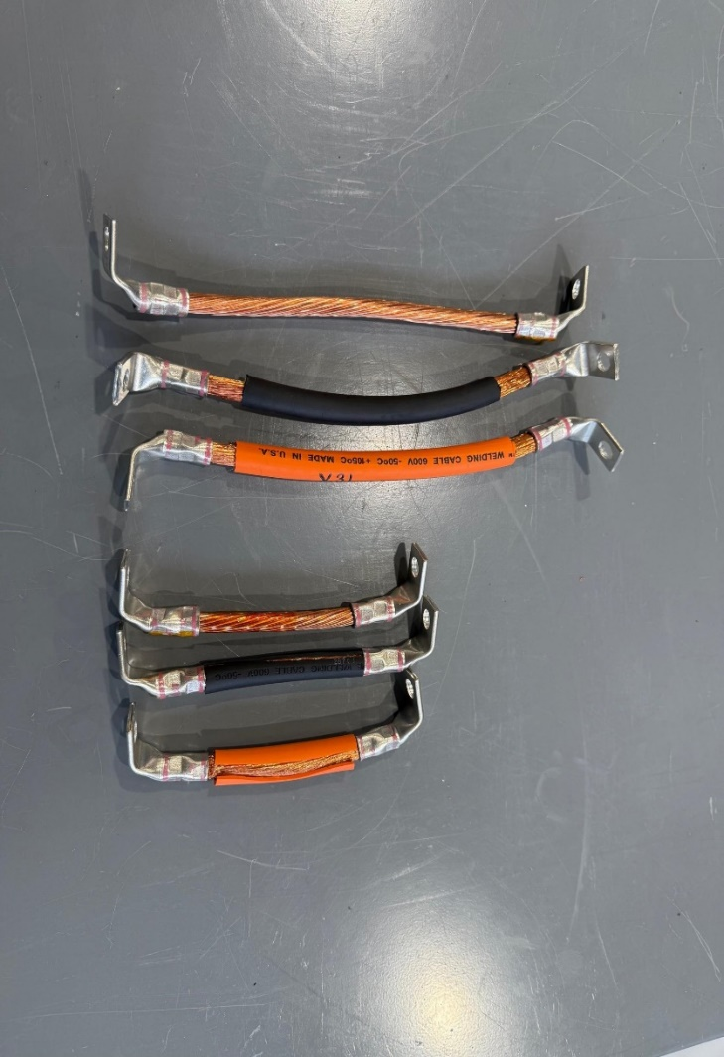
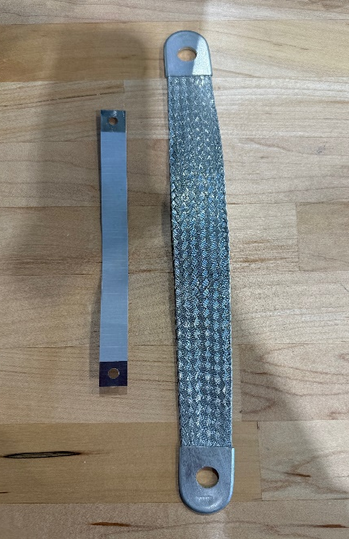
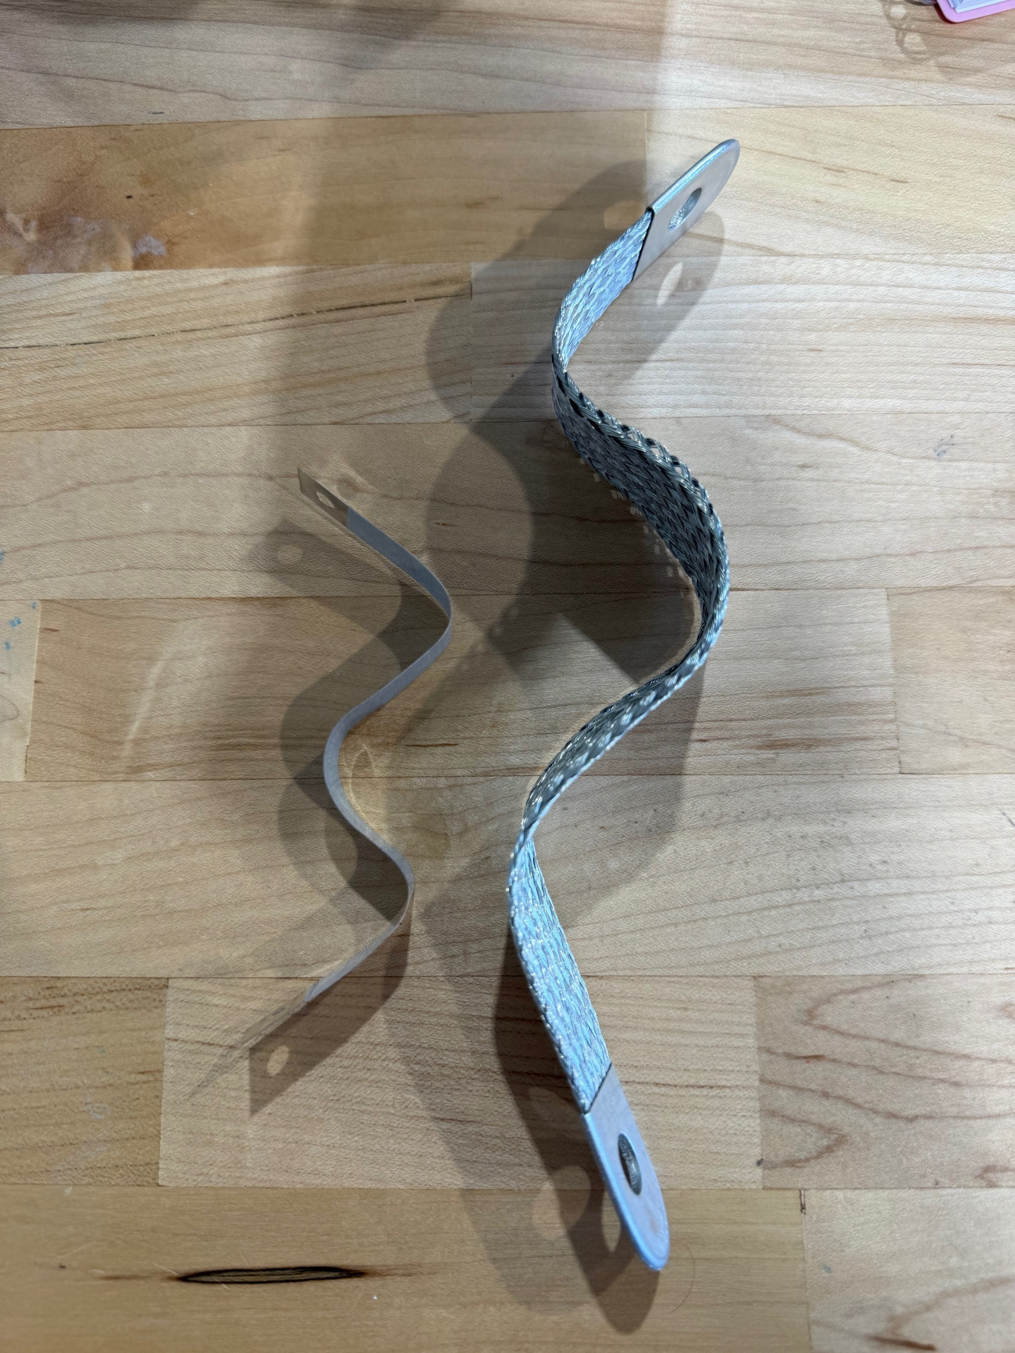
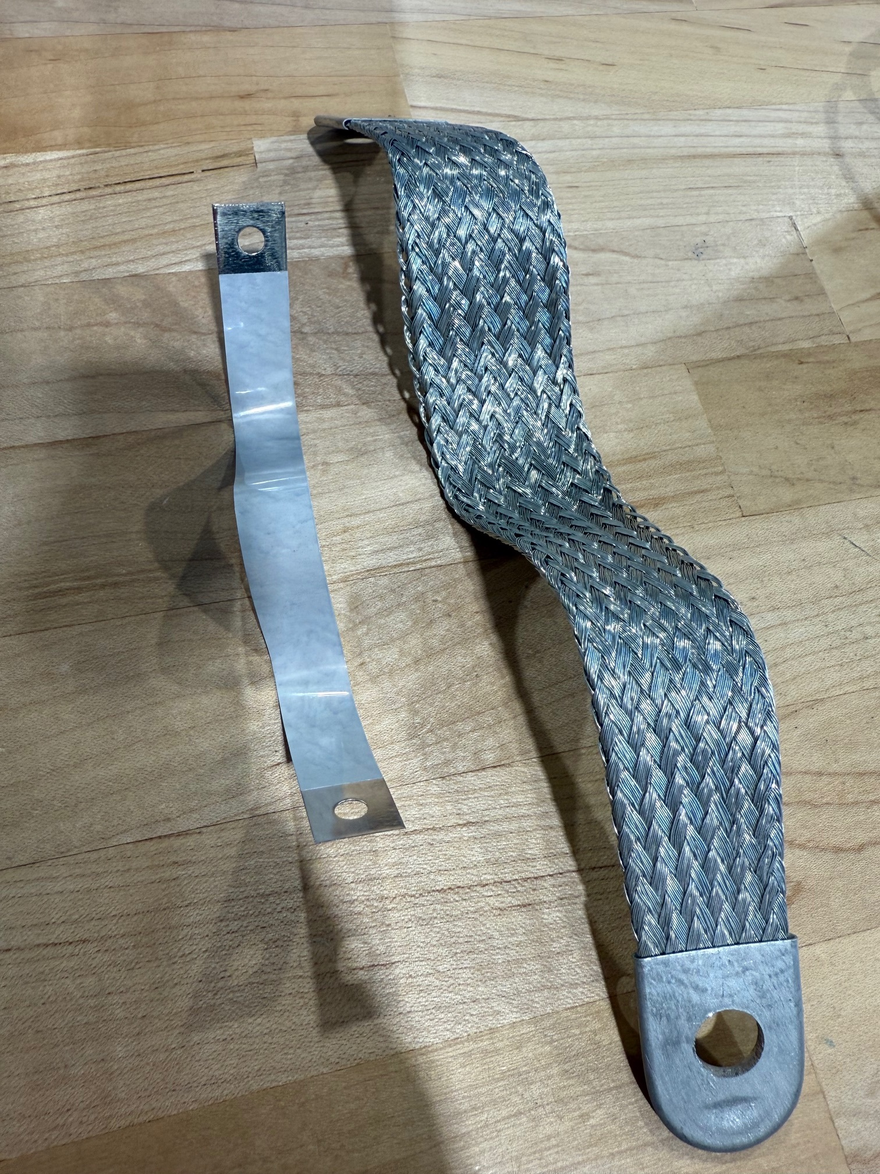
Thermal Strap Specifications – Phase I
Strap ID | Lug Material | Wire Type | Length (in) | Joining Method
1.0 | TPC | 19 Strand Copper Building Wire | 5 | In-House Crimp
2.0 | TPC | 975 Strand Copper Building Cable | 5 | In-House Crimp
3.0 | TPC | 2337 Strand Copper Building Cable | 5 | In-House Crimp
1.1 | TPC | 19 Strand Copper Building Wire | 9 | In-House Crimp
2.1 | TPC | 975 Strand Copper Building Cable | 9 | In-House Crimp
3.1 | TPC | 2337 Strand Copper Building Cable | 9 | In-House Crimp
4.0 | TPC | EMI-Reducing Copper Ribbon Grounding Strap | 6 | Pre-Assembled
5.0 | TPC | TPC Braided Grounding Strap | 9 | Pre-Assembled
5.0
1.1
2.1
4.0
3.1
1.0
2.0
3.0

Slide 6
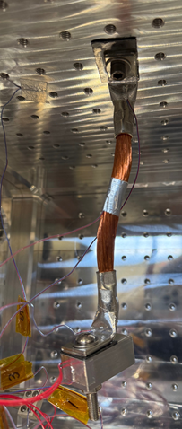
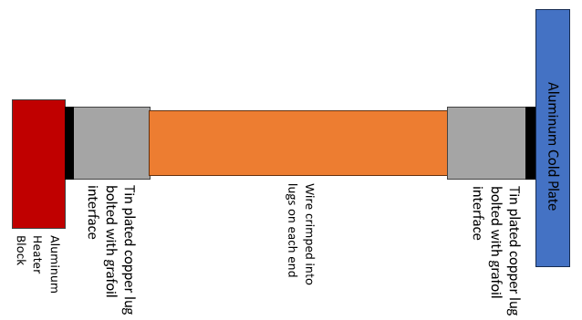
Test Matrix
Test # | Strap Description | Test Conditions | Cold Plate Temp, [C] | Heater Setpoint
1.0.A | 19 Strand, TPC | Ambient | 10 10 | 1W 3W
2.0.A | 975 Strand, TPC Black Insulation | Ambient | 10 10 | 1W 3W
3.0.A | 2337 Strand, TPC Orange Insulation | Ambient | 10 10 | 1W 3W
1.0.V | 19 Strand, TPC | Vacuum | 15 15 | 1W 3W
2.0.V | 975 Strand, TPC Black Insulation | Vacuum | 15 15 | 1W 3W
3.0.V | 2337 Strand, TPC Orange Insulation | Vacuum | 15 15 | 1W 3W
4.0.V | Copper Ribbon Grounding Strap | Vacuum | 10 10 | 1W 0.6W
5.0.V | TPC Braided Grounding Strap | Vacuum | 10 10 | 1W 3W
1.0.V.R | 19 Strand, TPC Reliability | Vacuum | 15 15 | 1W 3W
2.0.V.R | 975 Strand, TPC Black Insulation | Vacuum | 15 15 12 | 1W 3W 4W
3.0V.R | 2337 Strand, TPC Orange Insulation | Vacuum | 15 15 15 | 1W 3W 2W
2.1.V | 975 Strand, TPC Black Insulation | Vacuum | 15 15 | 1W 3W

Slide 7


Hand Calculations
Crimp resistance calculation:
Number of crimps per lug = 4
Crimp contact area = 0.25 in × 0.25 in = 0.0625 in²
Total contact area per lug = 4 × 0.0625 in² = 0.25 in²
Effective conduction depth through the crimp (L) = 1/32 in = 0.03125 in
Thermal conductivity of copper (k) = 401 W/m·K
Thermal resistance per lug = 0.0126 K/W
Total thermal resistance for both lugs (2 lugs per strap): 0.0252 K/W
Assumptions:
Consistent crimps
Constant material properties in copper wire and lugs
Negligible resistance in 4.0 and 5.0 thermal straps (pre-assembled)
$$G=\frac{k∙A}{L}$$
$$R=\frac{L}{k ∙A}$$
Calculation Results
# | Wire Type | L (m) | k (w/m-K) | Strand Dia (m) | A Wire (m²) | A Lug (m²) | L Lug (m) | R Wire (K/W) | R Crimp (K/W) | R Lug (K/W) | G Total (W/K)
1.0 | 19 strand | 0.1270 | 401 | 1.17E-03 | 2.04E-05 | 5.35E-05 | 2.54E-02 | 3.2729 | 0.0252 | 8.45E-01 | 0.20051
2.0 | 975 strand | 0.1270 | 401 | 7.62E-04 | 4.45E-04 | 5.35E-05 | 2.54E-02 | 0.0029 | 0.0252 | 8.45E-01 | 0.58228
3.0 | 2337 strand | 0.1270 | 401 | 6.60E-04 | 8.01E-04 | 5.35E-05 | 2.54E-02 | 0.0007 | 0.0252 | 8.45E-01 | 0.58305
1.1 | 19 strand | 0.2286 | 401 | 1.17E-03 | 2.04E-05 | 5.35E-05 | 2.54E-02 | 5.8913 | 0.0252 | 8.45E-01 | 0.13148
2.1 | 975 strand | 0.2286 | 401 | 7.62E-04 | 4.45E-04 | 5.35E-05 | 2.54E-02 | 0.0053 | 0.0252 | 8.45E-01 | 0.58149
3.1 | 2337 strand | 0.2286 | 401 | 6.60E-04 | 8.01E-04 | 5.35E-05 | 2.54E-02 | 0.0012 | 0.0252 | 8.45E-01 | 0.58286
4.0 | Ribbon | 0.1524 | 401 | 1.27E-02 | 4.19E-06 |  |  | 90.6275 |  |  | 0.01103
5.0 | Braided | 0.2286 | 315 | 2.22E-02 | 3.53E-05 |  |  | 20.5689 |  |  | 0.02917

Slide 8
Test and Preparation Procedure
Thermal Strap Construction
Obtain materials
Thermal Strap and Test Preparation
Clean thermal straps according to cleaning procedure
Test
Test according to test matrix
Trim wires to length
Crimp wire ends into lugs
Instrument thermal straps with 30 G type T thermocouples
Clean test location (cold plate for ambient, chamber for TVAC)
Test in ambient conditions
Test in TVAC conditions
Obtain premade straps
Assemble in-house straps

Slide 9
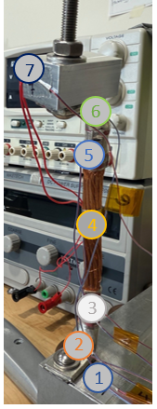
Bench Top Ambient Testing
Goal: Validate hand calculations
Method:
Thermal strap bolted to cold plate on one end and heater block on opposing end with Grafoil interface between each. Added a custom foam insulator around the strap to reduce convective losses and forced convection impacts from the environment
Each strap was tested under two or more power set points
Steady state, as defined by a temperature change of less than 0.5◦C over one hour per NASA Langley criteria (Welch, 2016), was held for a minimum of one hour
Results:
Increased understanding of thermocouple placement, improved estimation of conductivity values, improved data processing techniques to prepare for vacuum testing
TC # | Location
1 | Cold Plate
2 | Cold End Lug
3 | Cold End Crimp
4 | Middle of Wire
5 | Hot End Crimp
6 | Hot End Lug
7 | Heater Block
Strap ID | Wire Type, Length [in] | G [W/K]
1.0 | 19-Strand, 5 in | 0.186
2.0 | 975-Strand, 5 in | 0.179
3.0 | 2337-Strand, 5 in | 0.207

Slide 10
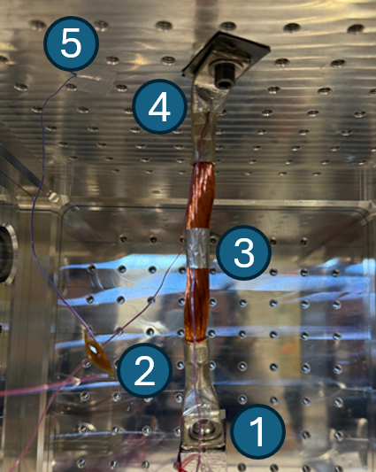
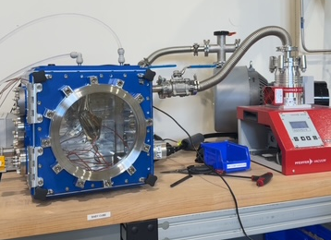
TVAC Testing
Tested in MSFC HI-TTeMP Ideal Vacuum Cube Chamber
Thermal strap bolted to the top of the chamber (cold plate)
Used Grafoil at each interface to improve contact
Wrapped strap in 11-layer MLI
Aluminized mylar & dacron netting
Each strap tested at 2 power set points with consistent cold plate temperature
Steady state held for one hour
TC # | Location
1 | Heater Block
2 | Hot End Lug
3 | Middle, Wires
4 | Cold End Lug
5 | Cold Plate
Strap ID | Wire Type, Length [in] | G [W/K]
1.0 | 19-Strand, 5 in | 0.169
2.0 | 975-Strand, 5 in | 0.163
3.0 | 2337-Strand, 5 in | 0.167
2.1 | 975-Strand, 9 in | 0.091
4.0 | EMI Copper Ribbon, 6 in | 0.012
5.0 | Braided TPC, 9 in | 0.043

Slide 11
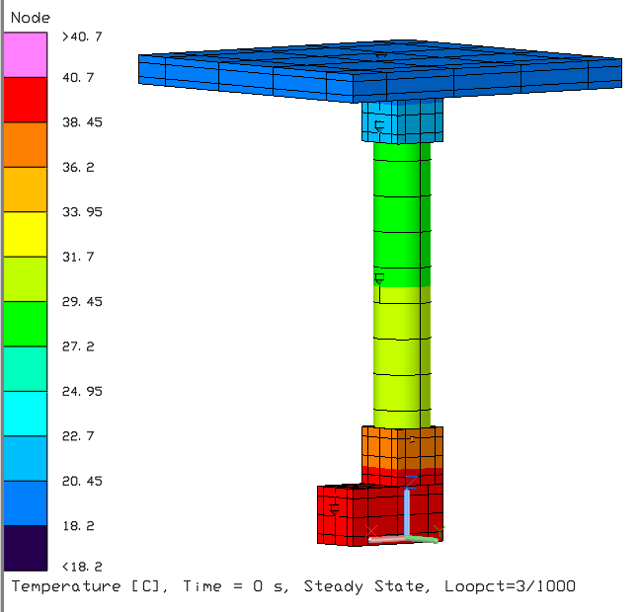
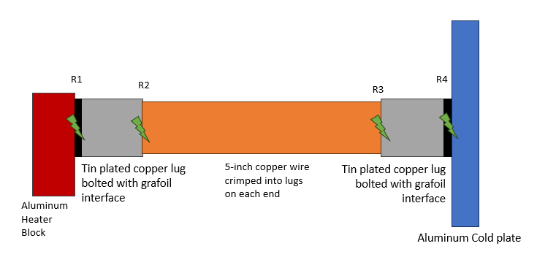
Thermal Analysis
Simple thermal model
Resistance Diagram/Test Set-up
5
2
3
4
1

Slide 12
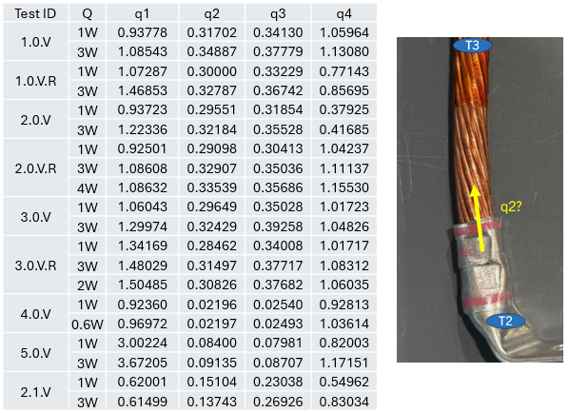
Iterative Improvements & Evolving Test Strategies
Standardized bolt torque to 75 in-lbf using a calibrated torque wrench (per MSFC-STD-486B)
Improved repeatability of test results by reducing interface resistance variability
Enabled better isolation of material and fabrication effects from mechanical interface inconsistencies
Addressed previously uncontrolled variability in lug-to-plate contact pressure from early tests
Supports more accurate correlation of thermal resistance values in predictive models

Slide 13
Strap Characterization
Developed a weighted matrix to evaluate each strap for thermal and practical performance
Thermal conductance ×3
Cost & Repeatability ×2
Malleability, Manufacturability, Convenience ×1
Scored 1–5 per factor → total weighted score

Slide 14
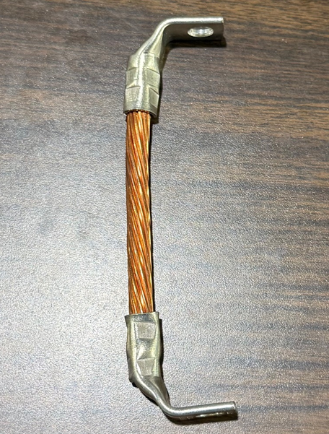
19-Strand Copper Strap (1.0)
Strap Build:
5-inch, 19 strand, copper building wire
Tin-plated copper lugs
Crimped twice per lug
Evaluation:
Averaged across all test cases conducted with this strap, 1.0 exhibited the highest thermal conductance at 0.169 W/K
Does not easily bend and would not be useful in connecting two interfaces in complex configurations
Can be manufactured with ease, design is easily replicated, and it performed similarly across repeatability tests
Characteristic | Value | Score
Conductivity | 0.169 W/K | 4
Manufacturability |  | 5
Cost | $29.85 | 4
Repeatability |  | 4
Malleability |  | 1
Convenience |  | 5

Slide 15
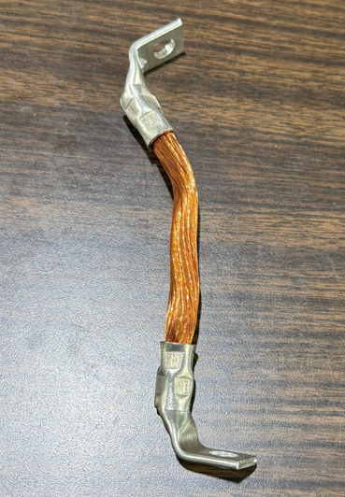
975-Strand Copper Strap (2.0)
Strap Build:
5-inch, 975 strand, copper building wire
Tin-plated copper lugs
Crimped twice per lug
Evaluation:
Averaged across all test cases conducted with this strap, 2.0 exhibited the 3rd highest thermal conductance, 0.163 W/K
While the strap is easily bent, it is not highly flexible and may place some force on attached objects when maneuvered into challenging installation locations
Due to the high wire count, some wires will fray or splay during construction, but performance proved repeatable regardless
Characteristic | Value | Score
Conductivity | 0.163 W/K | 4
Manufacturability |  | 4
Cost | $29.94 | 4
Repeatability |  | 4
Malleability |  | 3
Convenience |  | 5

Slide 16
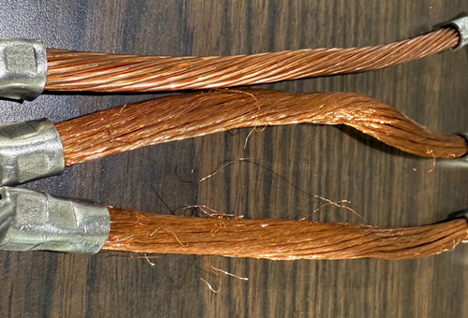
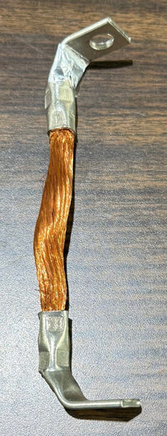
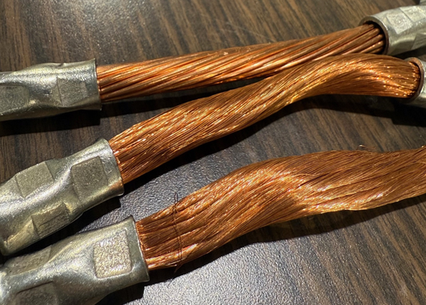
2337-Strand Copper Strap (3.0)
Strap Build:
5-inch, 2337 strand, copper building wire
Tin-plated copper lugs
Crimped twice per lug
Evaluation:
Averaged across all test cases conducted with this strap, 3.0 exhibited the 2nd highest thermal conductance, 0.167 W/K
This strap is the most malleable of the three copper wire straps due to the very thin individual wire diameter
Due to the high wire count, some wires will fray or splay during construction, worse than the 975-strand wire. The test results proved that the performance was still consistent, but visually, these straps are a bit more difficult to construct
1.1
2.1
3.1
1.0
2.0
Characteristic | Value | Score
Conductivity | 0.167 W/K | 4
Manufacturability |  | 3
Cost | $29.56 | 4
Repeatability |  | 4
Malleability |  | 4
Convenience |  | 5
3.0

Slide 17
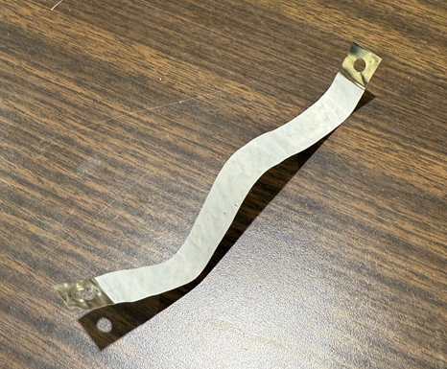
EMI-Reducing Ribbon Grounding Strap (4.0)
Strap Build:
COTS, 6-inch, copper ribbon, tin-plated copper terminals
Insulated with Mylar
Commonly used for circuit board applications
Evaluation:
Very low thermal performance; 0.012 W/K.
Highly malleable and can be used in tight spaces
Has primarily non-thermal applications for reducing electromagnetic interference
Lower convenience because this strap would have to be ordered rather than constructed with in-house materials.
Characteristic | Value | Score
Conductivity | 0.012 W/K | 1
Manufacturability |  | 5
Cost | $24.02 | 5
Repeatability |  | 5
Malleability |  | 5
Convenience |  | 3

Slide 18
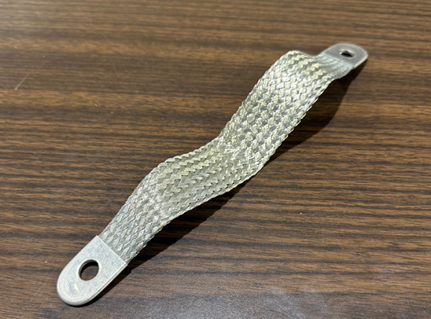
Braided Tin-Plated Copper Grounding Strap (5.0)
Strap Build:
COTS, 9-inch, braided TPC wire with TPC terminals
Commonly used in tight spaces for low electrical resistance applications
Evaluation:
Lower thermal performance, 0.043 W/K, but due to its length, is more comparable to other 9-inch straps
Highly malleable and can be used in tight spaces
Not primarily used for thermal applications
Very low cost
Lower convenience; this strap is constructed from materials not commonly available in HI-TTeMP
Characteristic | Value | Score
Conductivity | 0.043 W/K | 1
Manufacturability |  | 5
Cost | $14.16 | 5
Repeatability |  | 5
Malleability |  | 5
Convenience |  | 3

Slide 19
Strap Characterization Summary
Top performers: Straps 1.0, 2.0, and 3.0
Strong balance of thermal performance and repeatability
Commercial straps 4.0 & 5.0 scored lower
Poor thermal conductance despite convenience & malleability
Key Takeaways:
Lower strand count (Strap 1.0) showed the best overall thermal performance and repeatability
High strand count (3.0) increases flexibility but slightly reduces crimp consistency.
Commercial straps (4.0 & 5.0) typically unsuitable for primary thermal transfer roles, highly dependent on application

Slide 20

Other Interesting Comparisons
Cost per conductivity (CPC), normalized by length
$CPC=\frac{\left(Cost ÷ Length\right)}{Conductivity}$
This comparison proves that the braided tin-plated copper strap (5.0) performed better than initially observed
This is likely due to the braided configuration of strap 5.0 and a lack of wire splaying that occurs in the high strand copper wires built in-house

Slide 21
Next Steps
Use correlated thermal model to back-calculate contact pressure/resistances at the lug-heater block and lug-cold plate interfaces.
Expand on Phase I findings by evaluating new thermal strap fabrication methods, while still focusing on improving thermal conductance and reducing build time, complexity, and material costs.
Develop and test gallium-nickel (G/N) soldering method:
Low-temperature gallium-nickel paste applied to copper wire bundle for durable, conductive bonds.
Mitigates solder wicking seen in traditional high temperature solders, preserving strap flexibility.
Investigate high-conductivity vacuum-rated epoxy:
Might increase thermal conductivity at the previously crimped interface of the lug.
Test all new straps under standardized thermal vacuum conditions (as in Phase I) and evaluate thermal conductance, contact resistance, and durability.
Use results to create design guidelines for cost-effective, high-performance thermal straps for developmental thermal testing.

Slide 22
References
[1] Welch, J. W. (2016). Assessment of thermal balance test criteria requirements on test objectives and thermal design. International Conference on Environmental Systems (ICES). The Aerospace Corporation. Retrieved from https://s3vi.ndc.nasa.gov/ssri-kb/static/resources/ICES_2016_6.pdf

Slide 23
Questions?

