Slide 1

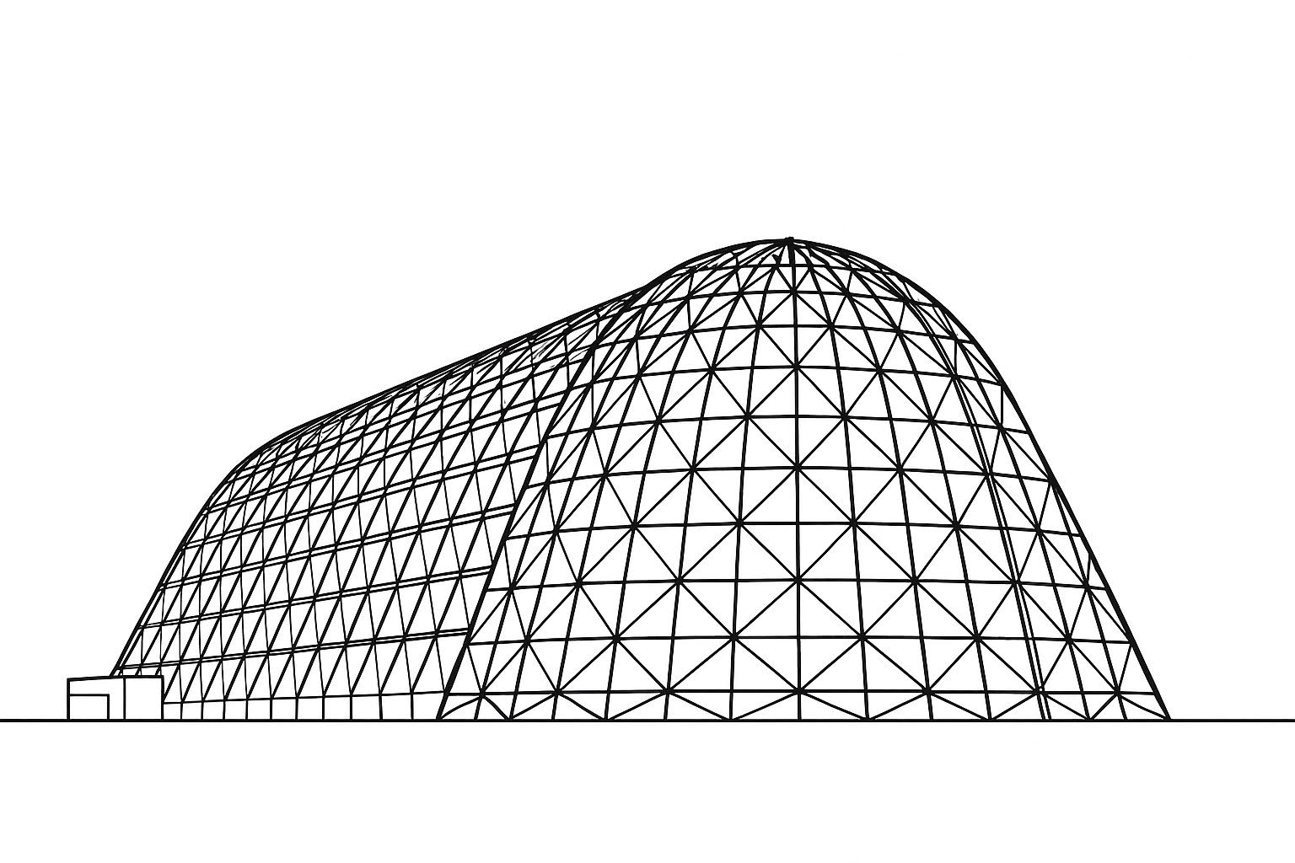

IHAB Thermal Cover Assembly Omission Thermal Study
TFAWS 2025 Passive Thermal Technical Session
Presented by: Jonah Smith and Rose Fong
Jonah R. Smith, Amentum, Houston, Texas 77058
Rose Y. Fong, Amentum, Houston, Texas 77058
Laurie Y. Carrillo, NASA JSC, Houston, Texas 77058
Thermal & Fluids Analysis Workshop 2025
NASA Ames Research Center
San Jose, CA
August 4-7, 2025

Slide 2
Background
Problem:
The Gateway program has considered removing the docking port thermal covers from the IHAB (International Habitation element) module to save mass, reduce complexity of docking, and improve EVA capability.
These thermal covers were designed to limit heat leak out of the docking ports during transit, so their removal risks IHAB thermal limit violations during launch/ascent, transit, and docking.
Complications:
Attitude constraints from Orion, which carries IHAB to Gateway, nominally put IHAB in permanent shadow throughout transit, limiting environmental heating.
Performing analysis with the covers removed, total heater power in transit was shown to greatly increase, and risks using too much power such that IHAB battery state-of-charge is not maintained above its minimum limit through transit and docking to Gateway.
This presentation details thermal considerations from the trade study performed by the Gateway program that will be used in determining whether or not IHAB docking port thermal covers can be removed.

Slide 3
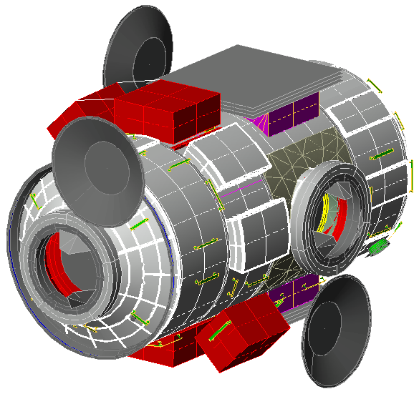
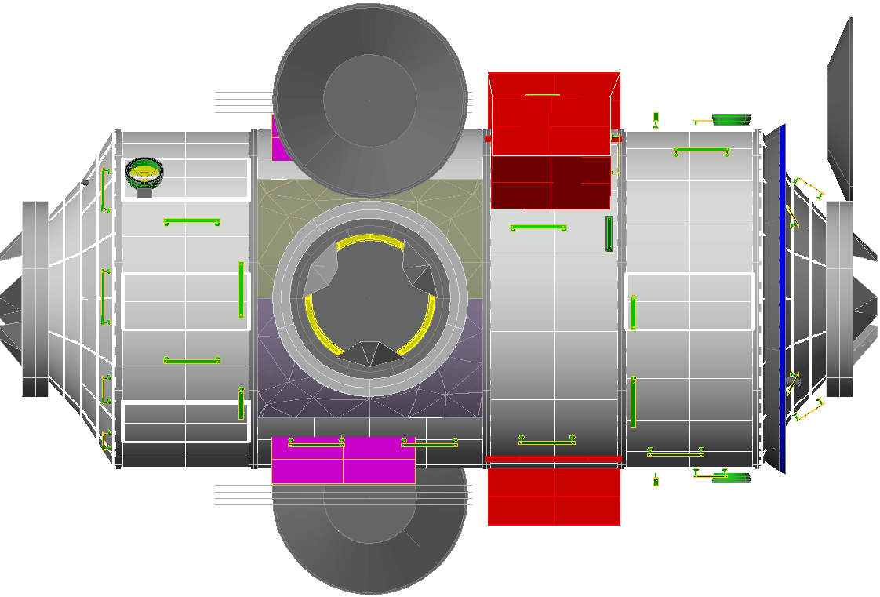
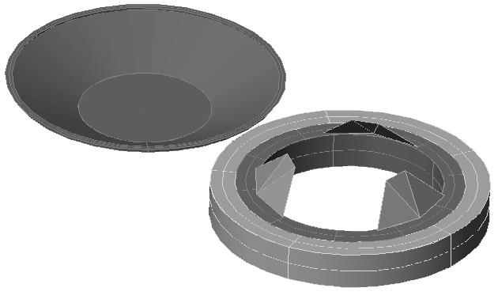
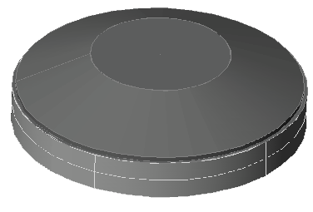
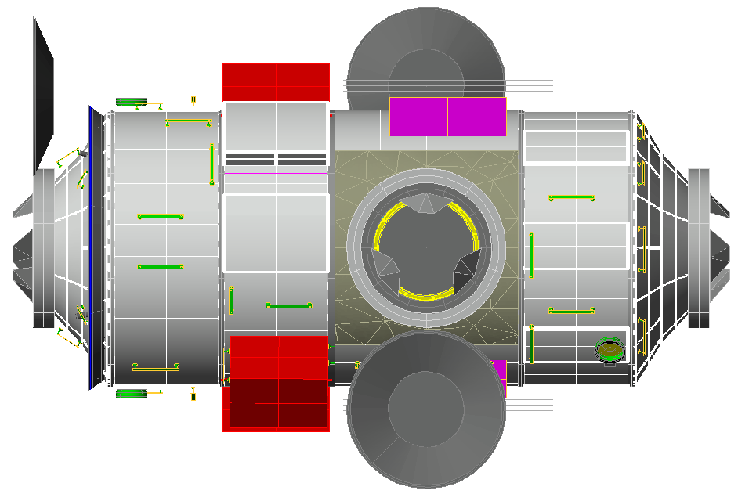
IHAB Thermal Cover Description
Three (3) Thermal Covers on I-Hab
1 Axial I-Hab aft over the Active-IBDM
2 Radial (I-Hab +Y, -Y)
Mission Scenarios of focus
Fly all TCA’s (baseline mission)
Omit Axial TCA only (covering Active-IBDM)
[Goal] Omit all TCAs (axial and two radial TCAs)
Isometric View
-Y Port
+Y Port
Open TCA
Closed TCA
-Y Port

Slide 4
Requirements Driving Design
Title | Explanation
Common Coolant - External ATCS (Active Thermal Control System) | Need to keep external coolant temperatures above -70°C to prevent freezing
Common Coolant - Internal ATCS | Need to keep internal coolant temperatures above -20°C to prevent freezing
Preclude Condensation | Cabin temperatures / shell temperatures need to be high enough to prevent condensation
Active Docking System Interface Compatibility | The delta-T with HALO (Habitation and Logistics Outpost ) NDSB2P (NASA Docking System Block 2 Passive) needs to be less than 55°C
IBDM (International Berthing and Docking Mechanism) Component Temperature Limits | Maintain IHAB’s docking mechanism components within temperature limits

Slide 5
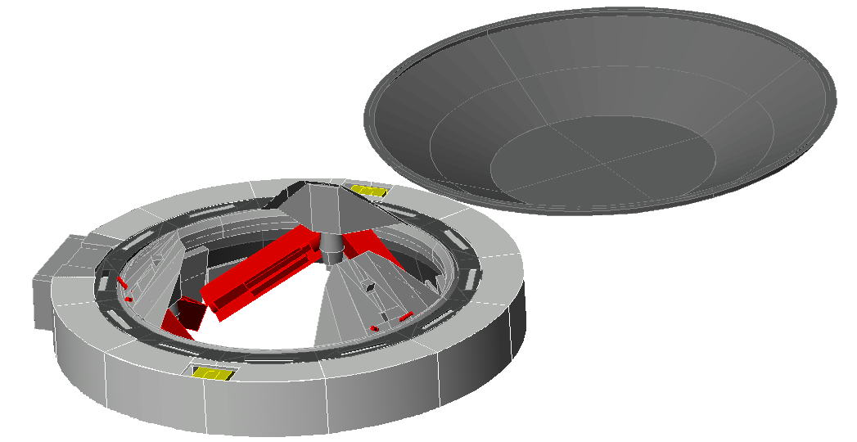
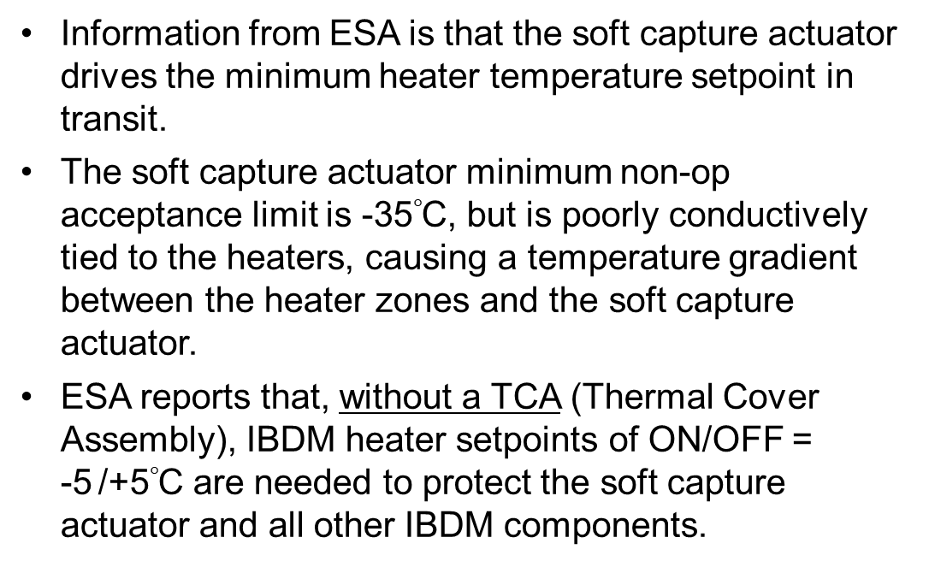
Boundary Conditions – IBDM Component Temperature Limits
Information from ESA is that the soft capture actuator drives the minimum heater temperature setpoint in transit.
The soft capture actuator minimum non-op acceptance limit is -35$°$C, but is poorly conductively tied to the heaters, causing a temperature gradient between the heater zones and the soft capture actuator.
ESA reports that, without a TCA (Thermal Cover Assembly), IBDM heater setpoints of ON/OFF = -5 /+5$°$C are needed to protect the soft capture actuator and all other IBDM components.
Soft Capture Actuator

Slide 6
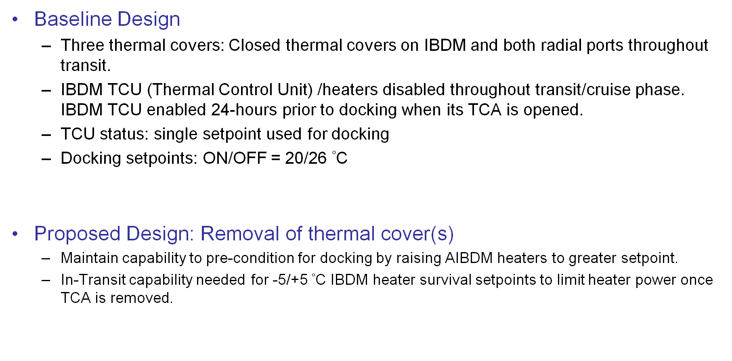
State of Design
Baseline Design
Three thermal covers: Closed thermal covers on IBDM and both radial ports throughout transit.
IBDM TCU (Thermal Control Unit) /heaters disabled throughout transit/cruise phase. IBDM TCU enabled 24-hours prior to docking when its TCA is opened.
TCU status: single setpoint used for docking
Docking setpoints: ON/OFF = 20/26 $°$C
Proposed Design: Removal of thermal cover(s)
Maintain capability to pre-condition for docking by raising AIBDM heaters to greater setpoint.
In-Transit capability needed for -5/+5 $°$C IBDM heater survival setpoints to limit heater power once TCA is removed.

Slide 7
Options to Gain -5/+5 $°$C Setpoint Transit Capability
Modify TCU to control current heaters.
Use MSM (Module System Manager) for control. If telemetry is available:
Override power switch status for heaters in the TCU to provide heater controls with flexible setpoints in MSM.
Remove the TCU and wire directly to the MSM for control.
Add separate set of transit heaters with fixed setpoint (-5C/+5C).

Slide 8
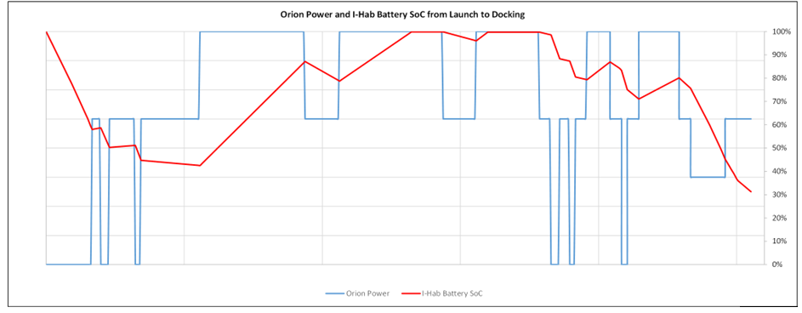

Power Timeline from Orion to IHAB vs. IHAB Battery SOC
Smart Heating
Smart Heating
NRI
Orion power to CPL
I-Hab Battery Charge
Time from Launch
The smart heating algorithm is activated as soon as the following conditions are met:
I-Hab battery is fully charged
Available current/power from Orion > I-Hab internal loads (including nominal shell heaters)
This results in converting excess energy by boosting shell heaters at higher setpoint, allowing smaller heater power consumption as soon as Orion provides less power (e.g. power outages), mitigating the power draw from I-Hab batteries.

Slide 9
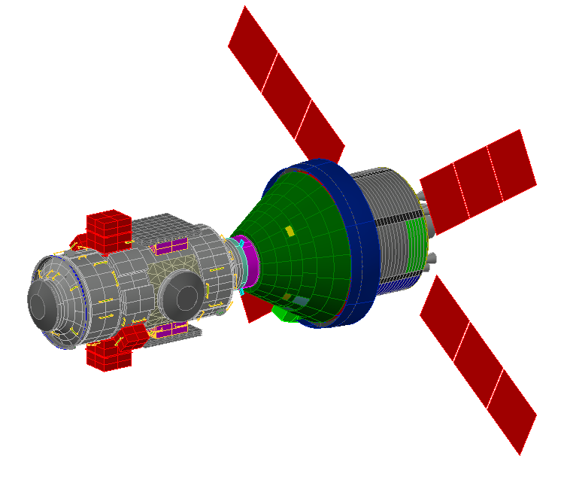
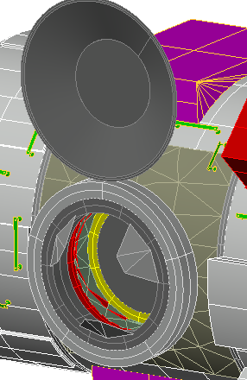
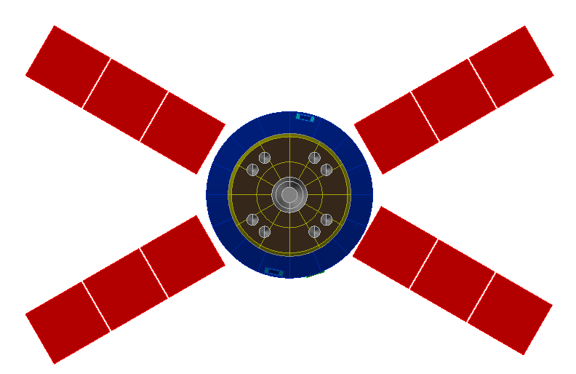
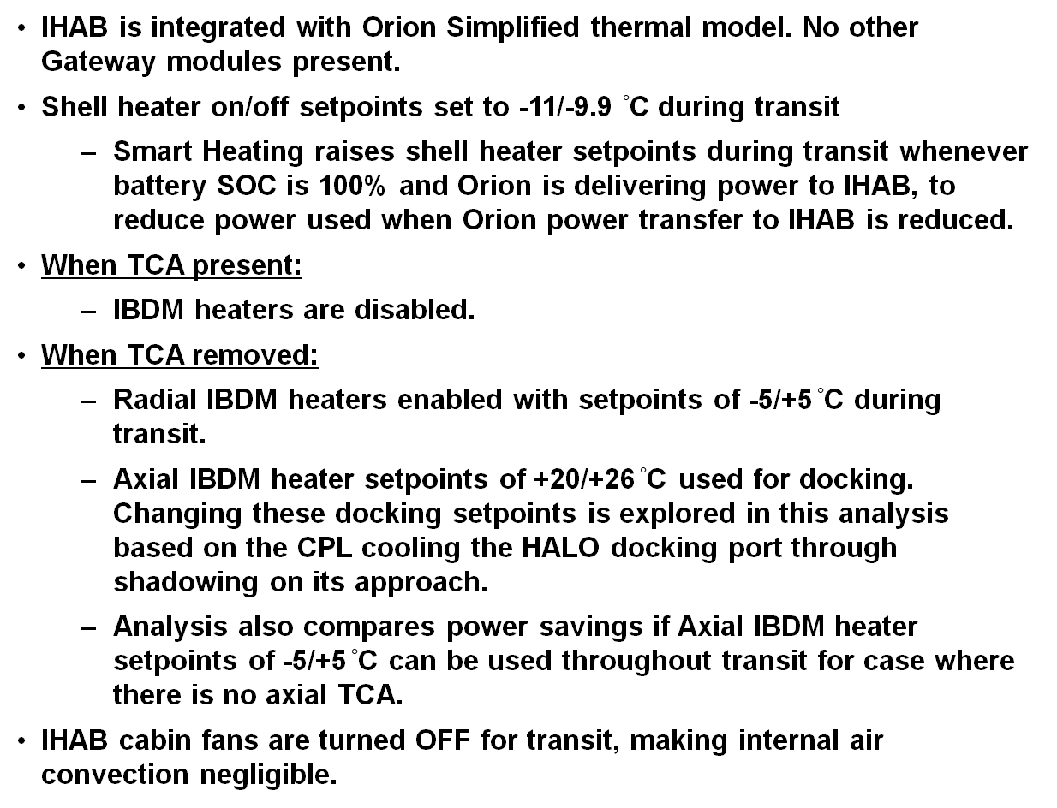
Model Overview
IHAB is integrated with Orion Simplified thermal model. No other Gateway modules present.
Shell heater on/off setpoints set to -11/-9.9 $°$C during transit
Smart Heating raises shell heater setpoints during transit whenever battery SOC is 100% and Orion is delivering power to IHAB, to reduce power used when Orion power transfer to IHAB is reduced.
When TCA present:
IBDM heaters are disabled.
When TCA removed:
Radial IBDM heaters enabled with setpoints of -5/+5$°$C during transit.
Axial IBDM heater setpoints of +20/+26$°$C used for docking. Changing these docking setpoints is explored in this analysis based on the CPL cooling the HALO docking port through shadowing on its approach.
Analysis also compares power savings if Axial IBDM heater setpoints of -5/+5$°$C can be used throughout transit for case where there is no axial TCA.
IHAB cabin fans are turned OFF for transit, making internal air convection negligible.
IHAB and Orion in Transit Configuration
IHAB
Orion

Slide 10
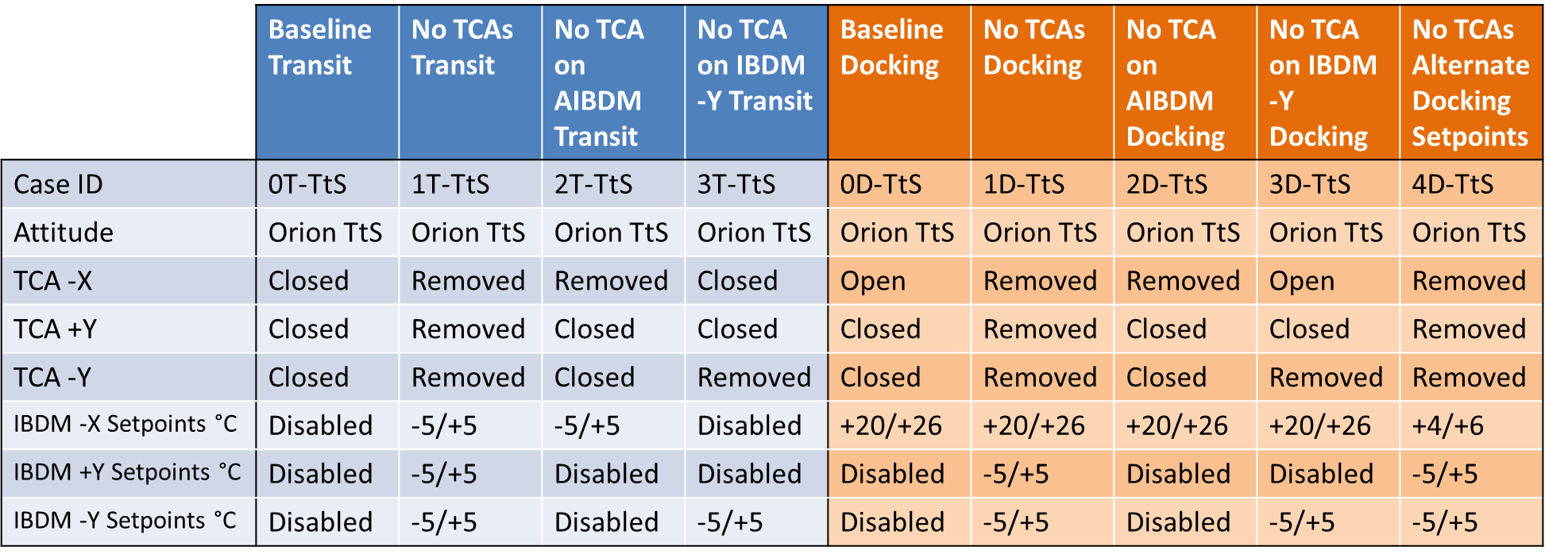
Case Matrix [1/2] – Orion Tail to Sun (TtS) Cases
All cases ran assuming cold environmental assumptions
Solar Flux = 1,310 W/m^2 per SLS-SPEC-159
No OLR (Outgoing Longwave Radiation) or Albedo flux from Earth or Moon
Alternate docking setpoint case based on Gateway analysis of maximum HALO docking port temperature using nominal docking timeline. Longer duration docking sequences allow docking setpoints to be lowered further.

Slide 11
Case Matrix [2/2] – Alternate Attitude Cases
 | Baseline Yaw+20 Transit | No TCAs Yaw+20 Transit | No TCA on AIBDM Yaw+20 Transit | No TCA on IBDM -Y Yaw+20 Transit | Baseline Yaw+90 Transit | No TCAs Yaw+90 Transit | No TCA on AIBDM Yaw+90 Transit | No TCA on IBDM -Y Yaw+90 Transit | No TCA on AIBDM Yaw+180 Transit
Case ID | 0T-Y20 | 1T-Y20 | 2T-Y20 | 3T-Y20 | 0T-Y90 | 1T-Y90 | 2T-Y90 | 3T-Y90 | 2T-Y180
Attitude | Yaw = 20 | Yaw = 20 | Yaw = 20 | Yaw = 20 | Yaw = 90 | Yaw = 90 | Yaw = 90 | Yaw = 90 | Yaw= 180
TCA -X | Closed | Removed | Removed | Closed | Closed | Removed | Removed | Closed | Removed
TCA +Y | Closed | Removed | Closed | Closed | Closed | Removed | Closed | Closed | Closed
TCA -Y | Closed | Removed | Closed | Removed | Closed | Removed | Closed | Removed | Closed
IBDM -X Setpoints °C | Disabled | -5/+5 | -5/+5 | Disabled | Disabled | -5/+5 | -5/+5 | Disabled | -5/+5
IBDM +Y Setpoints °C | Disabled | -5/+5 | Disabled | Disabled | Disabled | -5/+5 | Disabled | Disabled | Disabled
IBDM -Y Setpoints °C | Disabled | -5/+5 | Disabled | -5/+5 | Disabled | -5/+5 | Disabled | -5/+5 | Disabled

Slide 12
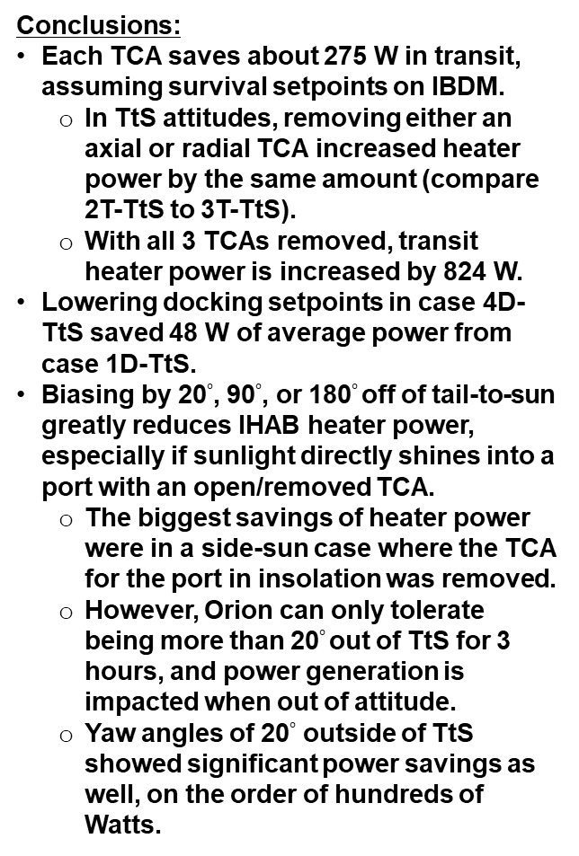
Results – Average Heater Power per Case
Conclusions:
Each TCA saves about 275 W in transit, assuming survival setpoints on IBDM.
In TtS attitudes, removing either an axial or radial TCA increased heater power by the same amount (compare 2T-TtS to 3T-TtS).
With all 3 TCAs removed, transit heater power is increased by 824 W.
Lowering docking setpoints in case 4D-TtS saved 48 W of average power from case 1D-TtS.
Biasing by 20$°$, 90$°$, or 180$°$off of tail-to-sun greatly reduces IHAB heater power, especially if sunlight directly shines into a port with an open/removed TCA.
The biggest savings of heater power were in a side-sun case where the TCA for the port in insolation was removed.
However, Orion can only tolerate being more than 20$°$out of TtS for 3 hours, and power generation is impacted when out of attitude.
Yaw angles of 20$°$ outside of TtS showed significant power savings as well, on the order of hundreds of Watts.
 | Steady-State Heater Power Results [W] (Unmargined)
Case ID | Total Heater Power | IBDM –X Heaters | IBDM +Y Heaters | IBDM –Y Heaters | Shell Heaters | Delta from 0T-TtS
0T-TtS Baseline, Transit | 1461 | 0 | 0 | 0 | 1248 | 0
1T-TtS No TCAs, Transit | 2285 | 470 | 458 | 454 | 698 | 824
2T-TtS No -X TCA, Transit | 1736 | 470 | 0 | 0 | 1061 | 275
3T-TtS No -Y TCA, Transit | 1734 | 0 | 0 | 456 | 1068 | 273
0D-TtS Baseline, Docking | 1765 | 600 | 0 | 0 | 962 | 0
1D-TtS No TCAs, Docking | 2324 | 600 | 457 | 453 | 612 | 559
2D-TtS No -X TCA, Docking | 1798 | 600 | 0 | 0 | 992 | 32
3D-TtS No -Y TCA, Docking | 2068 | 600 | 0 | 457 | 798 | 302
4D-TtS No TCAs, Docking Low Setpoints | 2276 | 508 | 456 | 453 | 657 | 510
0T-Y20 Yaw20, Transit | 1080 | 0 | 0 | 0 | 896 | -380
1T-Y20 No TCAs, Yaw20, Transit | 1499 | 465 | 456 | 0 | 393 | 39
2T-Y20 No -X TCA, Yaw20, Transit | 1357 | 469 | 0 | 0 | 702 | -103
3T-Y20 No -Y TCA, Yaw20, Transit | 948 | 0 | 0 | 0 | 762 | -512
0T-Y90 Yaw90, Transit | 420 | 0 | 0 | 0 | 335 | -1041
1T-Y90 No TCAs, Yaw90, Transit | 756 | 254 | 416 | 0 | 0 | -704
2T-Y90 No -X TCA, Yaw90, Transit | 630 | 288 | 0 | 0 | 250 | -830
3T-Y90 No -Y TCA, Yaw90, Transit | 178 | 0 | 0 | 0 | 97 | -1283
2T-Y180 No -X TCA, Yaw180, Transit | 422 | 0 | 0 | 0 | 306 | -1039

Slide 13
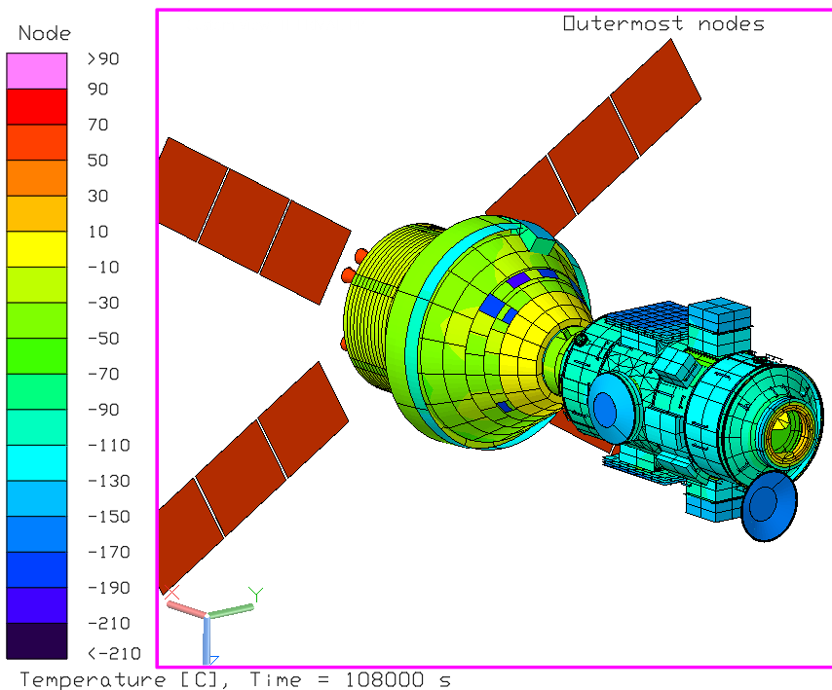
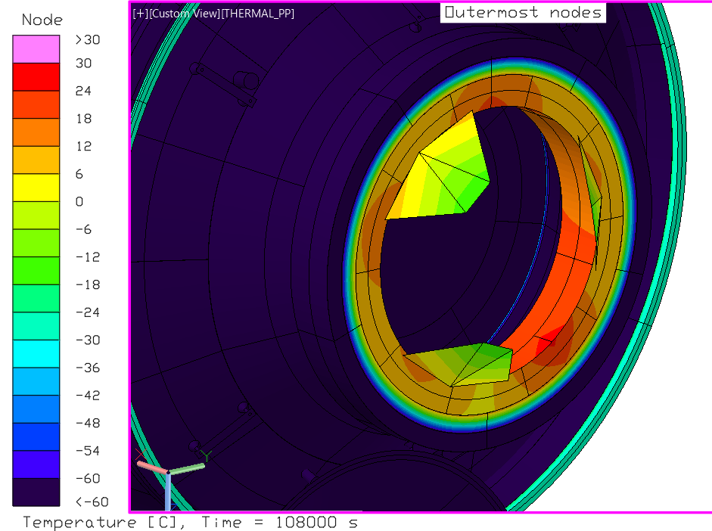
0D-TtS Baseline, Docking
Average AIBDM HCS temperature steadies out at 14°C, never reaching its setpoint of +20/+26°C

Slide 14
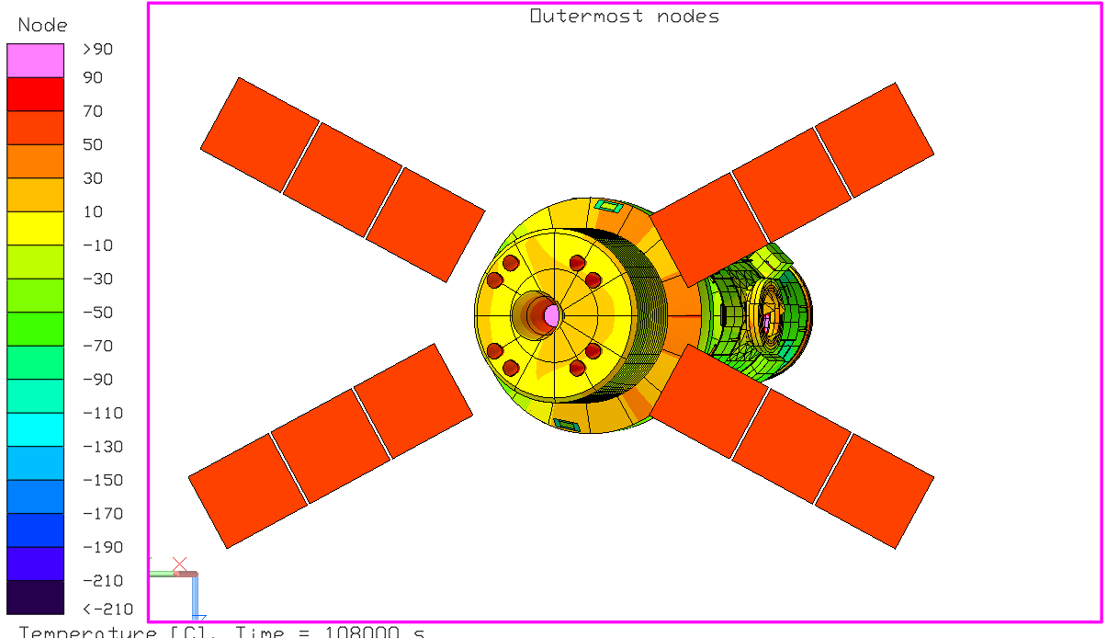
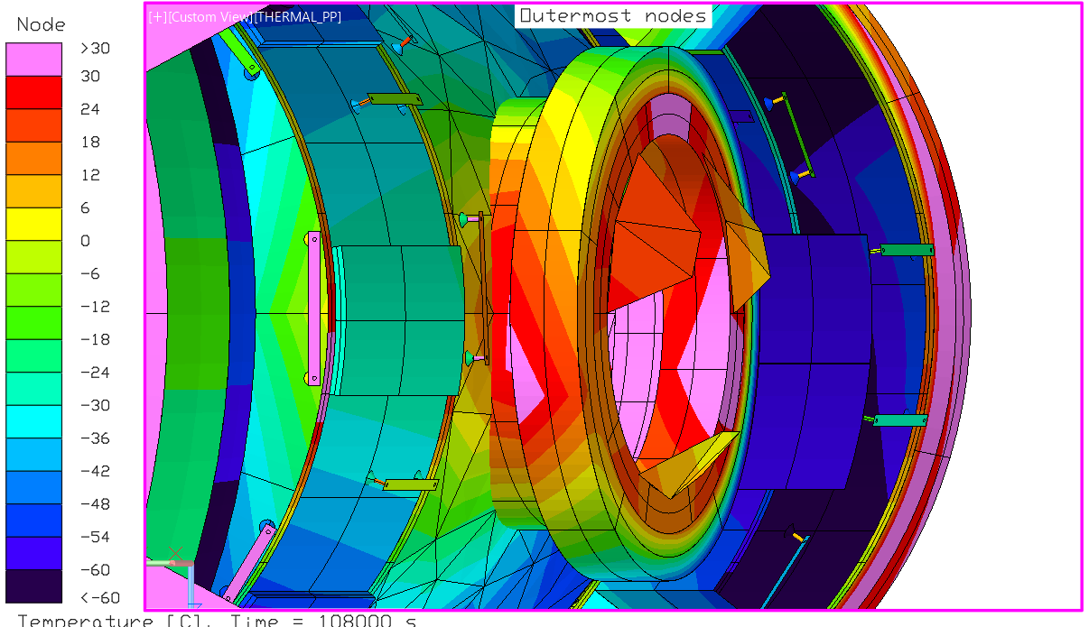
3T-Y20 No -Y TCA, Yaw20, Transit
-Y IBDM without TCA remains warm, well above its setpoints, in yaw = 20° attitude
View from Sun

Slide 15
Recommendations
Having the IBDM heaters have variable setpoints is highly recommended, especially on the AIBDM, to reduce heater power.
This is especially recommended at any port where the TCA is removed, such that docking temperature setpoints do not have to be maintained throughout the entire transit, and instead, survival setpoints can be used. This also allows for Smart Heating of the IBDM HCS and SCS.
If possible, override power switch status for heaters in the TCU to provide heater controls with flexible setpoints in MSM.
Eliminate TCU and control heaters directly from MSM.
Modify TCU to allow for flexible setpoints.
Alternatively, add a separate set of transit heaters on IBDMs to heat IBDMs during transit. These heaters are only used for transit and will not be used after docking.
Docking temperature setpoint for AIBDM can be reduced from current baseline and still meet delta-temperature requirement for docking to HALO NDS.
Protecting for an IBDM HCS temperature of ≈5°C gives good margin to docking to HALO NDS.
Extending the duration that Orion+CPL shadows the HALO docking port to ≈30 minutes allows IHAB to dock to HALO NDS using only survival setpoints on the AIBDM, but puts constraints on approach attitude and docking timeline. Savings from lower setpoints are outweighed by additional time spent on battery power if docking timeline has to be extended.

Slide 16
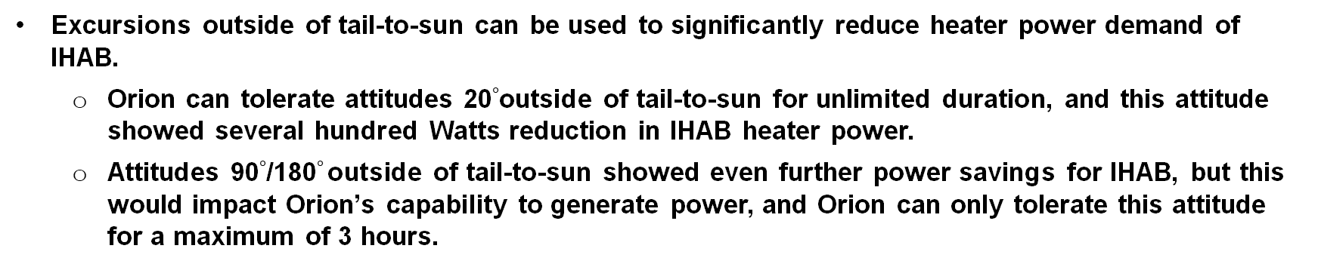
Recommendations continued
Excursions outside of tail-to-sun can be used to significantly reduce heater power demand of IHAB.
Orion can tolerate attitudes 20$°$outside of tail-to-sun for unlimited duration, and this attitude showed several hundred Watts reduction in IHAB heater power.
Attitudes 90$°$/180$°$outside of tail-to-sun showed even further power savings for IHAB, but this would impact Orion’s capability to generate power, and Orion can only tolerate this attitude for a maximum of 3 hours.

Slide 17
Current Status of TCA Removal
Baseline mission closes wrt to power. ✅
Removal of axial TCA is feasible wrt to power. Programmatic challenges remain.
Removal of all TCAs is not feasible per current analysis. Opportunities remain.
Study informed pathway:
ESA/TAS-I teams are taking action now to remove the TCU and redesign the IBDM Passive Thermal Control System (PTCS). They consider this redesign a prudent system level improvement, regardless of TCA omission outcome. It is expected to enhance CPL power efficiency which supports trade study objectives while also reducing I-Hab mass.
Recommend: After redesign, perform updated analysis. Any decision that includes the omission of the Axial cover (priority) require either near term risk acceptance to meet CDR deadline or longer-term forward work to resolve challenges prior to TCA assembly, integration, testing.

