Slide 1
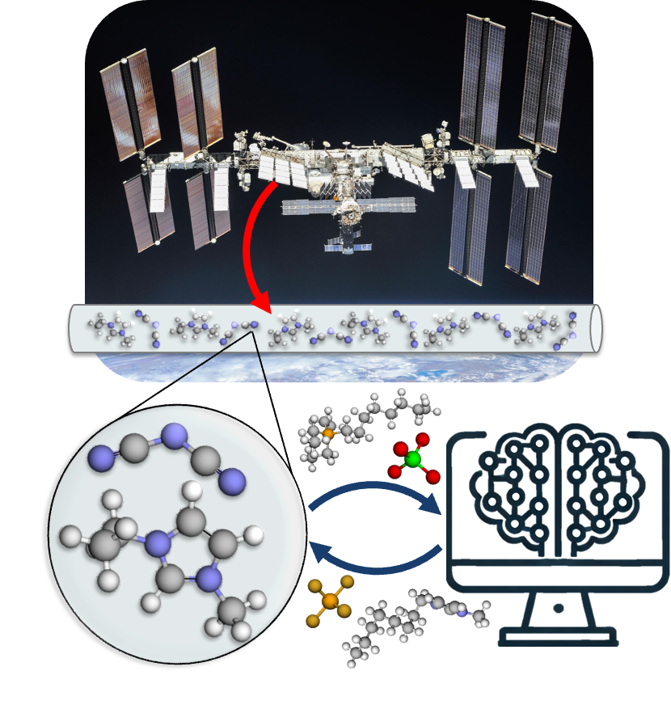

Machine Learning-Guided Design of Ionic Liquids for Next-Generation Pumped Fluid Loops
Thermal & Fluids Analysis Workshop 2025
NASA Ames Research Center
Thermal Control and Protection August 4, 2025
Source: NASA
Elif Acar, Eric Yablonski, and Sadaf Sobhani
Cornell University

Slide 2
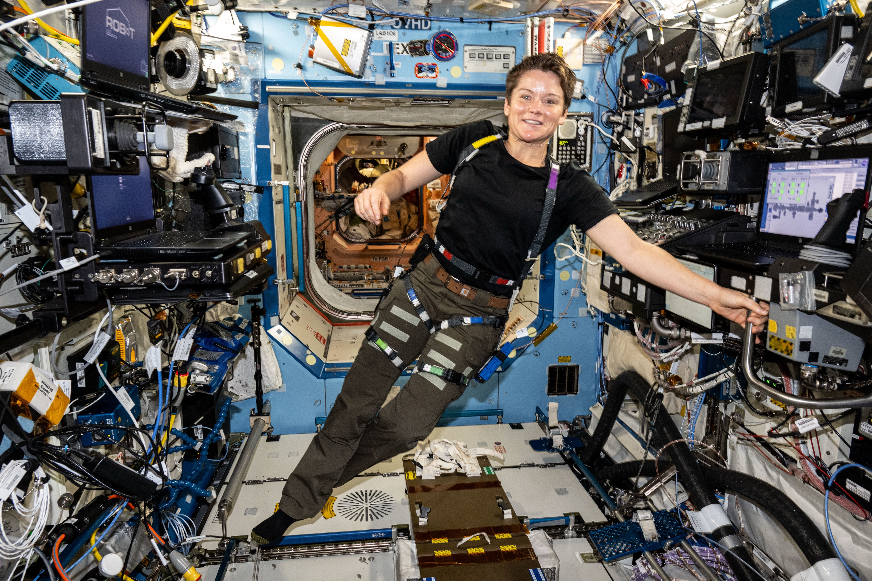
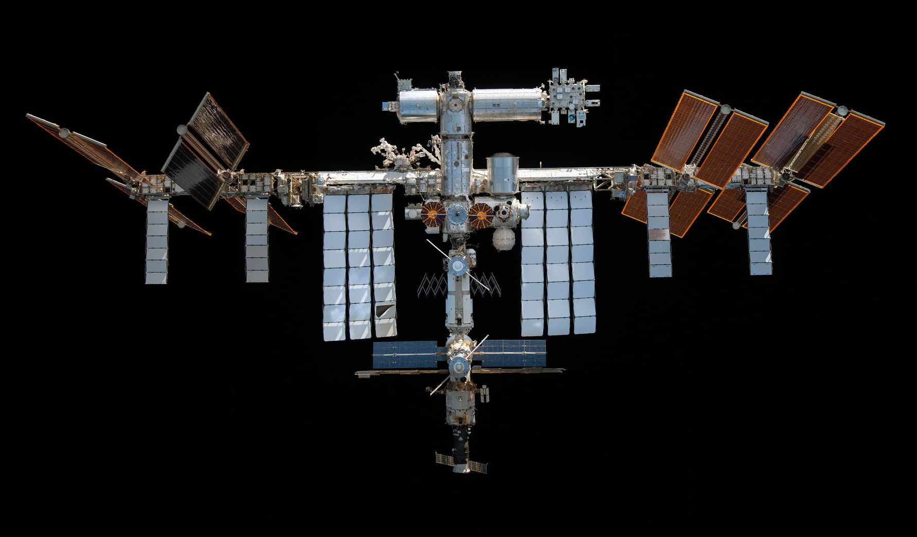
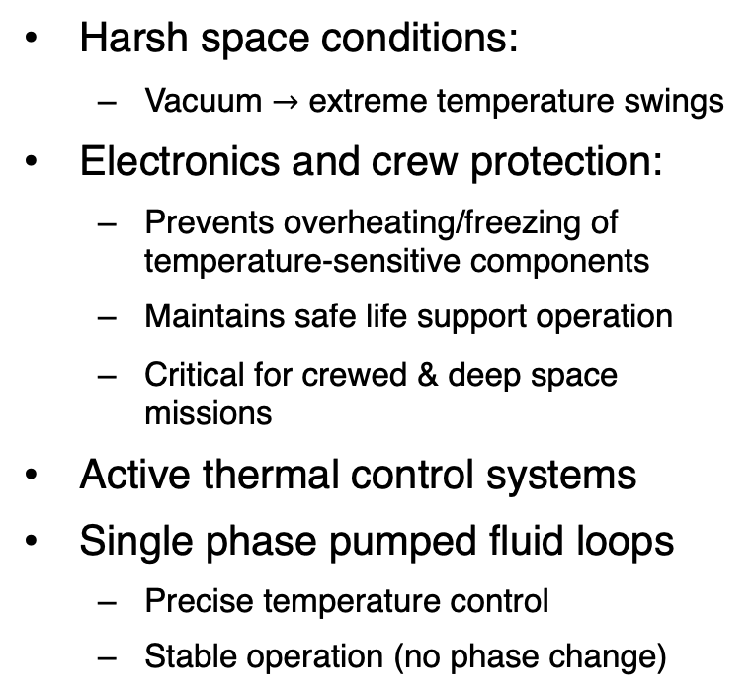
Thermal Control Systems
Harsh space conditions:
Vacuum $→$ extreme temperature swings
Electronics and crew protection:
Prevents overheating/freezing of temperature-sensitive components
Maintains safe life support operation
Critical for crewed & deep space missions
Active thermal control systems
Single phase pumped fluid loops
Precise temperature control
Stable operation (no phase change)
Heat Collection Transportation
Radiators
Heat Rejection
International Space Station (ISS)
Sources: NASA
Notes:
Space is a thermally harsh environment. Because of the vacuum, there's no atmosphere to buffer temperature changes — so spacecraft face extreme temperature swings, especially as they move in and out of sunlight.
To ensure mission success, we need thermal control systems to protect both electronics and crew. These systems prevent overheating or freezing of sensitive components and are essential for keeping life support systems stable — especially in crewed and deep space missions.
To meet these demands, active thermal control systems are used. Among them, single-phase pumped fluid loops are preferred for their precise temperature control and stability, since they avoid phase change and operate in a single liquid phase throughout the loop.
The image on the right shows the thermal loop on the ISS — with fluid circulating to collect, transport, and reject heat using external radiators.

Slide 3
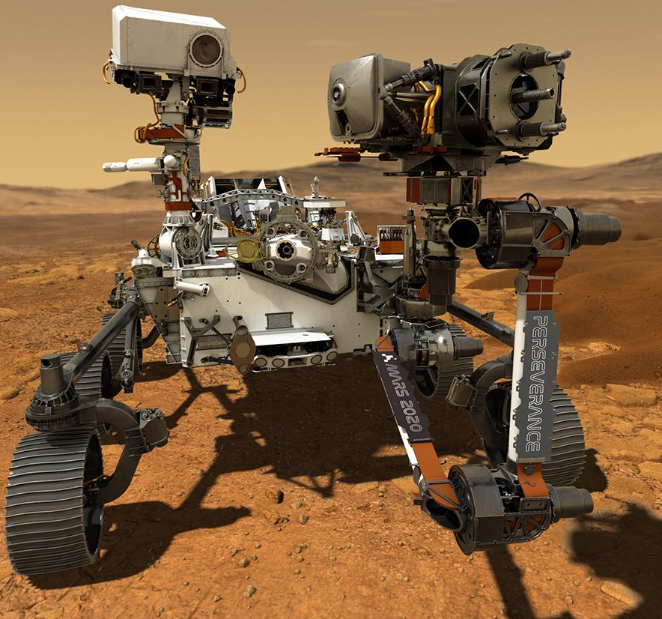
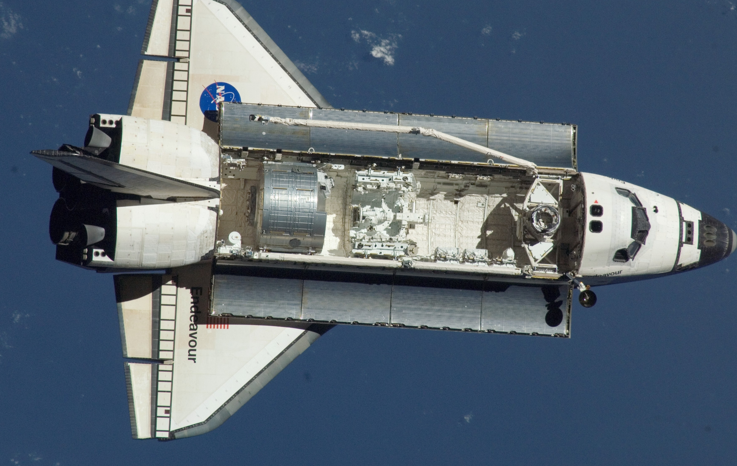





Single Phase Pumped Fluid Loops
Traditional working fluids are limited:
toxic
discontinued fluorinated liquids (forever chemicals)
Freon-11
Source: NASA
water
Freon-21
Two-fluid loop example
Design Considerations
Internal Loop
Water
PG (aq.)
External Loop
HFE-7200
FC-72
FC-770
Ammonia
Viscosity
Freezing Point
$$∆P→W_{pump}=f\left(ρ, μ\right)$$
$$\dot{m}=ρ\dot{V}$$
Specific Heat
Density
Thermal Conductivity
$$Nu=Dh_{conv}k^{−1}$$
$$\dot{Q}=f(ρ, C_{p},μ, k)$$
$$Pr=C_{p}μk^{−1}$$
Notes:
Single-phase pumped fluid loops are widely used in both robotic systems, like Mars rovers, and human spacecraft such as the Space Shuttle and the ISS. These loops can be single- or two-fluid systems, as shown in the diagram.
But there’s a catch — these systems require extra hardware like pumps and heat exchangers, which adds to system mass. More importantly, the choice of working fluid is very limited.
Some traditional fluids are toxic, making them unsafe for use in internal loops on human missions — even a small leak could be dangerous. Others, like many fluorinated liquids, are being discontinued because they are classified as forever chemicals. For example, 3M has stopped manufacturing some of them.
From a design perspective, the ideal fluid minimizes pump work and maximizes heat transfer. Pump work depends on density and viscosity, while heat transfer depends on thermal conductivity, specific heat, density, and again viscosity. So we want to reduce viscosity and freezing point while increasing the others.
And that’s really the motivation of our work — to find novel fluids, that satisfy these design considerations and can operate safely and efficiently in spacecraft thermal control systems.
$q=−kA\frac{dT}{dx}→A_{\frac{rad}{HTX}}=f(k)$
$\dot{m}=ρ\dot{V}→\dot{Q}=\dot{mC_{p}}∆T=f(ρ, C_{p})$
$∆P→W_{pump}=f\left(ρ, μ\right)$
$\dot{Q}=h_{conv}∆TA$ = $=\dot{m}C_{p}∆T$

Slide 4
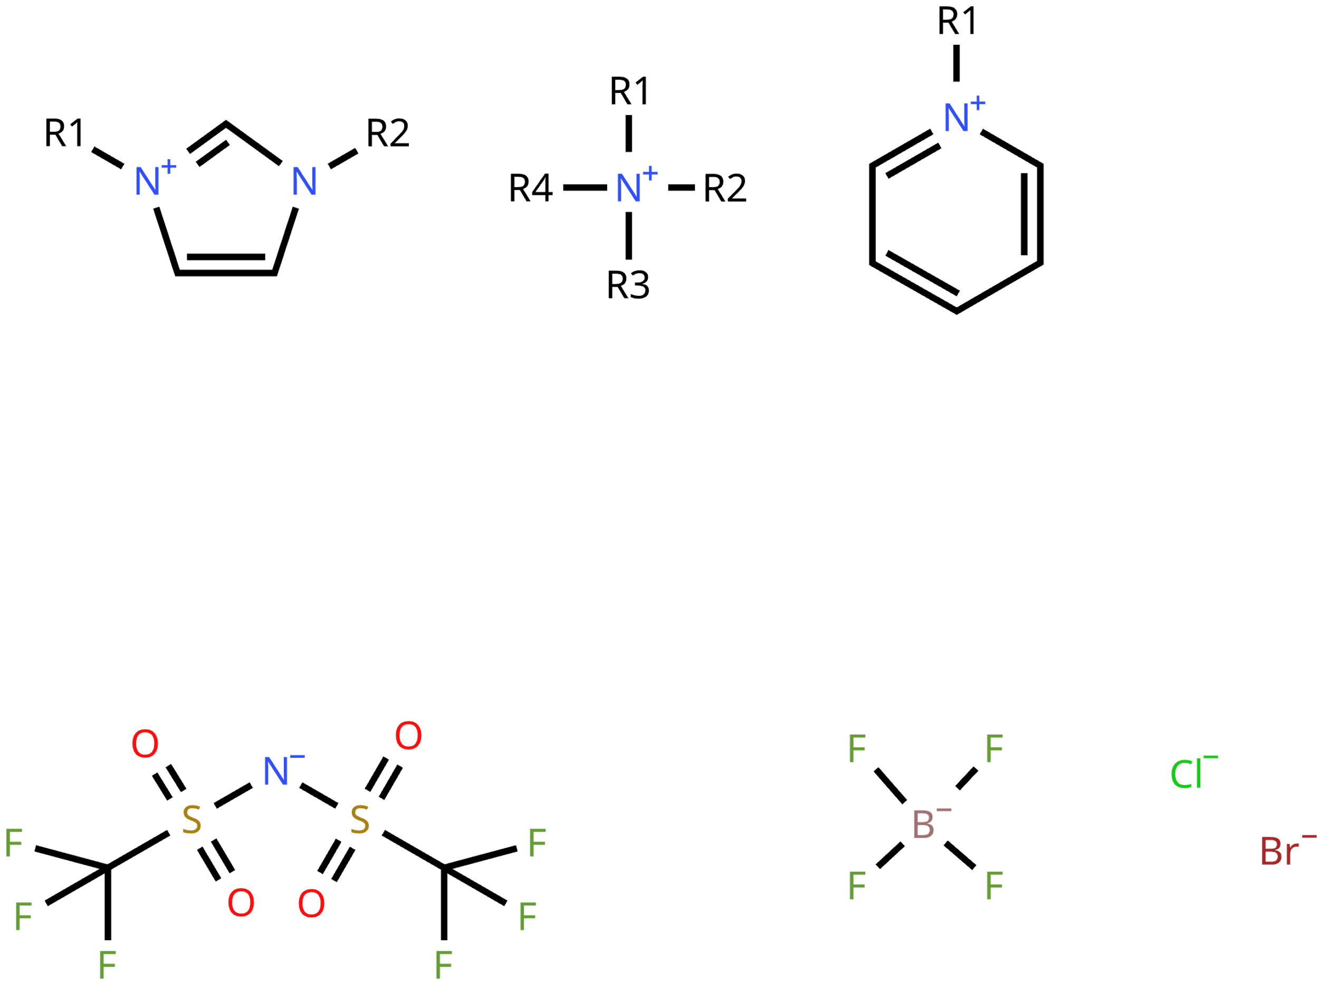
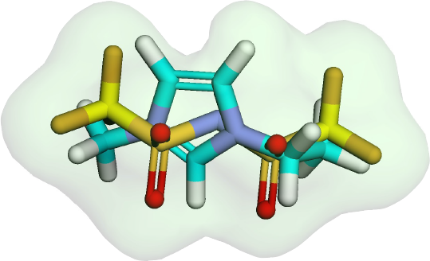
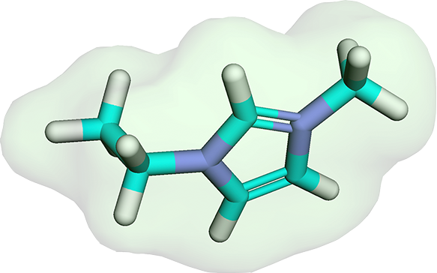

Ionic Liquids: Promising Working Fluids
Liquids comprised entirely of ions – molten salts
The combination of cations and anions forms ionic liquids, enabling the design of tailored properties
523 [J/mol.K]
0.0396 [Pa.s]
20$°$C
anion
anion
cations
imidazolium
halides
TFSI
484 [J/mol.K]
0.0478 [Pa.s]
pyridinium
Unique properties: (from electrostatic forces & interactions)
negligible vapor pressure & low volatility
high thermal stability
Notes:
And here we introduce ionic liquids.
These are liquids made entirely of ions — essentially molten salts — and they’re formed by combining a cation and an anion.
What makes them really exciting is that by changing the cation-anion pair, we can tune their properties. This means we can design ionic liquids with specific characteristics — thermal, physical, or chemical — depending on our application needs.
For example, this cation paired with bromide results in a solid at room temperature. But if we pair it with a different anion like TFSI, we get a liquid. And not just melting point — other properties like viscosity and specific heat also change depending on the pairing.
Thanks to their strong electrostatic interactions, they also have unique advantages — they show negligible vapor pressure, meaning they don’t evaporate easily, and they have excellent thermal stability.
So overall, ionic liquids offer a highly customizable and thermally stable alternative to traditional fluids, making them a very promising candidate for pumped fluid loops in spacecraft.
1-butylpyridinium Cl 405 K
1-ethyl-3-methylimidazolium Br 345 K
1-ethyl-3-methylimidazolium TFSI 263 K
1-ethyl-3-methylpyridinium TFSI 272 K

Slide 5
Why Machine Learning (ML)?
1,157
Unique Cations
406
Unique Anions
Vast chemical space
~10⁸ possible ILs
Traditional methods
Too slow for large-scale screening
ML advantages
Fast, predictive screening
Fewer experiments needed
469,742 generated ILs
Remove known and unsuitable-for-ML ILs
328,570 generated ILs
Notes:
Now the question is — how do we pick the most optimal ionic liquid for our purpose?
We turned to machine learning.
Because when you consider that there are potentially over 100 million possible ILs from different cation-anion combinations, it quickly becomes clear that traditional experimental or computational screening is just not feasible — it’s too slow and expensive.
Machine learning, on the other hand, offers a fast and predictive way to screen these ILs. It helps us narrow down the most promising candidates with desired properties while minimizing the need for trial-and-error experimentation.
Based on the cation-anion data we’ve collected so far, we were able to generate over 300 thousand novel IL candidates that are suitable for ML modeling — and we’re still expanding our design space to include even more.

Slide 6
Literature
Research Gap:
IL–ML for spacecraft heat transfer
Growing interest in ML-driven IL property prediction
Paduszyński, K. et al. (2014, 2019, and 2021): chemical industry
Predicted viscosity and melting point using ANN, SVM, MLR
Used group contribution features for ML comparison
Datta, R. et al. (2022): batteries and fuel cells
Predicted ionic conductivity using DNN and molecular descriptors
Emphasized data splitting that excludes test-set ILs from model development for realistic generalization
Another key area:
CO₂ capture-solubility
Saher, S. et al. (2025): Thermal energy storage for renewables
Predicted melting point and enthalpy of fusion using MLR and DNN
Used molecular descriptors
Validated predictions experimentally
Notes:
There’s been a surge in recent years in applying machine learning to predict ionic liquid properties — in fact, a new paper came out just last week from a group working on something similar, which shows this direction is gaining momentum.
Across the literature, we see applications ranging from the chemical industry to energy storage, batteries and carbon dioxide capture. Paduszyński's group explored viscosity and melting point prediction using various ML models. Datta’s team focused on ionic conductivity and emphasized how important the right data splitting strategy is for real-world prediction, which we applied to our work. Saher et al. went a step further by validating their melting point predictions experimentally for thermal energy storage systems.
However, while these studies show the potential of ML-IL integration, they don’t directly address spacecraft heat transfer. That’s the critical research gap our work focuses on — designing and predicting ILs specifically as high-performance heat transfer fluids for extreme environments in space applications.

Slide 7
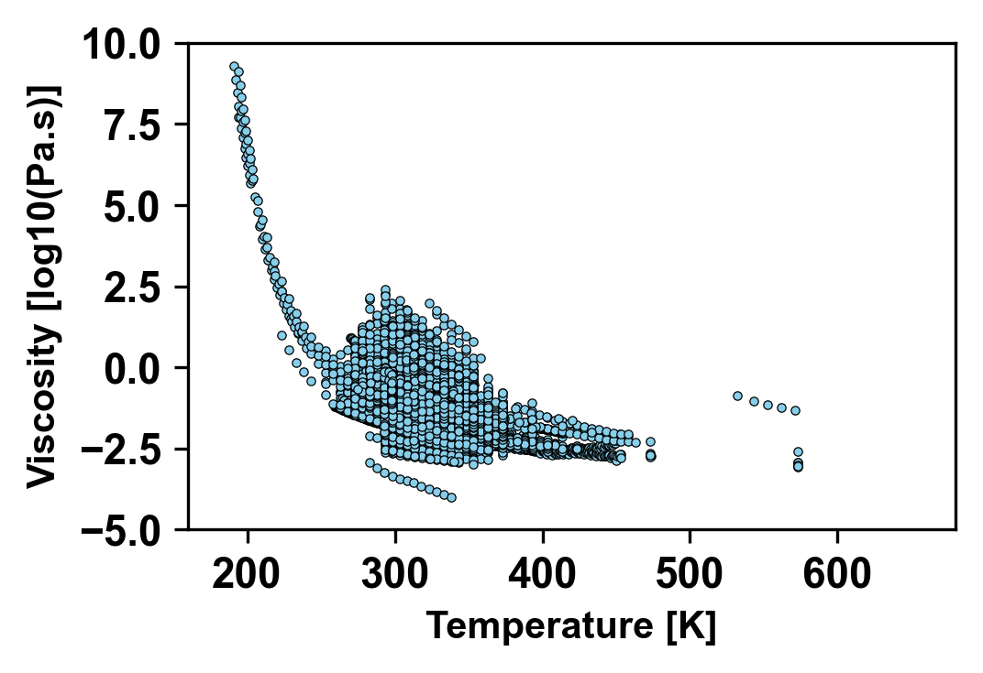
Data Gathering
NIST ILThermo Database
 | Unique ILs | Data points | Temperature Range [K]
Viscosity | 1,139 | 13,605 | 191.2 – 573
LPTT* | 1,458 | 1,458 | 170 – 581.6
Density | 1,329 | 18,368 | 253.15 – 573
Heat capacity | 305 | 10,478 | 183.45 – 663.1
Thermal conductivity | 89 | 708 | 273,15 – 438.07
Diverse ILs for generalized model
High number of data points improves ML learning
Wide temp range, especially low T, is critical
Non-linear behavior
Capturing complex patterns: ML
*LPTT: Liquid Phase Transition Temperature
Notes:
We started by gathering data from the NIST ILThermo database, which includes thermophysical property measurements for thousands of ionic liquids.
For effective machine learning development, we need three key things: a wide variety of ILs, a high number of data points, and a broad temperature range—especially on the low end, which is critical for spacecraft applications.
Among the properties, viscosity stood out. It had the best combination of unique ILs, rich data coverage, and a wide temperature span, making it ideal for training robust ML models.
Other properties, however, were more challenging. For example, thermal conductivity and liquid phase transition temperature had much lower data availability and variety, which limited model performance.
The figure on the right shows how complex and nonlinear these property trends can be—and that’s exactly where machine learning is most useful: capturing patterns that traditional models often miss.

Slide 8
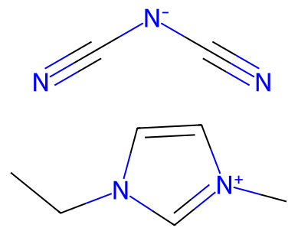
Featurization
Chemical Name
1-ethyl-3-methylimidazolium dicyanamide
py2opsin
Molecular Descriptors
Atom types
Bond types
Molecular Weight
Number of valance and radical electrons
Number of rings and acceptors
SMILES String
[N-](C#N)C#N.C(C)N1C=[N+](C=C1)C
RDKit
Notes:
After gathering the data, we applied featurization method.
Which is the process of transforming physical and chemical features of ionic liquids into vectoral representations as models can’t work directly with chemical names or molecular drawings.
First using py2opsin library we convert chemical names of ILs into SMILES strings.
From SMILES using RDkit library we obtain molecular descriptors of each unique IL.
These descriptors are numerical presentation of molecules such as atom types and bond types but its not limited to these as we obtained 210 descriptors.
At the bottom, you can see an example of this process for two ionic liquids with just a few of their descriptors shown.
--------
210 molecular descriptors

Slide 9
Data Preparation for Machine Learning
Train-Validate-Test set split ratios (%)
80-10-10:
viscosity
thermal conductivity
80-0-20:
density
LPTT
heat capacity
Data scaling
Min-Max normalization:
features of all
log10:
viscosity
thermal conductivity
no scale:
LPTT
density
heat capacity
Feature reduction
Zero variance
Fully correlated pairs
Missing data
LASSO regression
Ensures values are comparable
Improves model convergence
Prevents bias from large-scale differences
Train: Model learns patterns
Validation: Tune model & avoid overfitting
Test: Evaluate final model performance on unseen ILs
Removes irrelevant or redundant information
Improves model performance
Reduces overfitting risk
Notes:
After constructing the feature set, we prepared the data for machine learning by applying three key steps: splitting, scaling, and reduction.
We first split the data into train, validation, and test sets.
The training set is used for the model to learn patterns.
The validation set, when used, helps us tune the model and avoid overfitting.
And the test set is for final performance evaluation on completely unseen ILs. For some properties, like LPTT and density, we skipped validation because the model type didn’t require it.
Then, we applied scaling to ensure numerical comparability across features. This helps the model converge faster and prevents bias from large feature ranges. For properties like LPTT and density, we didn’t scale the target because it wasn’t necessary.
Lastly, we performed feature reduction to remove zero-variance or fully correlated features. This step reduces noise, prevents overfitting, and improves model performance overall.

Slide 10
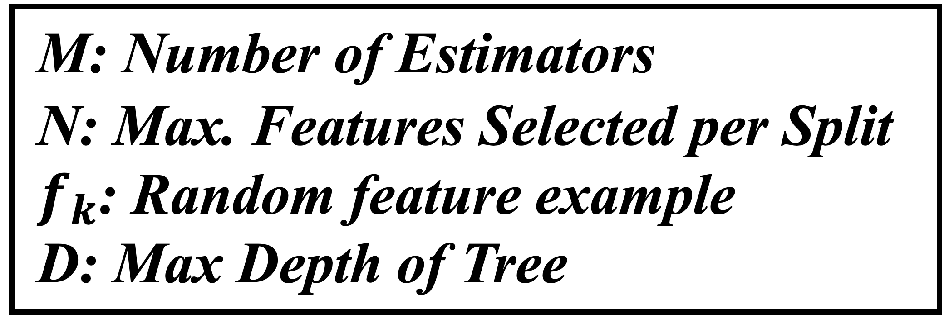
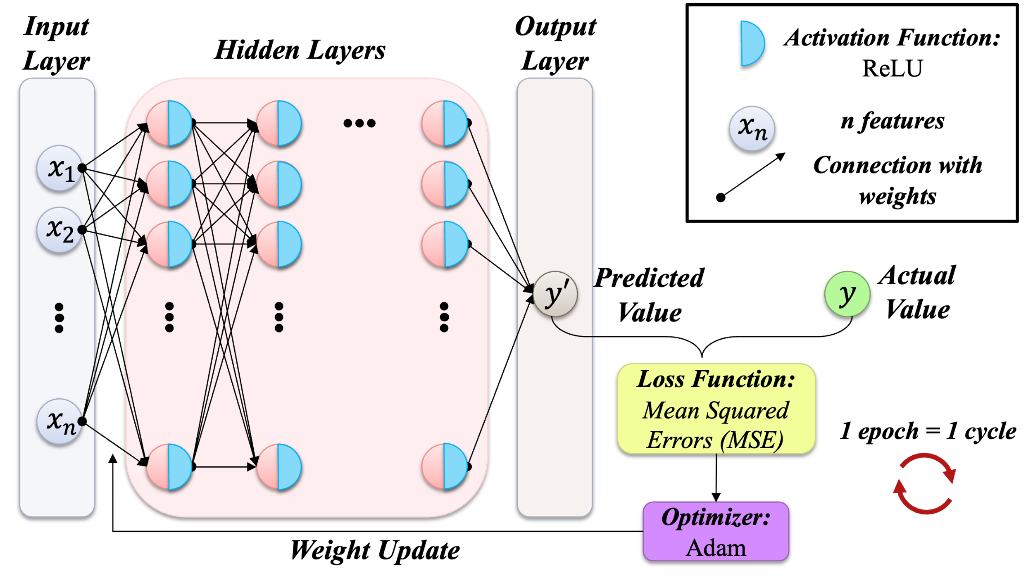
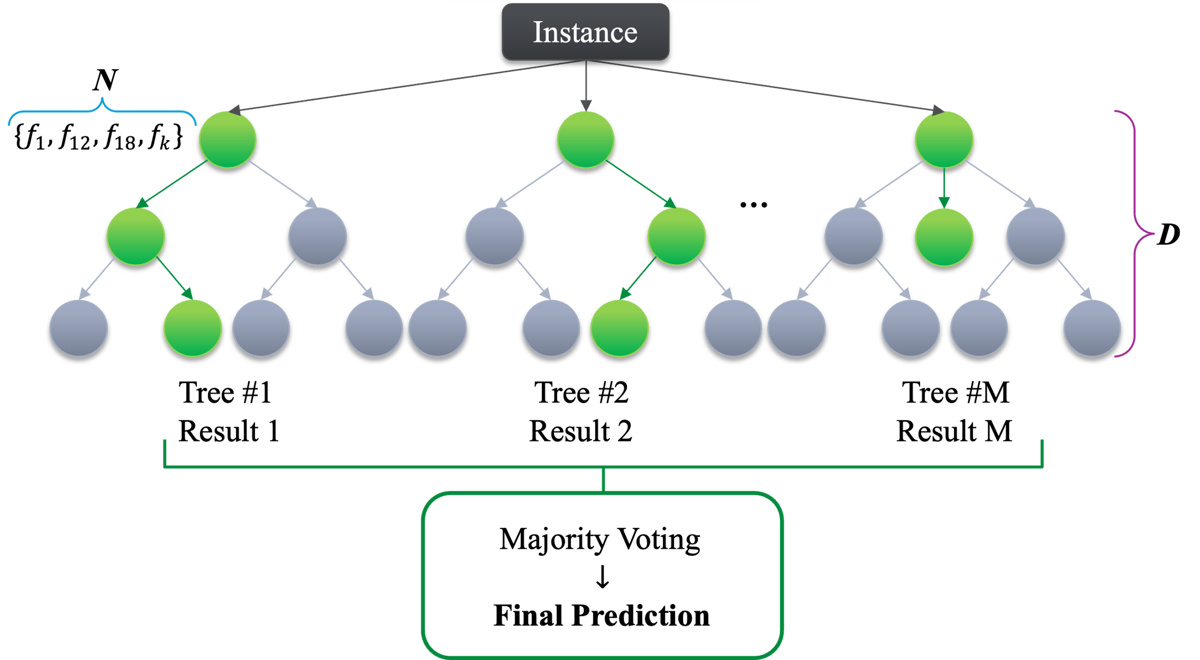
Model Development
*Acar, E. and Sobhani, S., (2025). "Predicting Thermophysical Properties of Ionic Liquids Using Deep Neural Networks and Random Forests," AIAA SCITECH 2025 Forum
Deep Neural Network
Random Forest
Viscosity
Thermal Conductivity
LPTT
Density
Heat Capacity
Notes:
For the sake of time, I won’t go into the details of machine learning models, but briefly—
We used Deep Neural Networks for viscosity and thermal conductivity, where the model learns through layers of interconnected neurons.
For other properties—LPTT, density, and heat capacity—we used Random Forest, an ensemble tree-based method that makes predictions by combining results from multiple decision trees.
Both models were selected based on performance and suitability for the type and size of data we had.

Slide 11
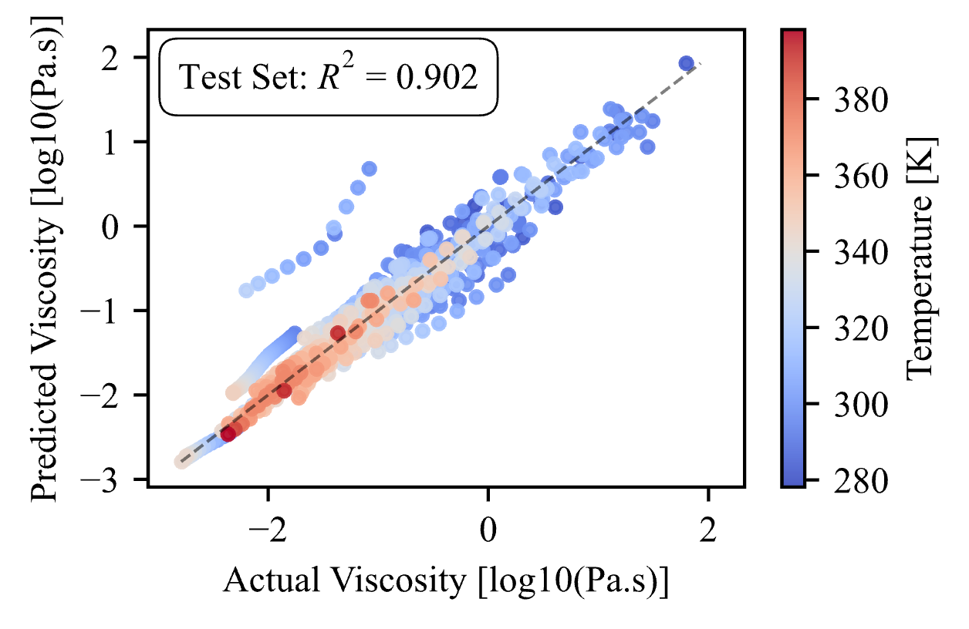
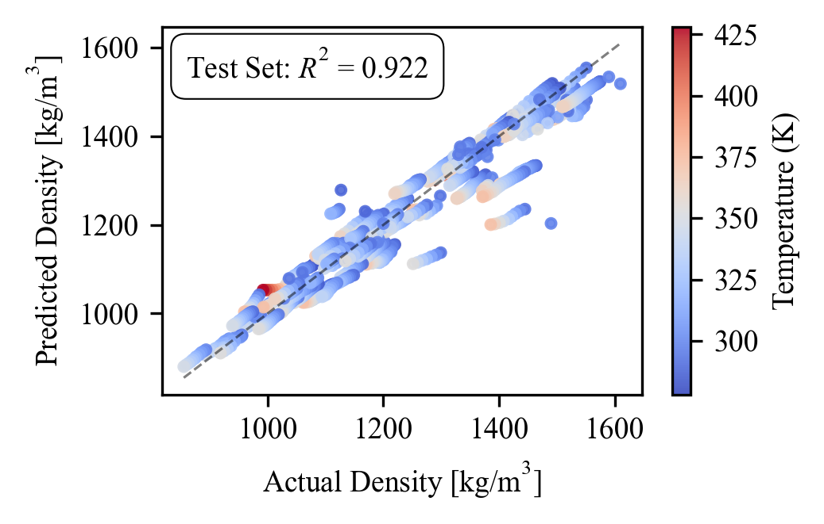
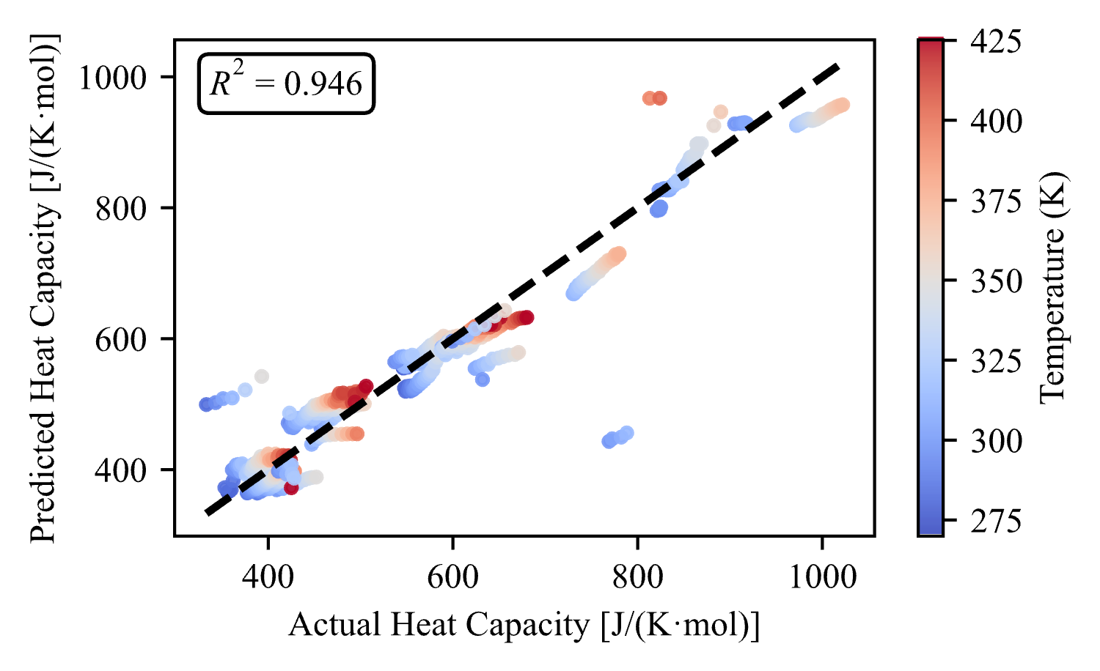
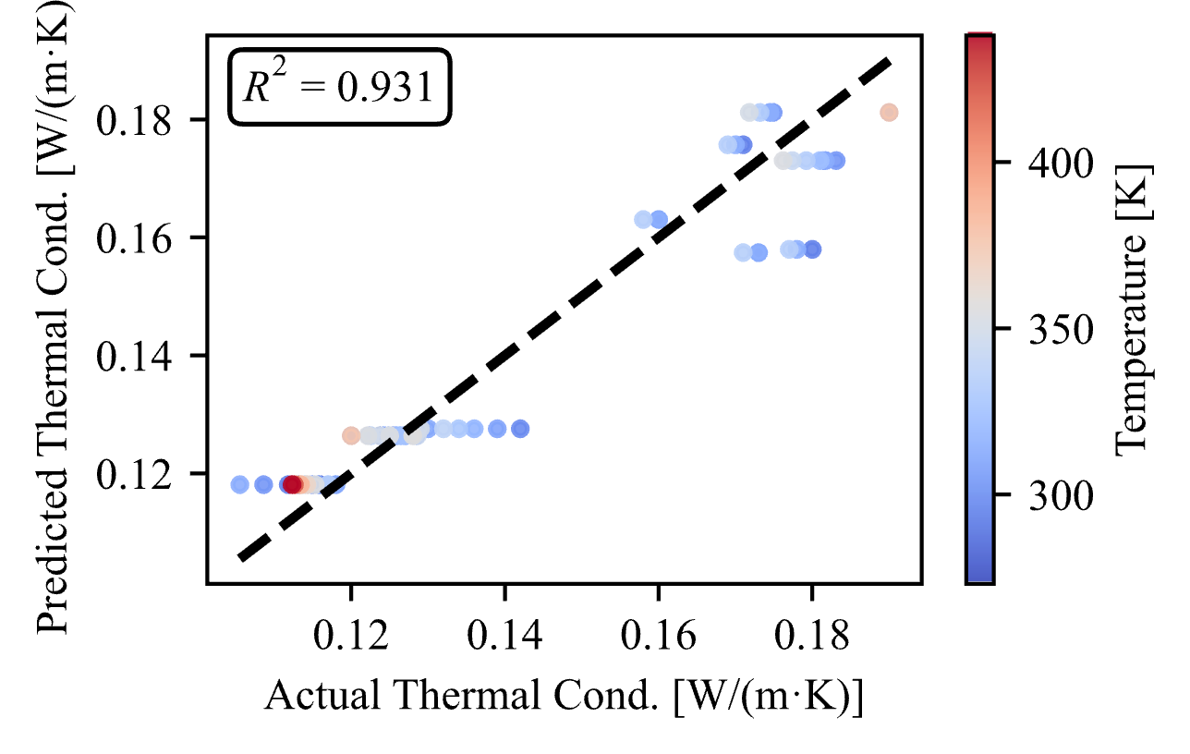
ML Model Performance
R² ~1 → good fit
Notes:
After the models were developed, we went through many rounds of training and testing—tuning hyperparameters and adjusting settings to reach optimal performance. It was a trial-and-error process that required quite a bit of iteration.
As you can see from the results, we’ve achieved strong model performance overall, with R² values close to 1, indicating a good fit.
That said, we do observe some outliers in each property. This is not unusual, but it also suggests there’s room for improvement—whether by refining model parameters, expanding the dataset, or exploring new features beyond the molecular descriptors we've been using.

Slide 12

System-Level Performance Analysis
Trained & Tested
ML Models
Input
Reflects how well a fluid performs in a pumped thermal control loop
Generated ILs
Molecular Descriptors
+ Temperature:223 to 373 K
(10 K step)
viscosity
Property Predictions
Figure of Merit
$$FOM=\frac{ρ^{0.58}C_{p}^{0.4}k^{0.6}}{μ^{0.47}}$$
$$∝\frac{\dot{Q}}{P_{pump}^{0.29}}∙\frac{1}{∆T}$$
density
System-Level Performance Analysis
LPTT
Heat Capacity
FOM adapted for turbulent flow
(from Ehrenpreis et al., 2020)
Thermal Conductivity
Notes:
Now that our models are trained and tested, we can use them to predict thermophysical properties of novel ionic liquids—generated by combining different cations and anions.
We applied the same preprocessing steps to these new ILs to generate features and selected a temperature range from 223 to 373 K in 10 K steps. Then, we asked our models to predict these properties for each IL-temperature pair.
But rather than evaluating each property in isolation, we conducted a system-level performance analysis. This gives a more holistic understanding of how well a fluid performs in a pumped thermal control loop.
We used a Figure of Merit (FOM) equation that reflects system-level efficiency based solely on fluid properties. We adapted Ehrenpreis et al.'s laminar FOM for turbulent flow to aligned with our system conditions. The FOM was calculated for each IL across the temperature range.

Slide 13
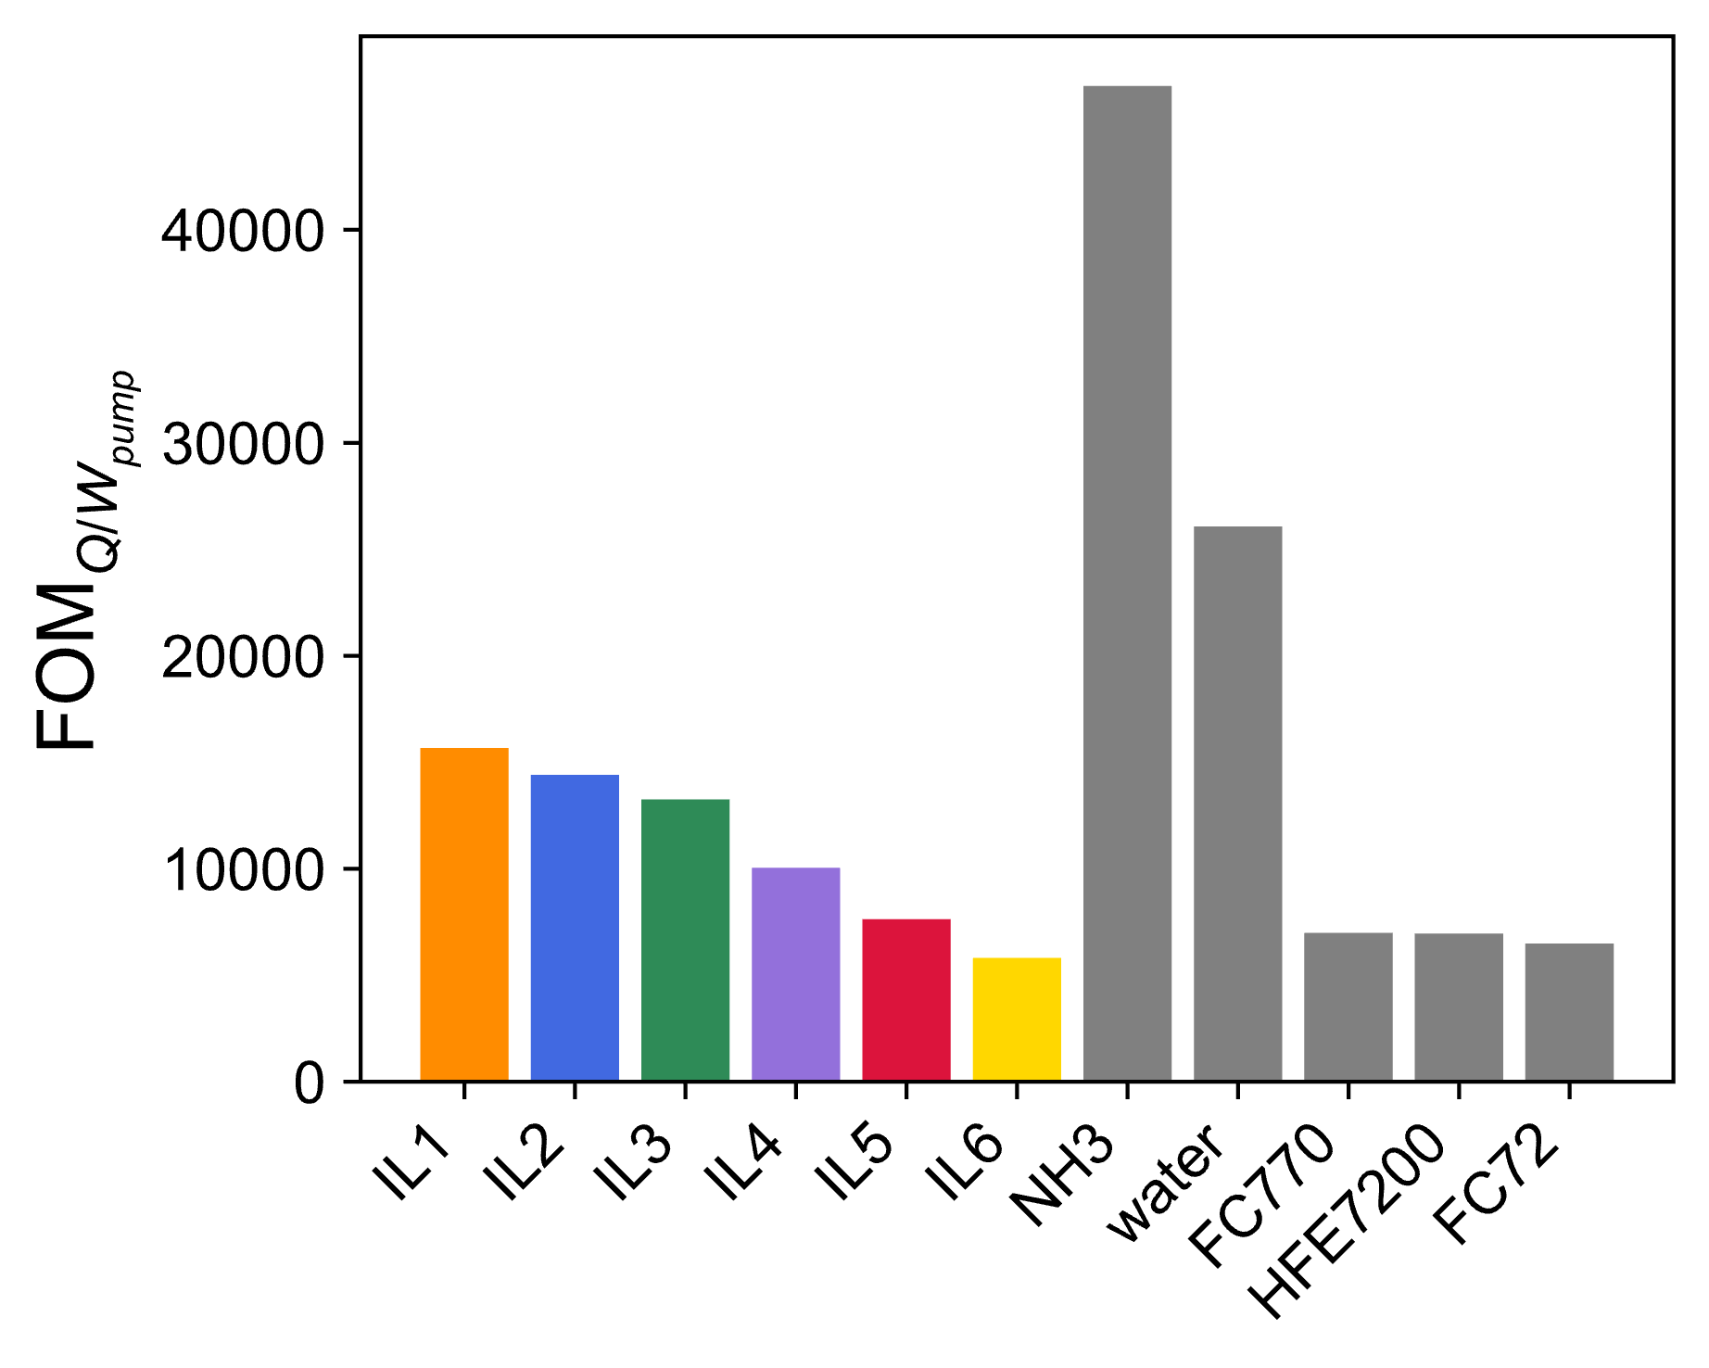
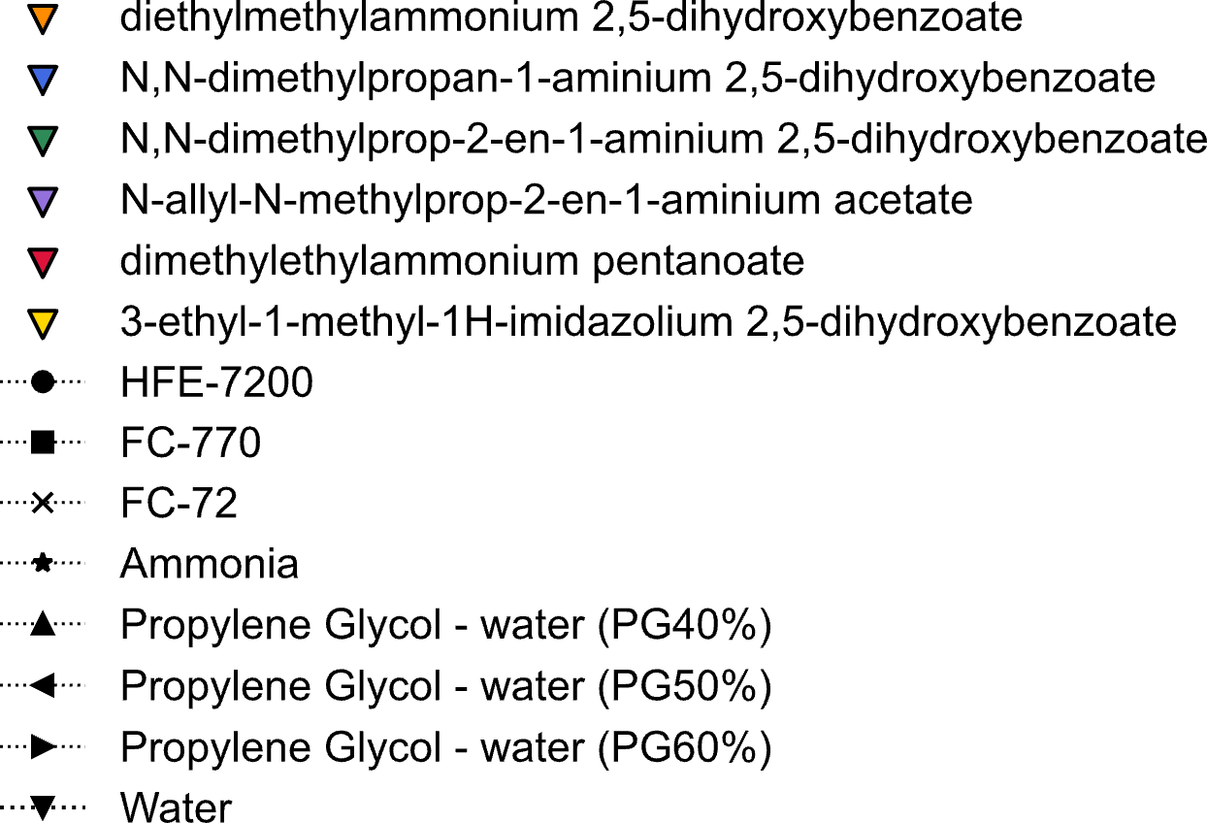
Promising System-Level Performance of ILs
Promising novel IL candidates are picked according to high FOM
at 283 K
Higher FOM → better performance:
better heat transport
lower pump power
smaller system size
Notes:
Now that we’ve calculated the FOM values using our ML-predicted properties, we can identify which ILs show the most promising system-level performance.
This chart shows FOM results at 283 Kelvin. We included several traditional fluids for comparison—like ammonia, water, and FC-based fluids.
We selected the top-performing ILs based on their high FOM, which corresponds to better heat transport, lower pump power, and smaller system size. As you can see, aside from ammonia, our ILs perform significantly better than the traditional options—especially in the context of space applications where efficiency and compactness are key.
Next, I’ll show how the properties of these ILs behave across temperatures to further assess their suitability.

Slide 14
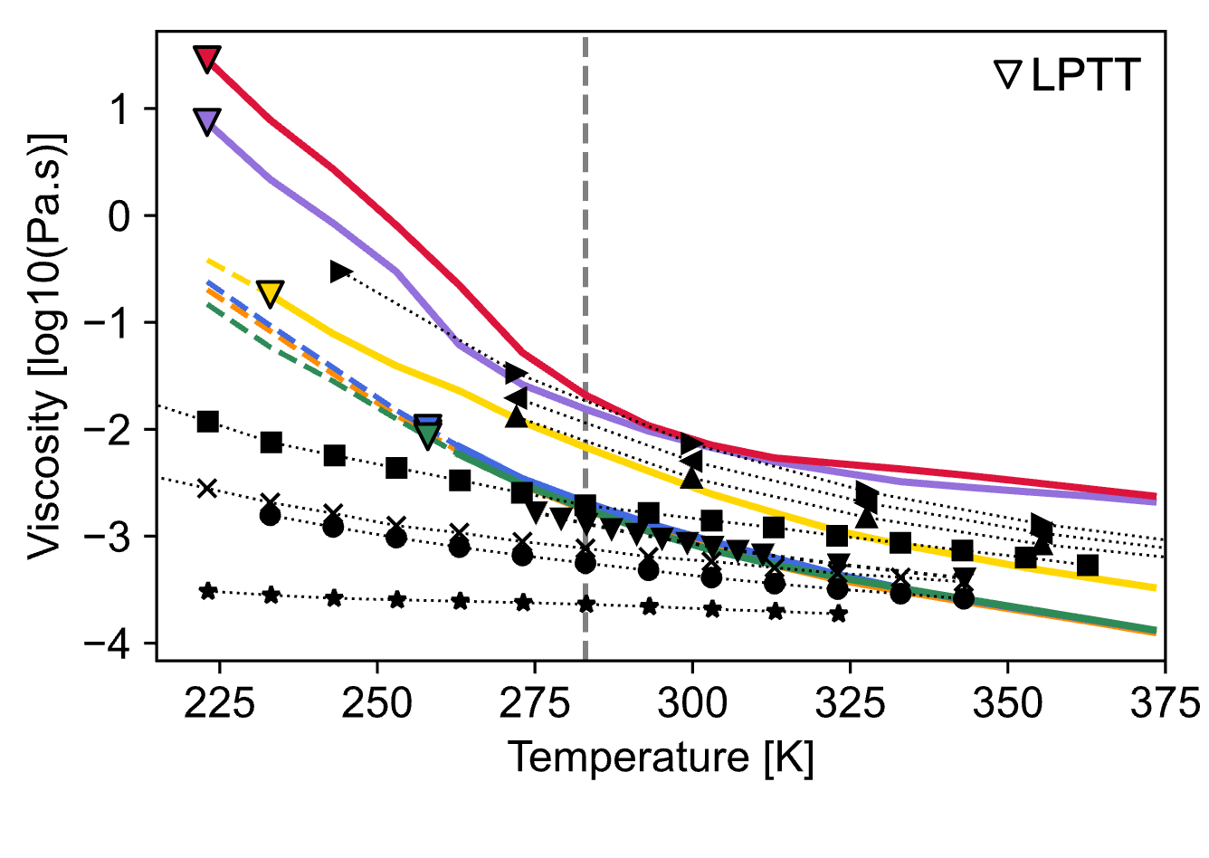
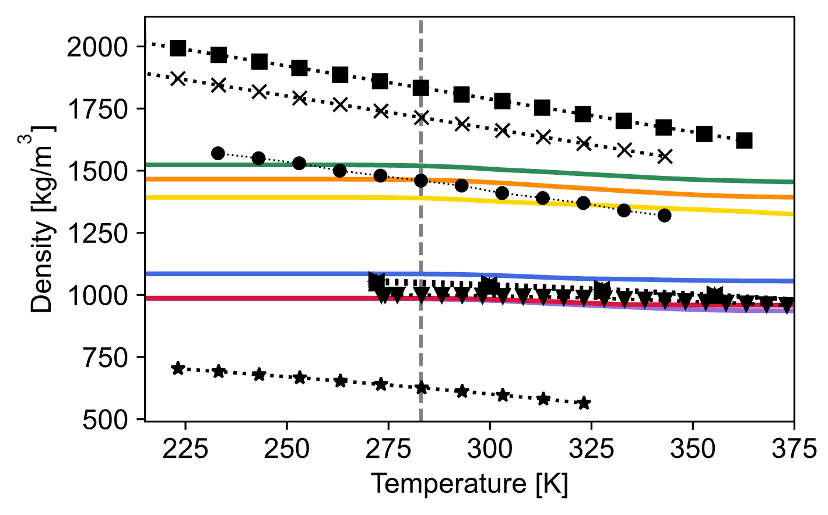
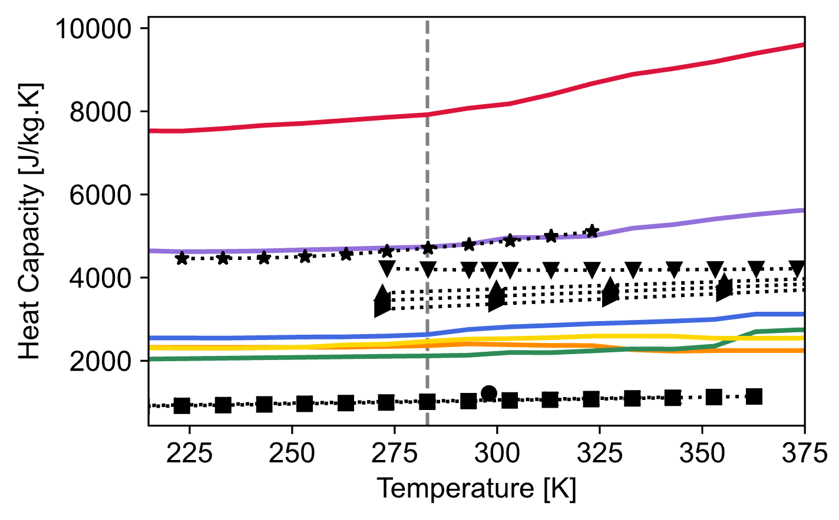
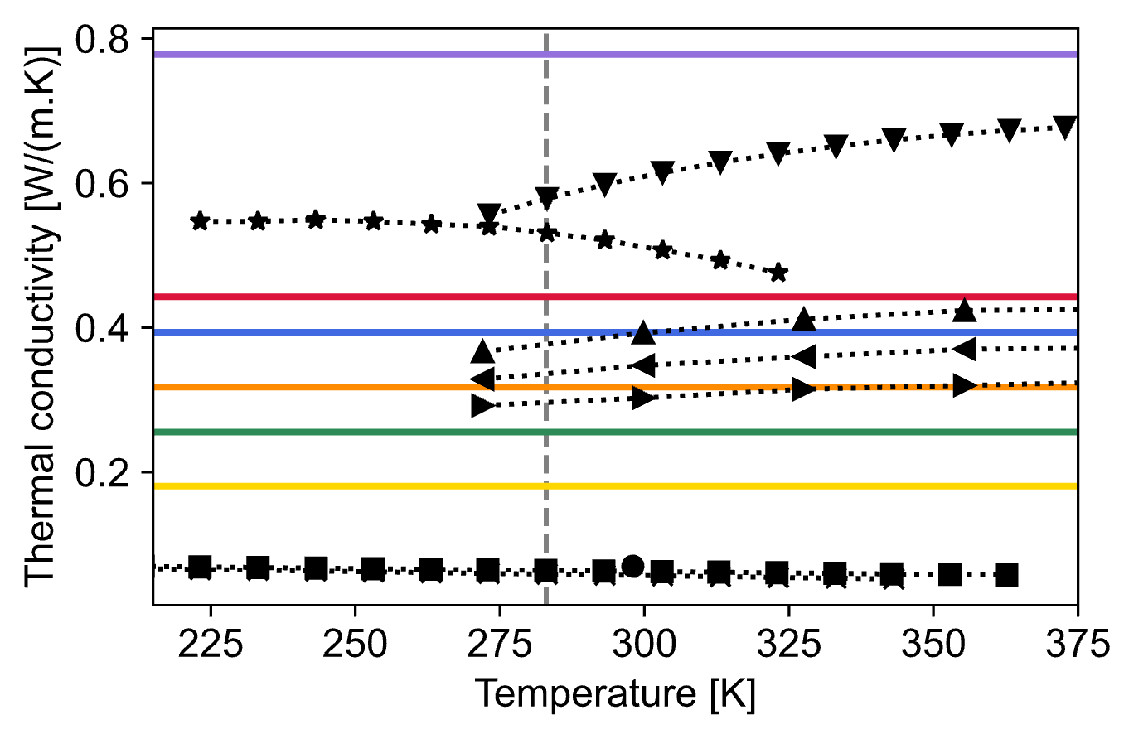

Properties of Top-Ranked Novel ILs
at 283 K
$$FOM=\frac{ρ^{0.58}C_{p}^{0.4}k^{0.6}}{μ^{0.47}}$$
195 K [LPTT]
273 K
146 K
135 K
183 K
Notes:
Here we examine the actual thermophysical property trends for the top-ranked ILs and compare them to traditional fluids.
Let’s start with viscosity. Ideally, we want low viscosity for reduced pumping power. The orange, blue, and green ILs perform well in this respect. Interestingly, even though the red IL has the highest viscosity, its overall FOM is still better than the yellow one. That tells us that despite being more viscous, it compensates through superior heat transfer properties.
Next, looking at density—we generally prefer higher values. The red IL again falls short here, but it's still in a reasonable range compared to several traditional fluids.
Now for heat capacity, and this is where the red IL shines. Its value is significantly higher than the others, which boosts its FOM and offsets weaknesses in viscosity and density.
A similar trend is seen in thermal conductivity. The red and purple ILs offer much higher values, which is another key contributor to good heat transport.
Lastly, ammonia’s FOM is outstanding due to its extremely low viscosity—even though it has lower density, its low resistance to flow dominates the FOM outcome.
Also, it's important to highlight the critical role of melting point. For example, water has high FOM, but its high freezing point limits its usability in low-temperature environments. So, even if a fluid has excellent predicted performance, it becomes irrelevant if it can’t operate at the required temperatures—especially in space applications where going cold is essential.
So what we’re seeing is a tradeoff: an IL doesn’t need to excel in all categories to perform well at the system level—strong performance in a few critical properties can carry the overall result.

Slide 15

Concluding Remarks
Introduced a ML framework to predict thermophysical properties of ILs and identified high-performance candidates for single-phase pumped fluid loops in spacecraft thermal control
Applied a Figure of Merit (FOM) approach to connect fluid properties with system-level performance
Addressed a critical research gap in developing advanced heat transfer fluids for extreme environments
Acknowledgments
Thomas Leimkuehler, NASA JSC
Eric Fox, NASA MSFC
Christopher Henry, NASA MSFC
Notes:
We introduced a machine learning framework to predict the thermophysical properties of ionic liquids (ILs) and identified promising high-performance candidates for use in single-phase pumped fluid loops in spacecraft thermal control.
To bridge fluid-level predictions with system-level relevance, we applied a Figure of Merit (FOM) approach that quantifies overall performance based on key fluid properties.
This work addresses a key research gap in the development of advanced heat transfer fluids suitable for extreme space environments.
Next steps include experimental validation of the top-performing IL candidates to confirm model predictions.
We aim to incorporate these new measurements to further refine and improve our ML models.
Additionally, we plan to extend our FOM analysis to even lower temperatures, which is essential for deep-space missions.
We want to acknowledge NASA for funding this project and thank our collaborators.

Slide 16
Thank You!
Questions?

