Slide 1

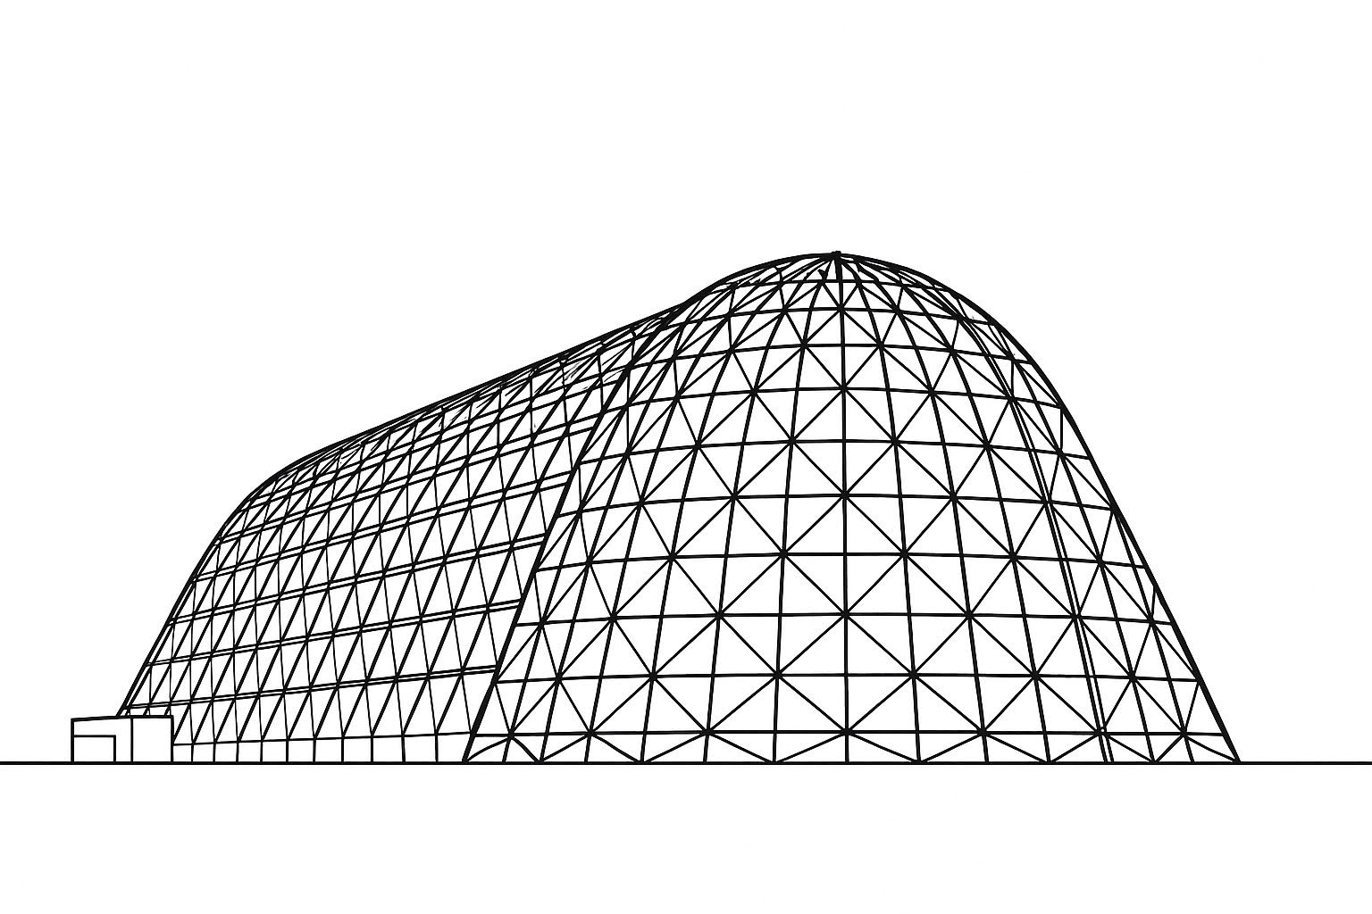

Atmospheric Waves Experiment (AWE) Thermal Control System: from Design through On-Orbit Thermal Performance
TFAWS 2025 Thermal Control & Protection Technical Session
Presented by: Mike Holt
Mike Holt, Matt Ralphs
Space Dynamics Laboratory
Thermal & Fluids Analysis Workshop 2025
NASA Ames Research Center
San Jose, CA
August 4-7, 2025

Slide 2

Outline
Introduction to AWE
Thermal Control System Overview
Thermal Models
Thermal Testing & Model Correlation
On-Orbit Performance
Conclusions
https://stockcake.com/s?q=sign%20post%20crossroads; Free, royalty free

Slide 3
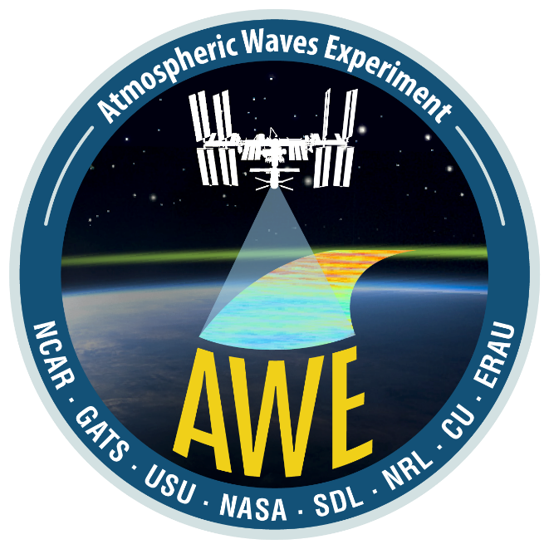





Introduction to AWE (1 of 2)
Atmospheric Waves Experiment (AWE) provides the first global characterization of atmospheric waves (https://www.awemission.org/)
The Space Dynamics Laboratory (SDL) in Logan, Utah was selected to execute AWE as a Class D mission of opportunity in NASA’s Science Mission Directorate, Heliophysics Division.
Measures the dynamics and structure of global mesospheric gravity waves near the mesopause region of the atmosphere
Several ground-based Mesospheric Temperature Mappers (MTM) have been used, but AWE is the first space-based MTM.
Installed on the international space station (ISS) ELC 1 Site 3 since November 2023

Slide 4
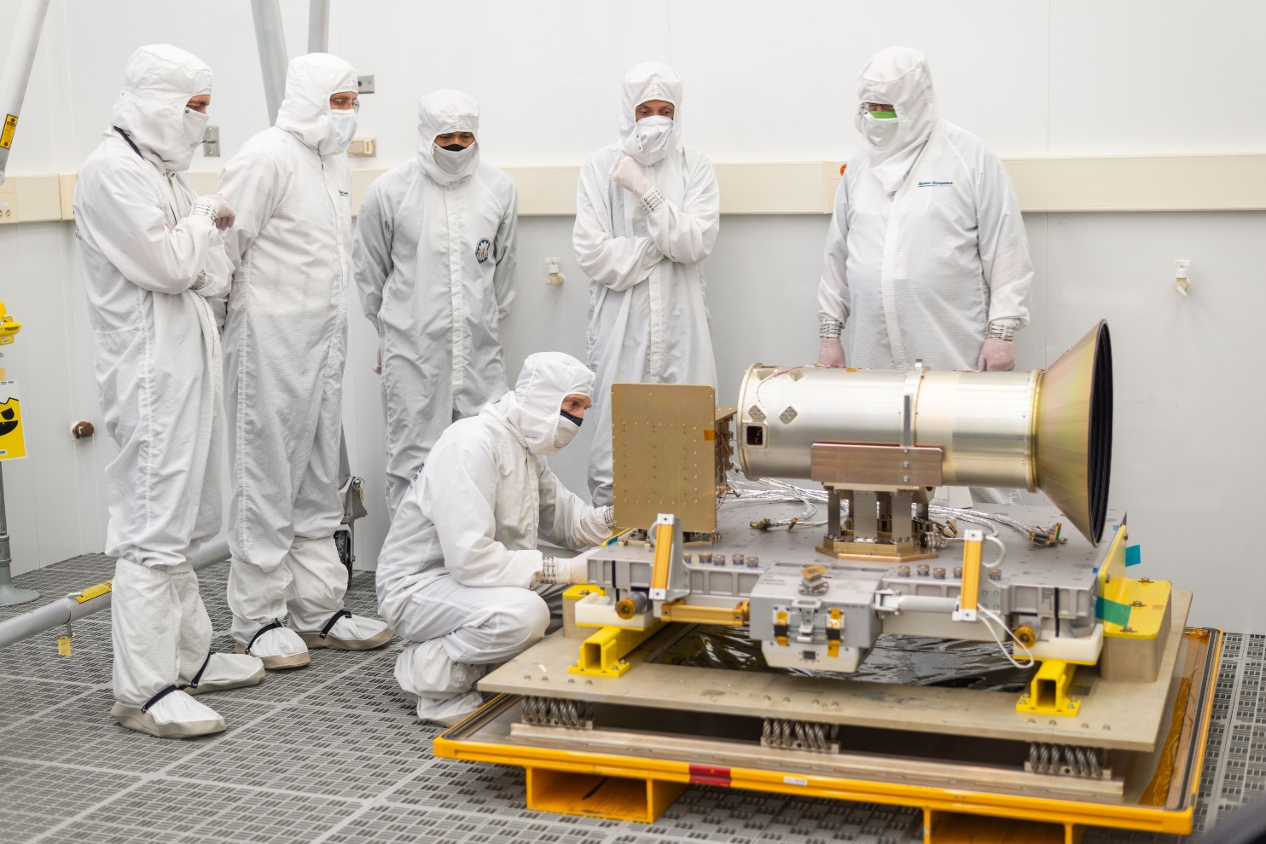
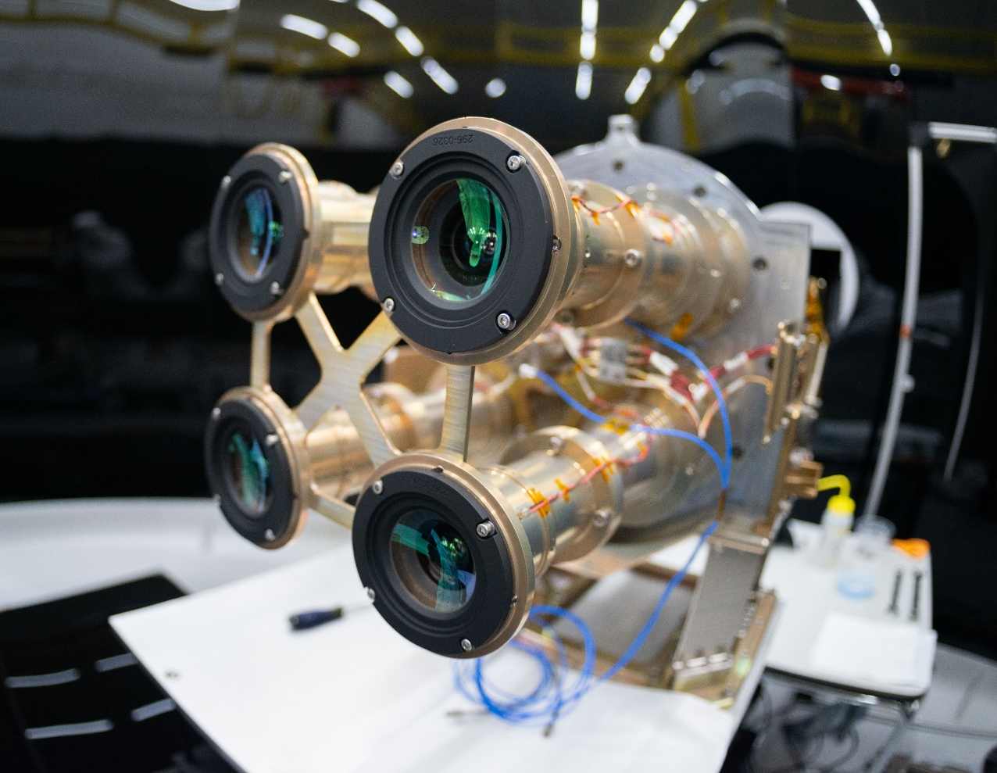
Introduction to AWE (2 of 2)
AWE is a suite of four wide field-of-view near-infrared cameras.

Slide 5

Outline
Introduction to AWE
Thermal Control System Overview
Thermal Models
Thermal Testing & Model Correlation
On-Orbit Performance
Conclusions
https://stockcake.com/s?q=sign%20post%20crossroads; Free, royalty free

Slide 6
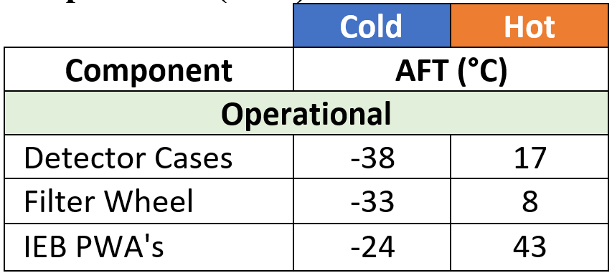
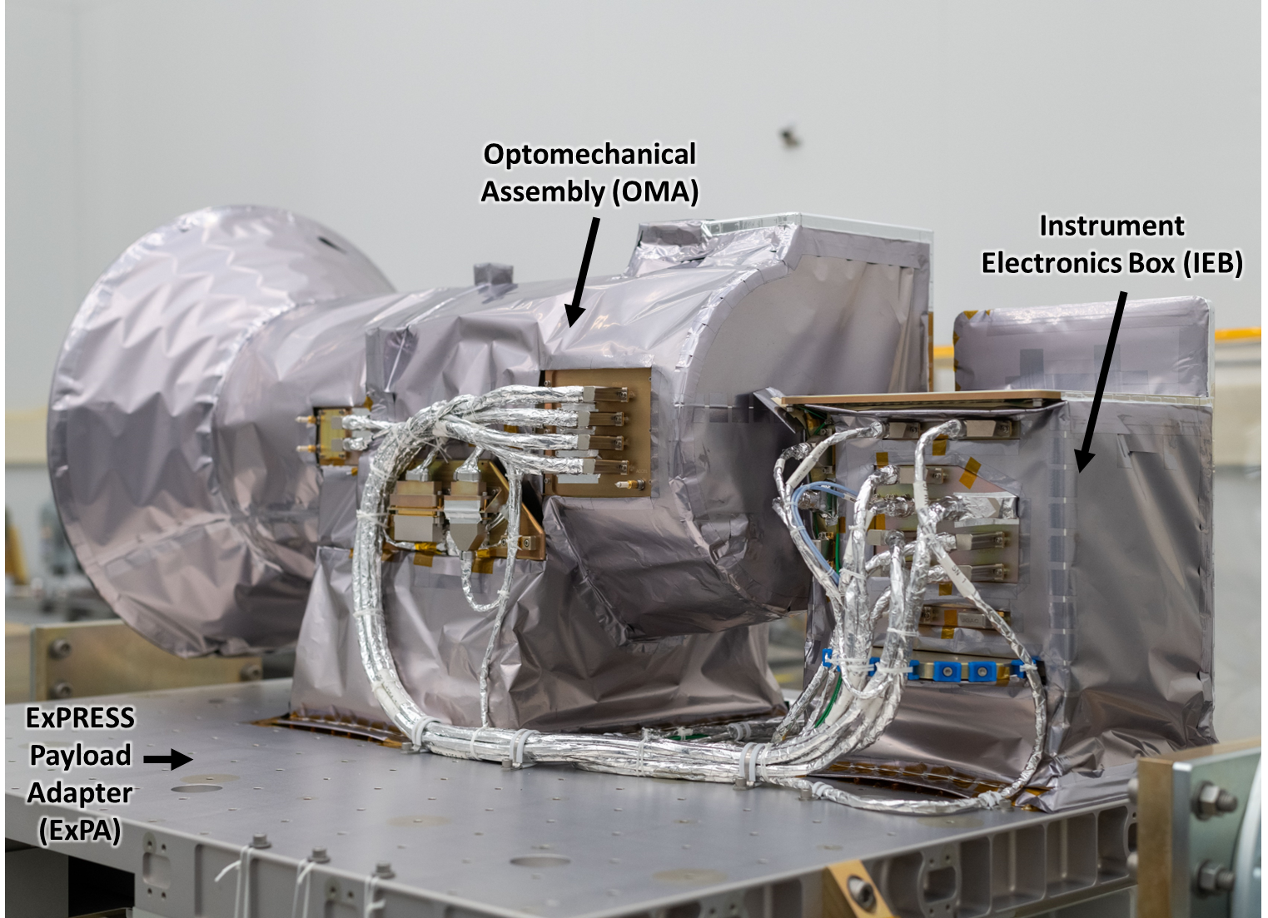
Thermal Control System Overview (1 of 3)
Optomechanical Assembly (OMA)
  Houses the telescopes, filter wheel, detectors
  Dedicated, bi-directional radiator
Instrument Electronics Box (IEB)
  Five electronics boards
  Dedicated bi-directional radiator
ExPRESS Payload Adapter (ExPA)
  Allows for power and data connections between the payload and the ISS

Slide 7
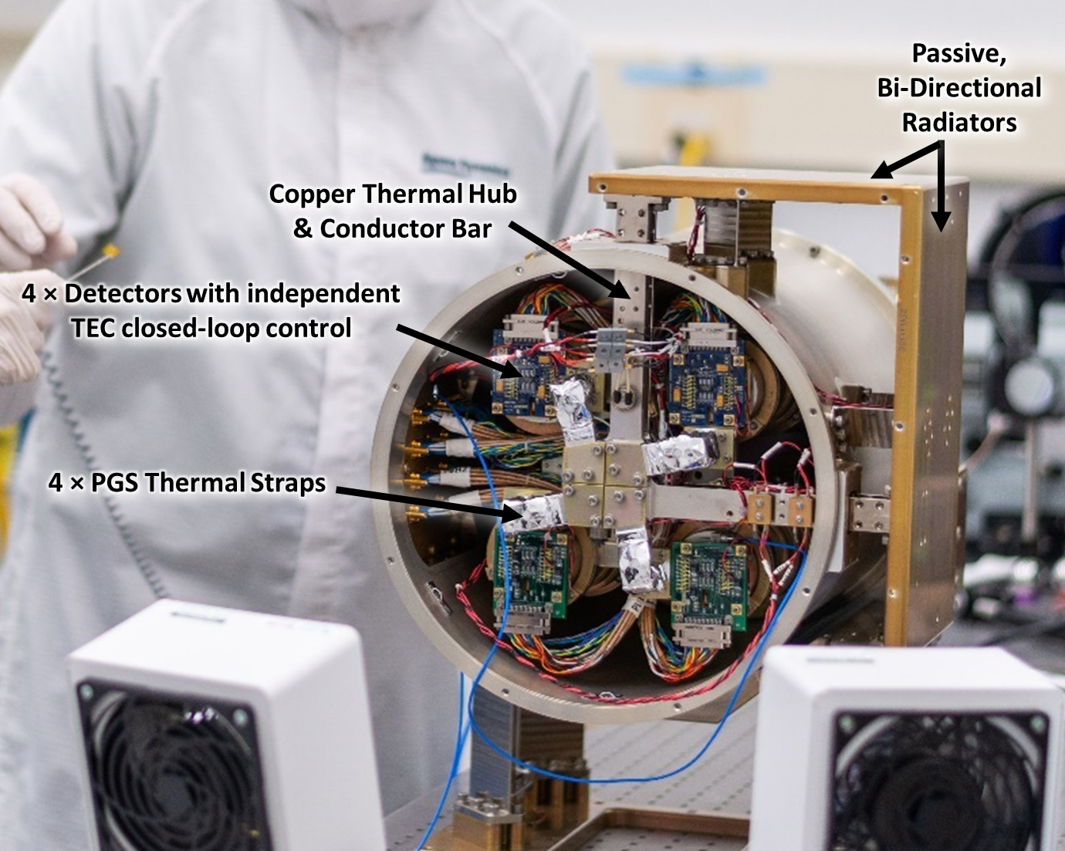
Thermal Control System Overview (2 of 3)
Bi-directional Radiators
  Maintain an unobstructed view to space
Four Detectors with independent TEC closed-loop control
  Continuously control the FPA to
  −30°C, heating and cooling
Copper thermal hub and conductor bar
  Good conductance to radiator with added thermal mass to survive unpowered robotic transfer
Four Pyrolytic Graphite Sheet (PGS) thermal straps
  Excellent vibration isolation and volume-specific thermal conductivity
  1.6 W/K, 52 grams, each

Slide 8
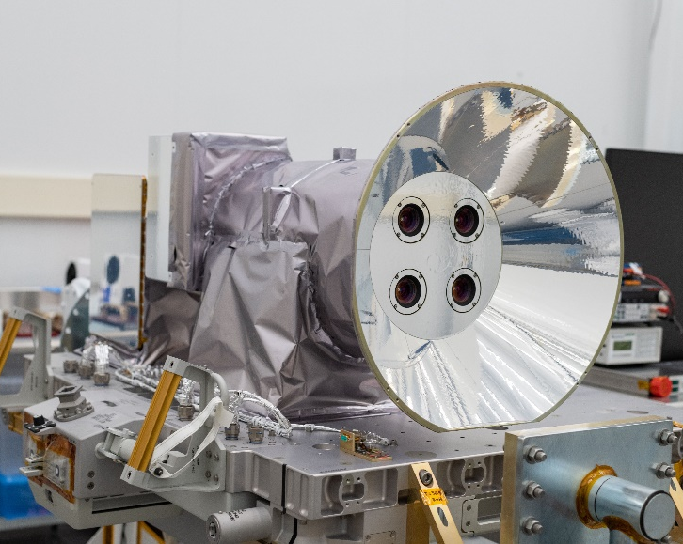
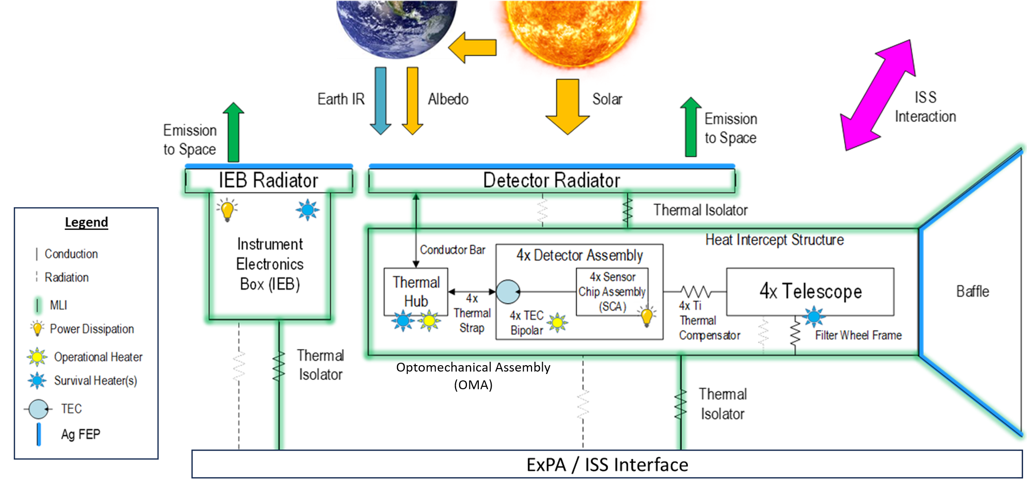
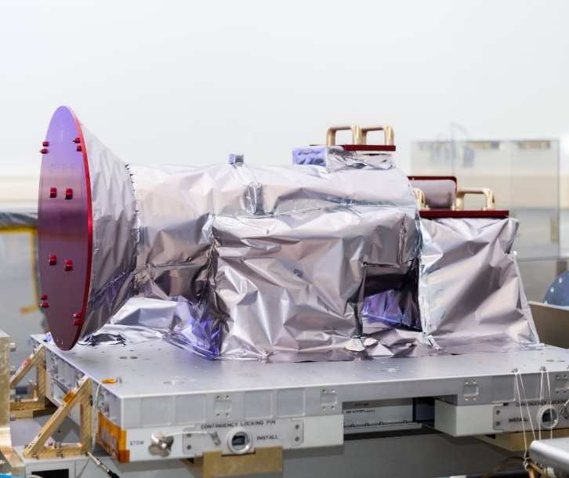

Thermal Control System Overview (3 of 3)

Slide 9
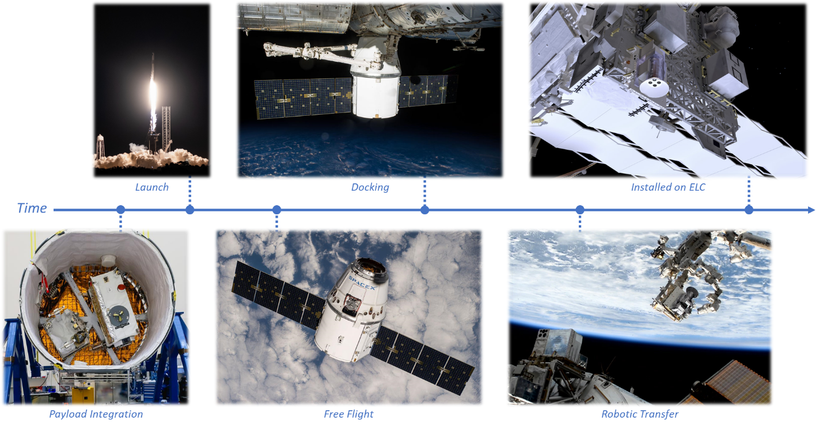
Thermal Control System Overview: Environment
Designed for two launch vehicles
Launched on CRS-29 aboard SpX Dragon Cargo

Slide 10

Outline
Introduction to AWE
Thermal Control System Overview
Thermal Models
Thermal Testing & Model Correlation
On-Orbit Performance
Conclusions
https://stockcake.com/s?q=sign%20post%20crossroads; Free, royalty free

Slide 11
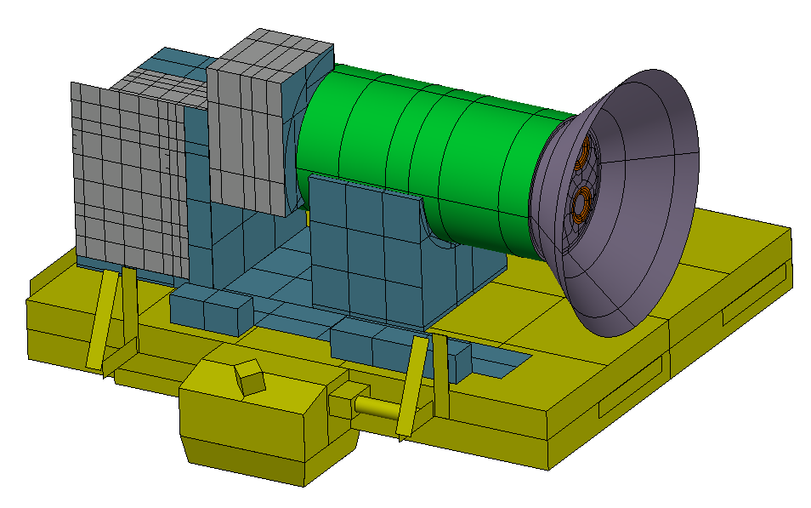
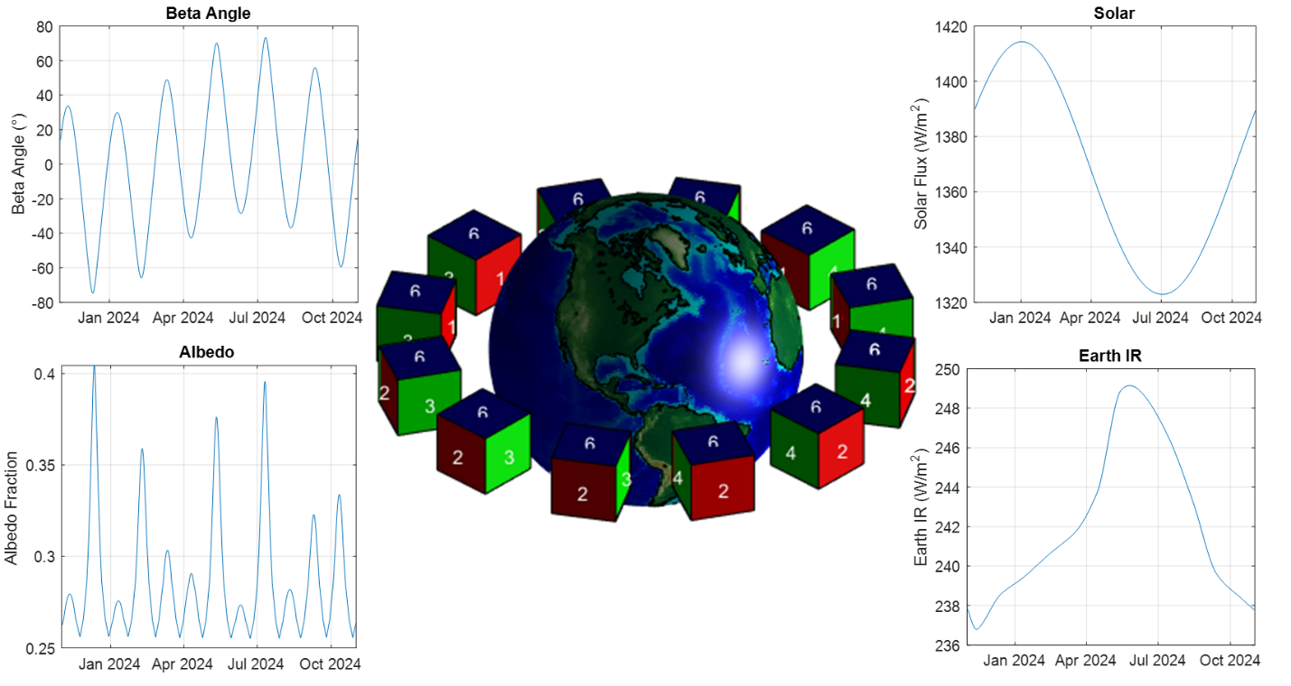
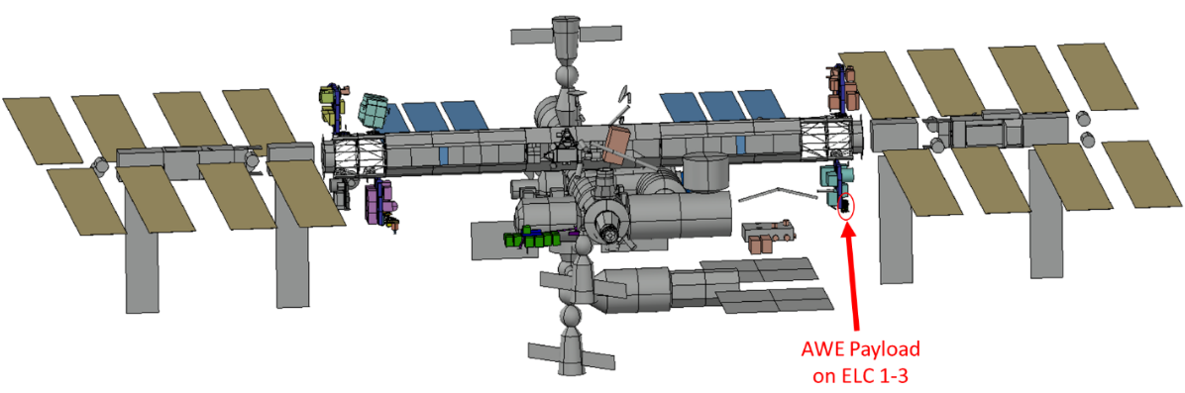
Thermal Models: Overview
Thermal Desktop Models:
Official thermal models
Accurate snapshots of predicted payload temperatures
Includes ISS and launch vehicle interactions
Used to verify requirements
Underwent several correlations to test data
MATLAB Model:
Analytical model that only includes nodes for baffle and OMA radiator
Quickly evaluate the impact of changing environmental loads
Predict temperatures into the future with forecast environments
OMA Radiator
Baffle

Slide 12
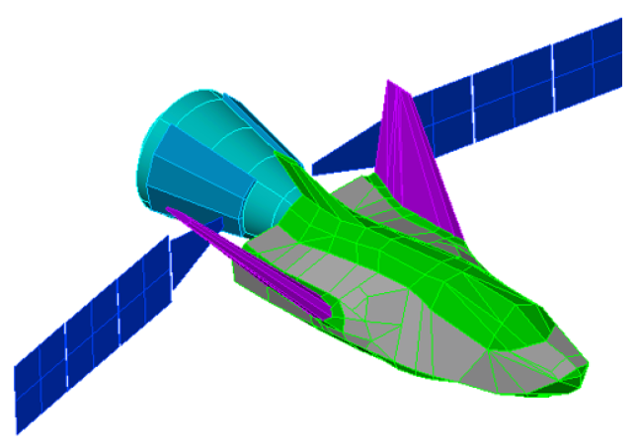

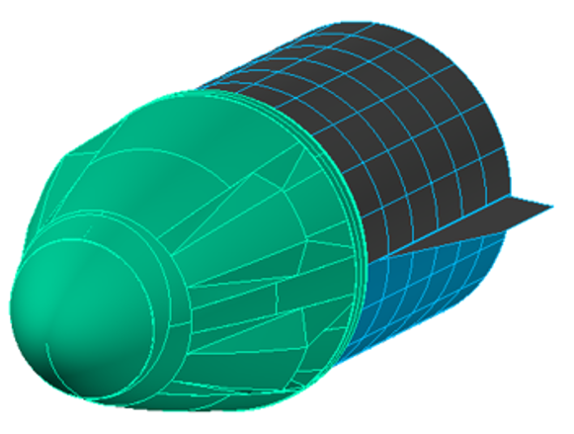
Thermal Models: Thermal Desktop
Thermal models include:
  AWE instrument developed by SDL
  ExPA provided by Boeing PTCS-ISS
  ISS provided by Boeing PTCS-ISS
  Launch vehicles provided by Boeing PTCS-ISS
ISS/AWE payload integrated thermal model takes ~8 hours to run each transient case
AWE Instrument
ExPA
Dream Chaser Cargo
SpX Dragon Cargo
ISS

Slide 13
Thermal Models: MATLAB
Based on Steven L. Rickman’s course, “Introduction to On-Orbit Thermal Environments” from the 2014 Thermal and Fluids Analysis Workshop (TFAWS)
Uses a six-sided box and calculates environmental heat loads
  Includes two surfaces that are conductively connected
OMA Radiator
Baffle

Slide 14

Outline
Introduction to AWE
Thermal Control System Overview
Thermal Models
Thermal Testing & Model Correlation
On-Orbit Performance
Conclusions
https://stockcake.com/s?q=sign%20post%20crossroads; Free, royalty free

Slide 15
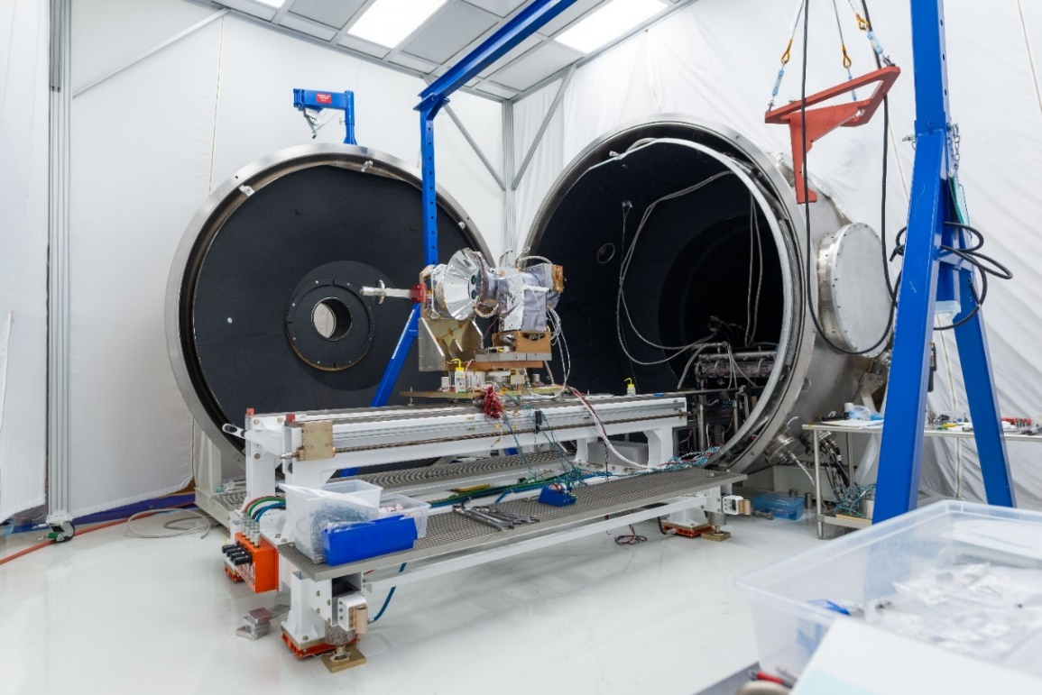
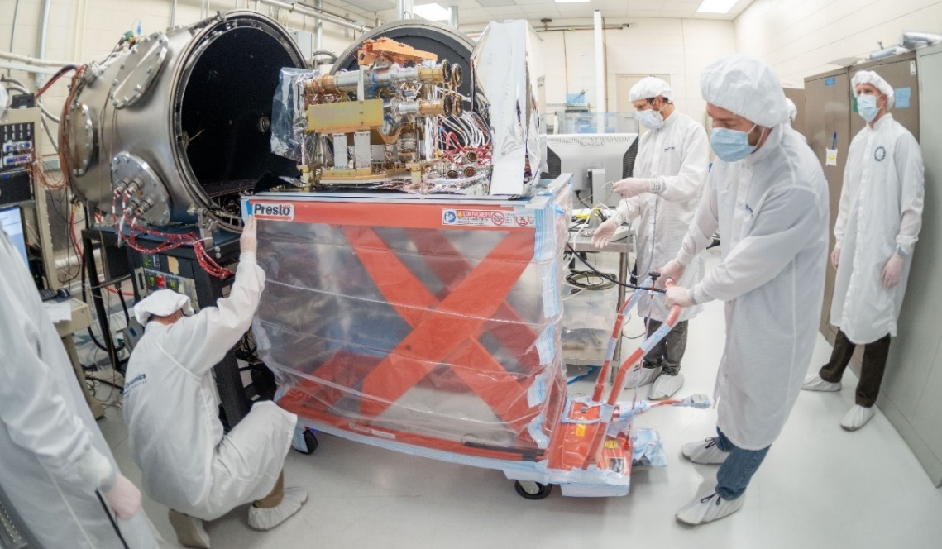
Thermal Testing and Model Correlation
AWE payload Thermal Desktop models were correlated to multiple thermal vacuum tests
Per NASA direction, the ExPRESS Payload Adapter (ExPA) was not included in the thermal vacuum tests
  The final flight configuration could not be fully simulated in thermal testing

Slide 16

Outline
Introduction to AWE
Thermal Control System Overview
Thermal Models
Thermal Testing & Model Correlation
On-Orbit Performance
Conclusions
https://stockcake.com/s?q=sign%20post%20crossroads; Free, royalty free

Slide 17
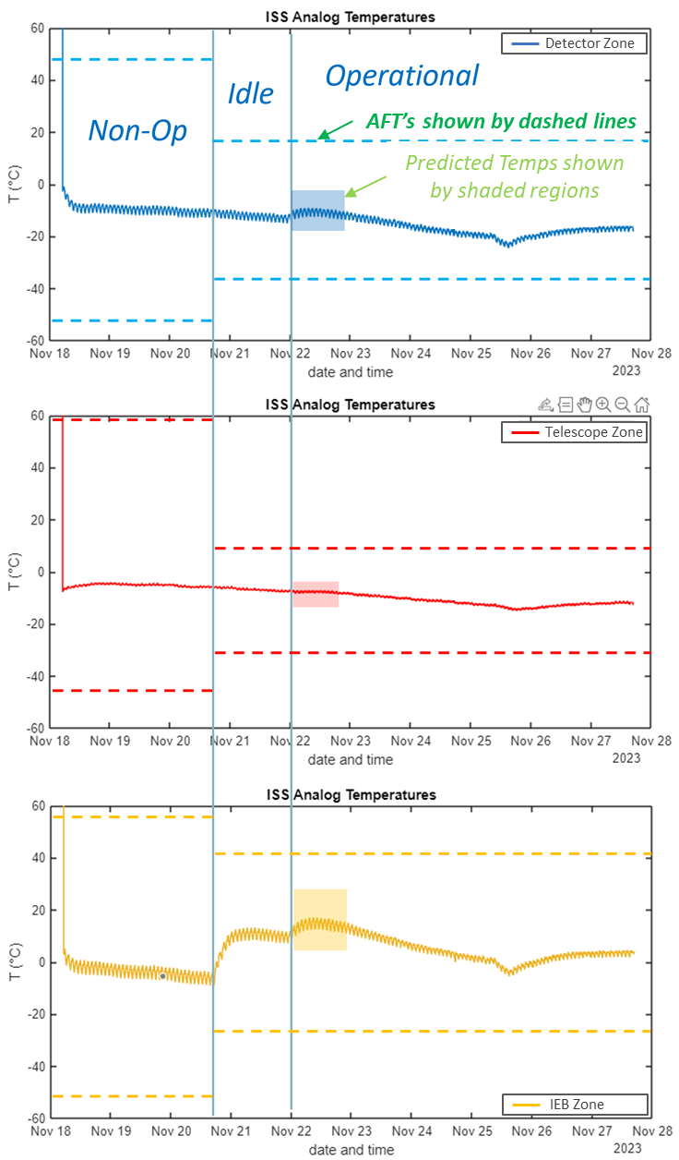
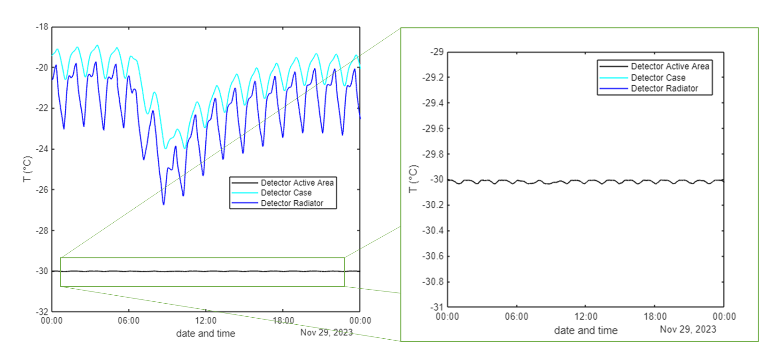
On-Orbit Performance: First Light
Temperatures were well within allowable flight temperature (AFT) limits
Operational temperatures are also well within predicted range
  Instrument temperatures vary ~3 ° C over an orbit
Detectors cooled to −30 ° C and very stable

Slide 18
On-Orbit Performance: MATLAB Correlation to Telemetry & Forecasts
Comparison of thermal model predictions with the payload and ISS telemetry shows good agreement overall:
  Model predicted temperatures were within 3°C for beta 0 °, but only within 10 ° C for more extreme negative beta angles
Matlab models correlated to ~8 months of telemetry allows for continued forecasting of AWE payload thermal performance
  Most significant change was adjusting the environmental heat loads (vs beta angle) to better account for ISS interactions

Slide 19
On-Orbit Performance: Year-Over-Year Telemetry (1 of 2)
Minimal performance changes year-over-year for the AWE thermal control system
  TEC performance is consistent
  No perceptible degradation in thermal control surfaces (radiators, baffle)
Differences in telemetry data are typically caused by ISS attitude changes
or TEC setpoint changes
Year 1: TEC Setpoint
Changed to −25°C
5-14 July 2025
ISS 180° Yaw Flip
discussed on
next slide

Slide 20
On-Orbit Performance: Year-Over-Year Telemetry (2 of 2)
Small spikes in temperature data are caused by small ISS attitude changes (visible in figures on right)
Small temperature differences at low beta angles are still under
investigation
circled below
Year 1: TEC Setpoint
Changed to −25°C
5-14 July 2025
ISS 180° Yaw Flip
20

Slide 21
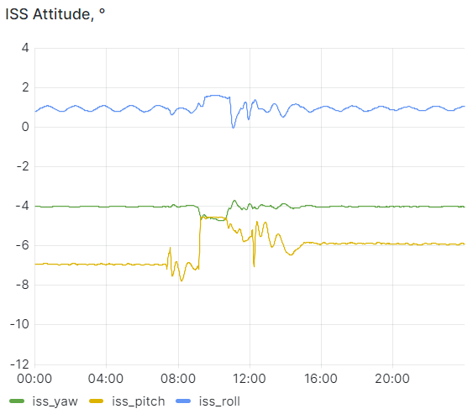
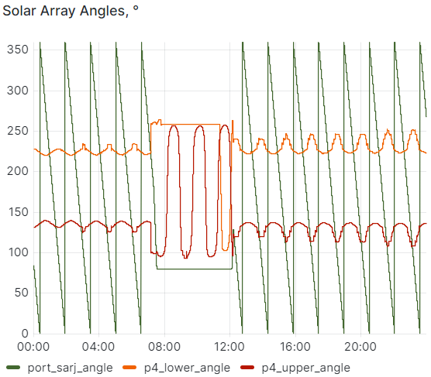
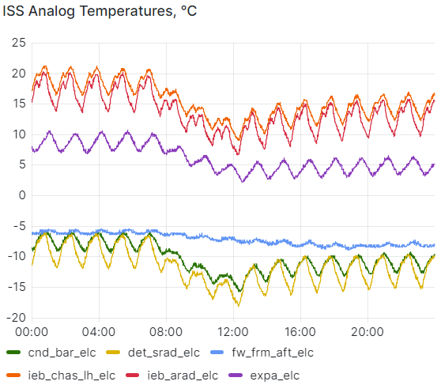
On-Orbit Performance: Lessons Learned
ISS attitude is adjusted regularly, often without prior notification (example at right)
  Primarily ISS pitch and solar panel orientation
  Payloads with a view of the solar panels and other ISS structures can see a large impact from these adjustments
ExPA temperatures were farthest from model predicted temperatures
  Wasn’t a huge surprise as NASA didn’t allow the ExPA to be included in the thermal testing
  Missed opportunity: should have taken emissivity measurements of the ExPA surfaces to compare against thermal model values
During TVAC testing, it was helpful to have a second temperature sensor (of a different type) placed near the flight sensors to provide insight into temperature sensor bias
  Flight ISS analog sensors (2-wire measurement, per ISS requirements) appear to have 2–3 ° C bias
Correlating to multiple sets of thermal test data throughout the program resulted in good predictions and few surprises on-orbit

Slide 22

Outline
Introduction to AWE
Thermal Control System Overview
Thermal Models
Thermal Testing & Model Correlation
On-Orbit Performance
Conclusions
https://stockcake.com/s?q=sign%20post%20crossroads; Free, royalty free

Slide 23
Conclusions
AWE thermal control system is performing as expected
  Payload temperatures have been continually maintained within predicted operational range
  Year-over-year results show consistent instrument performance
Test-correlation efforts were successful at reducing errors in thermal model performance predictions
  Stringent target correlation criteria and stability goals were met or exceeded during thermal testing
Telemetry-correlated MATLAB thermal model allows for forecasting payload thermal performance
On-orbit thermal performance of the AWE payload has been excellent!

Slide 24
Questions?

Slide 25
TFAWS 2025 Thermal Control & Protection Technical Session
Backup Charts

Slide 26
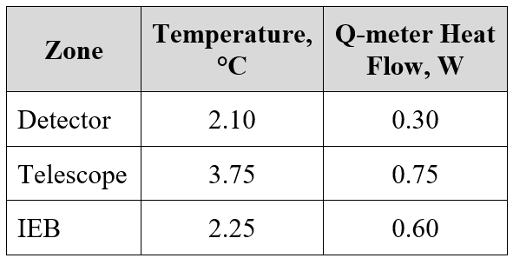
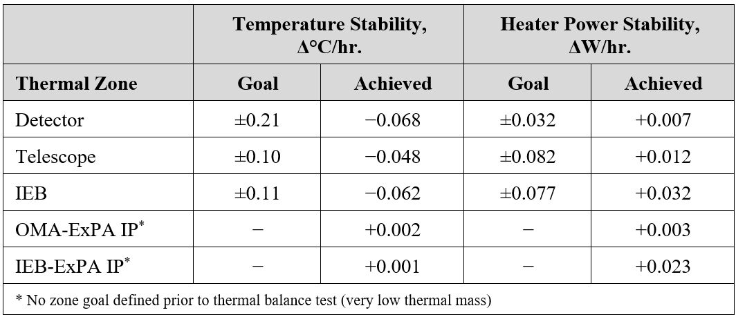
BACKUP Thermal Model Correlations (1 of 2)
Project budgeted 5 °C of modeling analysis uncertainty
When determining the target correlation criteria, we accounted for three primary sources of uncertainty:
  Temperature sensor uncertainty
  Temperature and heater power stability
  Model correlation accuracy
Target criteria were met or exceeded for all balance points
Model Correlation Criteria
Thermal Balance Stability Goals and Achieved Values

Slide 27
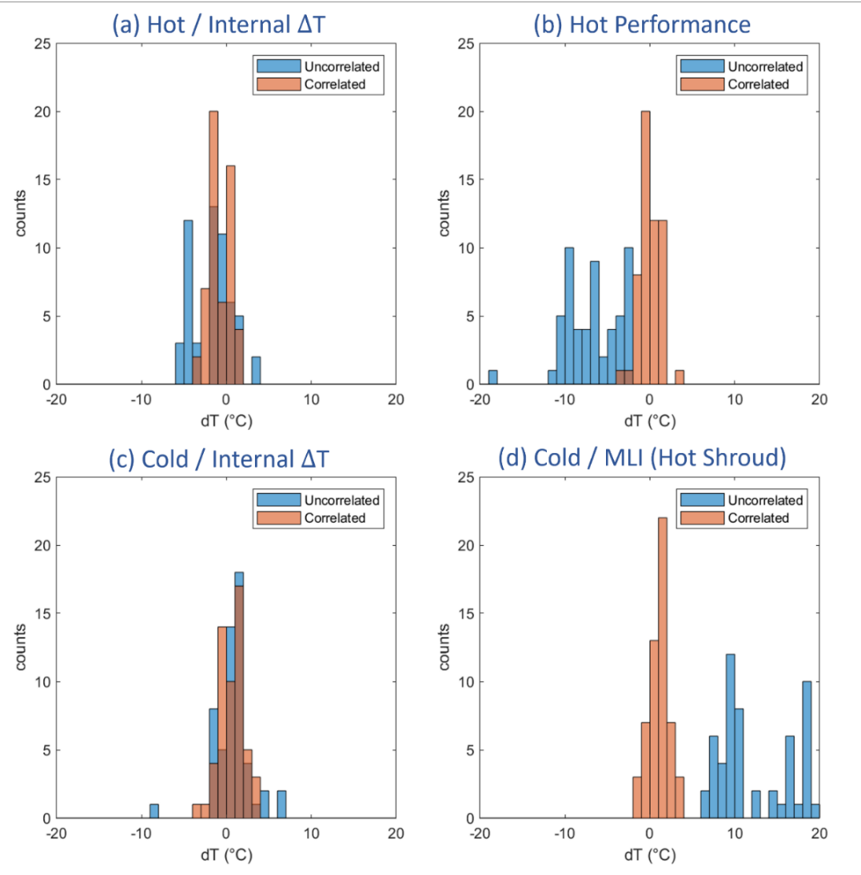
BACKUP Thermal Model Correlations (2 of 2)
Final flight instrument thermal vacuum testing included four distinct thermal balance points for model correlations.
Thermal model changes during final flight model correlation that most significantly affected the temperature and heat flow results were:
  MLI e*
  GSE connections to the hardware (joint conductance)
  Wiring harness conductances
  Note: previous TVAC tests helped to refine AWE instrument internal parameters.
Highest areas of outstanding uncertainty are related to the connections between AWE instrument and ExPA
  Conductances based on calculated estimates instead of test measured values

Slide 28
BACKUP On-Orbit Performance: Year-Over-Year Telemetry

