Slide 1

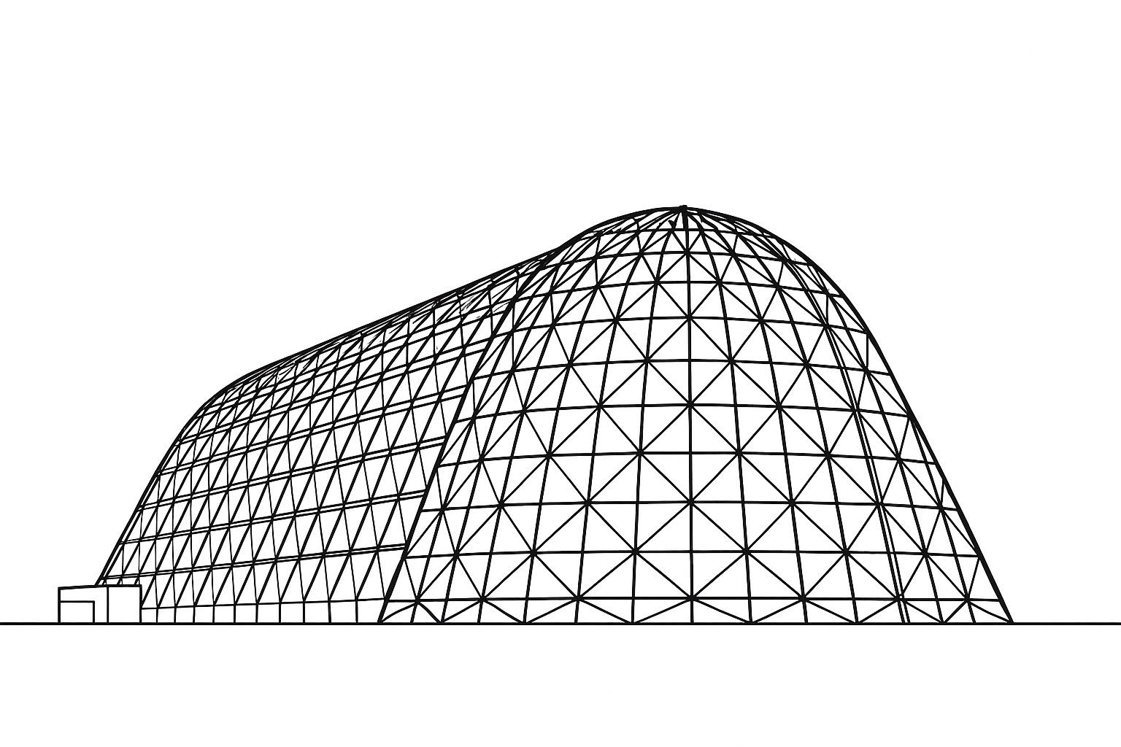

Atmospheric Waves Experiment (AWE) Thermal Balance: Internal Characterization, Correlation, and Lessons Learned
TFAWS 2025 Thermal Control & Protection Technical Session
Presented by: Matt Ralphs
Matt Ralphs, Mike Holt
Space Dynamics Laboratory
Thermal & Fluids Analysis Workshop 2025
NASA Ames Research Center
San Jose, CA
August 4-7, 2025

Slide 2
Abstract
The Atmospheric Waves Experiment (AWE) is providing the first global characterization of atmospheric waves that originate in Earth’s lower atmosphere and affect space weather. The instrument has been installed on the International Space Station’s (ISS) ExPRESS Logistics Carrier (ELC) site 1 since November 2023. The AWE flight thermal balance test at Space Dynamics Laboratory (SDL) was unique in that the radiation exchange from the radiators was not tested prior to flight. Instead, heaters were placed on the radiators to simulate environmental heat and control the boundary temperatures. Multi-layer insulation (MLI) was installed over the radiators and heat flow meters were installed near the radiators and the other external interfaces where heat can flow in and out of the instrument. This setup allowed for the heat flow inside the instrument to be well characterized, which decreased the uncertainty of internal gradients in the correlated thermal model. The external radiation exchange was predicted to have a high uncertainty due to the interactions and view factors to the ISS, such that the uncertainty of how the radiator coatings would perform was small compared to the uncertainty from view factors and emissivity values on the ISS side. Thus, the test deviated from a traditional thermal balance test and, instead, focused on minimizing the uncertainties that SDL could control. This paper details the AWE thermal balance test and thermal model correlation, touching on lessons learned and providing advice on how and when to test in this manner. This paper also summarizes the comprehensive calibration tests that the AWE payload underwent and the thermal challenges that it entailed.

Slide 3
Outline
Intro to Mission and Space Dynamics Lab (SDL)
Payload Intro and Design Overview
TVAC: Test Approach, Objectives, and Overview
Thermal Model Correlation
Calibration Testing: Thermal Solutions
Conclusion

Slide 4
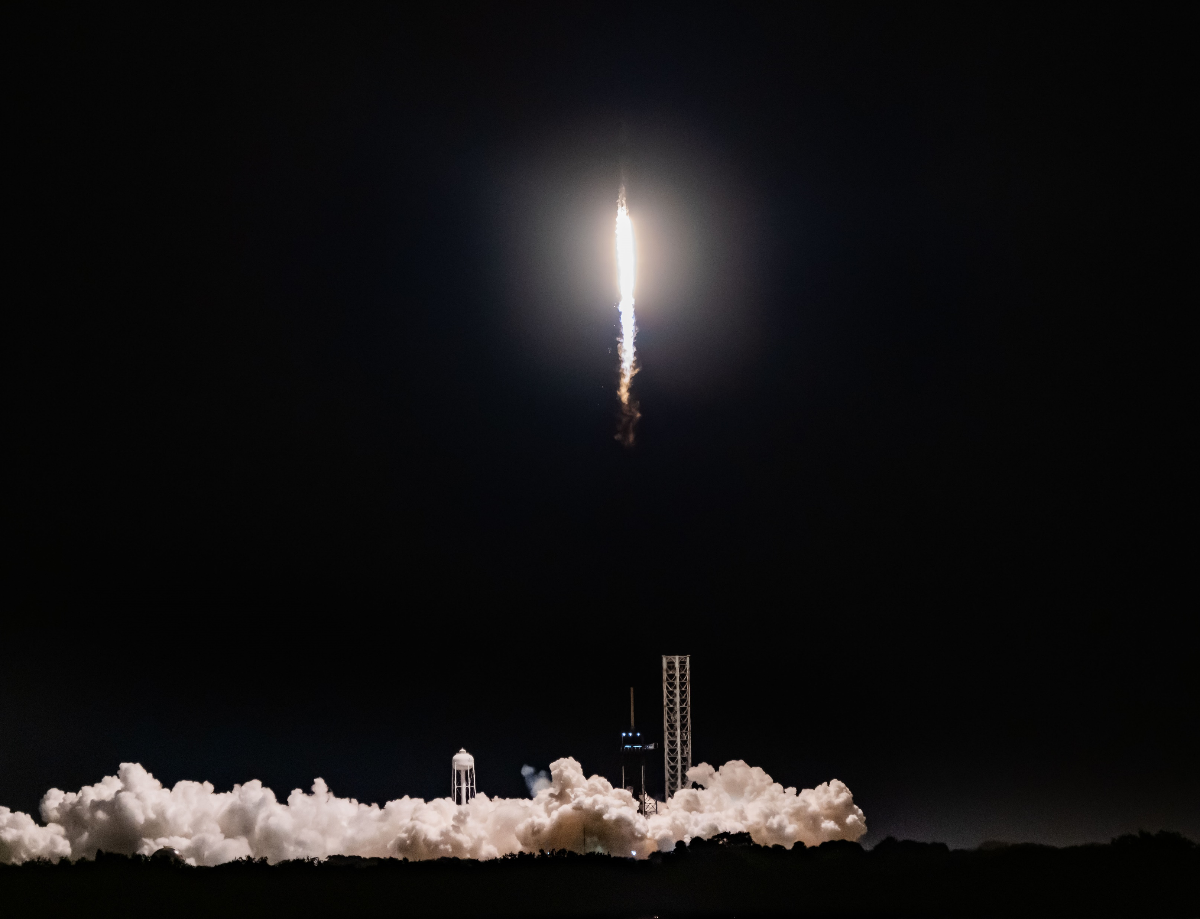
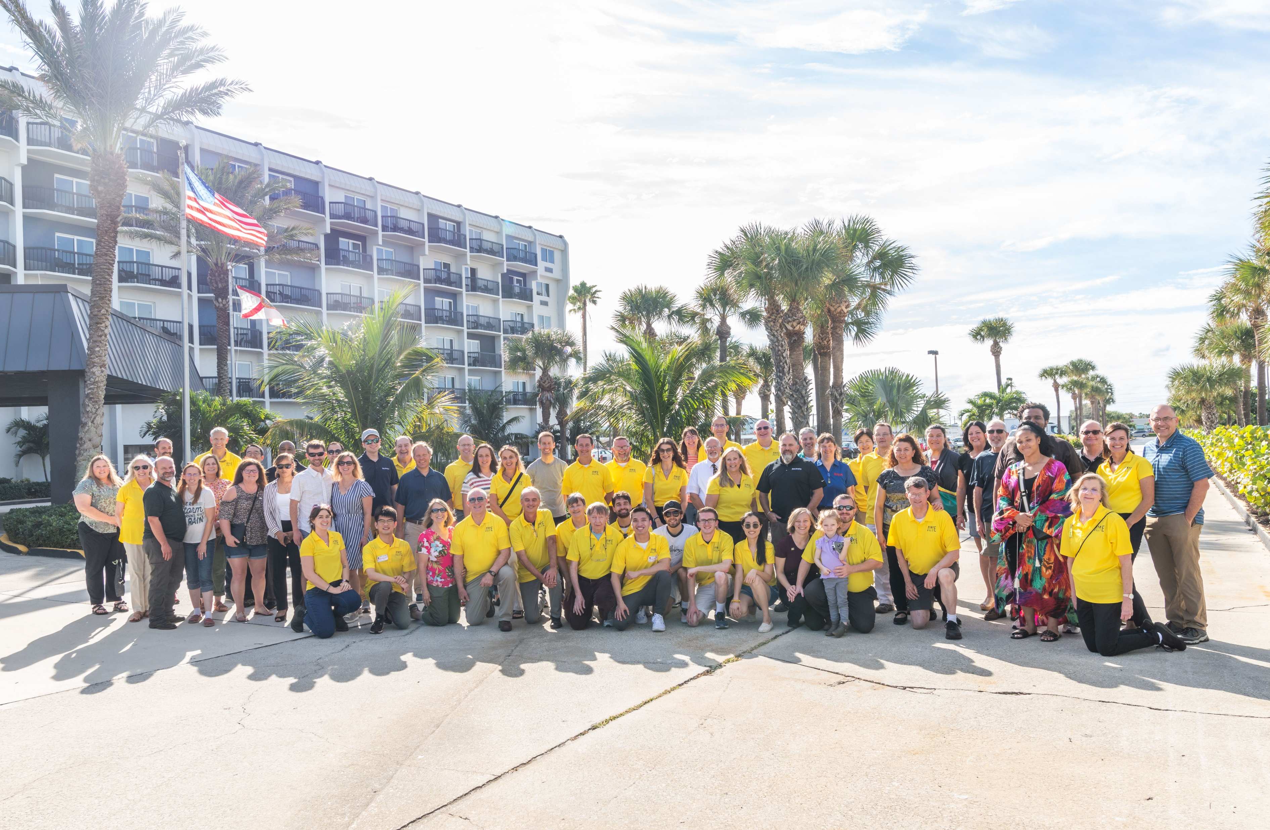
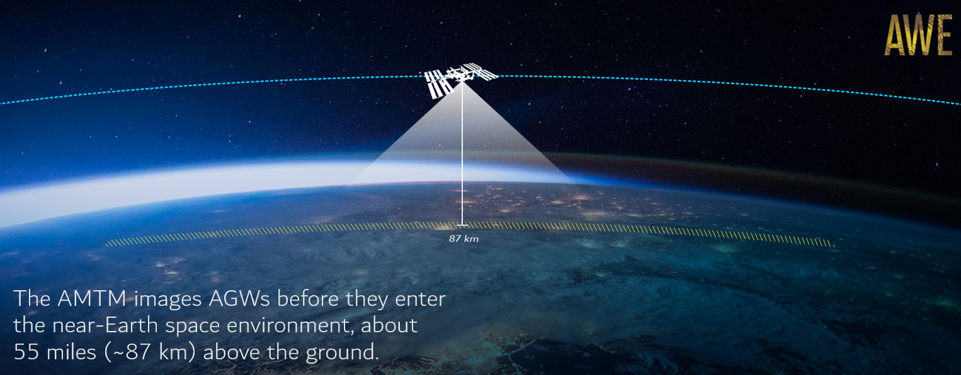
Introduction: Mission
Atmospheric Waves Experiment (AWE) is providing the first global characterization of atmospheric waves (see more at https://www.awemission.org/).
AWE is a suite of four wide field-of-view near infrared cameras that will measure the dynamics and structure of global mesospheric gravity waves near the mesopause region of the atmosphere.
The Space Dynamics Laboratory (SDL) in Logan, Utah was selected to execute AWE as a mission of opportunity in NASA’s Science Mission Directorate, Heliophysics Division.
The AWE payload was designed, fabricated, and tested by SDL.
The AWE payload Launched from KSFC and is installed on the International Space Station (ISS) ExPRESS Logistics Carrier (ELC) 1 Site 3.

Slide 5
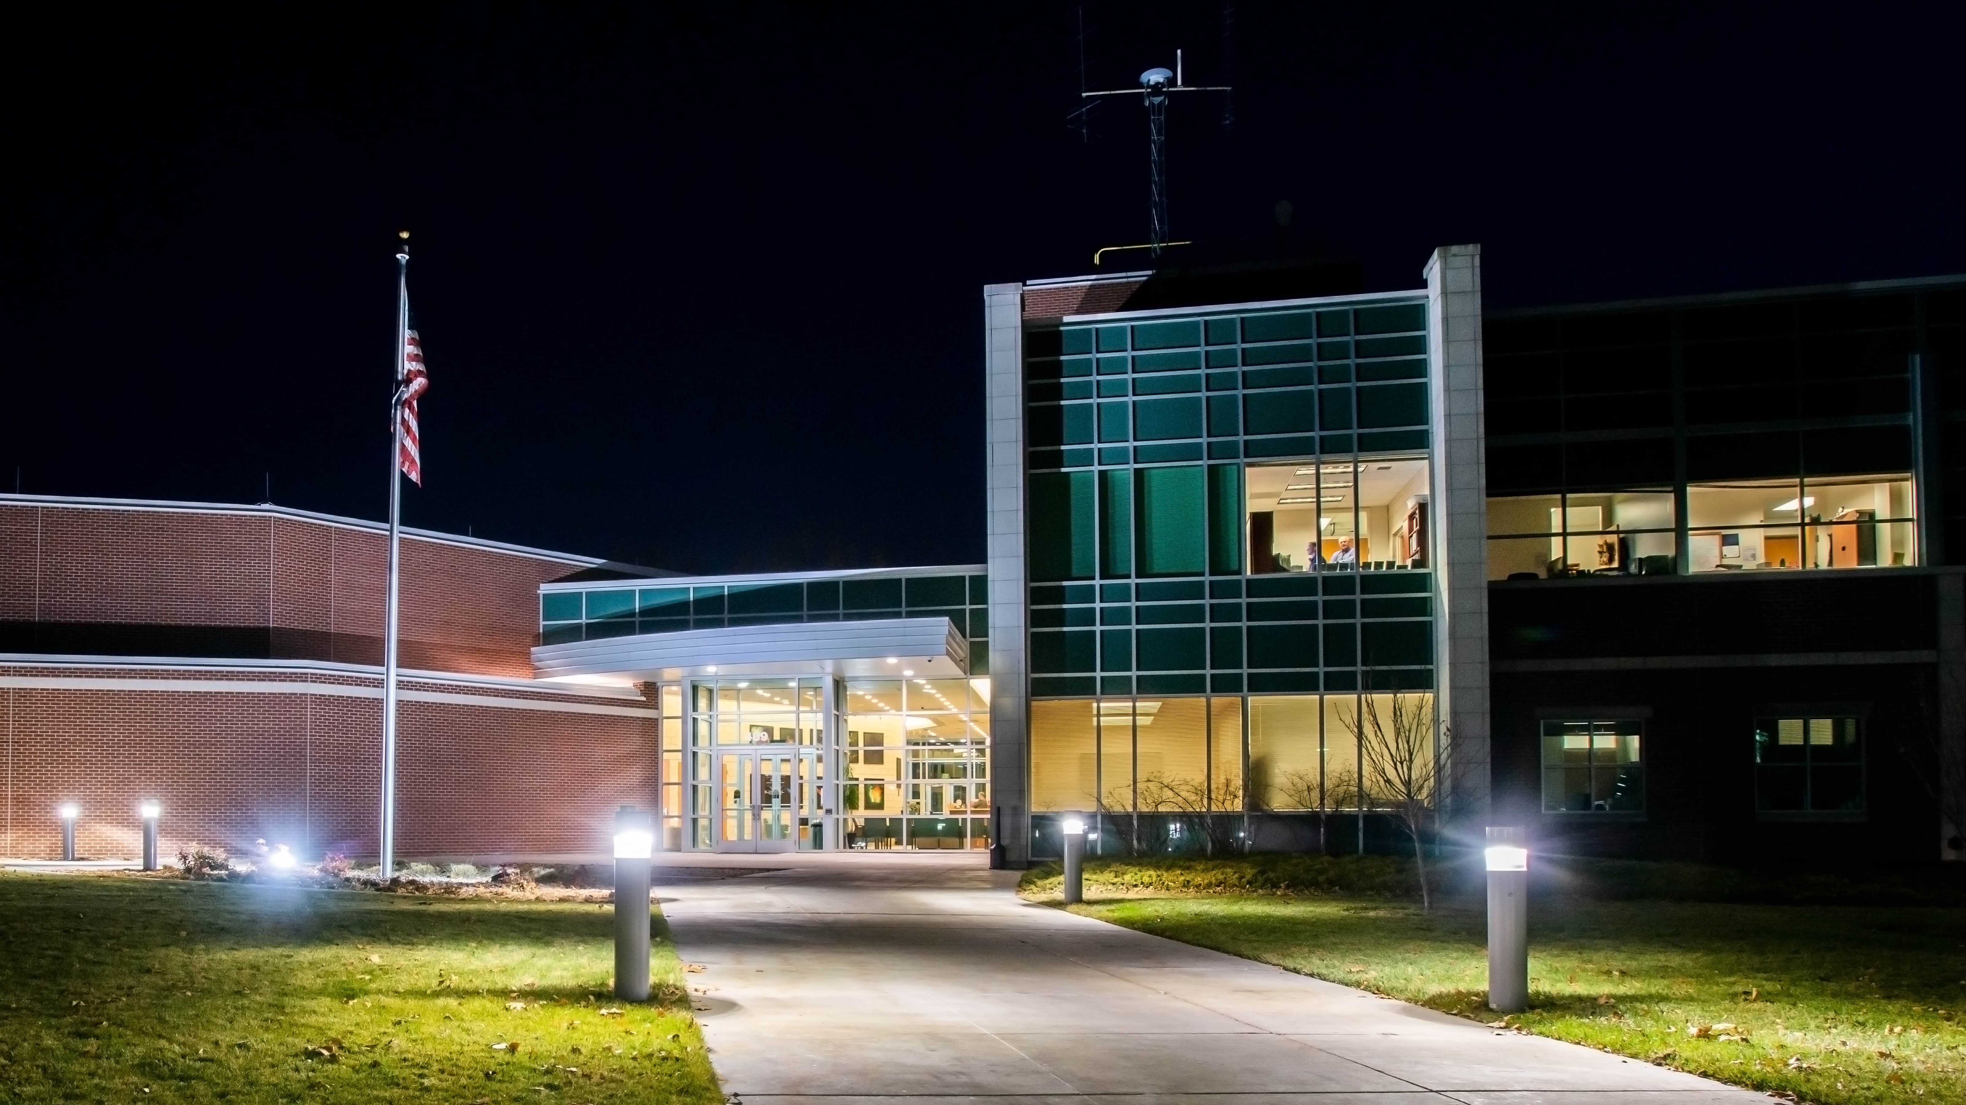
Introduction: SDL
United States Space Force UARC (University Affiliated Research Center)
1100+ specialized employees, 65% with over 10 years experience—the majority of which hold advanced degrees representing over 250 universities
Access to academic research and distinguished principal investigators

Slide 6

EMBEDDED CUSTOMER SUPPORT
Notes:
Overarching Takeaway:
With a focus on partner collaboration, SDL strives to align our growth, core competency development, offsite locations, and embedded support with our customers’ growth and needs.
Touchpoints (Highlight only the points most relevant to your audience):
As we continue to grow, it is important to continually attract and hire the most talented experts in the industry.
Our offsite locations, particularly in key industry hubs like ABQ, Huntsville, DC, and Stafford, help ensure we have the most talented staff to work on partner projects.
DoD: Department of Defense
MDA: Missile Defense Agency
NASA: National Aeronautics & Space Administration
USA: United States Army
USAF: United States Air Force
USMC: United States Marine Corps
USSF: United States Space Force

Slide 7
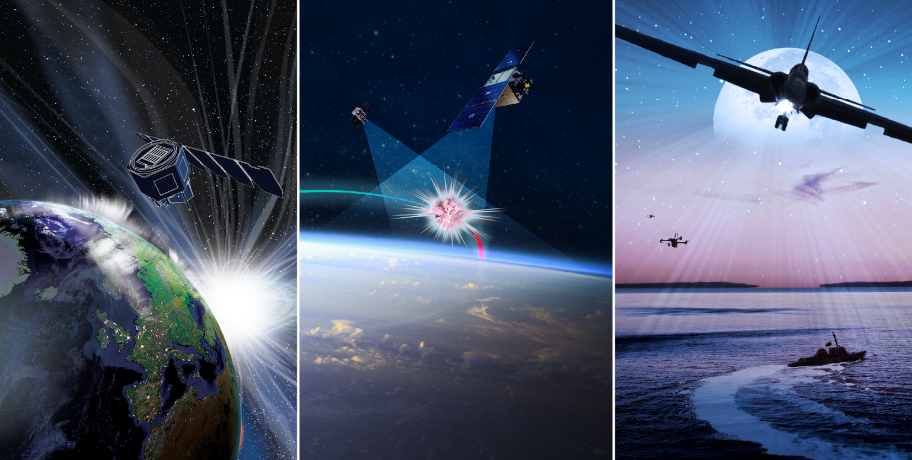
CIVIL & COMMERCIAL SPACE
Scientific Investigations
STRATEGIC &
MILITARY SPACE
DoD & IC Space Missions & Missile Defense
C4ISR SYSTEMS
DoD & IC Air, Land, Maritime & Cyber
SDL Proprietary
7

Slide 8
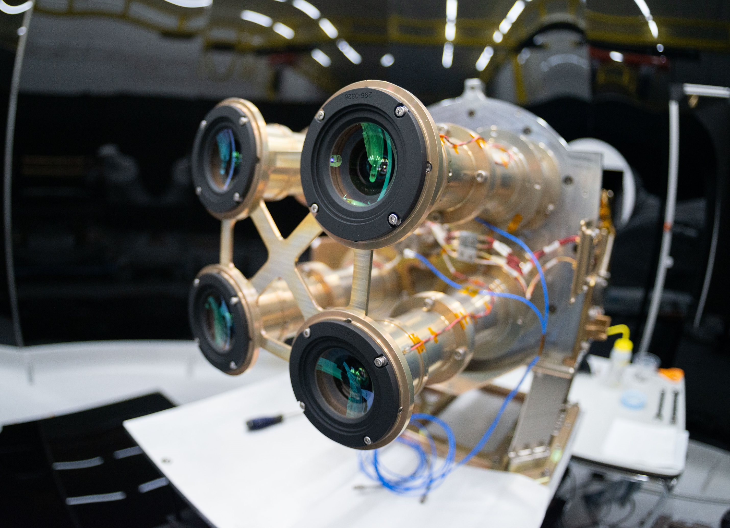
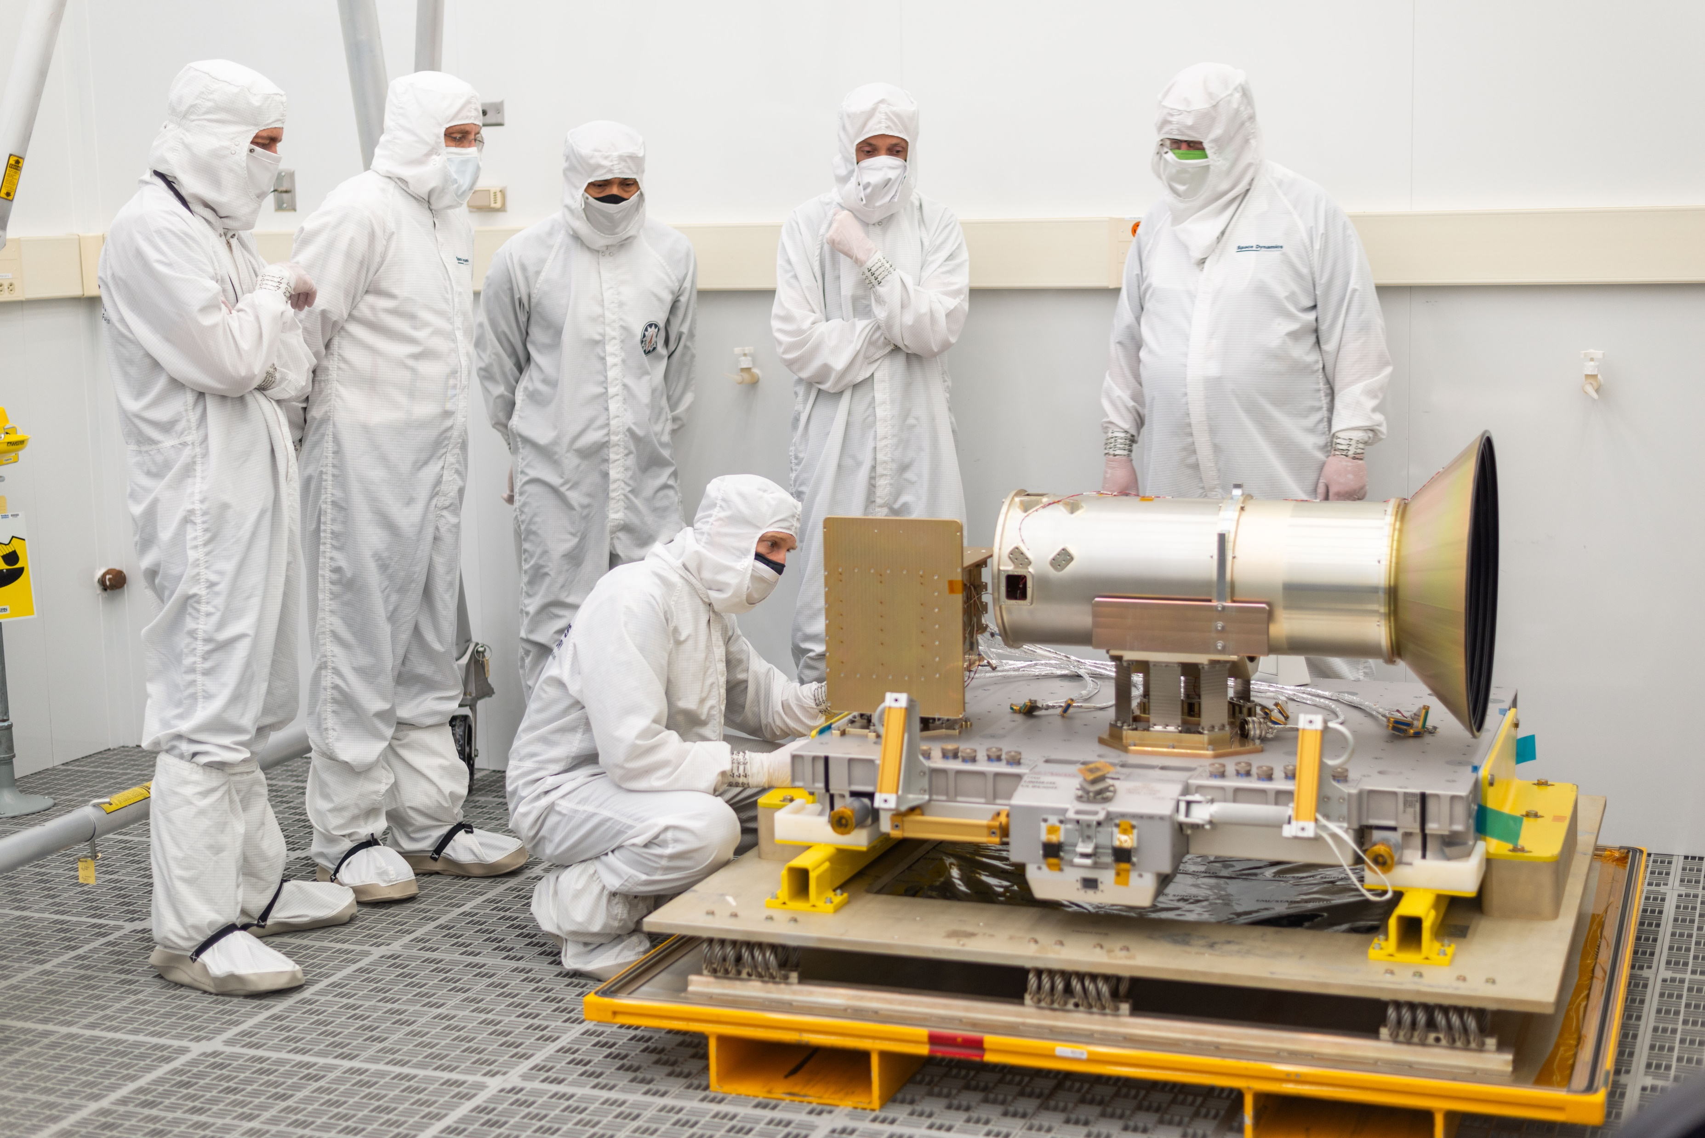
Introduction: AWE Payload
Wide field of view infrared imager
Four identical telescopes, four detectors, sunshield, standalone electronics box
A
B

Slide 9
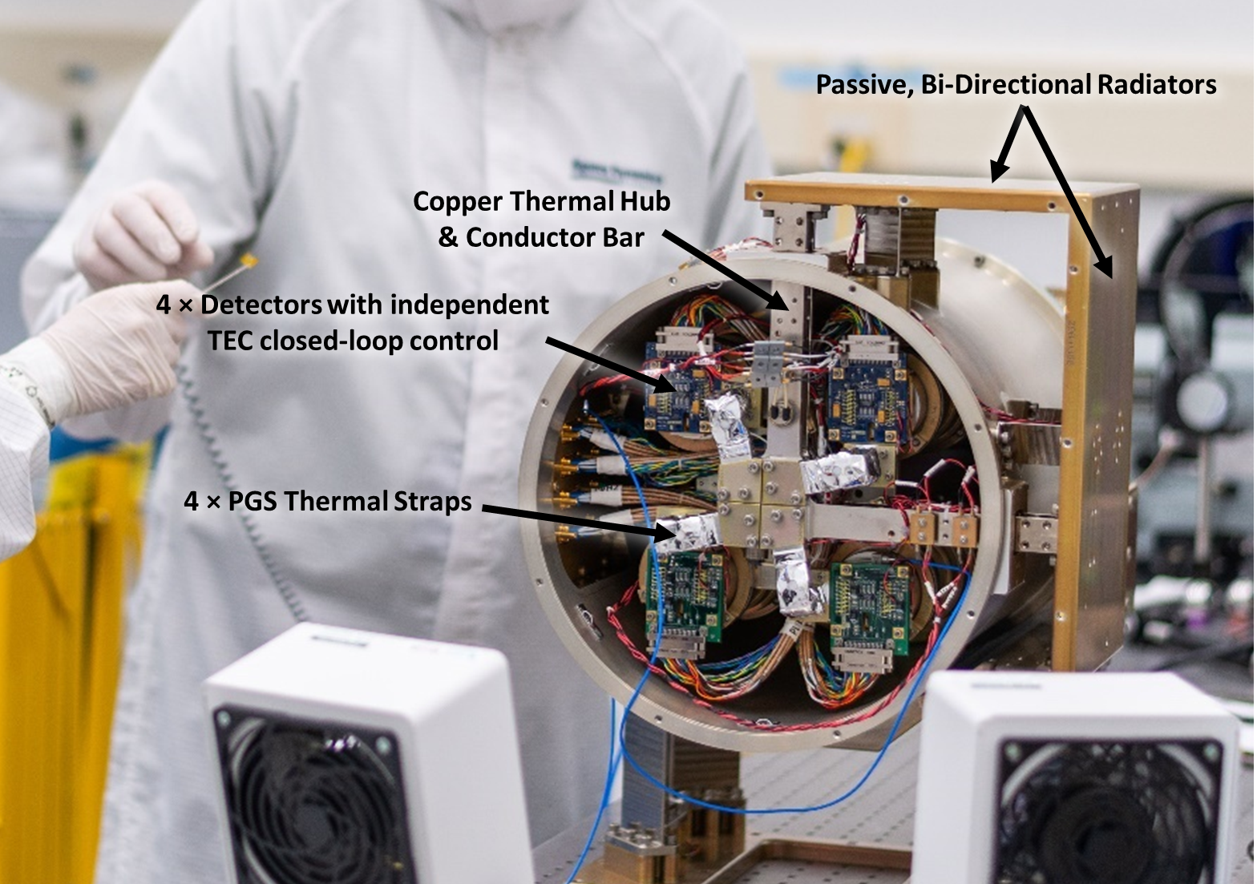
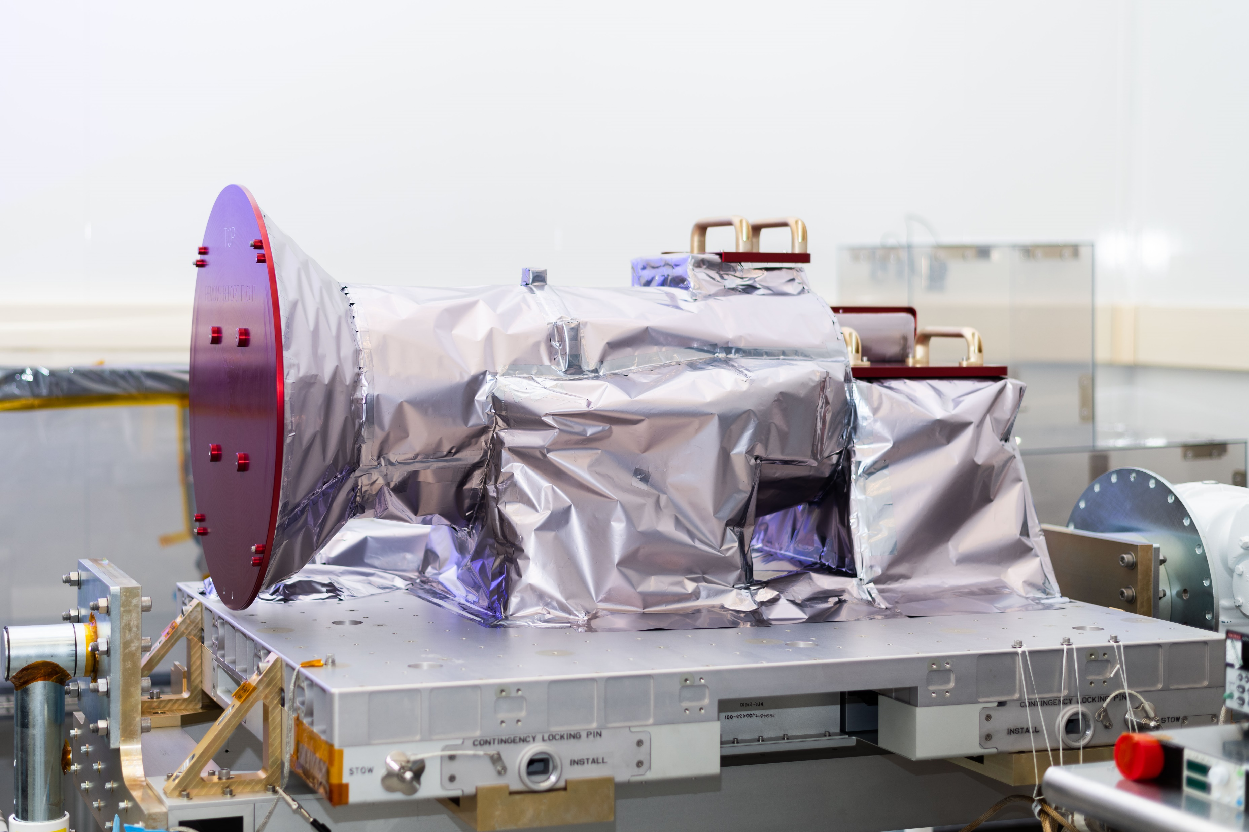
AWE Payload: Design
Riding on the ISS means we can’t control our attitude and have to deal with less-than-optimal solar angles
Bi-directional radiators to maintain an unobstructed view to space
Well insulated with MLI

Slide 10
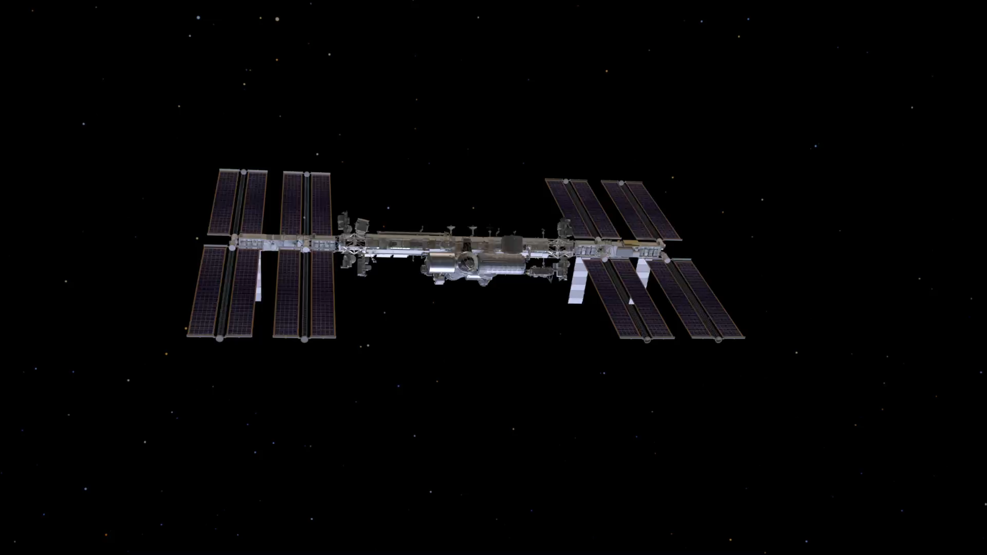
Installed on the International Space Station
(Credit: NASA)
The material is based upon work supported by the National Aeronautics and Space Administration under Contract Number 80GSFC18C0007. Any opinions, findings, and conclusions or recommendations expressed in this material are those of the author(s) and do not necessarily reflect the views of the National Aeronautics and Space Administration.

Slide 11
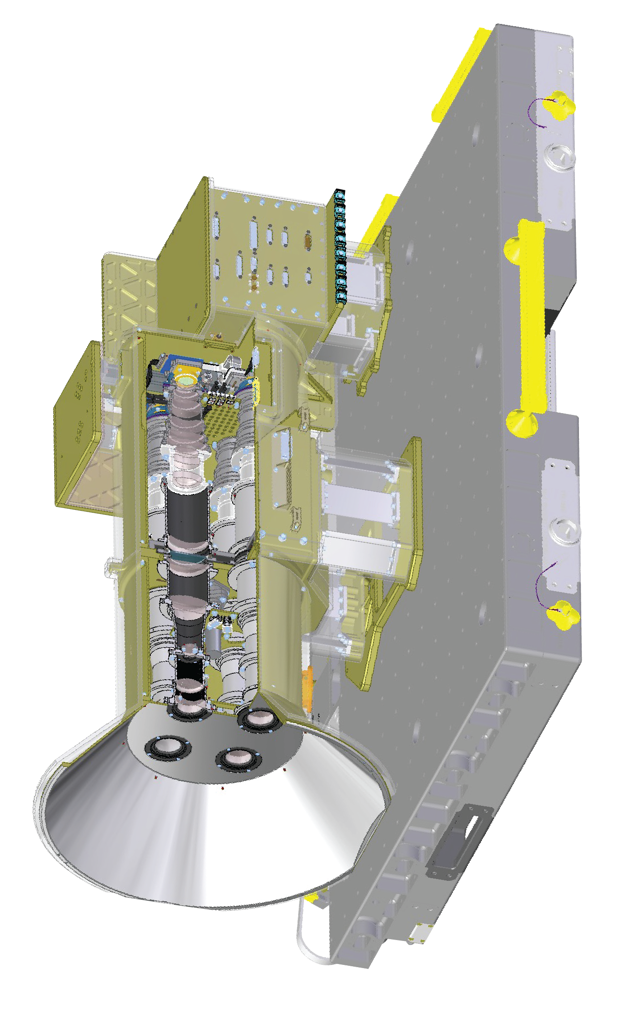
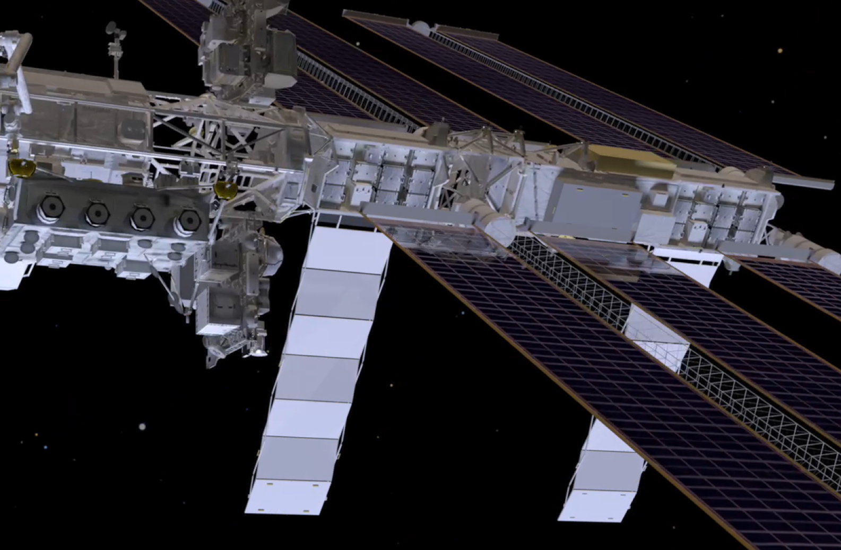
TVAC Objectives
Simple payload design for environmental loading; largest uncertainty in environmental loading is in ISS interactions and performance of MLI
Therefore, focus test on internal thermal balance (not including radiators) and characterize MLI performance
A
B
Inconsistent view of solar panels and space
AWE installed on ELC1-3

Slide 12
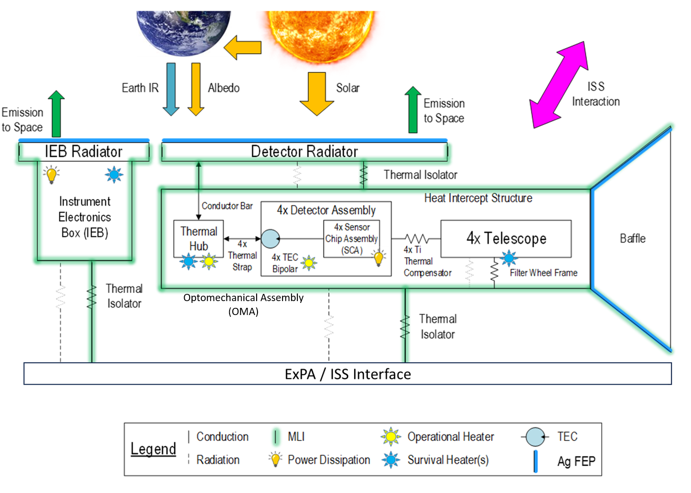
Test Approach: Overview
Cover radiative surfaces, MLI over everything, Q-meters everywhere heat goes in/out of the instrument
On Orbit Diagram
TVAC Testing Diagram
SDL’s TV East Chamber

Slide 13
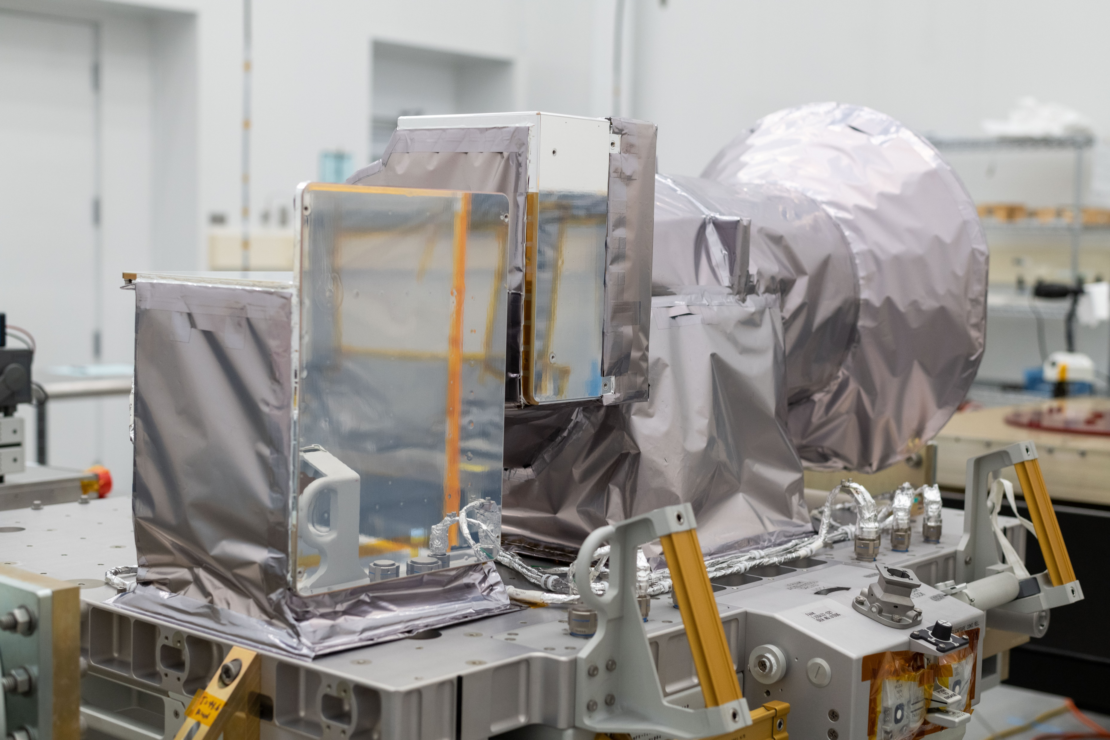
Test Approach: Overview
GSE MLI
GSE Kapton Heaters

Slide 14
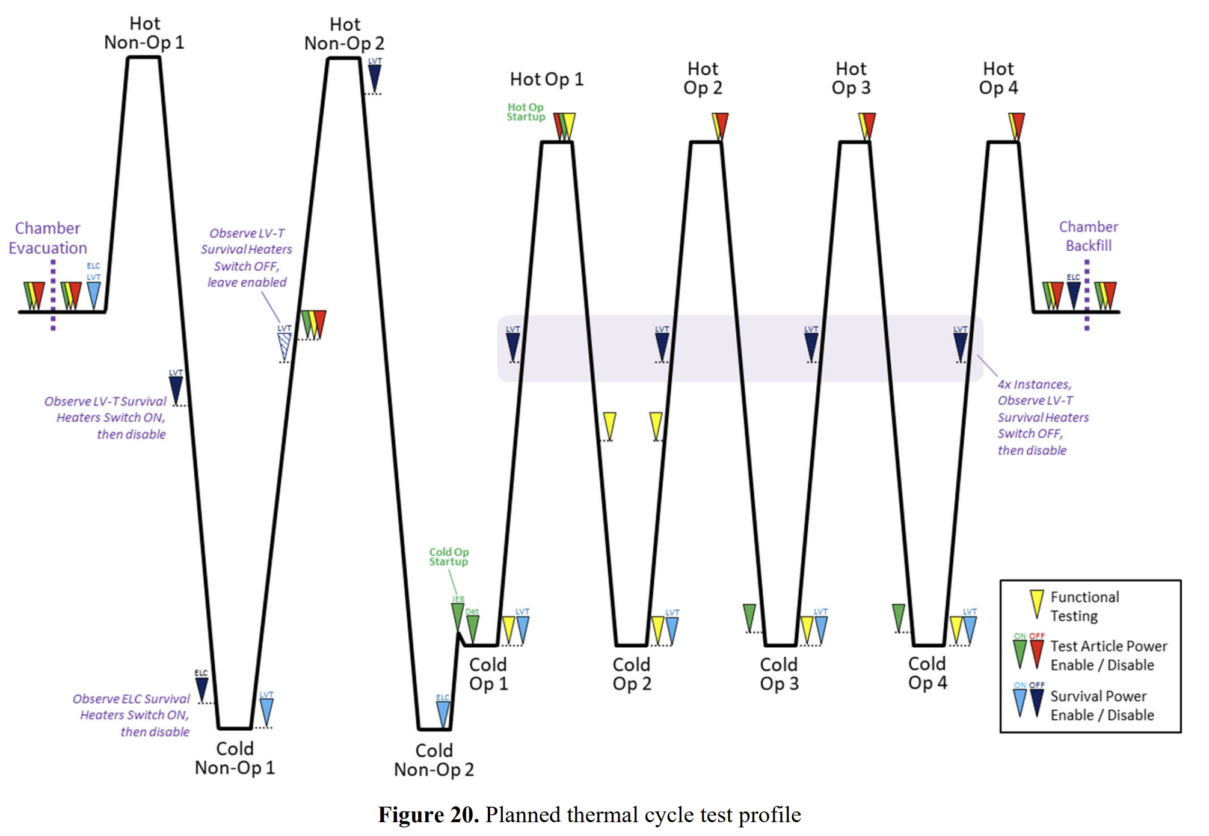
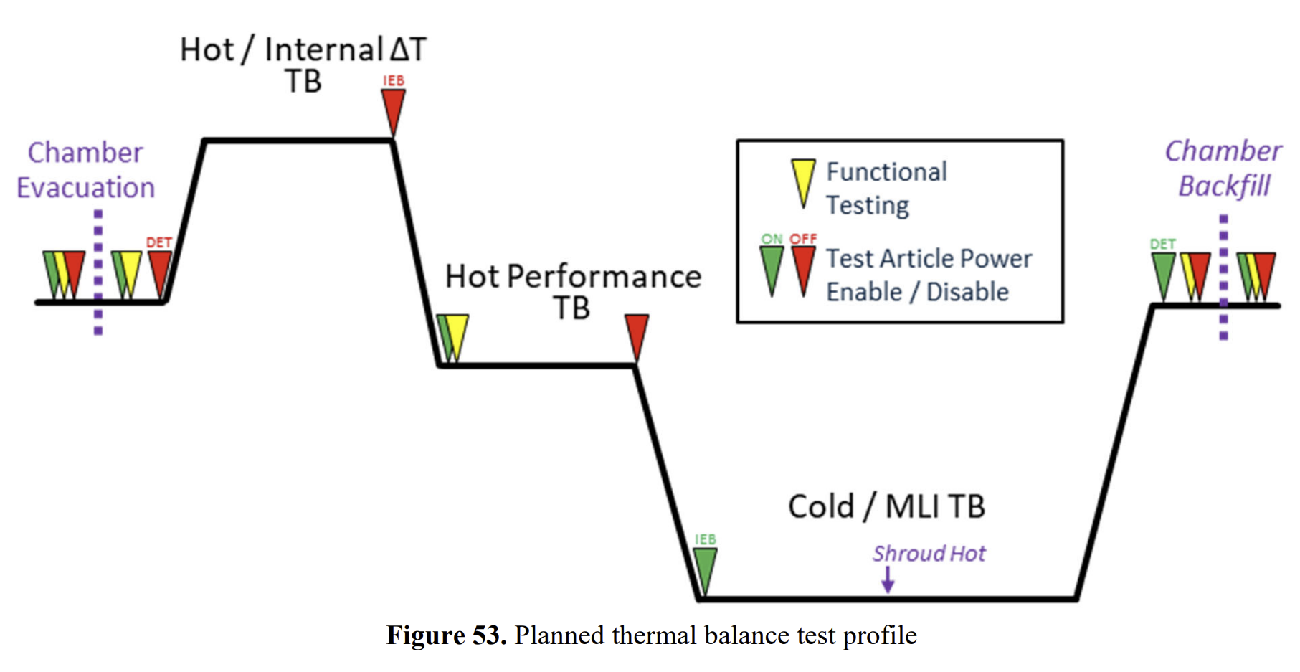
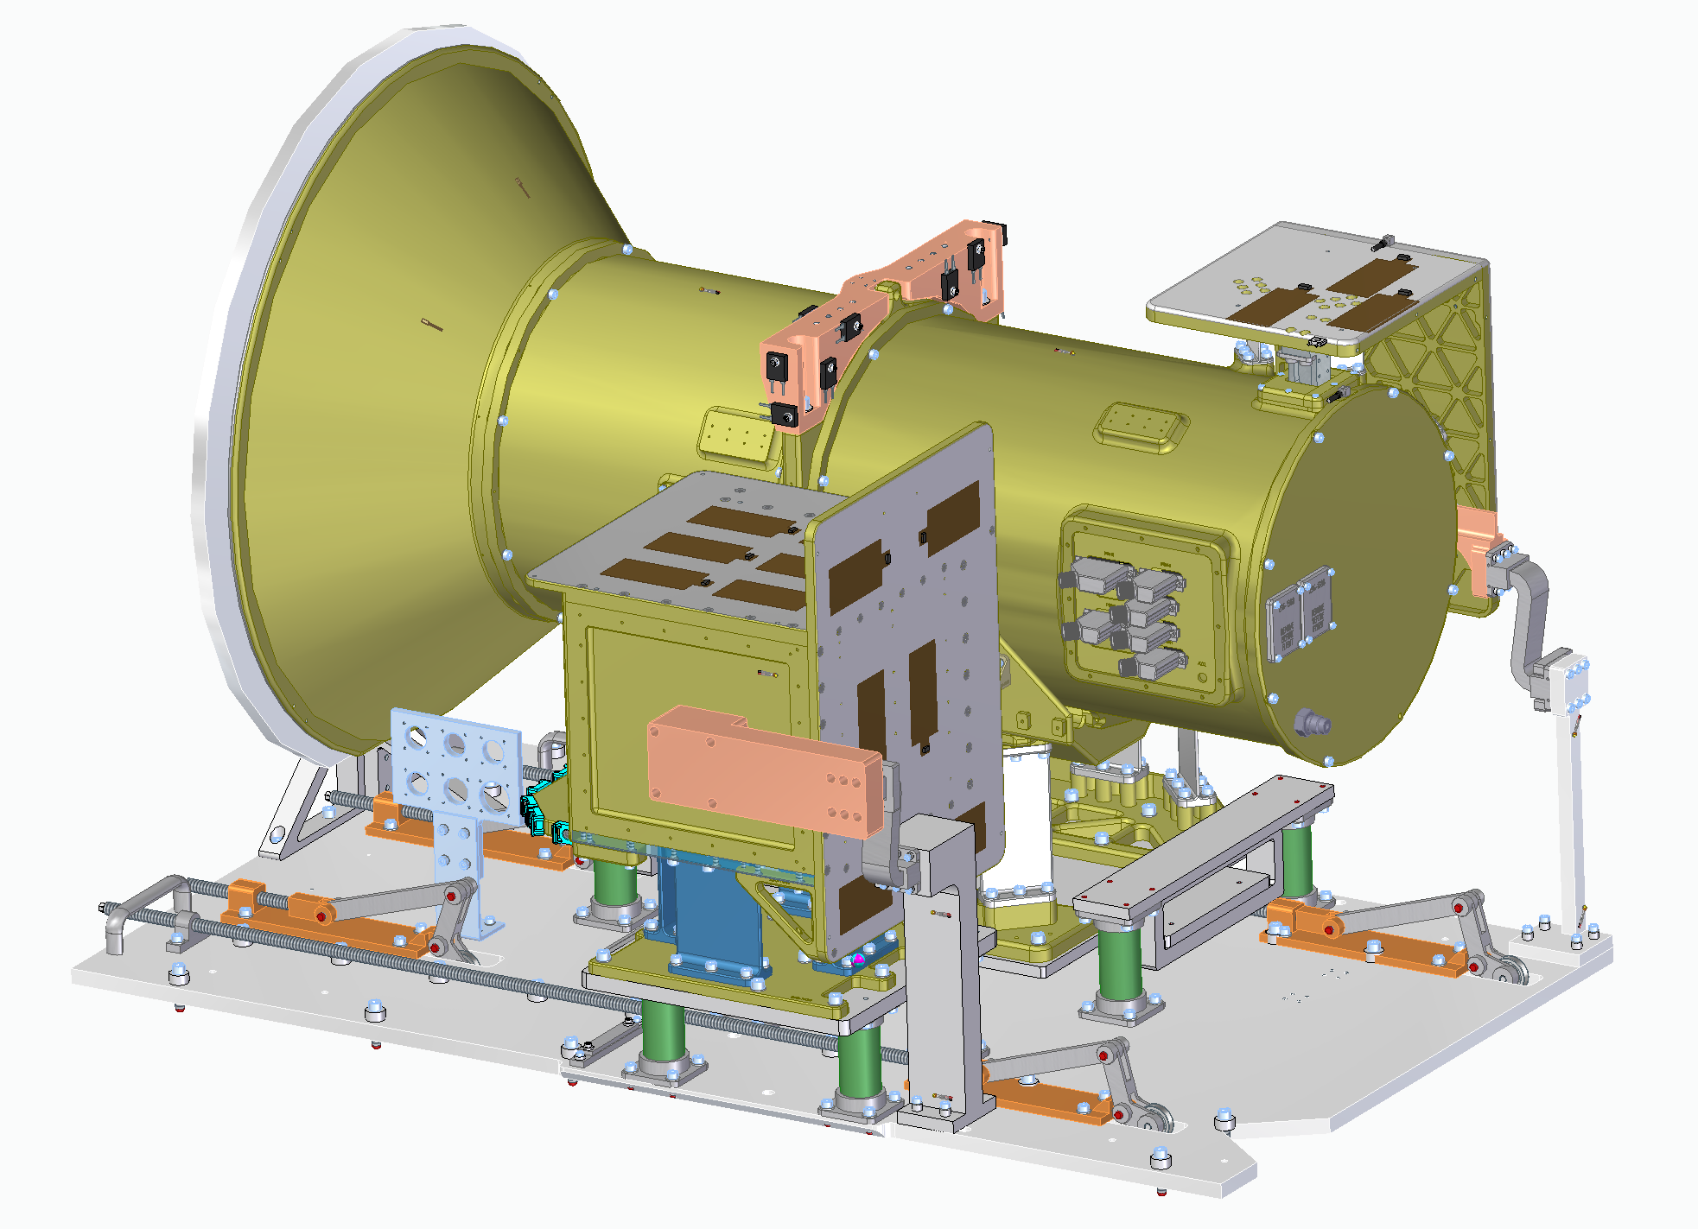
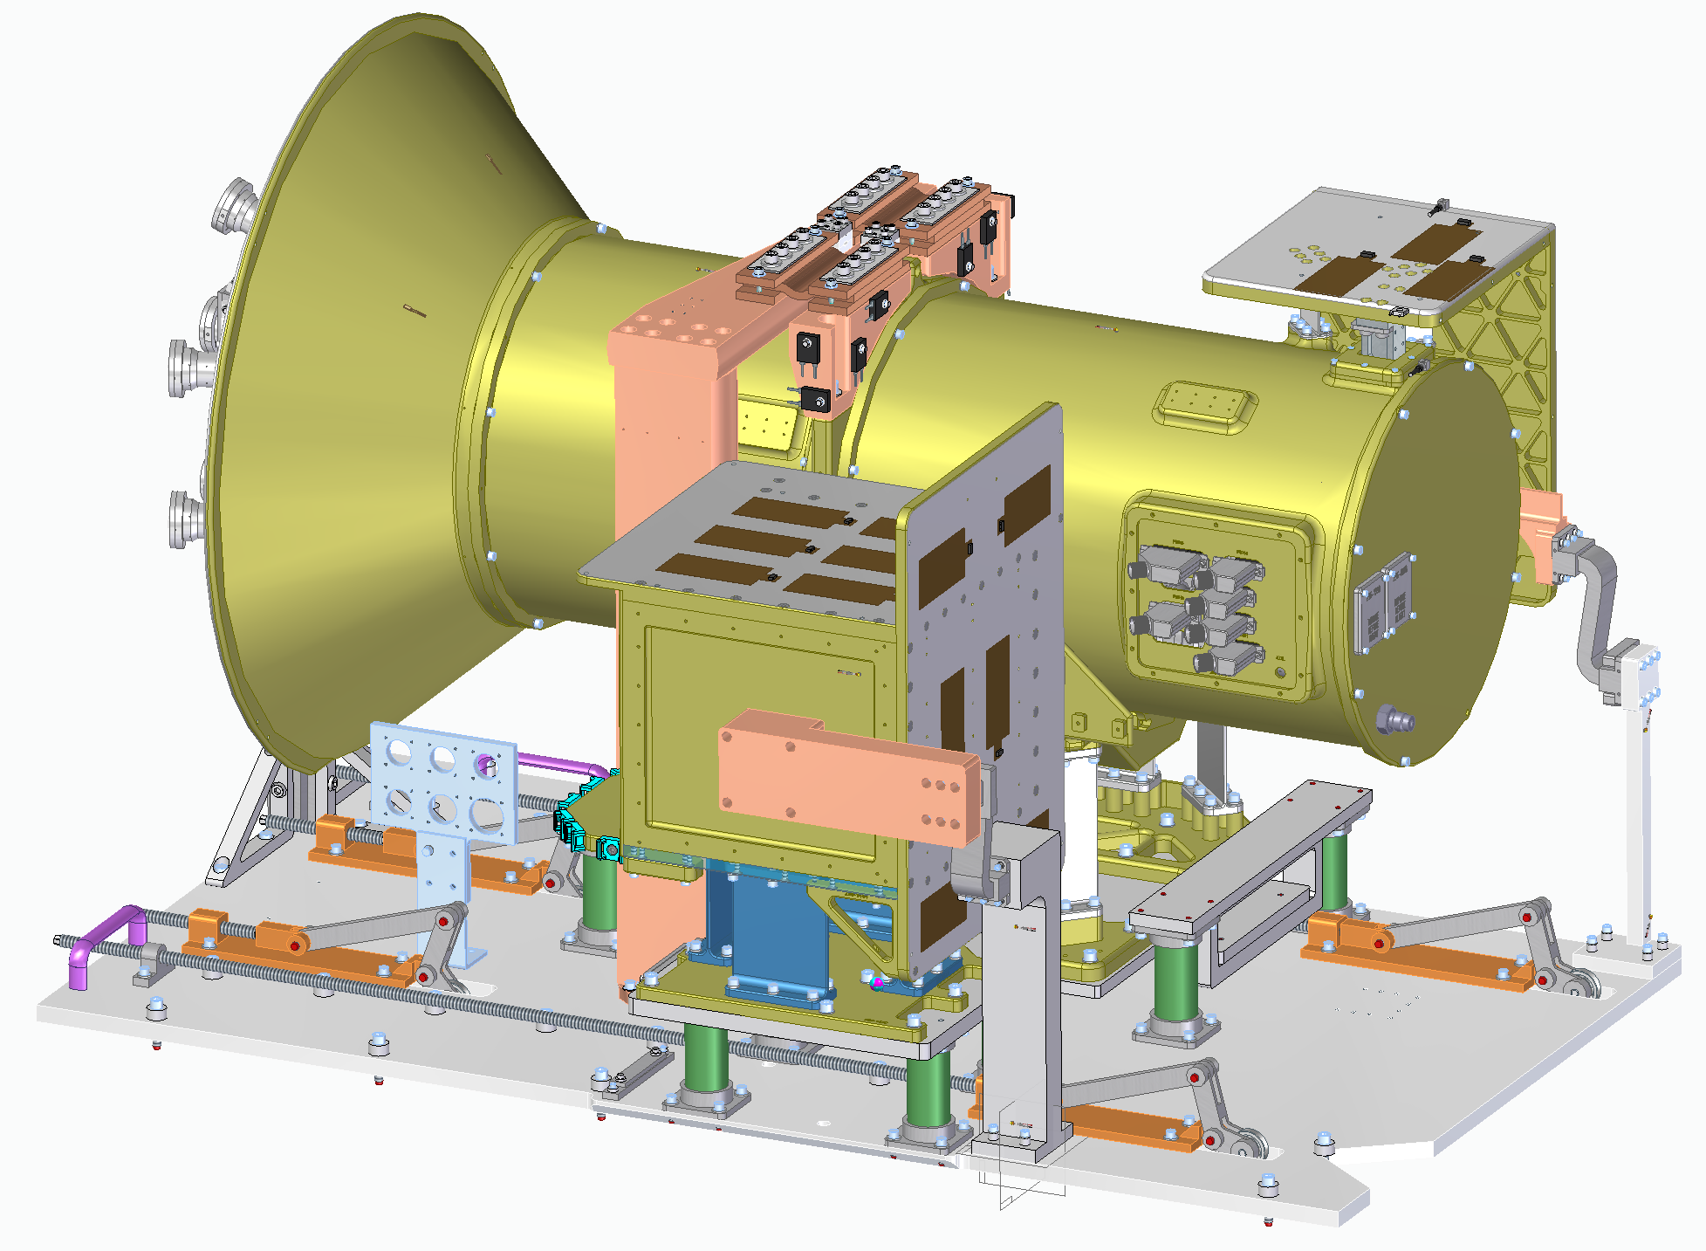
Test Approach: Overview
Thermal Cycle Test Configuration
Thermal Balance Test Configuration
Detector Radiator
(GSE heaters)
Filter Wheel Arch
(GSE heaters)
Cold Target
(GSE heaters)
Detector Radiator
(GSE heaters)
Collimators
Cold Target Q-meter
Detector Q-meter
IEB
(GSE heaters on radiator)
OMA-ExPA Simulator
(GSE heaters)
OMA-ExPA Simulator
(GSE heaters)
IEB-ExPA Simulator
(GSE heaters)
IEB Q-meter
IEB
(GSE heaters on radiator)
IEB-ExPA Simulator
(GSE heaters)

Slide 15
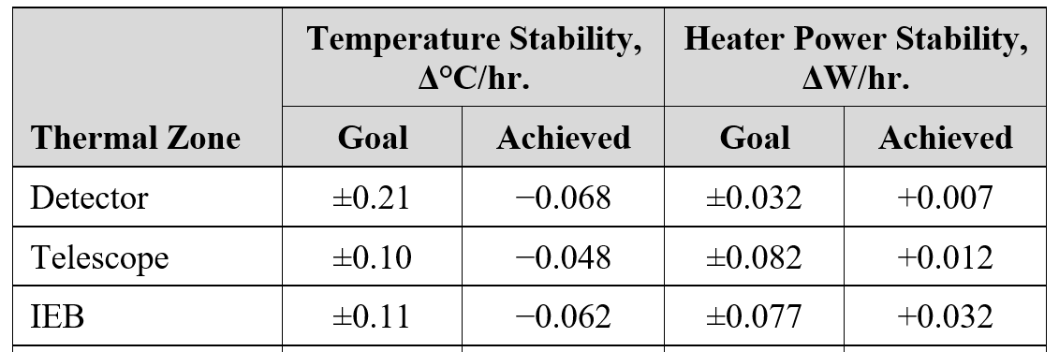
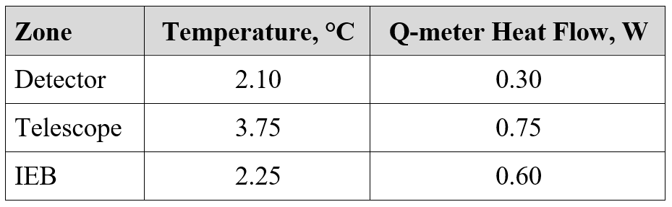
Test Stability and Thermal Model Correlation Criteria
Study was performed prior to the test to determine stability criteria and correlation criteria
  Based on each thermal zone’s sensitivity to variations in heat loads and temperature
Design budget/margin of 5ºC for analytical uncertainty needs to contain the following uncertainties:
  Temperature sensor reading
  Q-meter heat flow
  Test temperature stability (end of balance vs true steady state temperature)
  Final correlation temperature vs test data
Taylor Series Uncertainty Propagation resulted in the following stability and correlation criteria:

Slide 16
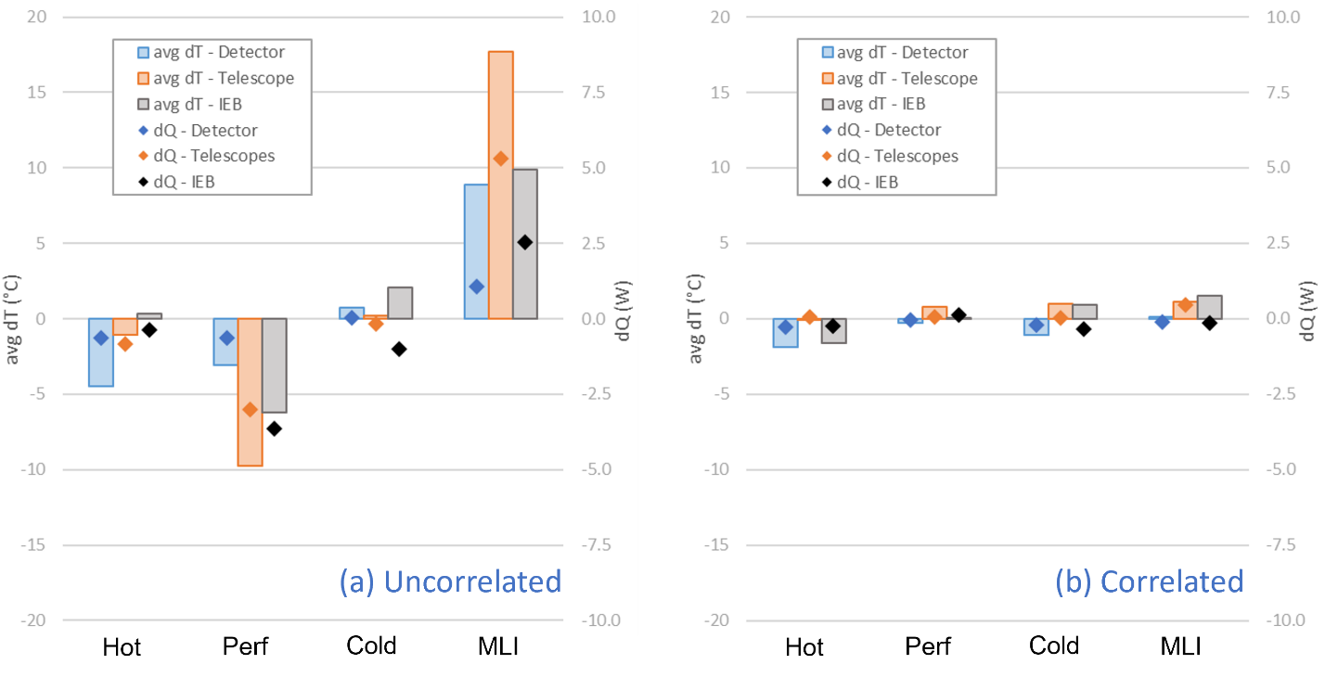
Thermal Model Correlation: Results
Correlation achieved to within goal for both temperature and heat flow

Slide 17
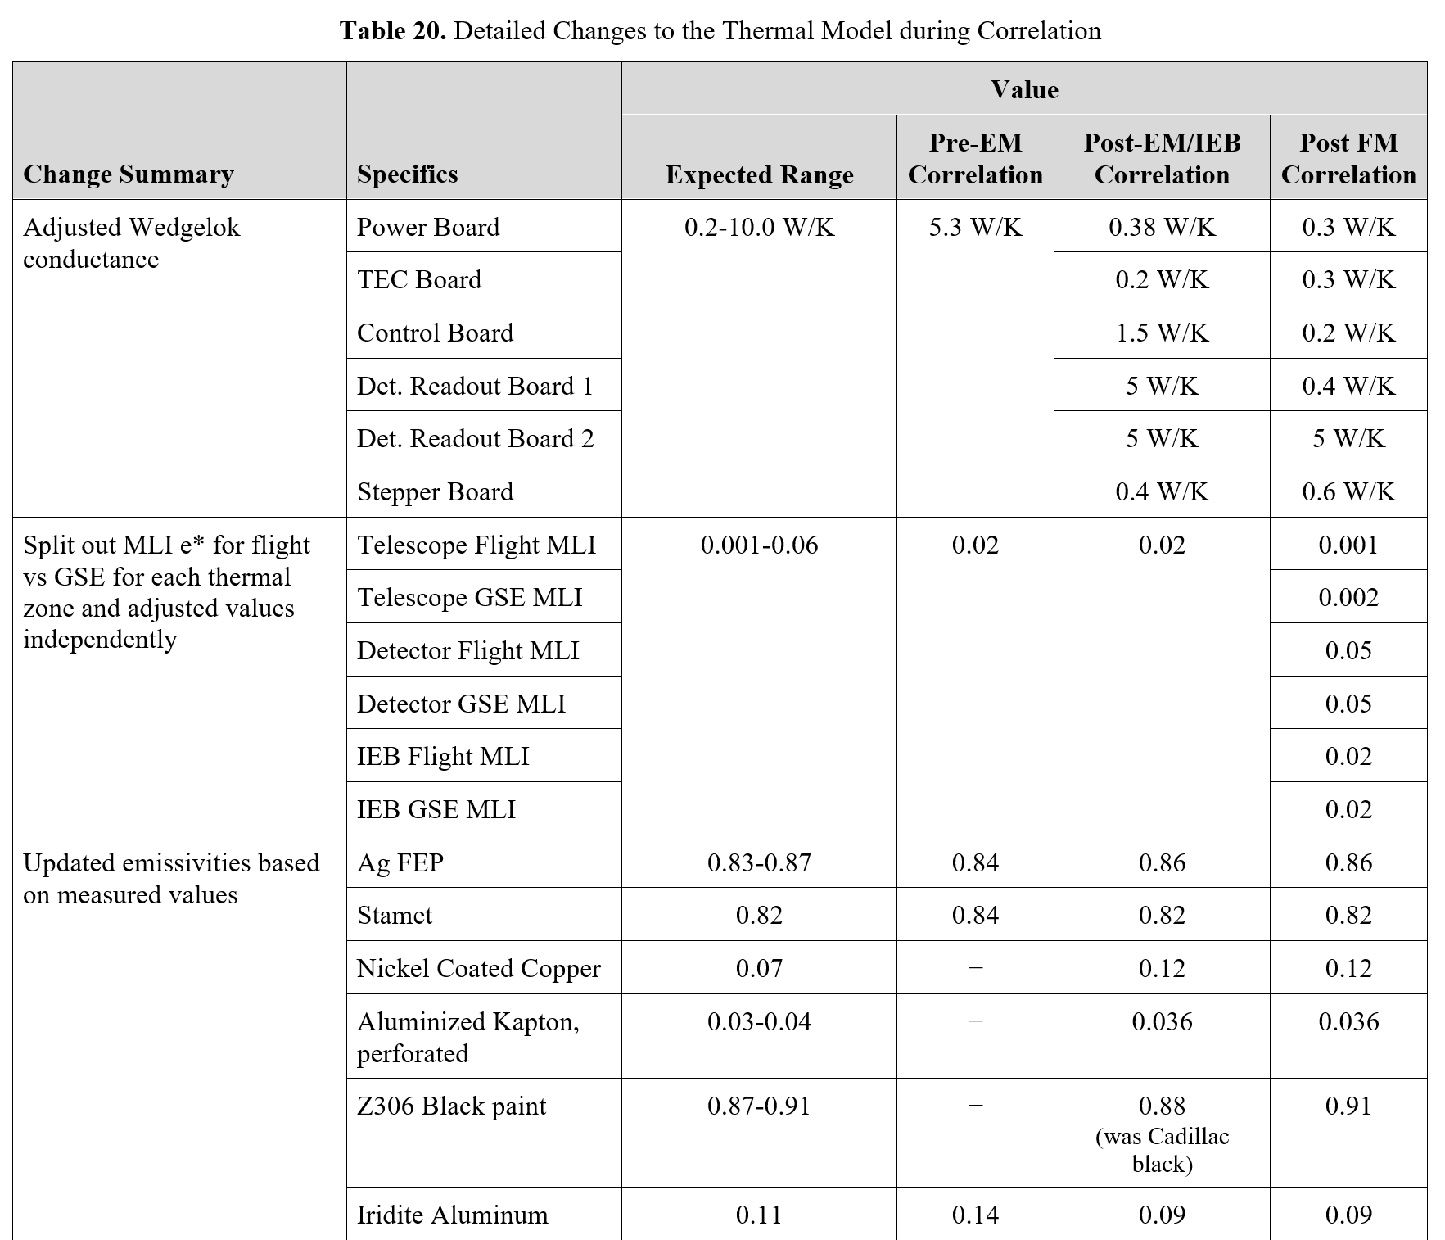
Thermal Model Correlation: Results
The largest changes made to correlate the model were:
  Wedge-Lok conductance
  MLI e*
  GSE connections to flight hardware

Slide 18
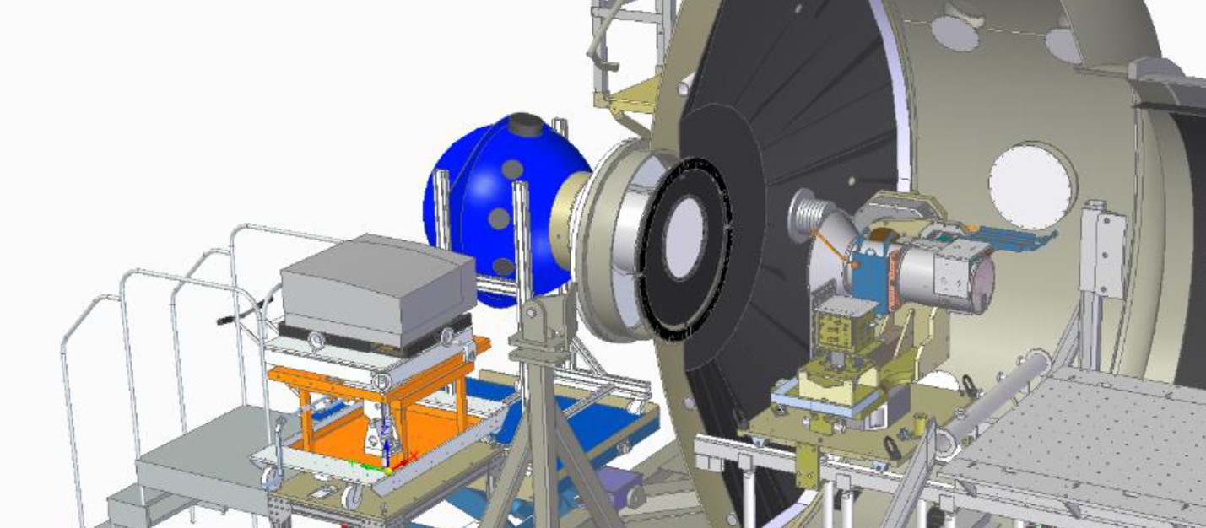
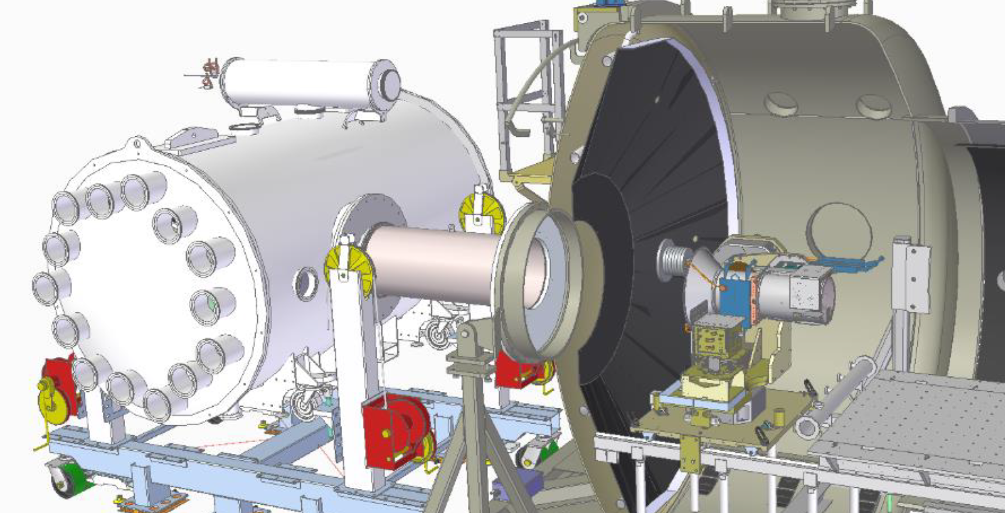
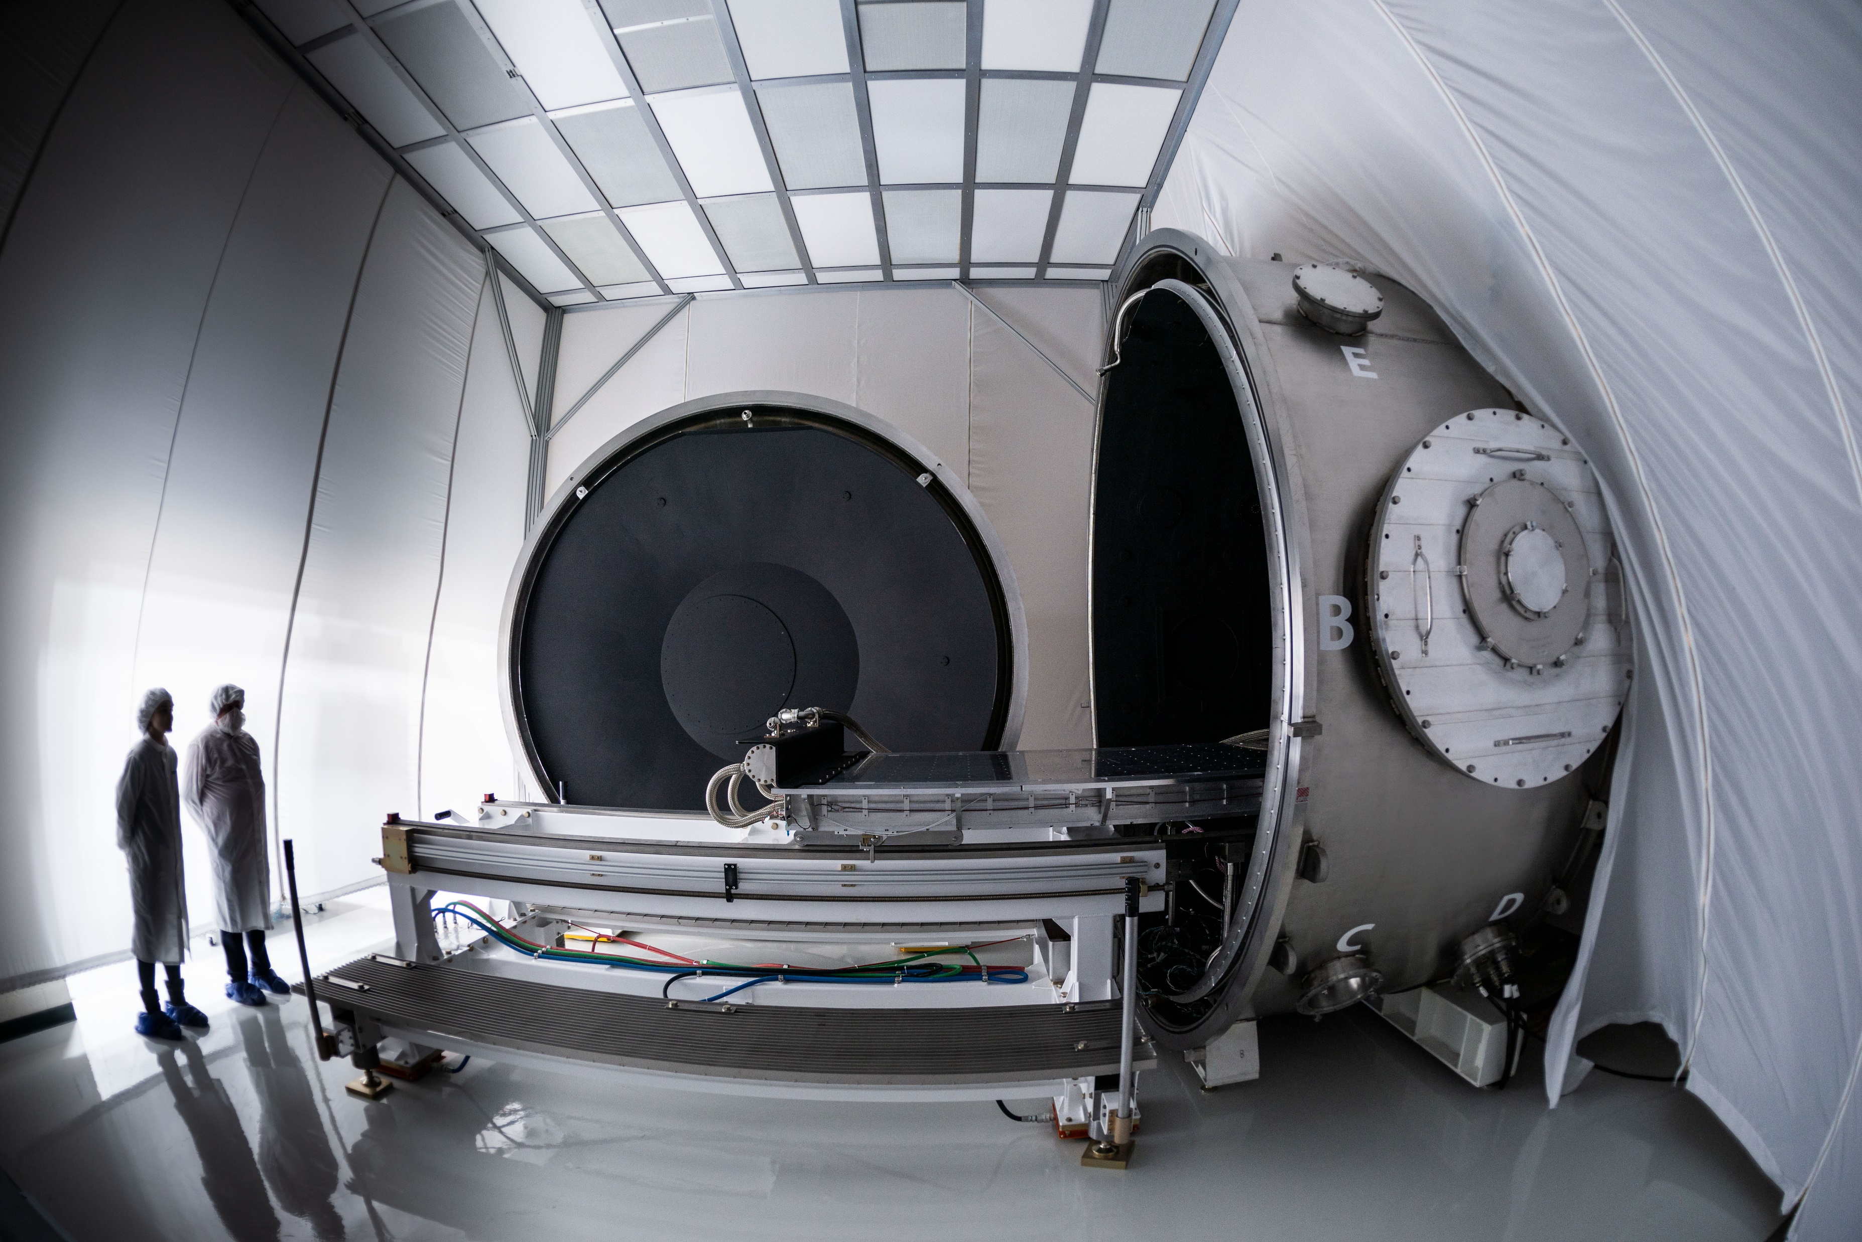
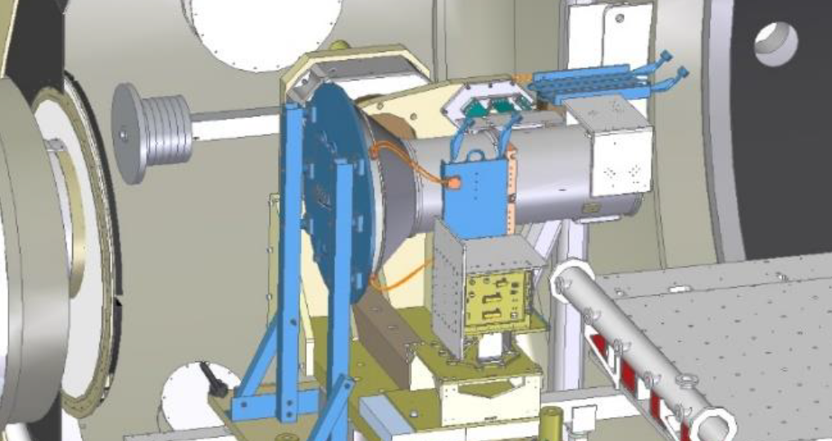
Calibration Testing: Overview
Three main calibration tests:
  Integrating Sphere
  Single Point Source
  Cold Target
Performed in SDL’s large THOR chamber on a 2-axis gimbal
  Full range of motion made thermal control of hardware challenging
Integrating Sphere
Collimators/Single Point Source
THOR: 12’ Diameter TVAC Chamber
Cold Target

Slide 19
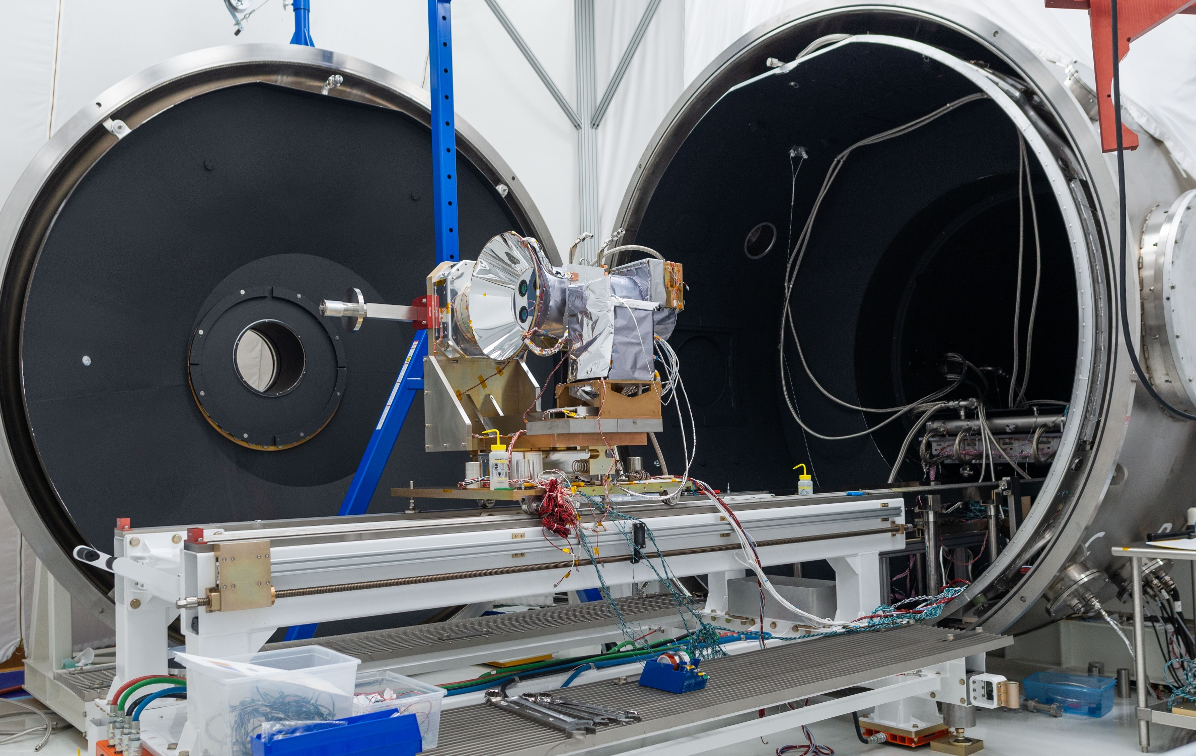
Calibration Testing: 2-Axis Gimbal
Instrument was LN₂ cooled through GSE heat exchangers with trim heaters on the instrument side of thermal straps to control instrument temperatures
LN₂ lines designed with slack for full Gimbal range of motion
LN₂ Flexible Lines
LN₂ Heat Exchangers
Trim Heaters on thermal straps

Slide 20
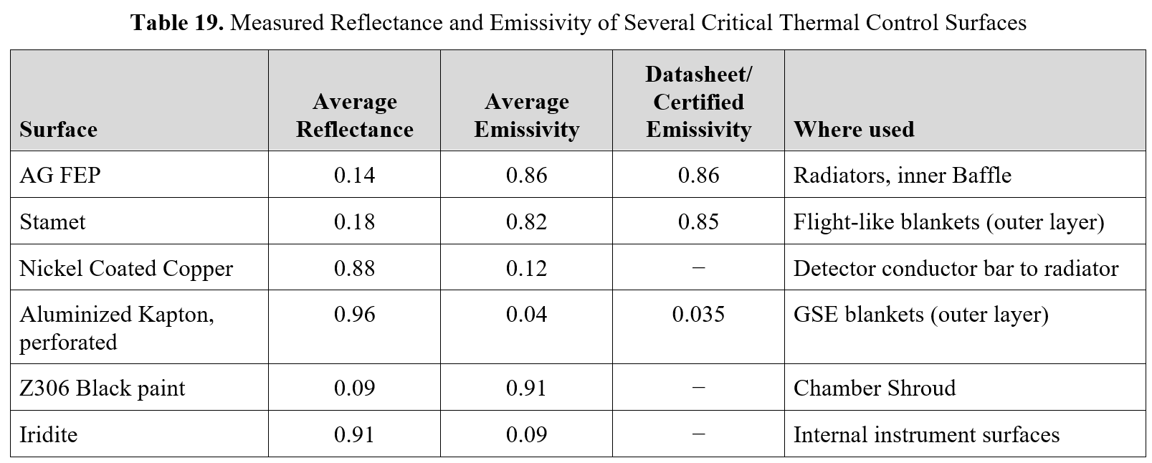
Lessons Learned
Measure everything you can to get your thermal model as close as possible before trying to correlate to test data
  Examples:
    We measured emissivity on all our critical coatings during assembly and used those values in the model correlation
    We measured the conductance of the thermal straps prior to the full assembly test
Use some form of Q-meter where possible to track heat flow in/out of the instrument
  Temperature data alone isn’t sufficient to get a really good thermal model correlation
  Can just be a metal bar or thermal strap with some form of calibration to understand Q vs dT

Slide 21
Conclusions
ISS interactions made radiative thermal model environment uncertain, so AWE TVAC test focused on the highest controllable uncertainties:
  Internal thermal balance
  MLI performance
Heaters put on radiative interfaces and covered with MLI; controlled as a temperature boundary while monitoring heat flow in/out of instrument
Q-meters connected near radiative interfaces to meter heat in/out of the instrument to provide excellent thermal model correlation
MLI performed better than expected and Wedge-Loks worse than expected
2-axis gimbal calibration test challenges overcome by LN₂ lines with slack for full range of motion

Slide 22
Questions?

Slide 23
Backup

Slide 24
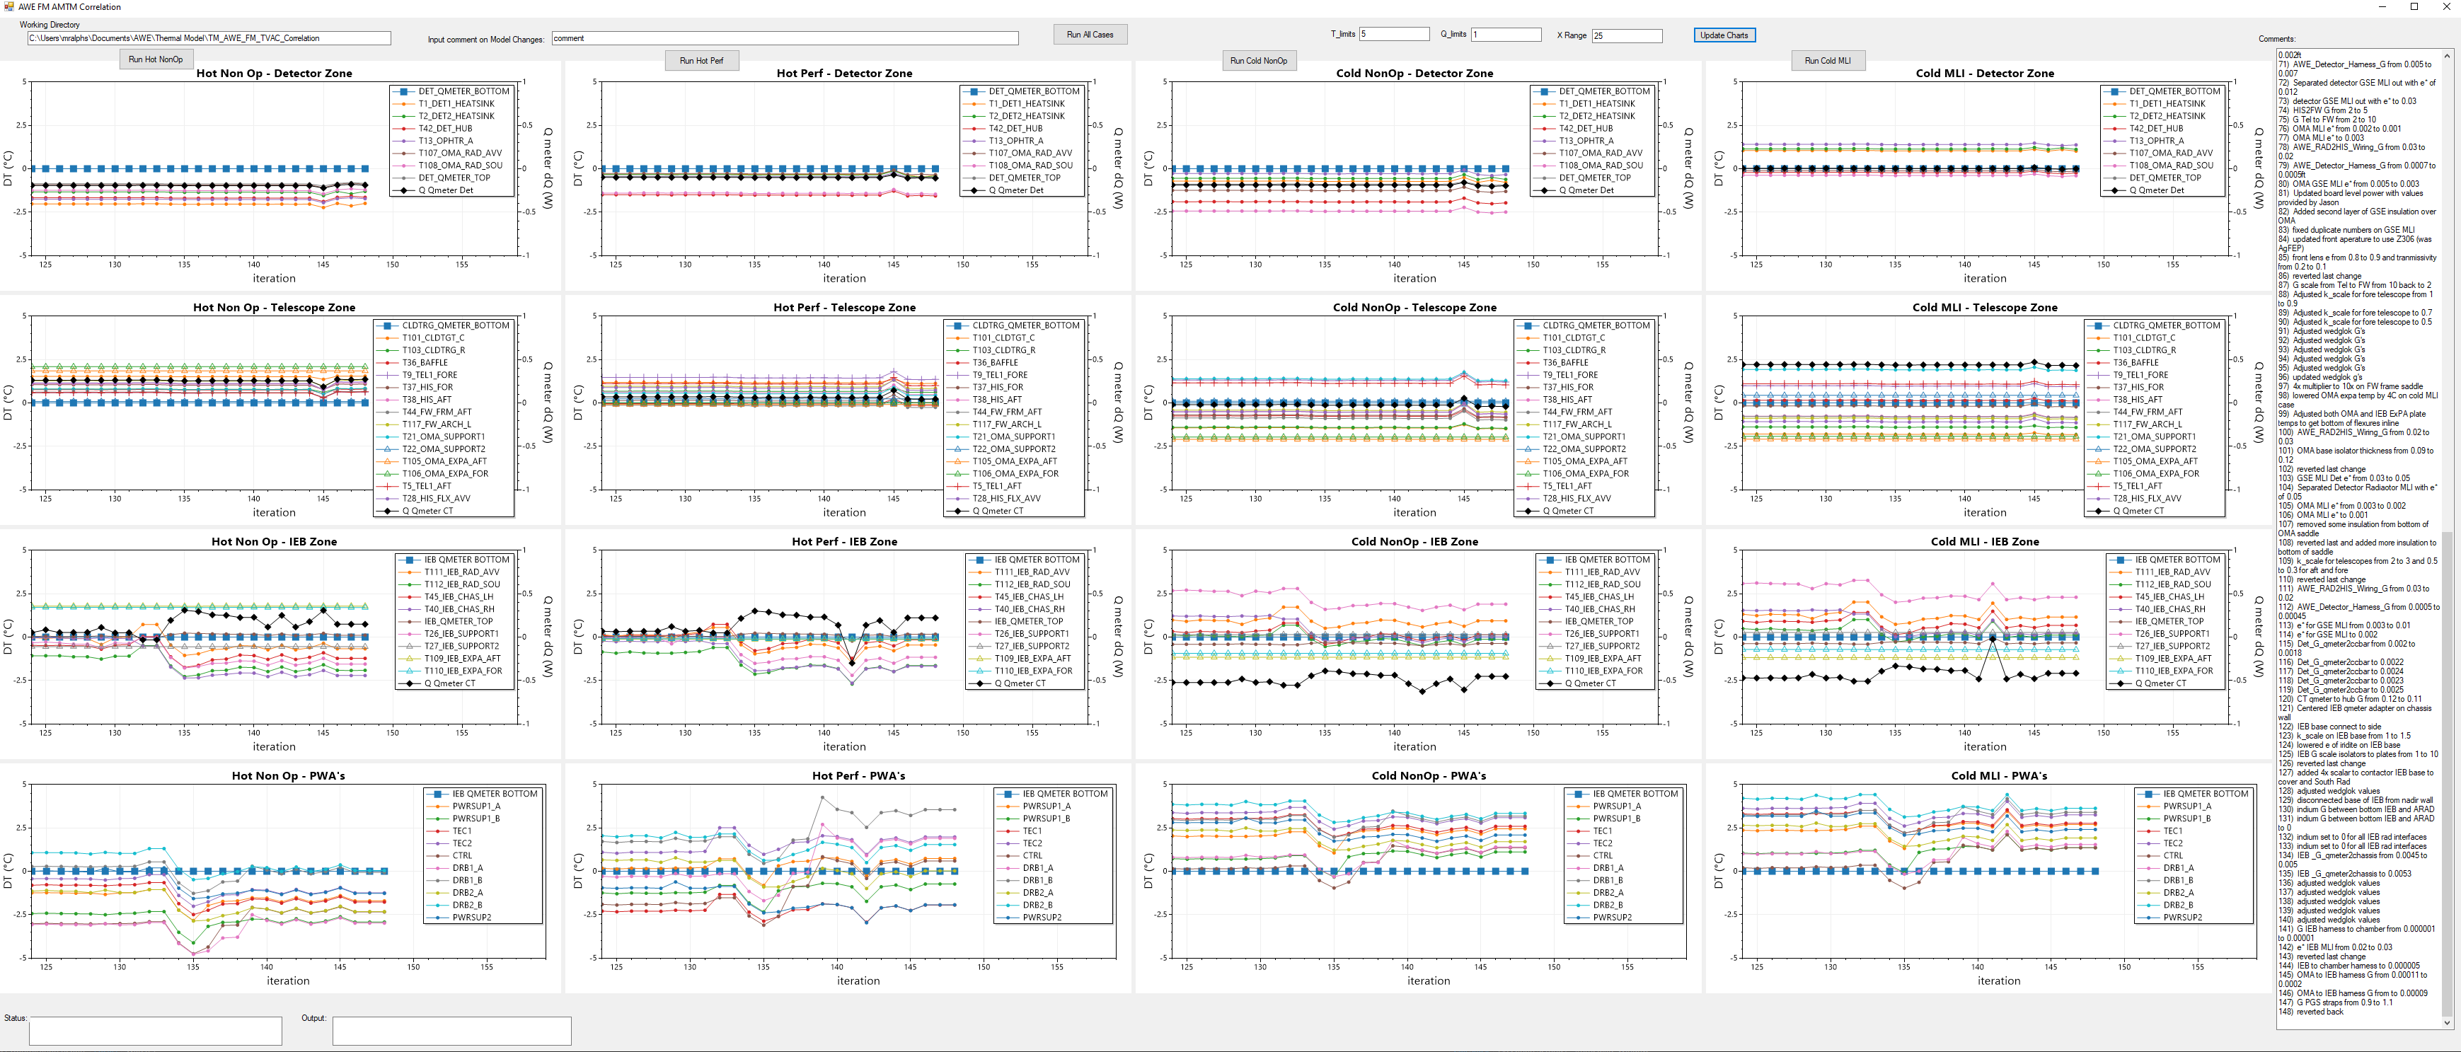
Thermal Model Correlation – Custom Open TD Interface

Slide 25
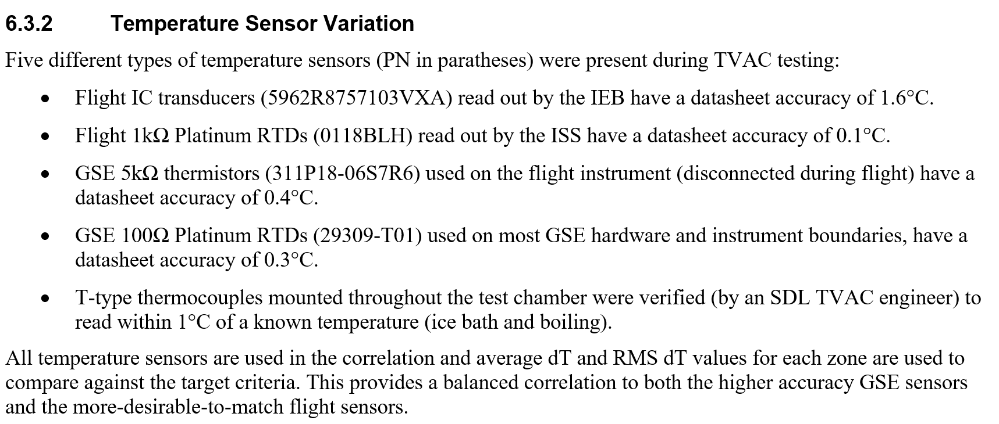
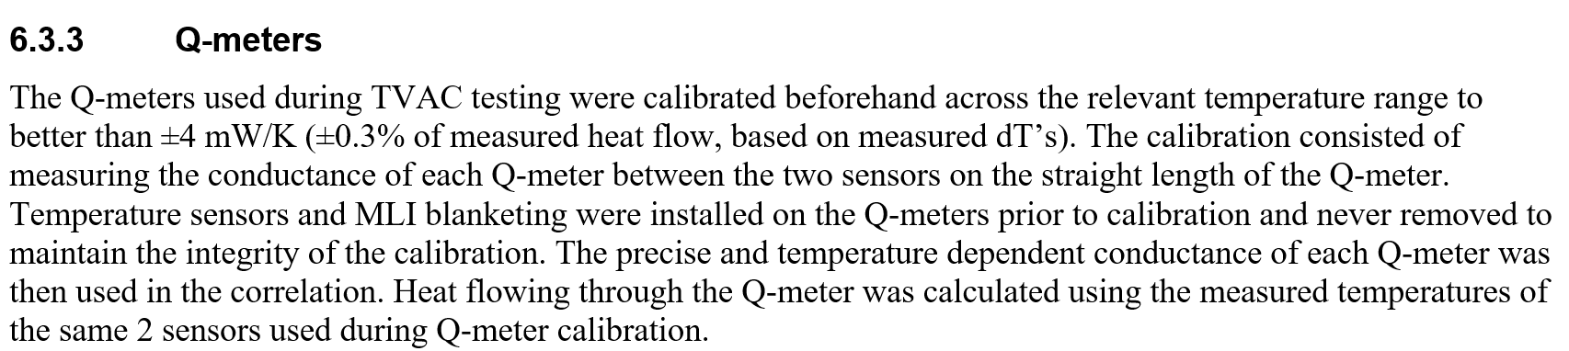
Temperature Sensors and Q-meter Calibration

Slide 26
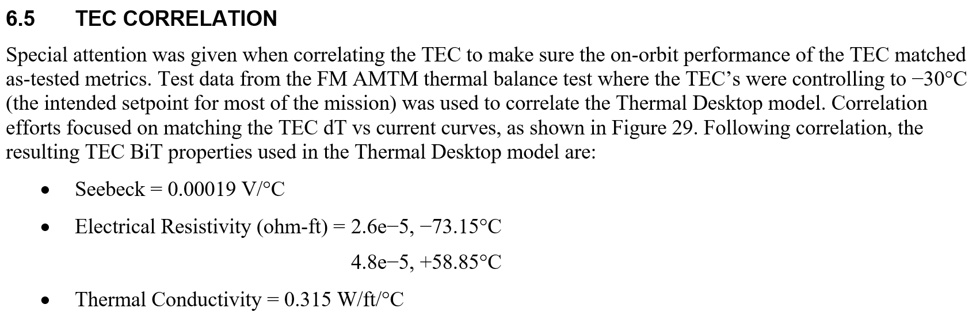
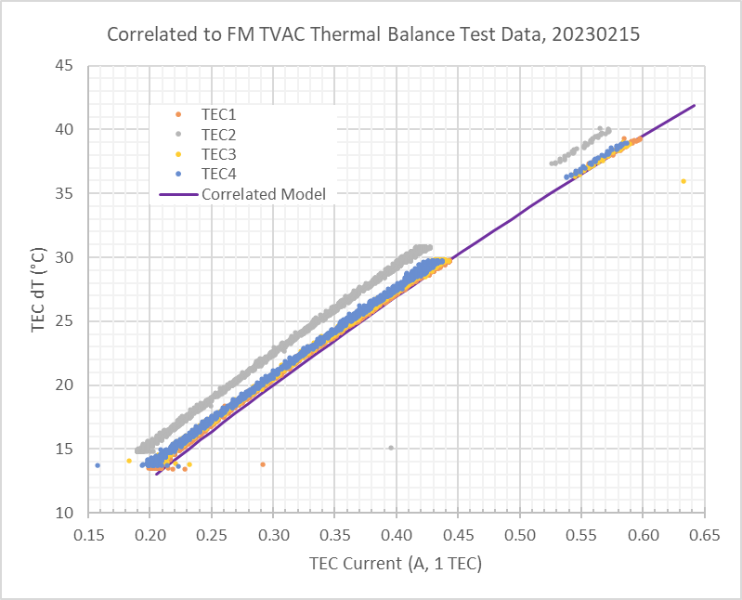
TEC Correlation

