Slide 1
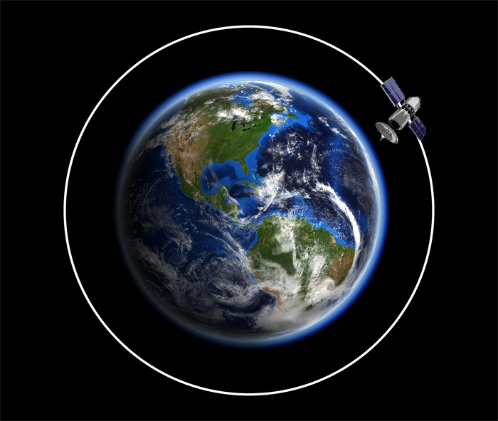
Notes:
LEO Orbit is defined by:
Orbital Period
Inclination
Velocity
Uses
Earth Observation (imaging, weather, climate)
Communications
Technology demonstrations and CubeSats
Advantages:
Low latency
Higher bandwith
Redunatnt coverage
Safe space environment

Slide 2
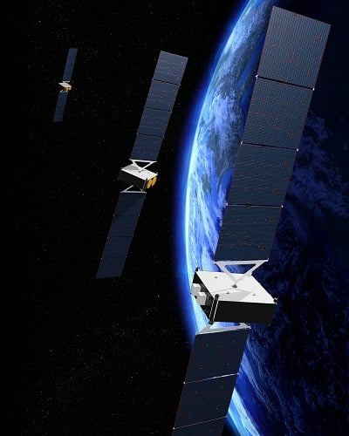
Notes:
All electric satellites
Advantage:
Reduced Launch Mass
Cost Saving: Launch more than one at the time
Extended mission duration
More room for payloads
Disadvantages:
Technology complexity
Power demand
Solar Arrays and battery pack

Slide 3







Discharge 30min
Charge 60min

Slide 4
Operating in Low Earth Orbit
Inherent Benefits:
Current
Thermal
Runaway
Mechanical
Inherent Challenges:
Cycling
Vacuum
SOC estimation
Hypervelocity impacts

Slide 5
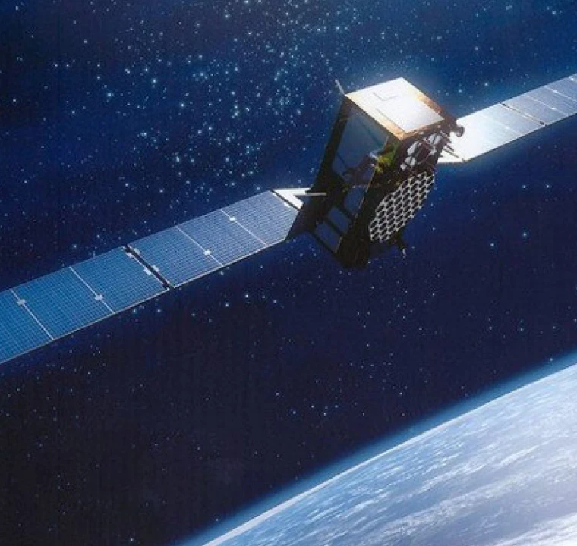
Optimization of Battery Thermal Management for LEO Satellites Using Multi-Physics Modeling in GT-SUITE
Massimiliano Mastrogiorgio
Staff Battery Application Engineer

Slide 6
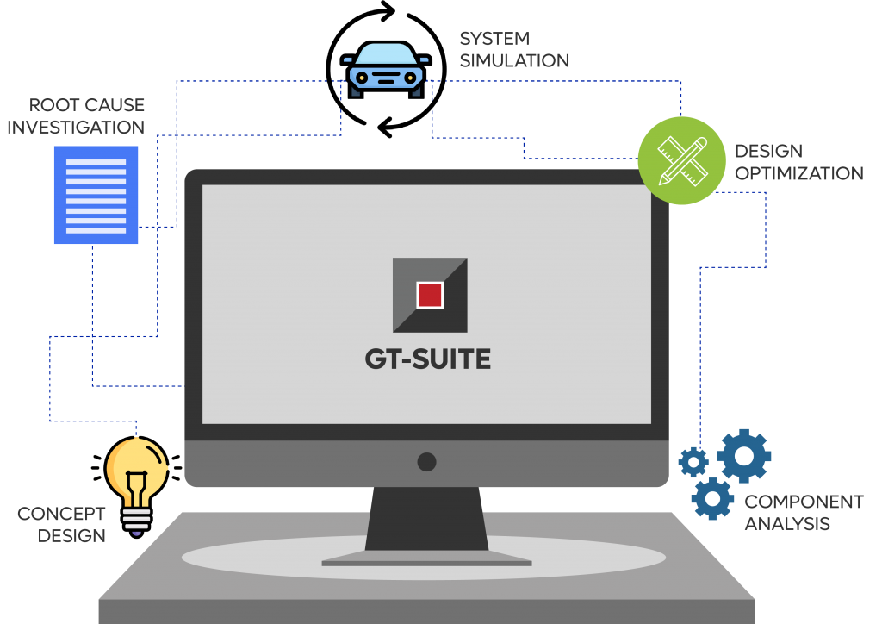
What is GT-SUITE?

Slide 7
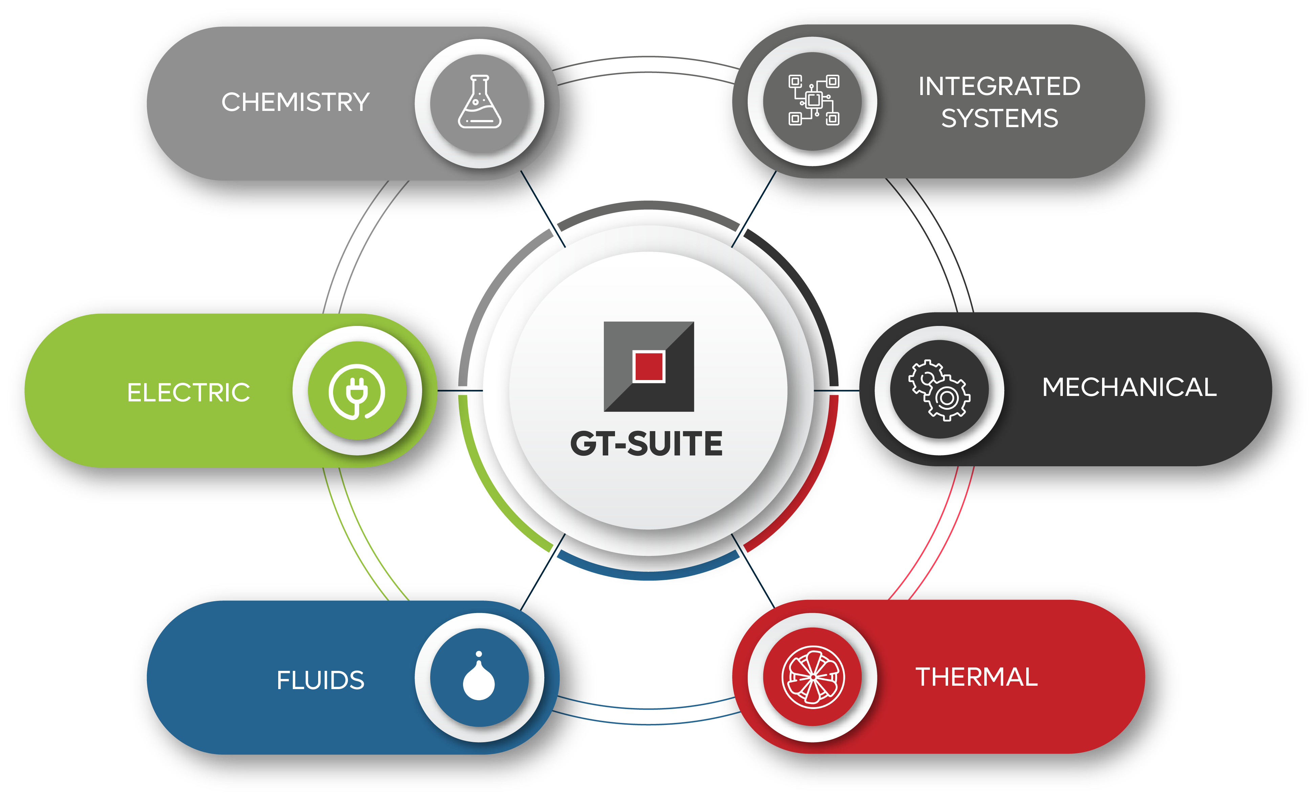

Slide 8
Core Physics Domains in Satellite Technology
Classical Mechanics
Electrical
Thermal
Chemistry
Fluids
Electrochemical

Slide 9
Classical Mechanics
Thermal
Electrical
Electrochemical

Slide 10
Classical Mechanics
Thermal
Electrical
Electrochemical

Slide 11
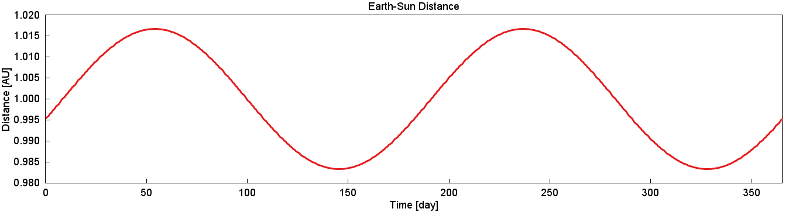
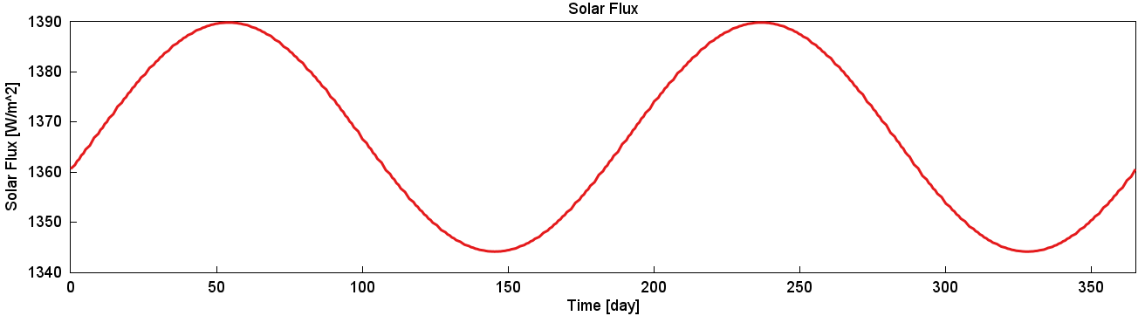
On-Orbit Thermal Environment
Position of Earth with respect to Sun and Solar Flux calculation

Slide 12
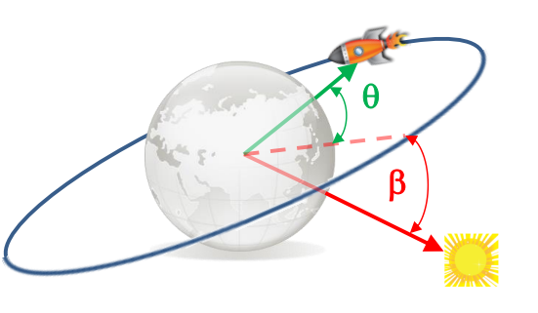
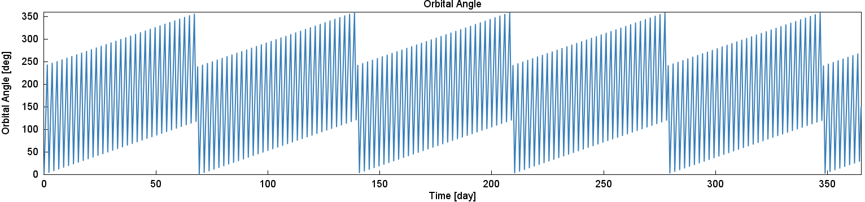
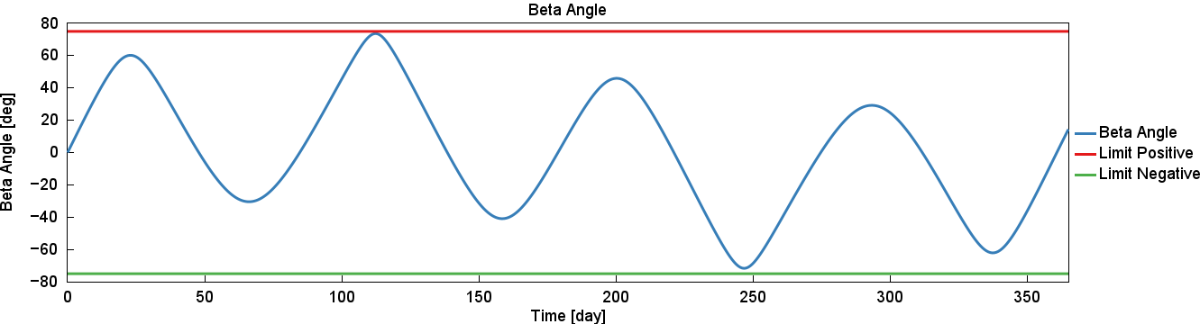
On-Orbit Thermal Environment
Position of satellite on LEO orbit

Slide 13
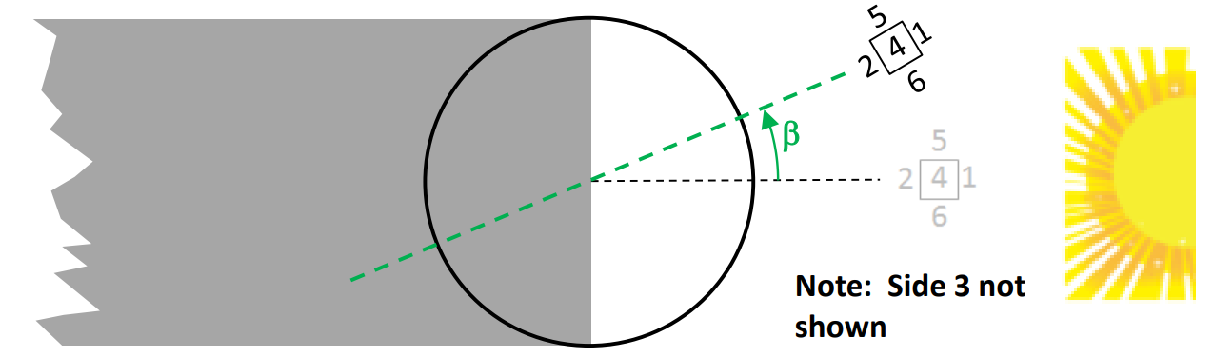
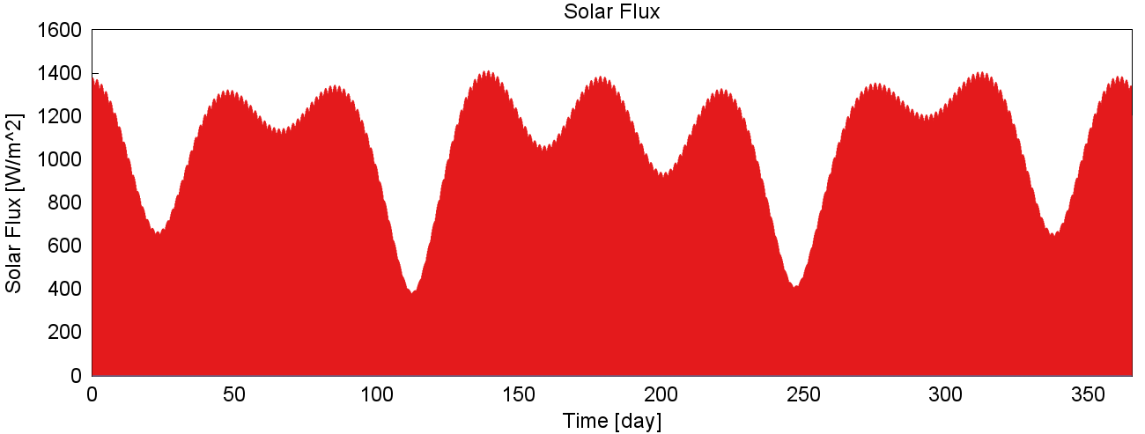
On-Orbit Thermal Environment
Notes:
Side 1 - faces away from the planet (zenith-facing) Side 2 - faces the planet (nadir-facing) Side 3 - faces forward (velocity vector-facing) Side 4 - faces aft (anti-velocity vector-facing) Side 5 - faces north Side 6 - faces south

Slide 14
Classical Mechanics
Thermal
Electrical
Electrochemical

Slide 15

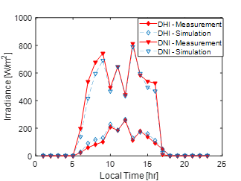
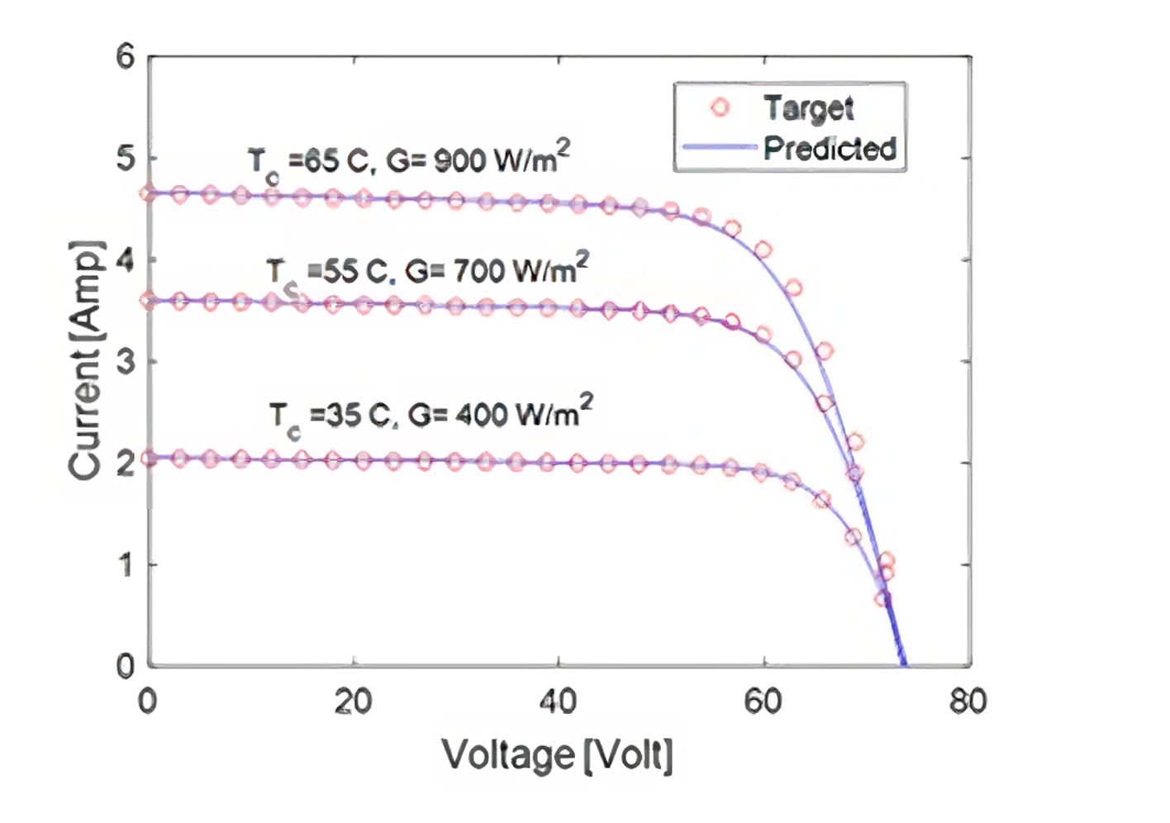
Solar Cell
Solar Cell template consists of three parts:
🌞 Irradiance –
Simulate solar energy input via sub-models or data inputs.
🔋Photovoltaic –
Focuses on electrical characteristics and energy conversion
🌡️Thermal –
Model temperature impact on solar cell performance
Latitude, Longitude, date, time
I-V Curve Validation
Daily Power Output of 11 by 4 Canadian Solar CS5P-220M

Slide 16
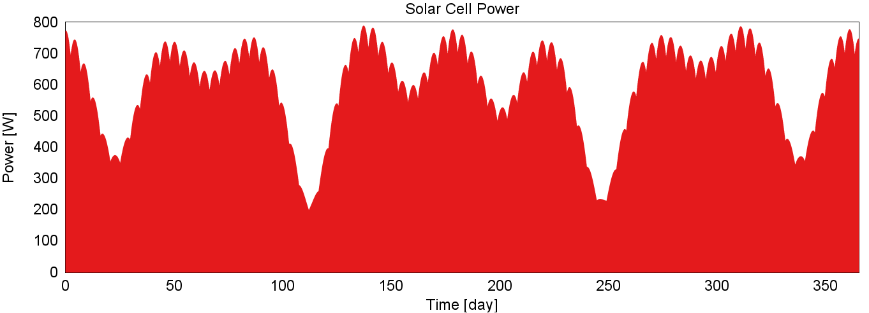
Solar Cell Power Generation
Dimensions of solar cell array: 0.56m (width) x 0.56m (length)
* Assumed whole power load of 200W

Slide 17
Classical Mechanics
Thermal
Electrical
Electrochemical

Slide 18
Battery Pack and Cell Selection
 | Automotive | Satellite | Implication
Lifetime Target | 500 cycles / 8 years | 5000 cycles / 5 years | 10x higher throughput
Power Profile | Varies by driver | Fixed | Simpler to plan, optimize, and test
Max C-Rate | 3C Charge / 0.5C Discharge | 0.5C Charge / 1C Discharge | Relatively low currents
Operating Temp | -10degC to +60degC | +25degC to +30degC | Ideal Temperatures
Cost Fraction of Vehicle | 33% | 1% | High-performance cells preferred

Slide 19

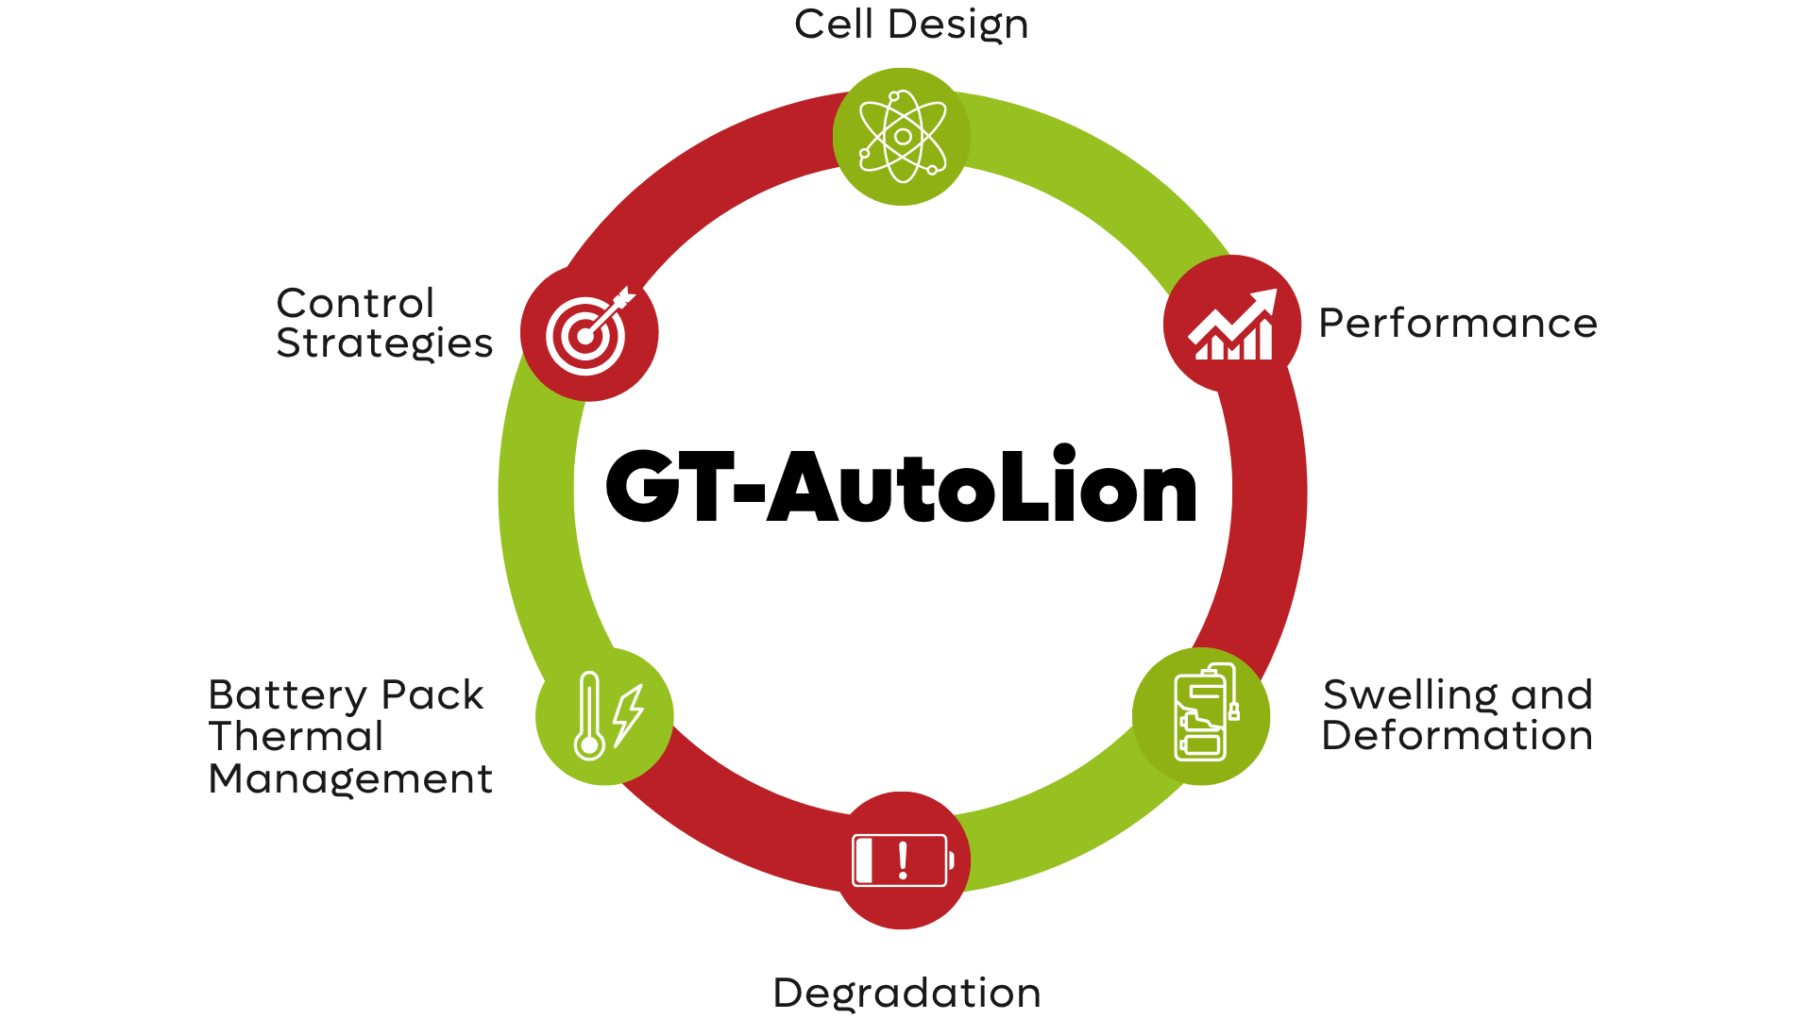
Battery Pack and Cell Selection
GT-AutoLion template

Slide 20
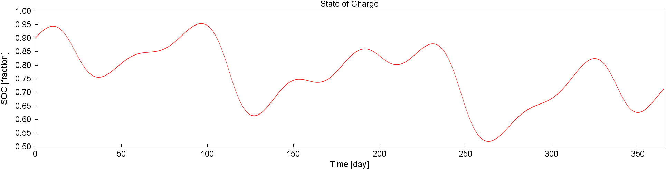
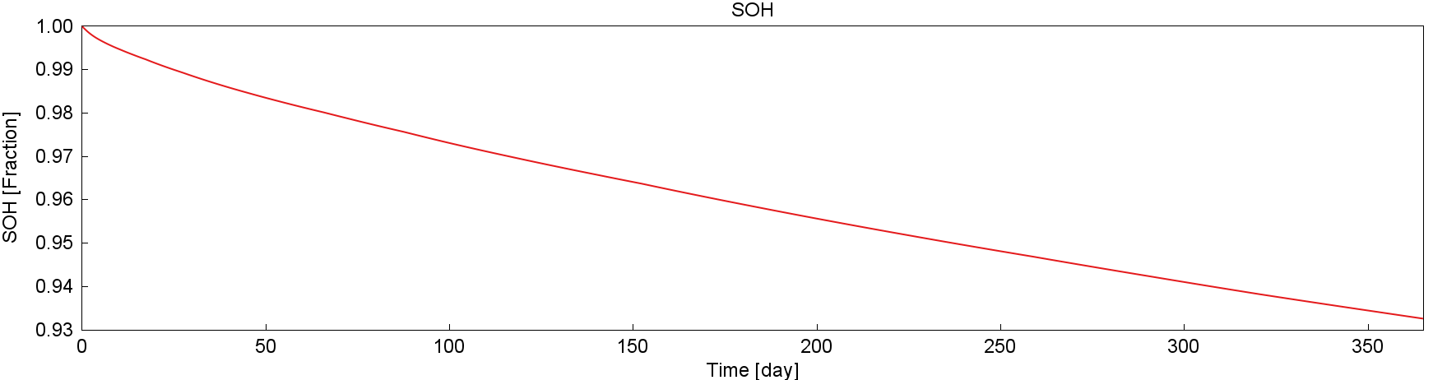
Battery Pack Monitoring

Slide 21
Classical Mechanics
Thermal
Electrical
Electrochemical

Slide 22

Thermal domain
Solar flux heating the faces of the satellite
Heat dissipation through radiation
Absorptivity
Emissivity
Conduction
Heat generation due to spacecraft electronics
* From 0D to full 3D system representation

Slide 23
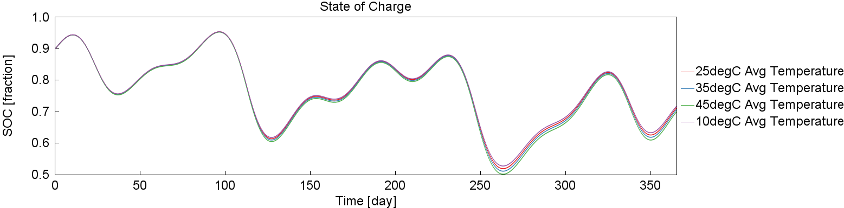
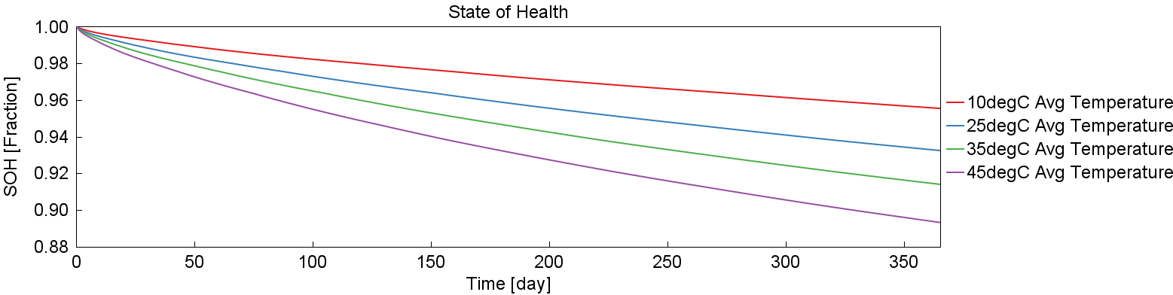
Battery Pack Monitoring and Temperature dependency

Slide 24
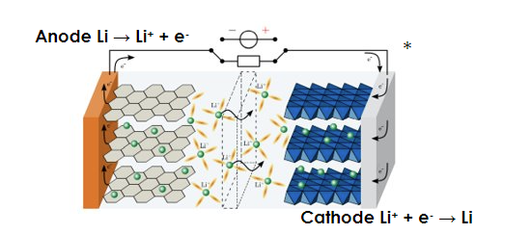
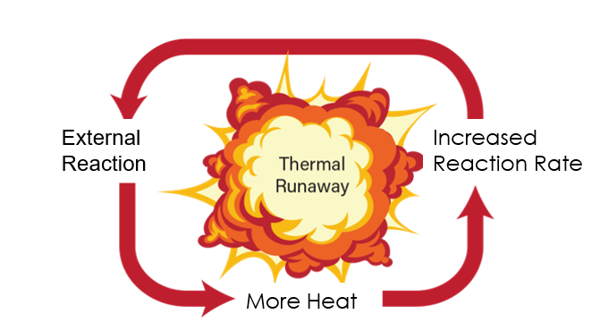
Main Driver of Thermal Runaway: “Temperature”
Normal operating condition
Thermal Runaway
A cell operating outside specified temperature causes undesirable exothermic side reactions leading to a catastrophic loop of events that ends with a destroyed Li-ion cell
A cell operating under safe temperature window has low losses, slow side reactions, and small heat generation.​

Slide 25
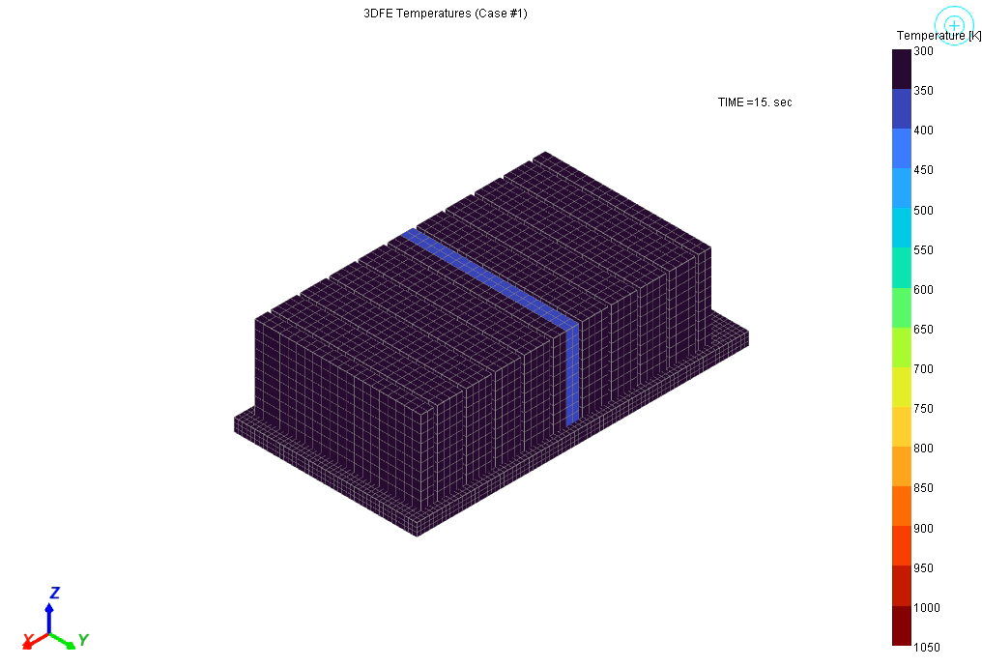
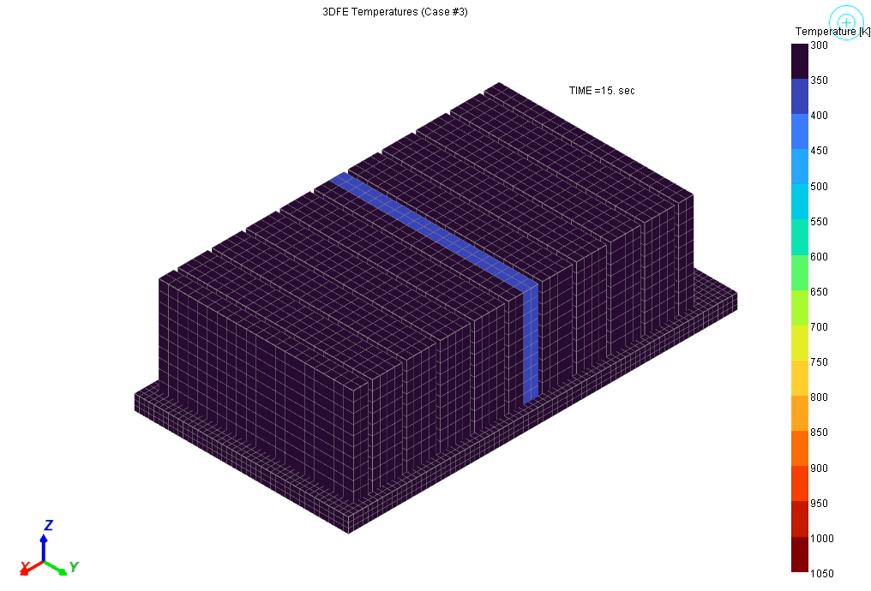
Thermal Runaway Modeling Results
Under cooling conditions, can see full module propagation and only partial propagation
All 20 cells enter thermal runaway
Only 4 cells enter thermal runaway
No coolant flow rate
Coolant flow rate

Slide 26
In Summary
A space application satellite design require a multi-physics approach
GT-SUITE provides a unique all-in-one solution
Sensitivity analysis on design parameters guide engineers towards optimal designs
Increase the detail and fidelity of the simulation to gain more insights into system behavior

Slide 27
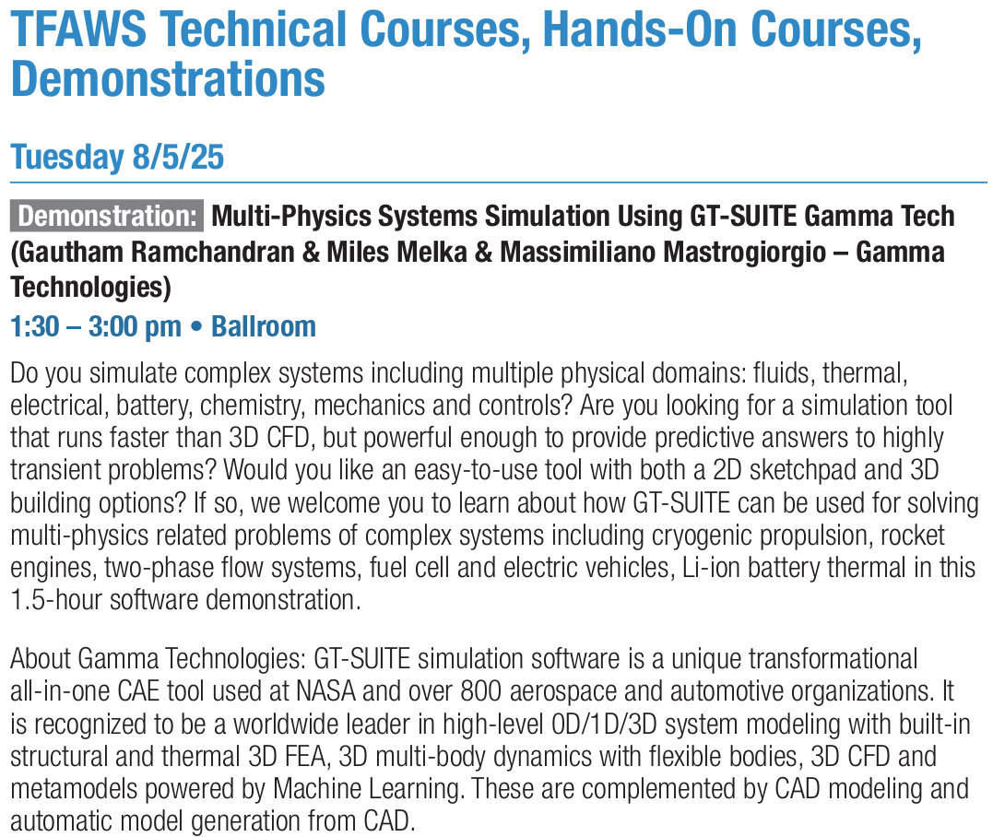






To learn more about this solution and experience GT-SUITE, Join our live demo this afternoon!

Slide 28
THANK YOU!
Massimiliano Mastrogiorgio
Staff Battery Application Engineer
m.mastrogiorgio@gtisoft.com
Credits to colleagues at Gamma Technologies:
Phil Mireault
Senior Staff Application Engineer
Mobility Systems & Integration
Nikhil Biju
Staff Application Engineer
Battery Systems
Gautham Ramchandran
Manager, Solutions Consulting
Brad Holcomb
Principal Application Engineer
Thermal Fluid Systems

