Slide 1

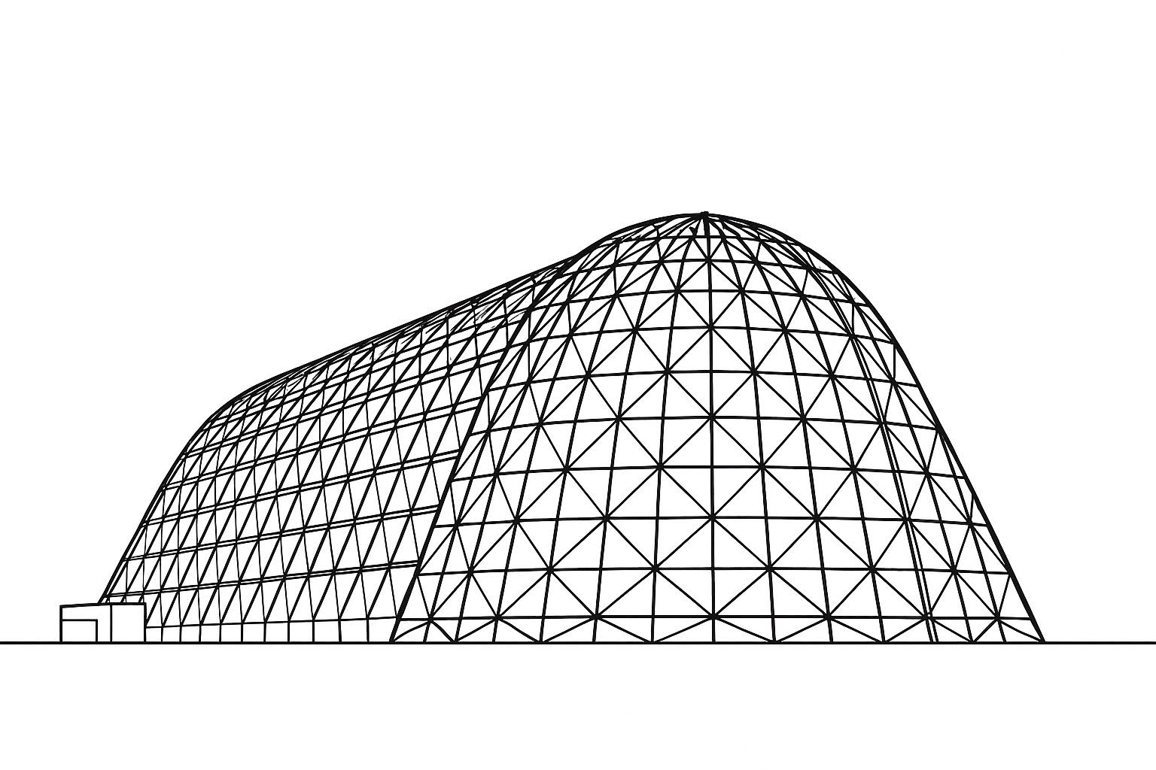

Lunar South Pole Terrain Effects on Radiator Performance
TFAWS 2025 Passive Thermal Technical Session
Presented by: Will Birmingham*
Will Grier**
Lisa Erickson***
*NASA / MSFC / EV34
**NASA / LaRC / D206
***NASA / JSC / EC611
Thermal & Fluids Analysis Workshop 2025
NASA Ames Research Center
San Jose, CA
August 4-7, 2025

Slide 2
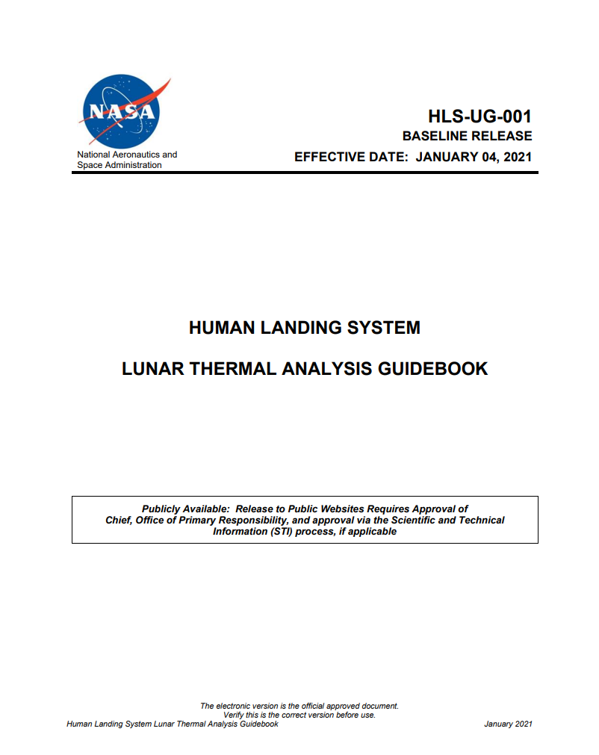

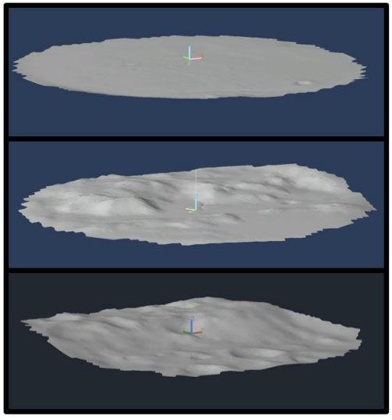
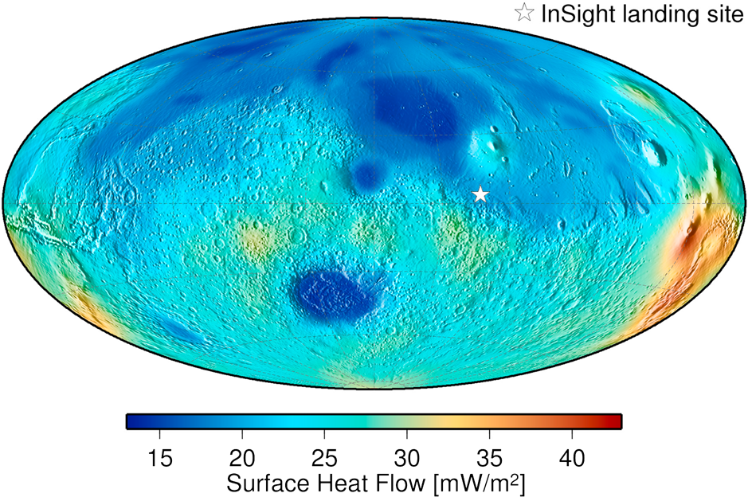
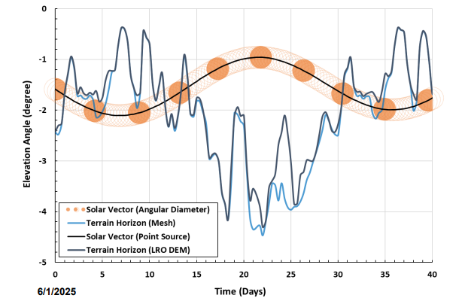
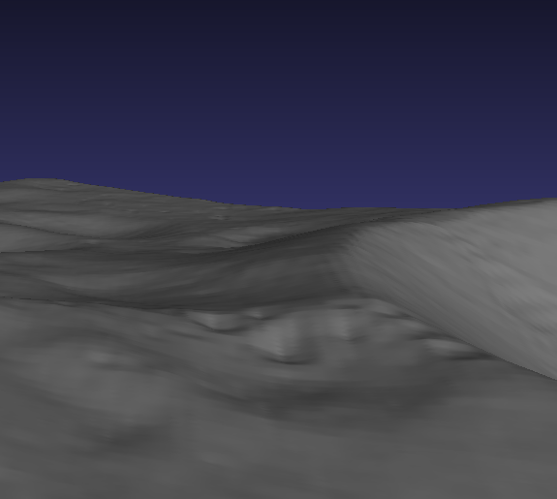
LUMENATE
The Lunar and Mars Environments Analysis Team (LUMENATE) is the new HLS funded team, attempting to improve lunar and mars environments thermal modeling practices
Activities planned for the immediate future include:
Support and connect the broader lunar and mars thermal analysis community
Updating the Lunar Thermal Analysis Guidebook (LTAG or HLS-UG-001) with improved guidance on modeling worst cases on the lunar surface, improved procedures for performing mission specific lunar surface analysis, predict impacts of lunar dust, etc.
Assembling/authoring a Mars Thermal Analysis Guidebook (MTAG)
The team is growing, but currently the three primary members are:
Lisa Erickson (lisa.erickson@nasa.gov) NASA / JSC / EC611
Will Grier (will.j.grier@nasa.gov) NASA / LRC / D206
Will Birmingham (william.j.birmingham@nasa.gov) NASA / MSFC / EV34
See Will Grier’s TFAWS 2025 presentation for more information and context
AKA “Lisa and the Wills”
Shackleton
PSRs are oddly shaped → LTAG methods are needed for thermal analysis of PSR operations.
https://quickmap.lroc.asu.edu
Crater with PSR
(~4.5km wide)

Slide 3
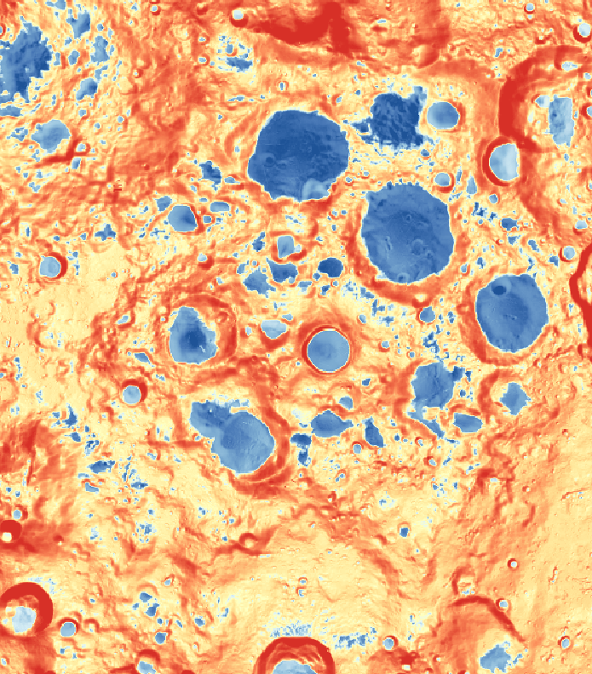
Introduction
Often, a preliminary lunar surface thermal analysis intended for radiator sizing will:
Assume steady state
Utilize a perfectly flat section of regolith
Select a shallow solar elevation angle that assumes some combination of slope and lunar latitude
While this modeling technique may be sufficient for an early feasibility study, it cannot capture the true bounding hot case
Especially on the lunar south pole, where the terrain is so dramatic, a true hot case will need to account for terrain rising into the field of view of the radiators
The problem: terrain degrades radiator performance and may be a key factor in radiator sizing, but accounting for terrain is often impossible during early mission-planning due to a lack of knowledge of the precise landing site
The solution: presented here are a set of bounding worst-case terrain-induced radiator performance reduction factors, obtained from a selection of hot spots on the lunar south pole. These factors can be used for radiator sizing during early mission planning before specific terrain details are known

Slide 4

Terrain-Induced Radiator Performance Degradation
The goal of the terrain-induced radiator heat rejection offset is to answer the question: “how much less heat would my radiator reject if terrain were considered?”
The terrain induced radiator heat flux reduction is given by:
$$∆Q={Q_{flat }− Q}_{terrain}$$
Where Q_terrain is the hot case radiator heat rejection flux when terrain is included and Q_flat is the hot case heat rejection flux when the lunar surface is modeled as perfectly flat
Because the ΔQ is only a function of incident solar and incident infrared energy, it is independent of radiator temperature.
Previous work found radiator performance degradation at equatorial latitudes to be significant. The goal is to extend this research to south polar locations [1]
Note: for a true apples-to-apples comparison of radiator performance, the same solar vector set is used for the flat terrain case and the corresponding detailed terrain case
Vs.

Slide 5
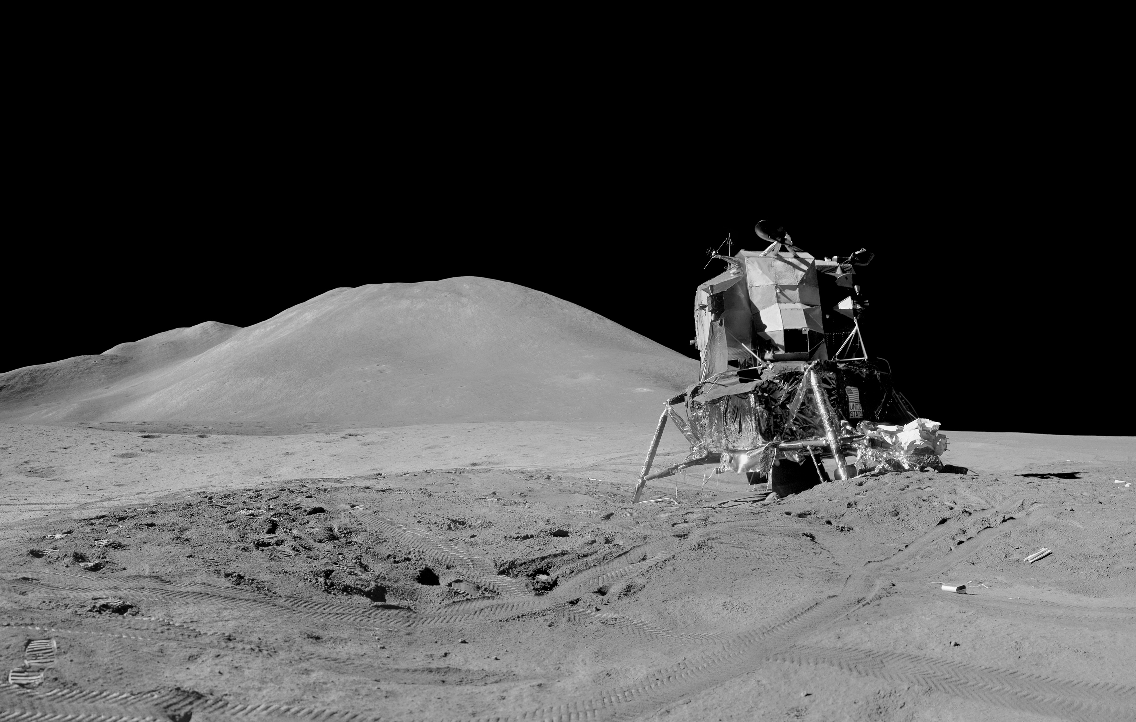
Goals
The goals of presenting these heat flux knockdowns are:
Improved radiator sizing: A radiator that is sized early to survive terrain is less likely to grow substantially as the design matures
Intuition building: There are still many unknowns, but lunar surface thermal environment is not a mysterious black box with infinite possibilities! There are ways to bound what environments a lunar asset’s TCS is likely to see on the lunar surface. This work outlines one of many ways to accomplish this.
https://www.nasa.gov/history/alsj/a15/a15.heatflow2.html

Slide 6
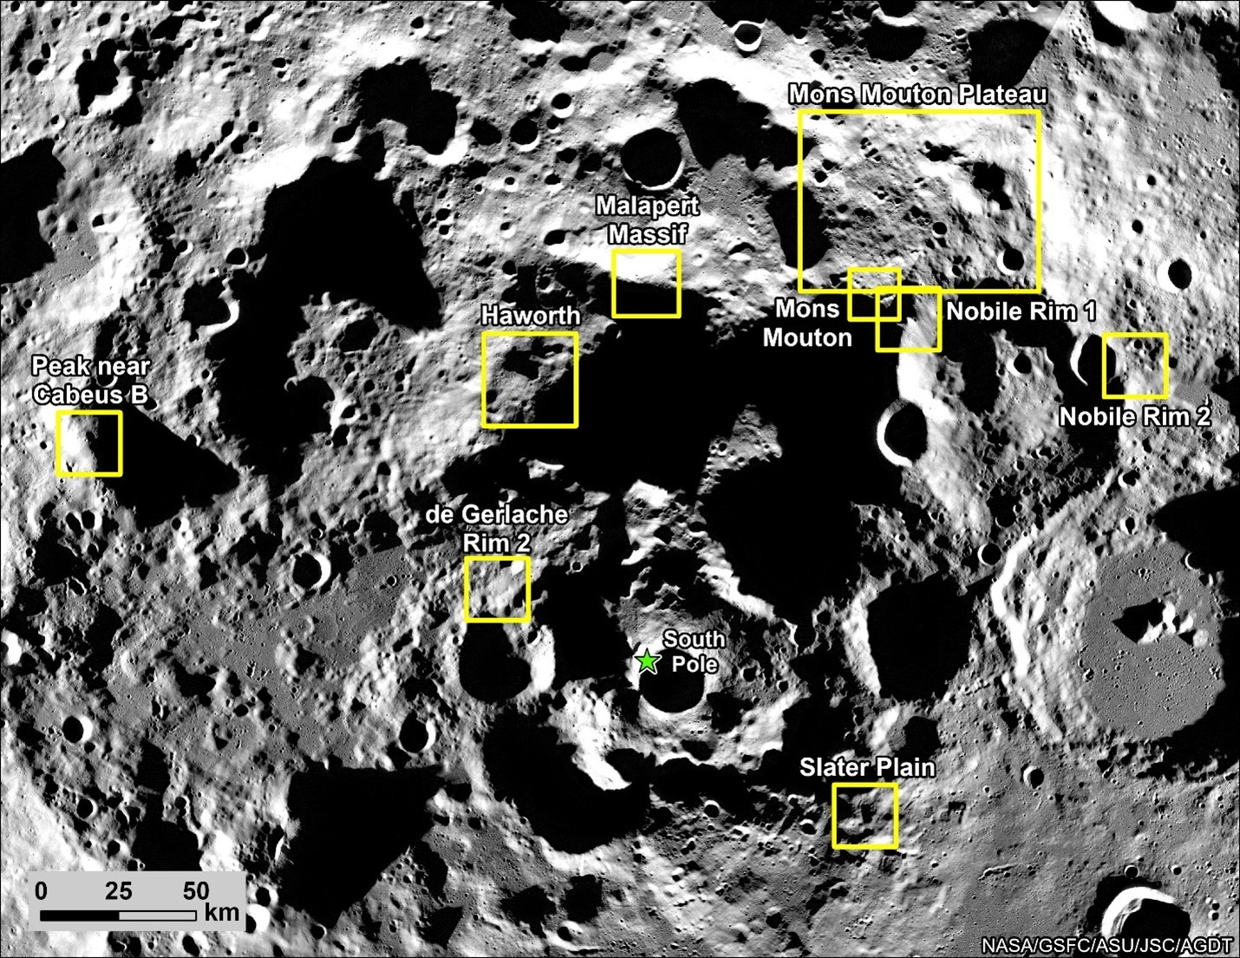
Artemis III Regions of Interest (2024)
This study only calculates worst-case radiator performance degradation for the Artemis III candidate landing regions, updated in 2024
Radiator degradation offsets are calculated for the worst-case hot spots found within each region
The nine regions [2]:
Malapert Massif
Mons Mouton Plateau
Mons Mouton
Nobile Rim 1
Nobile Rim 2
Slater Plain
de Gerlache Rim 2
Peak Near Cabeus B
Haworth
https://www.nasa.gov/news-release/nasa-provides-update-on-artemis-iii-moon-landing-regions/

Slide 7
Approach
To find extreme bounding “hot spots”, use lunar surface data to calculate a “Radiator Impact score” and locate extreme maxima within the nine Artemis III regions
Build a meshed terrain thermal model for each of these hot spot locations and a flat terrain thermal model, both with the same lander stand-in
Calculate heat rejection from the radiators in both models. The difference between heat flux from the radiators without terrain and heat rejection with terrain is the “terrain induced heat flux reduction.”
JPL Horizons
Data [3]
DIVINER
Temperature Data [4]
Radiator Impact
Score Calculation
Hot Spot
Identification
Artemis III
Landing Regions [2]
LOLA Digital
Elevation Models [5]
Detailed Terrain
Model
Terrain Induced Heat Flux Reduction
Simple Flat
Terrain Model

Slide 8
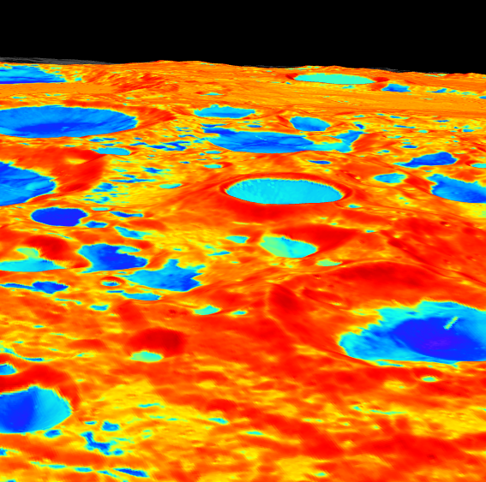


Hot Spot Identification Algorithm
Three factors selected to characterize radiator impacts:
1. Temperature:
Hotter terrain results in less radiator heat rejection capability. DIVINER temperature data is relatively low resolution.
2. Solar-Normal Dot Product
The greater the dot product between the solar vector and terrain normal vector, the greater the heat load on the terrain. This is calculated using higher resolution LOLA data and ephemeris data from JPL Horizons. The maximum for each point is obtained from 6 years of solar data.
3. Slope
Steeper slopes result in greater likelihood of hot terrain features entering the field of view of radiators.
$$\hat{n}$$
$$\hat{s}$$

Slide 9
Hot Spot Identification Algorithm
How the Radiator Impact Score is Calculated:
Normalized Temperature:
(Temperature put on a scale from 0 to 1)
Solar-Normal Dot Product
(Already on a scale from 0 to 1)
Normalized Slope:
(Normalized so that 0°= 0, and 90°= 1)
Radiator Impact Score
Example Data
X
X
=
(Normalized Temperature) X (Solar-Normal Dot Product) X (Normalized Slope) = Radiator Impact Score
Normalizing results in equal weighting of the three factors.
Multiplying here effectively functions as an “and” statement. All three factors must be high to achieve a high Radiator Impact Score
Once a map of “Radiator Impact Score” is created for each Artemis III region, hot spots can be visually identified

Slide 10
Radiator Impact Hot Spots
Maps of Radiator Impact Score
Malapert Massif
Mons Mouton Plateau
Mons Mouton
Maps were visually inspected, and the locations of extreme hot spots (the latitudes and longitudes shown above) were selected for thermal analysis (there is nothing else known to be interesting about these locations).

Slide 11
Radiator Impact Hot Spots
Maps of Radiator Impact Score
Nobile Rim 1
Nobile Rim 2
Slater Plain
Maps were visually inspected, and the locations of extreme hot spots (the latitudes and longitudes shown above) were selected for thermal analysis (there is nothing else known to be interesting about these locations).

Slide 12
Radiator Impact Hot Spots
Maps of Radiator Impact Score
de Gerlache Rim 2
Peak Near Cabeus B
Haworth
Maps were visually inspected, and the locations of extreme hot spots (the latitudes and longitudes shown above) were selected for thermal analysis (there is nothing else known to be interesting about these locations).

Slide 13
Hot Spot Locations
All 9 locations are generally very similar: Each has an extreme steep slope (that is generally north-facing), and the surface normal vector is pointed towards a gap in the horizon that the sun can peak through.
Note that the selection of locations on extreme slopes makes these calculations highly bounding. The goal is to understand the absolute worst-case scenario for early radiator sizing and intuition building
If the con ops of a lunar surface mission defined such that operation on or near steep slopes is not possible, this type of site selection can be re-done with a slope filter applied
Region Containing Hot Spot | Latitude (°) | Slope(°)
Malapert Massif | -85.8 | 30
Mons Mouton Plateau | -83.4 | 32
Mons Mouton | -85.6 | 28
Nobile Rim 1 | -85.6 | 31
Nobile Rim 2 | -84.0 | 27
Slater Plain | -86.9 | 22
de Gerlache Rim 2 | -88.6 | 27
Peak Near Cabeus B | -83.4 | 28
Haworth | -86.3 | 30

Slide 14
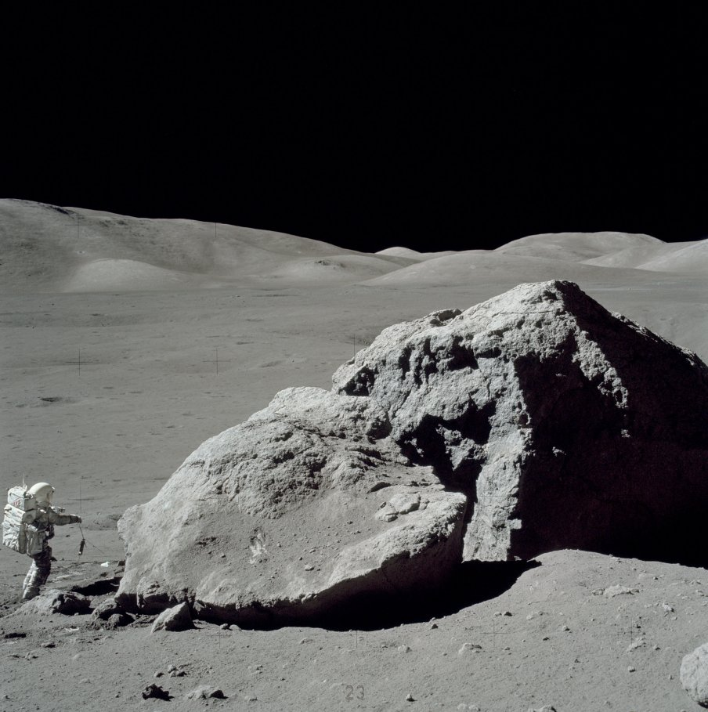
Caveats and Assumptions
Visual inspection was performed to ensure selection of large regions (rather than small isolated regions) where thermal impact is expected to be highest
This assessment is based on remotely sensed temperature and LIDAR data with a maximum of 60 meter per pixel resolution
There may be worse hot spots near objects like tall boulders that do not appear in this data (e.g. “Tracy’s rock” at the Apollo 17 Geology Station 6)
This data assumes that tall boulders and anthropogenic features can be generally be avoided when landing or relocating a lunar asset
The radiator impact score is primarily biased toward the infrared environment
This is because radiators are inherently sensitive to infrared and are ideally designed to reflect solar spectra
A black object (with high solar absorptance) on the lunar surface may encounter hot spots resulting from reflection and concentration of solar rays that differ from the infrared-biased hot spots selected for this study
The analysis to follow assumes a small lander that is likely to thermally interact with its own shadow. Structures with radiators far off the ground may encounter different degradation factors in different locations.
TSINK and QFLOW data are used derive incident solar and infrared which is then used to predict radiator heat rejection for different radiator coatings (clean and dusty white paint). This does not take into account secondary re-radiation of warmer radiator surfaces onto terrain and back onto the radiators
https://www.nasa.gov/history/alsj/a17/a17.sta6.html

Slide 15
Terrain Thermal Model Building: Meshing
1
2
3
Lunar Digital
Elevation Model (LDEM)
Convert LDEM to
point cloud
Calculate the locations
of horizon points
6
Selectively coarsen the
point cloud in regions
far away from points of
interest and maintain
resolution near points
of interest (such as horizon
points)
4
5
Divide the point cloud
into regions for selective
mesh refinement later
Upload the divided point
clouds into MeshLab
Raw Data
MATLAB
MeshLab
9
7
8
Convert mesh to Thermal
Desktop entities, apply
regolith properties, add
lander or vehicle model,
Etc.
Create a Poisson mesh and
perform a Taubin smooth
operation
Save as a DXF and open
the mesh in Thermal
Desktop
Thermal Desktop
10
11
JPL Horizons
Ephemerous Data
Perform a transient
initializer of sufficient
length for the surface
temperature to converge
12
Perform thermal analysis
of the period of interest

Slide 16
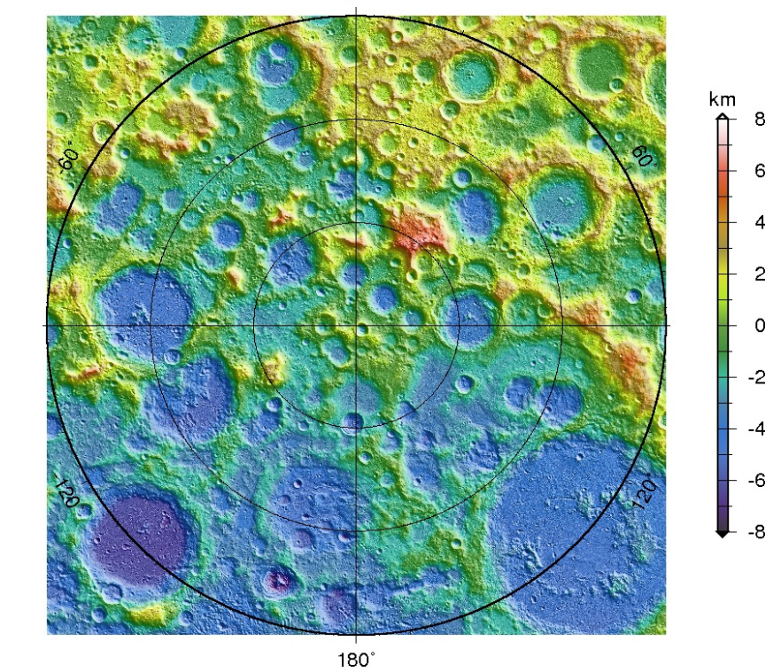
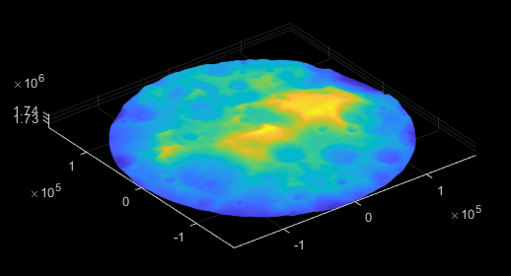
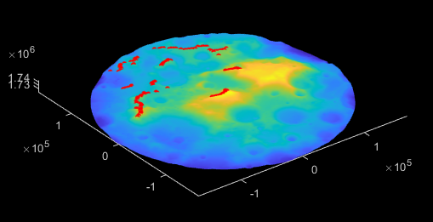
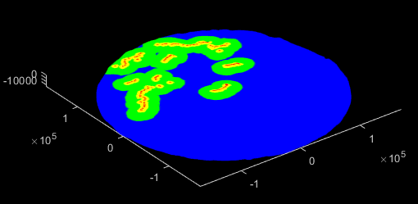
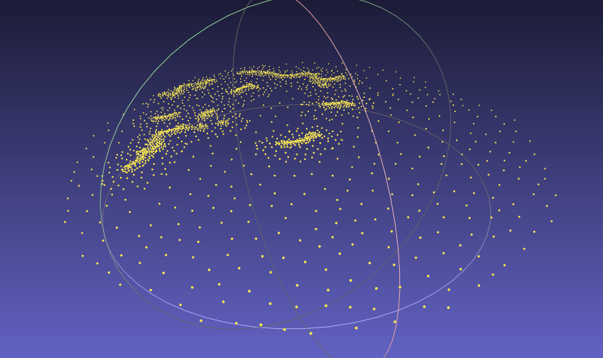
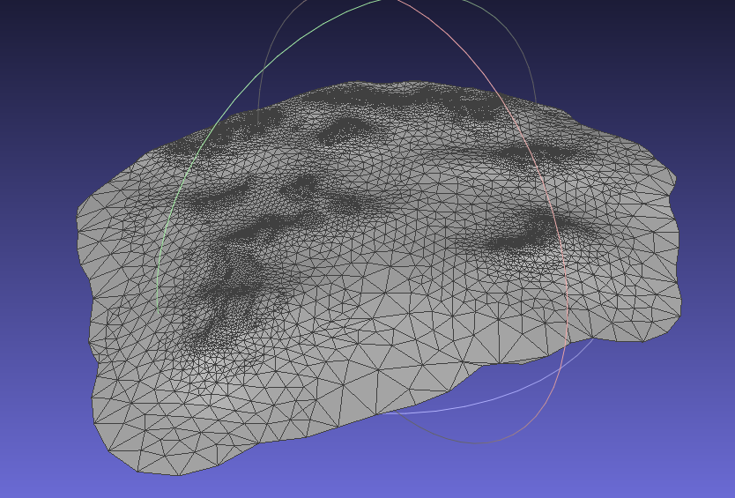
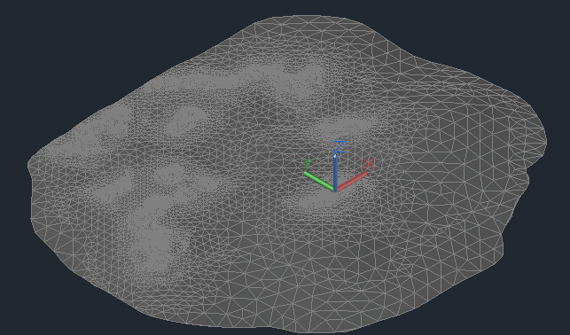
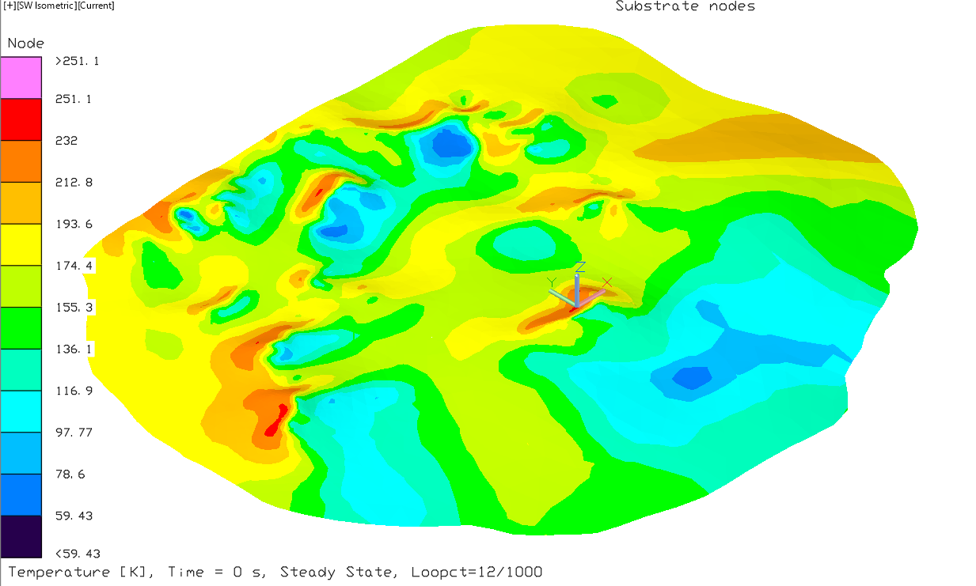
Terrain Thermal Model Building: Meshing
1
2
3
4
6
7
9
12

Slide 17
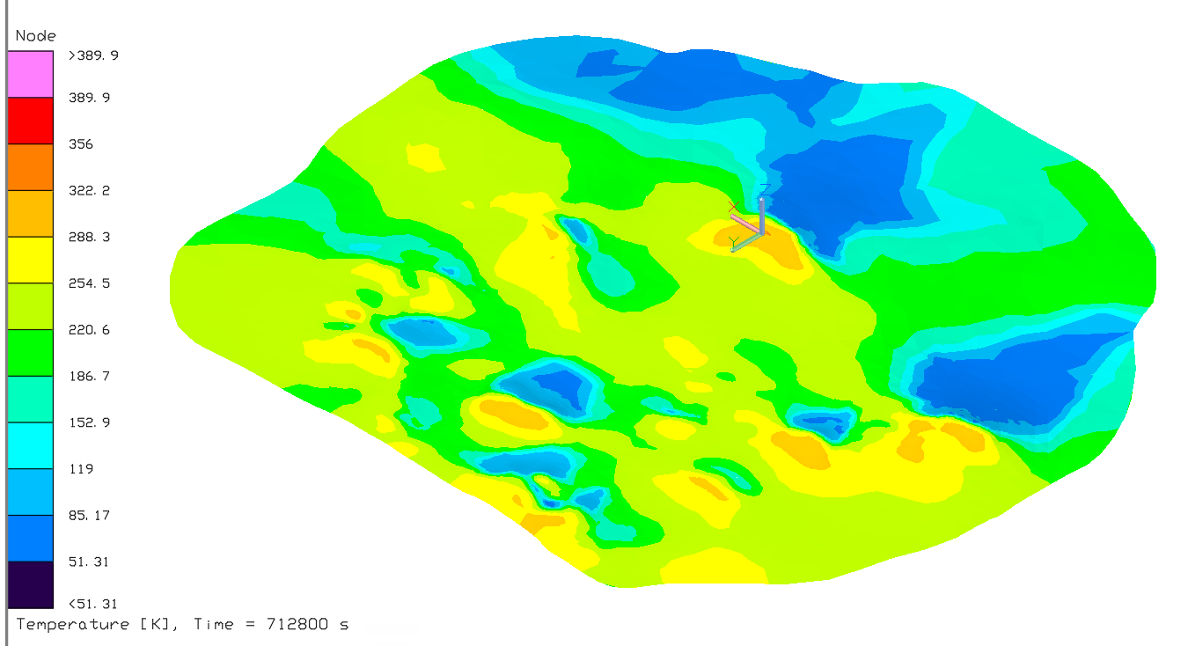
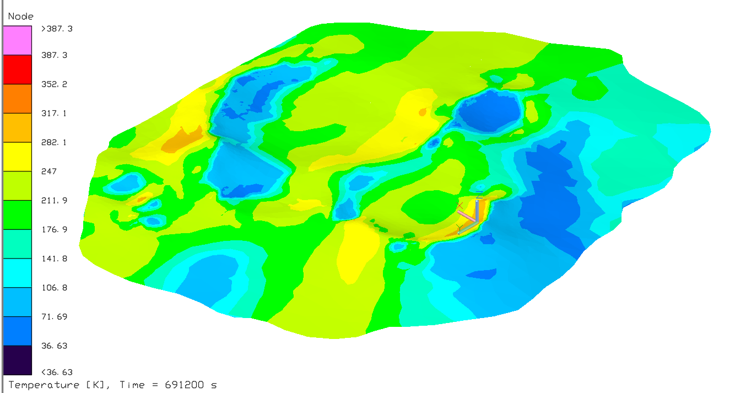
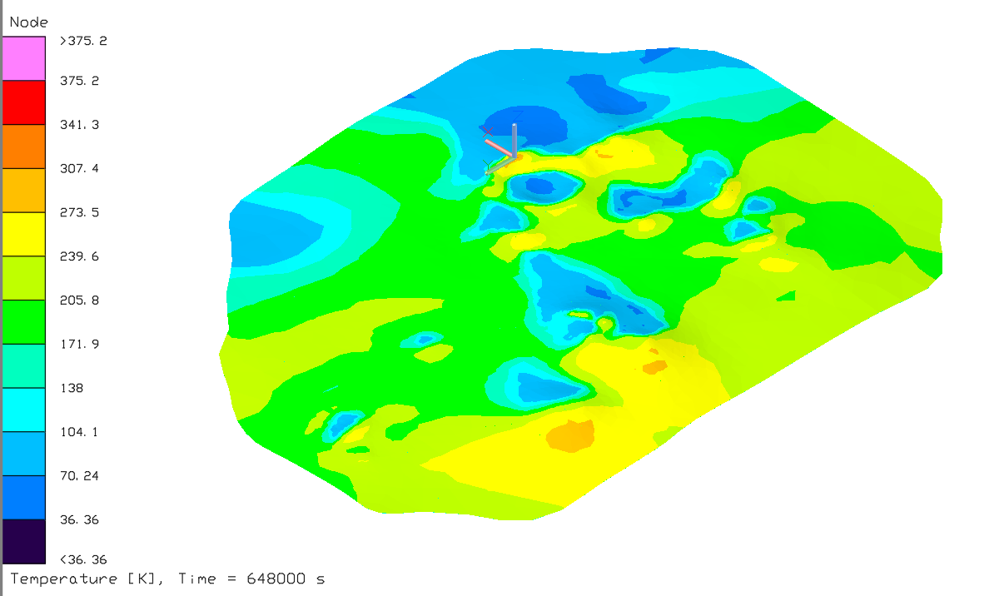
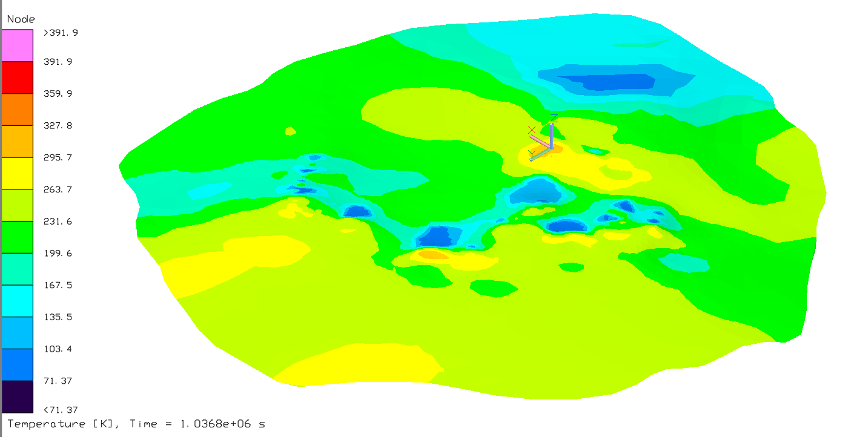
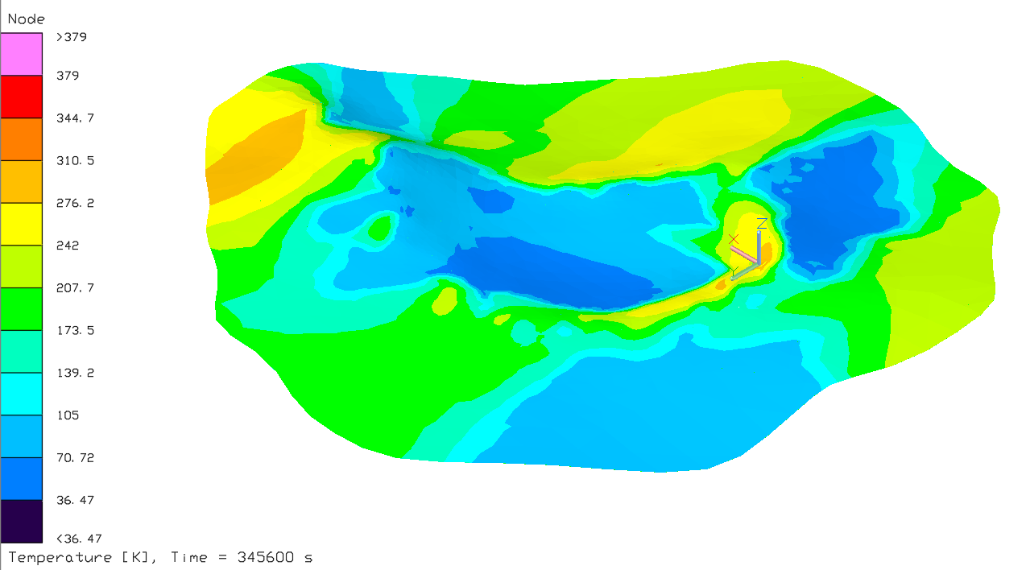
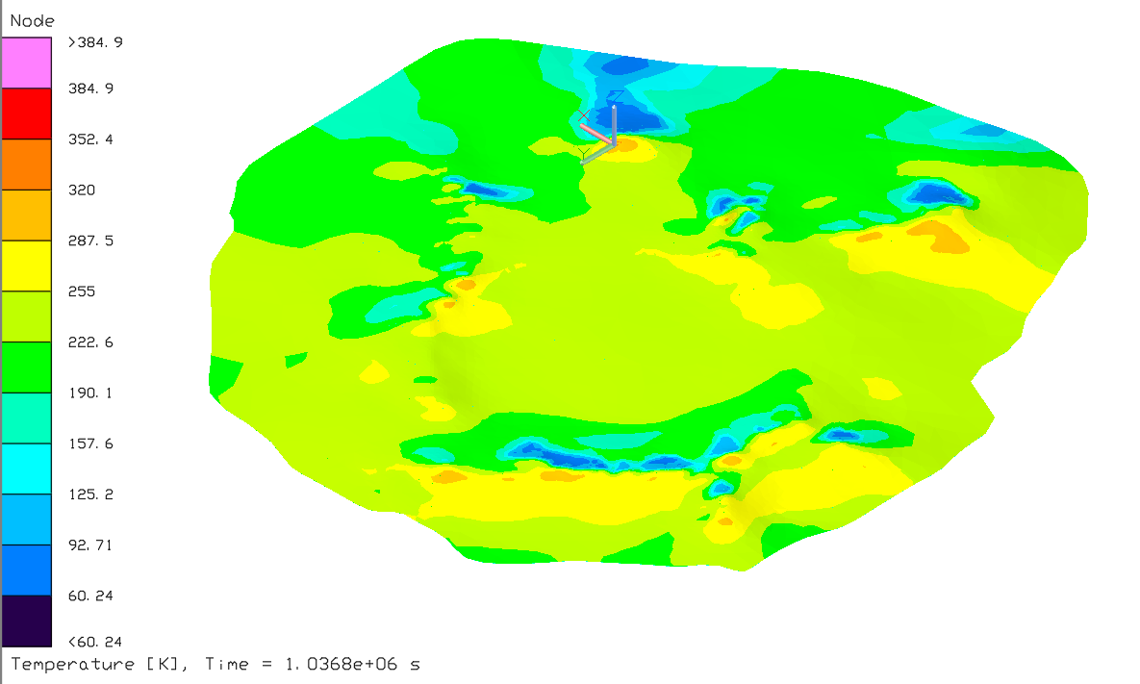
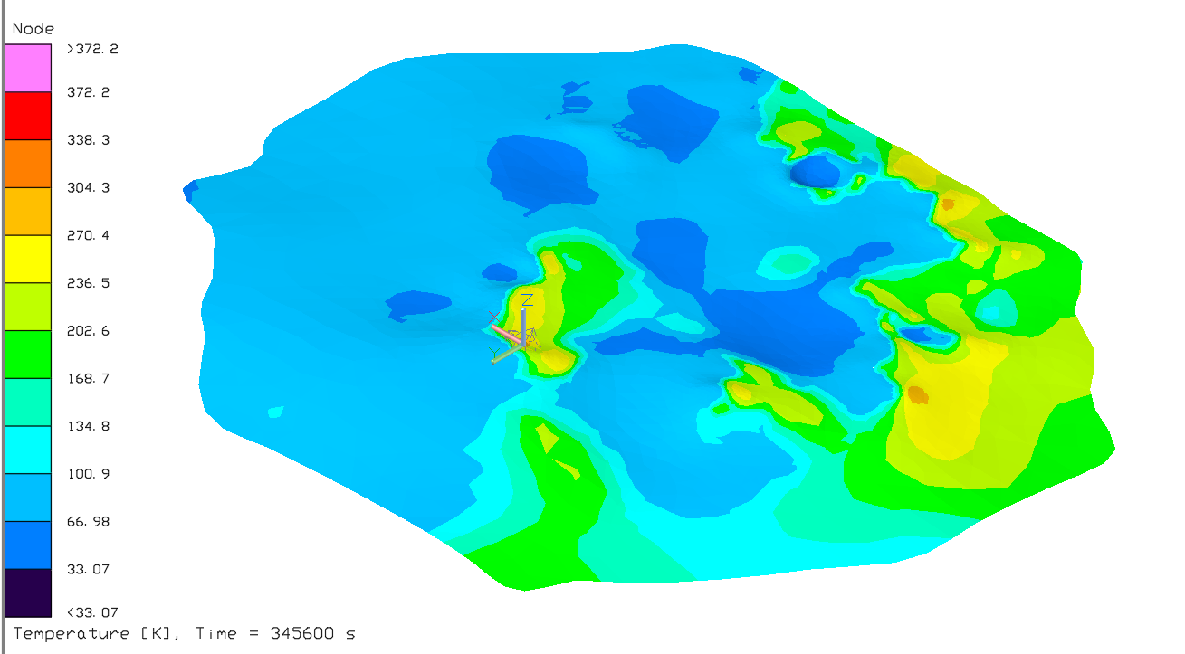
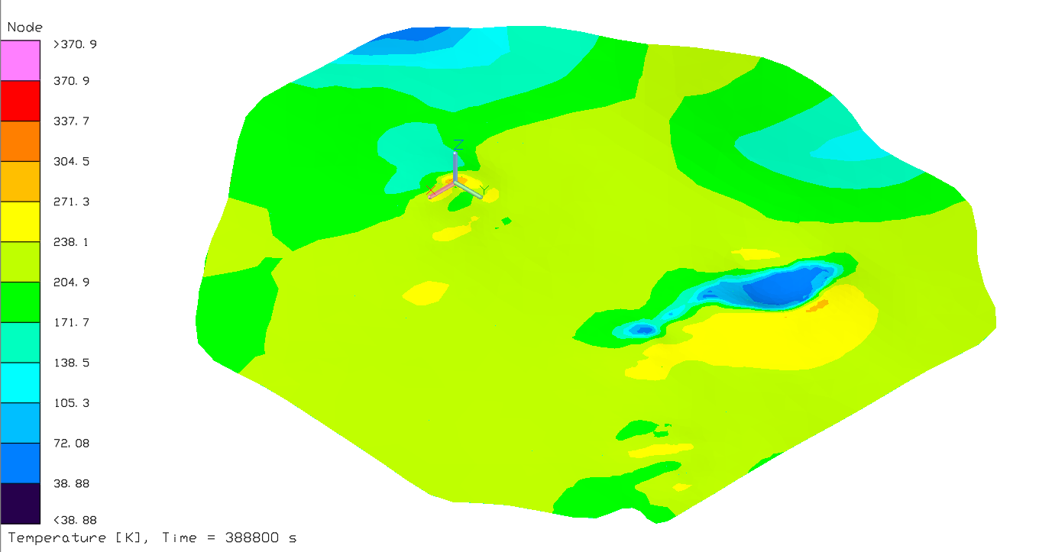
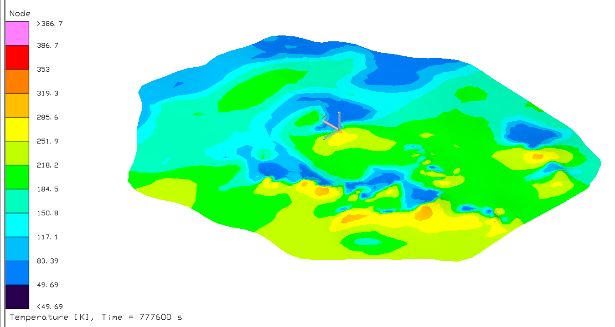
Detailed Terrain Thermal Model
Malapert Massif
Nobile Rim 1
de Gerlache Rim 2
Mons Mouton Plateau
Nobile Rim 2
Peak Near Cabeus B
Mons Mouton
Slater Plain
Haworth

Slide 18
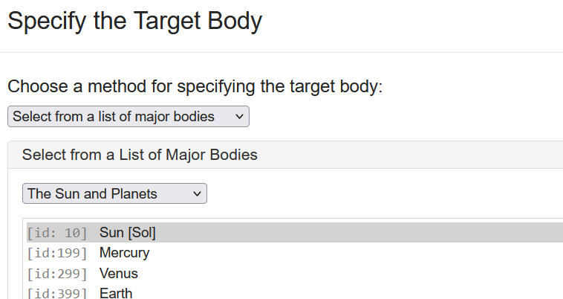
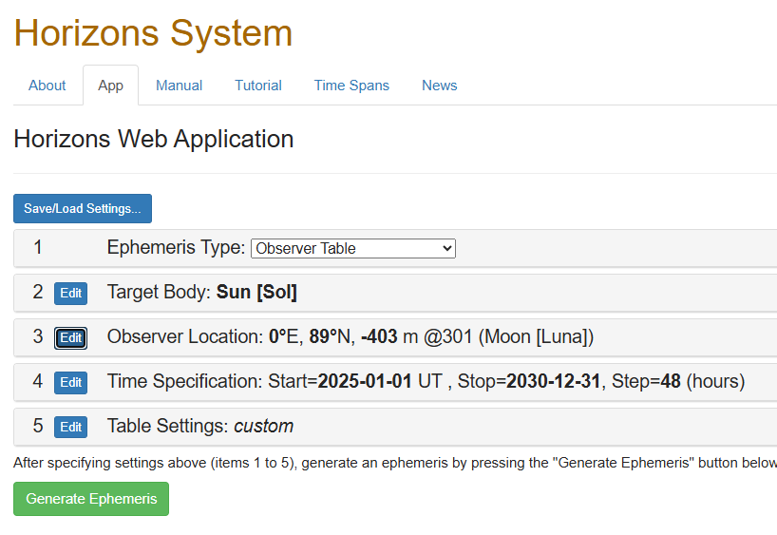
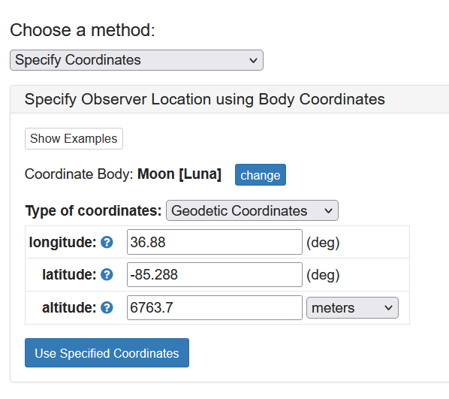
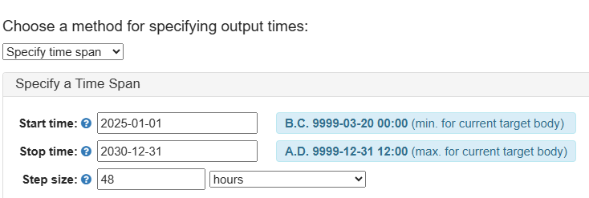

Terrain Thermal Model Building: Solar Data
Select “Observer Table”
JPL Horizons can be used to generate solar data from the perspective of a specific location:
https://ssd.jpl.nasa.gov/horizons/app.html#/
Azimuth is reported using local north as the datum
Excel can be used to format the azimuth and elevation data to a format that Thermal Desktop’s “Orbital Sun/Planet/Radius Vector List” orbit can read
Use “Observer range” to calculate solar flux as a function of distance and time, scaled to solar luminosity
Note: to find altitude, go to Quickmap, select LOLA SLDEM data, and use the “Value at Cursor” tool
https://quickmap.lroc.im-ldi.com/

Slide 19
Terrain Thermal Model Building: Regolith Properties
Thermophysical Properties
Thermal conductivity as a function of temperature and density is obtained from: Martinez, et al. 2021 [6]
Density as a function of depth is obtained from: Vasavada, et al. 2012 & Hayne, et al. 2017 [7,8]
Specific heat as a function of temperature is obtained from: Woods‐Robinson, et al. 2019 [9]
Regolith is modeled down to 2m with a total of 8 layers per methods described in the HLS Lunar
Thermal Analysis Guidebook (LTAG) [10]
Optical Properties
IR Emissivity:
The Cross-program Design Specification For Natural Environments (DSNE) recommended value used: ε = 0.95 [11]
Solar Absorptivity:
A worst-case hot min albedo piecewise function (courtesy of Lisa Erickson) was used to calculate solar absorptivity as a function
of solar incidence [12,13]:
Albedo is converted to absorptivity with: (absorptivity) = (1 – albedo)

Slide 20
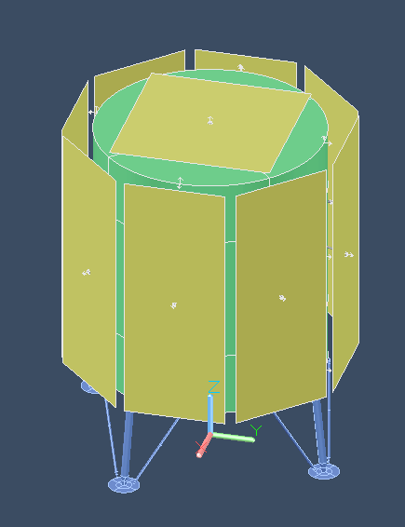
Lander Model
Main structure is an enclosed cylinder: 4.5m diameter, 5m tall.
The walls of the lander are convectively coupled to a 20°C bulk gas node.
Lander legs position the main cylinder ~1.5m off the ground.
The main goal of the lander is to create reasonable and realistic shadows/reflections on the regolith.
Radiators are all one-sided and 10m^2 each.
Vertical radiators are arranged in an array, so the most terrain-impacted radiator can be selected for calculating terrain-induced knock downs
Optical Properties:
Radiators (two analyzed):
Z93: α/ε = 0.16/0.92 [14]
Dusted Z93: α/ε = 0.5/0.92*
*α approximated using the rule of mixtures, assuming a coverage fraction of 50%:
α_{dusted} = 0.5* α_{dust} + 0.5α_{Z93} = 0.5 x 0.84 + 0.5 x 0.16 = 0.5
Lander exterior:
Beta Cloth: α/ε = 0.3/0.9 [14]
Lander legs:
Dusty Silver Teflon: α/ε = 0.46/0.81** [14]
**α approximated using the rule of mixtures, assuming a coverage fraction of 50%:
α_{dusted} = 0.5* α_{dust} + 0.5α_{Z93} = 0.5 x 0.84 + 0.5 x 0.08 = 0.46
NOTE: Emissivity is held constant for the dusted surface to maintain conservatism because emissivity will trend upward toward the emissivity of regolith for lightly dusted surfaces (in this case “lightly dusted” is assumed to be below 50% coverage [15]). Note that heavily dusted surfaces will exhibit a decrease in effective emissivity. Surfaces expected to be heavily dusted should be analyzed with greater conservatism.

Slide 21
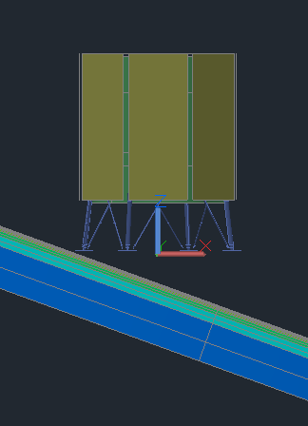
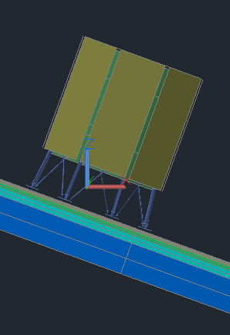
Lander Model: Case Matrix
Clean Z93
Gravity Aligned
Terrain Aligned
Gravity Aligned
Dusty Z93
Terrain Aligned
Clean Z93
Dusty Z93
All 4 cases are run for each of the 9 hot spot locations, resulting in 36 heat flux reductions calculated
Only 2 Thermal Desktop models need to be run for each lunar location: The gravity aligned and terrain aligned cases. All other data points can be derived using infrared and solar flux calculated from TSINKs

Slide 22
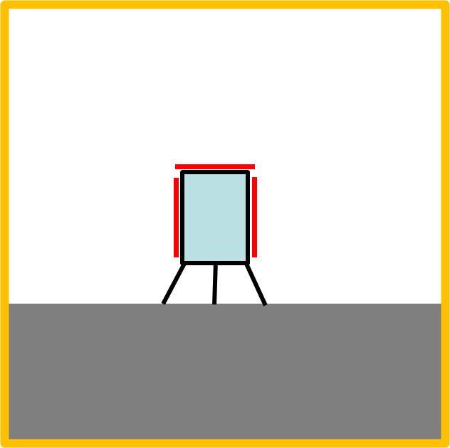
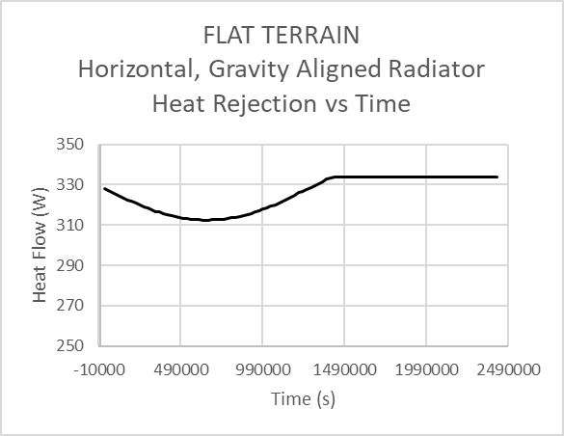

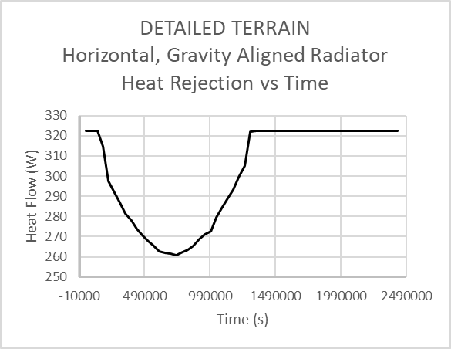



Radiator Degradation Calculation Example
Radiator performance is characterized by the minimum heat rejected over the course of a lunar day
The minimum heat rejection is used because it is the worst-case heat rejection and likely the value used for early radiator sizing
$$∆Q={Q_{flat }− Q}_{terrain}=\frac{312.4W}{10m^{2}} − \frac{260.9W}{10m^{2}}=$$
$$52$$
$$\frac{W}{m^{2}}$$
Example data taken from a Malapert Massif case with horizontal, gravity aligned, clean white radiators
The same flat control is used for both gravity aligned (shown here) and terrain aligned
Dusty radiator performance in terrain is compared against dusty radiator performance on flat terrain for a true comparison
Note that while the values of Q are radiator temperature dependent, the difference between the two is not

Slide 23
Radiator Terrain Degradation
Reduction in Radiator Heat Rejection Due to Terrain
Clean White Paint
Radiator Orientation Location | Gravity Aligned |  | Terrain Aligned
 | Horizontal | Vertical | Horizontal | Vertical
 | (W/m^2) | (W/m^2) | (W/m^2) | (W/m^2)
Malapert Massif | 52 | 162 | 119 | 315
Mons Mouton Plateau | 47 | 165 | 122 | 311
Mons Mouton | 3 | 84 | 81 | 196
Noble Rim 1 | 38 | 141 | 108 | 288
Nobile Rim 2 | 32 | 110 | 86 | 215
Slater Plain | 28 | 117 | 86 | 203
de Gerlache Rim 2 | 26 | 131 | 100 | 243
Peak Near Cabeus B | 31 | 126 | 105 | 246
Haworth | 26 | 141 | 112 | 275

Slide 24
Radiator Terrain Degradation
Reduction in Radiator Heat Rejection Due to Terrain
Dusty White Paint
Radiator Orientation Location | Gravity Aligned |  | Terrain Aligned
 | Horizontal | Vertical | Horizontal | Vertical
 | (W/m^2) | (W/m^2) | (W/m^2) | (W/m^2)
Malapert Massif | 71 | 124 | 348 | 233
Mons Mouton Plateau | 55 | 147 | 340 | 220
Mons Mouton | -38* | 67 | 241 | 152
Noble Rim 1 | 50 | 105 | 319 | 226
Nobile Rim 2 | 52 | 89 | 223 | 145
Slater Plain | 52 | 110 | 259 | 164
de Gerlache Rim 2 | 36 | 113 | 299 | 173
Peak Near Cabeus B | 23 | 111 | 288 | 173
Haworth | 17 | 140 | 321 | 211
* At this specific location, the sun disappears behind the horizon during peak solar heating for the detailed terrain model but not for the flat terrain model. This results in the flat terrain model being the worse case specifically for the dust covered case due to the dust causing increased sensitivity to solar heating

Slide 25
How to Use Heat Rejection Reduction Values
The primary use-case for these radiator heat rejection capacity knock-downs is very early in the mission planning and design phase, specifically to size radiators
The degradation offsets used in this analysis are only applicable to the 9 candidate Artemis III landing regions of interest; however, the study could be duplicated for any region on the moon
The steps for applying these factors are:
Build a simple model of your lunar asset on flat lunar terrain with the radiators bound to a set temperature and given optical properties set to the clean or dusty optical properties shown on slide 16.
Using JPL horizons, identify the worst-case hot scenario for the latitude of interest (most likely when the sun is at its highest elevation angle), and import the solar data as an orbit in the simplified Thermal Desktop model.
Run the hot case and calculate the total heat rejection from the radiator vs time.* Record the minimum heat rejection calculated during this case (and divide by area to convert to heat flux)
Given assumptions about region, radiator orientation, radiator cleanliness, radiator temperature, and terrain alignment, select a radiator heat flux reduction from one of the tables on the previous two slides
Subtract the offset selected in step 4 from the heat rejection calculated in step 3 – this is the bounding minimum heat rejection per unit area your asset may experience in the region of interest, accounting for terrain
Rescale the radiators and/or select components to accommodate this minimum heat rejection
Note that these knock-downs are intended to be highly bounding estimates. There is no replacement for performing your own analysis of your own lunar assets with reasonable representations of terrain. These tools are intended to improve the outcomes of early-mission radiator sizing - not to replace any thermal models
*Note For Thermal Desktop users, this can be done easily by converting the radiator nodes to arithmetic, attaching these to a boundary node with a high-magnitude conductor, and using the “QFOW” function to calculate the heat flow between the boundary node and the arithmetic radiator nodes.

Slide 26
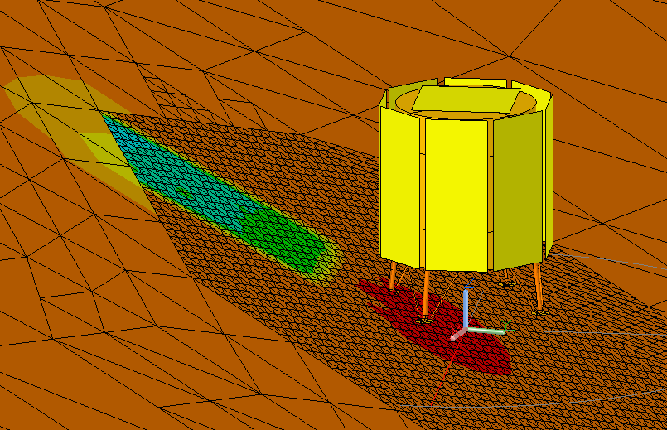
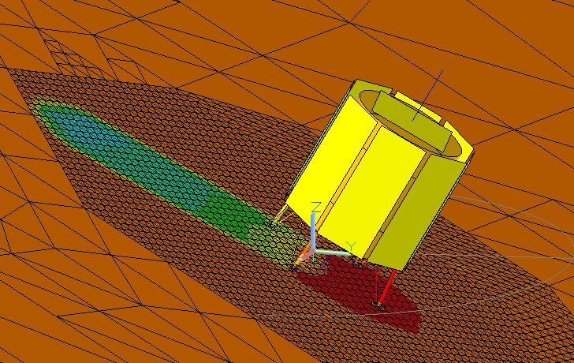
Conclusions and Observations
Radiator orientation:
Horizontal radiators saw less terrain-induced performance degradation in almost every case (the exception being terrain aligned dusty radiators)
Unless the radiator is intended to operate at very high temperatures, it is likely that vertical radiators and dusty horizontal radiators will absorb rather than reject heat in worst case terrain scenarios
Alignment:
All terrain aligned radiators experiences greater impacts from terrain than the gravity aligned counterparts
Terrain alignment results in similar or greater infrared flux, but also increases the solar flux (particularly for the horizontal radiator)
Dusty vs clean radiator coating:
The terrain-aligned dusty radiators were generally more affected by terrain than the gravity aligned dusty radiators
Dusty radiators are more sensitive to solar heating and a separate study should be done to identify locations where solar rather than IR heating is expected to be maximum
Forward work:
It is likely that many lunar missions will have a narrower scope and requirement set than what is assumed here. Consequently, this study may be duplicated for future missions with more bounds on applicable terrain, radiator design, etc.
The terrain modeling techniques presented here are still being refined, and they are set to be included in the next version of the Lunar Thermal Analysis Guidebook.

Slide 27
References
[1] Birmingham, W., Schunk, G., & Evans, B. (2024). Lunar latitude and terrain radiator sensitivity study . NASA technical reports
server (NTRS). https://ntrs.nasa.gov/citations/20240010276
[2] Taveau, J. (2024, October 28). NASA Provides Update on Artemis III Moon Landing Regions. NASA.
https://www.nasa.gov/news-release/nasa-provides-update-on-artemis-iii-moon-landing-regions/
[3] Jet Propulsion Laboratory. (n.d.). Horizons system. NASA. https://ssd.jpl.nasa.gov/horizons/app.html#/
[4] Williams, J.-P. (n.d.). Level4_polar/additional_maps. Index of /~jpierre/diviner.
http://luna1.diviner.ucla.edu/~jpierre/diviner/level4_polar/additional_maps/
[5] LOLA GDR information in polar stereographic projection for the South Pole. LOLA PDS Data Node. (n.d.).
https://imbrium.mit.edu/BROWSE/LOLA_GDR/POLAR/SOUTH_POLE/
[6] Martinez, A., & Siegler, M. A. (2021). A Global Thermal Conductivity Model for Lunar Regolith at Low
Temperatures. Journal of Geophysical Research: Planets, 126, e2021JE006829. https://
doi.org/10.1029/2021JE006829
[7] Vasavada, A. R., Bandfield, J. L., Greenhagen, B. T., Hayne, P. O., Siegler, M. A., Williams, J., & Paige, D. A.
(2012). Lunar equatorial surface temperatures and regolith properties from the Diviner Lunar Radiometer
Experiment. Journal of Geophysical Research: Planets, E12. https://doi.org/10.1029/2011je003987
[8] Hayne, P. O., Bandfield, J. L., Siegler, M. A., Vasavada, A. R., Ghent, R. R., Williams, J.-P., … Paige, D. A.
(2017). Global Regolith Thermophysical Properties of the Moon from the Diviner Lunar Radiometer Experiment.
Journal of Geophysical Research: Planets, 122, 2371–2400. https://doi.org/10.1002/2017JE005387
[9] Woods‐Robinson, R., Siegler, M. A., & Paige, D. A. (2019). A Model for The Thermophysical Properties of
Lunar Regolith at Low Temperatures. Journal of Geophysical Research: Planets, 124, 1989–2011.
https://doi.org/10.1029/2019JE005955

Slide 28
References
[10] Human Landing System Lunar Thermal Analysis Guidebook. (2021). National Aeronautics and Space Administration,
Baseline Release. https://ntrs.nasa.gov/api/citations/20210010030/downloads/HLS-UG- 001%20Lunar%20Thermal%20Analysis%20Guidebook%20Baseline_STI.pdf
[11] Cross-program Design Specification For Natural Environments (SLS-SPEC-159) Revision I. (2021). NASA Technical
Reports Server (NTRS). https://ntrs.nasa.gov/citations/20210024522
[12] E. J. Foote, D. A. Paige, M. K. Shepard, J. R. Johnson, and S. Biggar, “The bidirectional and directional hemispheric
reflectance of Apollo 11 and 16 soils: Laboratory and Diviner measurements,” Icarus, vol. 336, Jan. 2020.
[13] J.-P. Williams, D. A. Paige, B. T. Greenhagen, and E. Sefton-Nash, “The global surface temperatures of the Moon as
measured by the Diviner Lunar Radiometer Experiment,” Icarus, vol. 283, Feb. 2017.
[14] Kauder, L. (n.d.-a). Spacecraft Thermal Control Coatings References. NASA Technical Reports Server (NTRS).
https://ntrs.nasa.gov/citations/20070014757
[15] Gaier, J. R. et al. “The Effect of Simulated Lunar Dust on the Absorptivity, Emissivity, and Operating Temperature on AZ-93
and Ag/FEP Thermal Control Surfaces.” National Aeronautics and Space Administration, NASA/TM—2008-215492 , 1 Dec. 2008, https://ntrs.nasa.gov/citations/20090005996

