Slide 1

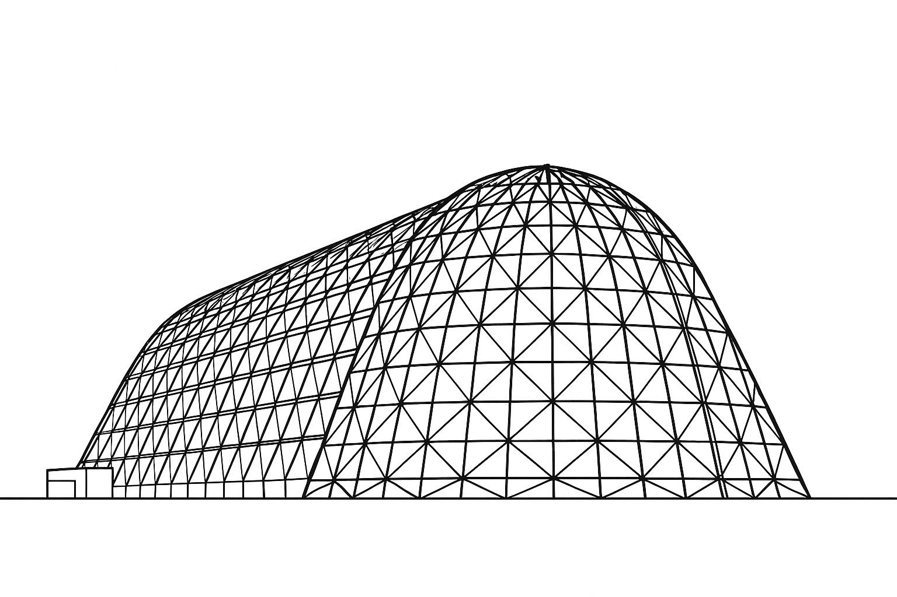

3D-Printed Loop Heat Pipes for CubeSat, SmallSat, and Lunar Habitat Applications
TFAWS 2025 Passive Thermal Technical Session
Presented by: SaiKiran Hota
Lawrence Bradley, Philip Graybill, Jimmy Hughes, Ion Nicolaescu, Adam Shreve, Chien-Hua Chen, SaiKiran Hota
Advanced Cooling Technologies, Inc.
Thermal & Fluids Analysis Workshop 2025
NASA Ames Research Center
San Jose, CA
August 4-7, 2025
Distribution A: Approved for public release; distribution is unlimited. Public Affairs release approval #AFRL-2025-3776

Slide 2
Agenda
Why 3D-Printed Loop Heat Pipes?
3D-Printed Loop Heat Pipes for Different Applications
Flight Demonstration CubeSat (3U)
CubeSat (12U)
SmallSat (ESPA-Class)
Lunar Habitat Application
Thermal Control Valve
Distribution A: Approved for public release; distribution is unlimited. Public Affairs release approval #AFRL-2025-3776

Slide 3
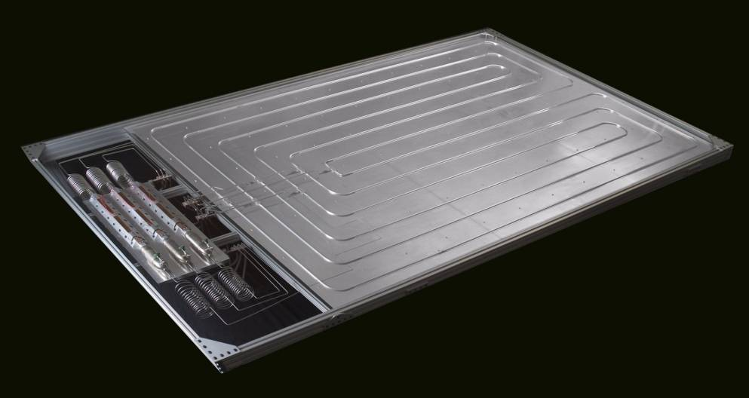
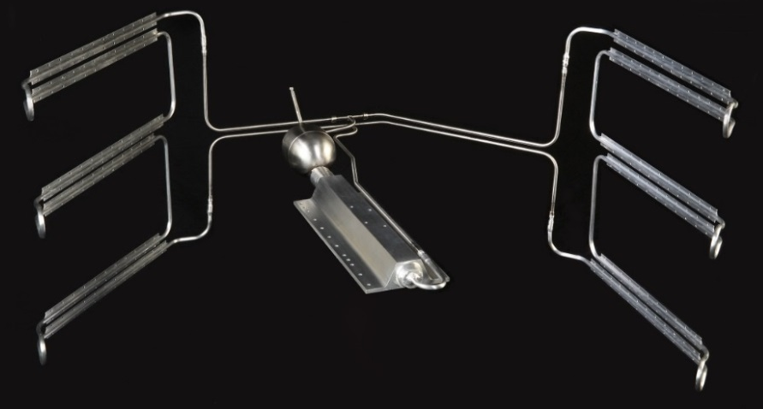
Why Loop Heat Pipes?
Why Loop Heat Pipes (LHP):
Performance in gravity adverse conditions (ground testing, lunar environments).
Heat can be spread to multiple surfaces.
Heat can be spread to a deployable radiator via flexible links.
Four Main Sizes Under Fabrication:
3U CubeSat
12U CubeSat
ESPA-Class SmallSat
Lunar Unit
Thermal Performance:
High thermal conductance
Pumping capability (>60” against gravity)
Long transport distance (10’)
Distribution A: Approved for public release; distribution is unlimited. Public Affairs release approval #AFRL-2025-3776

Slide 4
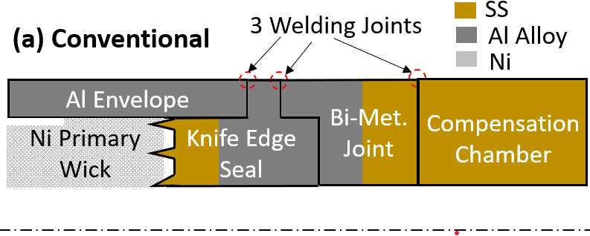
Types of Loop Heat Pipes
Types | Wick Structure | Pore Radius | Vapor Seal | Pros | Cons
Traditional | Sintered Nickel | 1µm | Knife-edge seal | Heritage (VIPER) | Complex manufacturing sequence
3D-Printed | 3D-Printed | 6µm | Integral to 3D-print | Simpler manufacturing process | AM Process may trigger additional qualification
Traditional
3D Printed
Welding Joint
Printed Envelope & Seal
Compensation Chamber
Printed Wick
Distribution A: Approved for public release; distribution is unlimited. Public Affairs release approval #AFRL-2025-3776

Slide 5
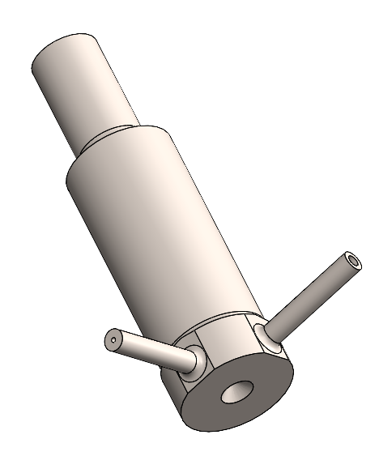
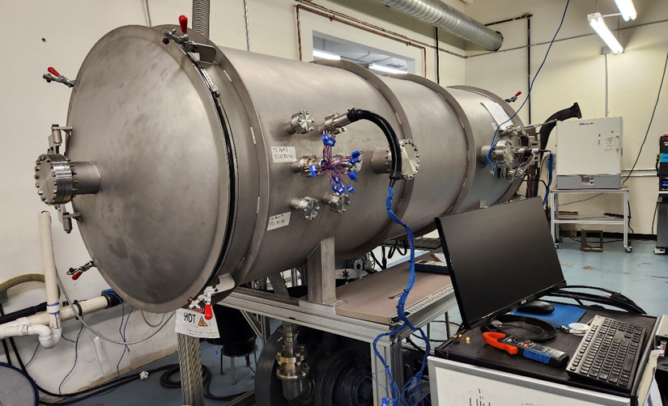
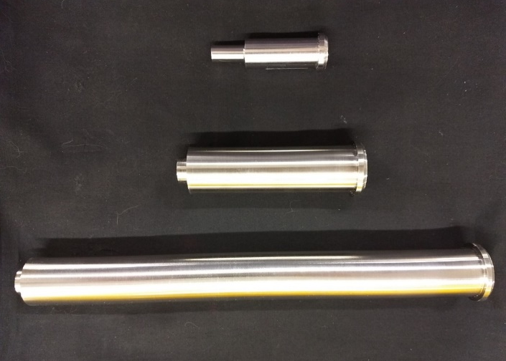
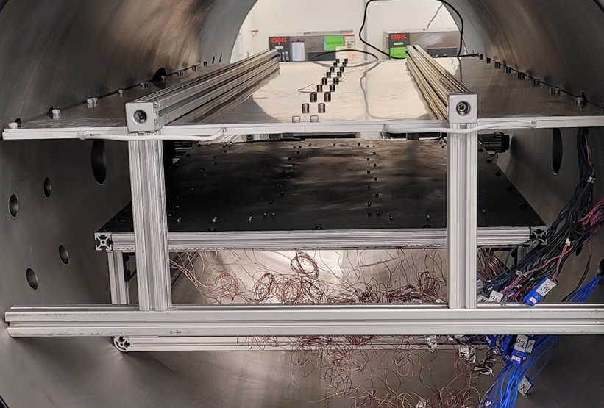
3D-Printed Loop Heat Pipe
The entire evaporator is 3D-printed
Significant cost reductions compared to traditional LHPs
Highly scalable
100W with a 1.25” long wick
450W with a 4” long wick
Low Power Startup
Low Heat Leak
CubeSat Evap (5/8”x1.25”)
Vapor Outlet
Thermal vacuum chamber
Charge Port
Integrated vapor space cap
1.25”
4”
10”
TVAC testing LHP (TRL6)
Distribution A: Approved for public release; distribution is unlimited. Public Affairs release approval #AFRL-2025-3776

Slide 6
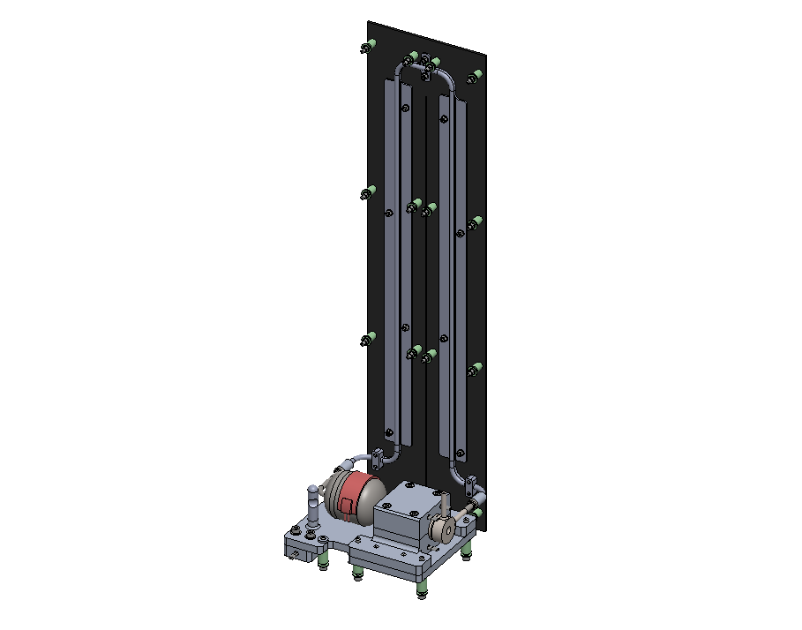
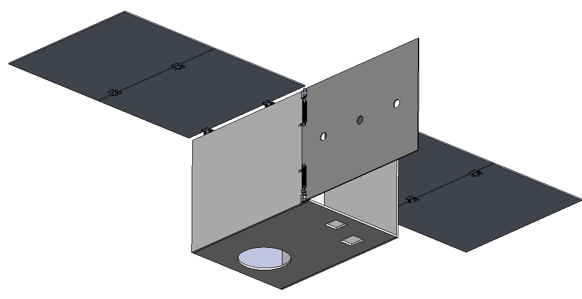
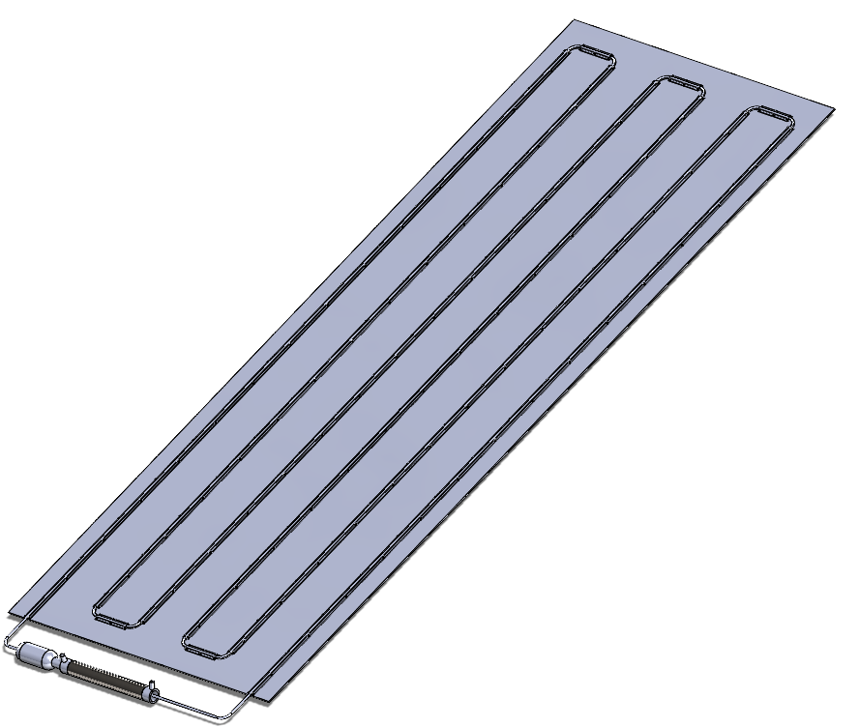
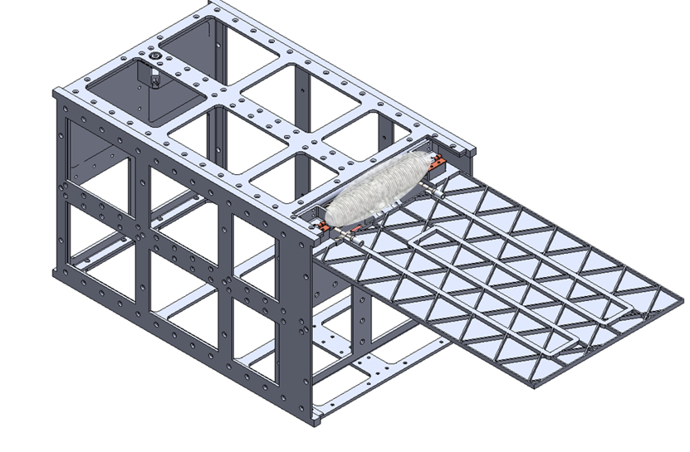
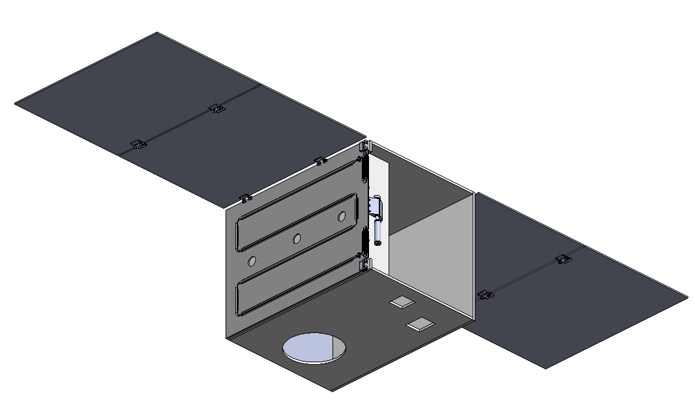
3D-Printed LHP Configurations for Many Applications
Four LHPs are being designed for different applications and are at various stages of the development and fabrication process.
One is a flight unit, and the other three are being developed through SBIR efforts
Four LHPs Under Development
Target Application | Heat Load | Operating Fluid | Deployable Radiator Panel (DRP) | Thermal Control Valve (TCV) | Approx. Wick Size
Tech Demo (CubeSat, 3U) | 16W | Ammonia | No | No | Ø5/8" x 1.25"
CubeSat (12U) | 50W | Ammonia | Yes | No | Ø5/8" x 1.25"
SmallSat | 300W | Ammonia | Yes | No | Ø1” x 4”
Lunar TCS | 1kW | Propylene | No | Yes | Ø1” x 10”
Tech Demo
CubeSat
SmallSat
Lunar
Distribution A: Approved for public release; distribution is unlimited. Public Affairs release approval #AFRL-2025-3776

Slide 7
Flight Unit
3U CubeSat
Distribution A: Approved for public release; distribution is unlimited. Public Affairs release approval #AFRL-2025-3776

Slide 8
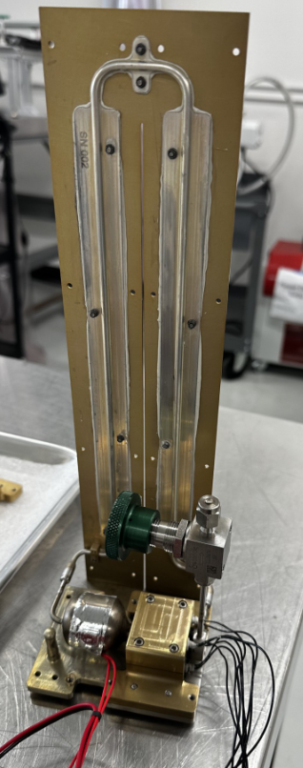
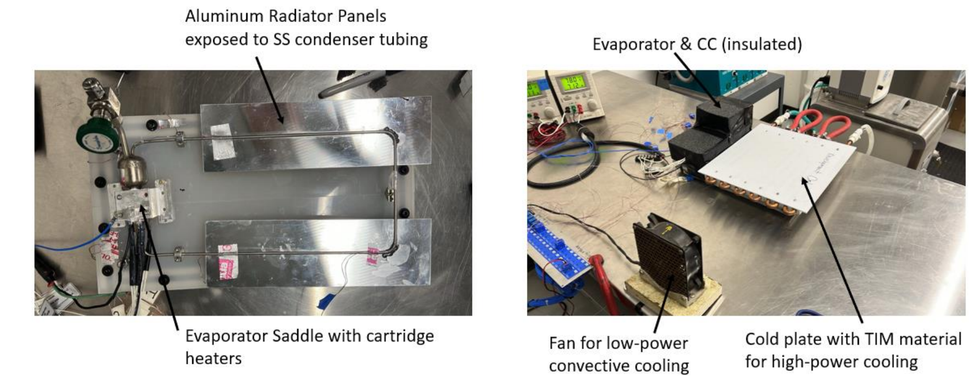
Flight Demonstration Unit
ACT will fly the 3D-printed LHP as a part of NASA’s CubeSat Launch Initiative (Early 2026)
The 3D-printed LHP is integrated into a 3U CubeSat (5/8”OD x 1.25” wick size)
Ambient testing has been completed on the LHP.
The 3D-printed LHP will be TRL 7 with a successful flight demonstration
Flight Unit
Distribution A: Approved for public release; distribution is unlimited. Public Affairs release approval #AFRL-2025-3776

Slide 9
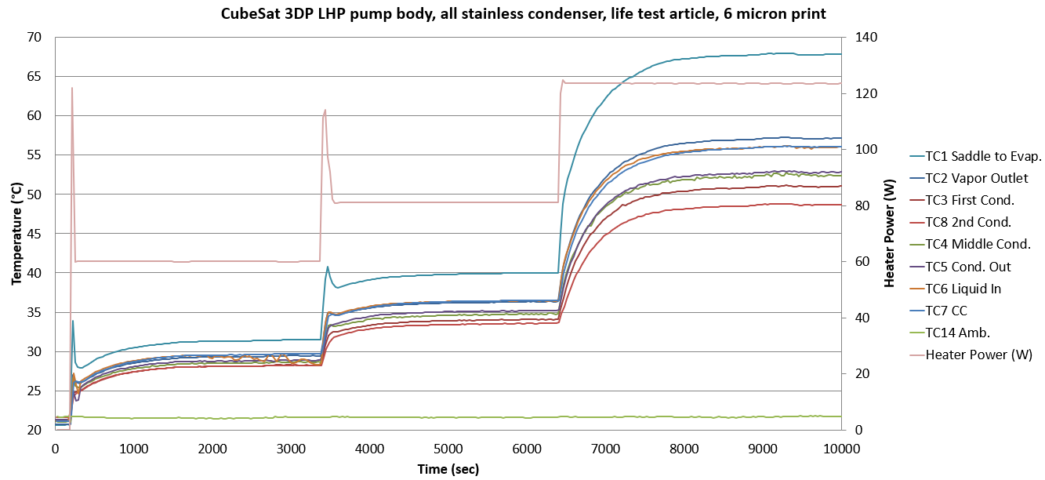
Technology Flight Demonstration
3U CubeSat evaporator demonstrated 125W of heat transport capability in lab testing (with cold plate condenser)
Nominal rejection of the flight unit is 16W (radiator limited)
Maximum LHP conductance of 4 W/K
Conductance = Heater Power / (TC1-TC5)
Distribution A: Approved for public release; distribution is unlimited. Public Affairs release approval #AFRL-2025-3776

Slide 10
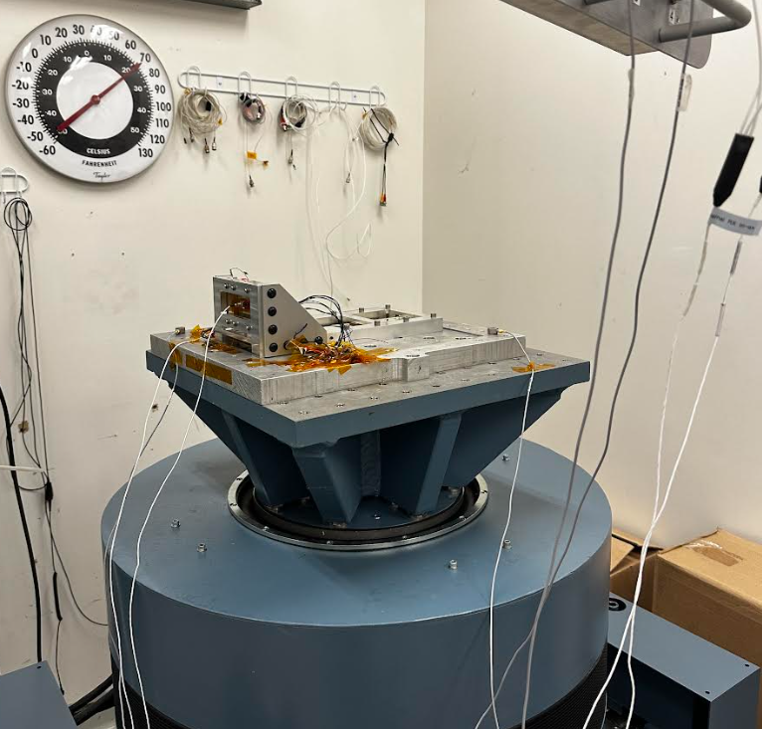
Flight Qualification: Vibration Testing
The LHP flight demonstration unit passed random vibration testing at NASA GSFC.
The assembly will next undergo TVAC testing, and then be shipped to NASA for integration with the flight payload.
CubeSat
Accelerometers
Vibration table
Distribution A: Approved for public release; distribution is unlimited. Public Affairs release approval #AFRL-2025-3776

Slide 11
SBIR Units
12U CubeSat, ESPA-Sat, Lunar Habitat
Distribution A: Approved for public release; distribution is unlimited. Public Affairs release approval #AFRL-2025-3776

Slide 12
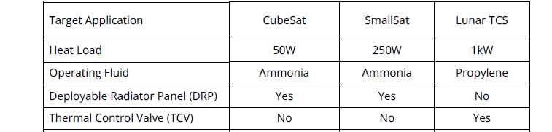
CubeSat Loop Heat Pipe Design
Heat Load: 50W
Fluid: Ammonia
Radiator Size: 0.06m²
Distribution A: Approved for public release; distribution is unlimited. Public Affairs release approval #AFRL-2025-3776

Slide 13
12U CubeSat Unit
The 12U CubeSat utilizes the same evaporator as the 3U CubeSat, paired to a deployable radiator panel (50W of rejection, single-sided).
ACT’s flexible transport lines couple the deployable radiator panel to the evaporator, allowing for two-phase fluid transport across the hinge-line, with low stack height.
CAD Model of 12U CubeSat in Deployed State
Distribution A: Approved for public release; distribution is unlimited. Public Affairs release approval #AFRL-2025-3776

Slide 14
SmallSat Loop Heat Pipe Design
Heat Load (250W)
Fluid: Ammonia
Radiator Size: 0.7m²
Distribution A: Approved for public release; distribution is unlimited. Public Affairs release approval #AFRL-2025-3776

Slide 15
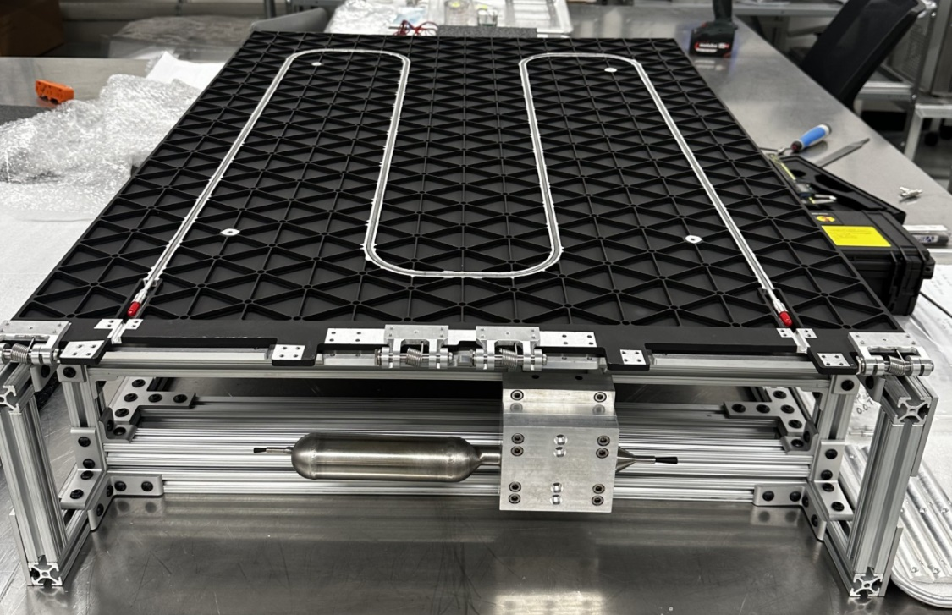
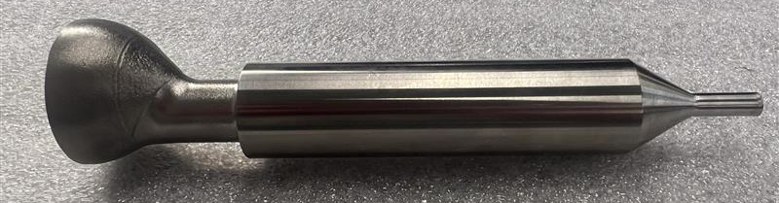
SmallSat Loop Heat Pipe
A 3D-printed LHP with deployable radiator is currently being fabricated for an ESPA-class SmallSat application.
The system is designed to provide an additional 300W of heat rejection.
For this LHP, part of the compensation chamber is printed with the rest of the evaporator, further reducing system cost.
SmallSat thermal management system including deployable radiator.
SmallSat evaporator w/ partial compensation chamber
Distribution A: Approved for public release; distribution is unlimited. Public Affairs release approval #AFRL-2025-3776

Slide 16
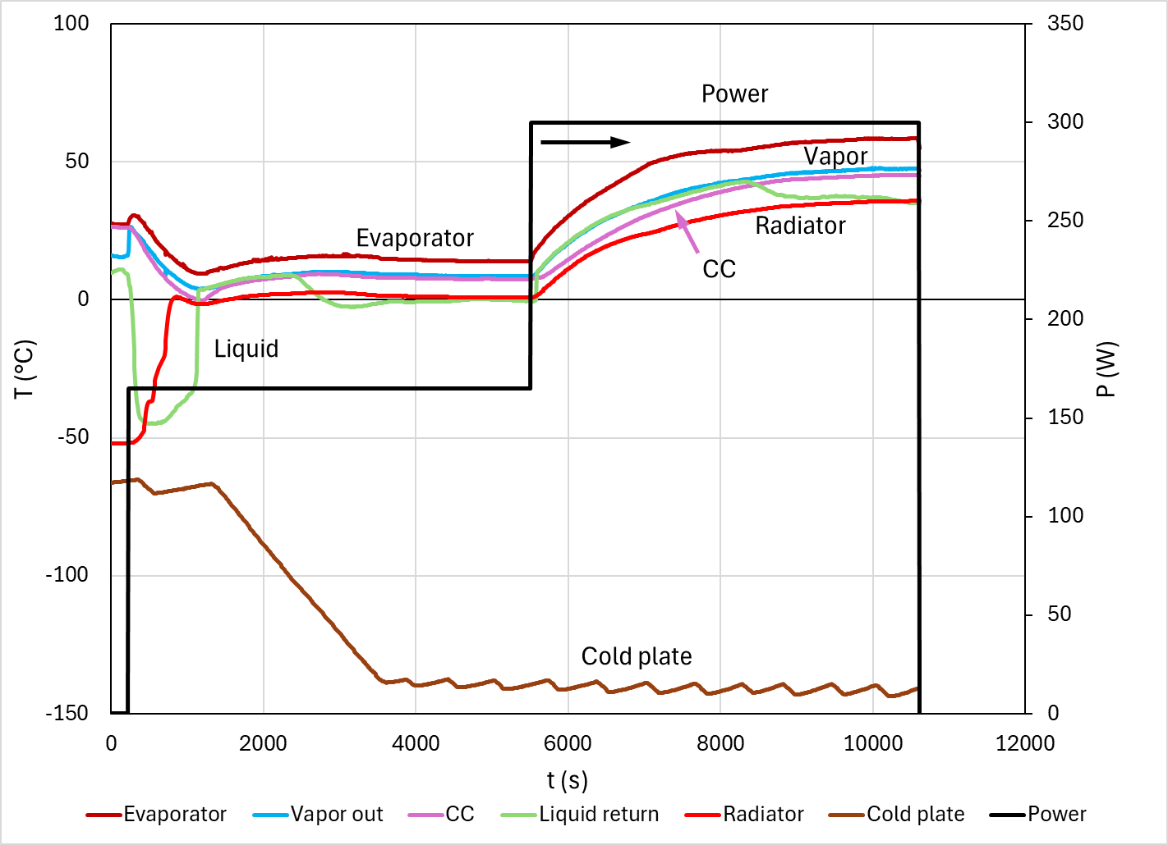
SmallSat LHP Performance
The SmallSat evaporator underwent TVAC testing in a separate program.
Conductance peaked at 12.5 W/K (300W)
Conductance = Power/(Evaporator-Radiator)
TVAC Testing of SmallSat LHP
Distribution A: Approved for public release; distribution is unlimited. Public Affairs release approval #AFRL-2025-3776

Slide 17
SmallSat Next Steps
Qualification Testing
Thermal vacuum chamber testing
Steady State Operation (September 2025)
Cold Start-Up Operation (September 2025)
Deployment Testing (October 2025)
Distribution A: Approved for public release; distribution is unlimited. Public Affairs release approval #AFRL-2025-3776

Slide 18
Lunar Loop Heat Pipe Design
Heat Load: 1kW
Fluid: Propylene
Radiator Size: 2.41m²
Thermal Control Valve
Distribution A: Approved for public release; distribution is unlimited. Public Affairs release approval #AFRL-2025-3776

Slide 19
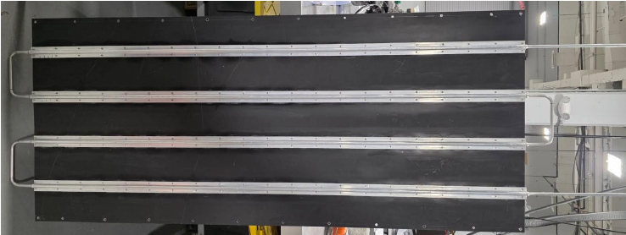
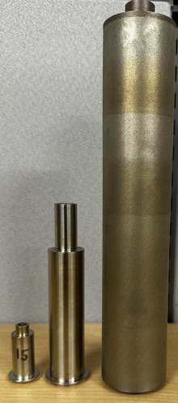
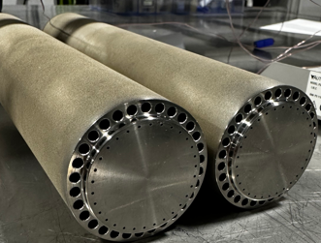
Lunar Loop Heat Pipe Fabrication
Heat is provided to the lunar LHP evaporator through liquid channels, with heat to be supplied from a 50/50 PGW mixture.
The liquid loop channels are printed with the rest of the evaporator.
Currently, the evaporator is awaiting integration with the radiator and thermal control valve.
Radiator Panel
Lunar Evaporator
SmallSat Evaporator
Liquid loop channels
CubeSat Evaporator
Distribution A: Approved for public release; distribution is unlimited. Public Affairs release approval #AFRL-2025-3776

Slide 20
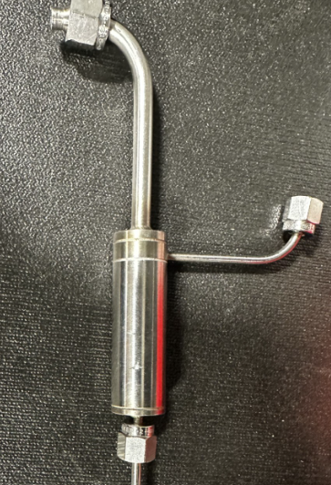
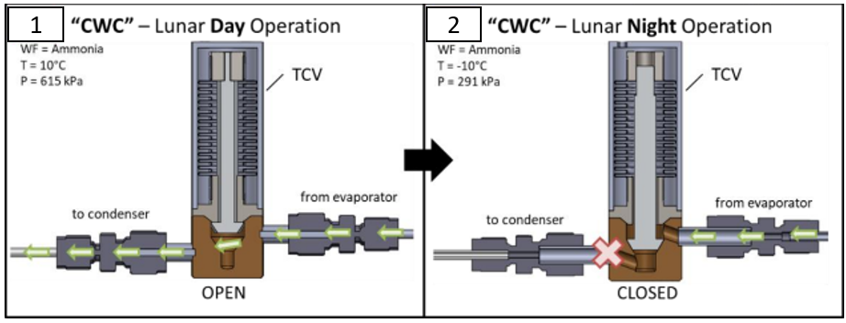
LHP With Thermal Control Valve
For lunar night survival, it is critical to turn down LHP conductance to keep heat at the payload.
A thermal control valve is a device that can passively decouple the LHP evaporator and radiator panel.
ACT’s thermal control valve design has few moving parts, and it actuates as the vapor pressure in the LHP changes.
Thermal Control Valve
Distribution A: Approved for public release; distribution is unlimited. Public Affairs release approval #AFRL-2025-3776

Slide 21
Lunar LHP Next Steps
Fabrication of the LHP (August 2025)
Integration with single-phase liquid loop heater (August 2025)
Qualification testing
Ambient Testing (September 2025)
Thermal vacuum chamber testing
Steady State Operation (October 2025)
Lunar Night Survival TCV Actuation (October 2025)
Distribution A: Approved for public release; distribution is unlimited. Public Affairs release approval #AFRL-2025-3776

Slide 22
Summary
3D-printing promises to reduce the cost and lead time for LHPs dramatically.
Four 3D-printed LHPs are in various stages of development for different applications:
3U CubeSat Flight Unit (15W)
12U CubeSat (50W)
ESPA-Class SmallSat (250W)
Lunar Habitat Unit (1kW)
ACT will continue fabrication of all four units through 2025.
Following a successful flight test, the 3D-printed LHP will be TRL 7 in early 2026.
Distribution A: Approved for public release; distribution is unlimited. Public Affairs release approval #AFRL-2025-3776

Slide 23
Acknowledgements
We’d like to thank Jon Allison and Mishra Columbia of the AFRL for their continued support of the SmallSat LHP.
A big thanks goes to Stephanie Mauro and William Johnson of NASA Marshall for their support of the CubeSat and Lunar LHPs.
Distribution A: Approved for public release; distribution is unlimited. Public Affairs release approval #AFRL-2025-3776

