Slide 1

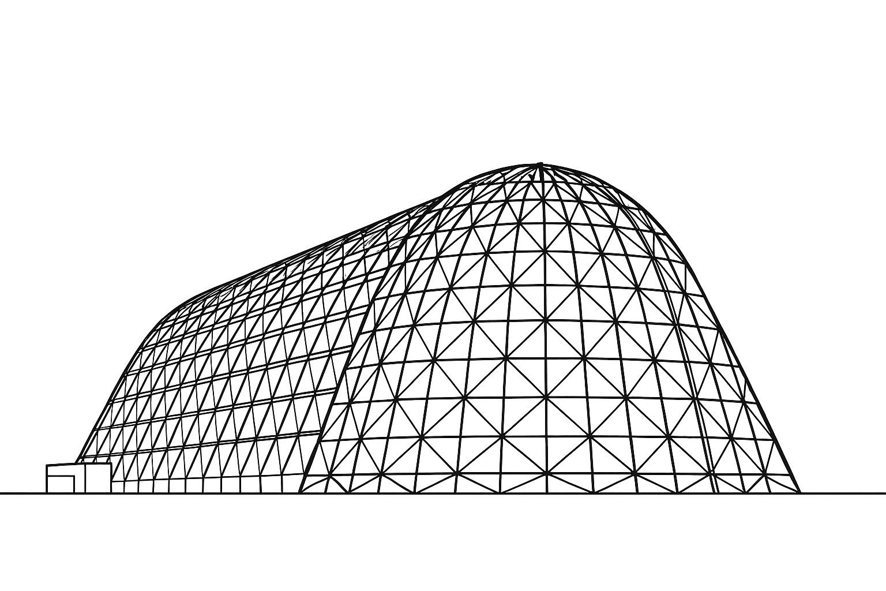

Novel Pulsating Heat Pipes Featuring Fractals for Performance Enhancement
TFAWS 2025 Thermal Control & Protection Technical Session
Presented by: Dr. Zishan Akhter
Dr. Zishan Akhter & Prof. Phillip Hart
Renewable and Sustainable Energy Research Center, Technology Innovation Institute (TII)
Thermal & Fluids Analysis Workshop 2025
NASA Ames Research Center
San Jose, CA
August 4-7, 2025

Slide 2

Introduction: PHP
Pulsating heat pipes (PHPs) are passive thermal management devices.
Wickless and capillary-driven, relying on pressure oscillations from evaporation/condensation cycles
Slug–plug vapor–liquid flow enables efficient two-phase heat transfer in serpentine or looped channels
Configurations: single-loop, multi-loop, flat-plate, embedded, and miniaturized (mPHPs)
Miniature PHPs (mPHPs): High surface-to-volume ratio resulting in faster thermal response and compact integration
Ideal for low-power thermal control in electronics, CubeSats, avionics, power modules, and fuel cells
Key performance factors: surface wettability, nucleation dynamics, fluid properties, flow regime stability
Scalable, lightweight solution for harsh environments — microgravity, vacuum, and constrained volumes

Slide 3
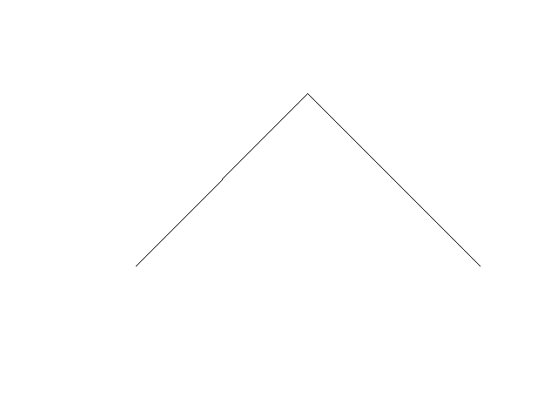
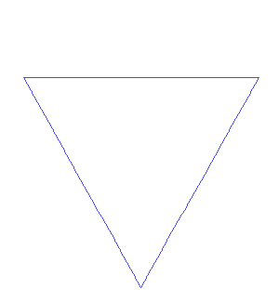


Introduction: Fractals
Fractals are self-similar, scale-invariant structures observed in both nature and mathematics
Enable multi-scale surface engineering for enhanced transport phenomena in fluids and heat transfer
In thermofluid systems, fractal textures increase wetted surface area and induce flow disturbances
Enhance phase-change heat transfer by promoting liquid film thinning, nucleation, and vapor transport
In this study, fractal wall textures are integrated into mPHPs to improve thermal response and performance
Koch snowflake
Sierpiński carpet
Heighway Dragon
Hilbert curve

Slide 4
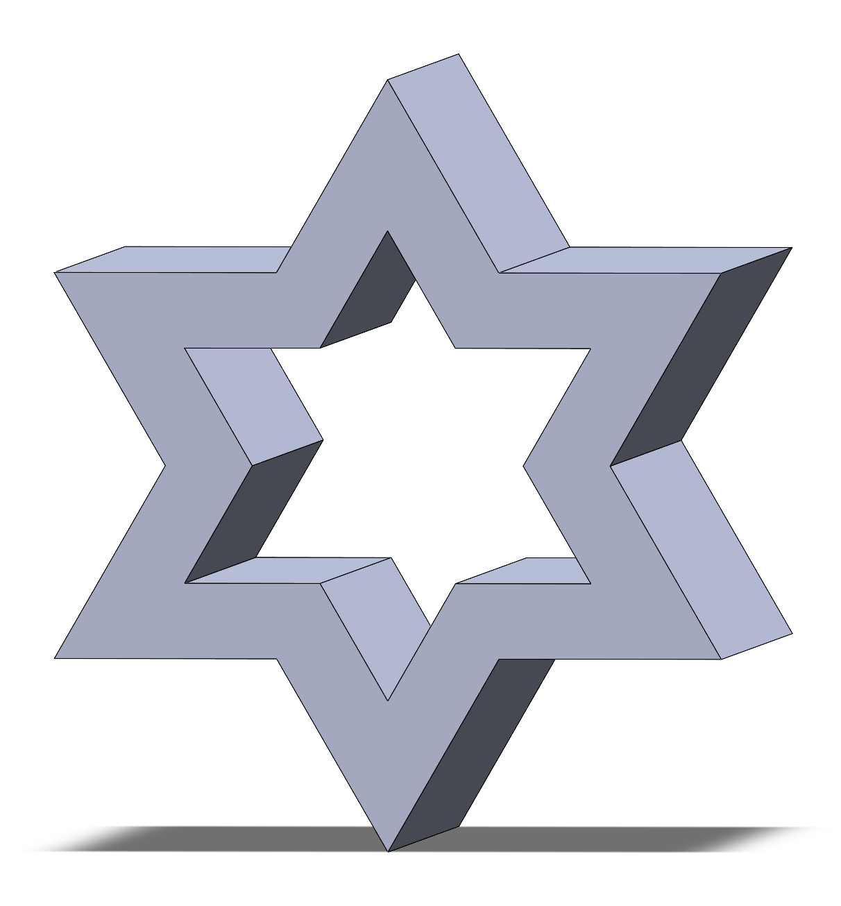
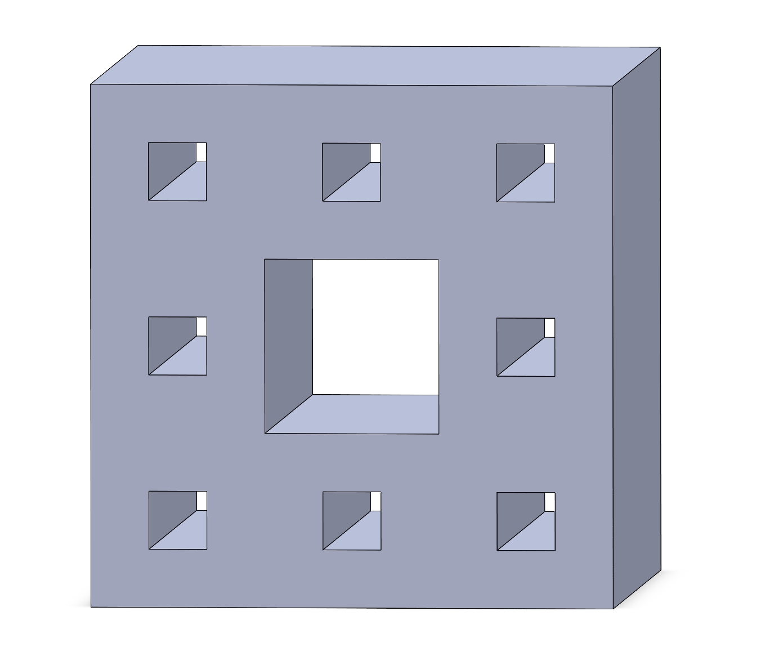
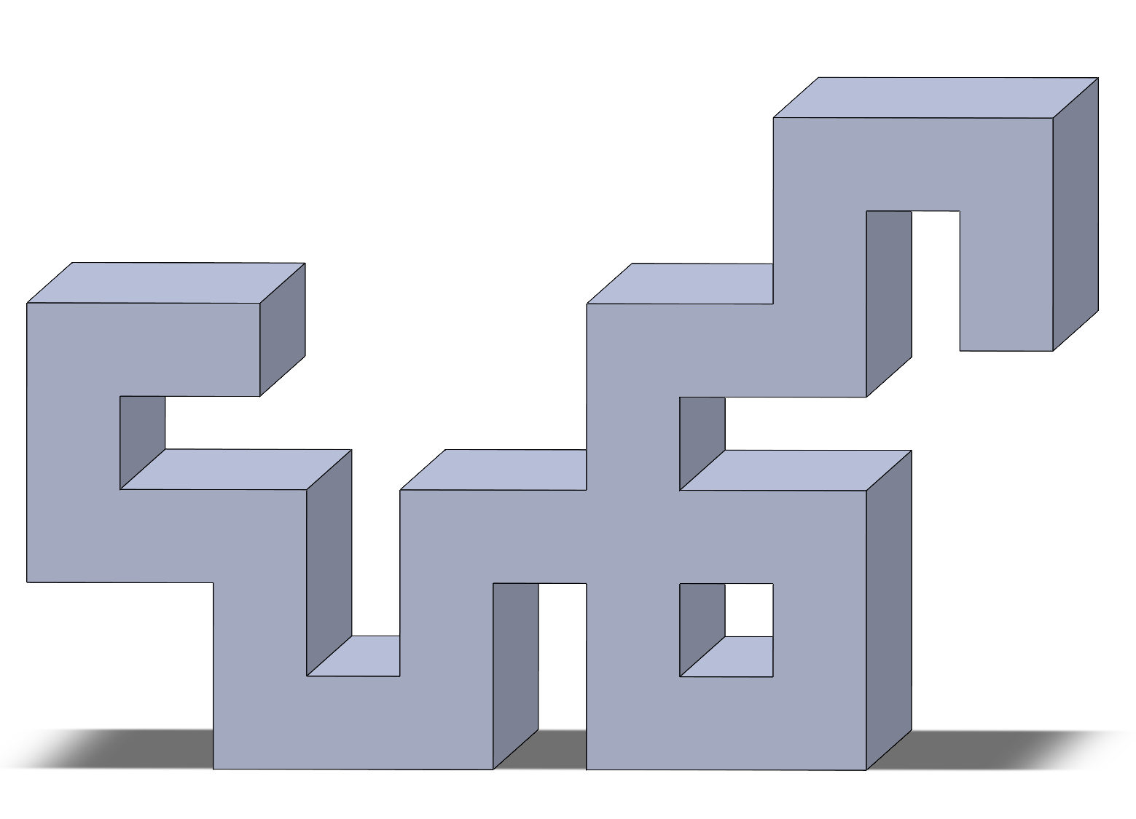
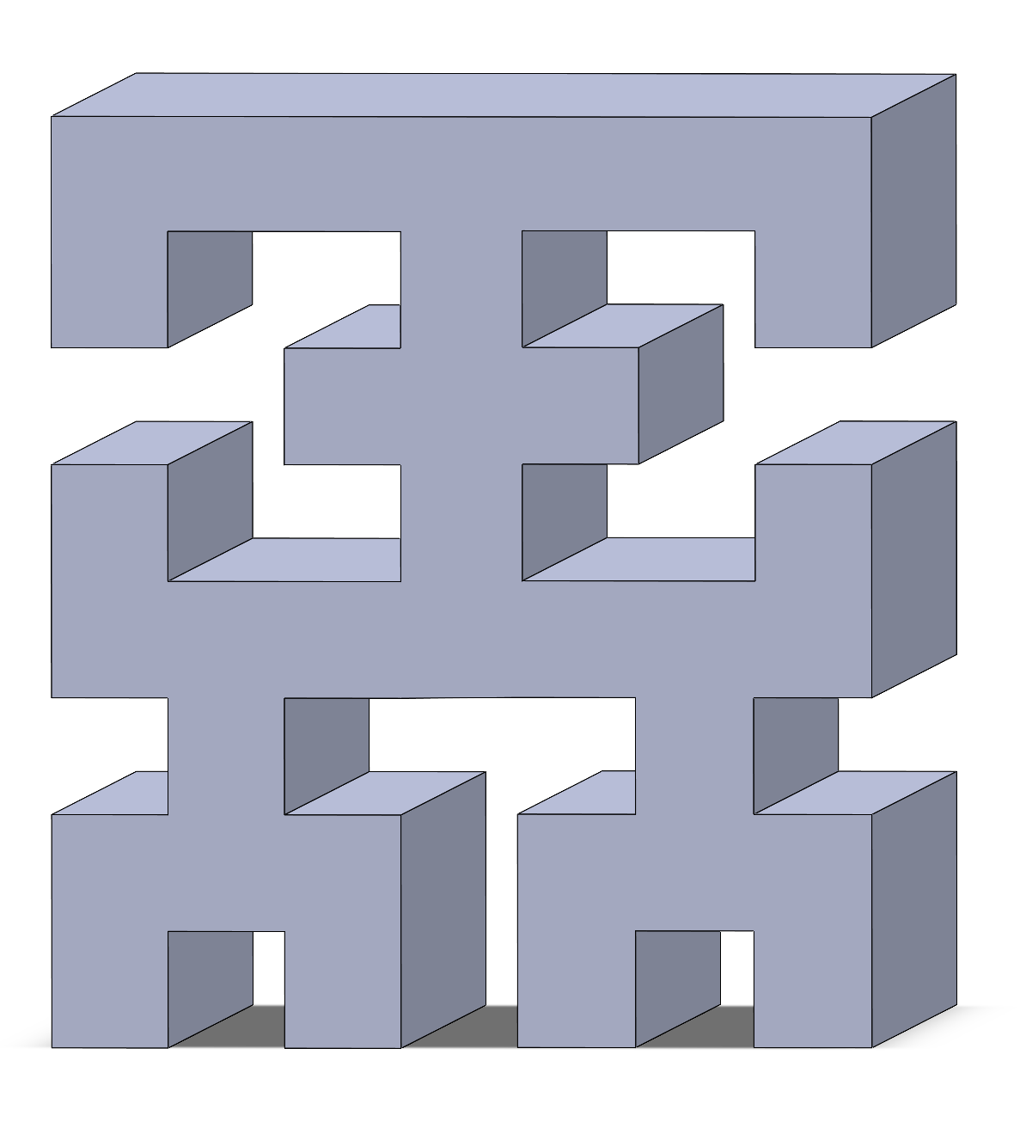
Fractal Selection
Koch snowflake: sharp edge density and high perimeter-to-area ratio enhance evaporation and thin-film formation
Sierpiński carpet: hierarchical porosity supports multi-scale nucleation site distribution and vapor-liquid separation
Heighway Dragon: curved, asymmetric contours induce localized vortices and directional flow confinement
Hilbert curve: space-filling, self-avoiding path ensures maximized wall-fluid contact with high geometric symmetry
Koch (order-1)
Srpk (order-2)
Drgn (order-4)
Hlbt (order-3)

Slide 5
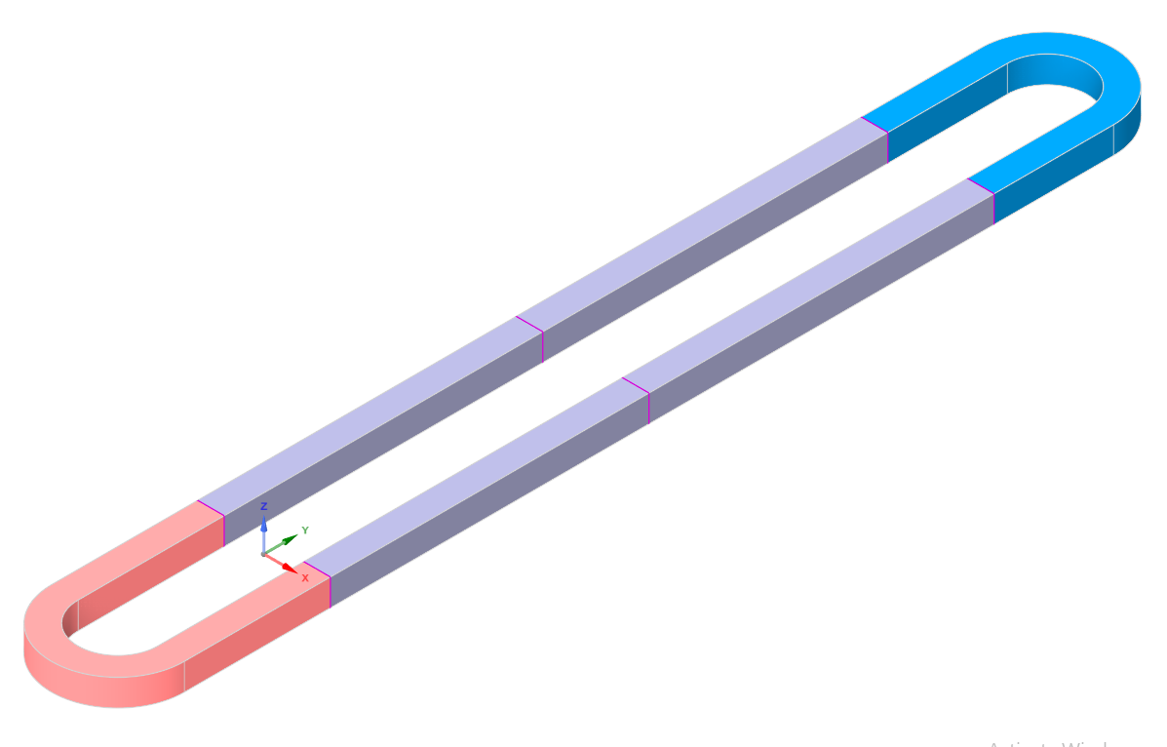
mPHP Design
5.5 mm
Condenser
Ø 3 mm
Adiabatic zone
25 mm
1 mm
Evaporator
1 mm
5.5 mm
Ø 5 mm
Gravity (-Y axis)

Slide 6
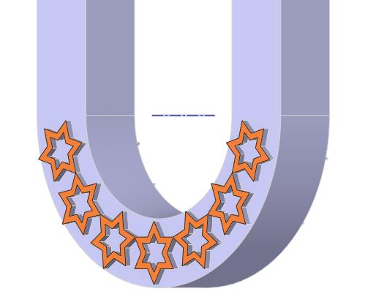
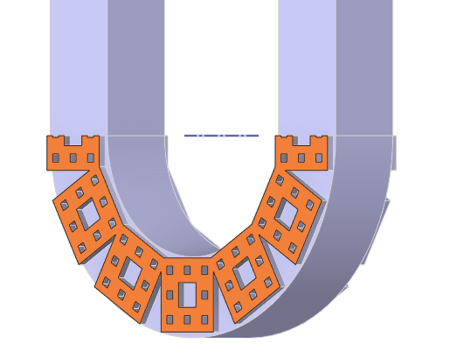
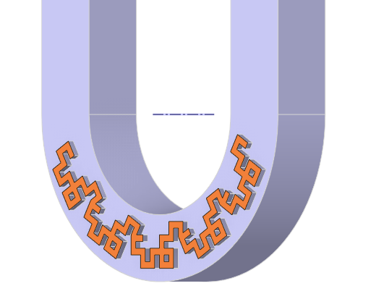
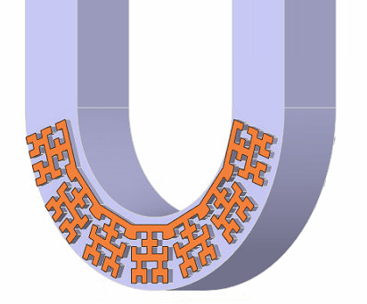
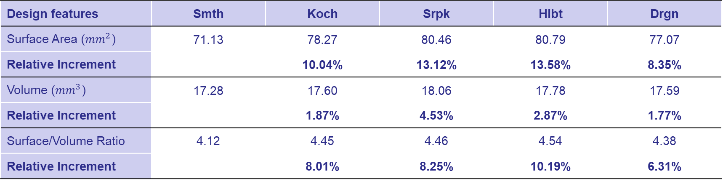
Fractal Integration
PHP-Design modification
Fractals grooved (0.1 mm) in curved zones
Surface area increased with minimal volume gain
Surface-to-volume ratio increased by ~10%
Design features | Smth | Koch | Srpk | Hlbt | Drgn
Surface Area (${mm}^{2}$) | 71.13 | 78.27 | 80.46 | 80.79 | 77.07
Relative Increment |  | 10.04% | 13.12% | 13.58% | 8.35%
Volume (${mm}^{3}$) | 17.28 | 17.60 | 18.06 | 17.78 | 17.59
Relative Increment |  | 1.87% | 4.53% | 2.87% | 1.77%
Surface/Volume Ratio | 4.12 | 4.45 | 4.46 | 4.54 | 4.38
Relative Increment |  | 8.01% | 8.25% | 10.19% | 6.31%
Koch
Srpk
Drgn
Hlbt

Slide 7
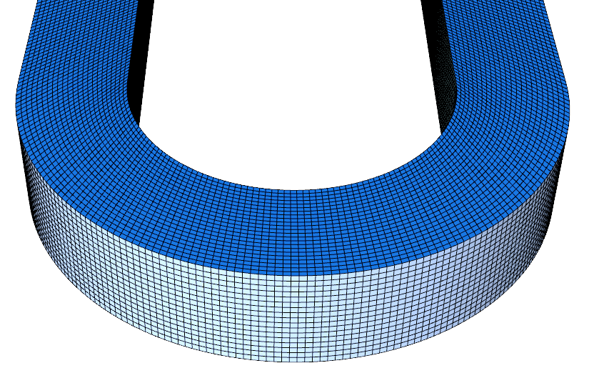
Setup & Modelling
Material Setup & BC
Working fluid: Ethanol
Saturation temperature: 351 K
Fill ratio: 50% (by volume)
Wall temperatures: Evaporator at 391 K, Condenser at 303 K
Wall condition: No-slip, no-penetration
Fluid–wall contact angle: 90° (neutral wetting)
CFD Modelling
Multiphase VOF model
Time step = 0.01-0.1 ms
Global average CFL maintained at ~1
Momentum model includes surface tension force
Figure: Close-up of the structured hexahedral mesh used in PHP modelling

Slide 8
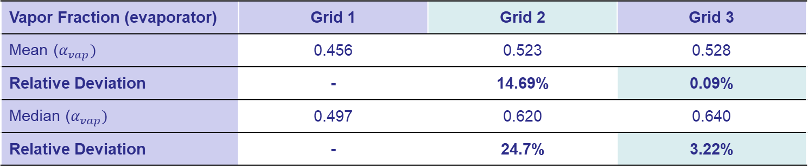
Grid Sensitivity
Grid Features | Grid 1 | Grid 2 | Grid 3
Max Cell Size | 0.09 mm | 0.06 mm | 0.04 mm
Min Cell Size | 7.5 µm | 5.0 µm | 3.3 µm
Total Cell Count | 182,400 | 554,829 | 1,806,250
Orthogonal Quality (avg/min) | 0.95/0.59 | 0.95/0.59 | 0.95/0.59
Skewness (avg/max) | 0.06/0.6 | 0.06/0.6 | 0.06/0.6
Aspect Ratio (max) | 3.65 | 3.78 | 3.85
Vapor Fraction (evaporator) | Grid 1 | Grid 2 | Grid 3
Mean ($α_{vap})$ | 0.456 | 0.523 | 0.528
Relative Deviation | - | 14.69% | 0.09%
Median ($α_{vap})$ | 0.497 | 0.620 | 0.640
Relative Deviation | - | 24.7% | 3.22%

Slide 9
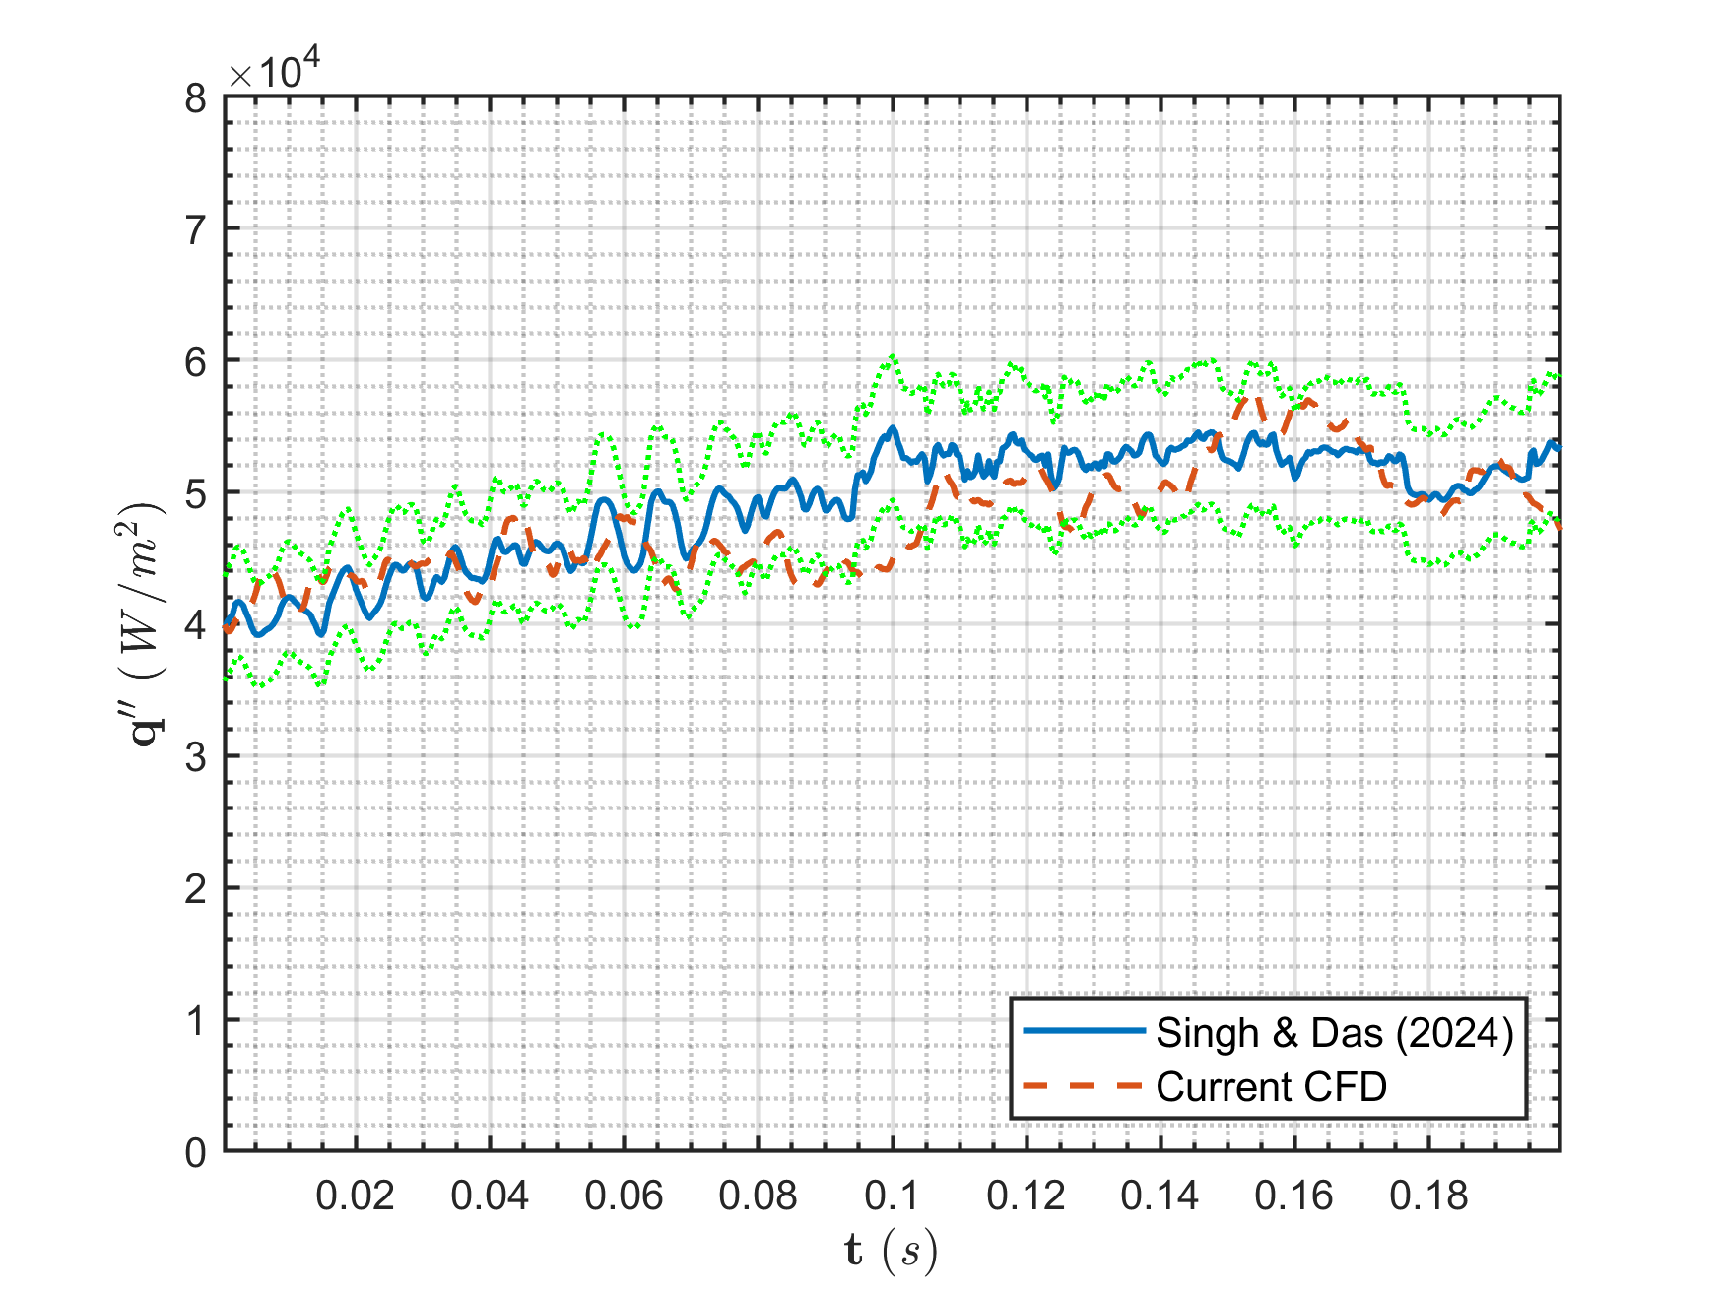
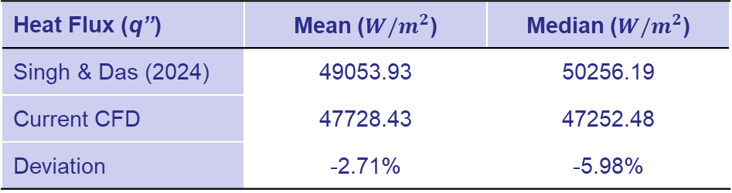
CFD Validation
Wall Heat Flux
Heat Flux (q’’) | Mean ($W/m^{2}$) | Median ($W/m^{2}$)
Singh & Das (2024) | 49053.93 | 50256.19
Current CFD | 47728.43 | 47252.48
Deviation | -2.71% | -5.98%
Time-averaged results align with published data
Mean and median deviations within ±6%
Captures transient, two-phase thermo-fluid behavior
Resolves oscillatory flow and phase-change dynamics
Figure: Transient wall heat flux under steady PHP operation
Reference: Singh & Das, Appl. Therm. Eng., 2024, https://doi.org/10.1016/j.applthermaleng.2024.124388

Slide 10
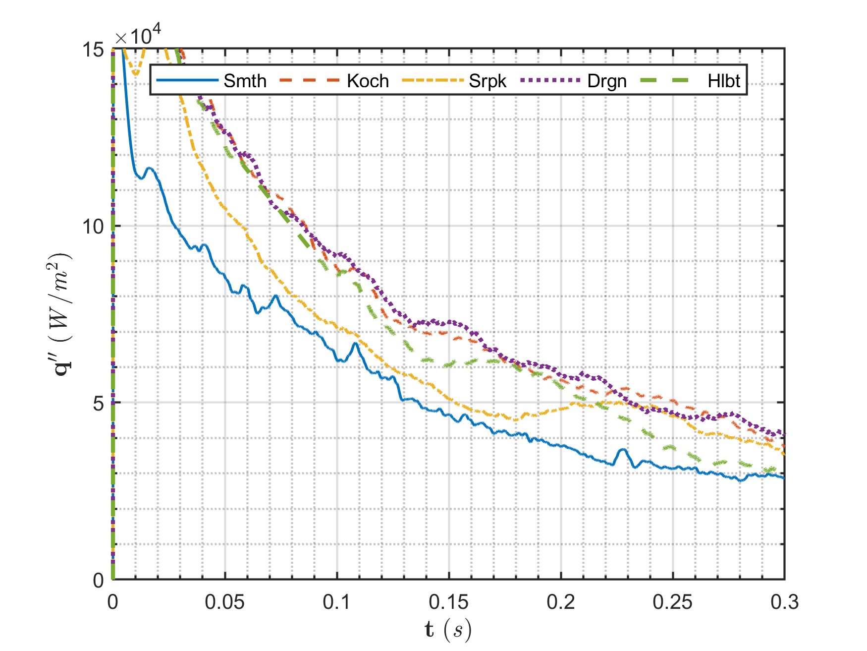
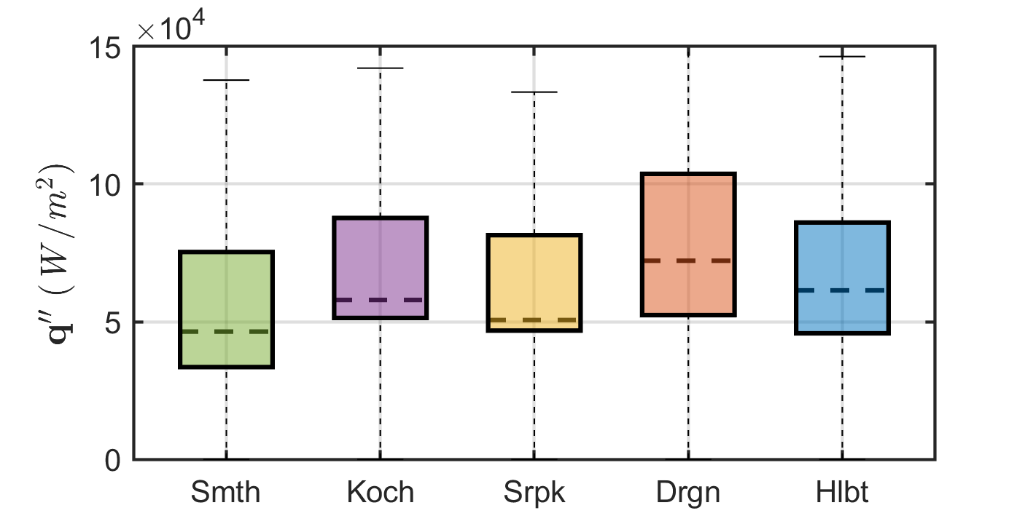
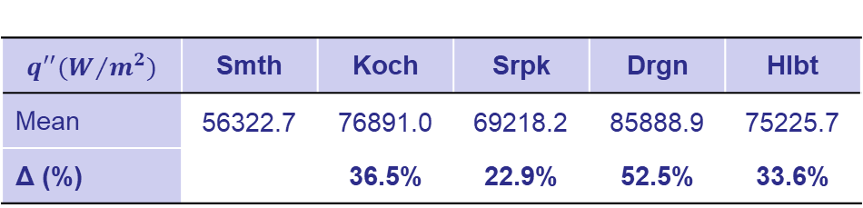
Results: Inception Stage
Wall Heat Flux
Fractals show higher initial 𝑞′′ from early nucleation
Heat flux drops sharply as vapor forms and insulates wall
Koch, Srpk and Drgn sustain 𝑞′′ via quick vapor detachment
Smooth PHP lags due to delayed wall wetting
Median 𝑞′′ increased by ~ 9-56% for fractals
$$q^{′′}(W/{m^{2}})$$ | Smth | Koch | Srpk | Drgn | Hlbt
Mean | 56322.7 | 76891.0 | 69218.2 | 85888.9 | 75225.7
Δ (%) |  | 36.5% | 22.9% | 52.5% | 33.6%
Figure: Temporal evolution of the area-weighted wall heat flux for different PHPs during inception stage

Slide 11
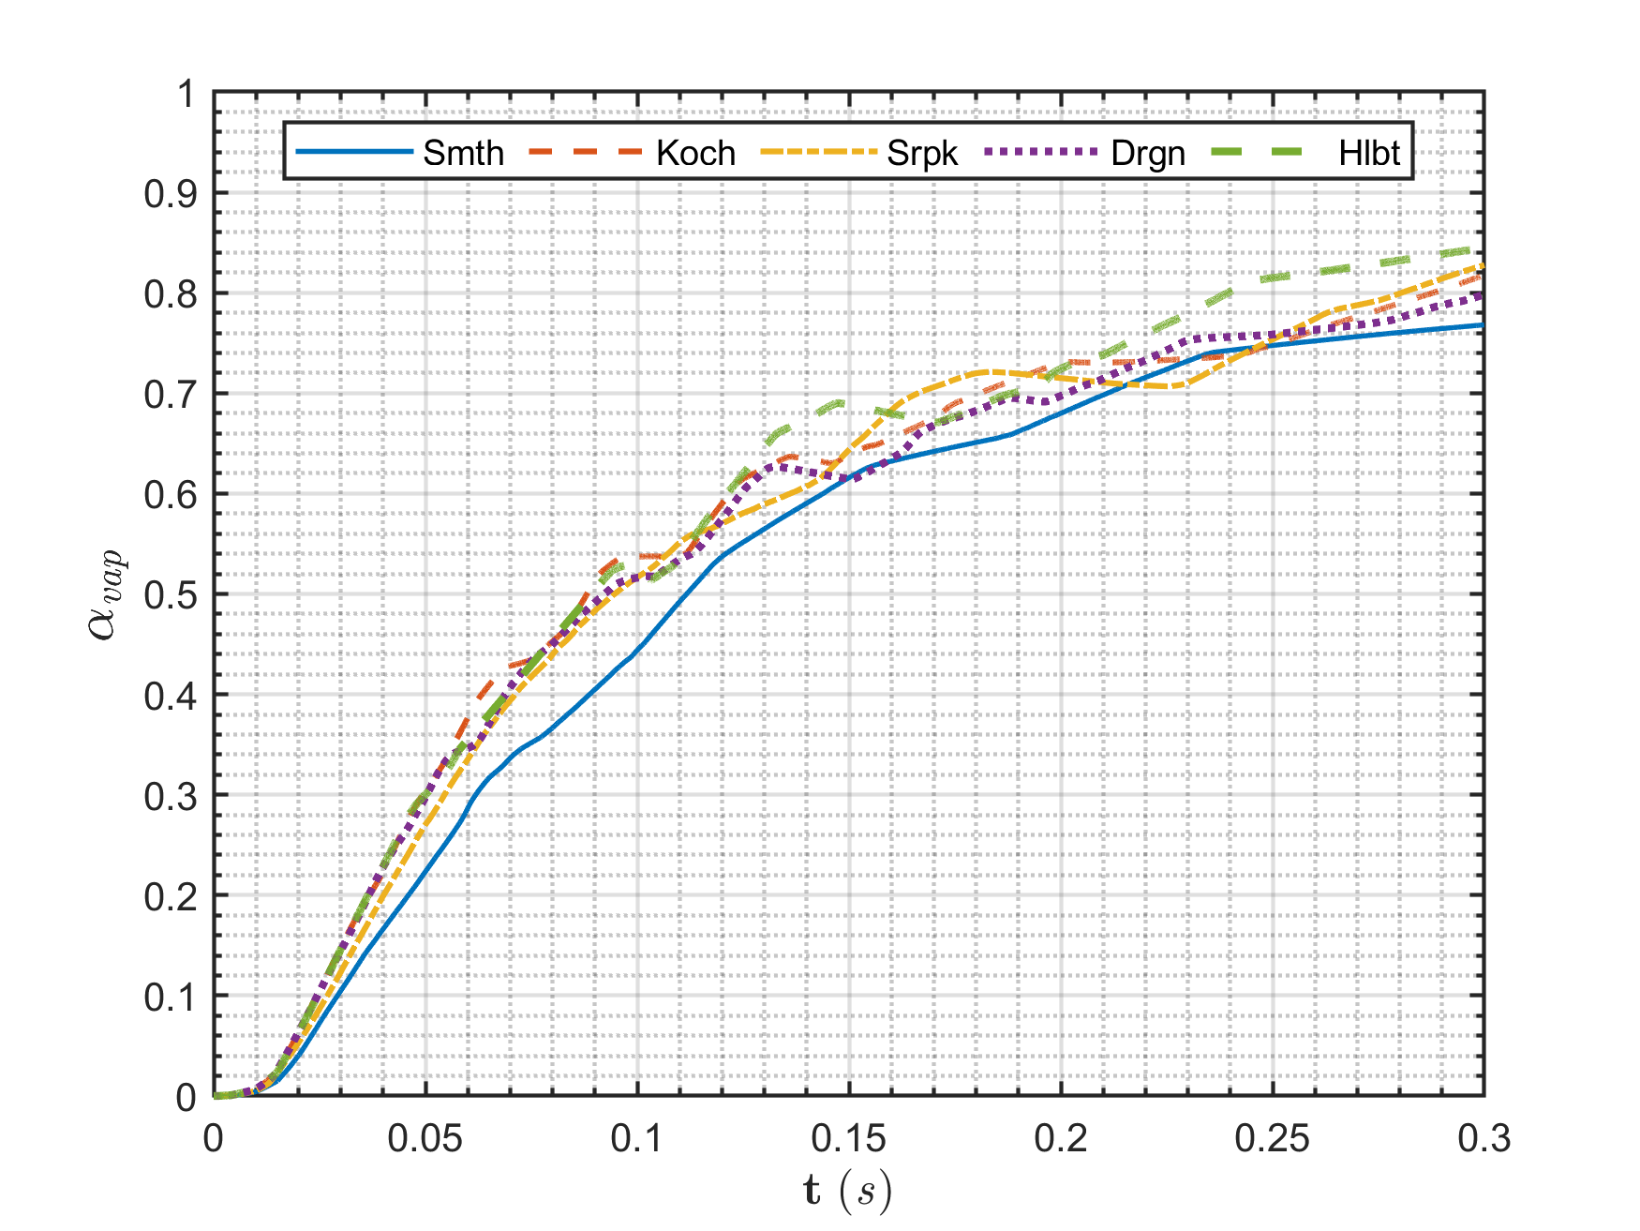
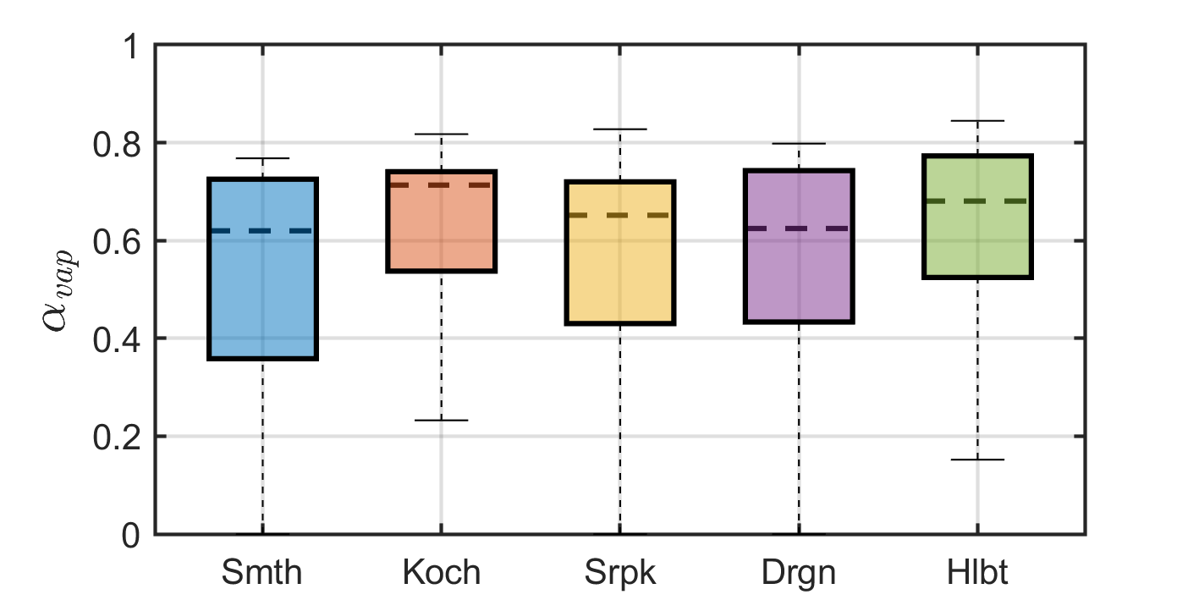
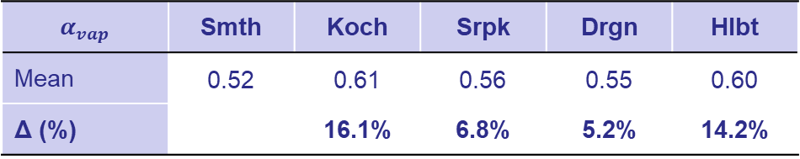
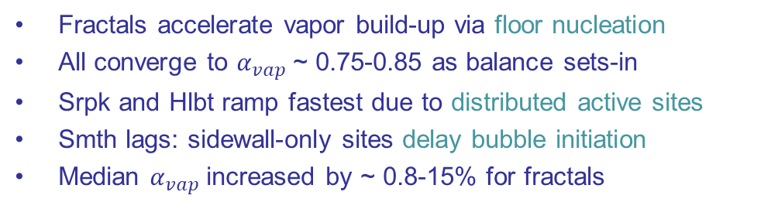
Results: Inception Stage
Vapor Volume Fraction
Fractals accelerate vapor build-up via floor nucleation
All converge to $α_{vap}$~ 0.75-0.85 as balance sets-in
Srpk and Hlbt ramp fastest due to distributed active sites
Smth lags: sidewall-only sites delay bubble initiation
Median $α_{vap}$increased by ~ 0.8-15% for fractals
$$α_{vap}$$ | Smth | Koch | Srpk | Drgn | Hlbt
Mean | 0.52 | 0.61 | 0.56 | 0.55 | 0.60
Δ (%) |  | 16.1% | 6.8% | 5.2% | 14.2%
Figure: Temporal evolution of the vapor volume fraction in evaporator for different PHPs during inception stage

Slide 12
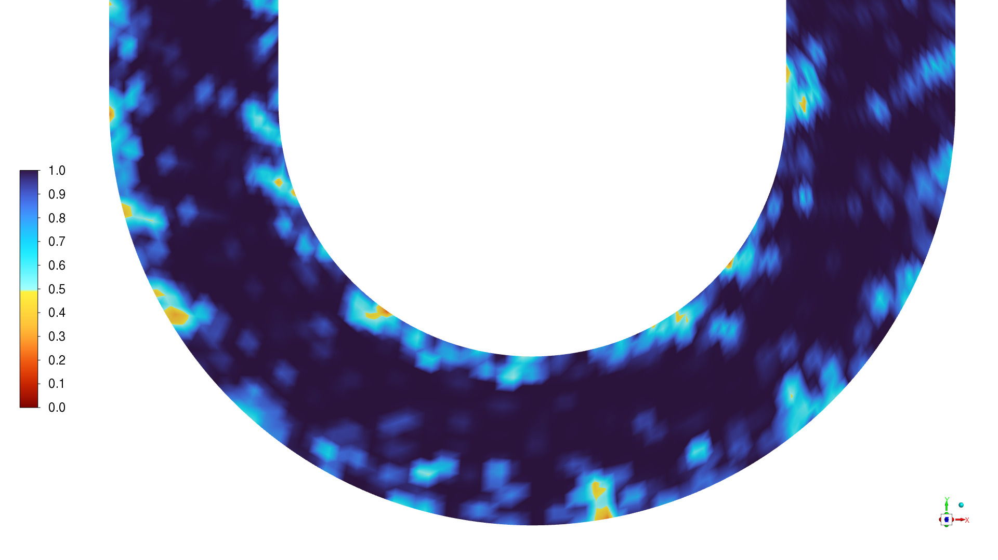
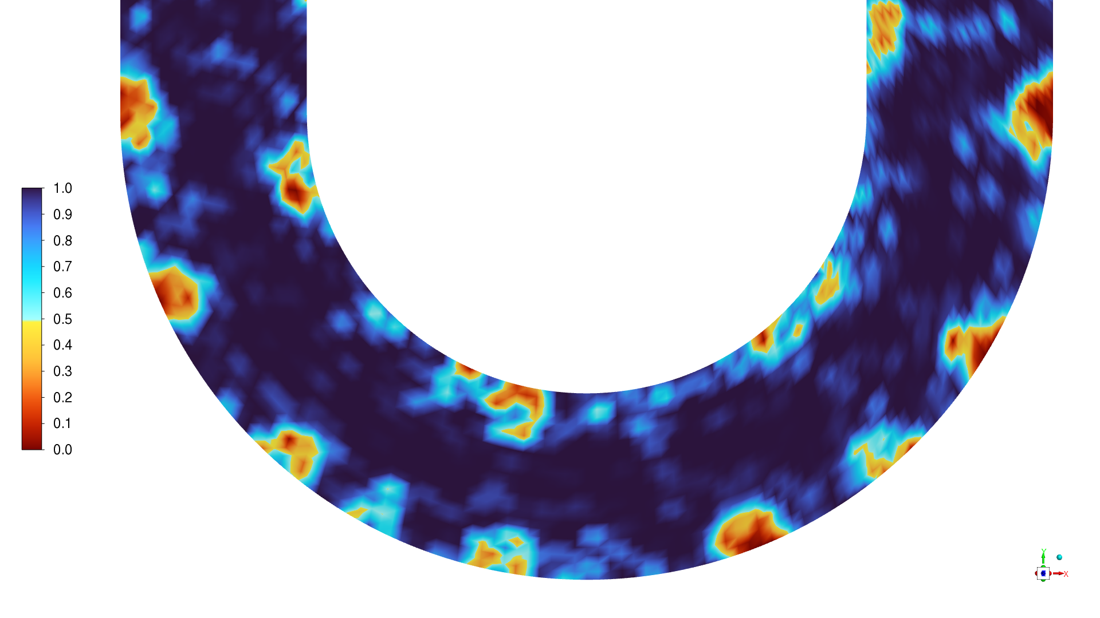
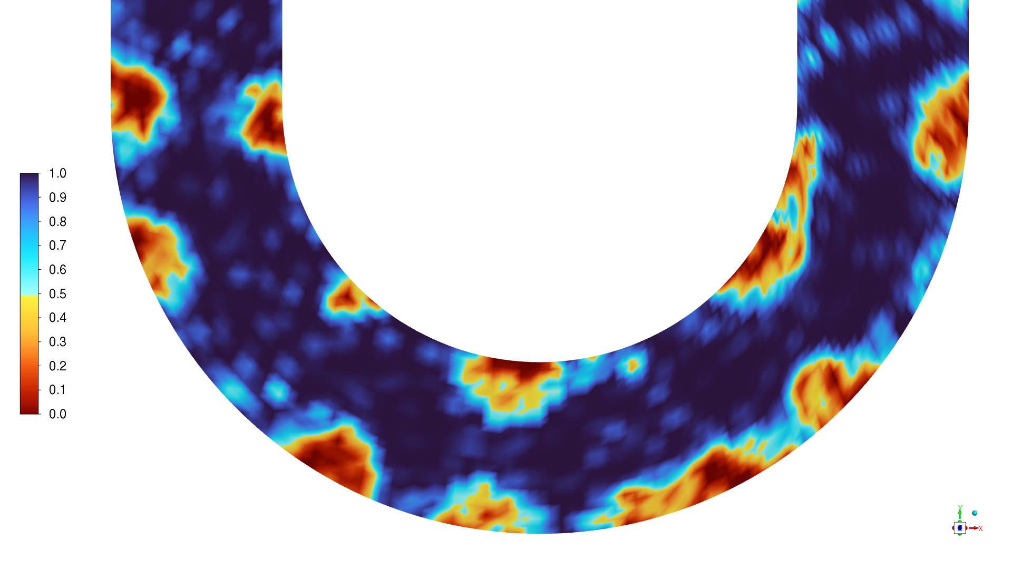
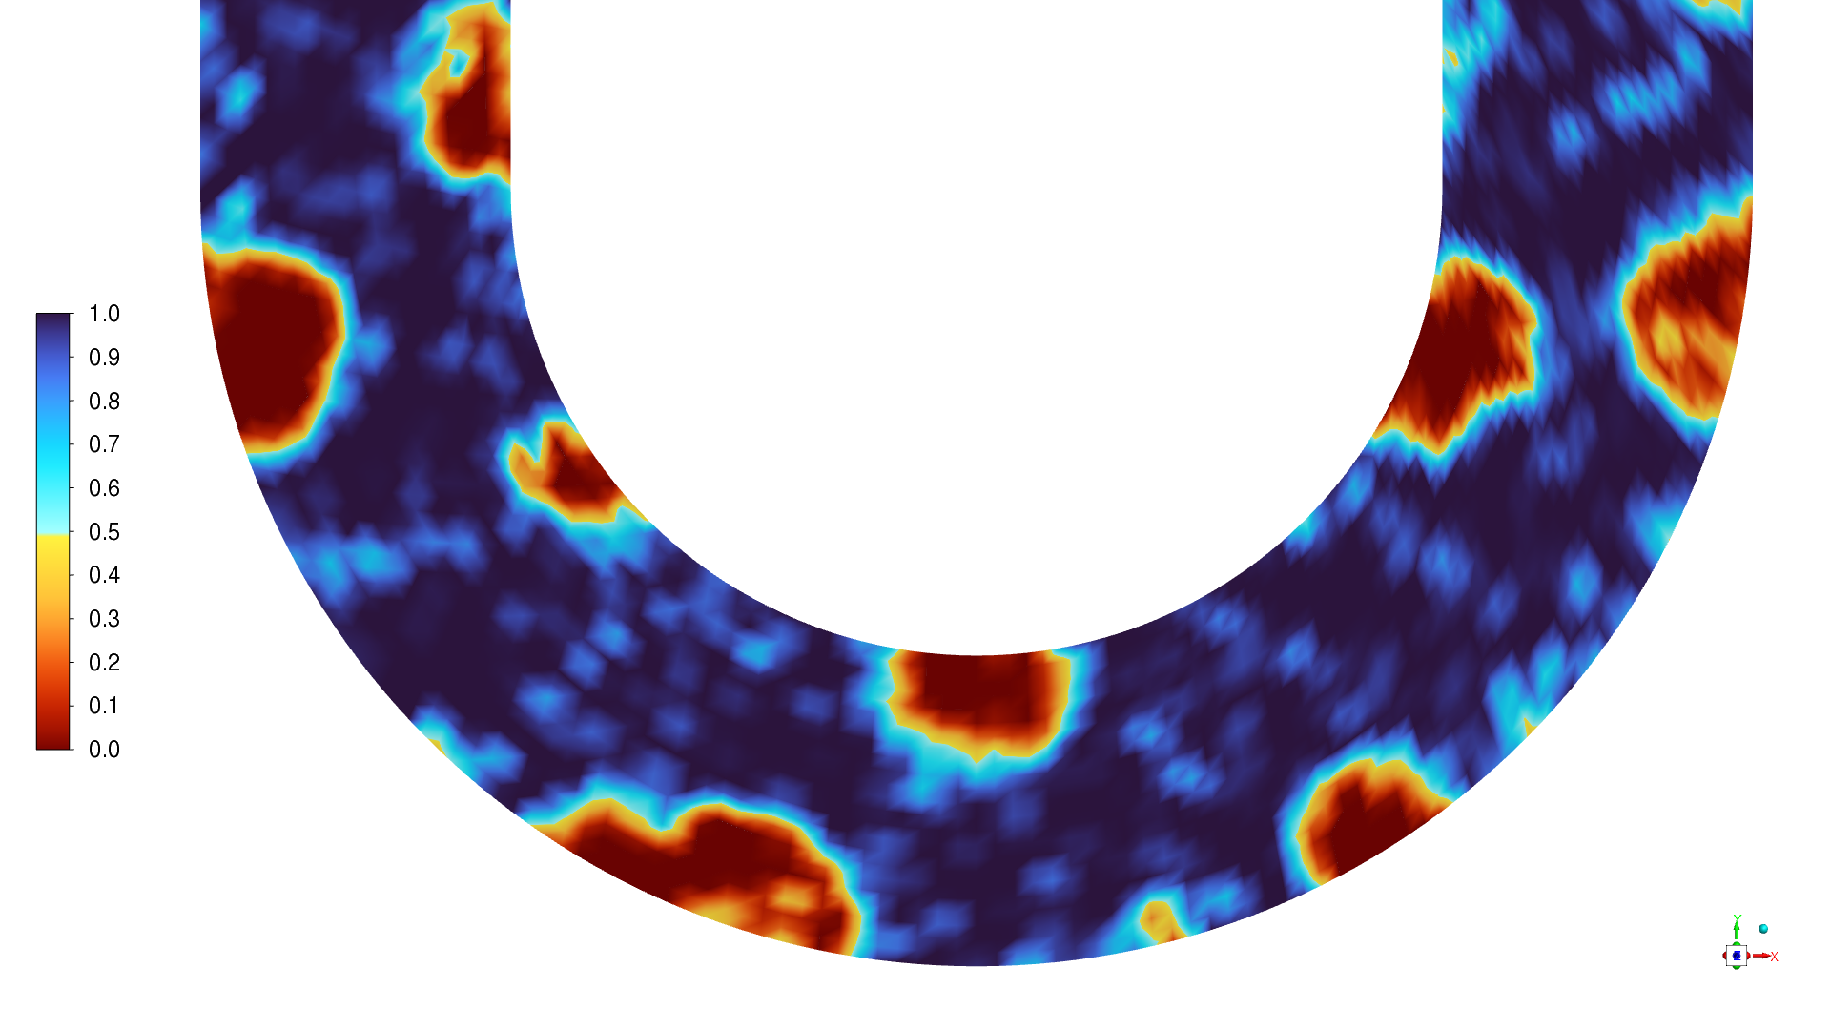
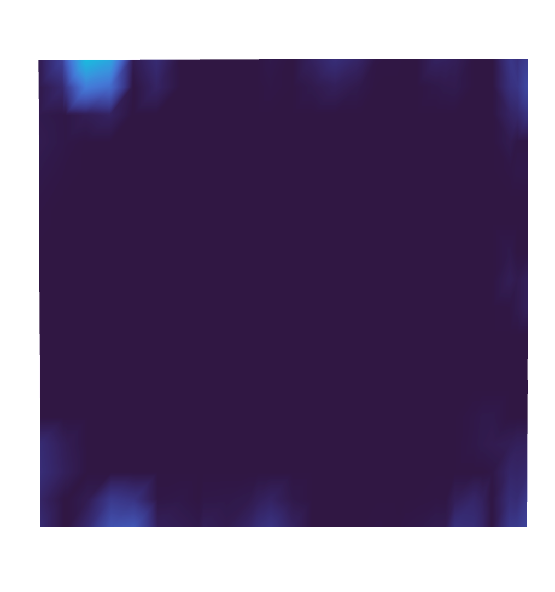
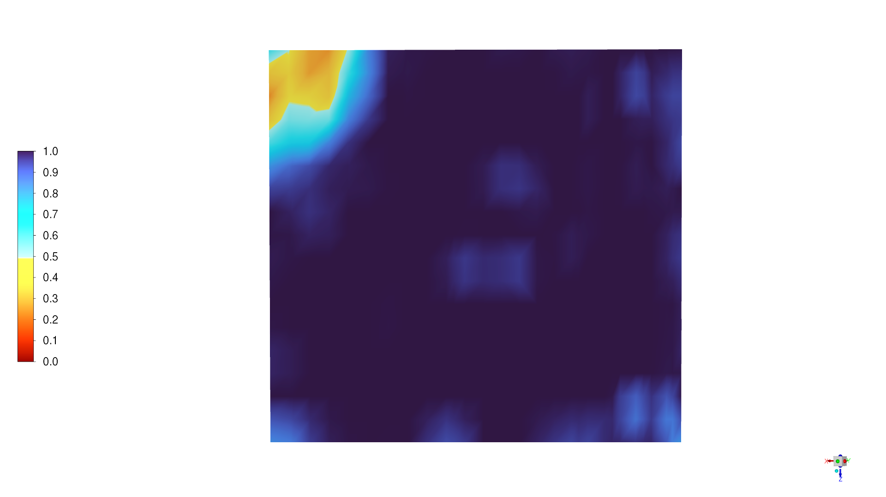
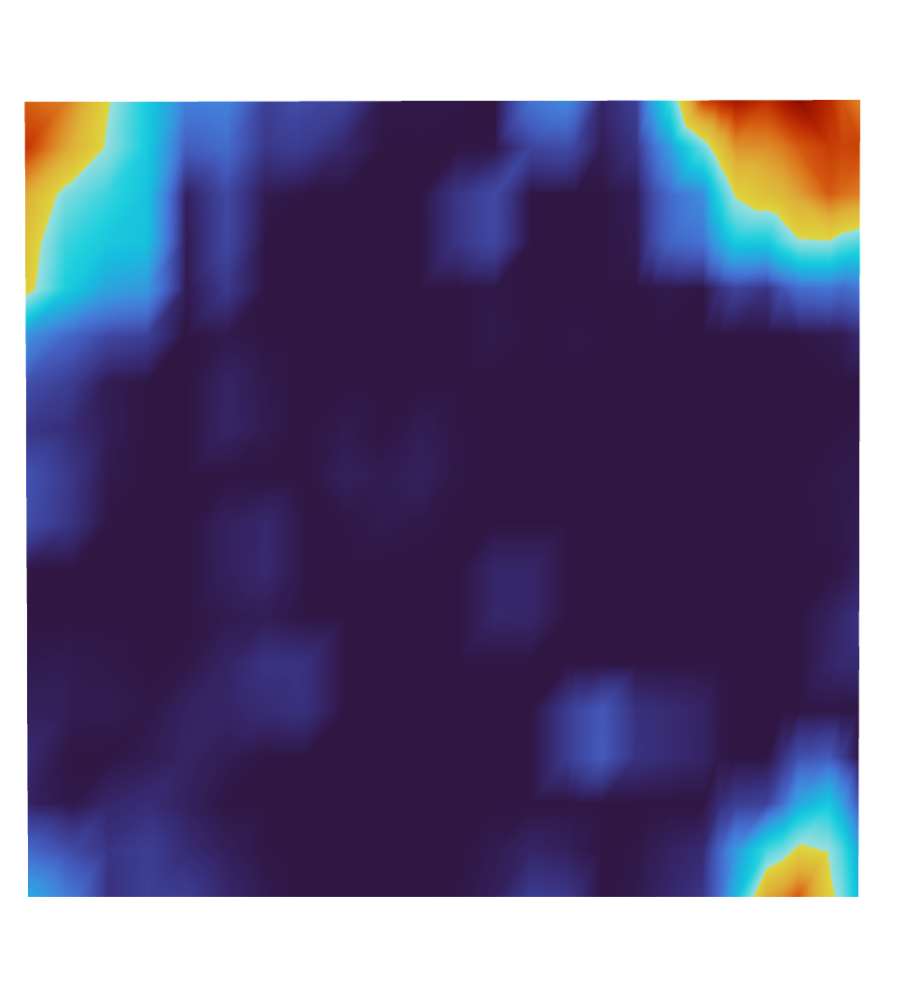
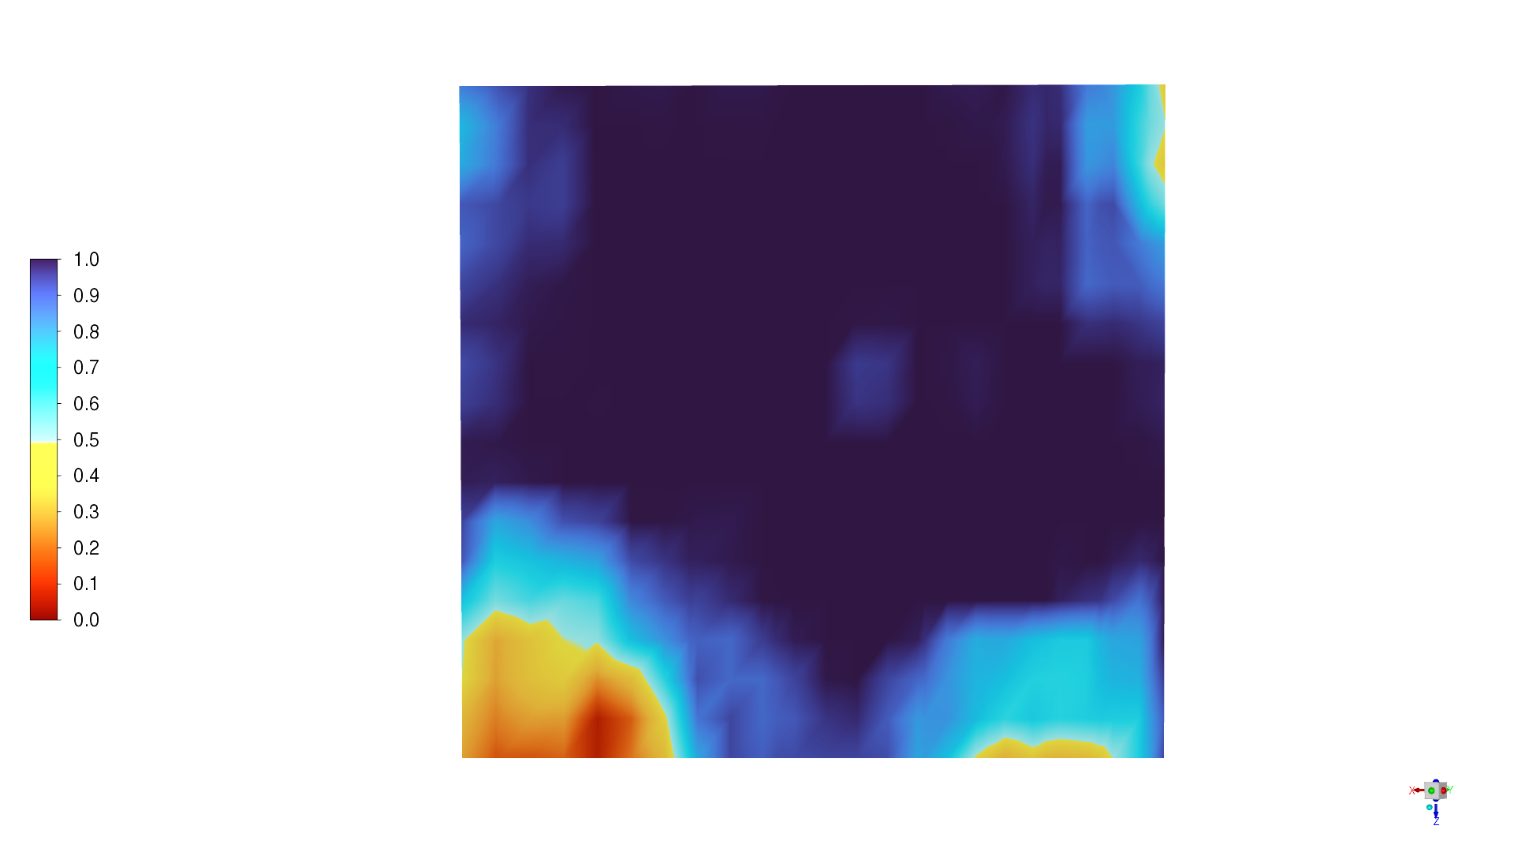
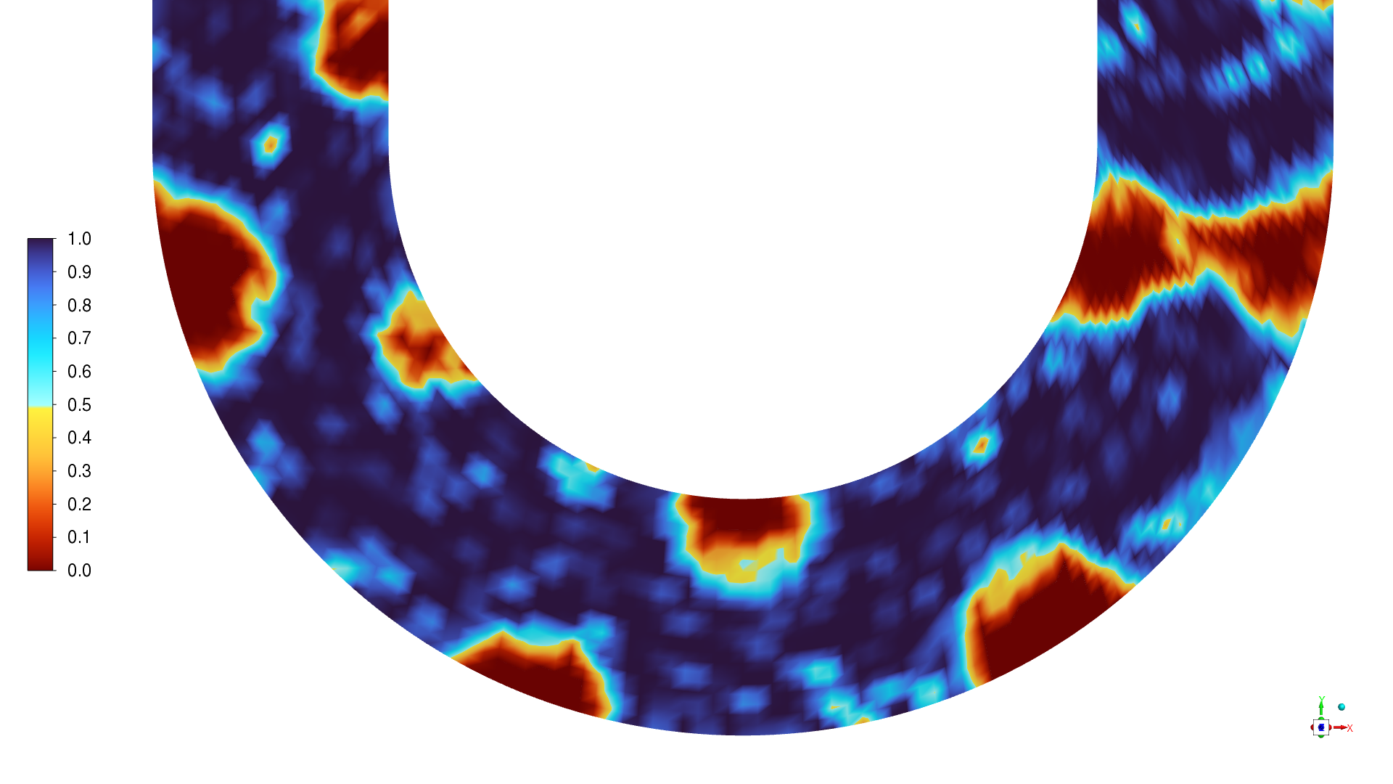
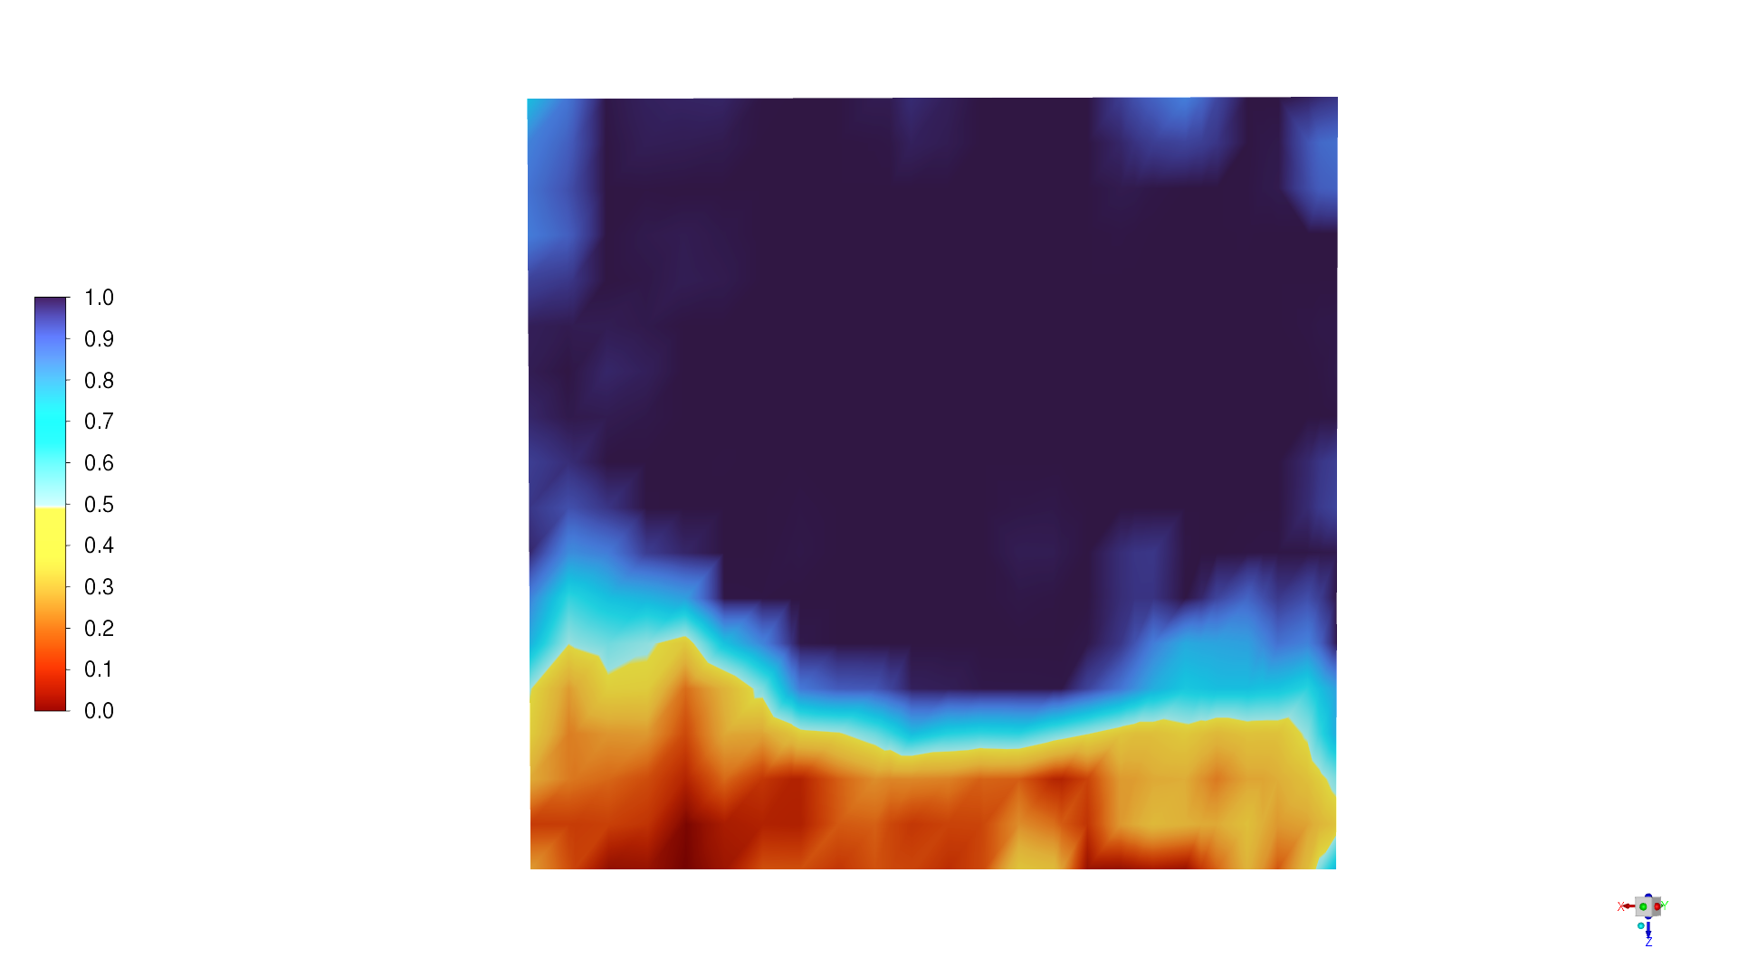
Results: Inception Stage
Bubble dynamics (Smth)
0.015 s
0.020 s
0.025 s
0.030 s
Characteristics:
Nucleation is random and unanchored, driven by stochastic superheat zones.
Bubble growth is nonuniform, causing uneven pressure wave generation.
Slugs fail to form early; instead, bubbles coalesce chaotically.
Cross-sectional vapor evolution reveals shallow penetration and unstable vapor bridges.
Delayed establishment of rhythmic plug–slug flow explains transient instability.
0.035 s

Slide 13
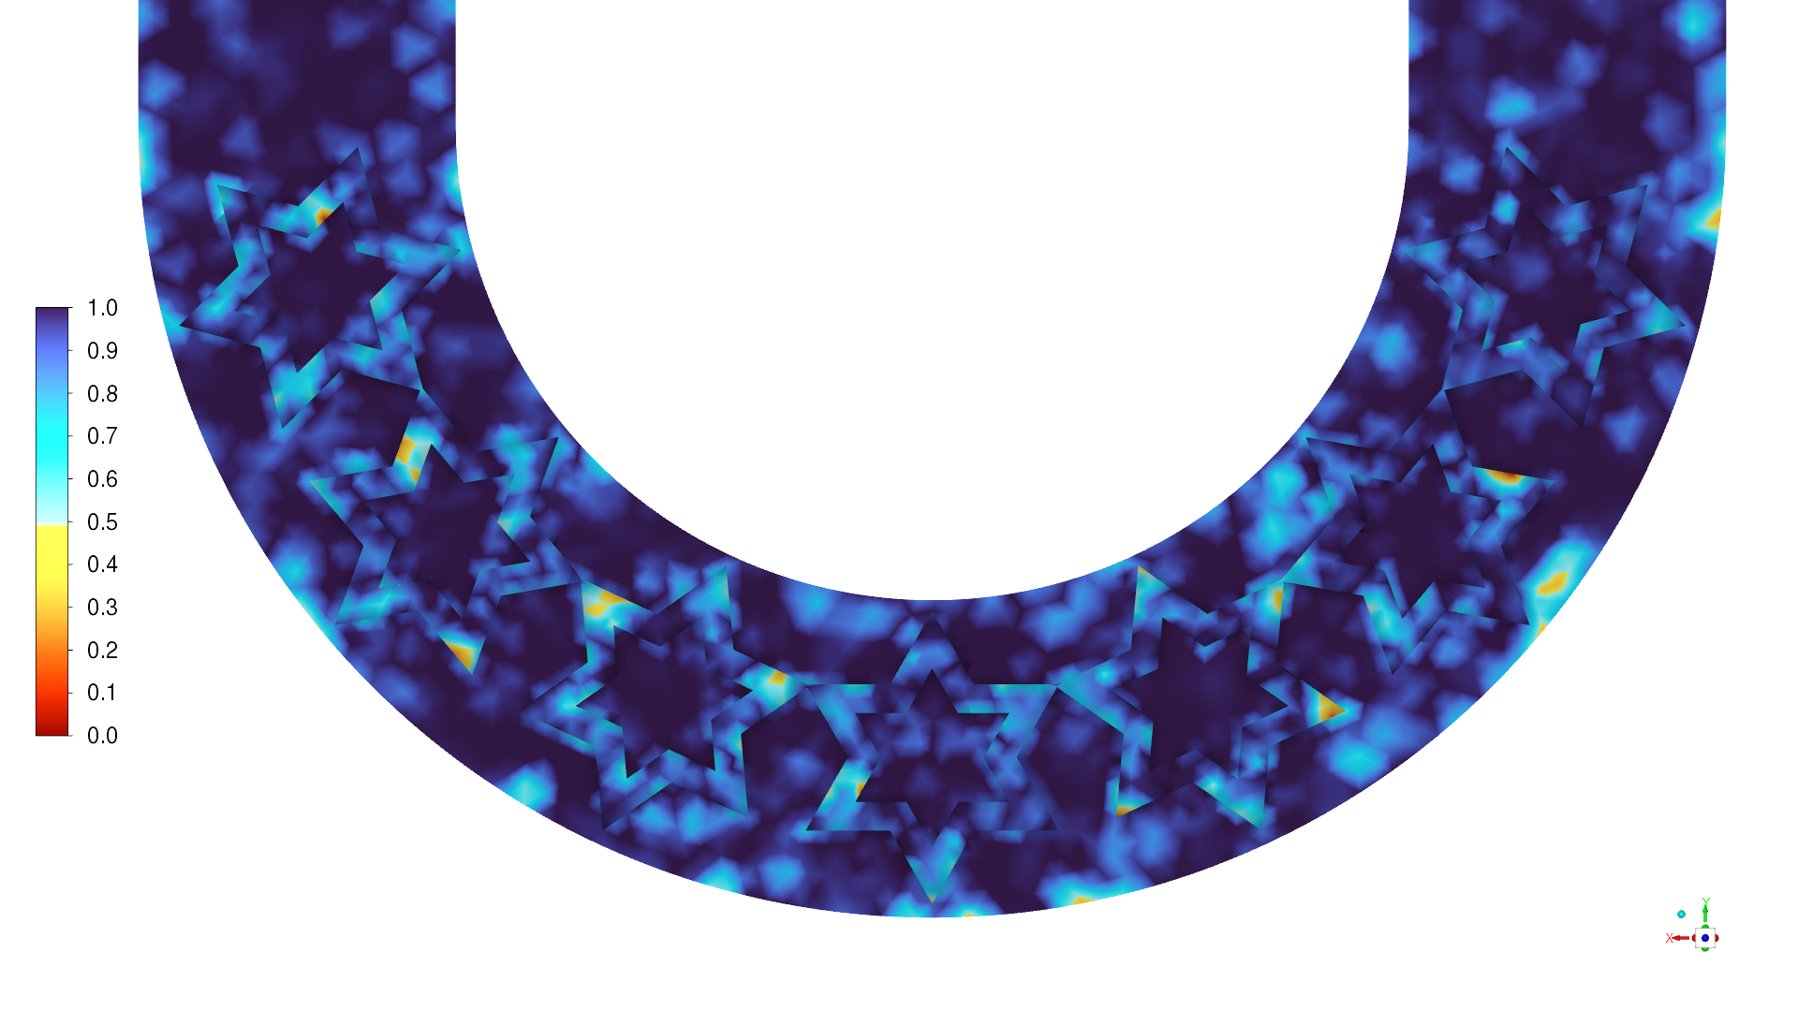
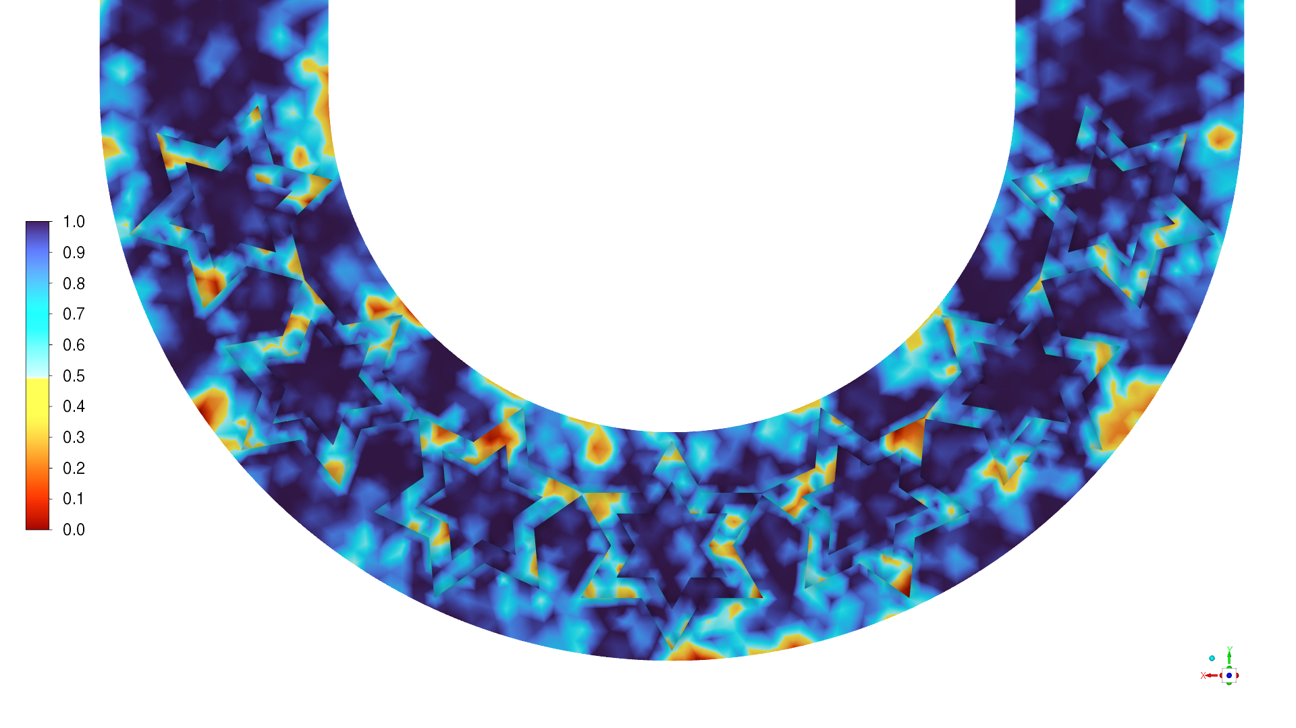
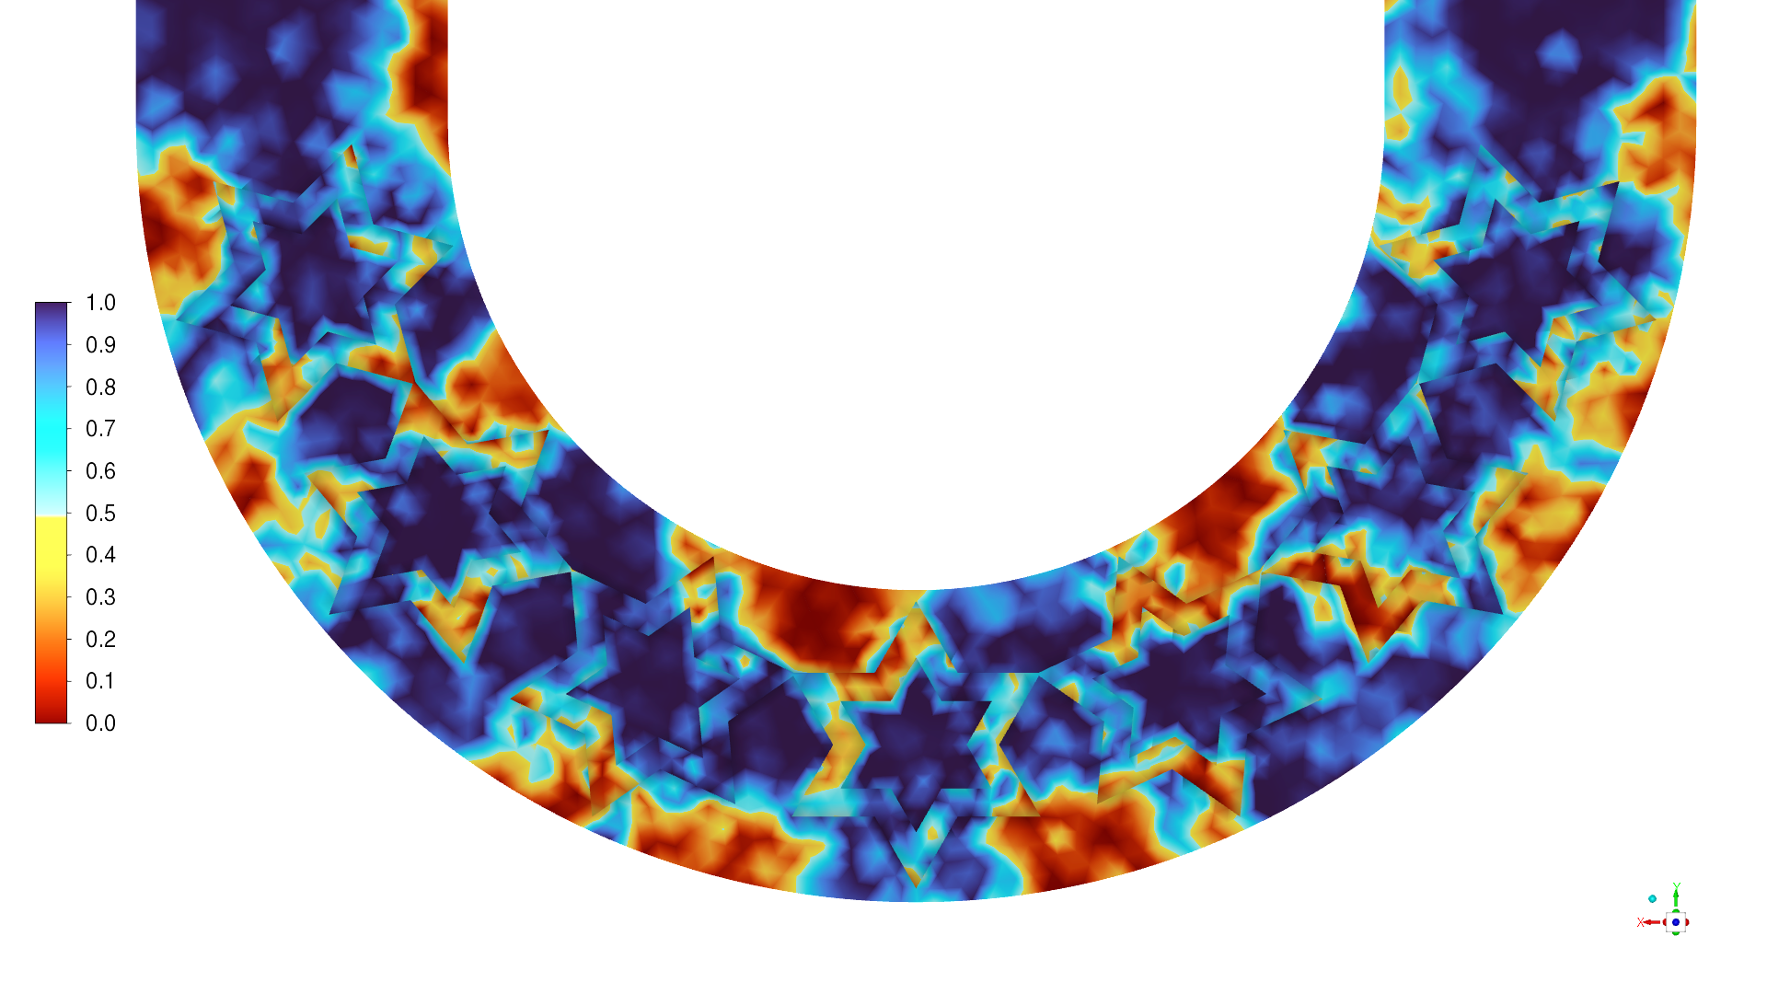
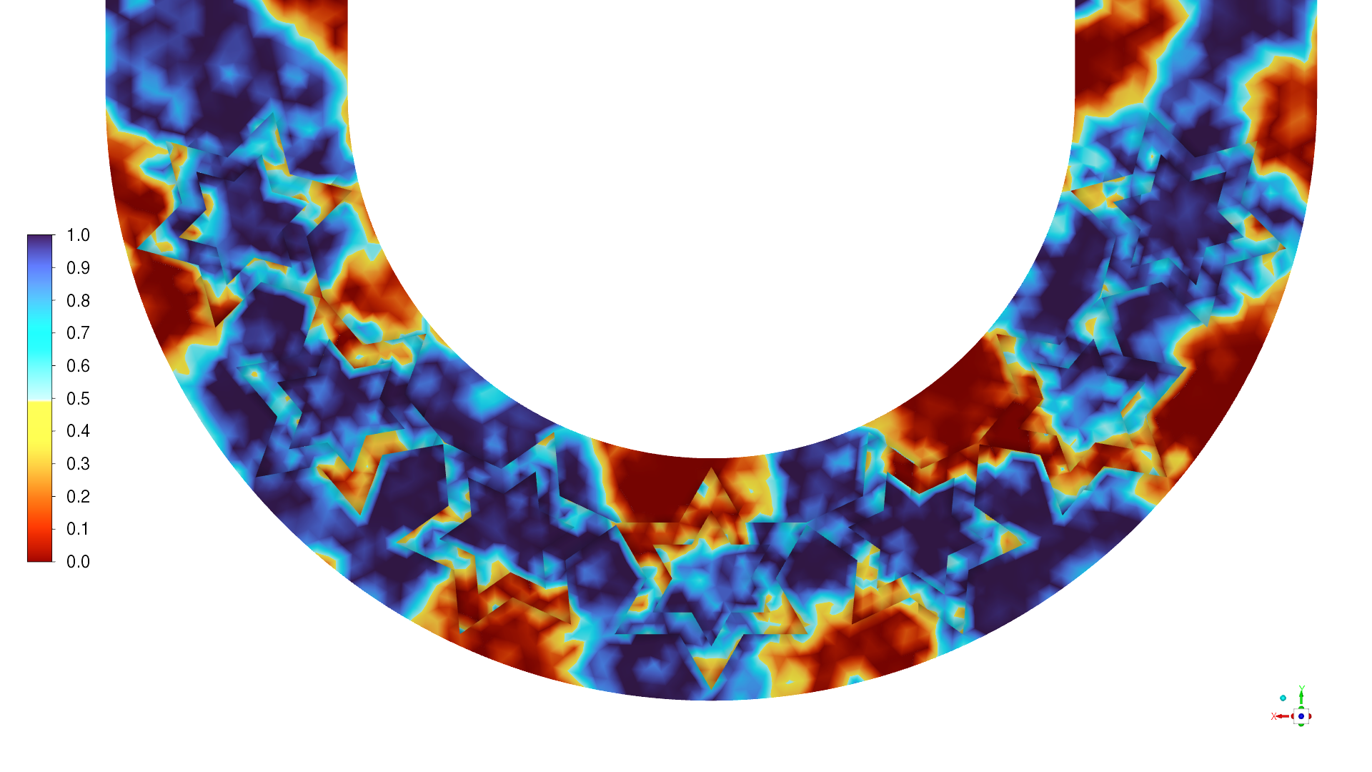
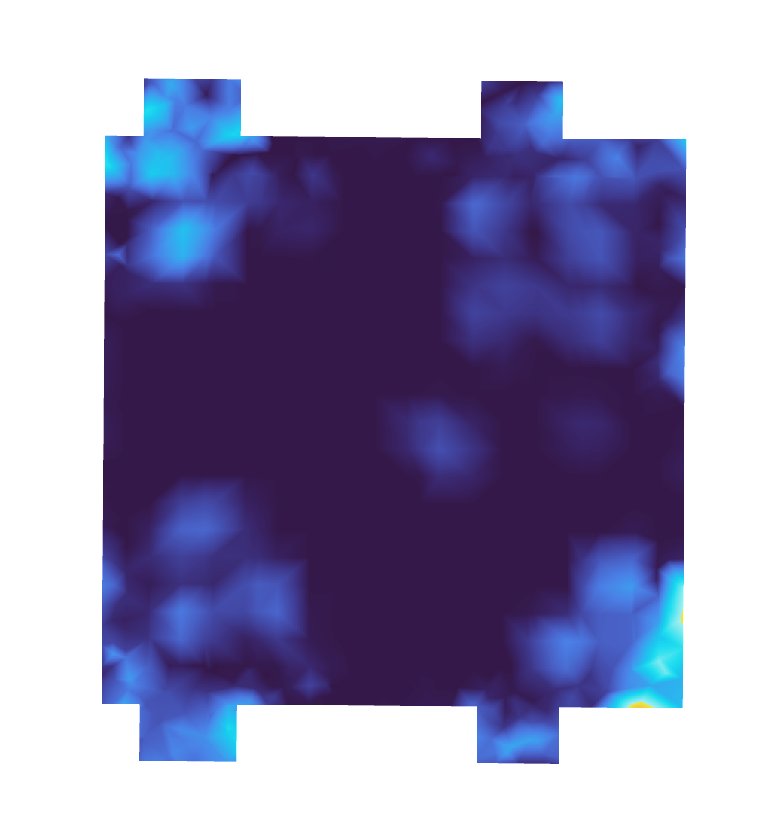
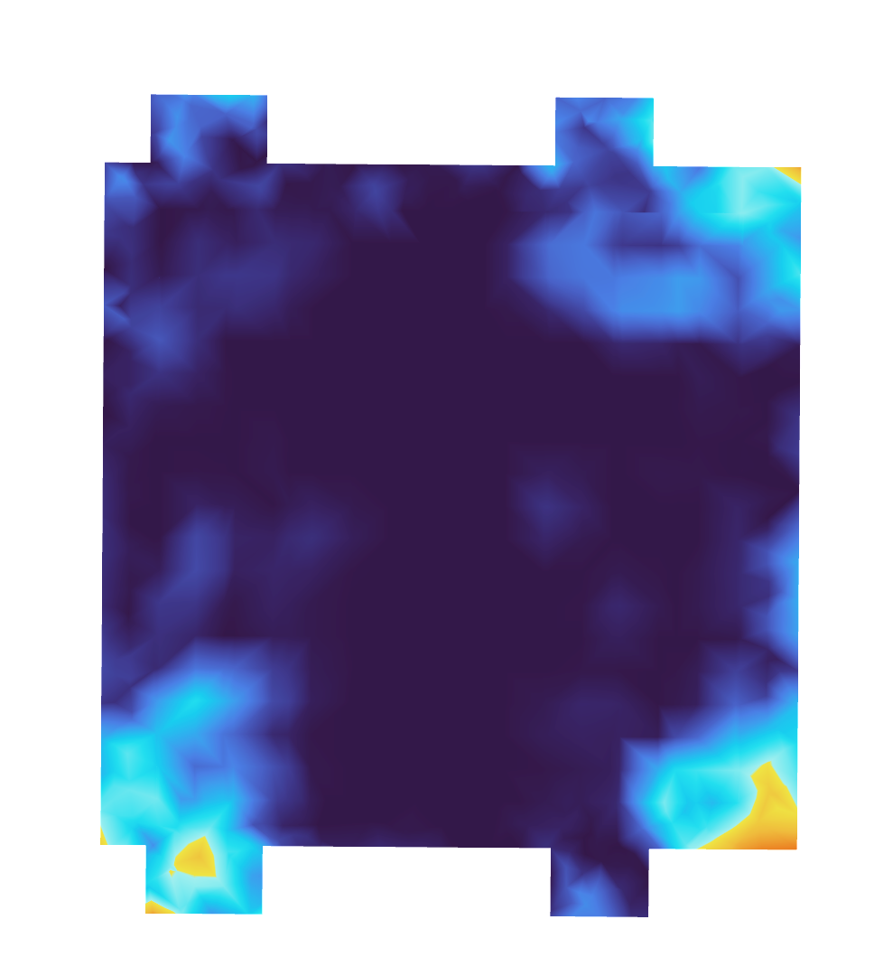
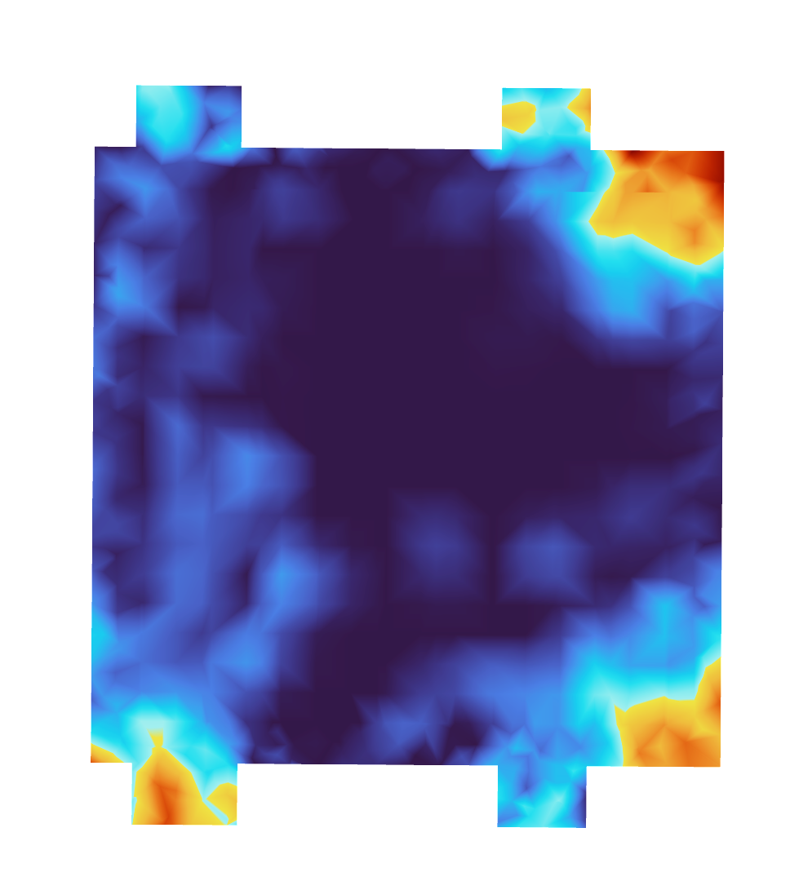
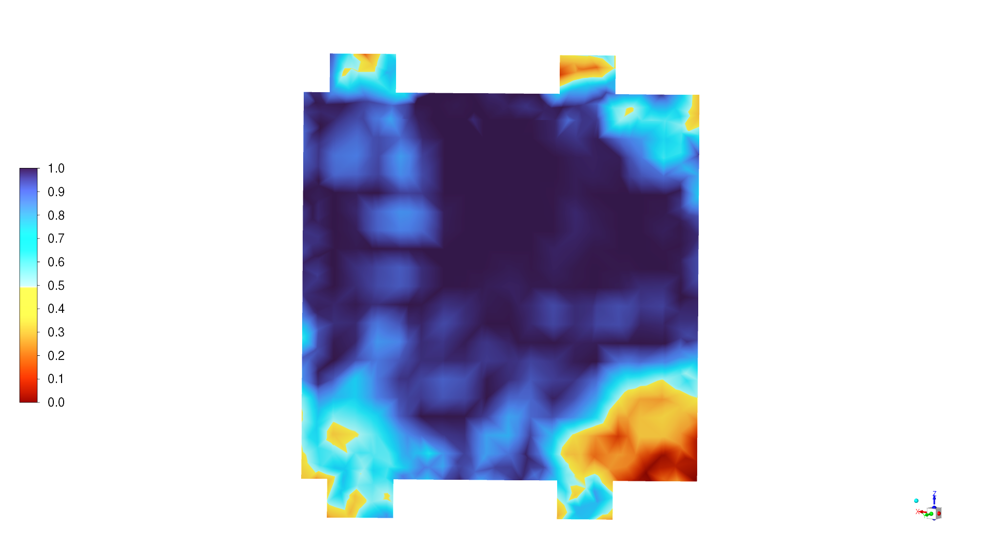
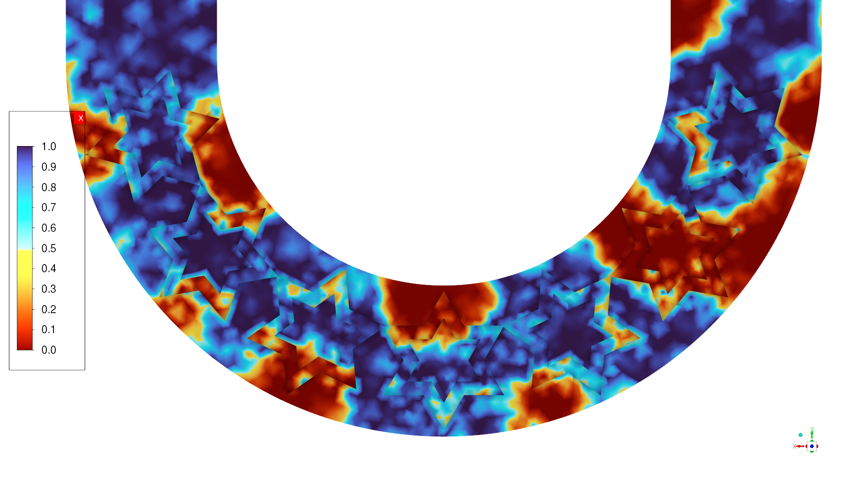
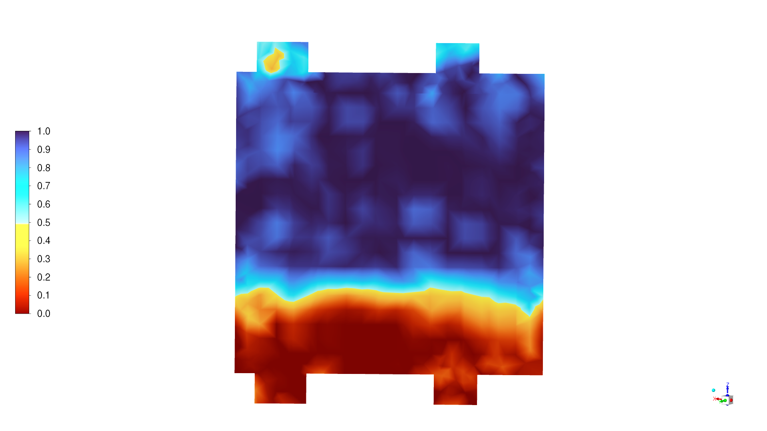
Results: Inception Stage
Bubble dynamics (Koch)
0.015 s
0.020 s
0.025 s
0.030 s
Characteristics:
Nucleation initiates at groove tips due to localized superheat.
Bubble coalescence accelerates slug formation by 0.030 s.
3D vapor evolution shows deep phase bridging across cross-section.
Surface grooves guide bubble growth and stabilize phase transitions.
Faster plug symmetry supports early thermal loop activation.
0.035 s

Slide 14
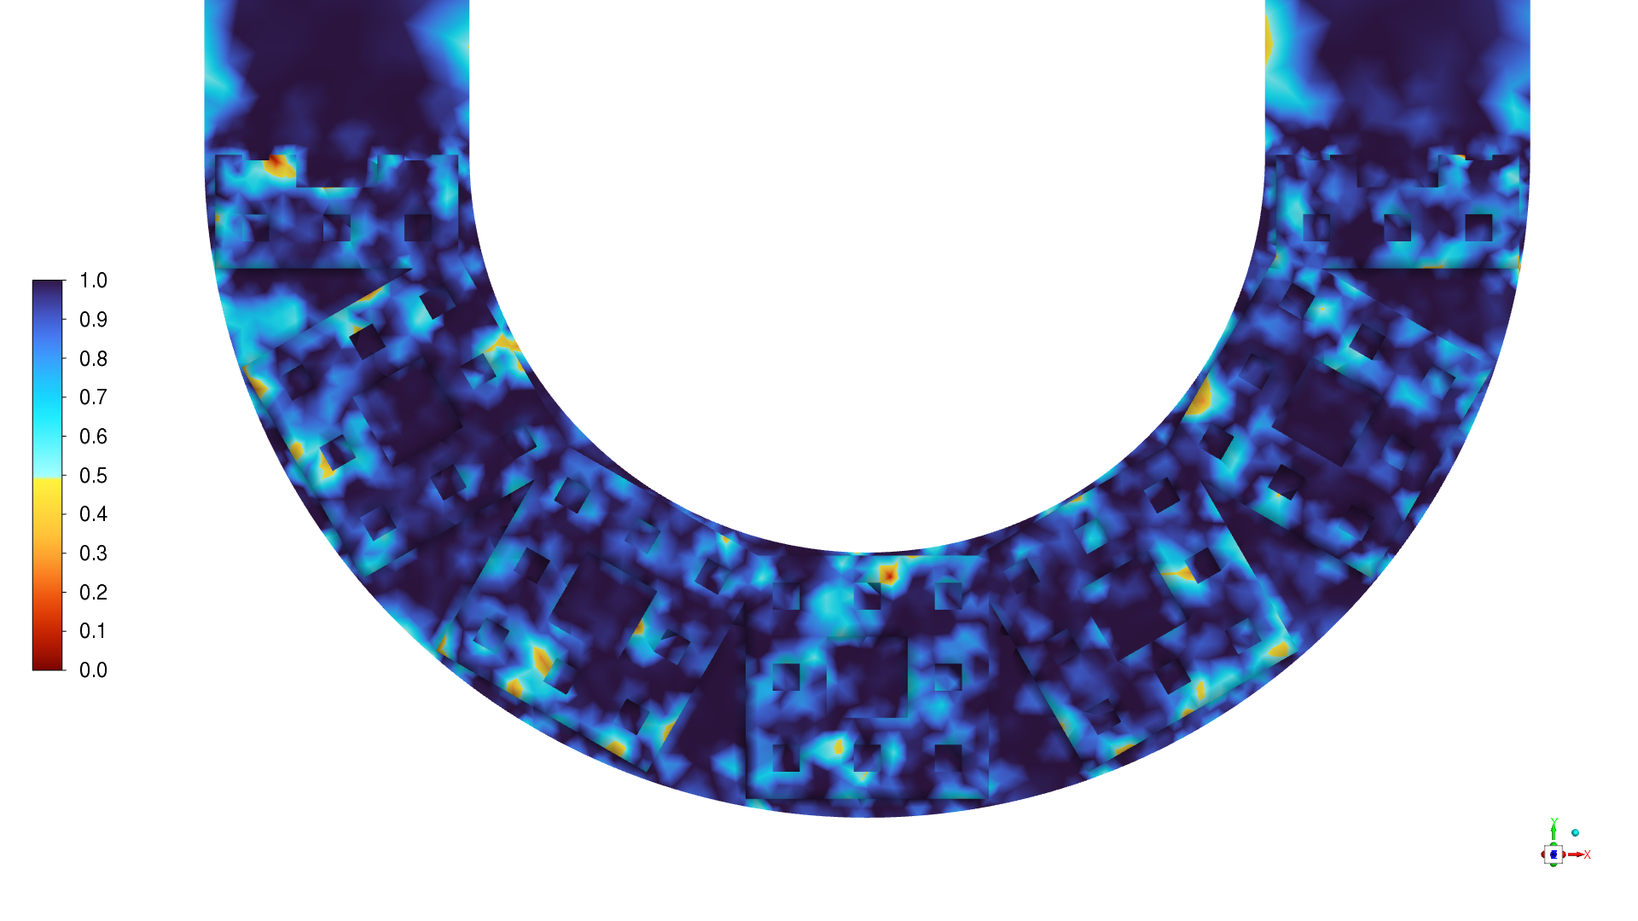
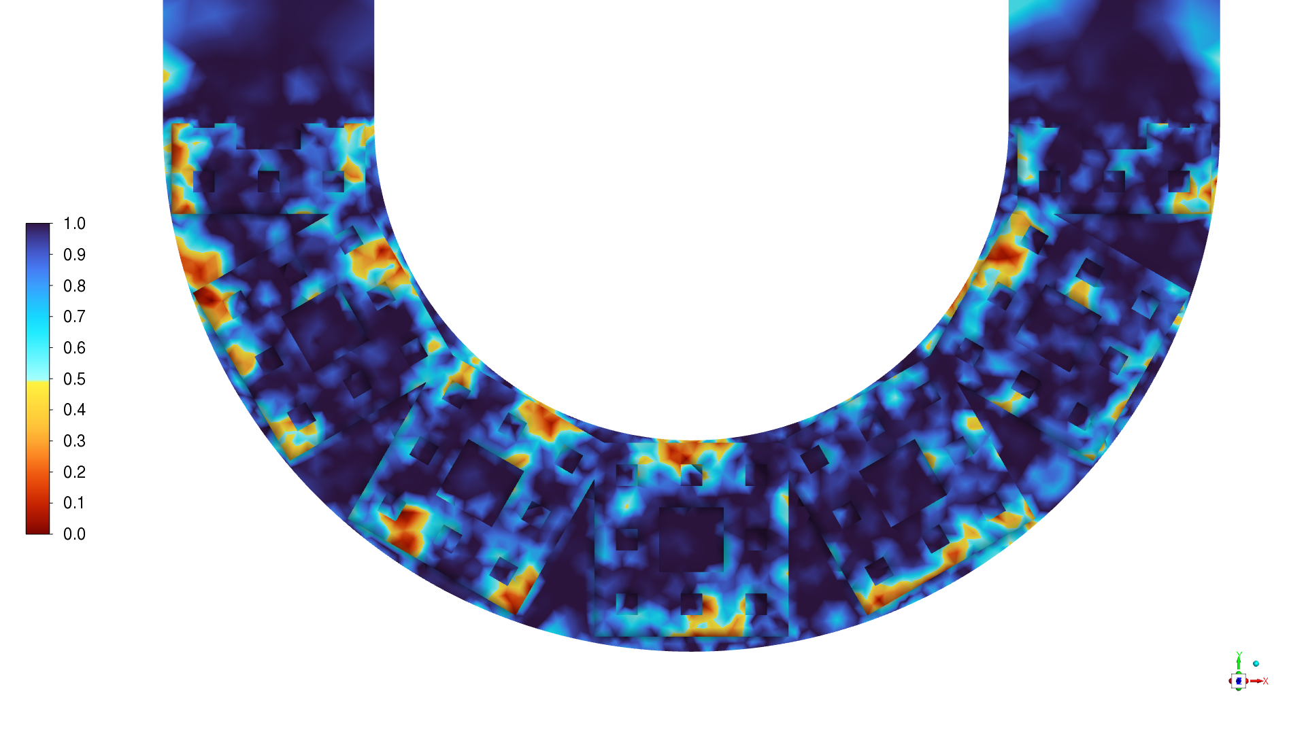
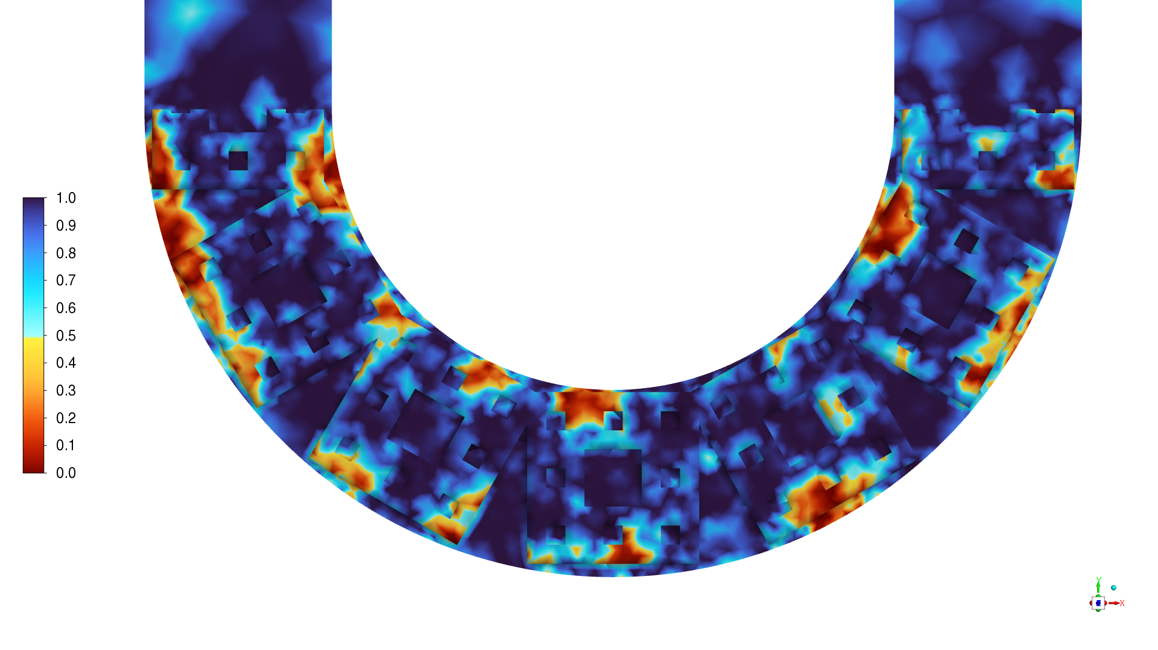
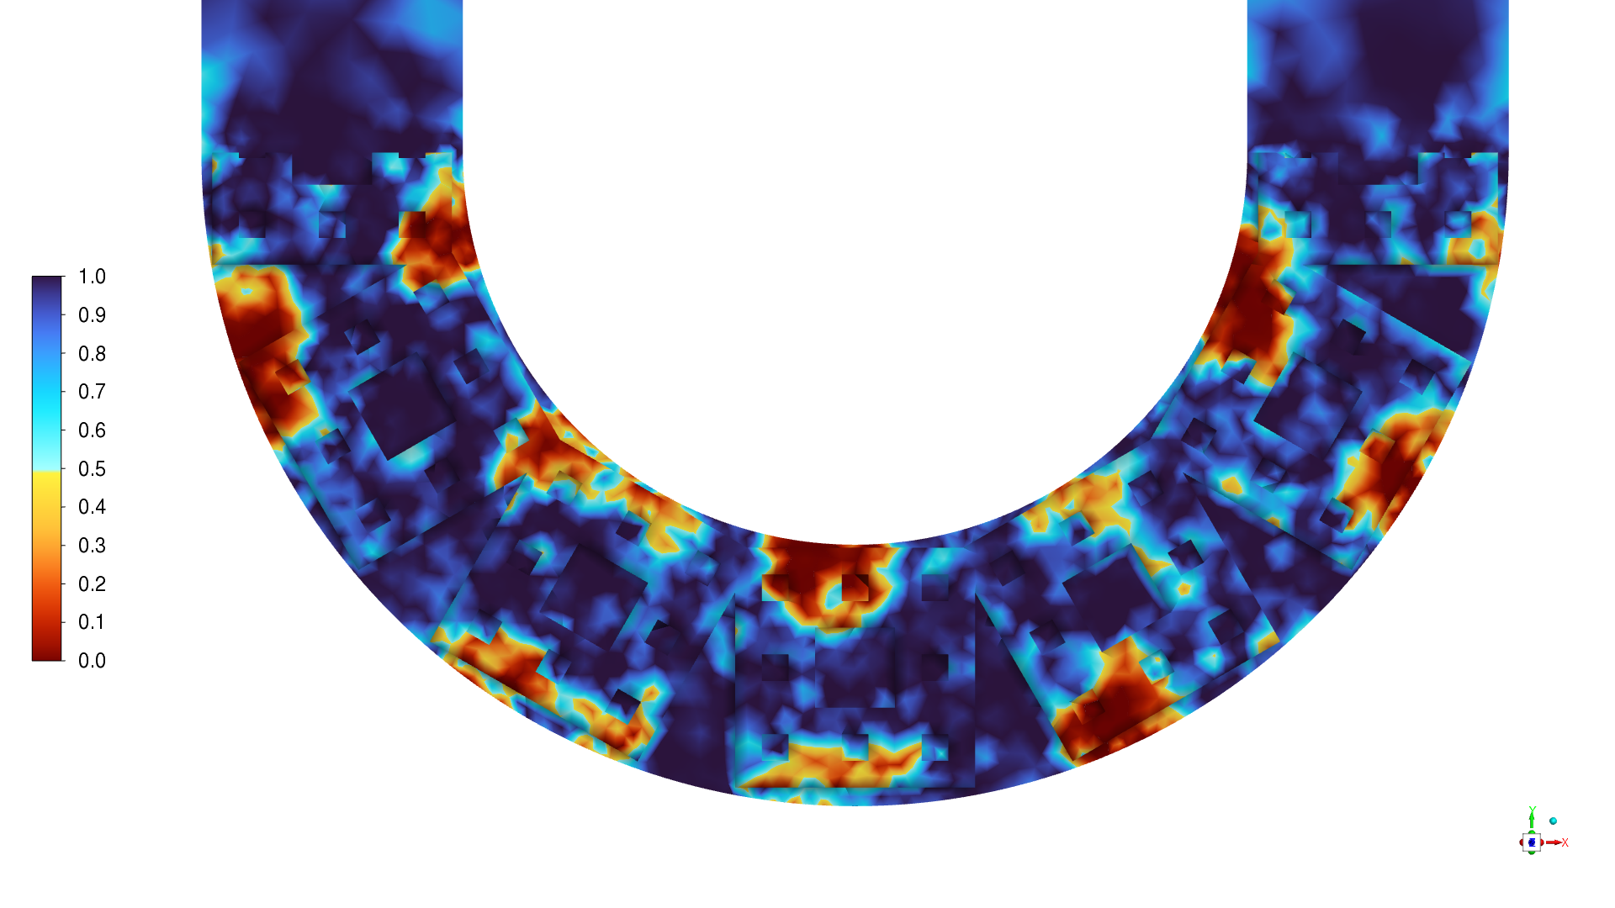
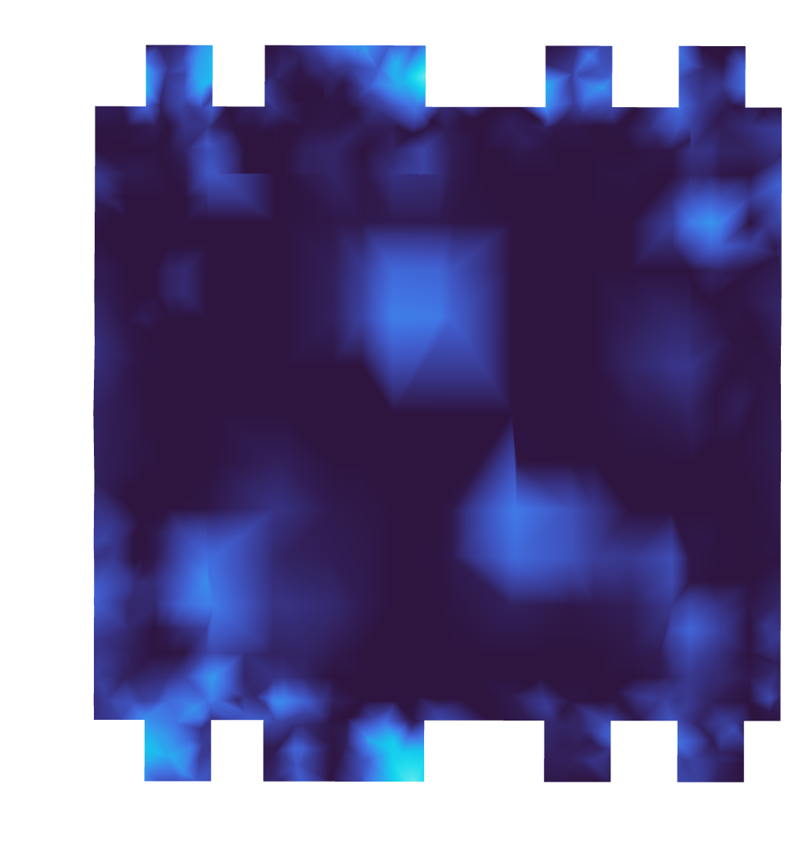
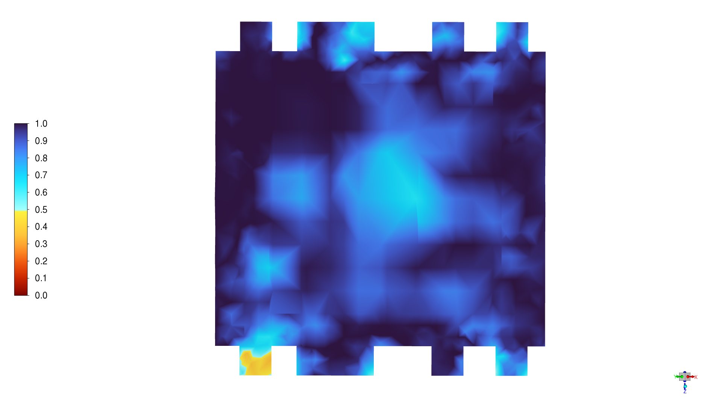




Results: Inception Stage
Bubble dynamics (Srpk)
0.015 s
0.020 s
0.025 s
0.030 s
Characteristics:
Hierarchical grooves induce rapid nucleation at corners.
Bubble clusters grow anisotropically (circumferential) and merge laterally.
Delayed plug formation (~0.035 s) with irregular vapor shape.
Cross-section shows incomplete phase bridging till late.
Strong nucleation density drives q″ but hinders vapor uniformity.
0.035 s

Slide 15





Results: Inception Stage
Droplet dynamics (Smth)
0.81 s
0.82 s
0.83 s
0.84 s
0.85 s
Characteristics:
Discrete condensation initiates at random surface sites
Droplets remain pinned—minimal sliding observed
No wetting guidance—growth limited to isolated spots
Weak droplet motion correlates with low thermal transport

Slide 16





Results: Inception Stage
Droplet dynamics (Koch)
0.22 s
0.23 s
0.24 s
0.25 s
0.26 s
Characteristics:
Koch grooves guide nucleation along patterned walls
Droplets elongate axially with rapid plug formation
Enhanced wall interaction boosts condensation rate
Structured grooves induce droplet shift and merging

Slide 17





Results: Inception Stage
Droplet dynamics (Srpk)
0.22 s
0.23 s
0.24 s
0.25 s
0.26 s
Characteristics:
Srpk nucleation aligned with self-similar wall voids
Dense square droplets show delayed plug merging
Stable coexistence of droplets and vapor films
Geometry sustains interfacial area, moderates axial flow

Slide 18



Results: Steady Stage
Wall Heat Flux
Fractals sustain high 𝑞′′ via stable phase cycling
Srpk, Koch enhance 𝑞′′ through vapor detachment, slug motion
Smth shows deeper flux dips from poor rewetting, weak coupling
Fractals narrow fluctuation bandwidth via rhythmic slug–plug flow
Loop stability achieved post 1.5 s as oscillations dampen
Median 𝑞′′ increased by ~ 8-38% for fractals
$$q^{′′}(W/{m^{2}})$$ | Smth | Koch | Srpk | Drgn | Hlbt
Mean | 51654.1 | 70173.5 | 70722.2 | 64454.7 | 66281.4
Δ (%) |  | 35.9% | 36.9% | 24.8% | 28.3%
Figure: Temporal evolution of the area-weighted wall heat flux during quasi-steady operation

Slide 19




Results: Steady Stage
Vapor Volume Fraction
Drgn, Hlbt retain more vapor via wall groove hold-up
Srpk, Koch reduce $α_{vap}$through faster condensation
Smth holds moderate vapor from sidewall-only nucleation
Fractals modulate slug–plug dynamics via vapor pocket tuning
Hlbt achieves optimal two-phase distribution across zone
Median $α_{vap}$vary between -19-28% for fractals
$$α_{vap}$$ | Smth | Koch | Srpk | Drgn | Hlbt
Mean | 0.59 | 0.54 | 0.45 | 0.67 | 0.75
Δ (%) |  | -8.4% | -23.6% | 14.9% | 27.6%
Figure: Temporal evolution of the vapor volume fraction in evaporator during quasi-steady operation

Slide 20





Results: Steady Stage
Slug/Plug Dynamics (Evaporator)
Smth
Koch
Srpk
Drgn
Hlbt

Slide 21





Results: Steady Stage
Slug/Plug Dynamics (Condenser)
Smth
Koch
Srpk
Drgn
Hlbt

Slide 22




Results: Steady Stage
Thermal Resistance
Fractals lower $R_{th}$by 20–29% via stable phase cycling
Srpk & Koch achieve lowest $R_{th}$through efficient vapor detachment
Smth shows high $R_{th}$due to poor rewetting and loop disruption
Fractals stabilize $R_{th}$via rhythmic slug–plug dynamics
Median $R_{th}$drops by ~21–28% for fractals
$$R_{th}(K/W)$$ | Smth | Koch | Srpk | Drgn | Hlbt
Mean | 0.00175 | 0.00128 | 0.00126 | 0.00137 | 0.00134
Δ (%) |  | 26.9% | 28.0% | 21.7% | 23.4%
Figure: Temporal evolution of the thermal resistance of PHPs during quasi-steady operation

Slide 23
Conclusion
Fractal wall designs significantly enhanced PHP thermal performance in both inception and steady stages
Koch and Srpk enabled early plug formation and highest wall heat flux through sharp-edged nucleation guidance
Hilbert and Dragon patterns sustained vapor hold-up and delivered balanced two-phase transport with lower fluctuations
Smooth-wall PHP lagged in nucleation and flow activation, resulting in higher thermal resistance and weaker circulation
Fractals reduced thermal resistance by ~ 28% and increased heat flux ~ 56%, driven by improved phase interaction

Slide 24
Future Research
Establish a benchtop experimental test rig to validate and extend numerical insights
Develop low-order modeling frameworks to simulate PHP dynamics with reduced computational cost
Adapt the rig for application-driven PHP development, targeting low-grade heat and passive cooling systems
Explore TPMS and bio-inspired geometries for enhanced control over phase distribution and wettability
Explore integrated design strategies for sustainable thermal management in microelectronics and building envelopes

Slide 25

Q&A Session
Dr. Zishan Akhter
zishan.akhter@tii.ae
Renewable and Sustainable Energy Research Center (RSERC)
Technology Innovation Institute (TII)
Abu Dhabi, UAE

Slide 27


Supplementary Data

Slide 28


Supplementary Data

