Slide 1

Characterization of Pulsating Heat Pipes for cooling detector planes and phased array antennas
Marcin Wójcik (KP Labs)
Artur Jurkowski (KP Labs)
Sławomir Pietrowicz (WUST)
Przemysław Kołakowski (Adaptronica)
Thermal & Fluids Analysis Workshop 2025
NASA Ames Research Center
San Jose, CA
August 4-7, 2025

Slide 2
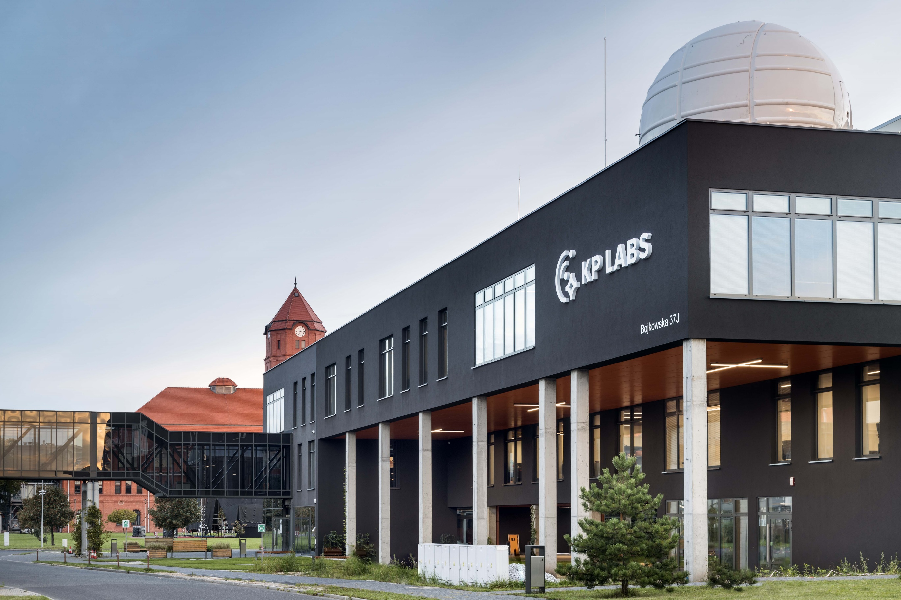





About us
Data processing electronics for space missions
Established in 2016
80+ team members
2300m² of private R&D facility
10+ missions & 35+ completed projects
Gliwice, Poland

Slide 3
Agenda
Project overview
Approach
Test campaign
Thermal results
Microvibration results
Summary

Slide 4


OUR PRODUCTS
SMART MISSION ECOSYSTEM
Project overview
MITIGATE

Slide 5

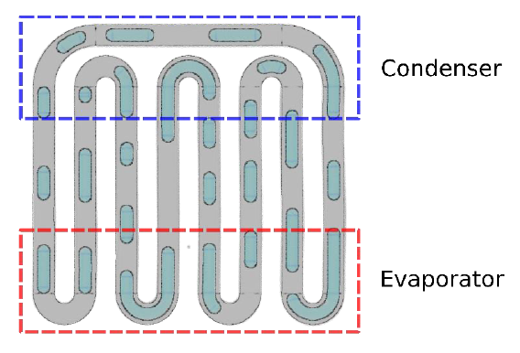
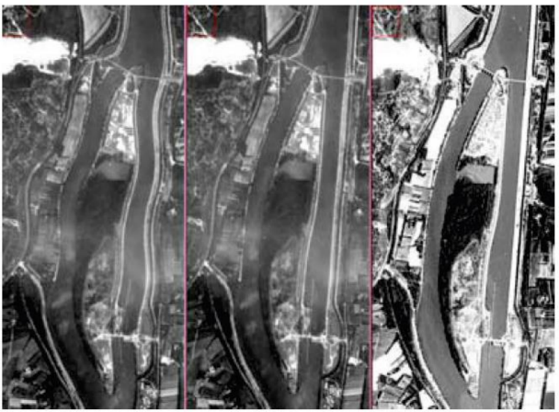
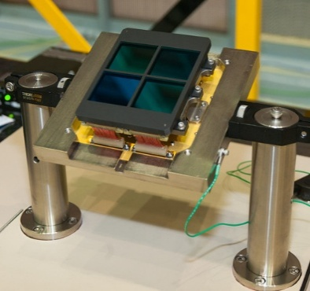
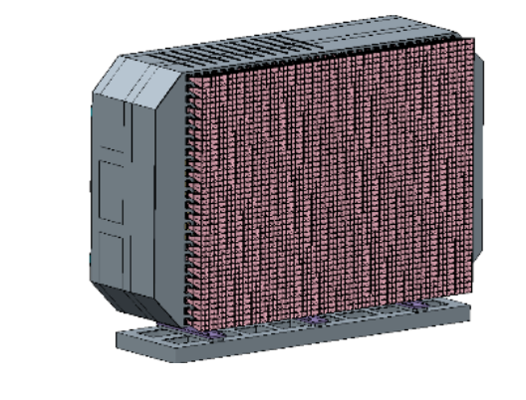
Motivation
MITIGATE project - Micro-g dIsturbance characTerizatIon and mitiGAtion in pulsaTing hEat pipes
This project is carried out for the European Space Agency as a part of TDE programme.
Project objectives
Manufacturing a set of PHP breadboards with various design features
Thermal characterization of breadboards
Characterization of microvibration disturbances
Consortium
KP Labs
Wrocław University of Science and Technology
Adaptronica
Research hypothesis
Potential applications
Detector plane cooling
Phased array antenna
Wang, Y. et al. 2020
NASA
ESA

Slide 6
OUR PRODUCTS
SMART MISSION ECOSYSTEM
Our approach
MITIGATE

Slide 7
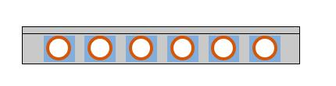
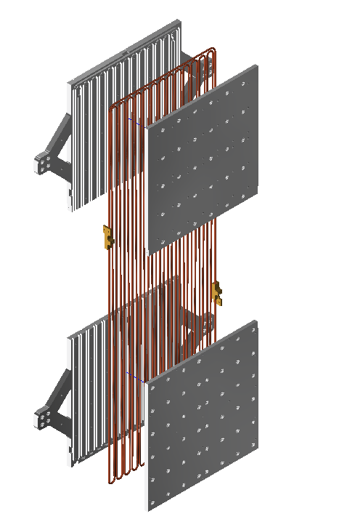
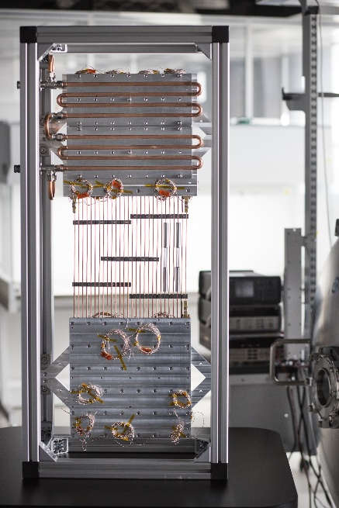
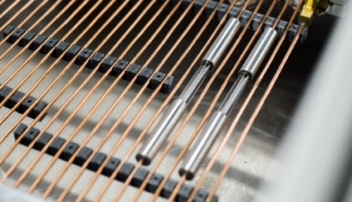
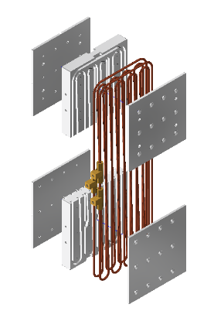
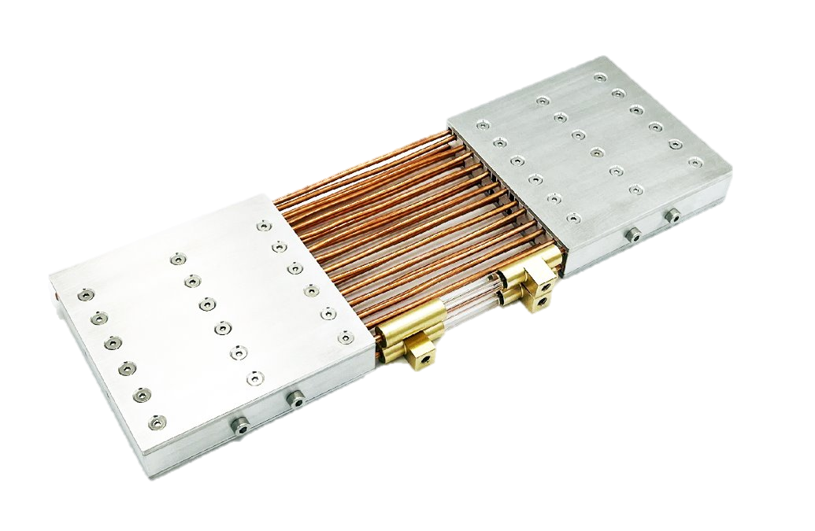
Breadboards
Large breadboards
Technology baseline
900x300mm (35.4x11.8 in)
Power transported: 200 W
Operational temperature -20°C to 65 °C (-4°F to 149°F)
1 row of loops
Aluminum cover
Tubular PHP
manufacturing simplicity
scalability
experience
Sandwich structure
Transparent section
Working fluid: methanol/acetone
Coper tubes
Interface material
Aluminum block
Small breadboards
300x100mm (11.8x3.8 in)
Power transported: 30 W
Operational temperature -20°C to 45°C (-4°F to 113°F)
2 rows of loops

Slide 8
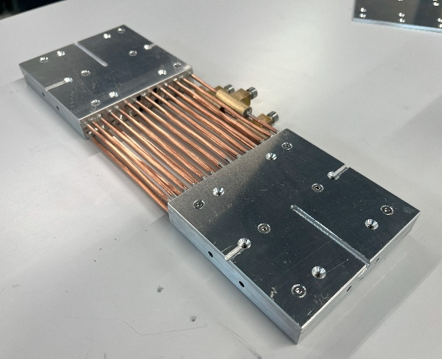
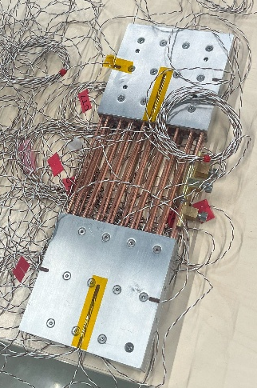
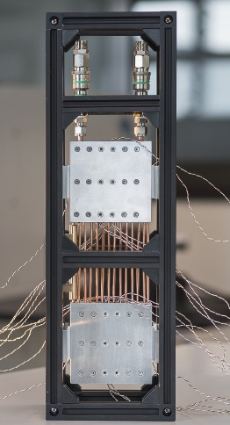
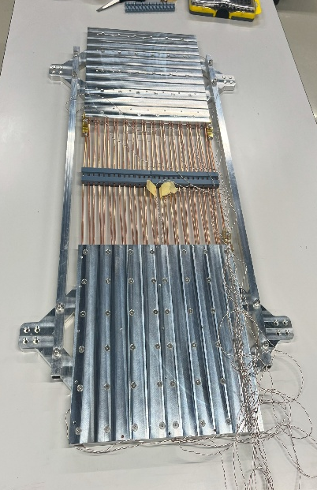
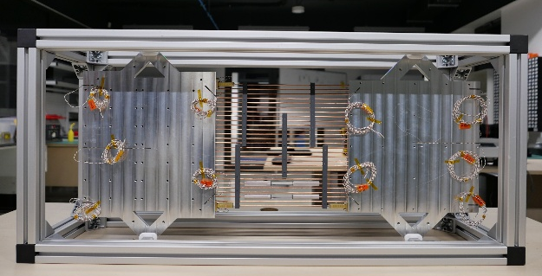
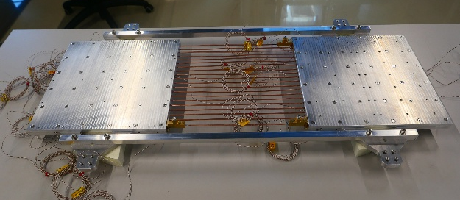
Breadboard versions
Design features
Internal diameter: 1.5 mm vs 2.5 mm
Number of turns: 10 vs 14 turns
Working fluid: methanol vs acetone
Interface: epoxy vs soldering
Study of the impact on performance
Breadboards | size​ | Internal diameter​ | Number of​ loops​ | Working ​ fluid​ | Interface​
CHBB_L1_M​ | Large​ | 1.5​ | 14​ | Methanol ​ | Epoxy
CHBB_L1_A​ | Large​ | 1.5​ | 14​ | Acetone​ | Epoxy​
CHBB_L2_M​ | Large​ | 1.5​ | 10​ | Methanol ​ | Epoxy
CHBB_L3_M​ | Large​ | 2.5​ | 14​ | Methanol ​ | Epoxy
CHBB_L3_A​ | Large​ | 2.5​ | 14​ | Acetone​ | Epoxy
CHBB_S1_M​ | Small​ | 1.5​ | 14​ | Methanol ​ | Epoxy
CHBB_S2_M​ | Small​ | 1.5​ | 10​ | Methanol ​ | Epoxy
CHBB_S3_M​ | Small​ | 1.5​ | 14​ | Methanol ​ | Soldered​
CHBB_S3_A​ | Small​ | 1.5​ | 14​ | Acetone​ | Soldered​

Slide 9
OUR PRODUCTS
SMART MISSION ECOSYSTEM
Test campaign
MITIGATE

Slide 10
Test campaign
Condenser temperatures
Power levels
Filling ratio optimization test
Horizontal Orientation
FR From 10% to 80%
SMALL
45˚C (113˚F)
10/20/30 W
LARGE
65˚C (149˚F)
100/200 W
SMALL
-20/10/30/45 ˚C (-4/50/86/113 ˚F)
10/20/30 W
Thermal performance test
Horizontal Orientation/Vertical (BHM&THM)
Optimal FR
LARGE
-20/10/30/50/65˚C (-4/50/86/122/149 ˚F)
100/150/200 W
30/45 ˚C
(86/113 ˚F)
Hor: 10/20/30 W
BHM/THM: 30W
Microvibration test
Horizontal Orientation/Vertical (BHM&THM)
Optimal FR
SMALL
LARGE
30/50 ˚C
(86/122 ˚F)
Hor: 100/150/200 W
BHM/THM: 200W

Slide 11
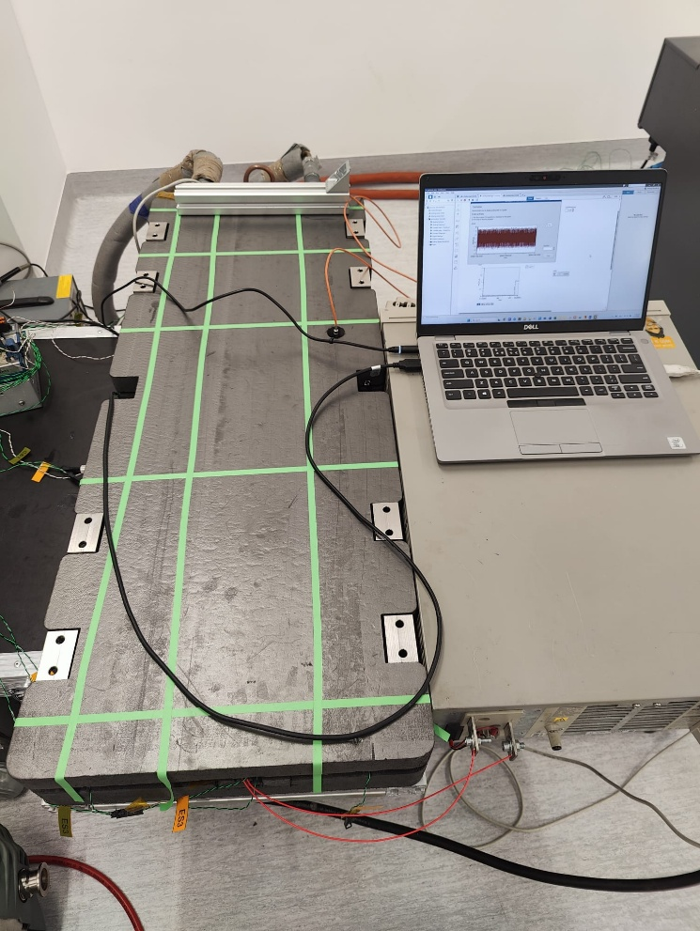
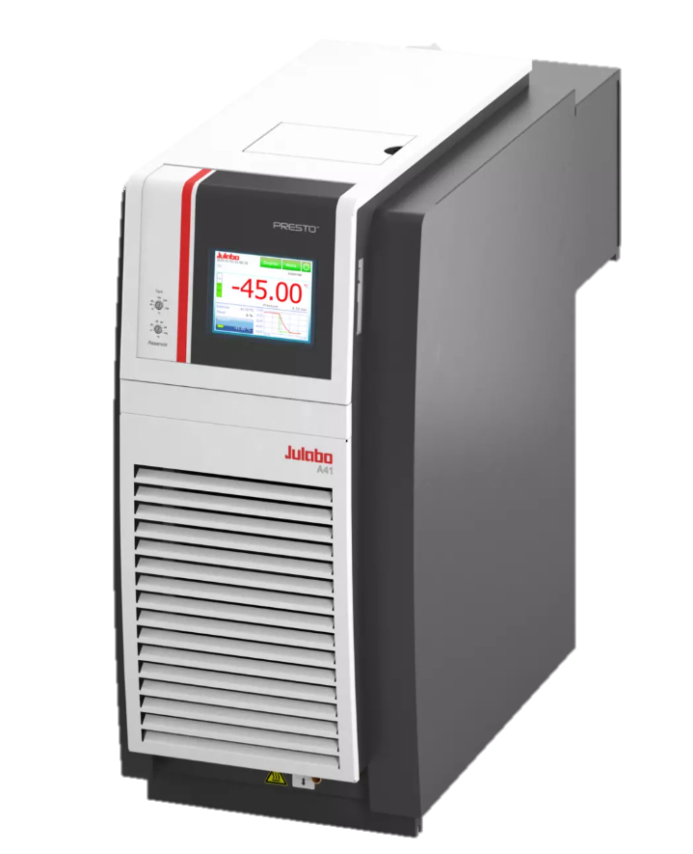
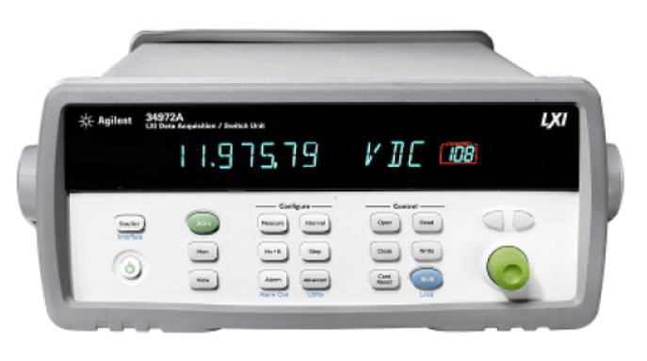
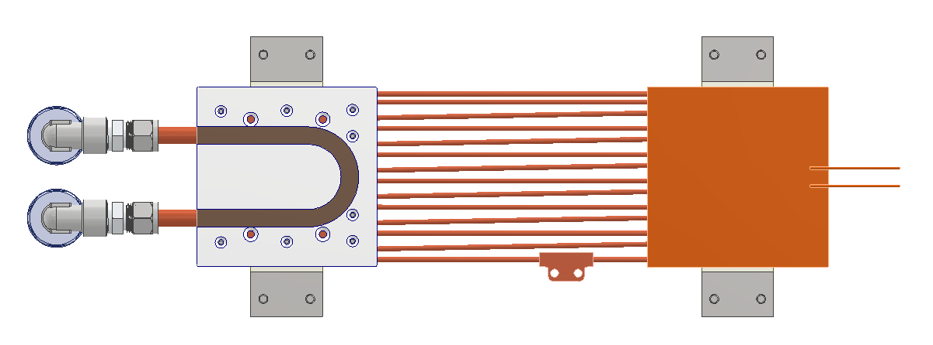
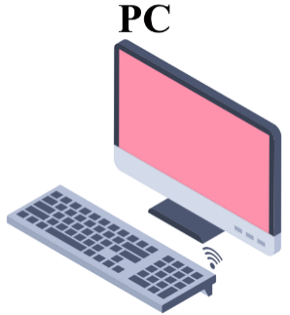
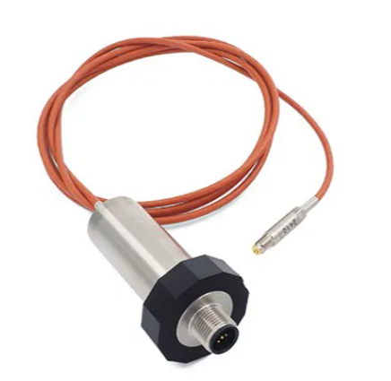
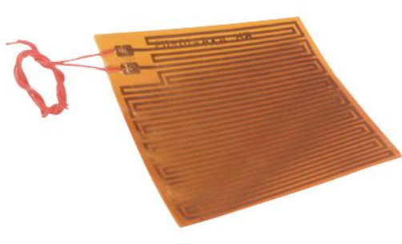
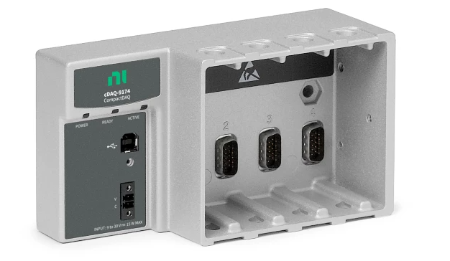
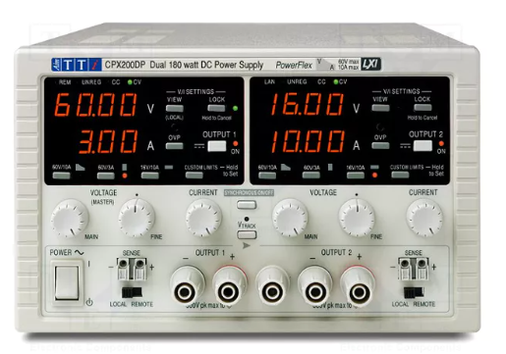
Thermal test stand
Chiller
DAQ
Pressure sensor
Kapton heater
DAQ
Power supply
+
-

Slide 12
OUR PRODUCTS
SMART MISSION ECOSYSTEM
Results
MITIGATE

Slide 13
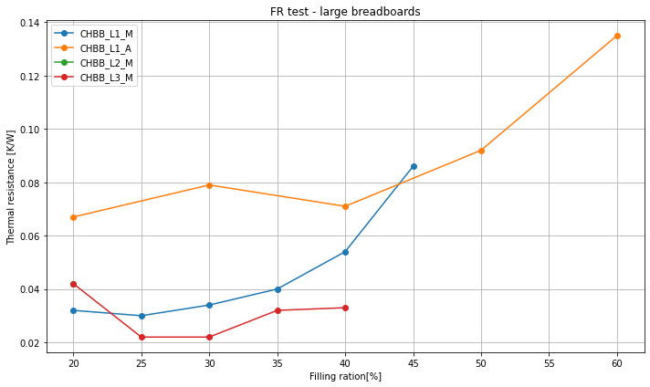
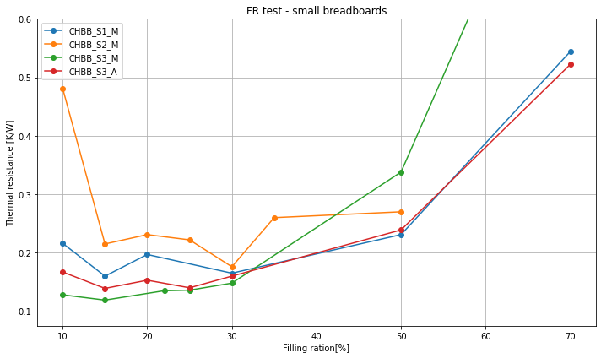
Filling ratio test
Optimal FR selected based on
the performance across all tested power levels
operation stability
in case of similar performance, the higher FR was selected
Obtained very low filling ratios for all small and large breadboards
Promising thermal performance
Results
Breadboards | Optimal Filling ratio
CHBB_L1_M​ | 30%
CHBB_L1_A​ | -
CHBB_L2_M​ | 20%
CHBB_L3_M​ | 30%​
CHBB_L3_A​ | 25%
CHBB_S1_M​ | 15%
CHBB_S2_M​ | 30%
CHBB_S3_M​ | 15%
CHBB_S3_A​ | 15%

Slide 14
Thermal performance
Performance @max power: 200W / 30W Thermal resistance [˚C/W]
BB | Design parameter | -20˚C (-4˚F) | 10˚C (50˚F) | 30˚C (86˚F) | 50˚C (122˚F) | 45 / 65˚C (113/149˚F)
Working fluid
CHBB_L3_M | Methanol | N/A | 0.077 | 0.033 | 0.027 | 0.025
CHBB_L3_A | Acetone | - | N/A | N/A | 0.066 | 0.027
CHBB_S3_M | Methanol | N/A | 0.315 | 0.152 | - | 0.123
CHBB_S3_A | Acetone | 1.540 | 0.212 | 0.183 | - | 0.164
For large breadboards methanol exhibited better performance by
achieving lower thermal resistance
wider operational temperature range
For smaller breadboard acetone gave worse thermal resistance, but it operated in wider temperature range.
TURNS
The 14-loop configuration demonstrated better thermal performance in all tested orientations.
CHBB_S1_M | 14 turns | N/A | 0.467 | 0.172 | - | 0.15
CHBB_S2_M | 10 turns | N/A | 0.436 | 0.199 | - | 0.174
DIAMETER
CHBB_L3_M | 2.5 mm | N/A | 0.077 | 0.033 | 0.027 | 0.025
CHBB_L1_M | 1.5 mm | - | - | N/A | 0.039 | 0.034
Wider operational temperature range for larger diameter
INTERFACE
CHBB_S1_M | Epoxy | N/A | 0.467 | 0.172 | - | 0.15
CHBB_S3_M | Soldered | N/A | 0.315 | 0.152 | - | 0.123
The soldered solution exhibited a reduced thermal resistance.
– not tested
N/A overheating

Slide 15
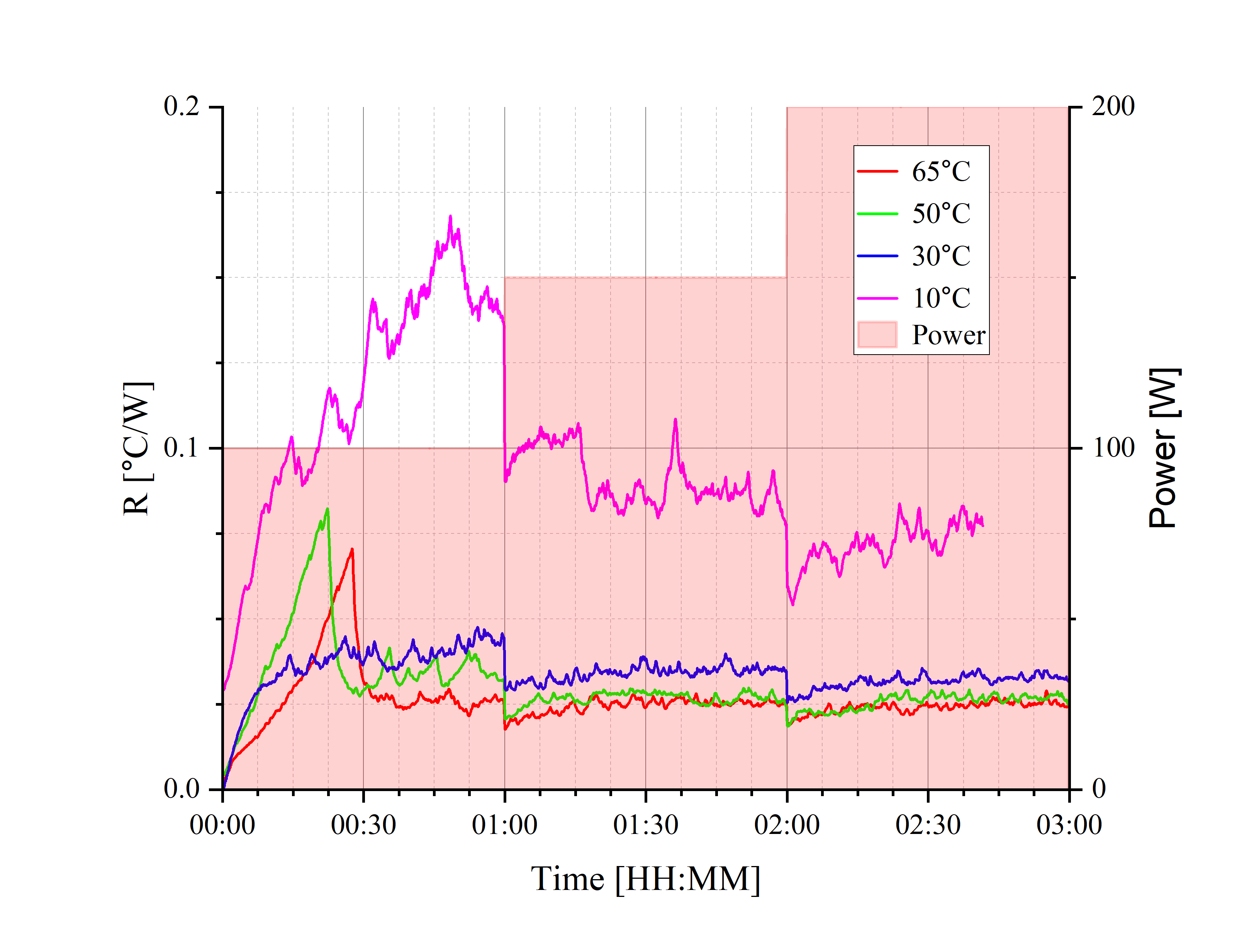
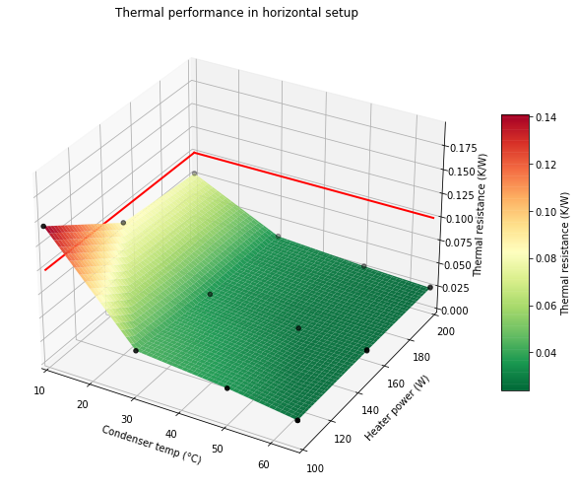
Thermal performance
CHBB_L3_M: large, 14 loops, 2.5 mm internal diameter, methanol
Horizontal:
The best performance was achieved at 65˚C (149˚F). Breadboard transported 200 W with 5˚C difference between evaporator and condenser
Operational temperature range:
At temperatures above the 30˚C (86˚F), breadboard exhibited stable operation
At 10˚C (50˚F) operation with higher thermal resistance
At -20˚C (-4˚F) breadboard did not start up
BHM
Worse thermal performance achieved
THM
Breadboard started up only at 50˚C (122 ˚F) when oriented against gravity
Thermal performance in horizontal setup
1
2
Thermal resistance ˚C/W
Mode | Orientation | Horizontal |  |  | BHM | THM
 | Heater power | 200W | 150W | 100W | 200W | 200W
Step-up | 65˚C (149 ˚F) | 0.025 | 0.025 | 0.025 | N/A | N/A
 | 50˚C (122 ˚F) | 0.027 | 0.027 | 0.035 | 0.034 | 0.231
 | 30˚C (86 ˚F) | 0.033 | 0.035 | 0.044 | 0.037 | N/A
 | 10˚C (50 ˚F) | 0.077 | 0.085 | 0.145 | 0.046 | N/A
 | -20˚C (-4 ˚F) | N/A | N/A | N/A | N/A | N/A

Slide 16
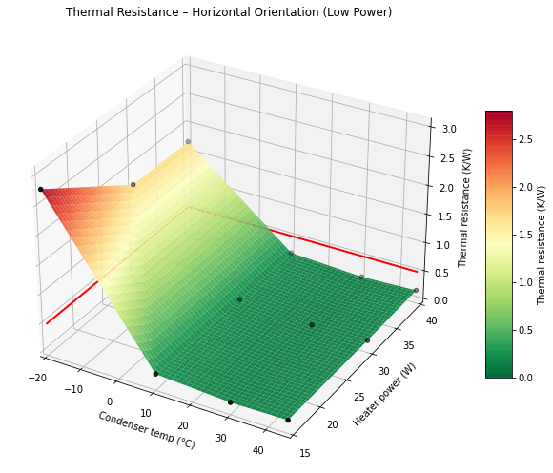
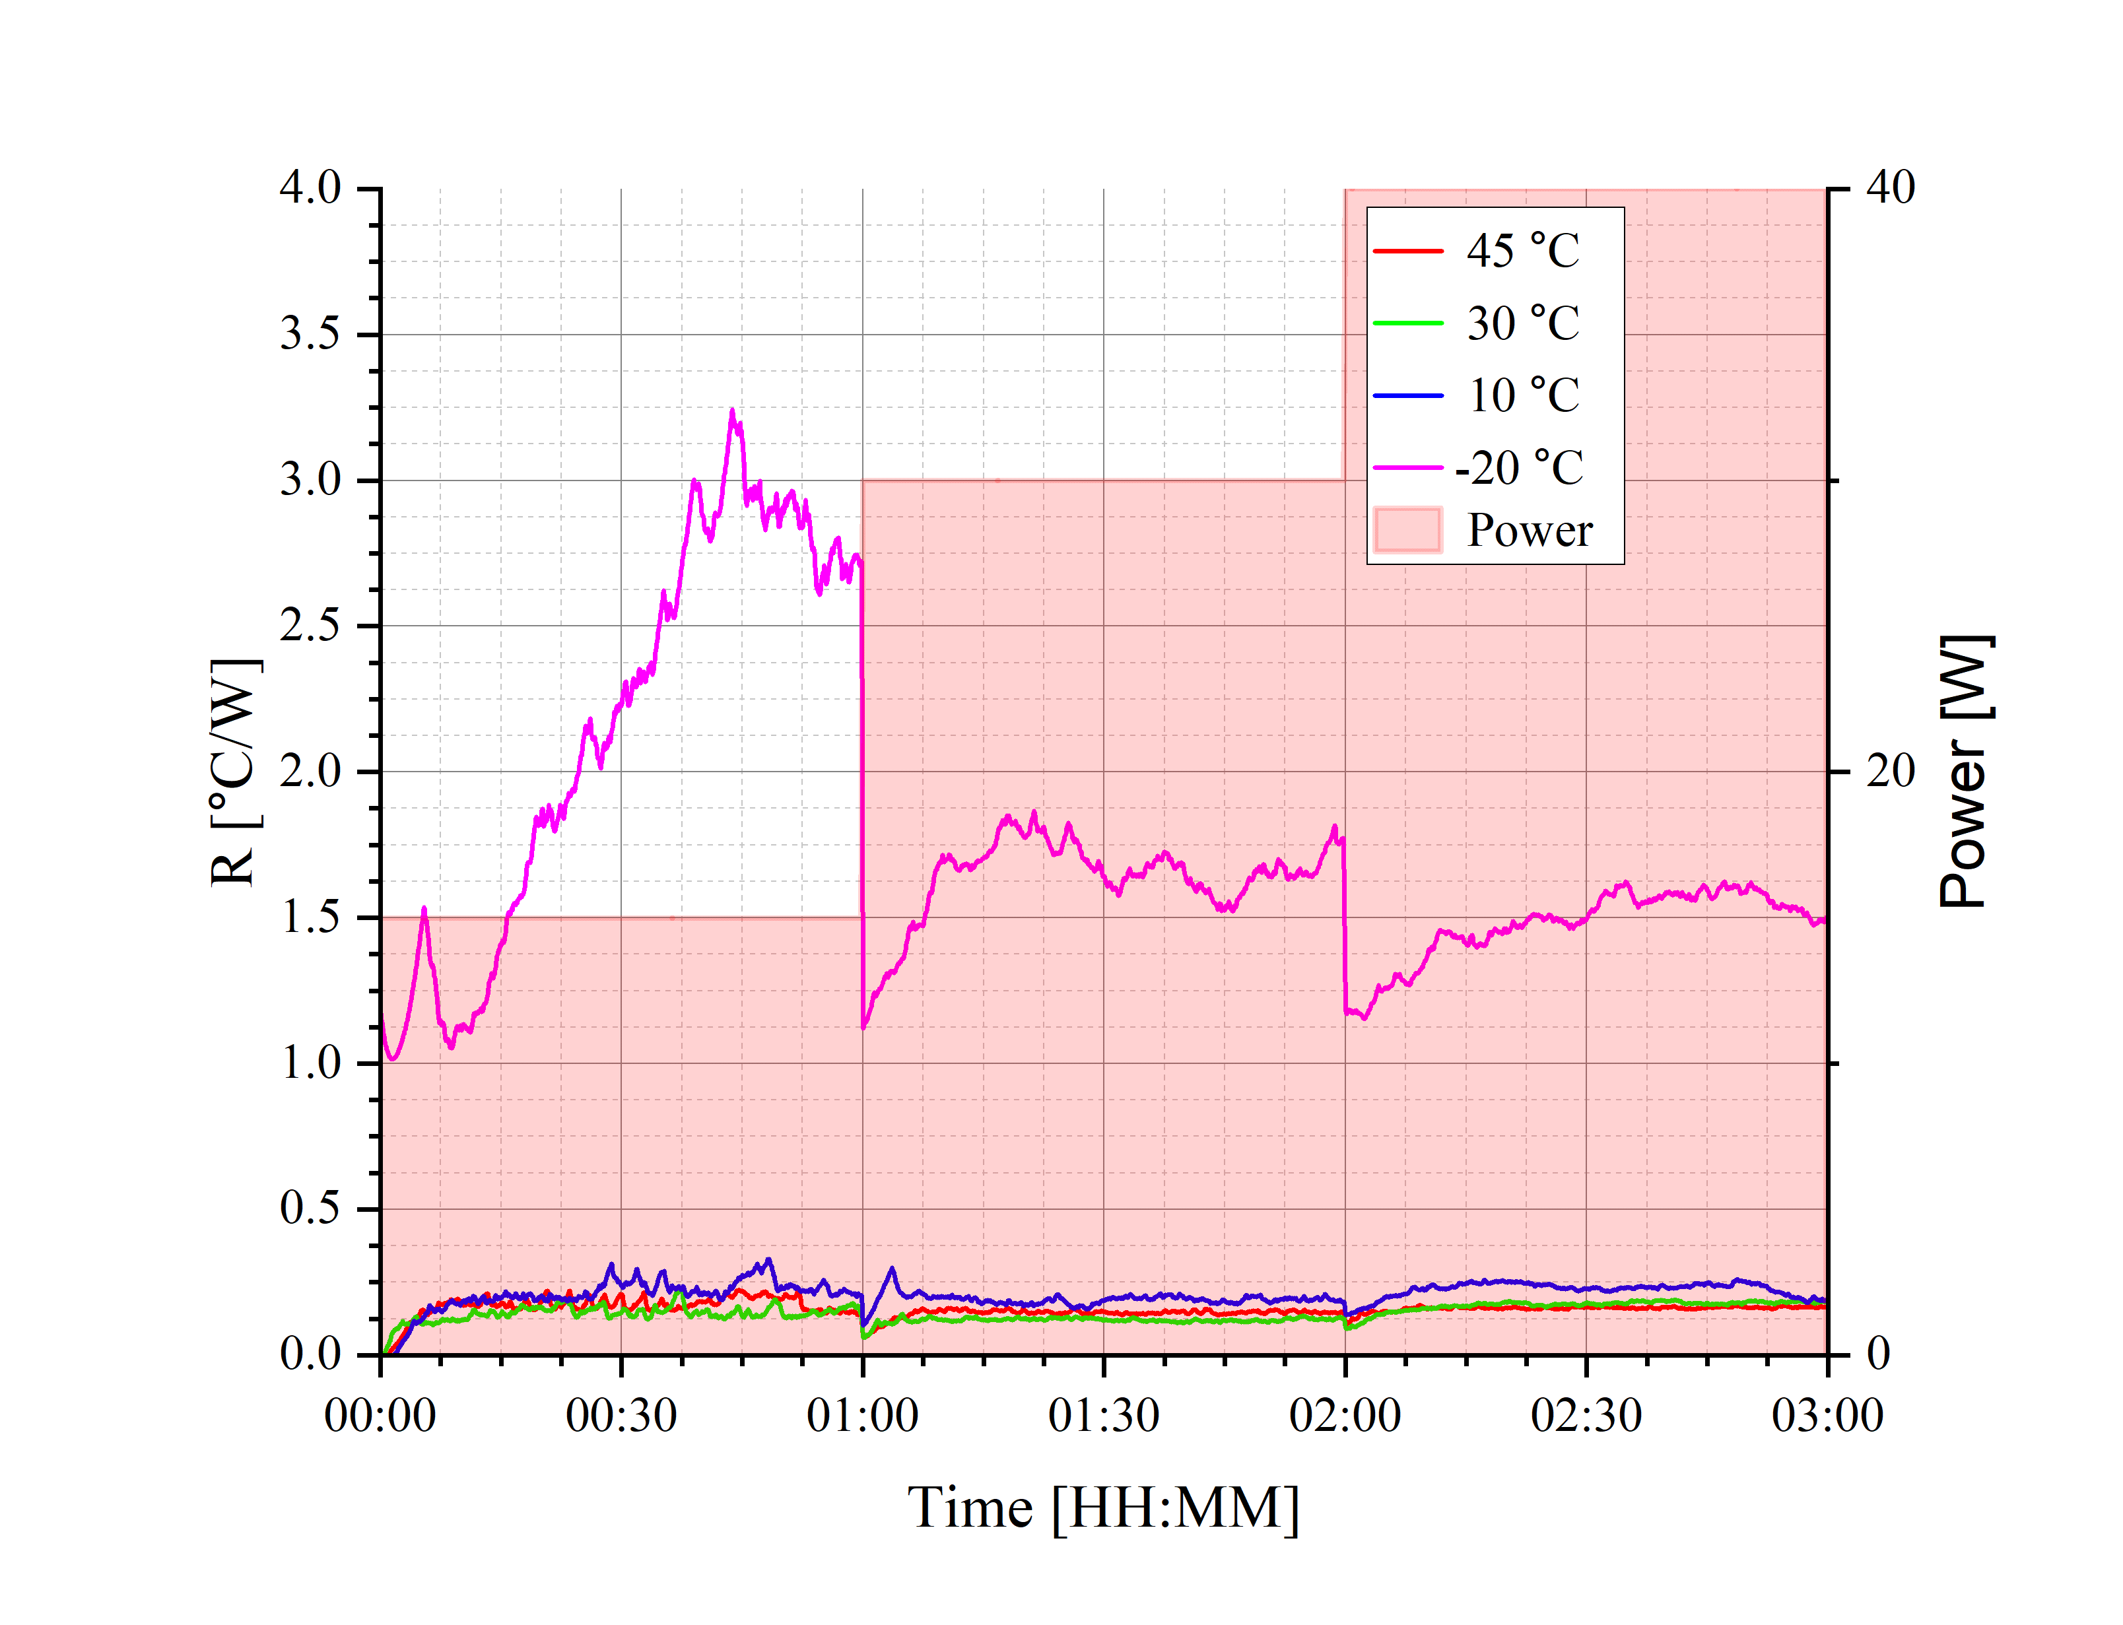
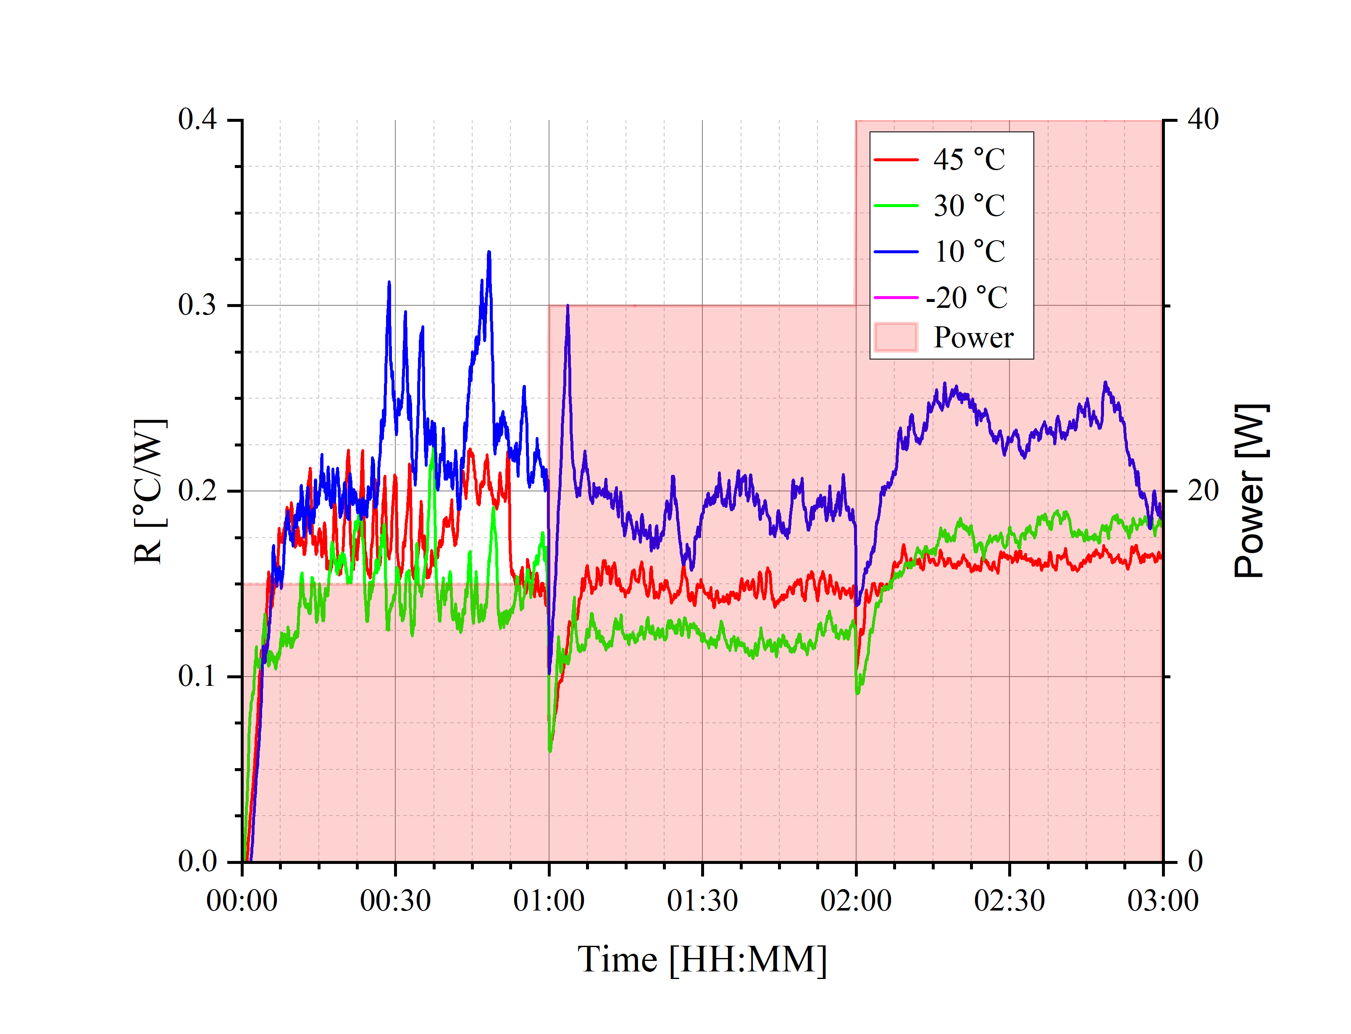
Thermal performance
CHBB_S3_A: small, 14 loops, 1.5 mm internal diameter, acetone
Thermal performance in horizontal setup
Horizontal:
The best performance was achieved at 30˚C (86˚F). Breadboard transported 30 Watts of heat with 3.7˚C difference between evaporator and condenser
Operational temperature range:
At temperature above the 30˚C (86 ˚F) breadboard exhibited stable operation
At 10˚C (50˚F) operation with slightly higher thermal resistance
At -20˚C (-4˚F) breadboard started up, but with high thermal resistance
BHM
Best thermal performance achieved in BHM orientation
THM
Breadboard operated only at higher temperatures (30&45˚C) when oriented against gravity
3
1
2
Thermal resistance ˚C/W
Mode | Orientation | Horizontal |  |  | BHM | THM
 | Heater power | 30W | 20W | 10W | 30W | 30W
Step-up | 45˚C (113˚F) | 0.164 | 0.149 | 0.164 | 0.119 | 0.241
 | 30˚C (86˚F) | 0.124 | 0.124 | 0.148 | 0.123 | 0.332
 | 10˚C (50˚F) | 0.191 | 0.191 | 0.222 | 0.107 | N/A
 | -20˚C (-4˚F) | 1.687 | 1.687 | 2.779 | 0.447 | N/A

Slide 17
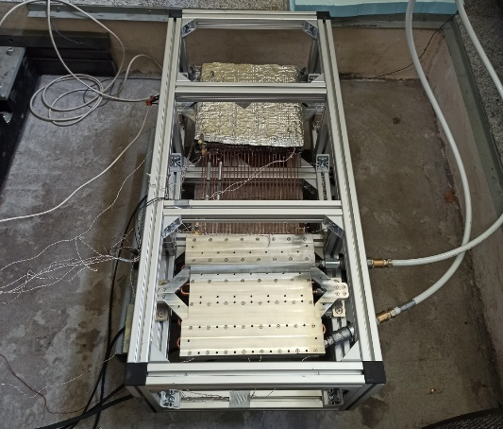
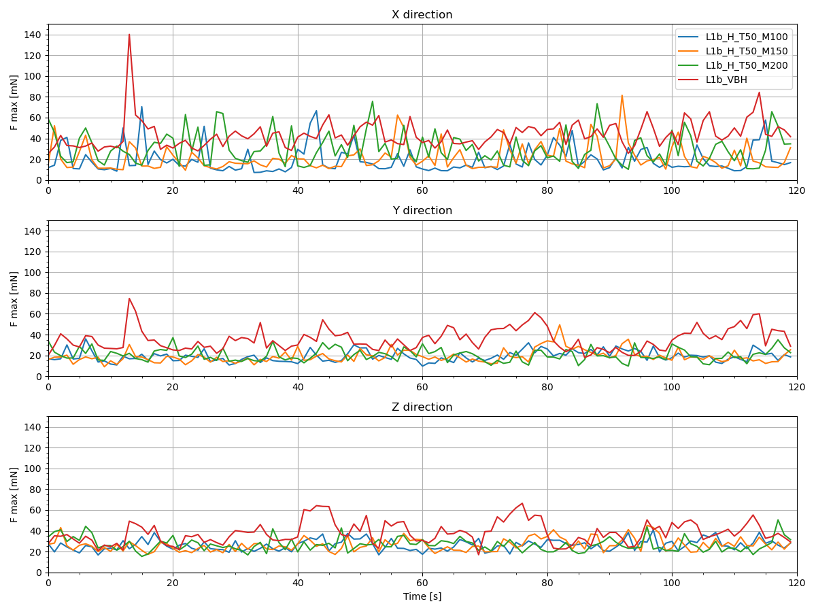
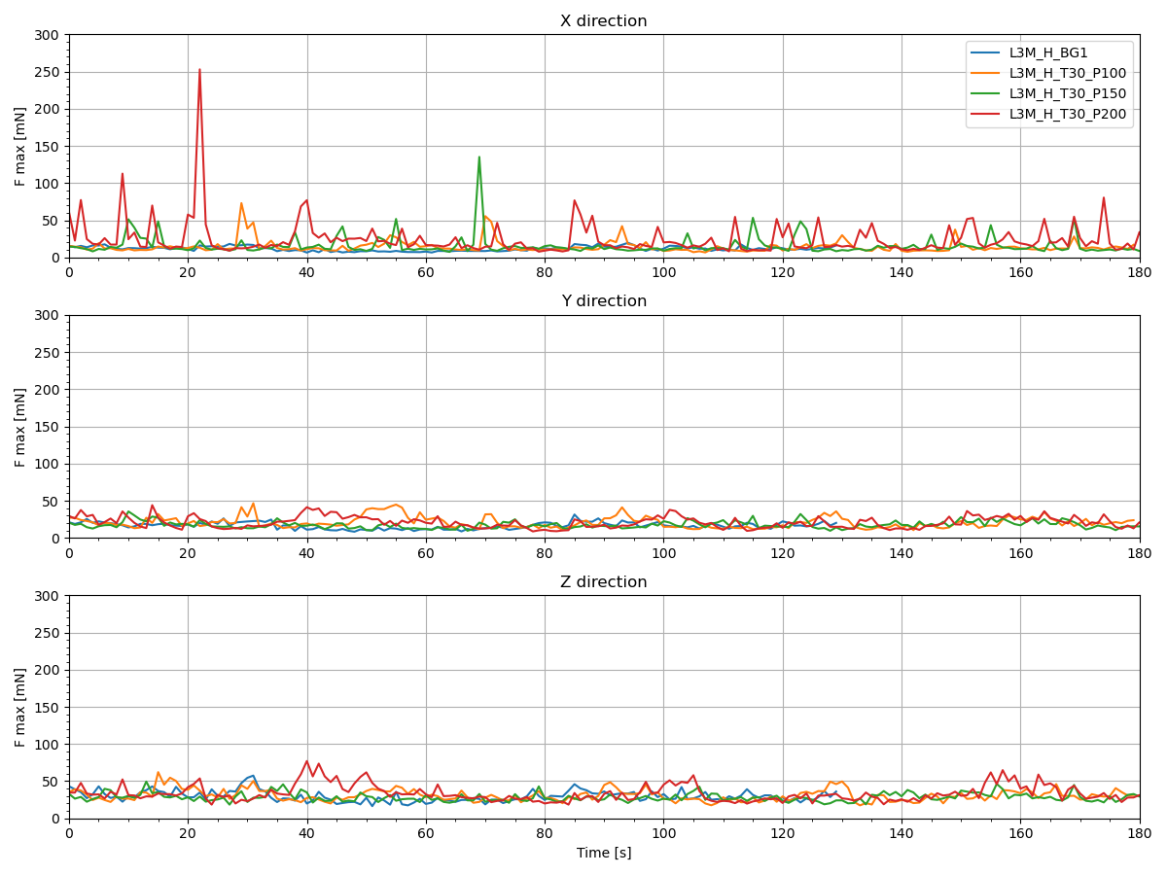
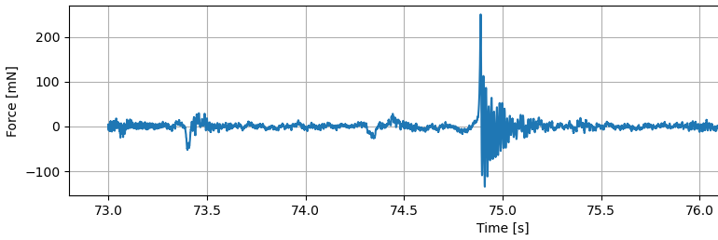
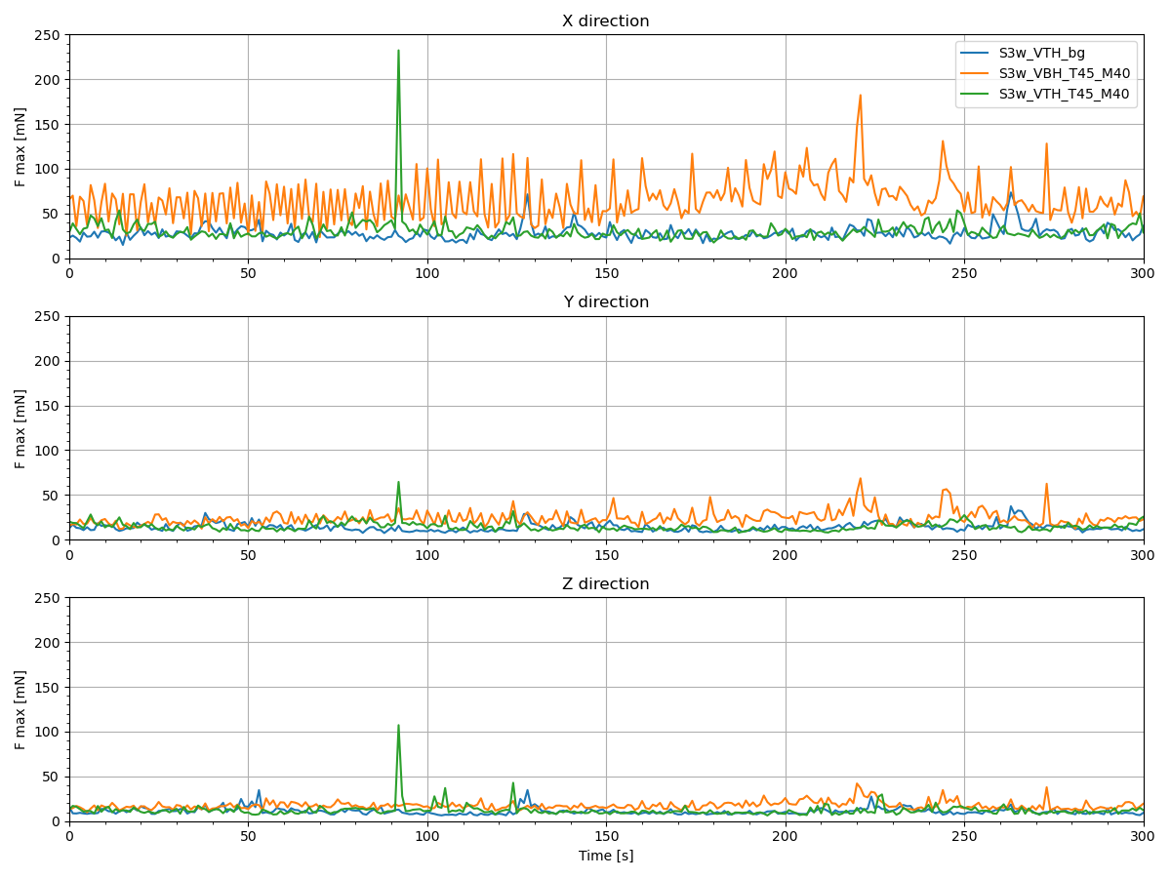
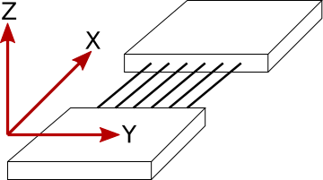
Microvib performance
Single spikes reaching up to 250 mN were observed during tests of various breadboards in different orientations
Potential source: thermomechanical stress relaxation or phenomena related to the working fluid, e.g., a vapor burst
CHBB_L1_M
CHBB_L3_M
CHBB_S3_A

Slide 18
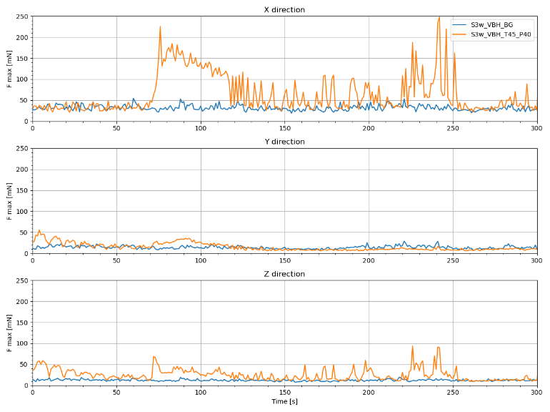
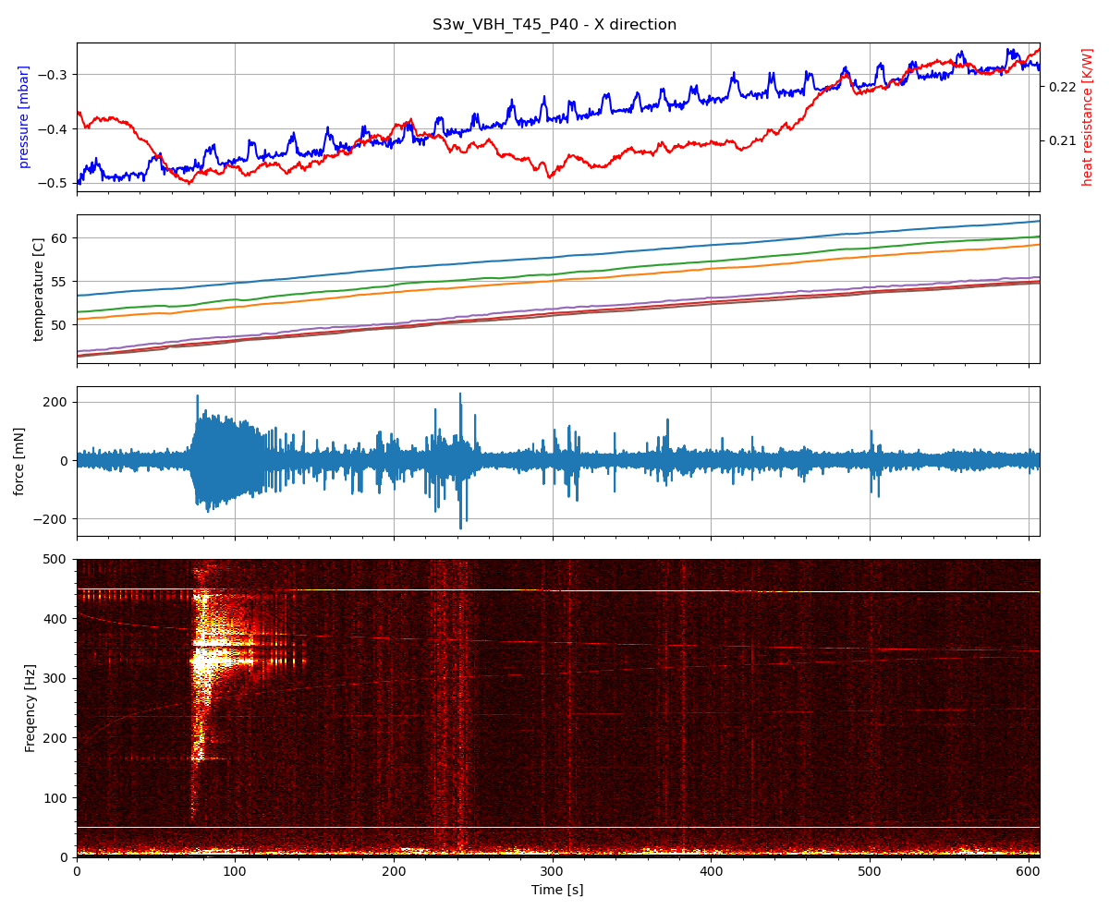
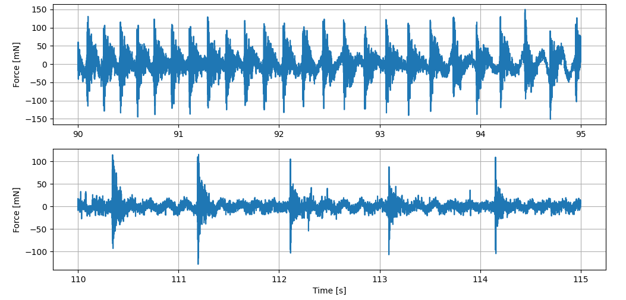
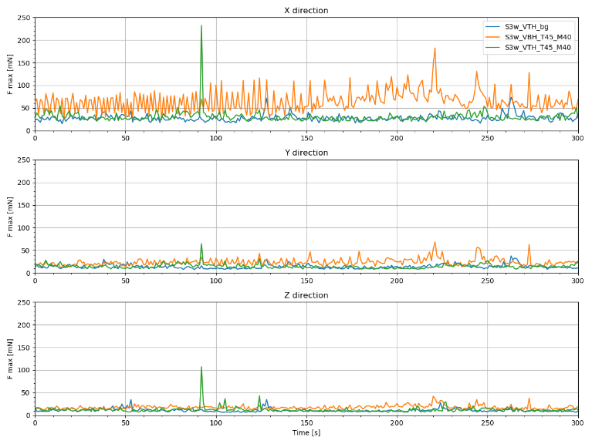
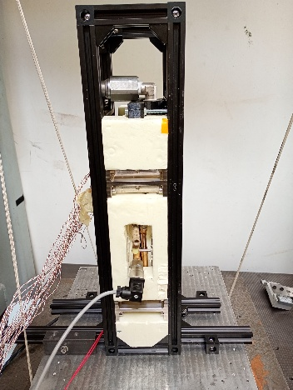
Microvib performance
A
B
Series of disturbances observed only in small soldered breadboard, in horizontal and BHM orientation.
Potential source: oscillating fluid motion
Greater and more frequent disturbances were observed during BHM testing, with single force spikes reaching 200–250 mN, while regular oscillations reached up to approximately 100 mN.
1
A
B
2

Slide 19
OUR PRODUCTS
SMART MISSION ECOSYSTEM
Summary
MITIGATE

Slide 20
Outlook
Optimal Filling Ratio: Best performance observed at low filling ratios (15–30%).
Best Small Breadboard: CHBB_S3_M (14 loops, methanol, internal diameter 1.5 mm) achieved 0.123 ˚C/W in nominal conditions.
Best Large Breadboard: CHBB_L3_M (14 loops, methanol, internal diameter 2.5 mm) reached 0.025 ˚C/W in nominal conditions.
Horizontal operation (0-g Operation): All small breadboards operated successfully in the horizontal orientation, whereas among the large breadboards, only the configuration with a larger diameter and methanol demonstrated stable operation at wide condenser temperature range.
Operational temperature range: Most breadboards exhibited improved performance at higher temperatures and power levels; CHBB_S3_A was the only unit to operate at −20 °C (−4 °F), demonstrating the broadest operational temperature range.
Microvibrations: Single spikes, observed across multiple breadboard configurations, may result from either thermomechanical stress relaxation or local vapor burst, whereas series-type disturbances, detected only in the small soldered breadboard, exhibited a repetitive pattern suggestive of fluid oscillations.

Slide 21
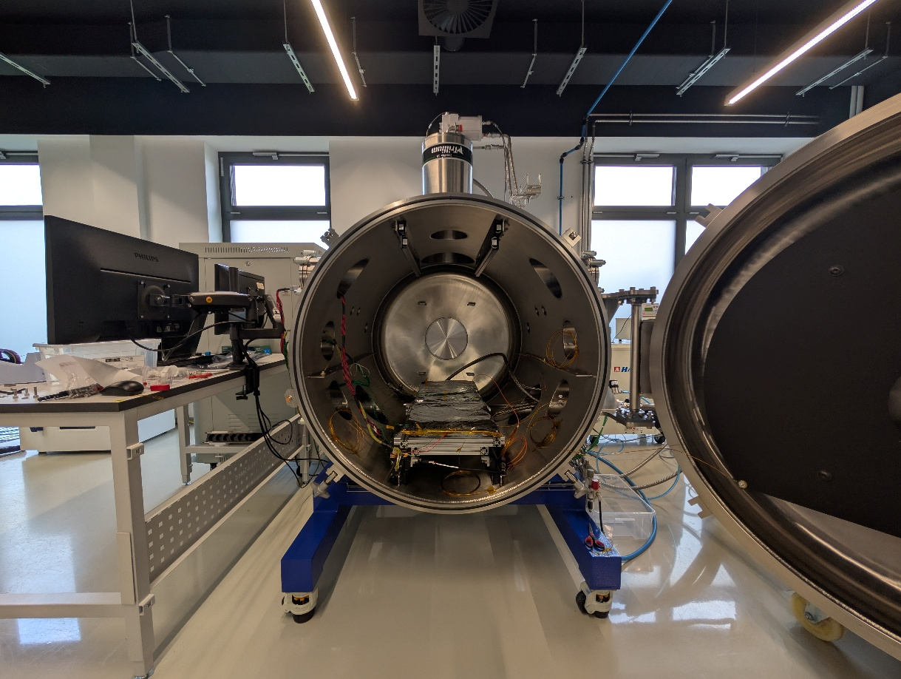
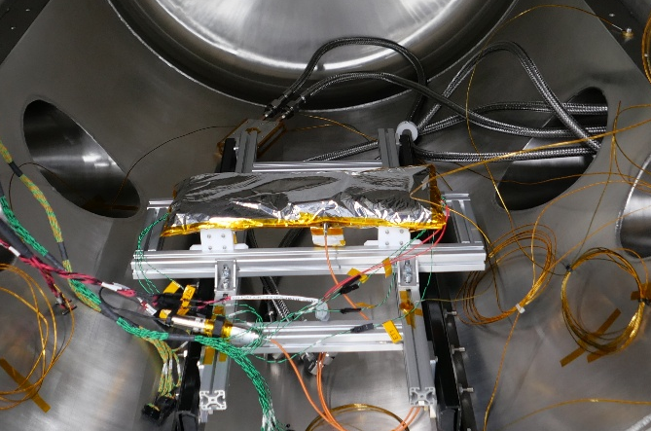
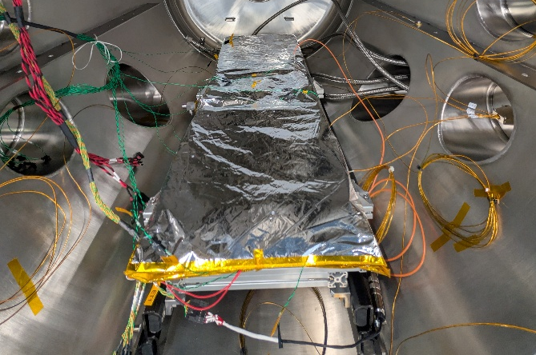
2nd phase of the project
Two final design selected
Test campaign:
FR tests
TVAC performance test
Microvibration tests
Thermal cycling test
Vibration testing

Slide 22





Thank you!
MWOJCIK@KPLABS.PL
www.kplabs.space
KP Labs
Bojkowska 37J
44-100 Gliwice, Poland

Slide 23
OUR PRODUCTS
SMART MISSION ECOSYSTEM
Backup slides
MITIGATE

Slide 24
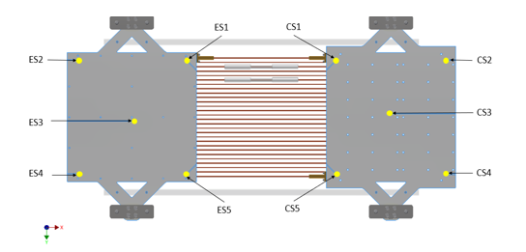
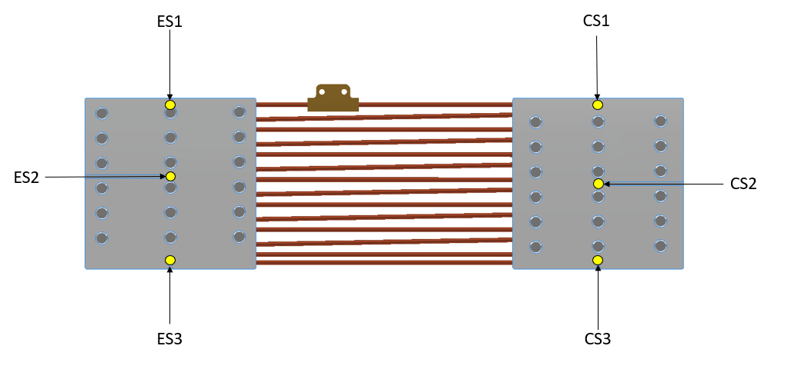
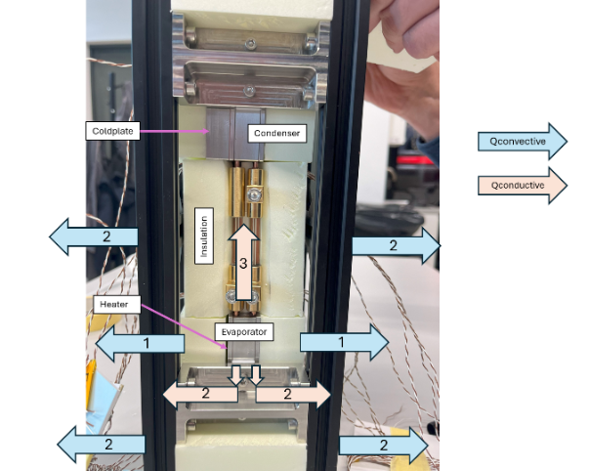


Thermal performance
$$R=\frac{T_{ES_AVG}−T_{CS_AVG}}{P}$$
where:
R – thermal resistance [°C/W];
T_{e} – temperature of the evaporator [°C];
T_{c} – temperature of the condenser [°C];
P – power transported (heat loss included) [W];
Heat loss test for small bb
Tests conducted in ambient conditions
- Test bench insulated with extruded polystyrene (XPS)
convective heat loss still present
At worst, losses reached up to 30% of total power
Notes:
Tutaj wspomnieć, że temperatury do wyliczenia oporu będą wzięte z centrum parowacza skraplacza.
Część czujników przyklejona jest do skraplacza/parowacza bezpośrednio i dają nam one informacje na temat rozkładu temperatury na parowaczu/skraplaczu. (podczas testu na etanolu można było odczytać, że jedna strona PHPa działa lepiej
Pozostałe czujniki przyklejone bezpośrednio do rurek miedzianych, żeby dały informacje

Slide 25





Microvib test
Test stand
A dynamometer setup: a force plate on four force-links, base plates rigidly mounted on massive concrete foundation.
Noisy environment – test carried out in the night-time
Low signal-to-noise ratio
During microvibration measurements, the coldplate was detached from the condenser via quick couplings
For small breadboard the base plate was suspended to better isolate the setup from external disturbances

