Slide 1
Thermal Correlation of a mechanically driven loop heat pipe for deep space science missions
Nayli Hayi-Slayman, Dr. Florian Sanchez, Jean-Frédéric Ruel
TFAWS 2025, August 4-7, 2025

Slide 2
Content
1
2
3
4
Introduction
Assumptions and setup
Results and discussions
Conclusion

Slide 3
Introduction

Slide 4
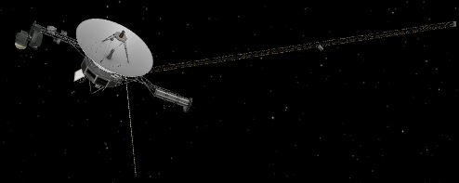
Importance of thermal control for deep space missions
Deep space science missions aim at exploring our solar system and beyond.
Deep space mission are expensive and a large portion of power bugdet is allocated to thermal control.
Voyager 1
(Source: https://science.nasa.gov/mission/voyager/)
Several research projects focus on advanced thermal management technologies for better thermal controls especially for deep space satellites ^{[1,2]}.
[1] Yi-Gao Lv et al., 2024, “Review on thermal management technologies for electronics in spacecraft environment”, Vol 3, Issue 3, Sept. 2024, Energy Storage and Saving.
[2] Birur, G. C.; O'Donnell, T., 2000, "Advanced thermal control technologies for space science missions at JPL", https://hdl.handle.net/2014/16270, ['Space Technology and Application International Forum (STAIF-2001)', 'Albuquerque, New Mexico, USA'], JPL Open Repository
Notes:
Example of active spacecraft operating outside the heliosphere → Voyager 1
Lots of research about loop heat pipes:
Passive ones/by capillarity were dominant since they didn’t require extra power
Two-Phase Mechanically Pumped Fluid Loop represents an efficient technological solution to control temperature of spacecraft equipment because:
The heat exchange in phase change is high
The temperature is stable during the phase change
The pumps allows to have a control on the flow and so on the heat to dissipate

Slide 5
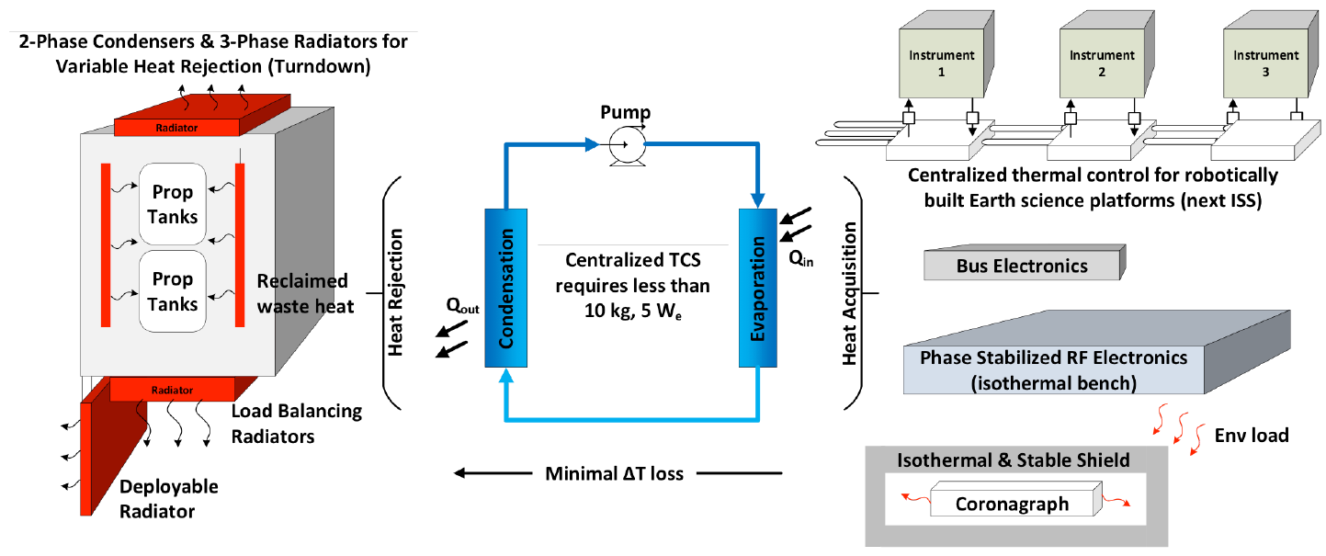
Performant thermal control with two-phase mechanically pumped fluid loop
Previous research looked at the benefits and challenges of using a two-phase mechanically pumped fluid loop for deep space science exploration [1,2].
Loop heat pipe represents a promising and efficient thermal management solution to control the temperature of spacecraft equipment because:
  The heat exchange in phase change is high
  The temperature is stable during the phase
  change
  The pumps allows to have a control on the
  flow and so on the heat to dissipate
[1] Sunada et al., 2016, “A Two-Phase Mechanically Pumped Fluid Loop for Thermal Control of Deep Space Science Missions”, ICES 2016-219, Vienna, Austria.
[2] K. Sakamoto et al., 2016, “System trade-off analysis of two-phase mechanically pumped fluid loop for thermal control of future deep space missions” TFAWS2016-AT-04, NASA ARC, CA, USA.
Notes:
Two-Phase Mechanically Pumped Fluid Loop represents an efficient technological solution to control temperature of spacecraft equipment because:
The heat exchange in phase change is high
The temperature is stable during the phase change
The pumps allows to have a control on the flow and so on the heat to dissipate

Slide 6
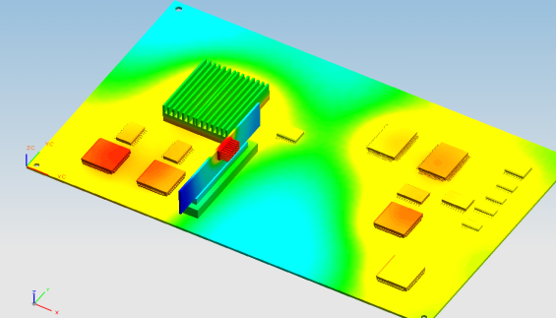
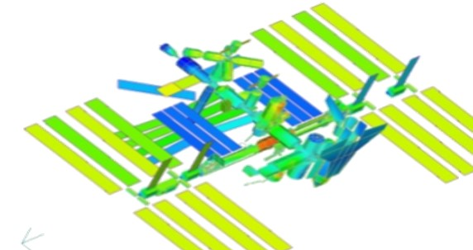

Modeling and accuracy challenges of loop heat pipe thermal analyses
Payload-level analysis
Full Spacecraft-level analysis
Computationally and time expensive
Usually not performed in early phases of design
Lots of simplifications and assumptions
Payload thermal behavior not necessarily captured with accuracy
Notes:
Payload first
Full spacecraft
Enumerate co-simulation analysis

Slide 7
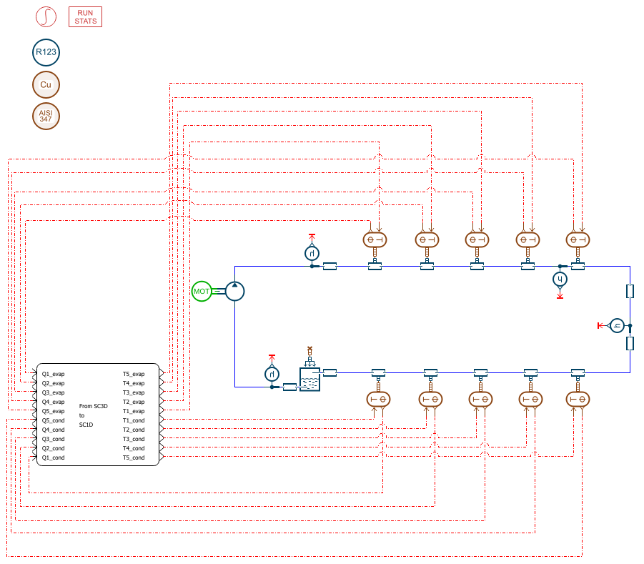
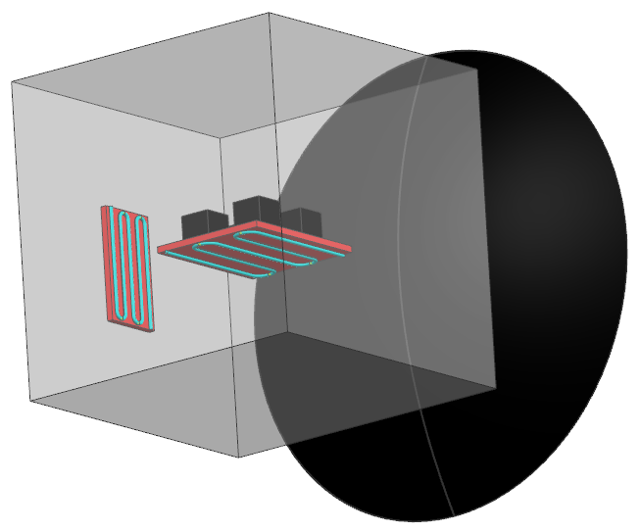
Modeling and accuracy challenges of loop heat pipe thermal analyses
Payload-level analysis
Co-simulation analysis*
Full Spacecraft-level analysis
Computationally and time expensive
Usually not performed in early phases of design
Ideal approach for validation
Provides the best of both « world »
Computational cost prevents doing a lot of iterations
Lots of simplifications and assumptions
Payload thermal behavior not necessarily captured with accuracy
Notes:
Payload first
Full spacecraft
Enumerate co-simulation analysis

Slide 8
Modeling and accuracy challenges of loop heat pipe thermal analyses
Payload-level analysis
Co-simulation analysis
Full Spacecraft-level analysis
Computationally and time expensive
Usually not performed in early phases of design
Provides the best of both « world »
Ideal approach for validation
Computational cost prevents doing a lot of iterations in the early design phases
Lots of simplifications and assumptions
Payload thermal behavior not necessarily captured with accuracy
Focus of today’s presentation
Reduced-thermal model of the loop heat pipe is required for full spacecraft analyses
Notes:
Payload first
Full spacecraft
Enumerate co-simulation analysis

Slide 9
Assumptions and setup

Slide 10
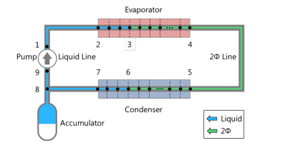
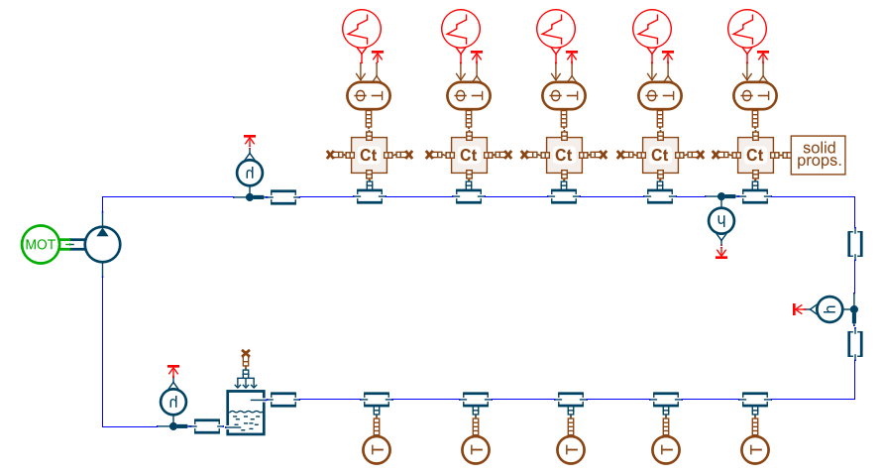
References data
Research paper with experimental data*
System model using Simcenter Amesim
Assumptions:
  Condensor is sinked at -25°C
  Fluid is R123 passing through copper pipe
  Pump flowing at 300cm³/mn
  Heat input of 600W
Pump
Evaporator
Goal: Develop a reduced model to match fluid temperatures in the evaporator
Tank
1D model
Condenser
*Sunada et al., A Two-Phase Mechanically Pumped Fluid Loop for Thermal Control of Deep Space Science Missions, ICES, 2016
Notes:
Two-Phase Mechanically Pumped Fluid Loop represents an efficient technological solution to control temperature of spacecraft equipment because:
The heat exchange in phase change is high
The temperature is stable during the phase change
The pumps allows to have a control on the flow and so on the heat to dissipate

Slide 11
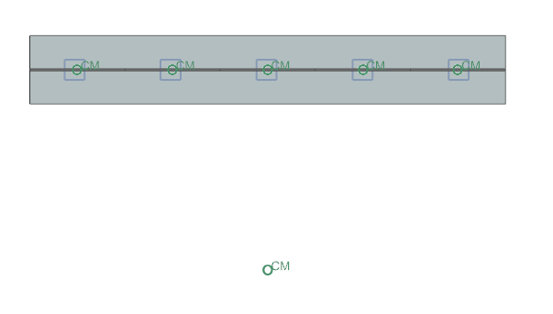
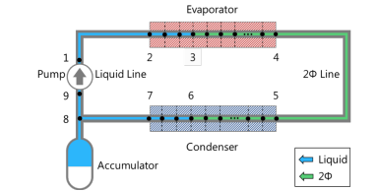



Loop heat pipe reduced model
Two-phased flow loop is modelled as 0D elements:
  $Q=\dot{m}{ C}_{p_eq} (T_{fluid,i}−T_{fluid,i+1}$)
  $\dot{m}$ : is fixed by the pump
  $C_{p_eq}$: Specific heat, temperature and phase dependent
$$\dot{m}{ C}_{p_liquid}$$
$$\dot{m}{ C}_{p_2φ}$$
Notes:
0D elements are connected with a « total conductance » equal to $\dot{m}{ C}_{p_eq}$

Slide 12
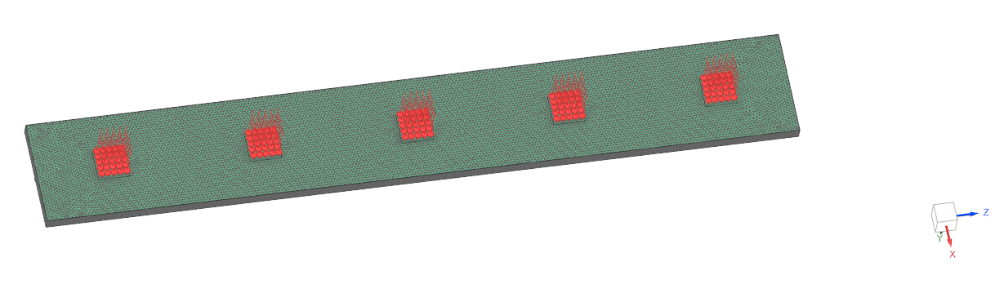
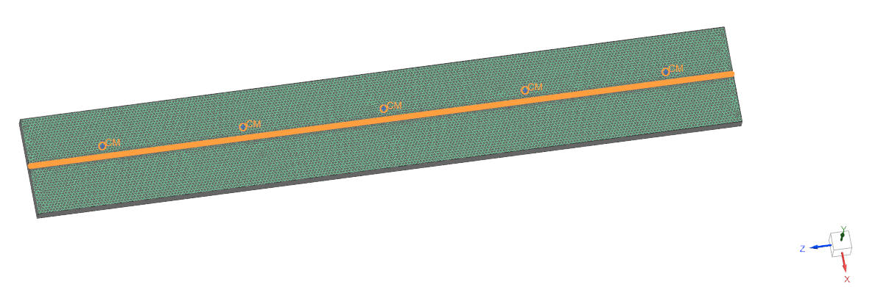
Operating conditions and properties
Evaporator modelled as linear solid
Meshed with 3D tetrahedral elements
5 dissipating units are located on the evaporator
  600W, applied uniformly as ~5W/cm²
Evaporator (Dissipating units side)
Evaporator (Heat pipe side)
Notes:
Two-Phase Mechanically Pumped Fluid Loop represents an efficient technological solution to control temperature of spacecraft equipment because:
The heat exchange in phase change is high
The temperature is stable during the phase change
The pumps allows to have a control on the flow and so on the heat to dissipate

Slide 13
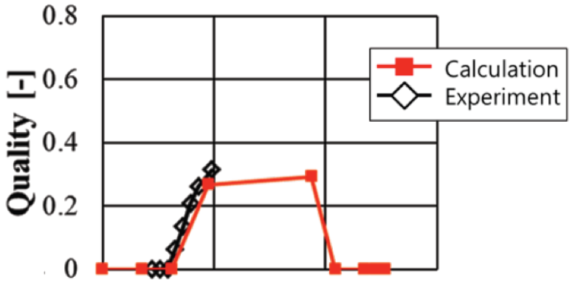
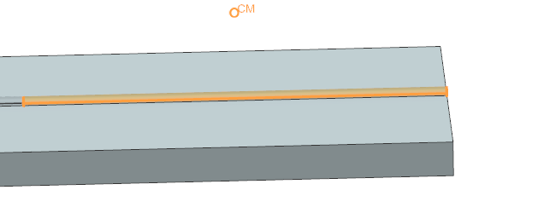








Thermal Correlation Design Variables
Specific heat can be estimated with $x$ being the quality:
  $${ C}_{p_2φ}=x{C_{p}}_{vapor}+\left(1−x\right){C_{p}}_{liquid}$$
$$\dot{m}{ C}_{p_liquid}$$
$$\dot{m}{ C}_{p_2φ}$$
$$\dot{m}{ C}_{p_2φ}$$
$$\dot{m}{ C}_{p_2φ}$$
$$\dot{m}{ C}_{p_liquid}$$
$$\dot{m}{ C}_{p_2φ}$$
$$Q=HTC.Area.(T_{fluid}−T_{solid})$$
From Sunada et al., 2016
HTC (Heat Transfer Coefficient) is unknown
Specific heat has lots of uncertainty along the pipe
Notes:
Each 0D has a HTC to an associated solid and a conductance with the previous and next 0D
The condenser is connected to a non-geometric element sinked at -25°C
6 HTC + 6 conductances modeeling the fluid heat flow => We end up with 11 design variables

Slide 14

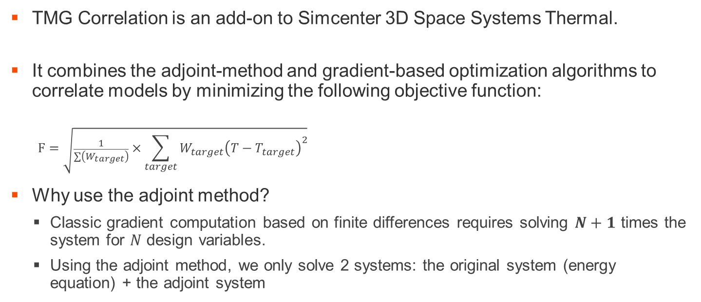
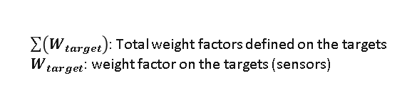
Automated Thermal Correlation
TMG Correlation is an add-on to Simcenter 3D Space Systems Thermal.
It combines the adjoint-method and gradient-based optimization algorithms to correlate models by minimizing the following objective function:
  $$F=\sqrt{\frac{1}{\sum{\left(W_{target}\right)}}×\sum_{target}{{W_{target}\left(T−T_{target}\right)}^{2}}}$$
Why use the adjoint method?
  Classic gradient computation based on finite differences requires solving $N+1$ times the system for $N$ design variables.
  Using the adjoint method, we only solve 2 systems: the original system (energy equation) + the adjoint system
$\sum{\left(W_{target}\right)}$: Total weight factors defined on the targets
$W_{target}$: weight factor on the targets (sensors)
Notes:
Automating correlation of 11 design variables by minimizing objective function

Slide 15
Results and discussions

Slide 16
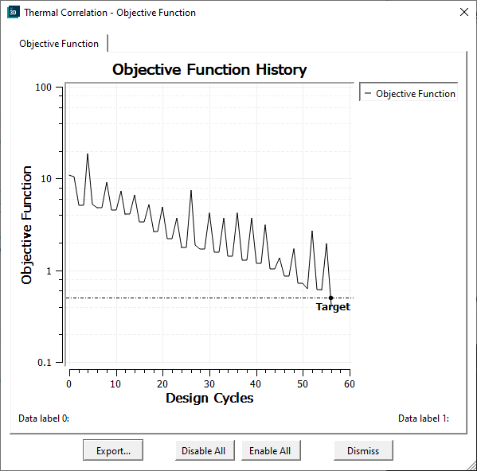
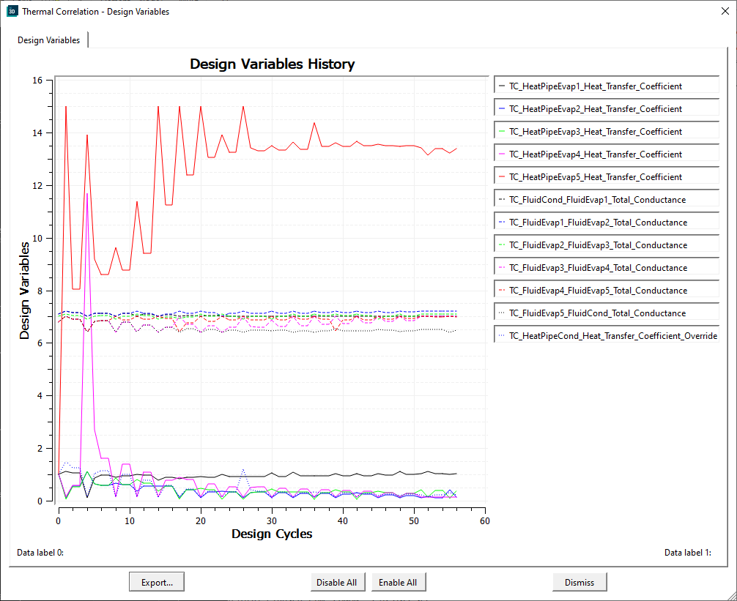
Thermal Correlation - Convergence
Correlation run converged in 42mn and 56 design cycles with stable design variables
Notes:
Target objective function = 0.3

Slide 17
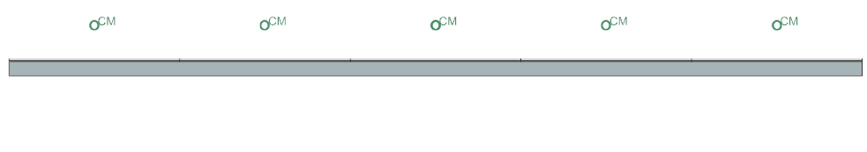














Thermal Correlation – Design Variables
Final “ Total Conductances” :
  Phase change happens later than assumed
  Specific heat varied up 4%
Final Heat Transfer Coefficients :
  When phase change occurs, heat transfer coefficients jump
  HTCs varied up to 1240%
$$7.2 W/dC$$
$$7.1W/dC$$
$$7 W/dC$$
$$6.9W/dC$$
$$518 W/(m^{2}.dC)$$
$$70 W/(m^{2}.dC)$$
$$179W/(m^{2}.dC)$$
$$75 W/(m^{2}.dC)$$
$$6685 W/(m^{2}.dC)$$
in
out
$$7.0 W/dC$$
$6.5$ $W/dC$
Initial Values
Initial Value
$$7.1 W/dC$$
$$500 W/(m^{2}.dC)$$
$$6.8 W/dC$$
From Sunada et al., 2016

Slide 18
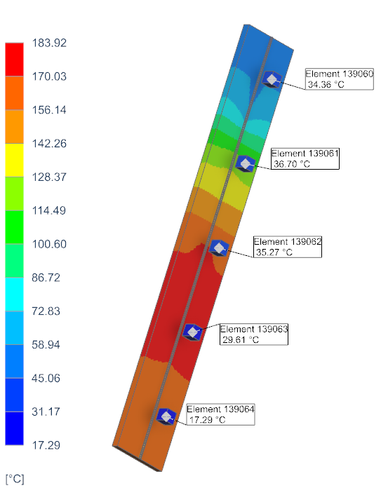
Fluid temperatures
Fluid temperature profile is similar to the system model
Correlated Temperatures
Notes:
Absolute Error has an absolute maximum of 0.896deltaC

Slide 19
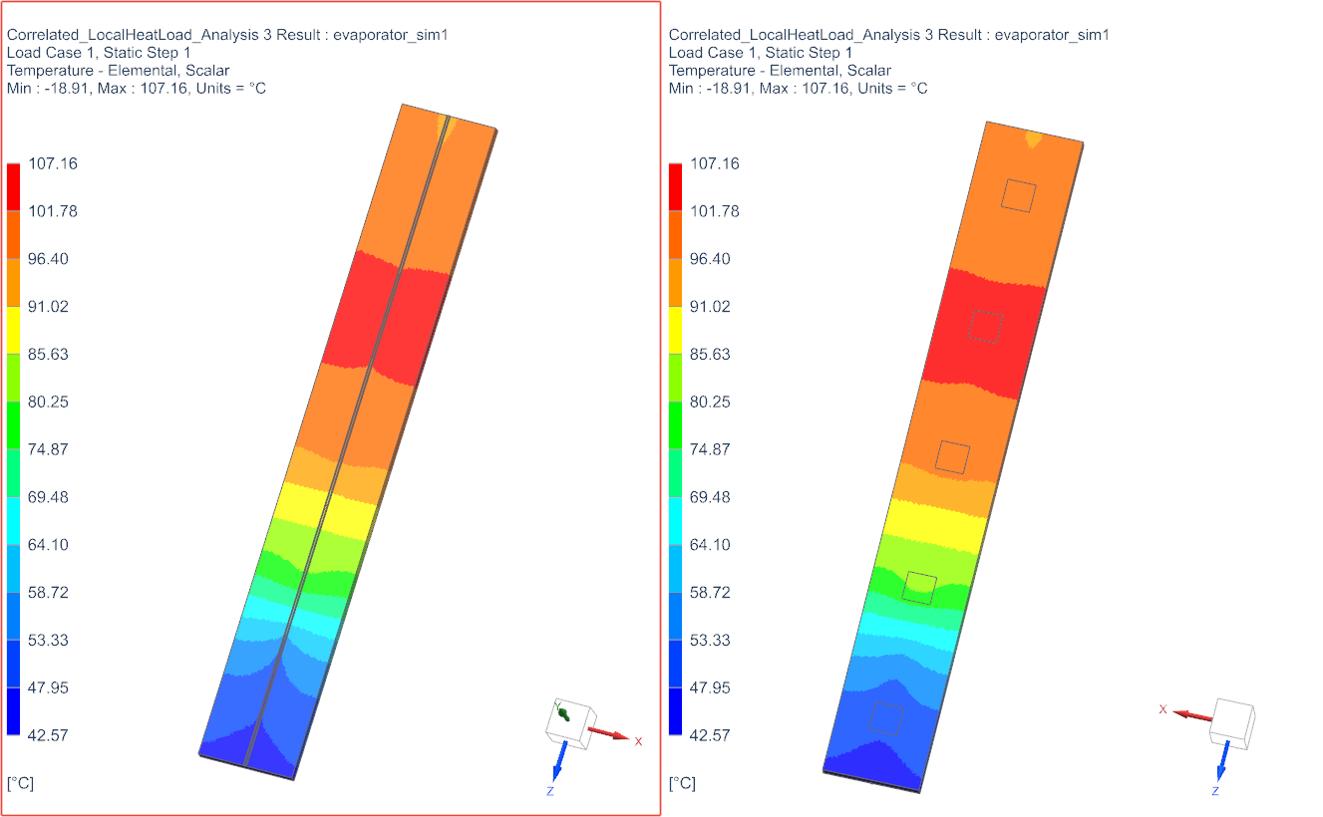
Evaporator temperatures
Evaporator temperature gets cooler as it’s exchange heat with the fluid
Region closer to the pipe are cooler locally
Solid Temperatures (pipe side)
Solid Temperatures (units side)

Slide 20
Conclusion

Slide 21
Conclusion and key take away
Using TMG Correlation, an adjoint-based solver, we successfully correlated the reduced-model of a loop heat pipe
  Reduced model predictions are accurate
  The entire correlation procedure took less than one hour in total
The same approach can be used for correlating other types of advanced cooling systems.
The procedure can be enhanced by automating the creation of the reduced model to save engineering time.

Slide 22


Thank you!
Nayli Hayi-Slayman
nayli.hayi-slayman@mayahtt.com
For more information,
visit mayahtt.com

Slide 24
Co-simulation enables seamless data transfer while leveraging the strengths of 0D/1D and 3D solvers
Simcenter Amesim
Simcenter 3D Thermal Multiphysics
Co-simulation
≈30 minutes
Amesim only
≈ minute
Simcenter 3D only
≈ minutes
Capture 3D dimensional nature of heat transfer to enhance system model accuracy
Fast transient simulation for fluid part with phase change
Co-simulation represents a compromise between computational time and accuracy

Slide 25
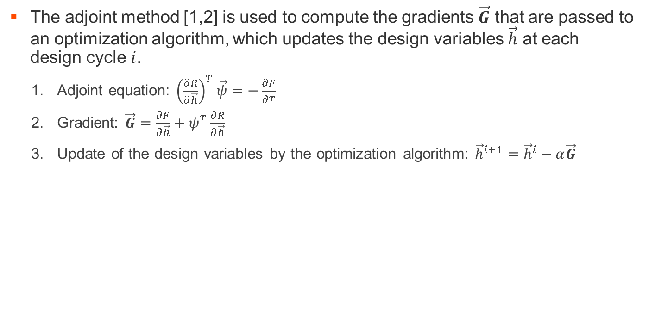
TMG Correlation: An adjoint-based solver for correlation
The adjoint method [1,2] is used to compute the gradients $\vec{G}$ that are passed to an optimization algorithm, which updates the design variables $\vec{h}$ at each design cycle $i$.
  Adjoint equation: ${\left(\frac{∂R}{∂\vec{h}}\right)}^{T}\vec{ψ}=−\frac{∂F}{∂T}$
  Gradient: $\vec{G}=\frac{∂F}{∂\vec{h}}+ψ^{T}\frac{∂R}{∂\vec{h}}$
  Update of the design variables by the optimization algorithm: ${\vec{h}}^{i+1}={\vec{h}}^{i}−α\vec{G}$
[1] Michaleris, P., Tortorelli, D. A., & Vidal, C. A. (1994). Tangent operators and design sensitivity formulations for transient non‐linear coupled problems with applications to elastoplasticity. International Journal for Numerical Methods in Engineering, 37(14), 2471-2499.
[2] Kast, S. M. (2017). An introduction to adjoints and output error estimation in computational fluid dynamics. arXiv preprint arXiv:1712.00693.

