Slide 1
Thermal Vacuum Testing of a VIPER Loop Heat Pipe
Ezequiel F. Medici
S&K Global Solutions, Houston, TX, 77058
Jodi C. Turk, and Elijah R. Stewart
NASA Marshall Space Flight Center, Huntsville, AL, 35812
Tim Page
Amentum Space Exploration Division, Huntsville, AL, 35812
Jose Dobarco-Otero
HX5 LLC, Houston, TX, 77058
Geronimo Quintanilla, Thomas B. Slusser, Zane W. Mittag, Juan M. Barragan, Angel Alvarez-Hernandez
NASA Johnson Space Center, Houston, TX, 77058
David C. Bugby
NASA Jet Propulsion Laboratory, Pasadena, CA 91109
Jimmy Hughes, Joshua Smay, and Calin Tarau
Advanced Cooling Technologies, Lancaster, PA, 17601

Slide 2
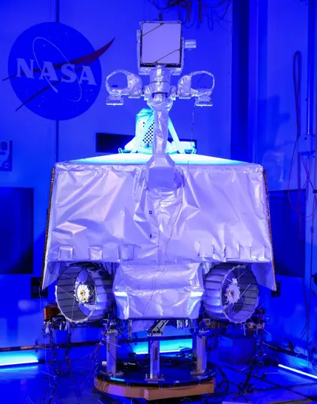
Background
VIPER Mission: Prospecting the south pole of the Moon, especially for water ice.
Payloads: TRIDENT, NSS, NIRVSS, and MSOLO.
General Mission Requirements and Goals:
100 days mission.
50 hours of hibernation.
7.2 hour of lunar permanent shadow region.
70 hours of payload instruments bakeout.
Thermal Management System:
4 Heat spreaders (with embedded ammonia CCHPs), warmbox, to collect the electronic waste heat.
4 Loop heat pipes, filled with propylene, to dissipate electronics waste heat into the sky.
7 Ammonia heat pipes around the warmbox, balancing the thermal load and providing LHP redundancy.
3 Ammonia heat pipes supporting the cooling of the MSOLO and NIRVSS payloads.
4 Radiators.
MLI and isolators.

Slide 3
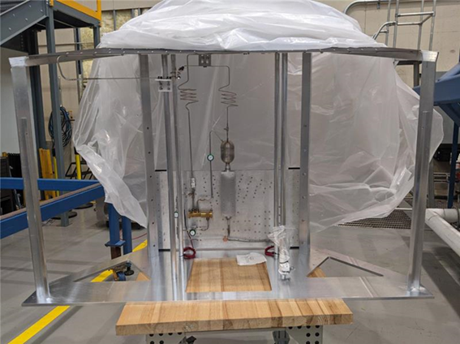
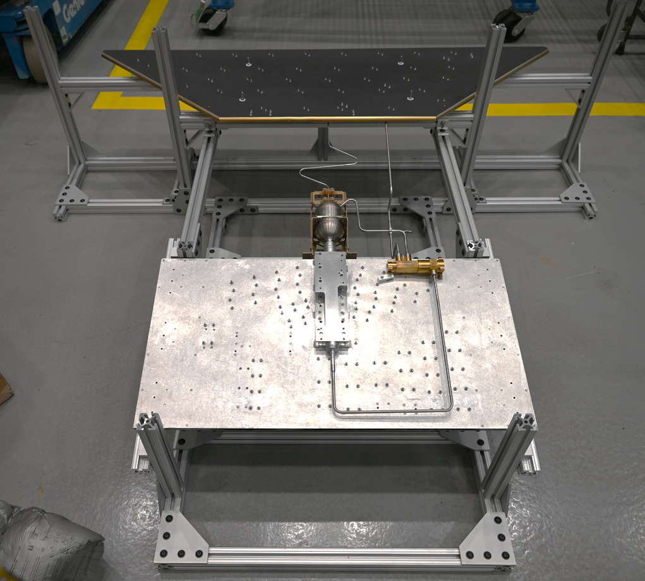
Test Objectives
TVAC #1
LHP Performance characterization under earth and moon-like environment (1/6 of Earth gravity).
Thermal control valve, TVC, performance characterization.
LHP hot shutdown, feasibility, required, power, and recovery.
Power required to sustain hibernation.
LHP startup heating choreography post hibernation and post hot LHP shutdown.
Effect of the sink temperature on the LHP performance.
Practice flight procedures and training for thermal console.
TVAC #4

Slide 4
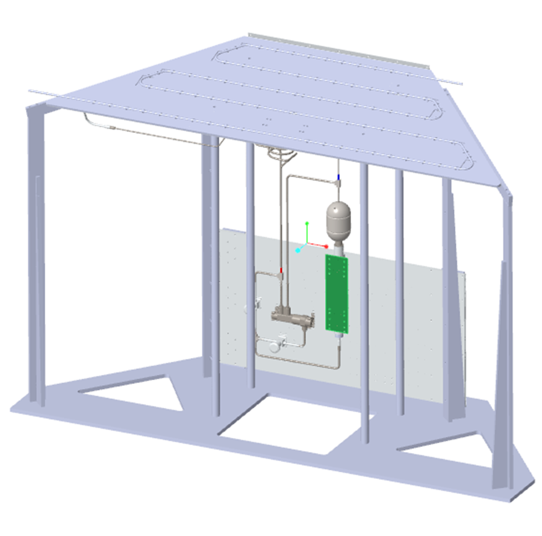
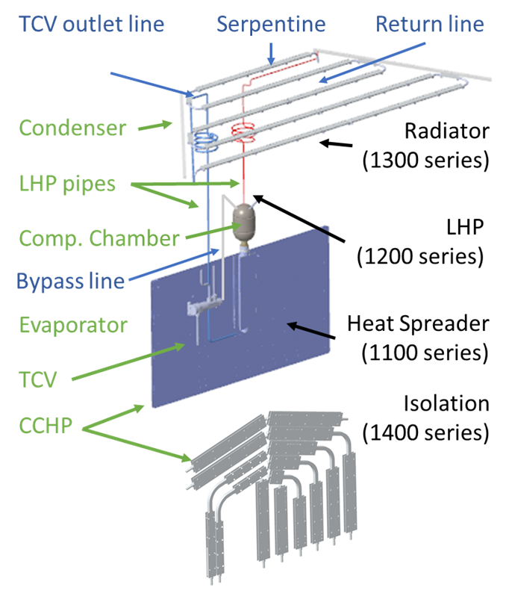
Test Article Configuration: TVAC #1
Components:
1 Heat spreader with embedded ammonia CCHPs. 42.9g of ammonia.
No mass simulators.
1 Evaporator and compensation chamber. assembly. 209.4g of propylene.
1 Aluminum phase sheet radiator.
1 TCV, temperature set points [0°C to 20°C].
Liquid and vapor lines.
Baseline configuration :
Vertical heat spreader and LHP.
Tested with and without TCV.

Slide 5
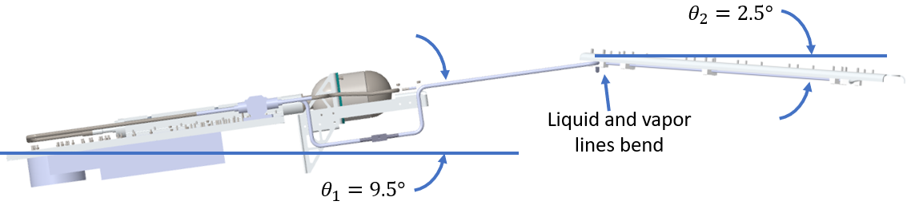
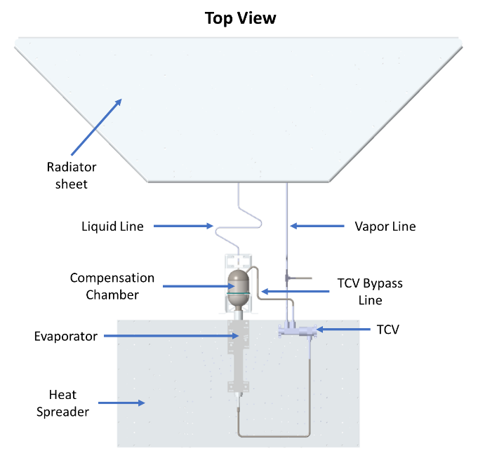
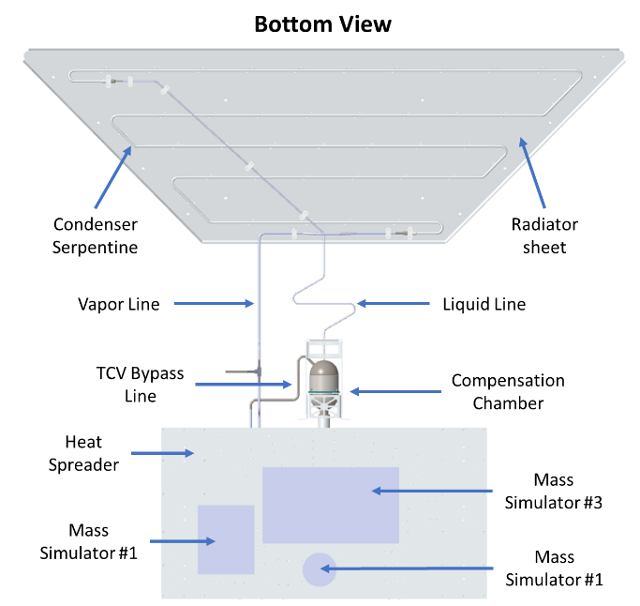
Test Article Configuration: TVAC #4
Components:
1 Heat spreader with embedded ammonia CCHPs. 42.9g of ammonia.
3 Mass simulators. 9.9 kg, 2.2kg, and 0.7kg respectively.
1 Evaporator and compensation chamber. assembly. 209.4g of propylene.
1 Aluminum phase sheet radiator.
1 TCV, temperature set points [-10°C to 10°C].
Liquid and vapor lines.
Lunar environment:
Baseline configuration: vertical heat spreader and LHP.
Moon: 1/6 of Earth gravity.
Test configuration: evaporator, CC, and radiator inclined.
CC and radiator height difference adjusted to gravity head.

Slide 6
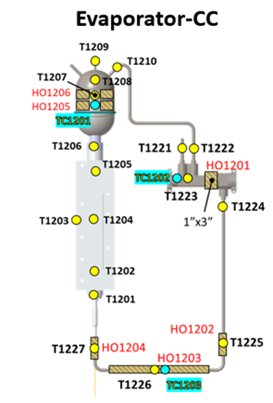
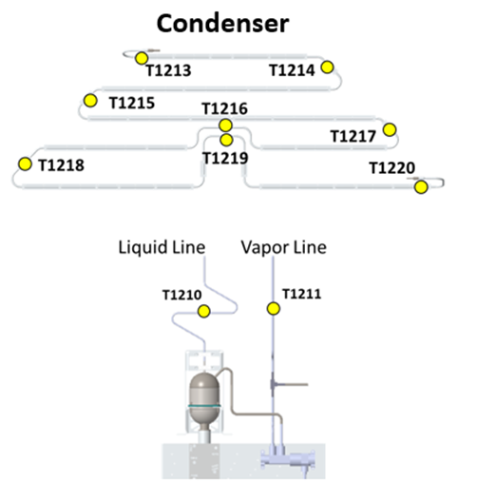
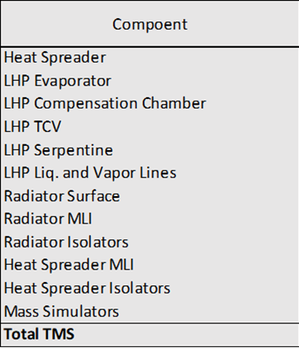
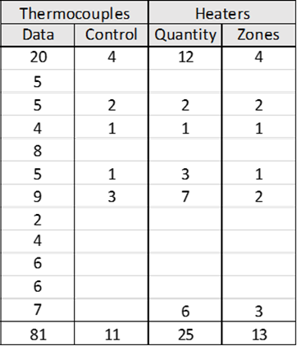
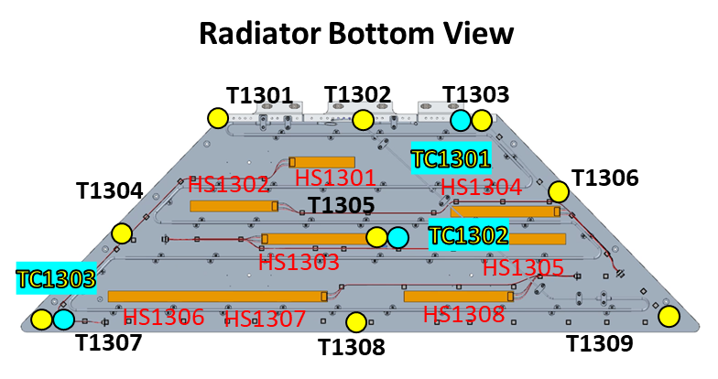
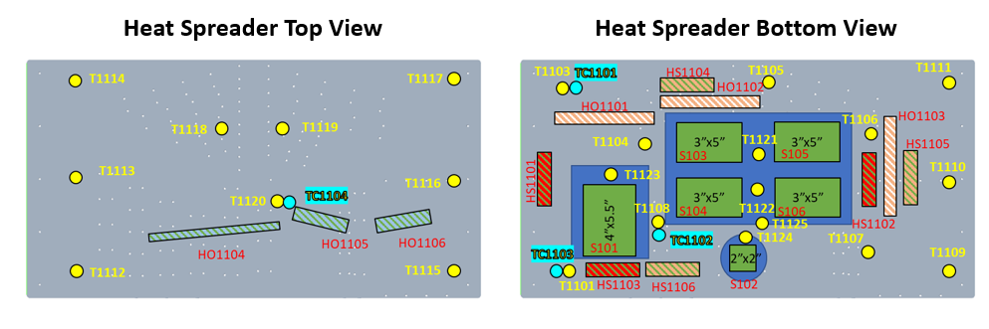
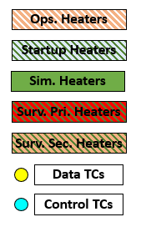
TVAC #4 Instrumentation
TVAC #1
TVAC #4

Slide 7
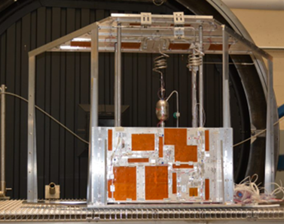
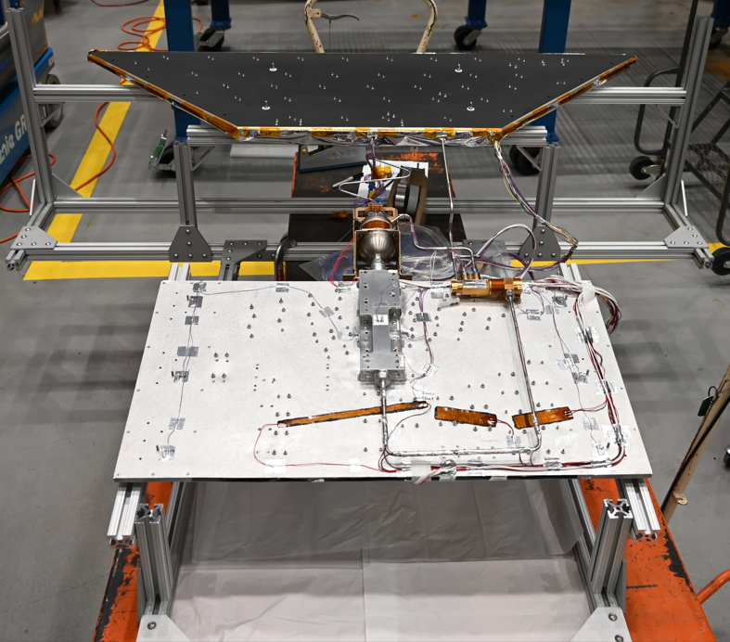
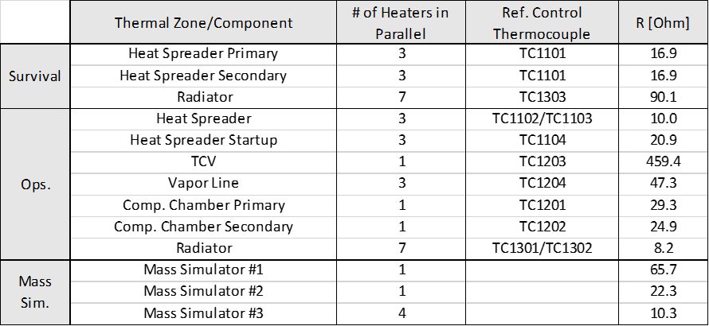
Power Control System
Three heater power control system strategies:
Constant power mode, no temperature feedback control.
Setting on/off temperature set points, simulating a mechanical thermostat control.
PID temperature control. When PID temperature control feedback loop was available, a control thermocouple was used as reference.
TVAC #1
TVAC #4

Slide 8
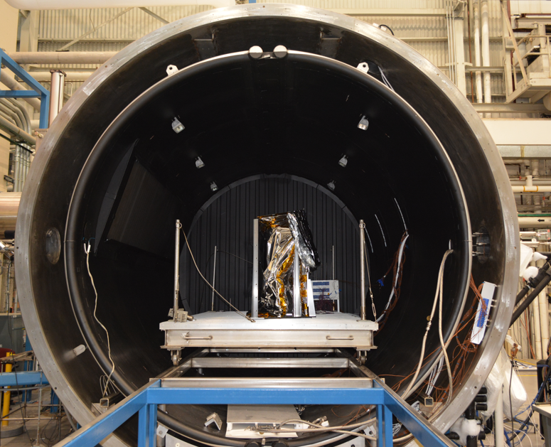
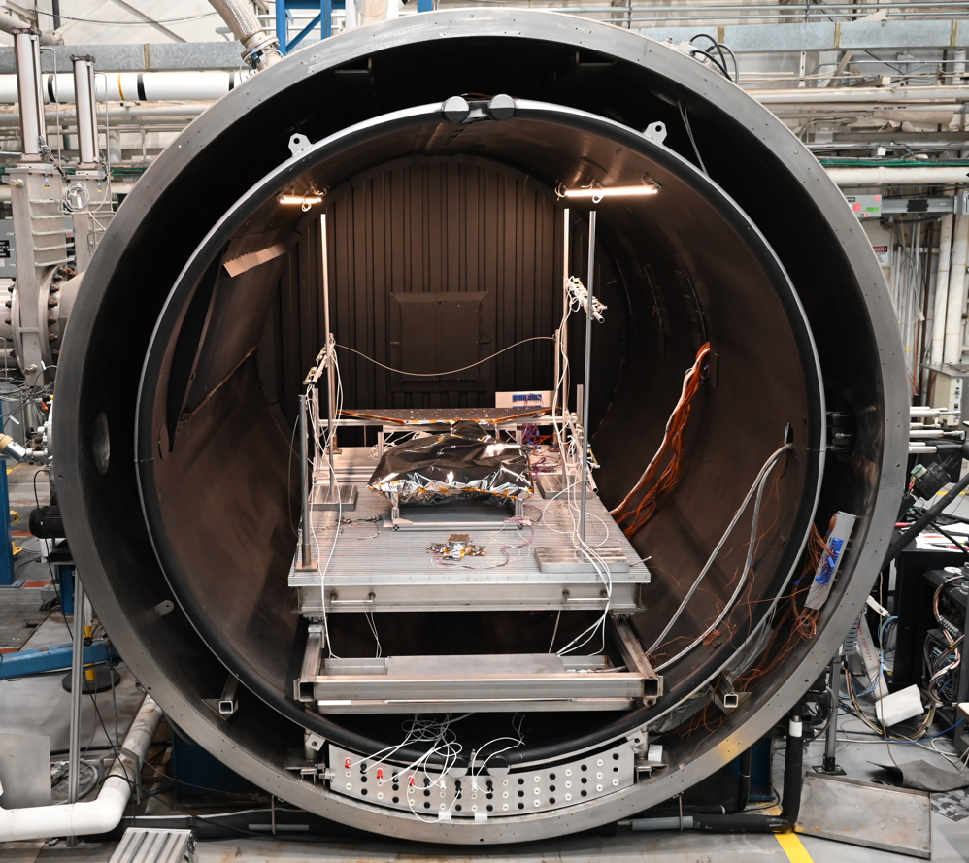
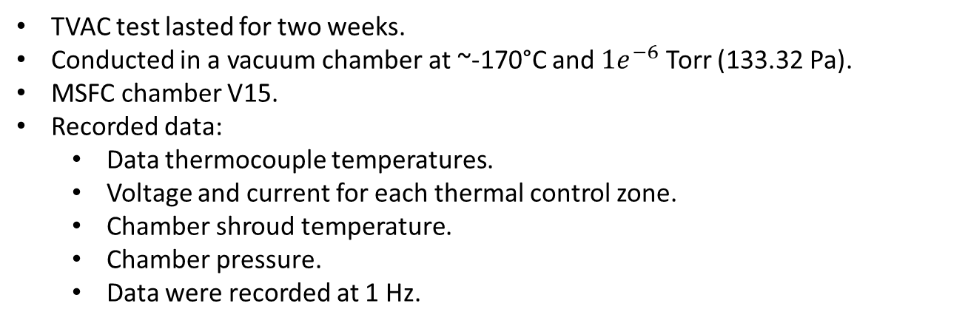
Test Environment: TVAC #1 and TVAC #4
TVAC test lasted for two weeks.
Conducted in a vacuum chamber at ~-170°C and $1e^{−6}$ Torr (133.32 Pa).
MSFC chamber V15.
Recorded data:
Data thermocouple temperatures.
Voltage and current for each thermal control zone.
Chamber shroud temperature.
Chamber pressure.
Data were recorded at 1 Hz.

Slide 9
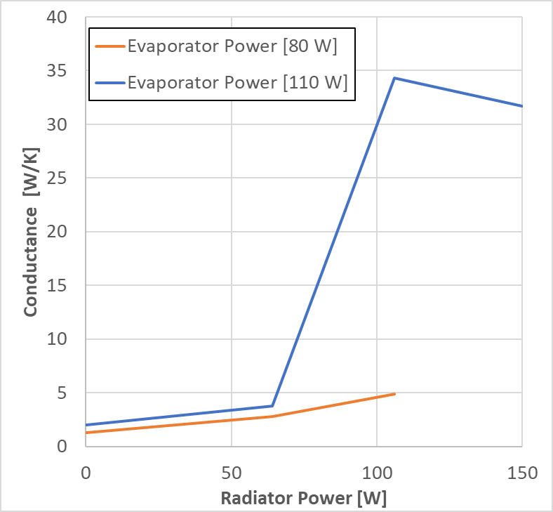
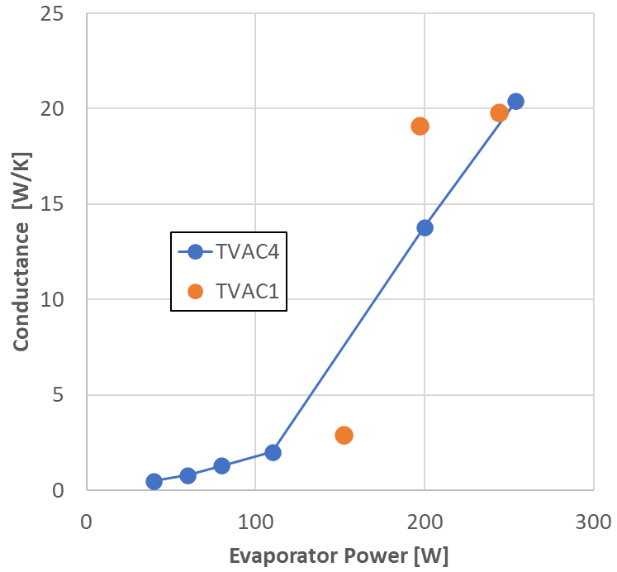
LHP Steady Ops.
Radiator heat to simulate different Tsink:
64 W = -53°C
106 W = -24°C
150 W = -3°C
LHP Conductance as measure of the LHP steady state performance
No heat on the radiator, Tsink = 148°C

Slide 10
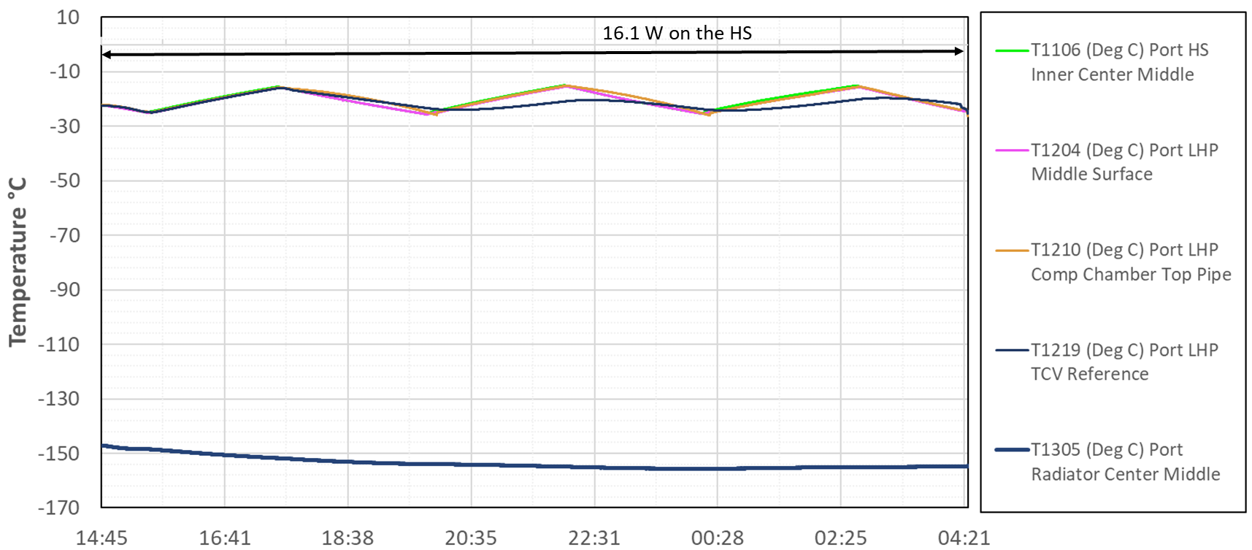
Hibernation TVAC #1
Several conditions tested:
Thermostat Temp set point: --30°C -16.11°C.
Baseline -22.1°C.
Heater power: 16.1 W
Duty cycle: 8.5 W
LHP in reverse flow.
Tested without TCV with PID temperature control set point at -22.1°C.: 95.8 W

Slide 11
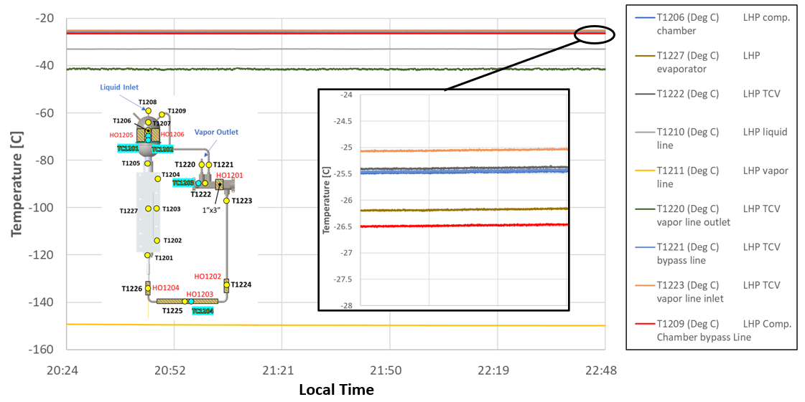
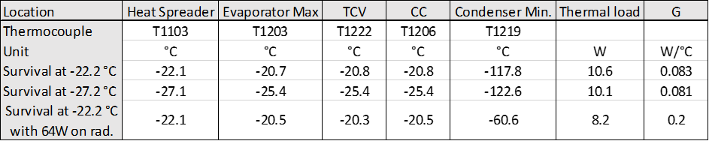
Hibernation TVAC #4
Several conditions tested:
Baseline -22.1°C.
Cold set point -27.1°C.
Intermediate hibernation with sun heating the radiator, 64W, effective Tsink -53°C.
LHP in reverse flow.

Slide 12
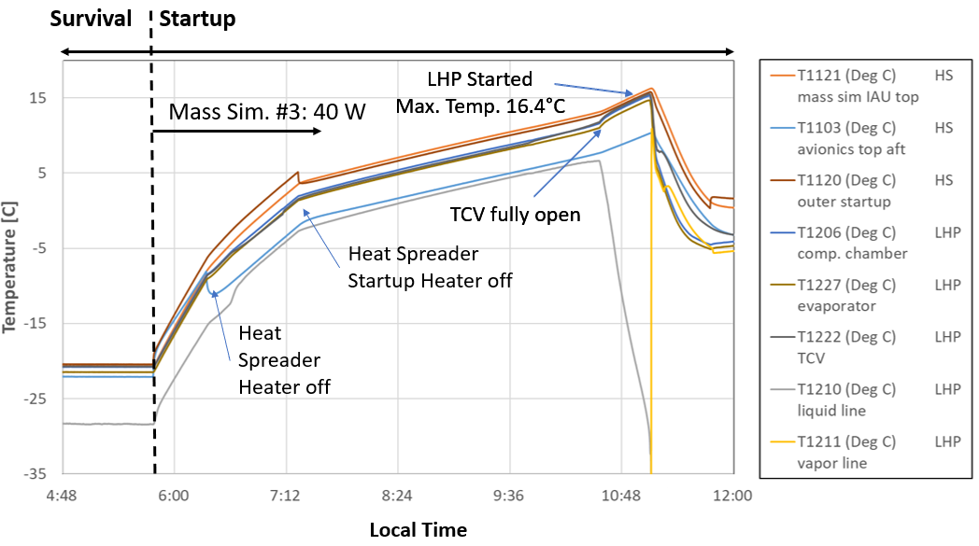
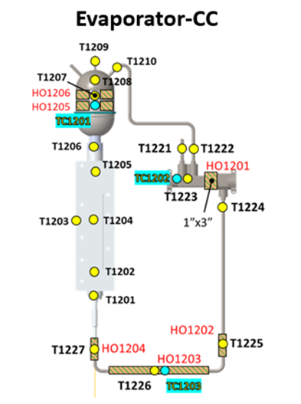
LHP Startup
Wakeup post-hibernation:
Heaters are set to bring the warmbox temperature within operational temperature.
Two heaters working in parallel with two different on/off temperature set points.
Some components, IAU and transceiver, are powered on automatically (mass sim. #3).
During hibernation, the LHP stayed in reverse flow. Liquid line TC temperature hotter than vapor line TC temperature.
LHP shifted to forward flow when the TCV reached its fully open temperature set point (blocking the flow through the TCV bypass line into the CC).
Consistent and repetitive LHP startup except when forcing the LHP into reverse flow using the CC heaters (hot shutdown). In that scenario, vapor line heaters power on is needed to force the LHP into forward flow.

Slide 13
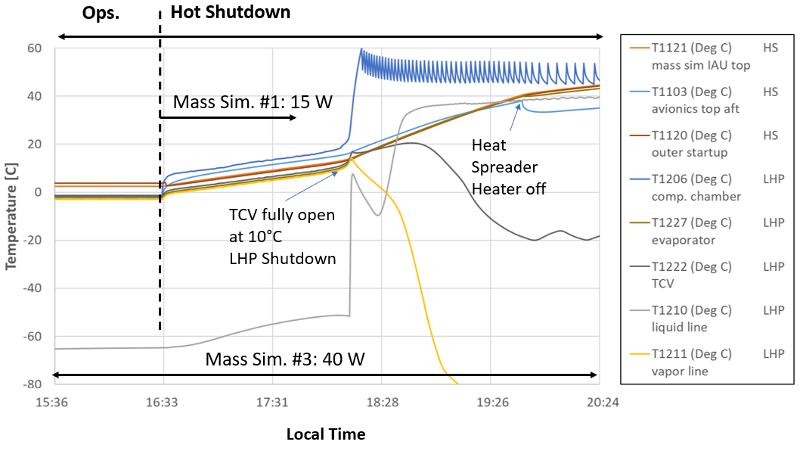
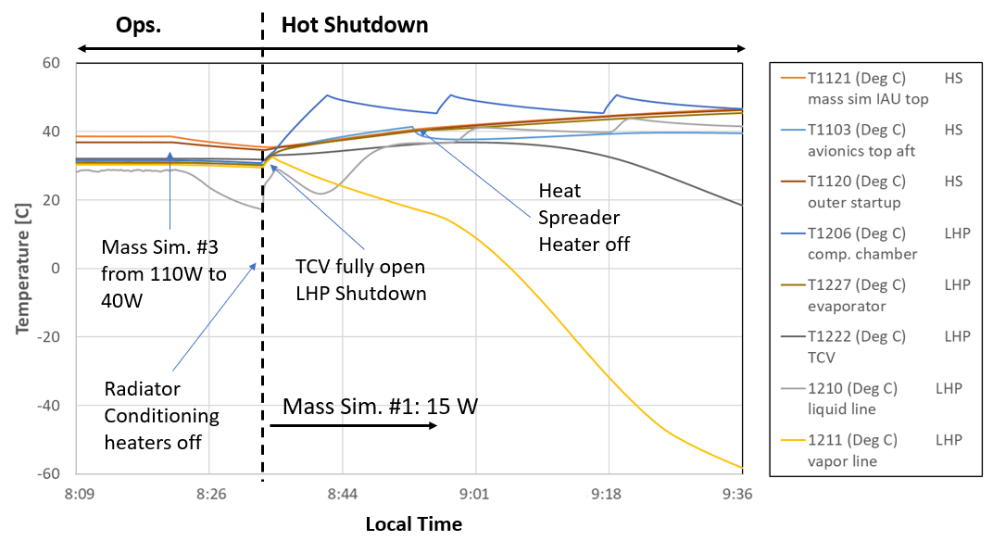
LHP Hot Shutdown
LHP hot Shutdown:
Reduce the LHP heat transport capability to increase the avionic boxes temperature and perform bakeout.
LHP hot shutdown initialized by applying:
36 W on the CC heaters with on/off temperature set point of 45°C/50°C.
Mass simulator #1 with constant 15 W.
Mass simulator #3 with constant 40 W.
45 W on the heat spreader heaters with on/off temperature set point of 35°C/40°C.
The initial condition was steady ops. at ~0°C. This implies the TCV was partially open, allowing CC vapor to flow into the radiator. LHP shutdown happened when the TCV became fully open.
When the initial condition was changed to +25°C the LHP shutdown happened almost immediately confirming the TCV bypass hypothesis.

Slide 14
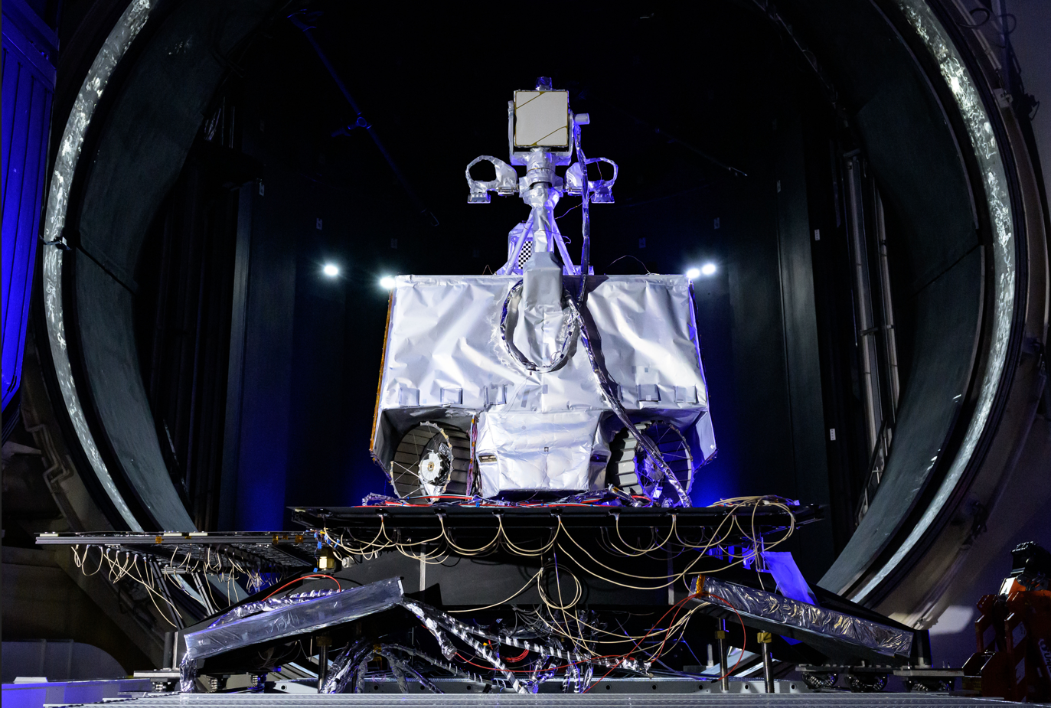
Summary
LHP can operate stable under Earth and Moon-like environment for a broad range of thermal loads.
Data to model and correlate LHP performance. Specifically, steady state tests provided a relationship between the LHP heat transport capacity as a function of the thermal loads and evaporator and condenser temperatures.
LHP heat transport was significantly reduced during hibernation by incorporating a TCV into the LHP design.
Successful LHP self-startup post hibernation. Tested heating the vapor line when assistance to force forward flow was needed.
Successful LHP hot shutdown by heating the CC.
Practice flight rules and thermal console operator training. LHP startup and hot shutdown allowed for a real-life console operator practice.

Slide 15
Questions?
Acknowledgments
The authors would like to thank Marshall Space Flight Center ET20 environmental test facility team, ES22 and EV34 thermal analysts for their support in carrying out the TVAC test.
The authors would also like to thank Dmitry Khrustalev whose support and contributions were crucial to the success of the test campaign.

