Slide 1





An Upscaled Continuum Framework with Improved Force Closure For Flow over Heterogeneous Porous Structures
Daniel Fust
Sourabh Apte
Acknowledgements: Drs. S. Balachandar, M. Khanwale, S. Jain, J. Wang, & X. He
Thermal & Fluids Analysis Workshop 2025
Frontera

Slide 2
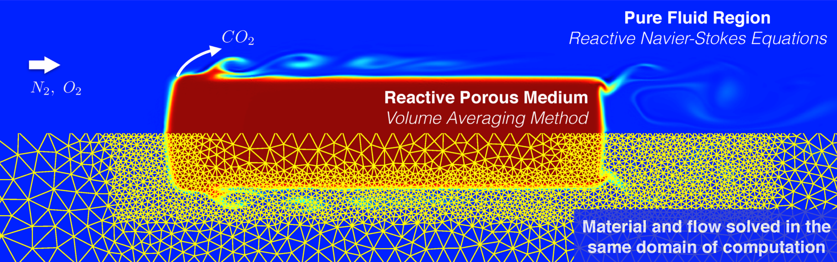
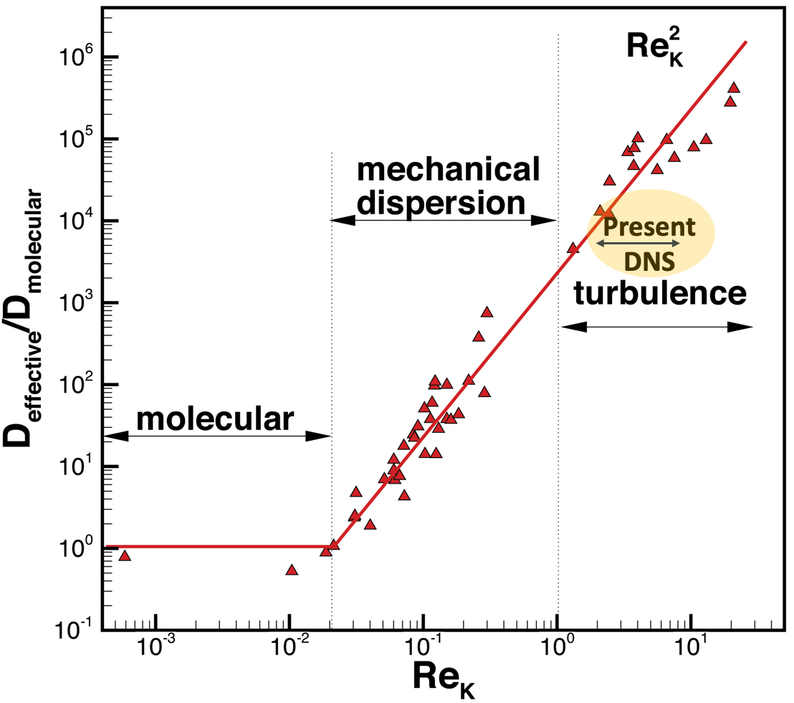
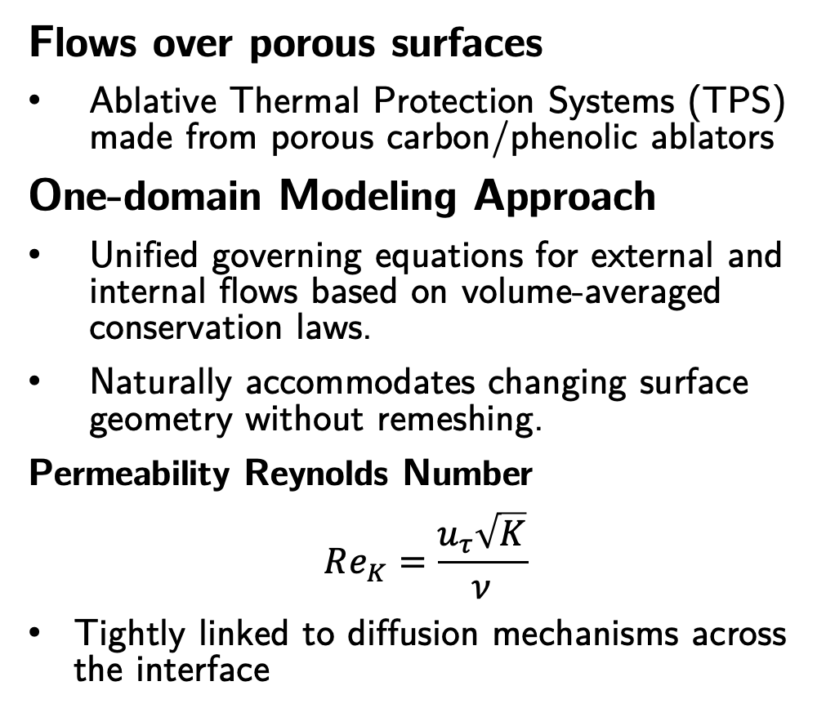
Motivation
Flows over porous surfaces
Ablative Thermal Protection Systems (TPS) made from porous carbon/phenolic ablators
One-domain Modeling Approach
Unified governing equations for external and internal flows based on volume-averaged conservation laws.
Naturally accommodates changing surface geometry without remeshing.
Permeability Reynolds Number
$$Re_{K}=\frac{u_{τ}\sqrt{K}}{ν}$$
Tightly linked to diffusion mechanisms across the interface
From Mansour et al. Annu. Rev. Fluid Mech. 2024
Darcy flow
Inertial flow
Karra
Present DNS
Turbulent flow .
Effective diffusion coefficient vs. $Re_{K}$. Modified from Karra, Apte, etal. (JFM 2023)
based on Voermans et al (JFM, 2017)

Slide 3
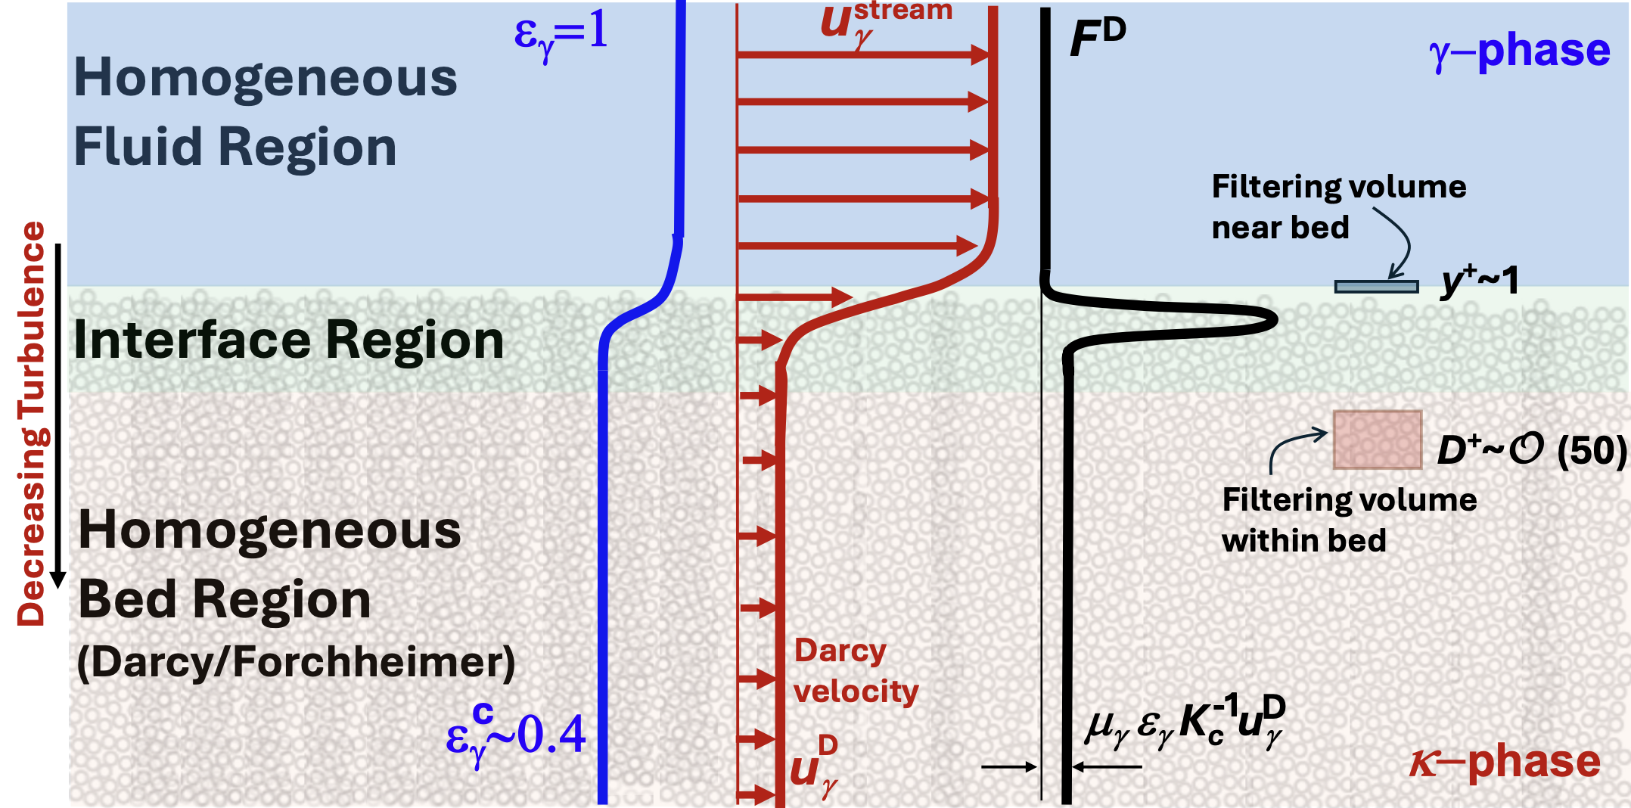
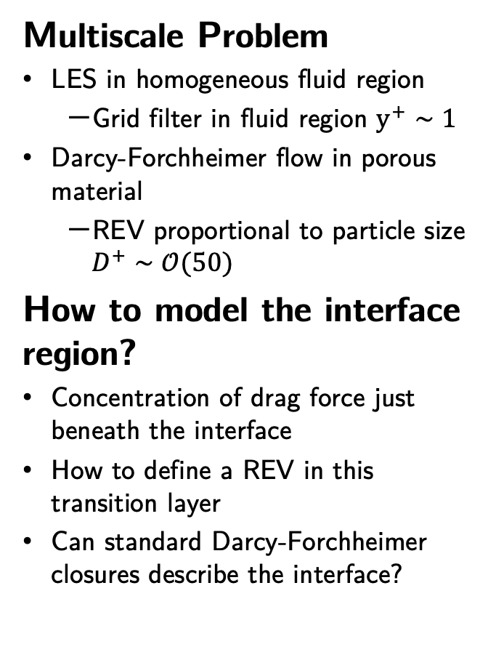
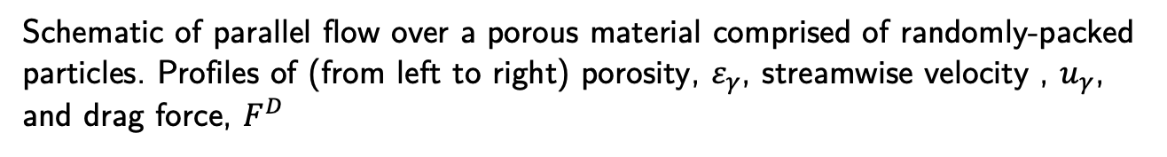
Toward Upscaled Models
Multiscale Problem
LES in homogeneous fluid region
Grid filter in fluid region $y^{+}∼1$
Darcy-Forchheimer flow in porous material
REV proportional to particle size $D^{+}∼𝒪(50)$
How to model the interface region?
Concentration of drag force just beneath the interface
How to define a REV in this transition layer
Can standard Darcy-Forchheimer closures describe the interface?
Schematic of parallel flow over a porous material comprised of randomly-packed particles. Profiles of (from left to right) porosity, $ε_{γ}$, streamwise velocity , $u_{γ}$, and drag force, $F^{D}$

Slide 4
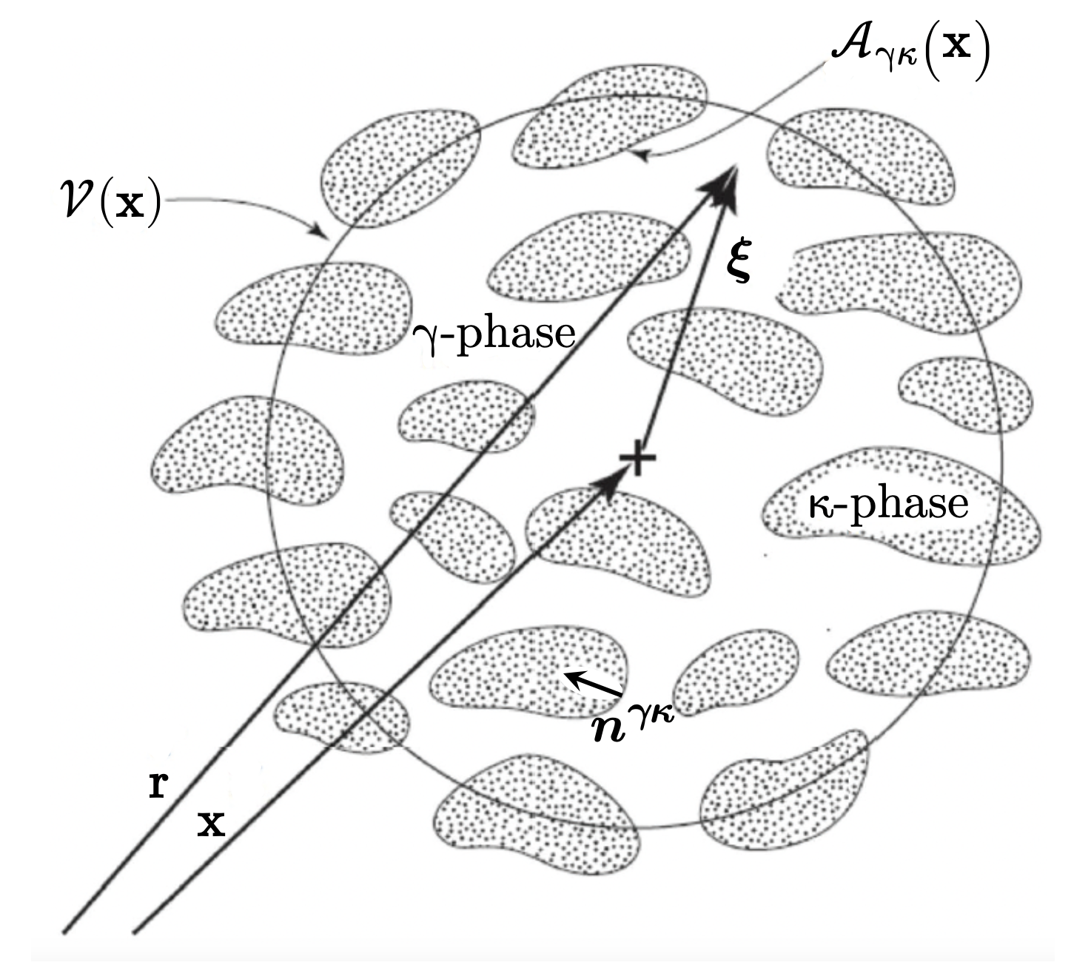
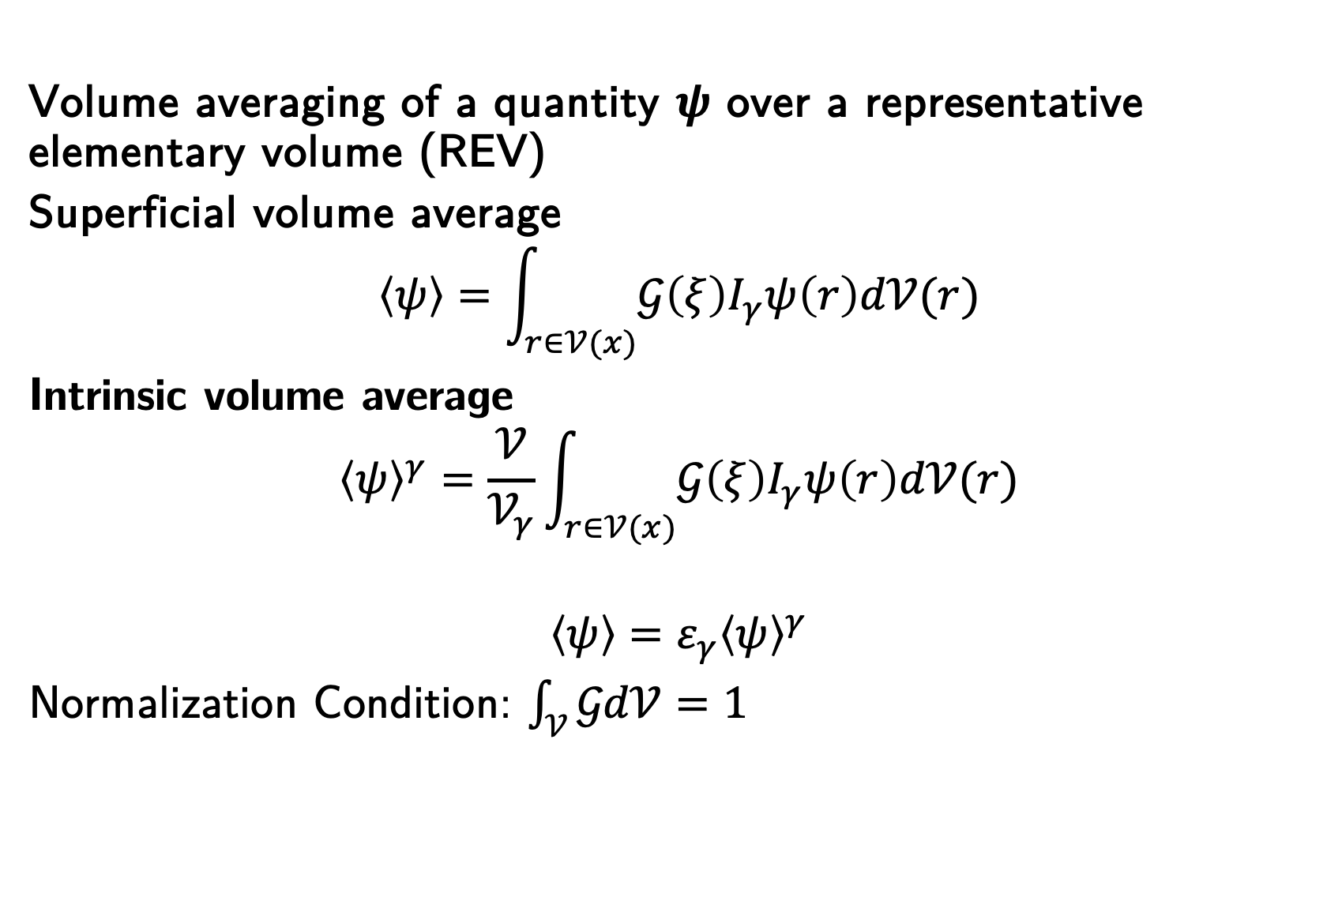
Spatial Averaging
Volume averaging of a quantity $ψ$ over a representative elementary volume (REV)
Superficial volume average
$$\left\langle ψ\right\rangle =\int_{r∈𝒱(x)}{𝒢\left(ξ\right)I_{γ}ψ\left(r\right)d𝒱(r)}$$
Intrinsic volume average
$${\left\langle ψ\right\rangle }^{γ}=\frac{𝒱}{𝒱_{γ}}\int_{r∈𝒱(x)}{𝒢\left(ξ\right)I_{γ}ψ\left(r\right)d𝒱(r)}$$
$$\left\langle ψ\right\rangle =ε_{γ}{\left\langle ψ\right\rangle }^{γ}$$
Normalization Condition: $\int_{𝒱}{𝒢d𝒱=1}$
Kernel
Indicator
porosity
Schematic of a representative elementary volume

Slide 5
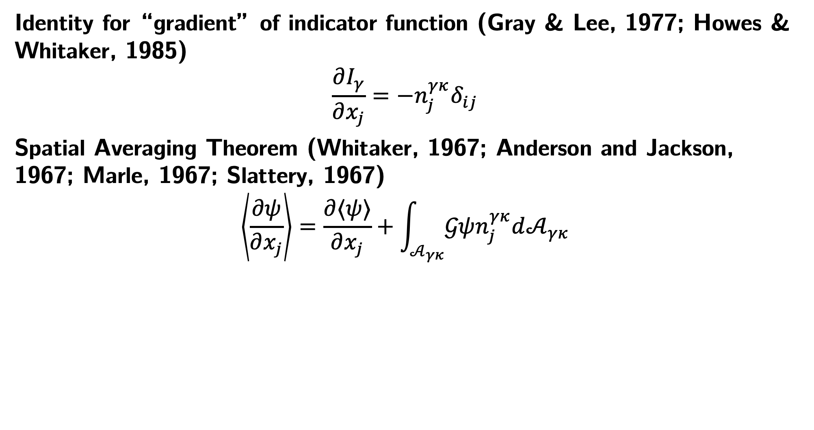
Spatial Averaging Theorem
Identity for “gradient” of indicator function (Gray & Lee, 1977; Howes & Whitaker, 1985)
$$\frac{∂I_{γ}}{∂x_{j}}={−n}_{j}^{γκ}δ_{ij}$$
Spatial Averaging Theorem (Whitaker, 1967; Anderson and Jackson, 1967; Marle, 1967; Slattery, 1967)
$$\left\langle \frac{∂ψ}{∂x_{j}}\right\rangle =\frac{∂⟨ψ⟩}{∂x_{j}}+\int_{𝒜_{γκ}}{𝒢ψn_{j}^{γκ}d𝒜_{γκ}}$$
Integration over surface of porous microstructure

Slide 6
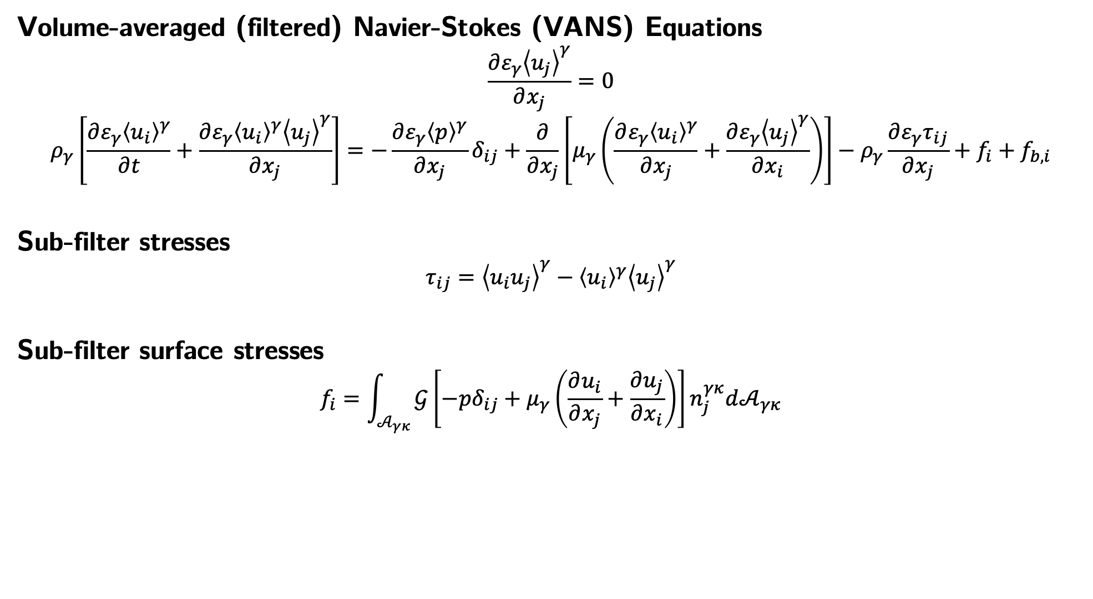
Volume-averaged Navier-Stokes Equations
Volume-averaged (filtered) Navier-Stokes (VANS) Equations
$$\frac{∂ε_{γ}{\left\langle u_{j}\right\rangle }^{γ}}{∂x_{j}}=0$$
$$ρ_{γ}\left[\frac{∂{ε_{γ}\left\langle u_{i}\right\rangle }^{γ}}{∂t}+\frac{∂ε_{γ}{\left\langle u_{i}\right\rangle }^{γ}{\left\langle u_{j}\right\rangle }^{γ}}{∂x_{j}}\right]=−\frac{∂ε_{γ}{\left\langle p\right\rangle }^{γ}}{∂x_{j}}δ_{ij}+\frac{∂}{∂x_{j}}\left[μ_{γ}\left(\frac{∂ε_{γ}{\left\langle u_{i}\right\rangle }^{γ}}{∂x_{j}}+\frac{∂ε_{γ}{\left\langle u_{j}\right\rangle }^{γ}}{∂x_{i}}\right)\right]−ρ_{γ}\frac{∂ε_{γ}τ_{ij}}{∂x_{j}}+f_{i}+f_{b,i}$$
Sub-filter stresses
$$τ_{ij}={\left\langle u_{i}u_{j}\right\rangle }^{γ}−{\left\langle u_{i}\right\rangle }^{γ}{\left\langle u_{j}\right\rangle }^{γ}$$
Sub-filter surface stresses
$$f_{i}=\int_{𝒜_{γκ}}{𝒢\left[−pδ_{ij}+μ_{γ}\left(\frac{∂u_{i}}{∂x_{j}}+\frac{∂u_{j}}{∂x_{i}}\right)\right]n_{j}^{γκ}d𝒜_{γκ}}$$

Slide 7
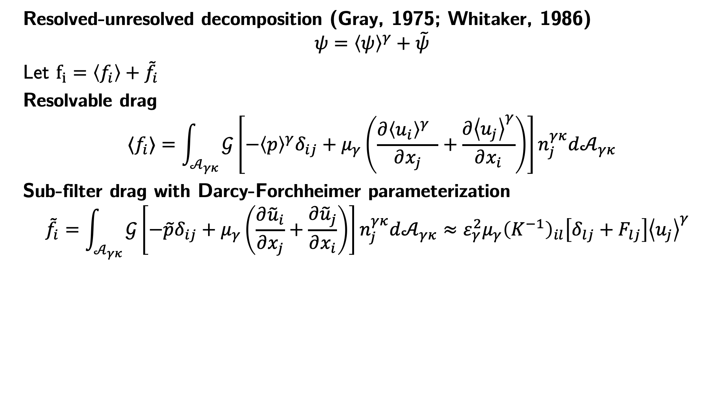
Decomposition of the Sub-filter Stresses
Resolved-unresolved decomposition (Gray, 1975; Whitaker, 1986)
$$ψ={\left\langle ψ\right\rangle }^{γ}+\tilde{ψ}$$
Let $f_{i}=\left\langle f_{i}\right\rangle +{\tilde{f}}_{i}$
Resolvable drag
$$⟨f_{i}⟩=\int_{𝒜_{γκ}}{𝒢\left[−{\left\langle p\right\rangle }^{γ}δ_{ij}+μ_{γ}\left(\frac{∂{\left\langle u_{i}\right\rangle }^{γ} }{∂x_{j}}+\frac{∂{\left\langle u_{j}\right\rangle }^{γ}}{∂x_{i}}\right)\right]n_{j}^{γκ}d𝒜_{γκ}}$$
Sub-filter drag with Darcy-Forchheimer parameterization
$${\tilde{f}}_{i}=\int_{𝒜_{γκ}}{𝒢\left[−\tilde{p}δ_{ij}+μ_{γ}\left(\frac{∂{\tilde{u}}_{i}}{∂x_{j}}+\frac{∂{\tilde{u}}_{j}}{∂x_{i}}\right)\right]n_{j}^{γκ}d𝒜_{γκ}}≈ε_{γ}^{2}μ_{γ}{\left(K^{−1}\right)}_{il}\left[δ_{lj}+F_{lj}\right]{\left\langle u_{j}\right\rangle }^{γ}$$
Darcy-Forchheimer approximation

Slide 8
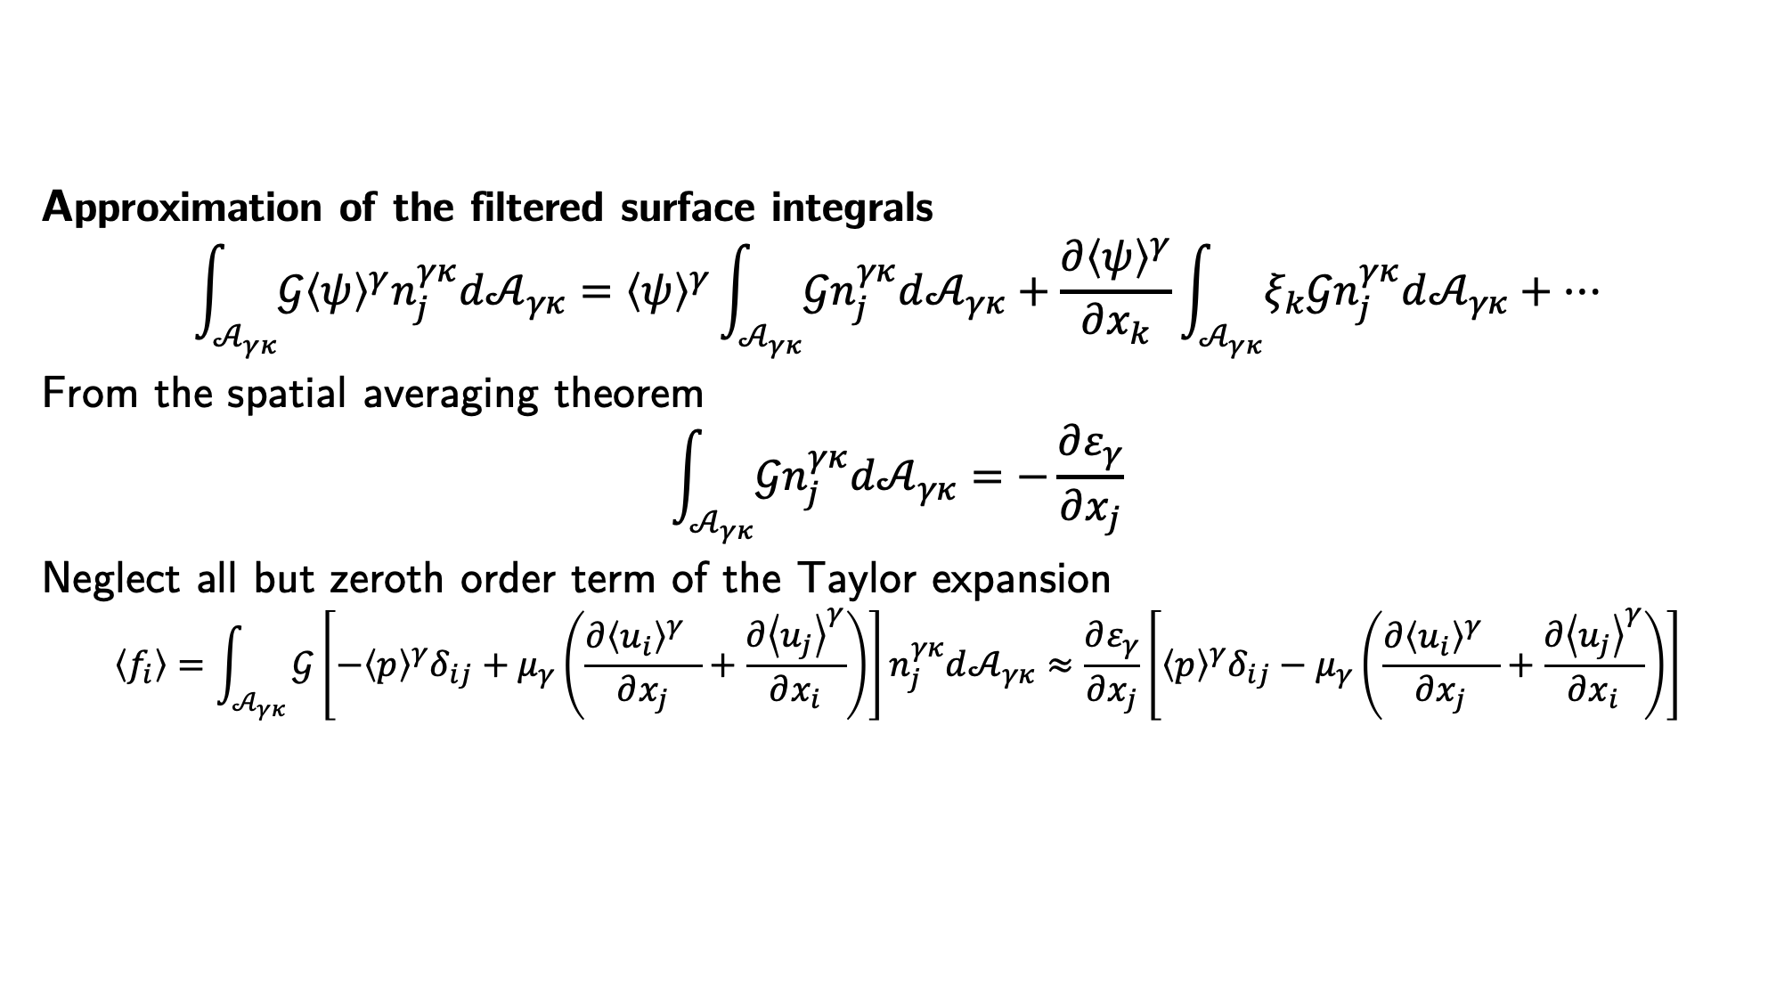
Decomposition of the Sub-filter Stresses
Approximation of the filtered surface integrals
$$\int_{𝒜_{γκ}}{𝒢{\left\langle ψ\right\rangle }^{γ}n_{j}^{γκ}d𝒜_{γκ}}={\left\langle ψ\right\rangle }^{γ}\int_{𝒜_{γκ}}{𝒢n_{j}^{γκ}d𝒜_{γκ}}+\frac{∂{\left\langle ψ\right\rangle }^{γ}}{∂x_{k}}\int_{𝒜_{γκ}}{ξ_{k}𝒢n_{j}^{γκ}d𝒜_{γκ}}+…$$
From the spatial averaging theorem
$$\int_{𝒜_{γκ}}{𝒢n_{j}^{γκ}d𝒜_{γκ}}=−\frac{∂ε_{γ}}{∂x_{j}}$$
Neglect all but zeroth order term of the Taylor expansion
$$\left\langle f_{i}\right\rangle =\int_{𝒜_{γκ}}{𝒢\left[−{\left\langle p\right\rangle }^{γ}δ_{ij}+μ_{γ}\left(\frac{∂{\left\langle u_{i}\right\rangle }^{γ} }{∂x_{j}}+\frac{∂{\left\langle u_{j}\right\rangle }^{γ}}{∂x_{i}}\right)\right]n_{j}^{γκ}d𝒜_{γκ}}≈\frac{∂ε_{γ}}{∂x_{j}}\left[{\left\langle p\right\rangle }^{γ}δ_{ij}−μ_{γ}\left(\frac{∂{\left\langle u_{i}\right\rangle }^{γ} }{∂x_{j}}+\frac{∂{\left\langle u_{j}\right\rangle }^{γ}}{∂x_{i}}\right)\right]$$

Slide 9
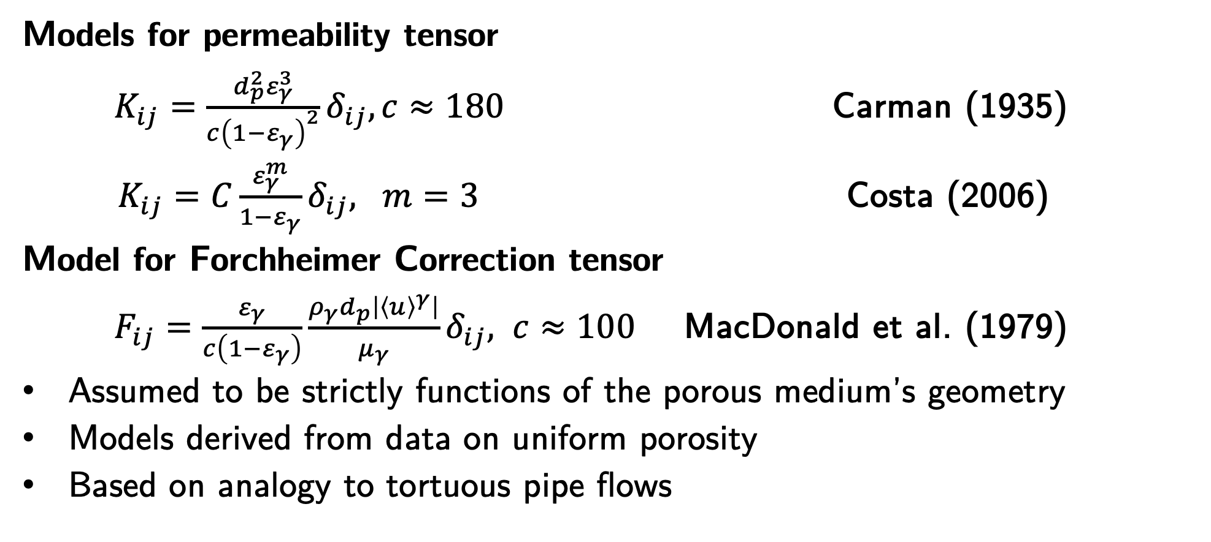
Permeability Models
Models for permeability tensor
$K_{ij}=\frac{d_{p}^{2}ε_{γ}^{3}}{c{\left(1−ε_{γ}\right)}^{2}}δ_{ij}, c≈180$ Carman (1935)
$K_{ij}=C\frac{ε_{γ}^{m}}{1−ε_{γ}}δ_{ij}, m=3$ Costa (2006)
Model for Forchheimer Correction tensor
$F_{ij}=\frac{ε_{γ}}{c\left(1−ε_{γ}\right)}\frac{ρ_{γ}d_{p}\left|{\left\langle u\right\rangle }^{γ}\right|}{μ_{γ}}δ_{ij}, c≈100$ MacDonald et al. (1979)
Assumed to be strictly functions of the porous medium’s geometry
Models derived from data on uniform porosity
Based on analogy to tortuous pipe flows

Slide 10
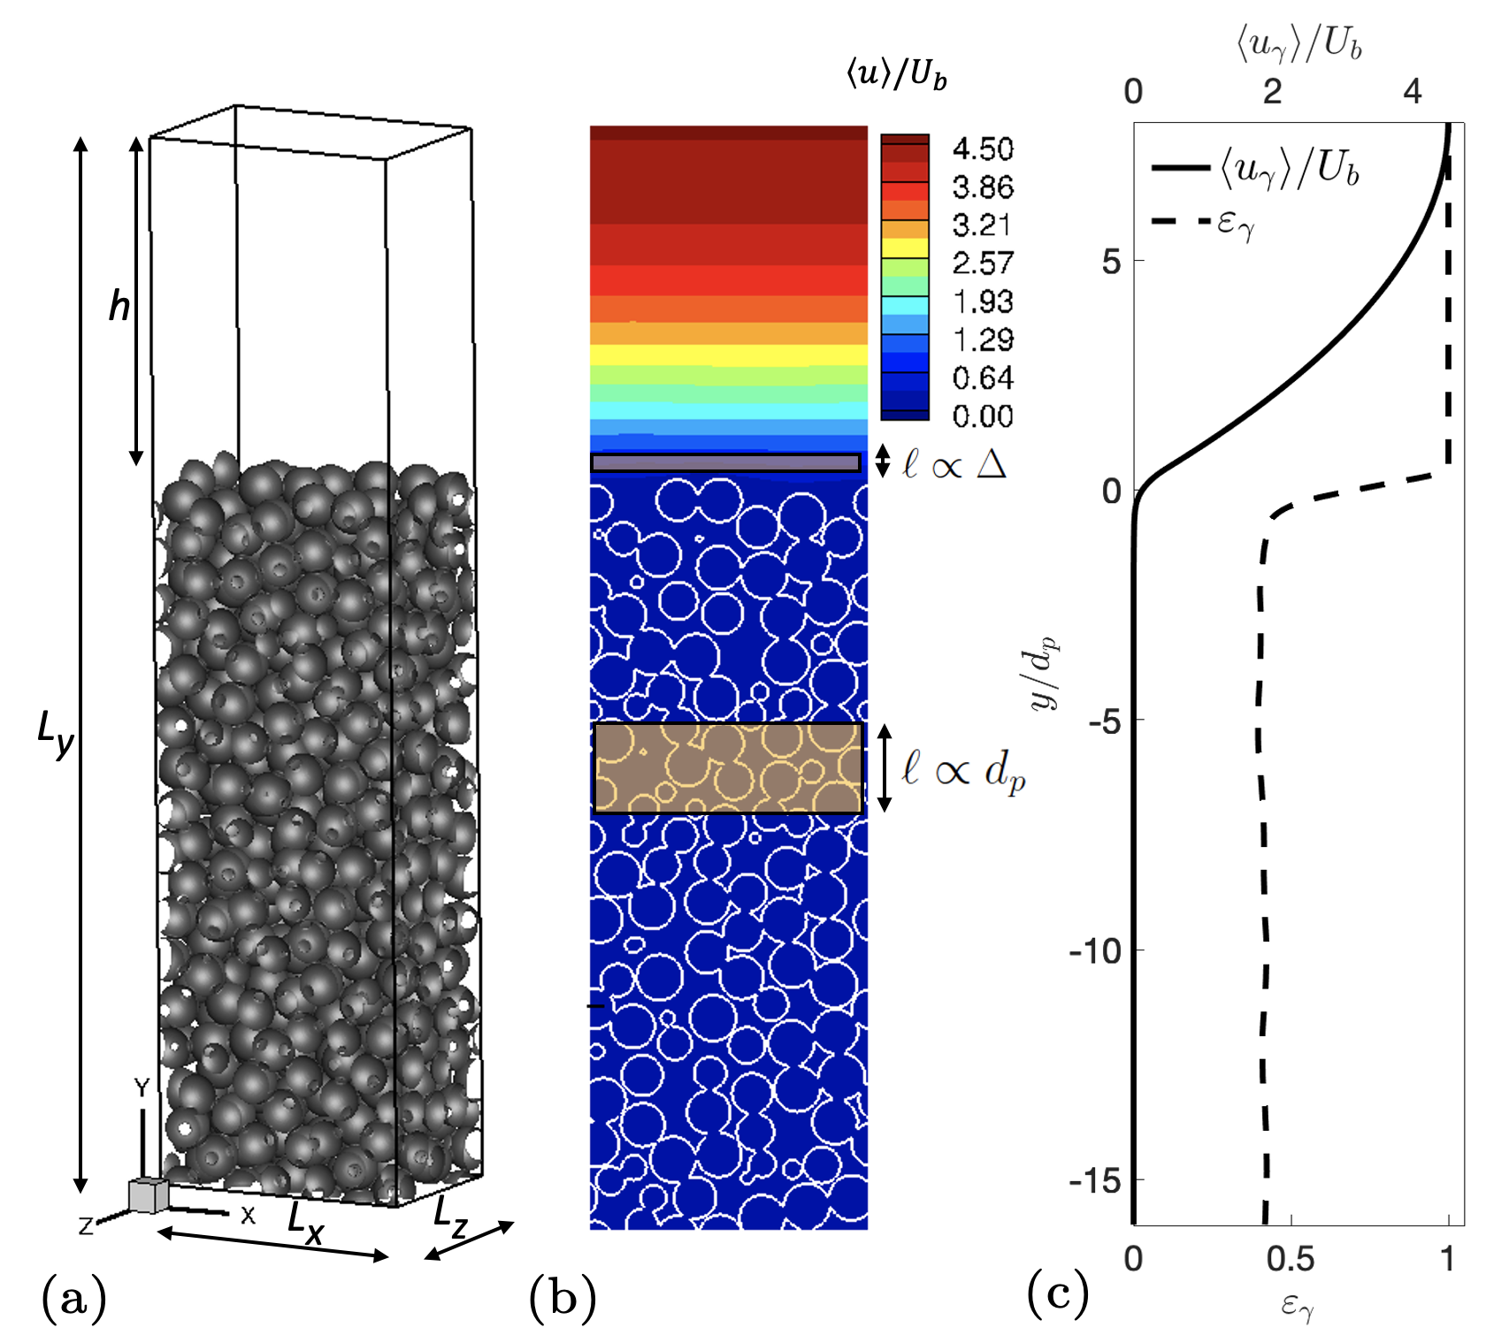
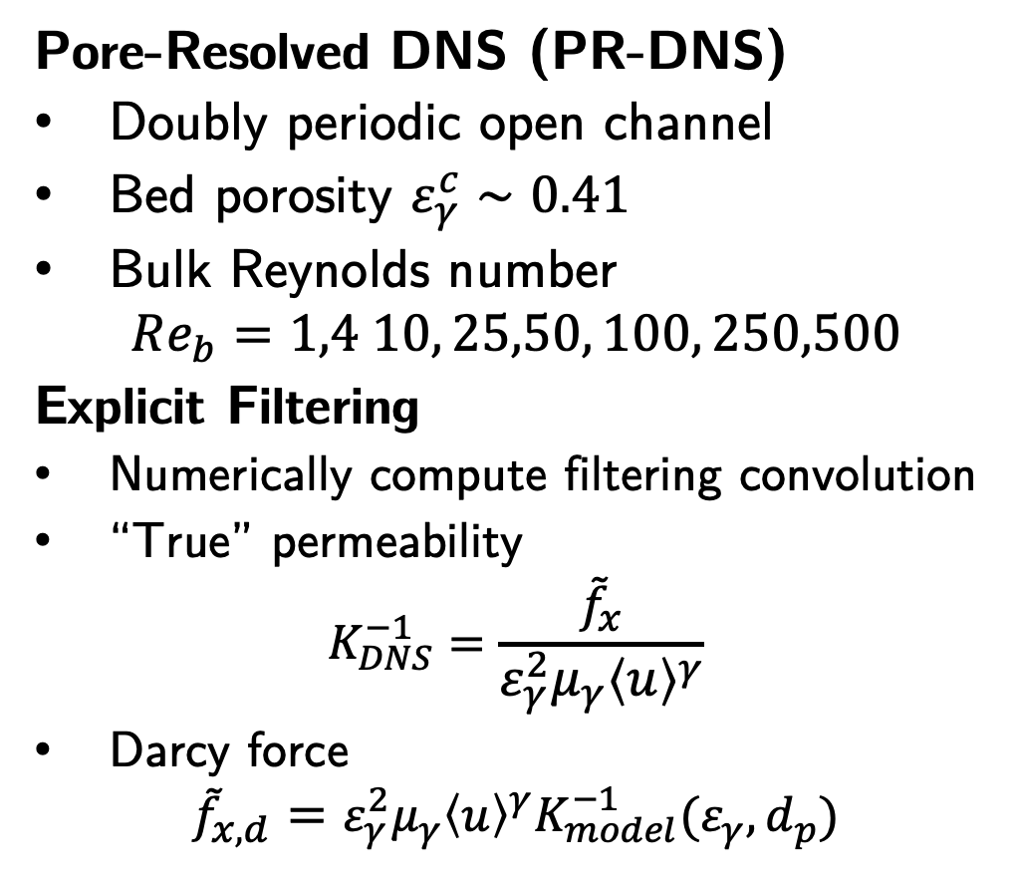
Numerical Experiments
Pore-Resolved DNS (PR-DNS)
Doubly periodic open channel
Bed porosity $ε_{γ}^{c}∼0.41$
Bulk Reynolds number
$$Re_{b}=1,4 10, 25,50, 100, 250,500$$
Explicit Filtering
Numerically compute filtering convolution
“True” permeability
$$K_{DNS}^{−1}=\frac{{\tilde{f}}_{x}}{ε_{γ}^{2}μ_{γ}{\left\langle u\right\rangle }^{γ}}$$
Darcy force
$${\tilde{f}}_{x,d}=ε_{γ}^{2}μ_{γ}{\left\langle u\right\rangle }^{γ}K_{model}^{−1}(ε_{γ},d_{p})$$

Slide 11
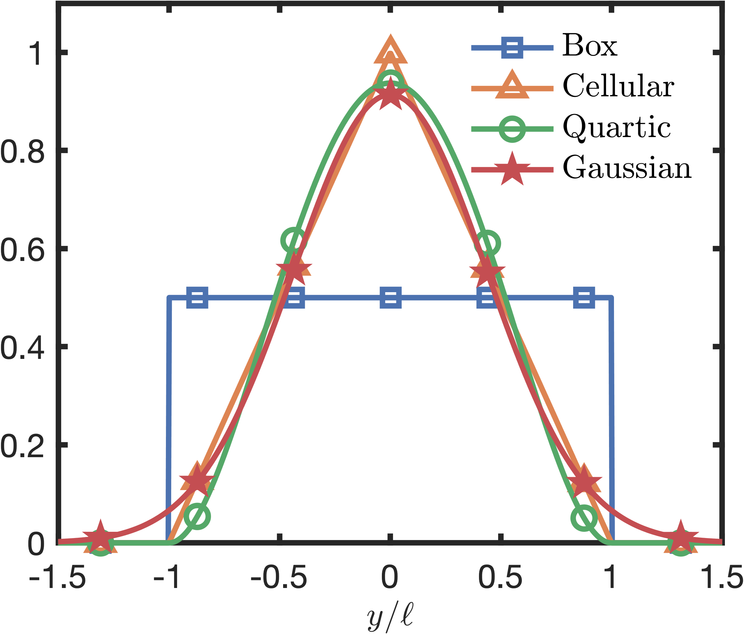
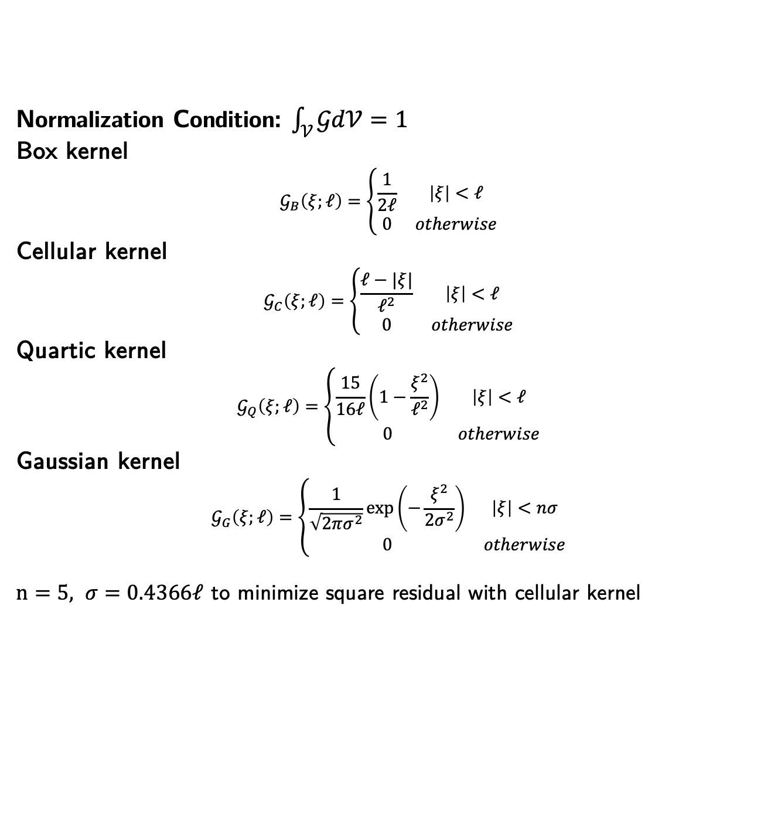
Filter Kernels
Normalization Condition: $\int_{𝒱}{𝒢d𝒱=1}$
Box kernel
$$𝒢_{B}\left(ξ;ℓ\right)=\left\{\begin{matrix}\frac{1}{2ℓ} & \left|ξ\right|<ℓ \\ 0 & otherwise\end{matrix}\right.$$
Cellular kernel
$$𝒢_{C}\left(ξ;ℓ\right)=\left\{\begin{matrix}\frac{ℓ−|ξ|}{ℓ^{2}} & \left|ξ\right|<ℓ \\ 0 & otherwise\end{matrix}\right.$$
Quartic kernel
$$𝒢_{Q}\left(ξ;ℓ\right)=\left\{\begin{matrix}\frac{15}{16ℓ}\left(1−\frac{ξ^{2}}{ℓ^{2}}\right) & \left|ξ\right|<ℓ \\ 0 & otherwise\end{matrix}\right.$$
Gaussian kernel
$$𝒢_{G}\left(ξ;ℓ\right)=\left\{\begin{matrix}\frac{1}{\sqrt{2πσ^{2}}}\exp\left(−\frac{ξ^{2}}{2σ^{2}}\right) & \left|ξ\right|<nσ \\ 0 & otherwise\end{matrix}\right.$$
$n=5, σ=0.4366ℓ$ to minimize square residual with cellular kernel

Slide 12
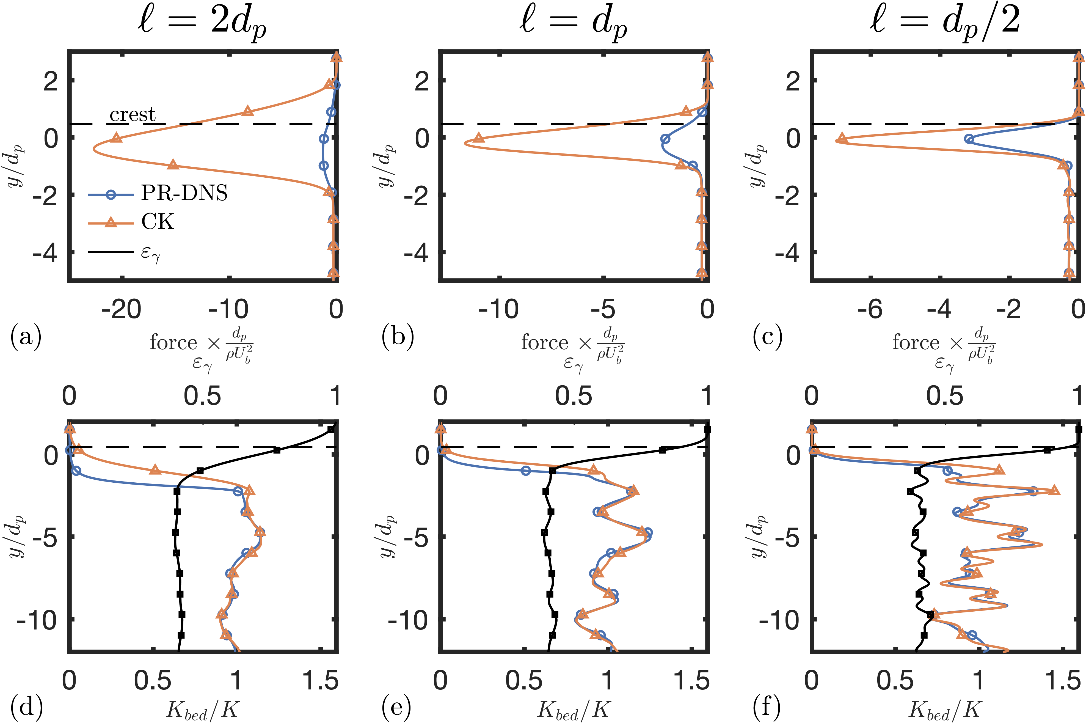
Explicit Filtering
Larger filter widths
Permeability models track PR-DNS deep in bed
Force is diffused far into free-stream
Drag prediction is poor at the interface
Darcy-Forchheimer force model sees erroneously velocity due to samples of free-stream.
Smaller filter widths
Better alignment of predicted drag peaks
Poorer alignment of permeability model and PR-DNS
(Top) Sub-filter drag forces from PR-DNS vs drag predicted from Dary parameterization; (Bottom) porosity and permeability from PR-DNS and from Carman-Kozeny model

Slide 13
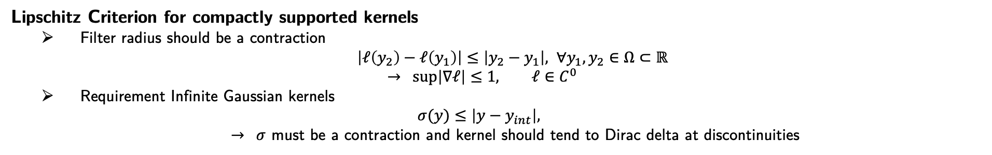
Variable Filtering
Can a variable-width filter leverages advantages of both large and small filters?
Varying filter length too quickly, filtering generates artificial peaks and breaks monotonicity
Lipschitz Criterion for compactly supported kernels
Filter radius should be a contraction
$\left|ℓ\left(y_{2}\right)−ℓ\left(y_{1}\right)\right|≤\left|y_{2}−y_{1}\right|, ∀y_{1},y_{2}∈Ω⊂ℝ$
$$→ \sup\left|∇ℓ\right|≤1, ℓ∈C^{0}$$
Requirement Infinite Gaussian kernels
$$σ(y)≤\left|y−y_{int}\right|,$$
$→ σ$ must be a contraction and kernel should tend to Dirac delta at discontinuities

Slide 14
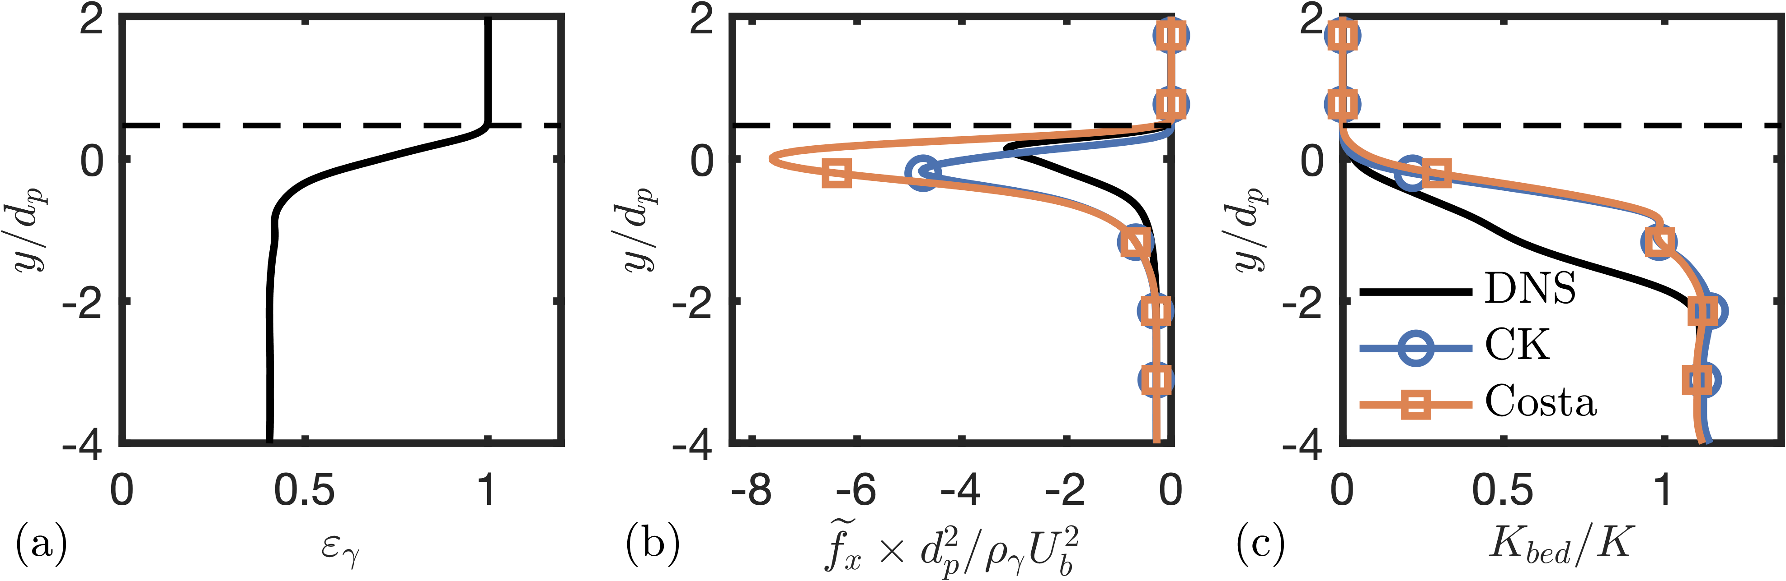
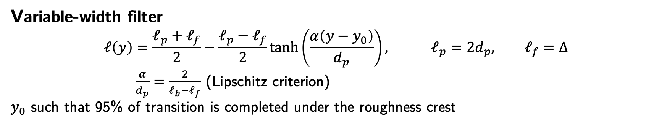
Variable Filtering
Variable-width filter
$$ℓ\left(y\right)=\frac{ℓ_{p}+ℓ_{f}}{2}−\frac{ℓ_{p}−ℓ_{f}}{2}\tanh\left(\frac{α\left(y−y_{0}\right)}{d_{p}}\right), ℓ_{p}=2d_{p}, ℓ_{f}=Δ$$
$\frac{α}{d_{p}}=\frac{2}{ℓ_{b}−ℓ_{f}}$ (Lipschitz criterion)
$y_{0}$ such that 95% of transition is completed under the roughness crest
Key takeaways
Sharpness of the interface is preserved
Darcy-Forchheimer parameterizations with standard permeability models still do not predictor force in the transition layer.

Slide 15
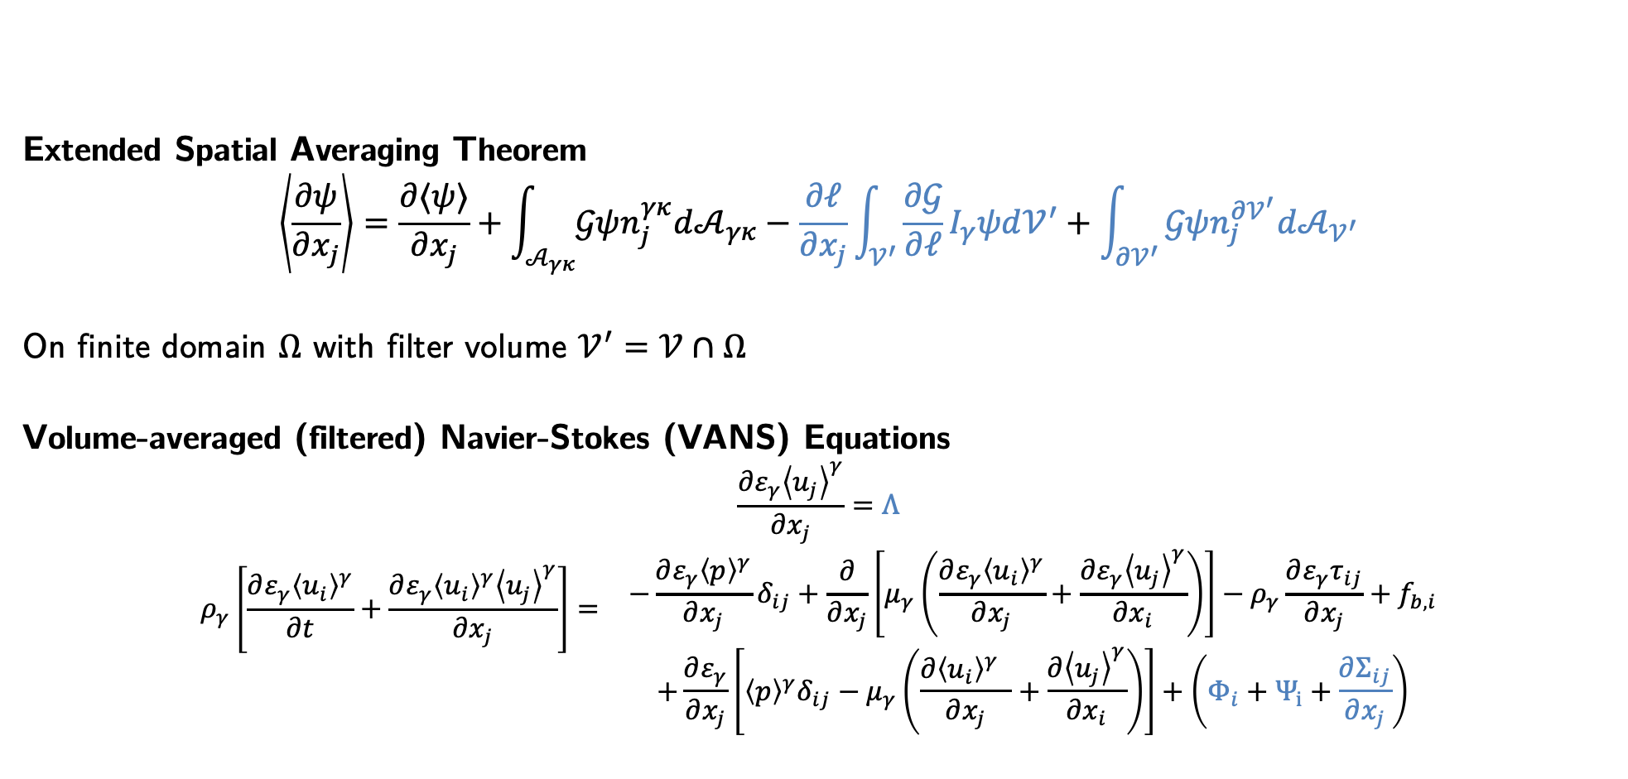
Modifications of VANS for Variable Filtering
Extended Spatial Averaging Theorem
$$\left\langle \frac{∂ψ}{∂x_{j}}\right\rangle =\frac{∂⟨ψ⟩}{∂x_{j}}+\int_{𝒜_{γκ}}{𝒢ψn_{j}^{γκ}d𝒜_{γκ}}−\frac{∂ℓ}{∂x_{j}}\int_{𝒱^{′}}{\frac{∂𝒢}{∂ℓ}I_{γ}ψd𝒱^{′}}+\int_{∂𝒱^{′}}{𝒢ψn_{j}^{∂𝒱^{′}}d𝒜_{𝒱^{′}}}$$
On finite domain $Ω$ with filter volume $𝒱^{′}=𝒱∩Ω$
Volume-averaged (filtered) Navier-Stokes (VANS) Equations
$$\frac{∂ε_{γ}{\left\langle u_{j}\right\rangle }^{γ}}{∂x_{j}}=Λ$$
$$\begin{matrix}\begin{aligned}ρ_{γ}\left[\frac{∂{ε_{γ}\left\langle u_{i}\right\rangle }^{γ}}{∂t}+\frac{∂ε_{γ}{\left\langle u_{i}\right\rangle }^{γ}{\left\langle u_{j}\right\rangle }^{γ}}{∂x_{j}}\right]= \\ \\ \end{aligned} & \begin{aligned}−\frac{∂ε_{γ}{\left\langle p\right\rangle }^{γ}}{∂x_{j}}δ_{ij}+\frac{∂}{∂x_{j}}\left[μ_{γ}\left(\frac{∂ε_{γ}{\left\langle u_{i}\right\rangle }^{γ}}{∂x_{j}}+\frac{∂ε_{γ}{\left\langle u_{j}\right\rangle }^{γ}}{∂x_{i}}\right)\right]−ρ_{γ}\frac{∂ε_{γ}τ_{ij}}{∂x_{j}}+f_{b,i} \\ +\frac{∂ε_{γ}}{∂x_{j}}\left[{\left\langle p\right\rangle }^{γ}δ_{ij}−μ_{γ}\left(\frac{∂{\left\langle u_{i}\right\rangle }^{γ} }{∂x_{j}}+\frac{∂{\left\langle u_{j}\right\rangle }^{γ}}{∂x_{i}}\right)\right]+\left(Φ_{i}+Ψ_{i}+\frac{∂Σ_{ij}}{∂x_{j}}\right)\end{aligned}\end{matrix}$$
Change in filter volume
Clipping by finite domain
Filter commutation term
Filter commutation terms

Slide 16
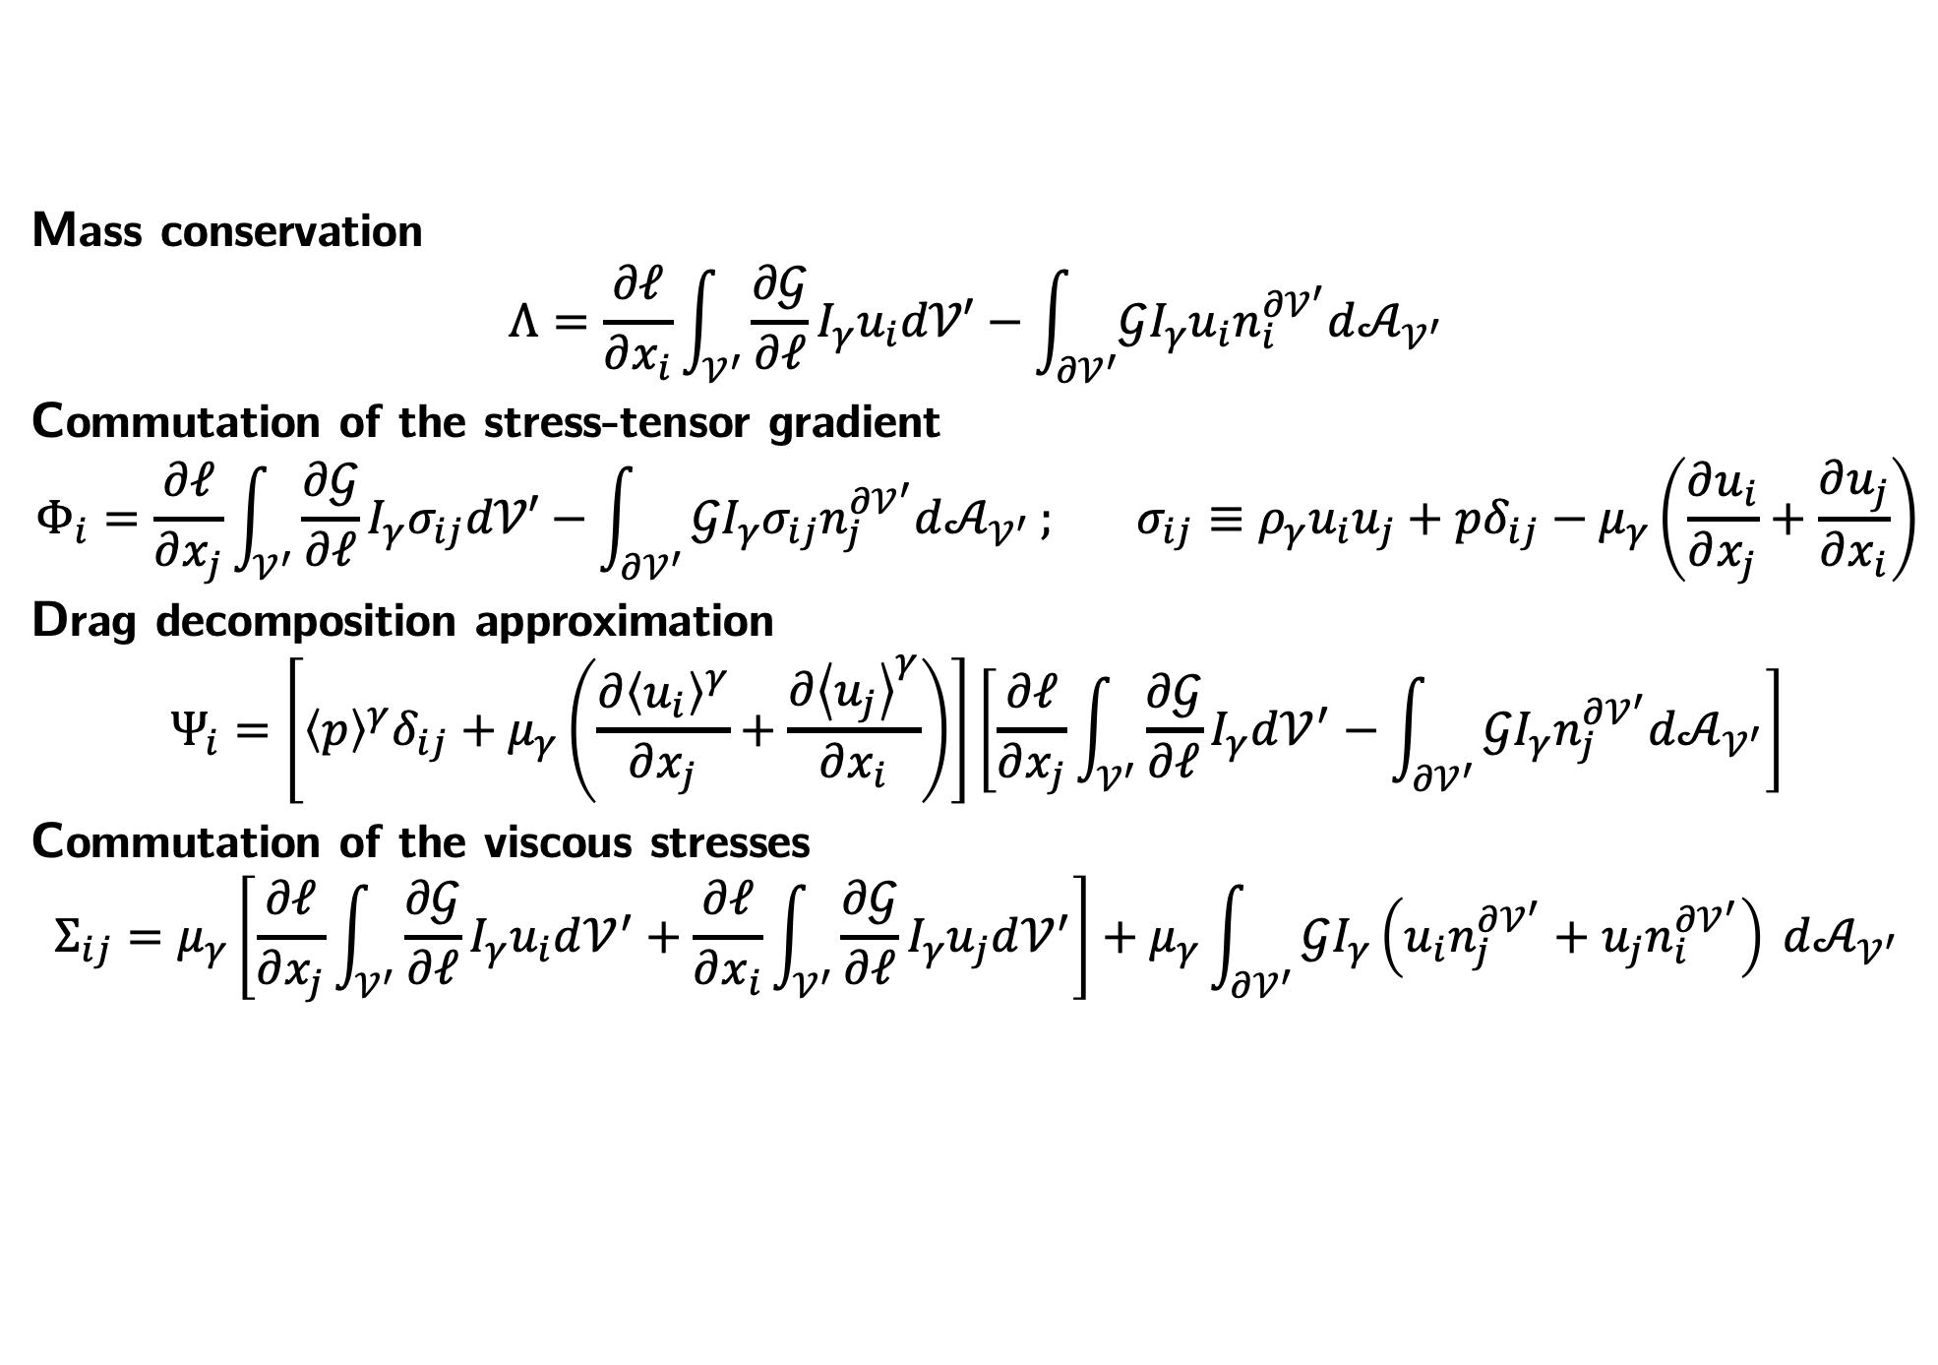
Filter Commutation Terms
Mass conservation
$$Λ=\frac{∂ℓ}{∂x_{i}}\int_{𝒱^{′}}{\frac{∂𝒢}{∂ℓ}I_{γ}u_{i}d𝒱′}−\int_{∂𝒱^{′}}{𝒢I_{γ}u_{i}n_{i}^{∂𝒱^{′}}d𝒜_{𝒱^{′}}}$$
Commutation of the stress-tensor gradient
$$Φ_{i}=\frac{∂ℓ}{∂x_{j}}\int_{𝒱^{′}}{\frac{∂𝒢}{∂ℓ}I_{γ}σ_{ij}d𝒱′}−\int_{∂𝒱^{′}}{𝒢I_{γ}σ_{ij}n_{j}^{∂𝒱^{′}}d𝒜_{𝒱^{′}}}; σ_{ij}≡ρ_{γ}u_{i}u_{j}+pδ_{ij}−μ_{γ}\left(\frac{∂u_{i}}{∂x_{j}}+\frac{∂u_{j}}{∂x_{i}}\right)$$
Drag decomposition approximation
$$Ψ_{i}=\left[{\left\langle p\right\rangle }^{γ}δ_{ij}+μ_{γ}\left(\frac{∂{\left\langle u_{i}\right\rangle }^{γ}}{∂x_{j}}+\frac{∂{\left\langle u_{j}\right\rangle }^{γ}}{∂x_{i}}\right)\right]\left[\frac{∂ℓ}{∂x_{j}}\int_{𝒱^{′}}{\frac{∂𝒢}{∂ℓ}I_{γ}d𝒱^{′}}−\int_{∂𝒱^{′}}{𝒢I_{γ}n_{j}^{∂𝒱^{′}}d𝒜_{𝒱^{′}}}\right]$$
Commutation of the viscous stresses
$$Σ_{ij}=μ_{γ}\left[\frac{∂ℓ}{∂x_{j}}\int_{𝒱^{′}}{\frac{∂𝒢}{∂ℓ}I_{γ}u_{i}d𝒱^{′}}+\frac{∂ℓ}{∂x_{i}}\int_{𝒱^{′}}{\frac{∂𝒢}{∂ℓ}I_{γ}u_{j}d𝒱^{′}}\right]+μ_{γ}\int_{∂𝒱^{′}}{𝒢I_{γ}\left(u_{i}n_{j}^{∂𝒱^{′}}+u_{j}n_{i}^{∂𝒱^{′}}\right) d𝒜_{𝒱^{′}}}$$

Slide 17
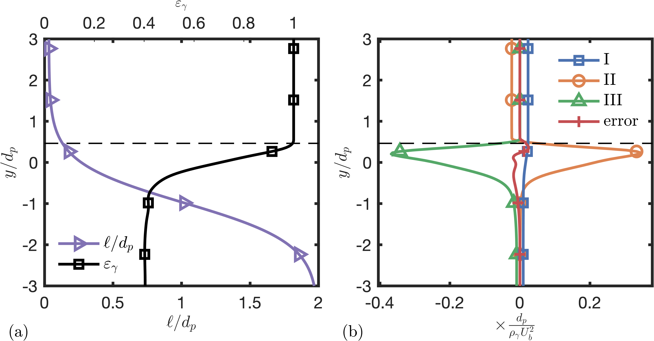
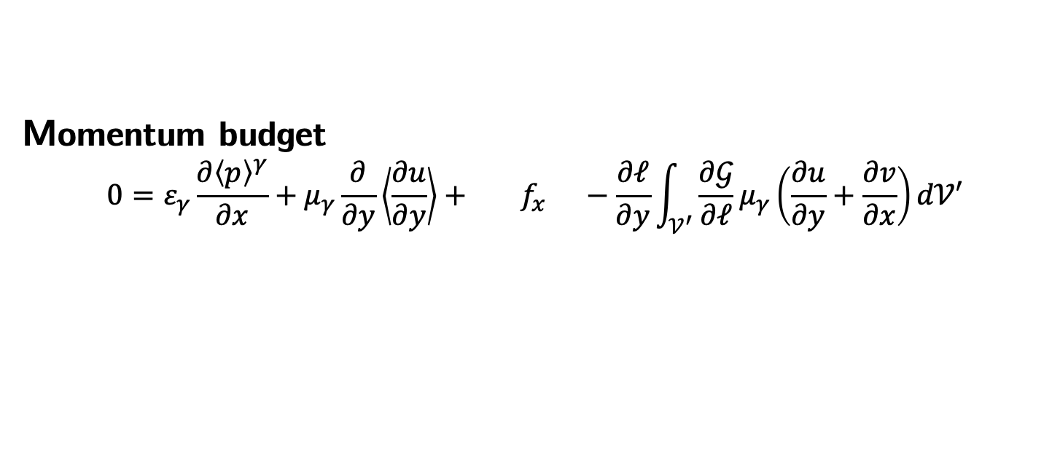

Momentum Balance
Momentum budget
$$0=ε_{γ}\frac{∂{\left\langle p\right\rangle }^{γ}}{∂x}+μ_{γ}\frac{∂}{∂y}\left\langle \frac{∂u}{∂y}\right\rangle + f_{x} −\frac{∂ℓ}{∂y}\int_{𝒱^{′}}{\frac{∂𝒢}{∂ℓ}μ_{γ}\left(\frac{∂u}{∂y}+\frac{∂v}{∂x}\right)d𝒱′}$$
I
II
III
(net drag)
IV (part of $Φ_{x}$)
Drag force and viscous shear force dominate near the interface.
Filter commutation terms are small with respect to the drag force.
Commutation errors cannot account for discrepancy between the modeled Darcy force and directly filtered PR-DNS drag force.
(a) Filter length and porosity profiles; (b) Momentum budget term profiles for a variable filter volume

Slide 18
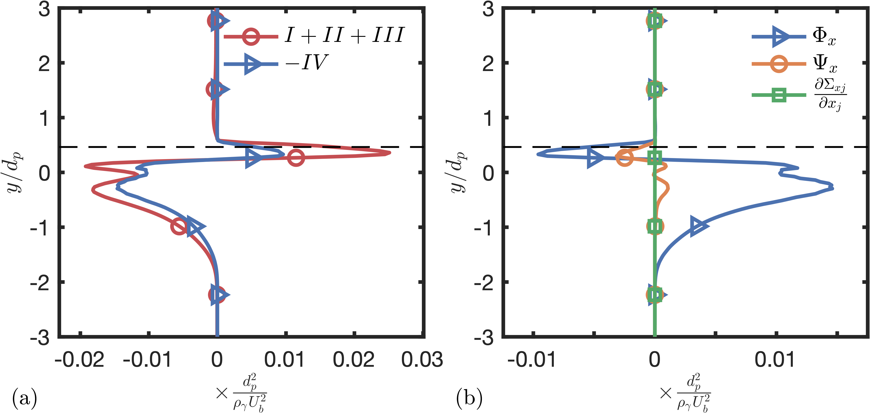
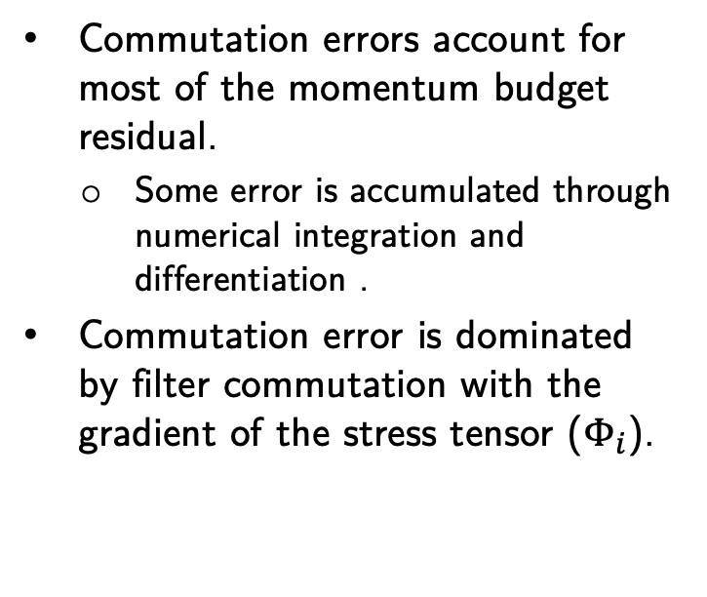
Commutation Errors
Momentum budget
$$0=ε_{γ}\frac{∂{\left\langle p\right\rangle }^{γ}}{∂x}+μ_{γ}\frac{∂}{∂y}\left\langle \frac{∂u}{∂y}\right\rangle + f_{x} −\frac{∂ℓ}{∂y}\int_{𝒱^{′}}{\frac{∂𝒢}{∂ℓ}μ_{γ}\left(\frac{∂u}{∂y}+\frac{∂v}{∂x}\right)d𝒱′}$$
I
II
III
(net drag)
IV (part of $Φ_{x}$)
Commutation errors account for most of the momentum budget residual.
Some error is accumulated through numerical integration and differentiation .
Commutation error is dominated by filter commutation with the gradient of the stress tensor ($Φ_{i}$).
(a) Momentum budget residual with stress gradient commutation error profile; (b) Momentum commutation term profiles

Slide 19
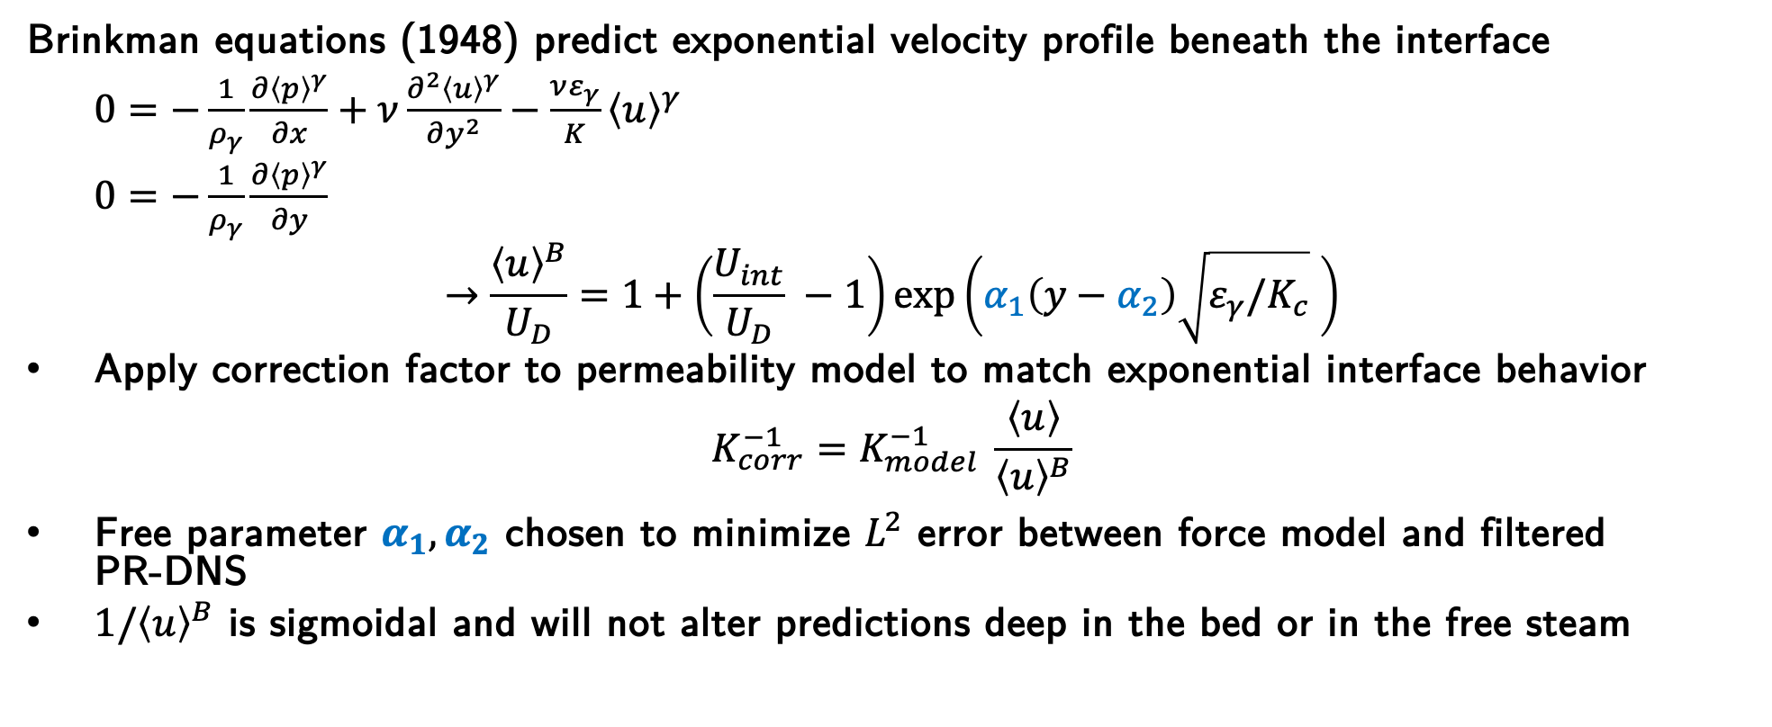
Brinkman-based Correction
Brinkman equations (1948) predict exponential velocity profile beneath the interface
$0=−\frac{1}{ρ_{γ}}\frac{∂{\left\langle p\right\rangle }^{γ}}{∂x}+ν\frac{∂^{2}{\left\langle u\right\rangle }^{γ}}{∂y^{2}}−\frac{νε_{γ}}{K}{\left\langle u\right\rangle }^{γ}$
$0=−\frac{1}{ρ_{γ}}\frac{∂{\left\langle p\right\rangle }^{γ}}{∂y}$
$$→\frac{{\left\langle u\right\rangle }^{B}}{U_{D}}=1+\left(\frac{U_{int}}{U_{D}} −1\right)\exp\left(α_{1}\left(y−α_{2}\right)\sqrt{ε_{γ}/K_{c}} \right)$$
Apply correction factor to permeability model to match exponential interface behavior
$$K_{corr}^{−1}=K_{model}^{−1} \frac{\left\langle u\right\rangle }{{\left\langle u\right\rangle }^{B}}$$
Free parameter $α_{1},α_{2}$ chosen to minimize $L^{2}$ error between force model and filtered PR-DNS
${1/\left\langle u\right\rangle }^{B}$ is sigmoidal and will not alter predictions deep in the bed or in the free steam

Slide 20
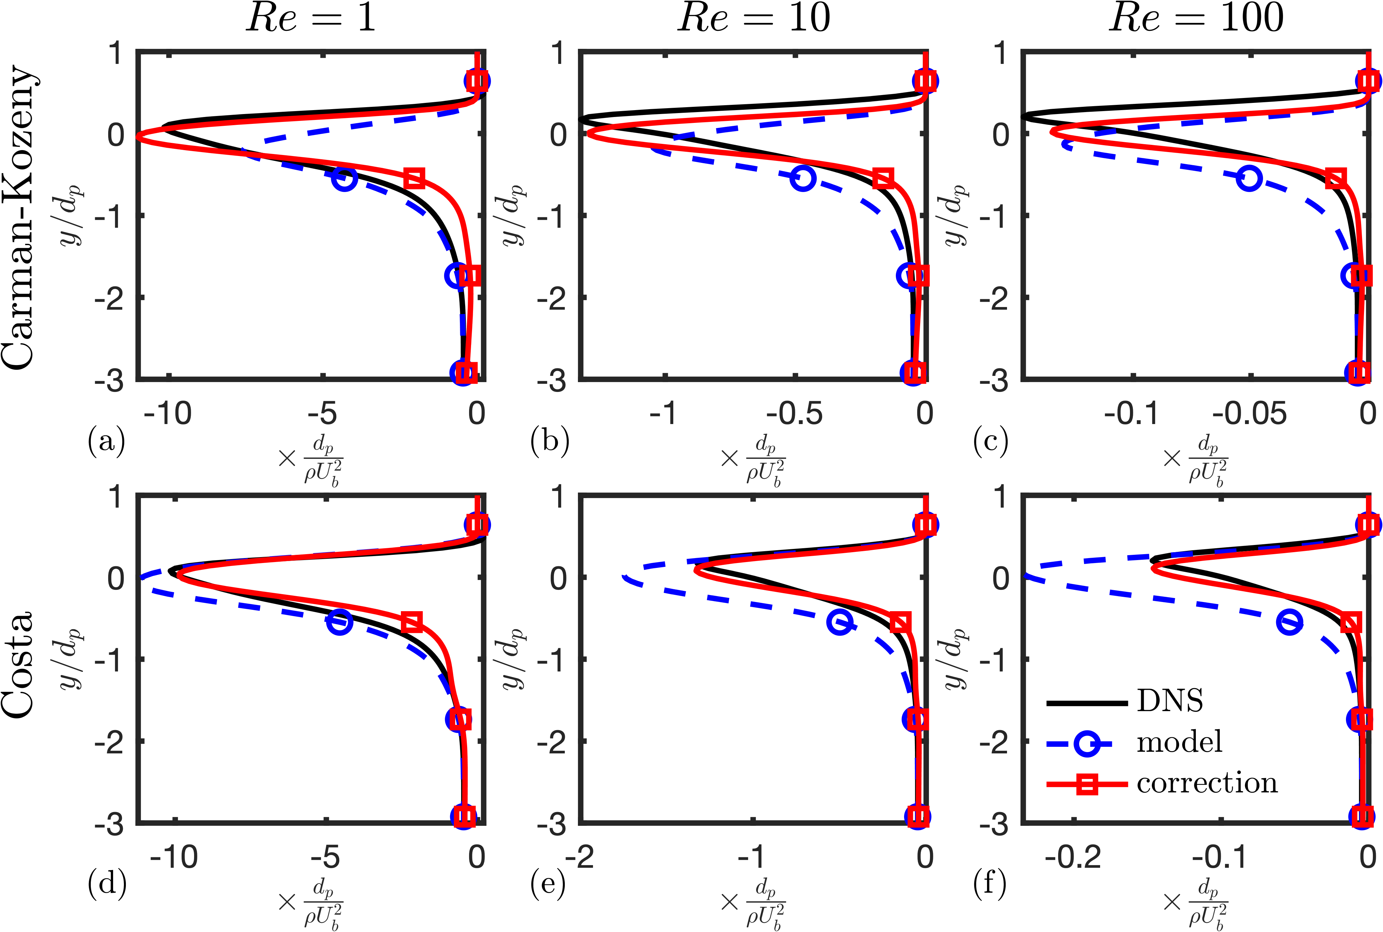
Brinkman-based Correction
Darcy force parameterization with Brinkman correction factor can match filtered PR-DNS values in the interface and bed.
Costa model for permeability is more compatible with multiplicative correction because it better matches the location of the peak force despite poorly predicting the magnitude.
Sub-filter drag force from filtered PR-DNS and given by Darcy parameterization with and without Brinkman correction factor.

Slide 21
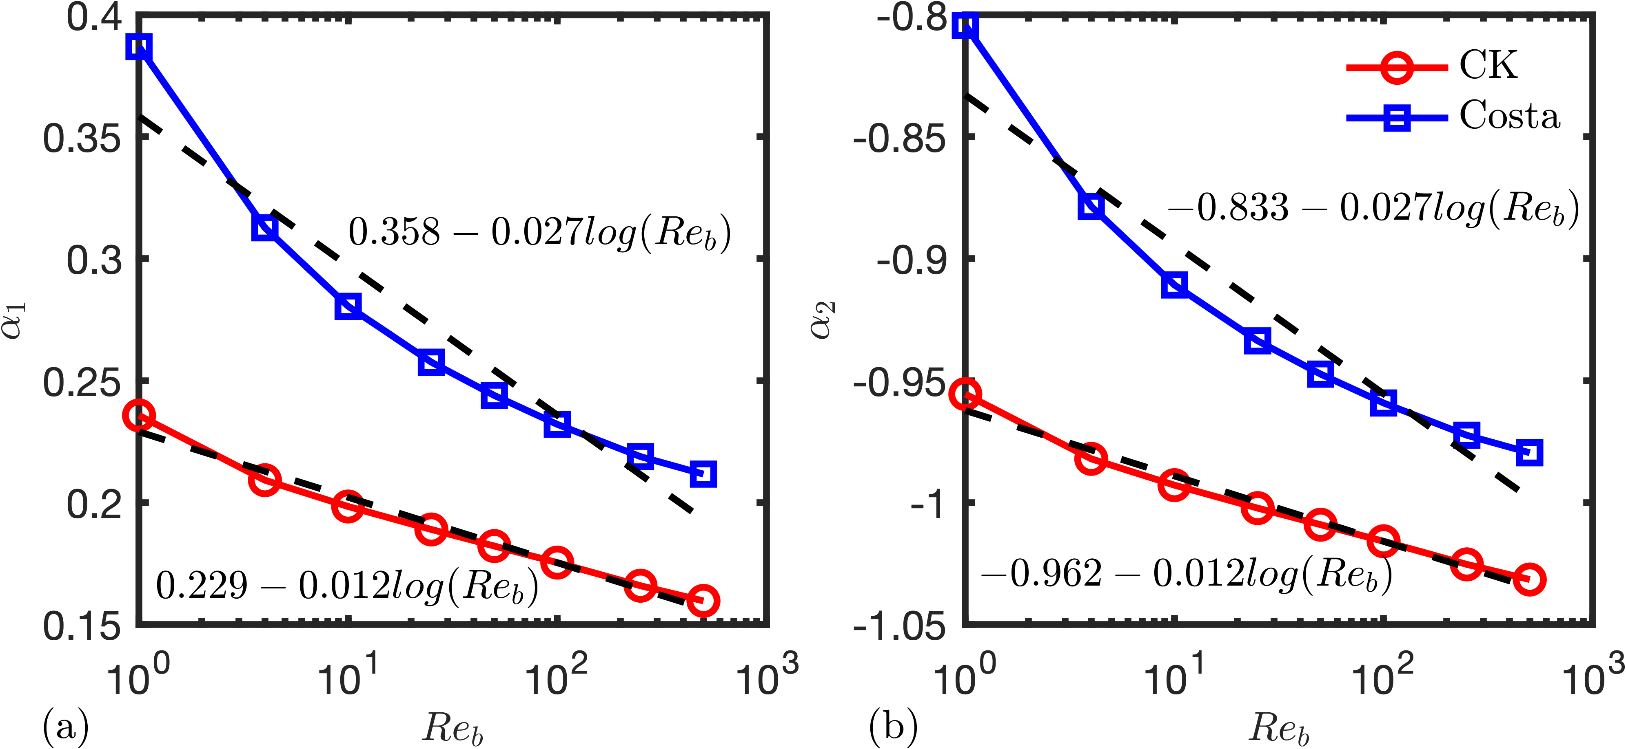
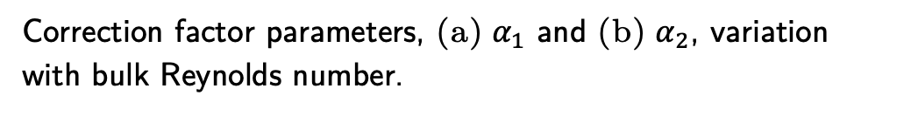
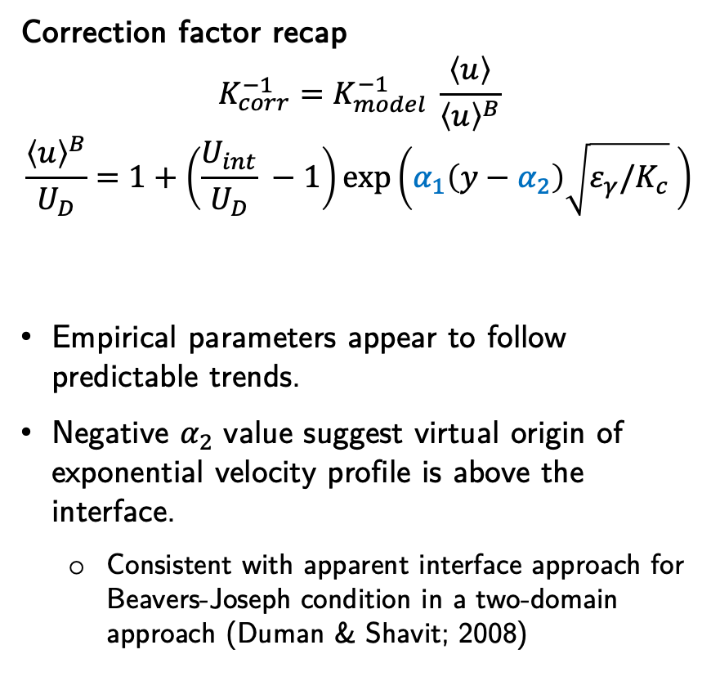
Correction Factor Parameters
Correction factor recap
$$K_{corr}^{−1}=K_{model}^{−1} \frac{\left\langle u\right\rangle }{{\left\langle u\right\rangle }^{B}}$$
$$\frac{{\left\langle u\right\rangle }^{B}}{U_{D}}=1+\left(\frac{U_{int}}{U_{D}} −1\right)\exp\left(α_{1}\left(y−α_{2}\right)\sqrt{ε_{γ}/K_{c}} \right)$$
Empirical parameters appear to follow predictable trends.
Negative $α_{2}$ value suggest virtual origin of exponential velocity profile is above the interface.
Consistent with apparent interface approach for Beavers-Joseph condition in a two-domain approach (Duman & Shavit; 2008)
Correction factor parameters, (a) $α_{1}$ and (b) $α_{2}$, variation with bulk Reynolds number.

Slide 22
Appendix

Slide 23
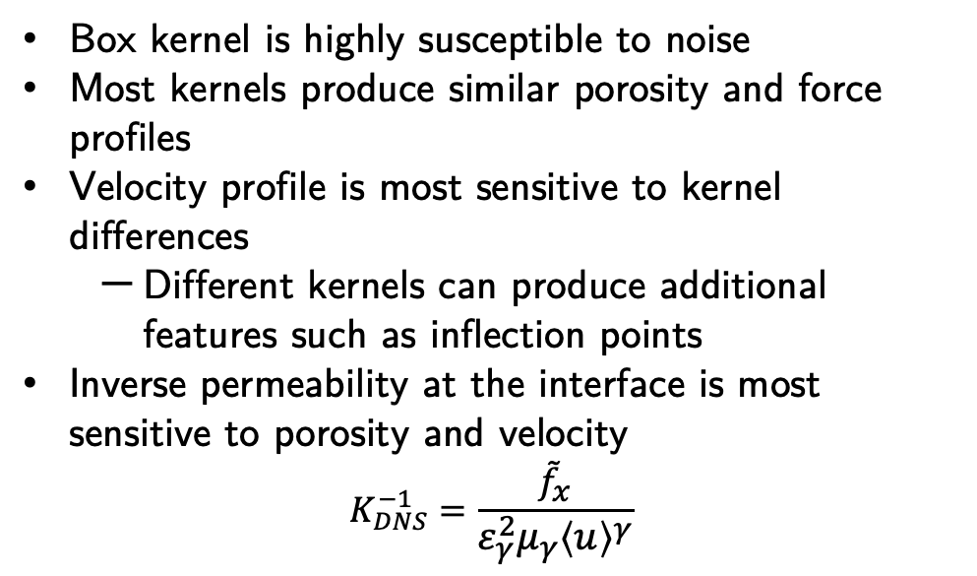
Kernel Effects
Box kernel is highly susceptible to noise
Most kernels produce similar porosity and force profiles
Velocity profile is most sensitive to kernel differences
Different kernels can produce additional features such as inflection points
Inverse permeability at the interface is most sensitive to porosity and velocity
$$K_{DNS}^{−1}=\frac{{\tilde{f}}_{x}}{ε_{γ}^{2}μ_{γ}{\left\langle u\right\rangle }^{γ}}$$

Slide 24
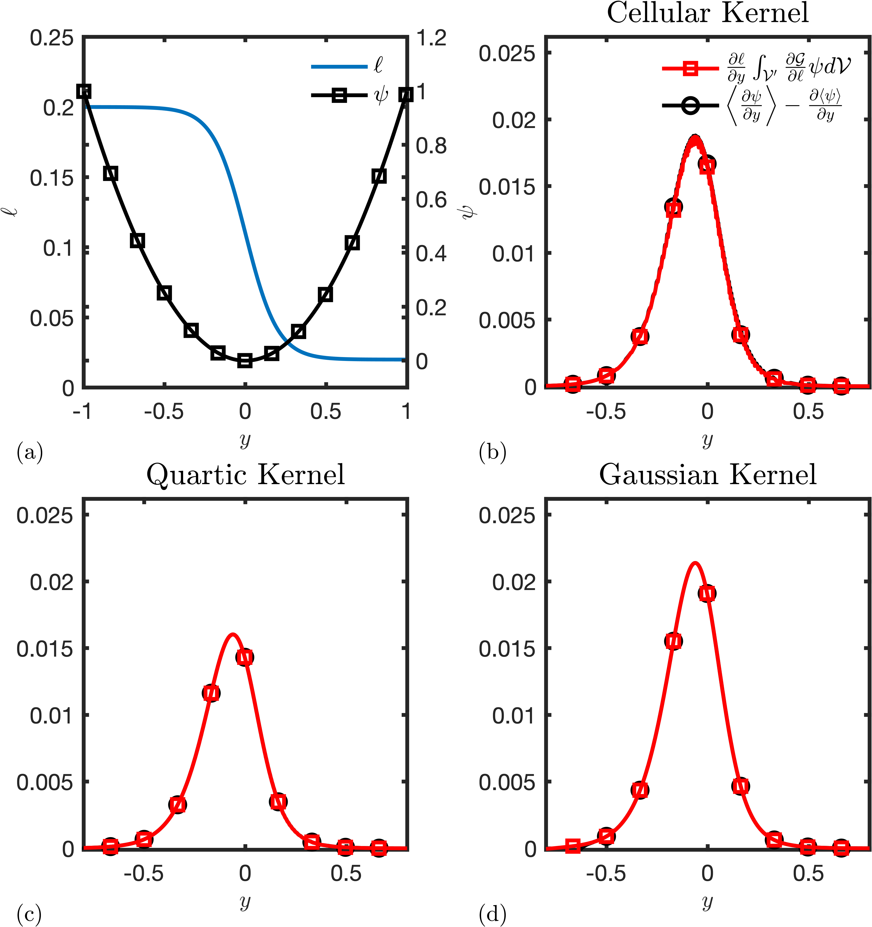
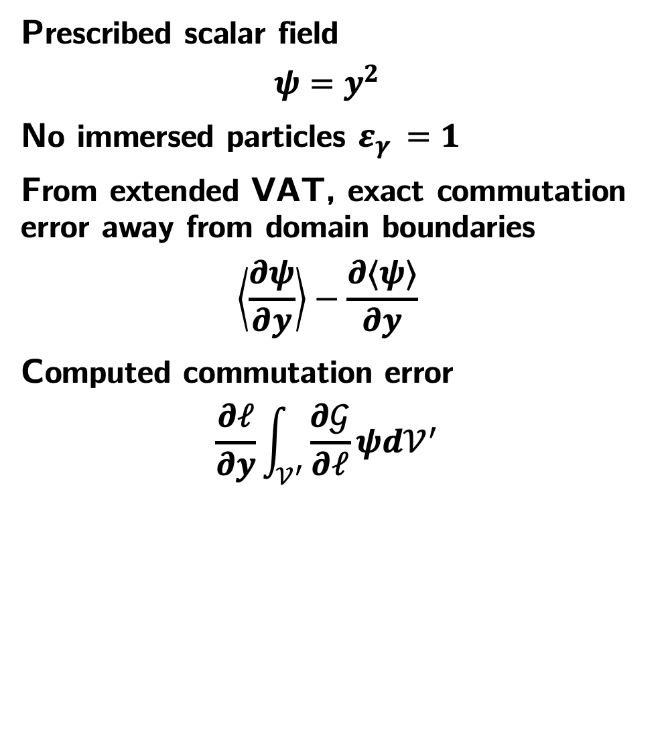
Validation of Commutation Error Computation
Prescribed scalar field
$$ψ=y^{2}$$
No immersed particles $ε_{γ }=1$
From extended VAT, exact commutation error away from domain boundaries
$$\left\langle \frac{∂ψ}{∂y}\right\rangle −\frac{∂⟨ψ⟩}{∂y}$$
Computed commutation error
$$\frac{∂ℓ}{∂y}\int_{𝒱^{′}}{\frac{∂𝒢}{∂ℓ}ψd𝒱^{′}}$$

Slide 25
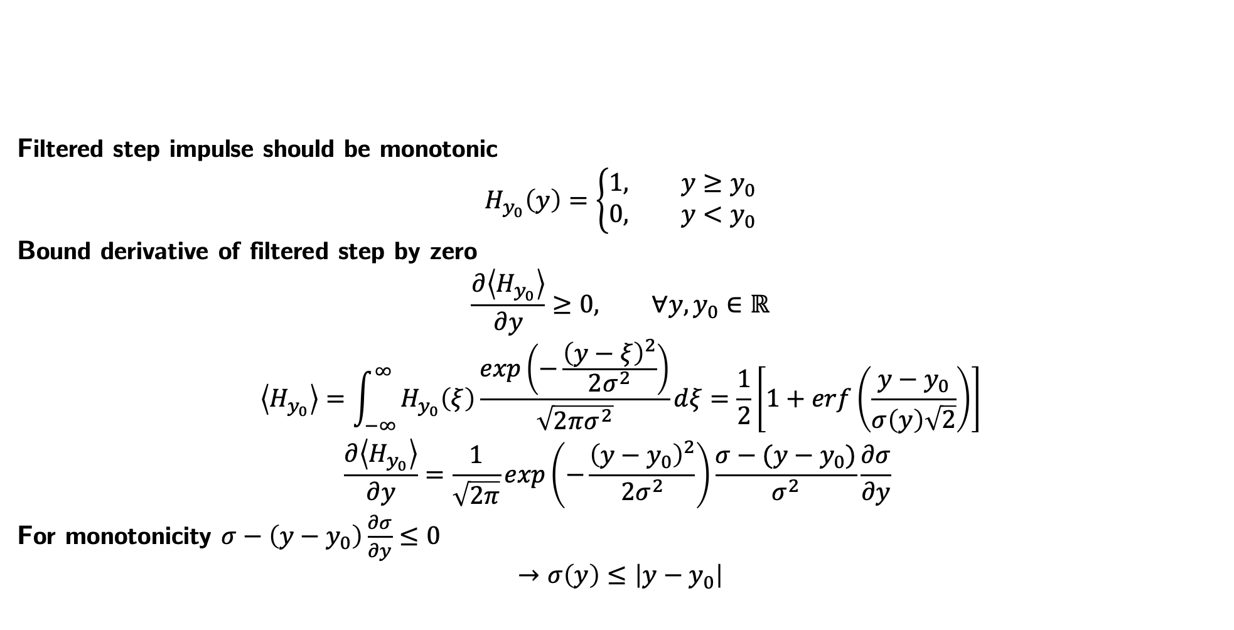
Filter Restrictions for Gaussian Kernel
Filtered step impulse should be monotonic
$$H_{y_{0}}\left(y\right)=\left\{\begin{aligned}1, y≥y_{0} \\ 0, y<y_{0}\end{aligned}\right.$$
Bound derivative of filtered step by zero
$$\frac{∂\left\langle H_{y_{0}}\right\rangle }{∂y}≥0, ∀y,y_{0}∈ℝ$$
$$\left\langle H_{y_{0}}\right\rangle =\int_{−∞}^{∞}{H_{y_{0}}\left(ξ\right)\frac{exp\left(−\frac{{\left(y−ξ\right)}^{2}}{2σ^{2}}\right)}{\sqrt{2πσ^{2}}}dξ}=\frac{1}{2}\left[1+erf\left(\frac{y−y_{0}}{σ\left(y\right)\sqrt{2}}\right)\right]$$
$$\frac{∂\left\langle H_{y_{0}}\right\rangle }{∂y}=\frac{1}{\sqrt{2π}}exp\left(−\frac{{\left(y−y_{0}\right)}^{2}}{2σ^{2}}\right)\frac{σ−(y−y_{0})}{σ^{2}}\frac{∂σ}{∂y}$$
For monotonicity $σ−\left(y−y_{0}\right)\frac{∂σ}{∂y}≤0$
$$→σ\left(y\right)≤\left|y−y_{0}\right|$$

