Slide 1

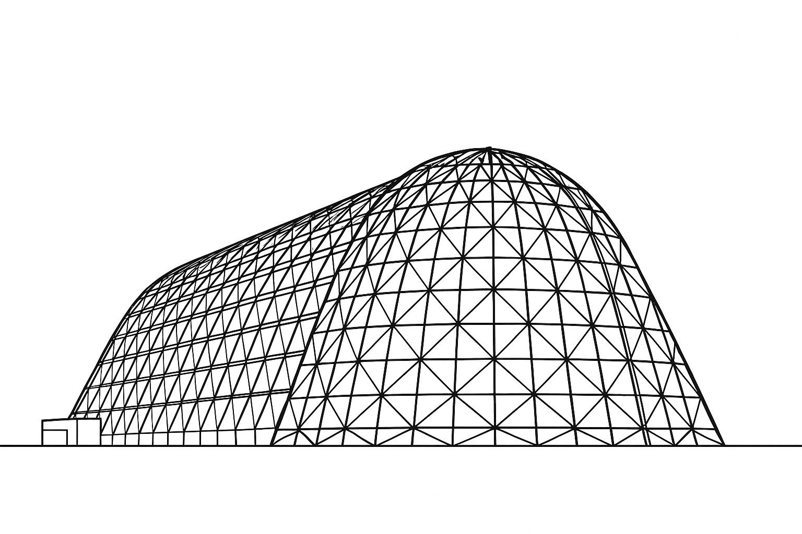

Assessing HALO Radiator Thermal Coatings: Testing and
Validation of Natural and Induced Environments
TFAWS 2025 Passive Thermal Technical Session
Presented by: Aidan Svoboda
Aidan Svoboda¹, Anna Dinkel²
¹Amentum
²GeoControl Systems
Thermal & Fluids Analysis Workshop 2025
NASA Ames Research Center
San Jose, CA
August 4-7, 2025

Slide 2
Agenda
Background Information
Environmental Exposure of Gateway
Environmental Qualification Testing Flow
Structural Qualification Testing
Optical Qualification Testing
Overall Results

Slide 3
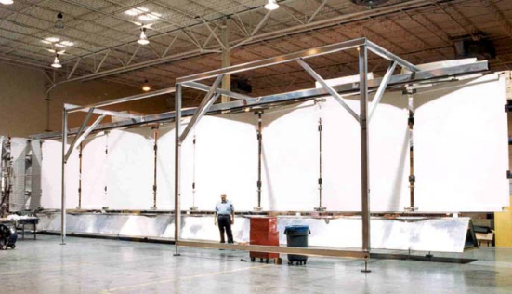
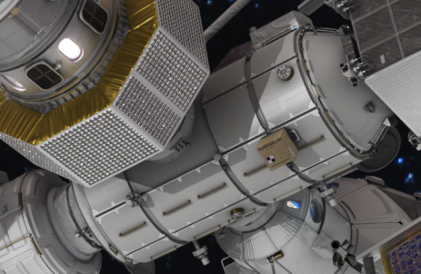
Background
Radiator thermal coatings are used to assist in the thermal management of spacecraft
White paints and optical solar reflectors (OSRs) are chosen for their favorable optical properties (low α, high ε)
Chosen materials must be able to endure extreme space environments, without structural or optical degradation
ISS Deployable Radiator Assembly, coated with Z93 white paint [1]
HALO Module of Gateway with Body Mounted Radiators [2]

Slide 4
Environmental Exposure of Gateway
Optical degradation
Yellowing/darkening of coating
Decreases heat rejection capability (HRC)
Structural damage
Flaking, cracking, or removal
Creates contamination hazard, and can decrease HRC
Natural/Induced Environment | Exposure Type | Type of Coating Damage
Solar Rays | Ultraviolet (UV) Radiation | Optical
Van Allen Belts | Charged Particles (protons + electrons) | Optical
Crew Interactions | Shear/normal loading on coatings | Structural
Plume Impingement | Contamination and heat | Optical and Structural
Venting | Particle Contamination | Optical
Lunar Dust | Particle Contamination | Optical
Cosmic Rays | Gamma Radiation | Structural
Temperature Extremes | Thermal Cycling | Structural

Slide 5
Environmental Qualification Testing Flow
To fully evaluate the structural stability of a coating, the following qualification test series was performed for HALO performed:
Bend Test
Surface/Volume Resistivity
Gamma Radiation
Vacuum Thermal Cycling
Peel Test
Kick Test
UV
Physical Degradation Test
Optical Degradation Test
Charged Particles
Contamination
Plume Heating

Slide 6
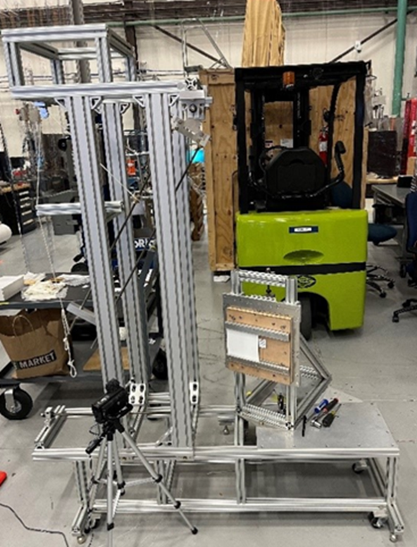
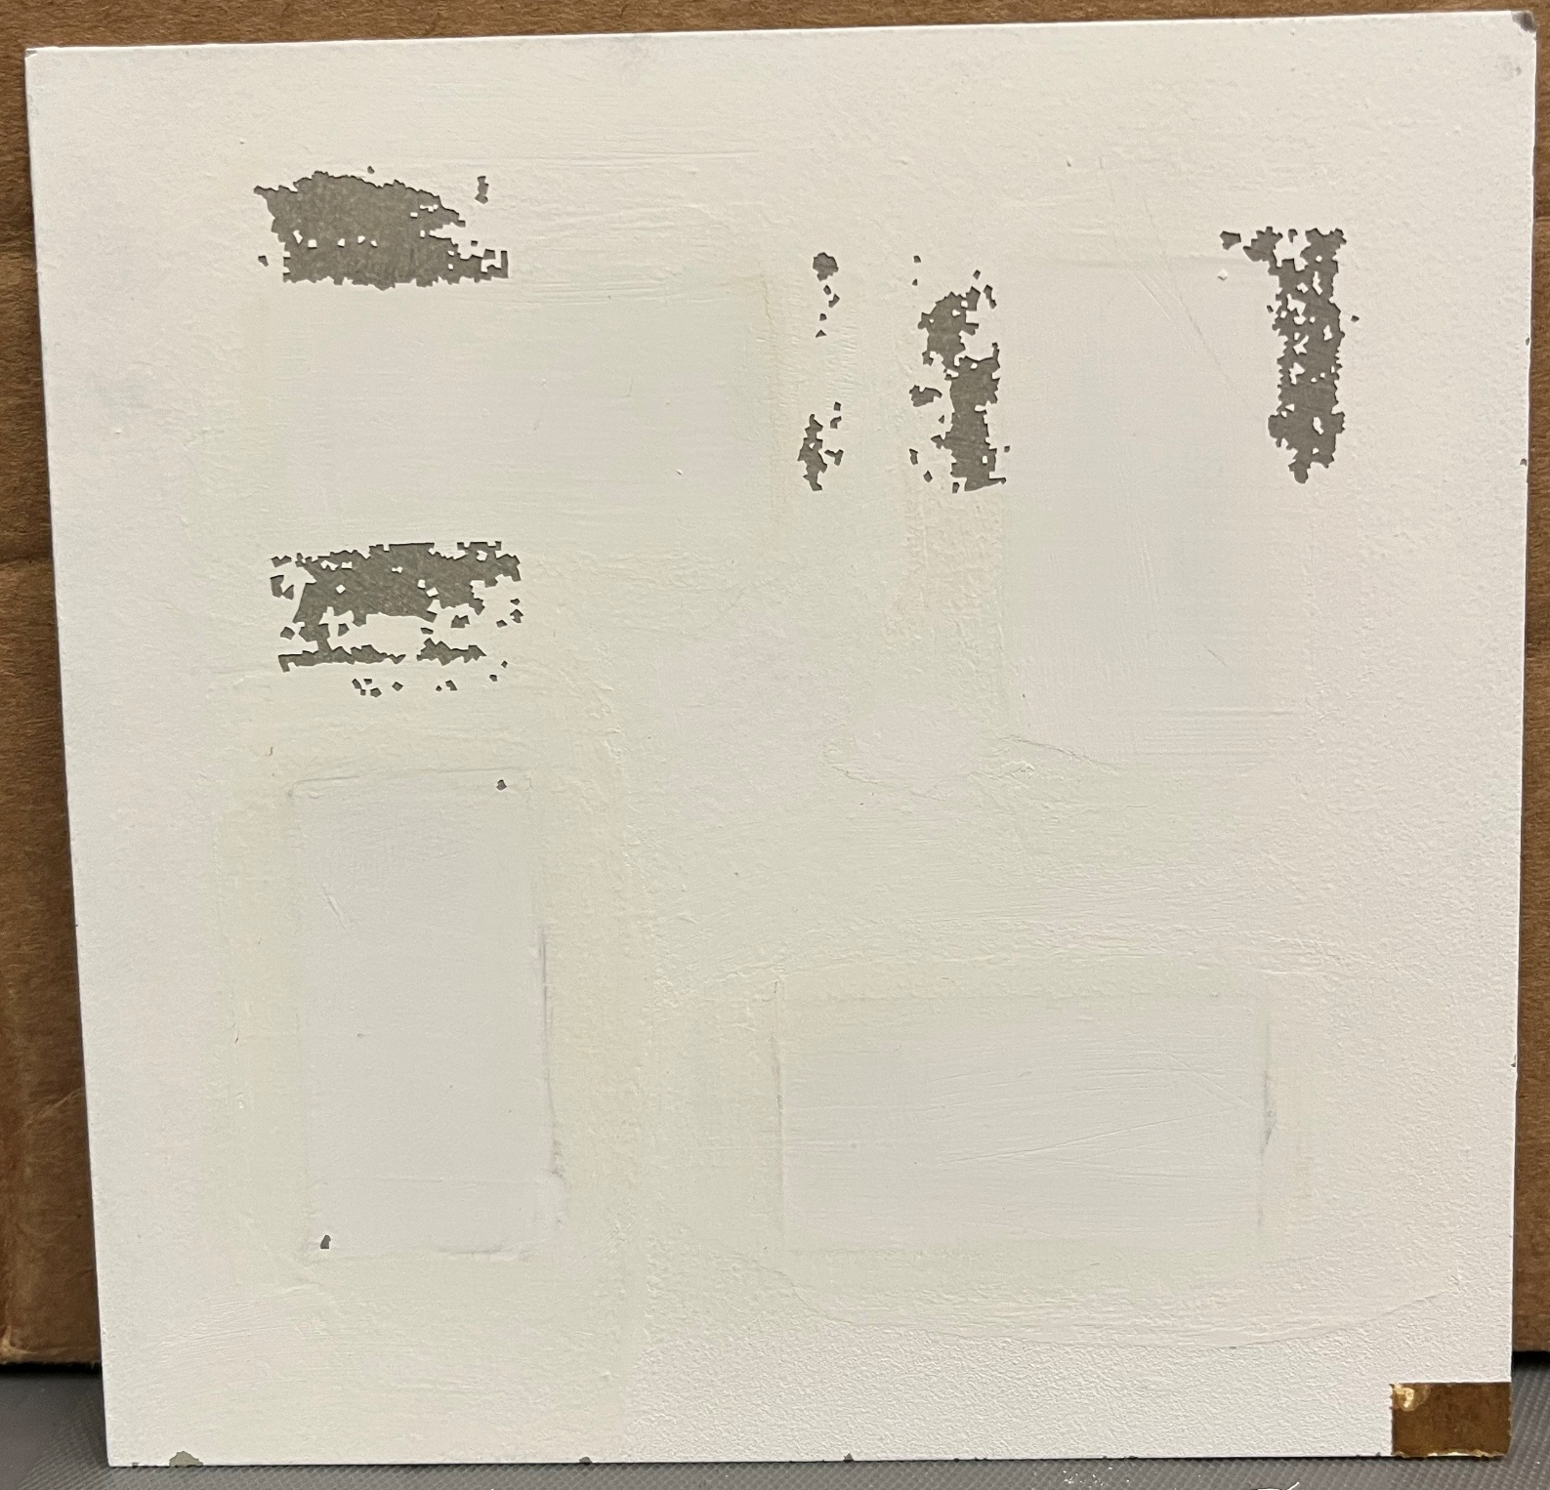
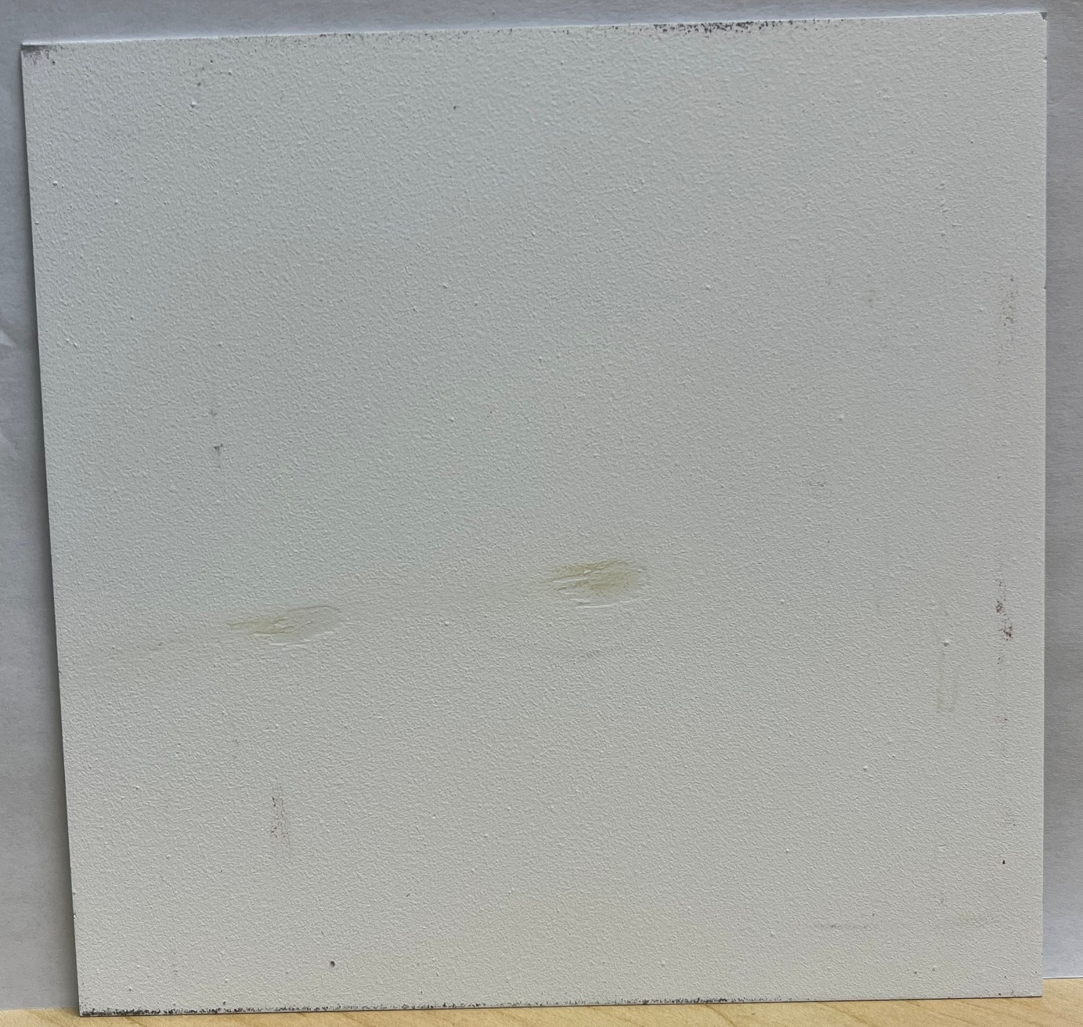
Structural Qualification Testing
Gamma radiation testing is conducted to assess a coating’s resistance to adhesion degradation as a result of gamma radiation
Thermal cycling testing is used to represent the physical stress of mission-life temperature cycling
Tape peel testing is performed in accordance with ASTM D3359-23, and is the standard test of coating adhesion
“Kick” testing is a JSC-developed method to assess a coating’s resistance to crew impacts
Coating Damage Caused by Tape Peel Testing
Coating Damage Caused by Kick Testing
JSC Test Fixture Used for Kick Testing

Slide 7
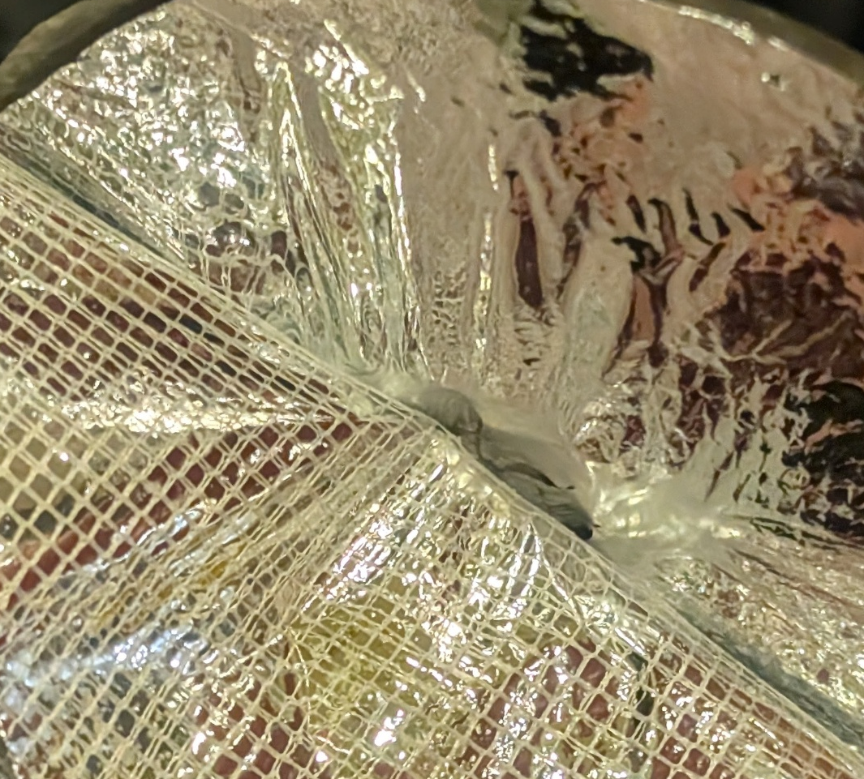
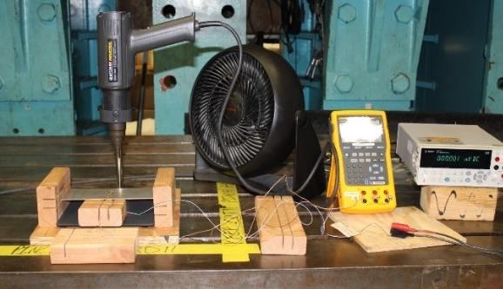
Structural Qualification Testing contd.
Surface/volume resistivity and ESD testing determines how resistive a coating is to current and electrical discharges
Bend testing characterizes how resistant a coating is to mechanical deflection
Plume testing evaluates the structural and optical impacts of exposing materials to plume-representative heat loads
MLI Damage Caused by Plume Testing
Plume testing setup
MSFC Europa Clipper charge test setup [3]

Slide 8
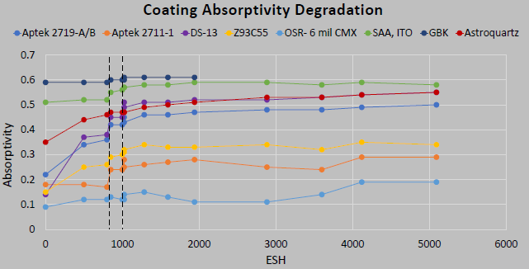
Optical Qualification Testing
Charged particle testing exposes a coating to free electrons and protons which can damage and yellow a coating
UV testing exposes a coating to simulated solar ultraviolet radiation, which can damage and yellow coatings
Solar Absorptivity Degradation from Gateway UV/Charged Particle Test [4]
Gateway sample pre and post UV/Charged Particle Testing [4]

Slide 9
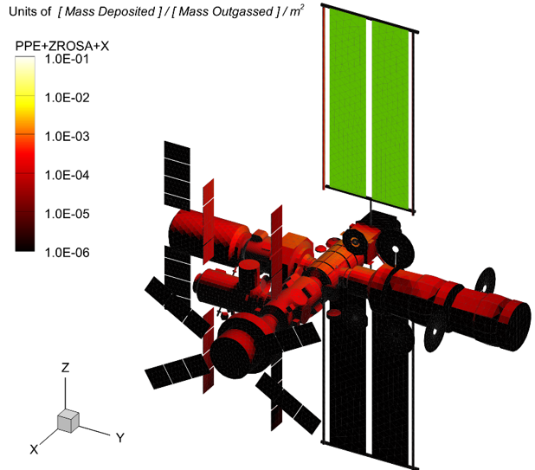
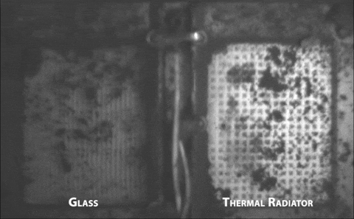
Optical Qual contd.
Additional environments that should be considered when estimating end-of-life optical property performance include:
Sputtering
Molecular Contamination
Outgassing
Atomic Oxygen
Lunar Dust
Example View Factor Calculation for Materials Outgassing [5]
MISSE Thermal Control Materials Pre and Post Flight [6]
Surface Coated with Lunar Dust from Blue Ghost Mission 1 [7]

Slide 10
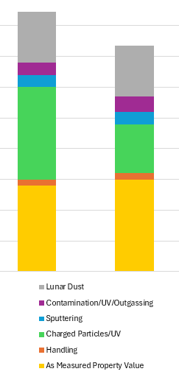
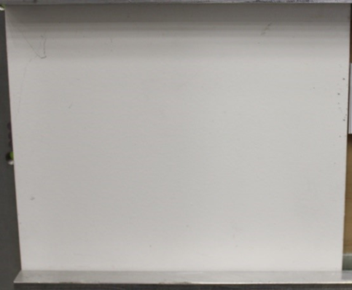
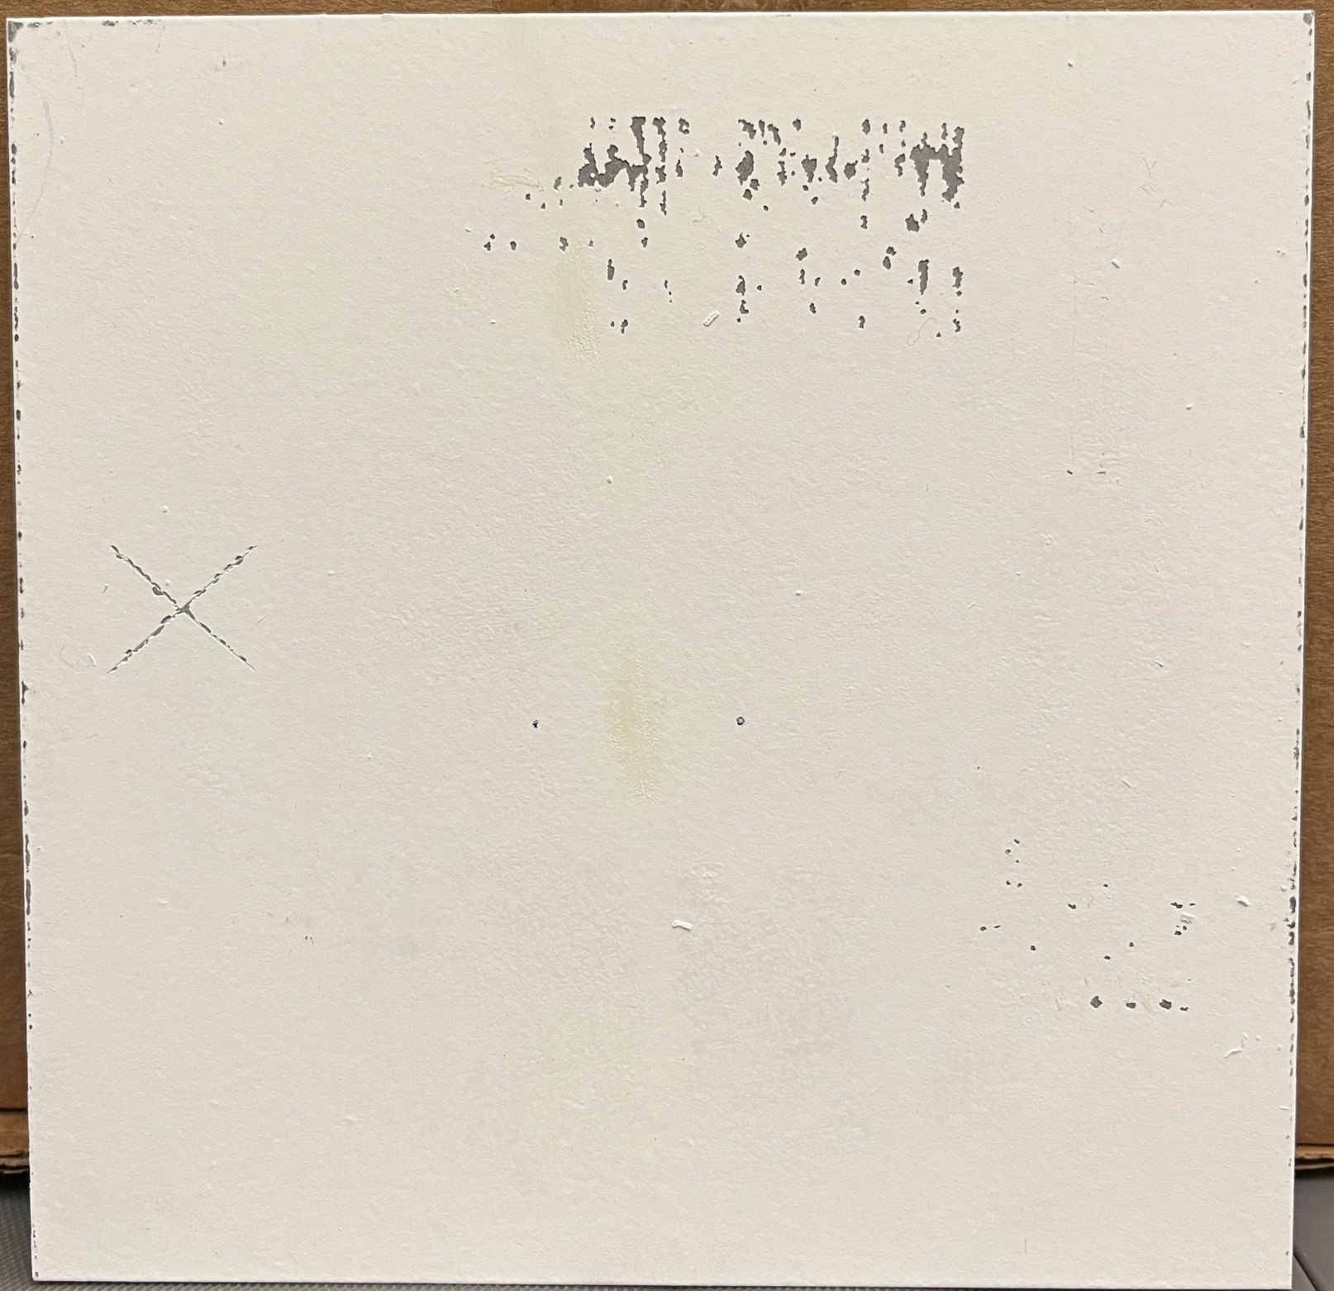
Overall Results
Test data is used to qualify a coating’s structural and optical performance in the space environment
Results of various optical property evaluations can be “stacked up” to produce end-of-life property estimations
Exposure to strenuous physical stressors without structural failure qualifies adhesive performance
Additional testing validates adequate electrical performance, dust resistance, and various other properties
Kick testing
Peel testing
Example solar absorptance degradation stack-ups

Slide 11
Conclusions
Spacecraft are exposed to a variety of strenuous natural and induced environments during their mission lifetime, which can cause structural and optical degradation to radiator coatings
Radiator coatings are vital for maximizing the vehicle’s heat rejection capability (HRC), and any significant coating degradation can reduce HRC
Environmental exposures vary heavily depending on a spacecrafts orbit, mission lifespan, system design, and mission objectives
To qualify a coating for a particular mission, the environmental stressors should first be assessed and quantified, and then a testing series as detailed here should be undertaken
Future work for HALO radiator coatings includes atomic oxygen testing and lunar dust testing

Slide 12
Acknowledgements
Special thanks to:
Jim Easey
Jessie Beddoe
Abigial Howard
Mark Hasegawa
Kristin McKittrick
Laurie Carrillo
Brandon Hoffman

Slide 13
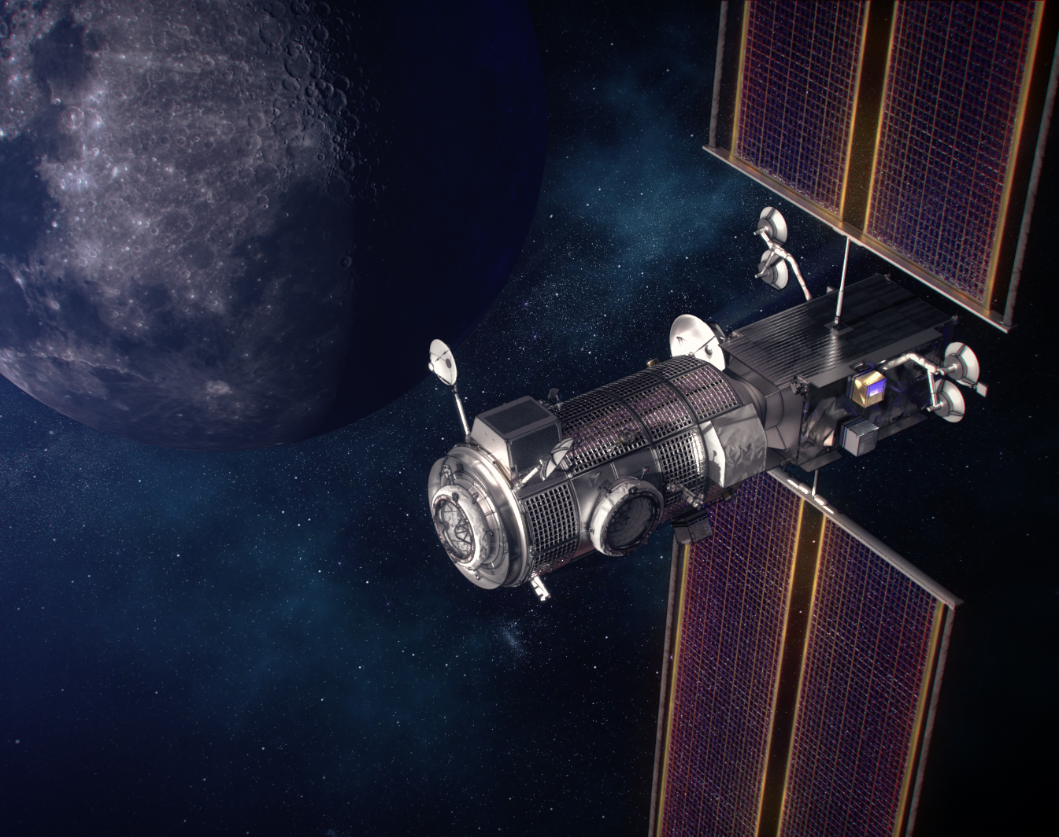
Questions?
Thank you

Slide 14
References
[1] 2021 Feb. “Active Thermal Control System (ATCS) Overview”. NASA. [accessed 2025 July 18]; https://www.nasa.gov/wp-content/uploads/2021/02/473486main_iss_atcs_overview.pdf
[2] 2022 Oct. 5. “Gateway: A Deep Space Home, and So Much More”. NASA. [accessed 2025 July 18]; https://www.nasa.gov/missions/artemis/gateway-halo-a-deep-space-home/
[3] Schneider, T. et. Al. 2022. “Thermal Control Coating Charging Tests for the Europa Clipper Mission”. NASA. [accessed 2025 July 21]; https://ntrs.nasa.gov/api/citations/20220006760/downloads/16thSCTC_paper_Thermal-Control-Charging-Schneider_113.pdf
[4] Zinecker, A. and Spivey, B. 2022 July 22. “Solar Absorptivity Degradation of Spacecraft Materials Due to UV and Charged Particles in the Gateway Environment”. NASA. [accessed 2025 July 20]; https://ntrs.nasa.gov/citations/20220011070
[5] Quiroz, C., et. Al. 2024 October 7. “Overview of the Lunar Gateway External Contamination Environment”. NASA. [accessed 2025 July 21]; https://ntrs.nasa.gov/citations/20240011495
[6] Kenny, M., McNulty, R., and Finckenor, M. 2009 June. “Further Analysis of Thermal Control Coatings on MISSE for Aerospace Applications”. NASA. [accessed 2025 July 20]. https://ntrs.nasa.gov/api/citations/20090028808/downloads/20090028808.pdf
[7] Plucinsky, S. 2025 March 27. “NASA’s Dust Shield Successfully Repels Lunar Regolith on Moon”. NASA. [accessed 2025 July 20]; https://www.nasa.gov/image-article/nasas-dust-shield-successfully-repels-lunar-regolith-on-moon/
[8] O’Connor, K. 2015 Sept. 22. “Lotus Coating – Mitigating Surface Contamination”. NASA. [accessed 2025 July 21]; https://ntrs.nasa.gov/api/citations/20150020486/downloads/20150020486.pdf

Slide 15
Backup

Slide 16
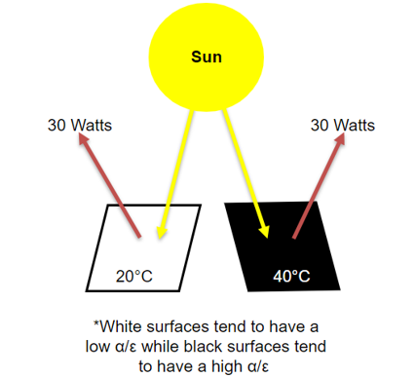
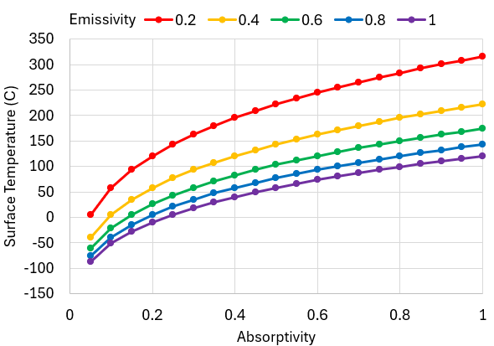
Optical Properties Overview
The two primary optical properties of concern for spacecraft thermal coatings are solar absorptivity (α) and infrared (IR) emissivity (ε)
IR Emissivity:
Effectiveness of a material to dissipate heat in the form of infrared radiation
IR emittance is a value represented by the ratio of the materials emittance to that of a black body (0.0 to 1.0)
Solar Absorptivity:
Effectiveness of a material to absorb solar radiation
Absorptance is a value represented by the ratio of the absorbed energy to the incident energy (0.0 to 1.0)
α/ε Ratio:
The overall thermal performance of a material is often quantified by the ratio α/ε
High α/ε: The surface absorbs a high amount of heat relative to how much it emits
Typical materials: Uncoated metals, dark surfaces/coatings
Typical use for spacecraft: solar arrays
Low α/ε: The surface emits a high amount of heat relative to how much it absorbs
Typical materials: Light surfaces/coatings, anodized metals, plastics, OSRs
Typical use for spacecraft: radiators

Slide 17
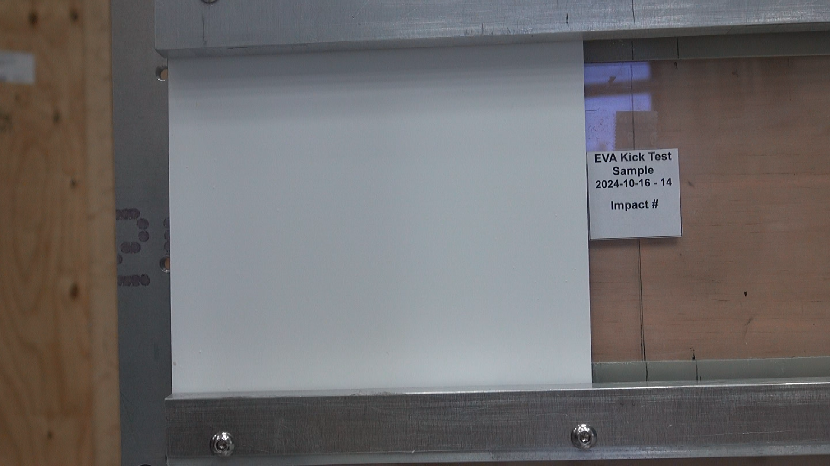
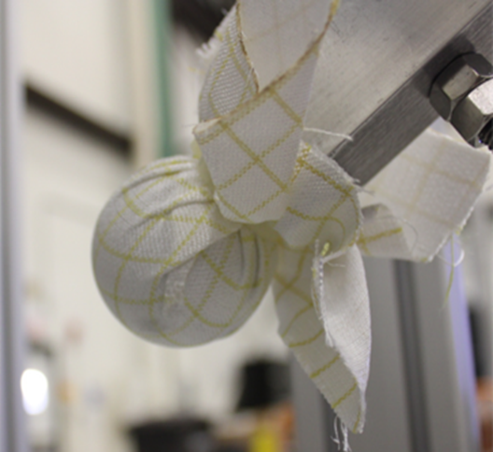
Kick Testing
An additional component to explore when considering component stability is interactions with crew members
The HALO vehicle utilizes body-mounted radiators, and these radiators fall within EVA workspaces
As such, it became necessary to evaluate any thermal coatings against representative crew related impacts
A "kick” test was created, which uses a weighted pendulum arm to simulate a 350lb load on coated radiator samples
50 impacts are applied to each sample to fulfill loading requirements
Test impact on sample
2-inch diameter Ortho-Fabric wrapped steel ball used for impacts

Slide 18

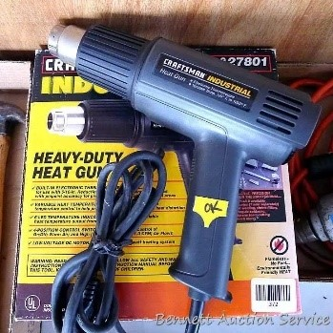
Plume Testing
Due to presence of visiting vehicles at Gateway, modules will be exposed to the pluming thrusts of other vehicles
For HALO, this means that its radiator coatings may be exposed to plume heating
In order to assess the robustness of HALO radiator thermal coatings against plume heating, the following heat exposures were used during testing:
To apply these heat loads, a heat gun setup was utilized, as shown to the right
Heat Flux (kW/m²) | Time (s) | Cycles
32.0 | 2.0 | 10
64.0 | 1.0 | 10
Full test setup
Heat gun

Slide 19

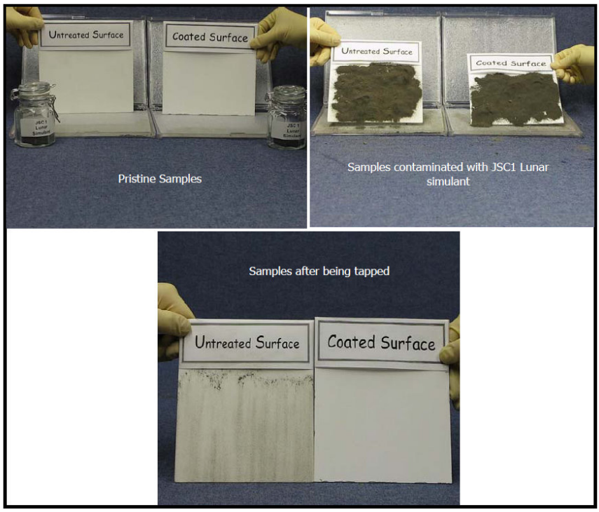
Lunar Dust
Lunar dust and its effects on the thermal performance of spacecraft is a hot topic item
Lunar dust poses a huge risk to radiators due to its insulative nature, sub-optimal optical properties, and adhesive tendencies
For lunar missions, the following options can be considered for radiator coatings:
Naturally dust repellent coatings (Lotus coating, work function matching coating)
Cleanable/brushable coatings
Enhanced BOL optics coatings
Electrodynamic dust shield (EDS) compatible coatings
Blue Ghost 1 EDS Demonstration [7]
Lotus Coating Demonstration [8]

