Slide 1

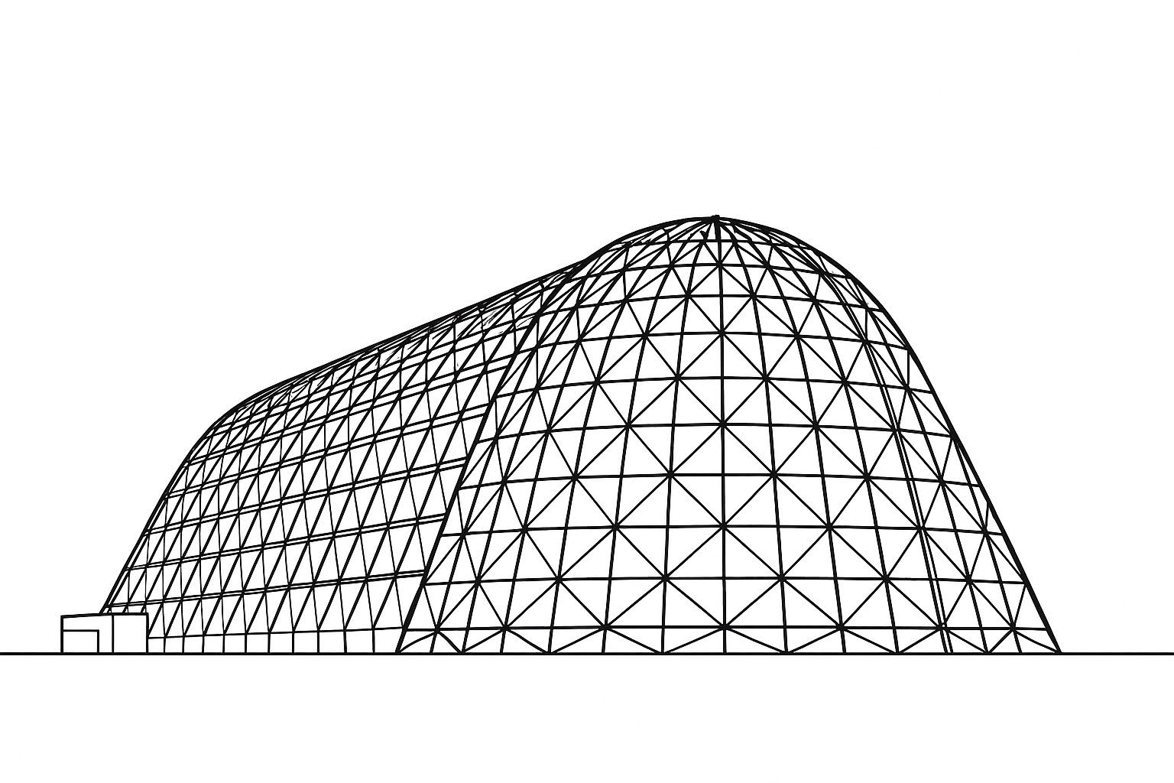

FROSTE: Designing a Thermal Control System for Cryogenic Lunar Sample Return
TFAWS 2025 Thermal Control and Protection Technical Session
Presented by: Faiyaj Khan and Claire Silaire
Elijah Stewart¹, Claire Silaire¹, Faiyaj Khan², Greg Schunk³
¹NASA MSFC, ²BRC, ³Amentum
Thermal & Fluids Analysis Workshop 2025
NASA Ames Research Center
San Jose, CA
August 4-7, 2025

Slide 2
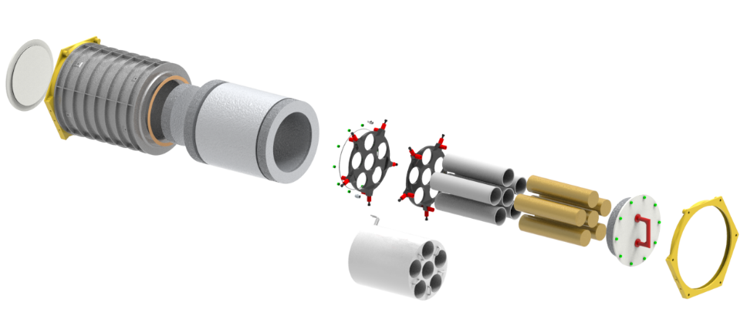
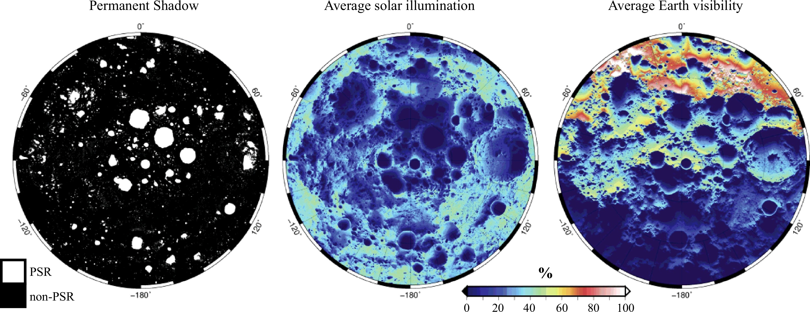
FROSTE Overview
Frozen Return of Samples to Earth (FROSTE) is targeting cryogenic sample return from Permanently Shadowed Regions (PSRs) at the lunar south pole.
Temperatures at these regions are below 100K and FROSTE will be required to maintain lunar regolith samples at these temperatures through sample collection to splashdown on Earth to preserve the trapped volatiles in the sample.
Stowage Interface (Notional)
Top Lid , MLI
handle
Core Samples
Phase Change Material (Thermal Mass)
Sample tubes
Tube holder
MLI wrap
Solar Illumination at the Lunar South Pole^{[1]}
Outer Casing
MSFC Advanced Concepts Office Preliminary Design

Slide 3
FROSTE Thermal Challenges
Operate in different environments with varying requirements tied to each. Power availability throughout the mission will require a robust thermal control system. These include:
Crewed Vehicles
Lunar Surface
PSRs
Transit
Earth Re-entry
Sample Recovery
Currently targeting to maintain samples at 80 K. With varying environments above, the thermal control system is using a combination of active and passive thermal management:
Active
Stirling cycle cryocooler
Passive
Phase Change Material (PCM)
Multilayer insulation (MLI)
Thermally isolating structural design
Notes:
Challenge: large design space
Different safety requirements for crewed and non-crewed space
Sample target temperature is not set which affects overall thermal control architecture
Robotic vs human interfacing

Slide 4
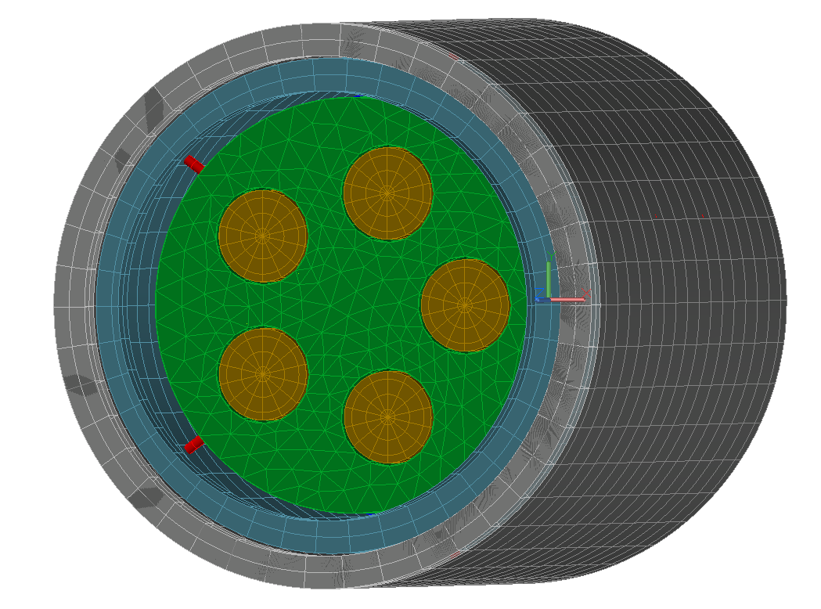
FROSTE Thermal Model
FROSTE will require three levels of containment for the regolith samples. Currently the thermal model includes the secondary sealed container (SSC), PCM Tank, and primary sealed container (PSC) that will be used to directly contain the samples.
PCM Tank
iMLI is modeled using methods developed by Brian Hamill MSFC and presented at TFAWS 2024^{[2]}.
PSC design will be defined by the core drilling element. Currently not a part of the FROSTE project and geometry is assumed.
Structural supports are made with S-glass and limit conduction from PCM tank to SSC.
*Lid is hidden
PSC x5
iMLI
Structural Supports
SSC
FROSTE Thermal Model
Notes:
Materials:
Primary Sealed Container and SSC: Stainless Steel
PCM Tank: Aluminum

Slide 5
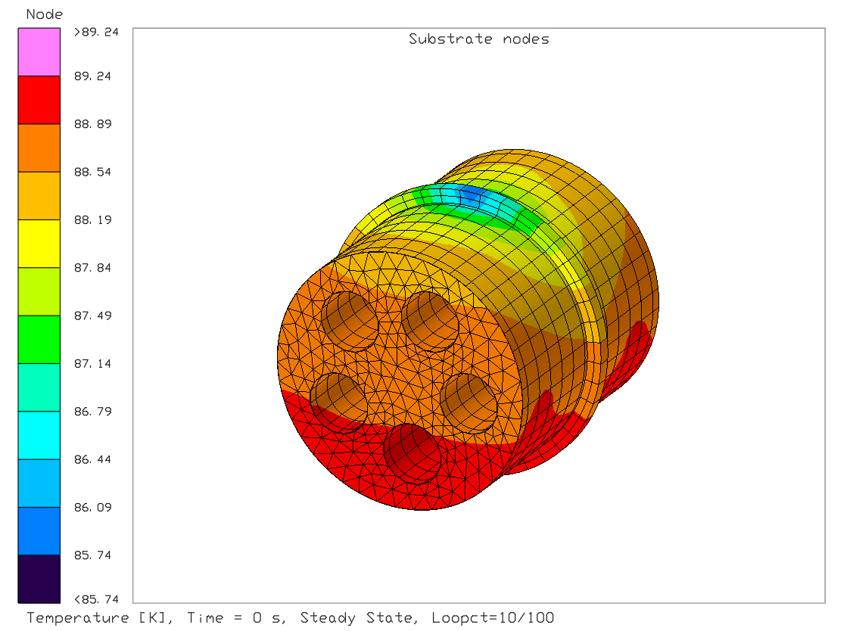
FROSTE Thermal Trade Studies
Thermal Control Architecture
Passive radiator vs active cryocooler
Cryocooler interface
Heat exchanger cooling loop with gaseous Neon vs thermal strap
iMLI sizing
PCM tank material selection
Assessing available additively manufacturable alloys
PCM tank internal design
Mesh vs fins
PCM cooldown methods
Finned Lid vs lid removal vs active cooling
Contour plot with thermal strap interface to cryocooler

Slide 6
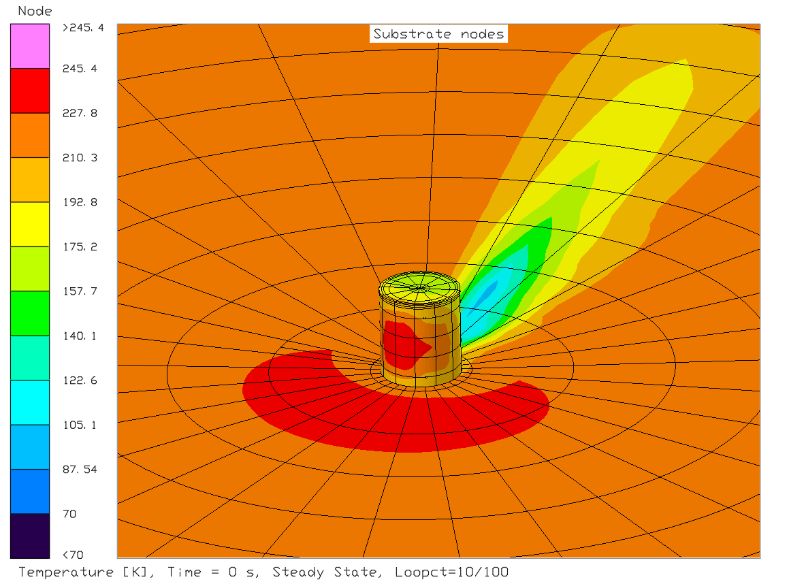
FROSTE Heat Loss
Assessed three different thermal environments:
Cabin environment
Lunar surface
PSR
Calculating heat removal required to maintain sample temperatures at 80K
Cabin is warmest of the three environments
Lunar surface allows for radiation to deep space
PSR does not require any heat removal and gets below 80K given enough time out of the sun
Contour plot of SSC on lunar surface

Slide 7
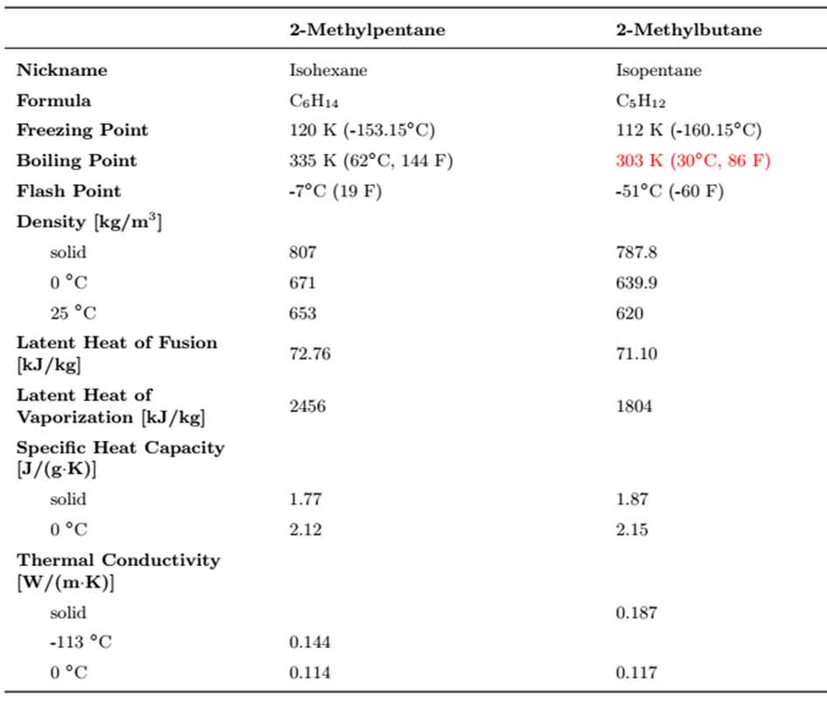
Phase Change Material
The PCM will be a major constituent of the passive thermal control system
Candidate PCM’s:
2-Methylpentane (120 K)
2-Methylbutane (112 K)
Goal: Cool down the PCM as quickly as possible and maintain cryogenic temperatures
Testing currently underway to confirm thermal properties of candidate PCM’s.
PCM Thermal Properties ^{[3]}

Slide 8
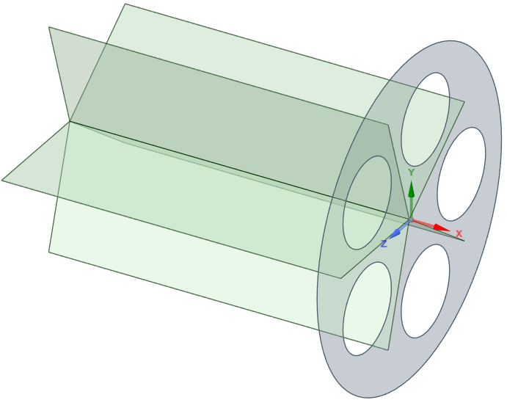
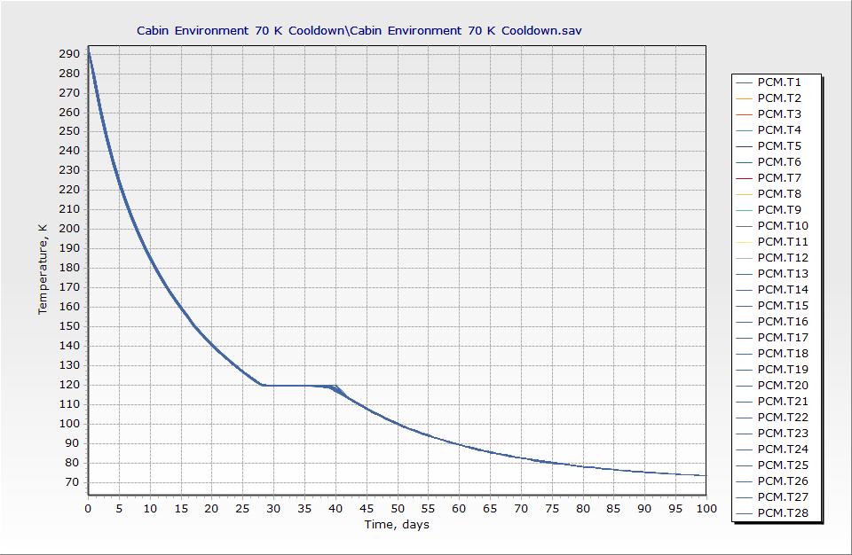
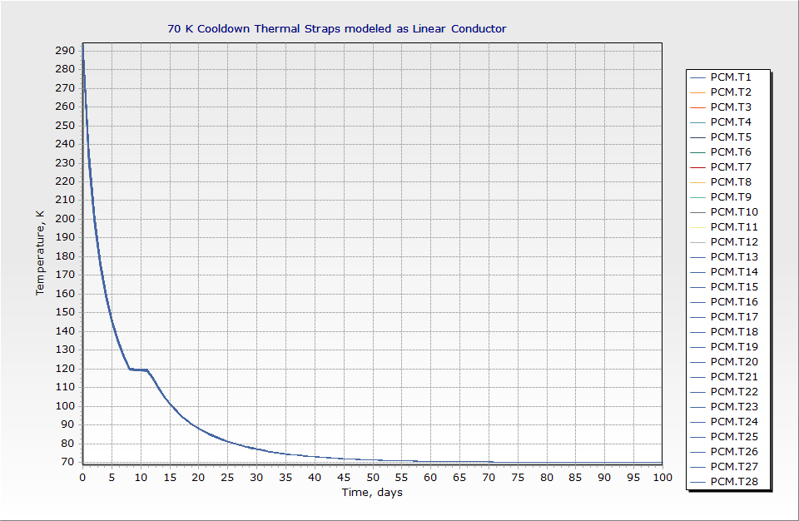
PCM Tank Internal Design Trade Study: Finned Structure
Introducing a high conductivity finned structure into the PCM tank assists in heat transfer and overall cooldown
Studies done on different fin thicknesses and materials
Results showed that cooldown time was significantly decreased
Lunar surface environment
Originally took 27 days to reach phase change passively
Finned lid drove phase change to the 7 day mark
Finned Lid Structure to be placed in the PCM Tank
No Lid Cooldown
Finned Lid Cooldown

Slide 9
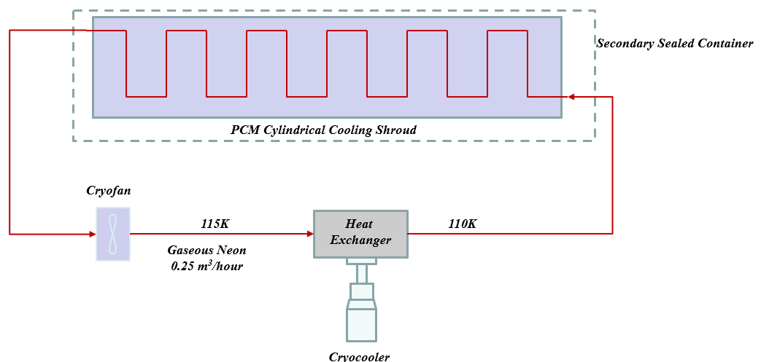
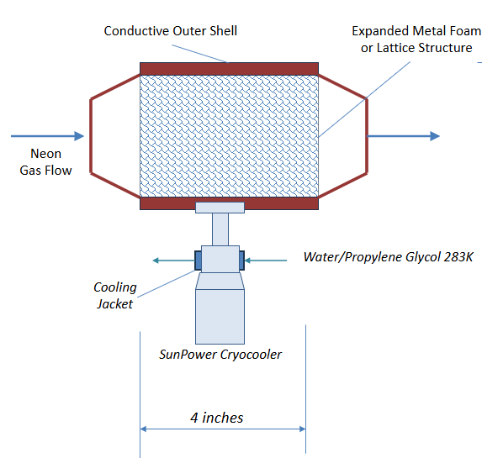
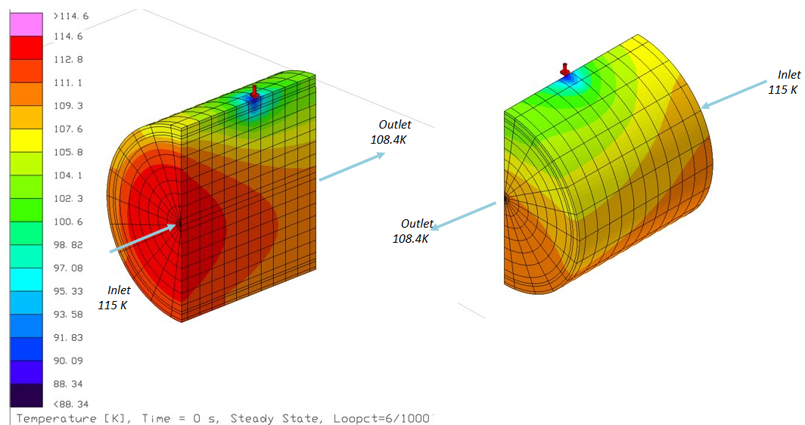
Cryocooler Interface Trade Study
Active cooling system consisting of a Ne cooling shroud, Stirling cryocooler, and heat exchanger
Neon cooling loop within the PCM Tank
Sized to remove up to 15 W of heat leak from the SSC
Stirling Cryocooler:
Sun Power cryocooler: able to reject 19 W at 100 K
Cryofan rejects heat externally from loop
Heat exchanger:
Core is made of expanded metal foam within conductive cylinder
High areal density (25 in² per 1 in³)
Metal foam is well within allowable pressure drop for baseline Cryofan capacity
Cool Out
283K
Cool In
273K
Neon cooling shroud coupled to cryocooler via heat exchanger
Expanded Metal Foam Heat Exchanger
Contour Plot of Heat Exchanger

Slide 10
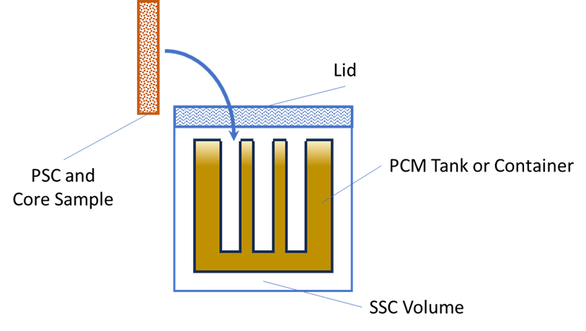
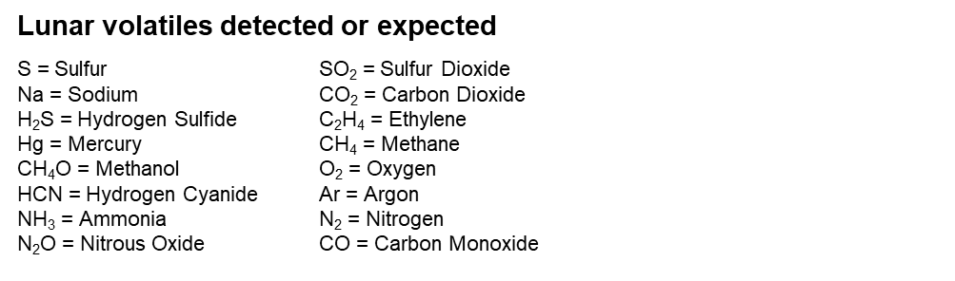

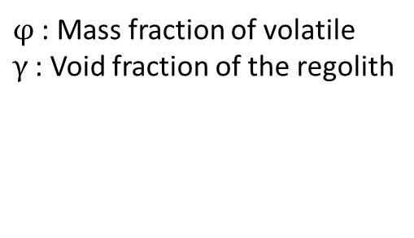
Volatiles and Pressurization
Unintended loss of cooling can lead to melting and subsequent vaporization of solid volatile(s) in the sample.
Concerns are rupture of the PSC or leakage through the sealing interface from differential pressure across containers, which may pose crew and mission safety risk
Approach-
Identify minimum amount of volatile material needed to achieve the substance's vapor pressure at cabin ambient temperature
6 kg of sample per capsule, 5 capsules per FROSTE device
Single volatiles[4-5], on the right, are considered independently
Future verification efforts - JSC's Lunar Crater Observation and Sensing Satellite (LCROSS) data
Lunar regolith's density[6] & porosity[6] are factored in
Results show that traces amounts of volatiles (percent of sample by mass) need to be present for H20 (5.7e-6%), CO (0.9%), CO2 (2.9%), NH3 (0.2%), C2H4 (1.3%) to reach vapor pressure
For smaller mass fractions, the risk that enough of the volatile is present in the sample to achieve the pressure is increased
FROSTE SSC Anatomy (Not to Scale)

Slide 11
Conclusion/Forward Work
Preliminary SSC trade studies have shown reasonable thermal performance and only requiring the use of one cryocooler.
Determined cryocooler could be conductively tied to SSC using thermal strap vs fluid loop.
Additive manufactured proof of concept SSC and perform thermal vacuum testing to verify thermal performance.
Thermal vacuum testing to validate PCM candidates' characteristics.
Provide thermal models for PCM testing and additively manufactured SSC.
Complete Thermal Analysis Report by end of FY25.

Slide 12
Thank you for your attention!
Questions?

Slide 13
References
[1] E. Mazarico, G.A. Neumann, D.E. Smith, et al., “Illumination conditions of the lunar polar regions using LOLA topography” (2011). Icarus, 211, pp.1066-1081, Available: https://www.sciencedirect.com/science/article/pii/S0019103510004203?via%3Dihub
[2] B. Hamill, “Development of an Equation to Characterize Heat Flux Through IMLI and A Method to Implement in Thermal Desktop®” (2014). NASA TFAWS, Available: https://ntrs.nasa.gov/citations/20240009584
[3] Yang et al., “A Comprehensive Review on Sub-Zero Temperature Cold Thermal Energy Storage Materials, Technologies and Applications,” Journal of Applied Energy, Vol. 288, 2021.
https://www.sciencedirect.com/science/article/pii/S0306261921001033#f0160
[4] Zhang, Jo Ann, David A. Paige. "Cold-Trapped Organic Compounds at the Poles of the Moon and Mercury: Implications for Origins." Geophysical Research Letters, vol. 36, no. 16, 2009 Available: https://doi.org/10.1029/2009gl038614.
[5] Fray, N., and B. Schmitt. "Sublimation of Ices of Astrophysical Interest: A Bibliographic Review." Planetary and Space Science, vol. 57, no. 14-15, 2009, pp. 2053-2080., Available: https://doi.org/10.1016/j.pss.2009.09.011.
[6] SLS-SPEC-159: Cross Program Design Specifications for Natural Environment Available: https://ntrs.nasa.gov/citations/20210024522
The “PCM Thermal Properties” are from “A comprehensive review on sub-zero temperature cold thermal energy storage materials, technologies, and applications: State of the art and recent developments (https://www.sciencedirect.com/science/article/pii/S0306261921001033).” This reference is licensed under the Creative Commons Attribution-NonCommercial-NoDerivatives 4.0 International License (https://creativecommons.org/licenses/by-nc-nd/4.0/).

