Slide 1
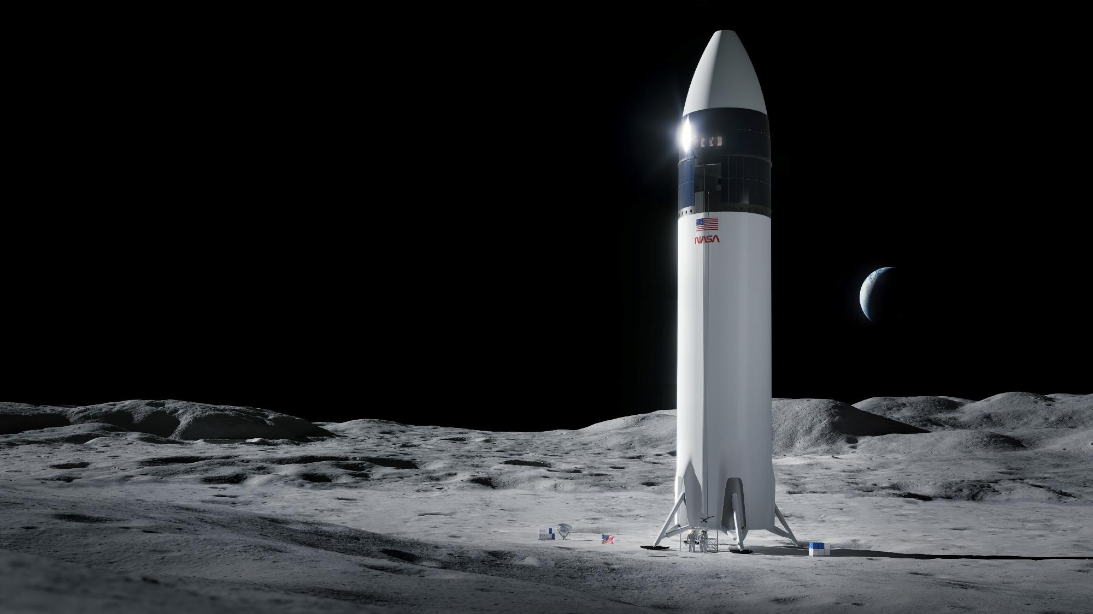
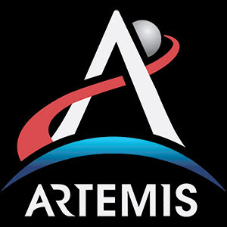
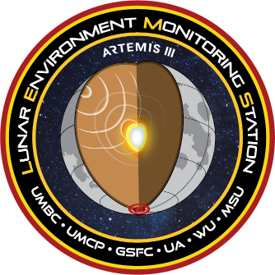


LEMS-A3
Lunar Environment Monitoring Station Thermal Control Subsystem
Juan Rodriguez-Ruiz, GSFC 545
Ethan Burbridge, Vertex Aerospace / GSFC 545
Thermal And Fluids Analysis Workshop
August 4-8, 2025
TC&P XI - 03

Slide 2
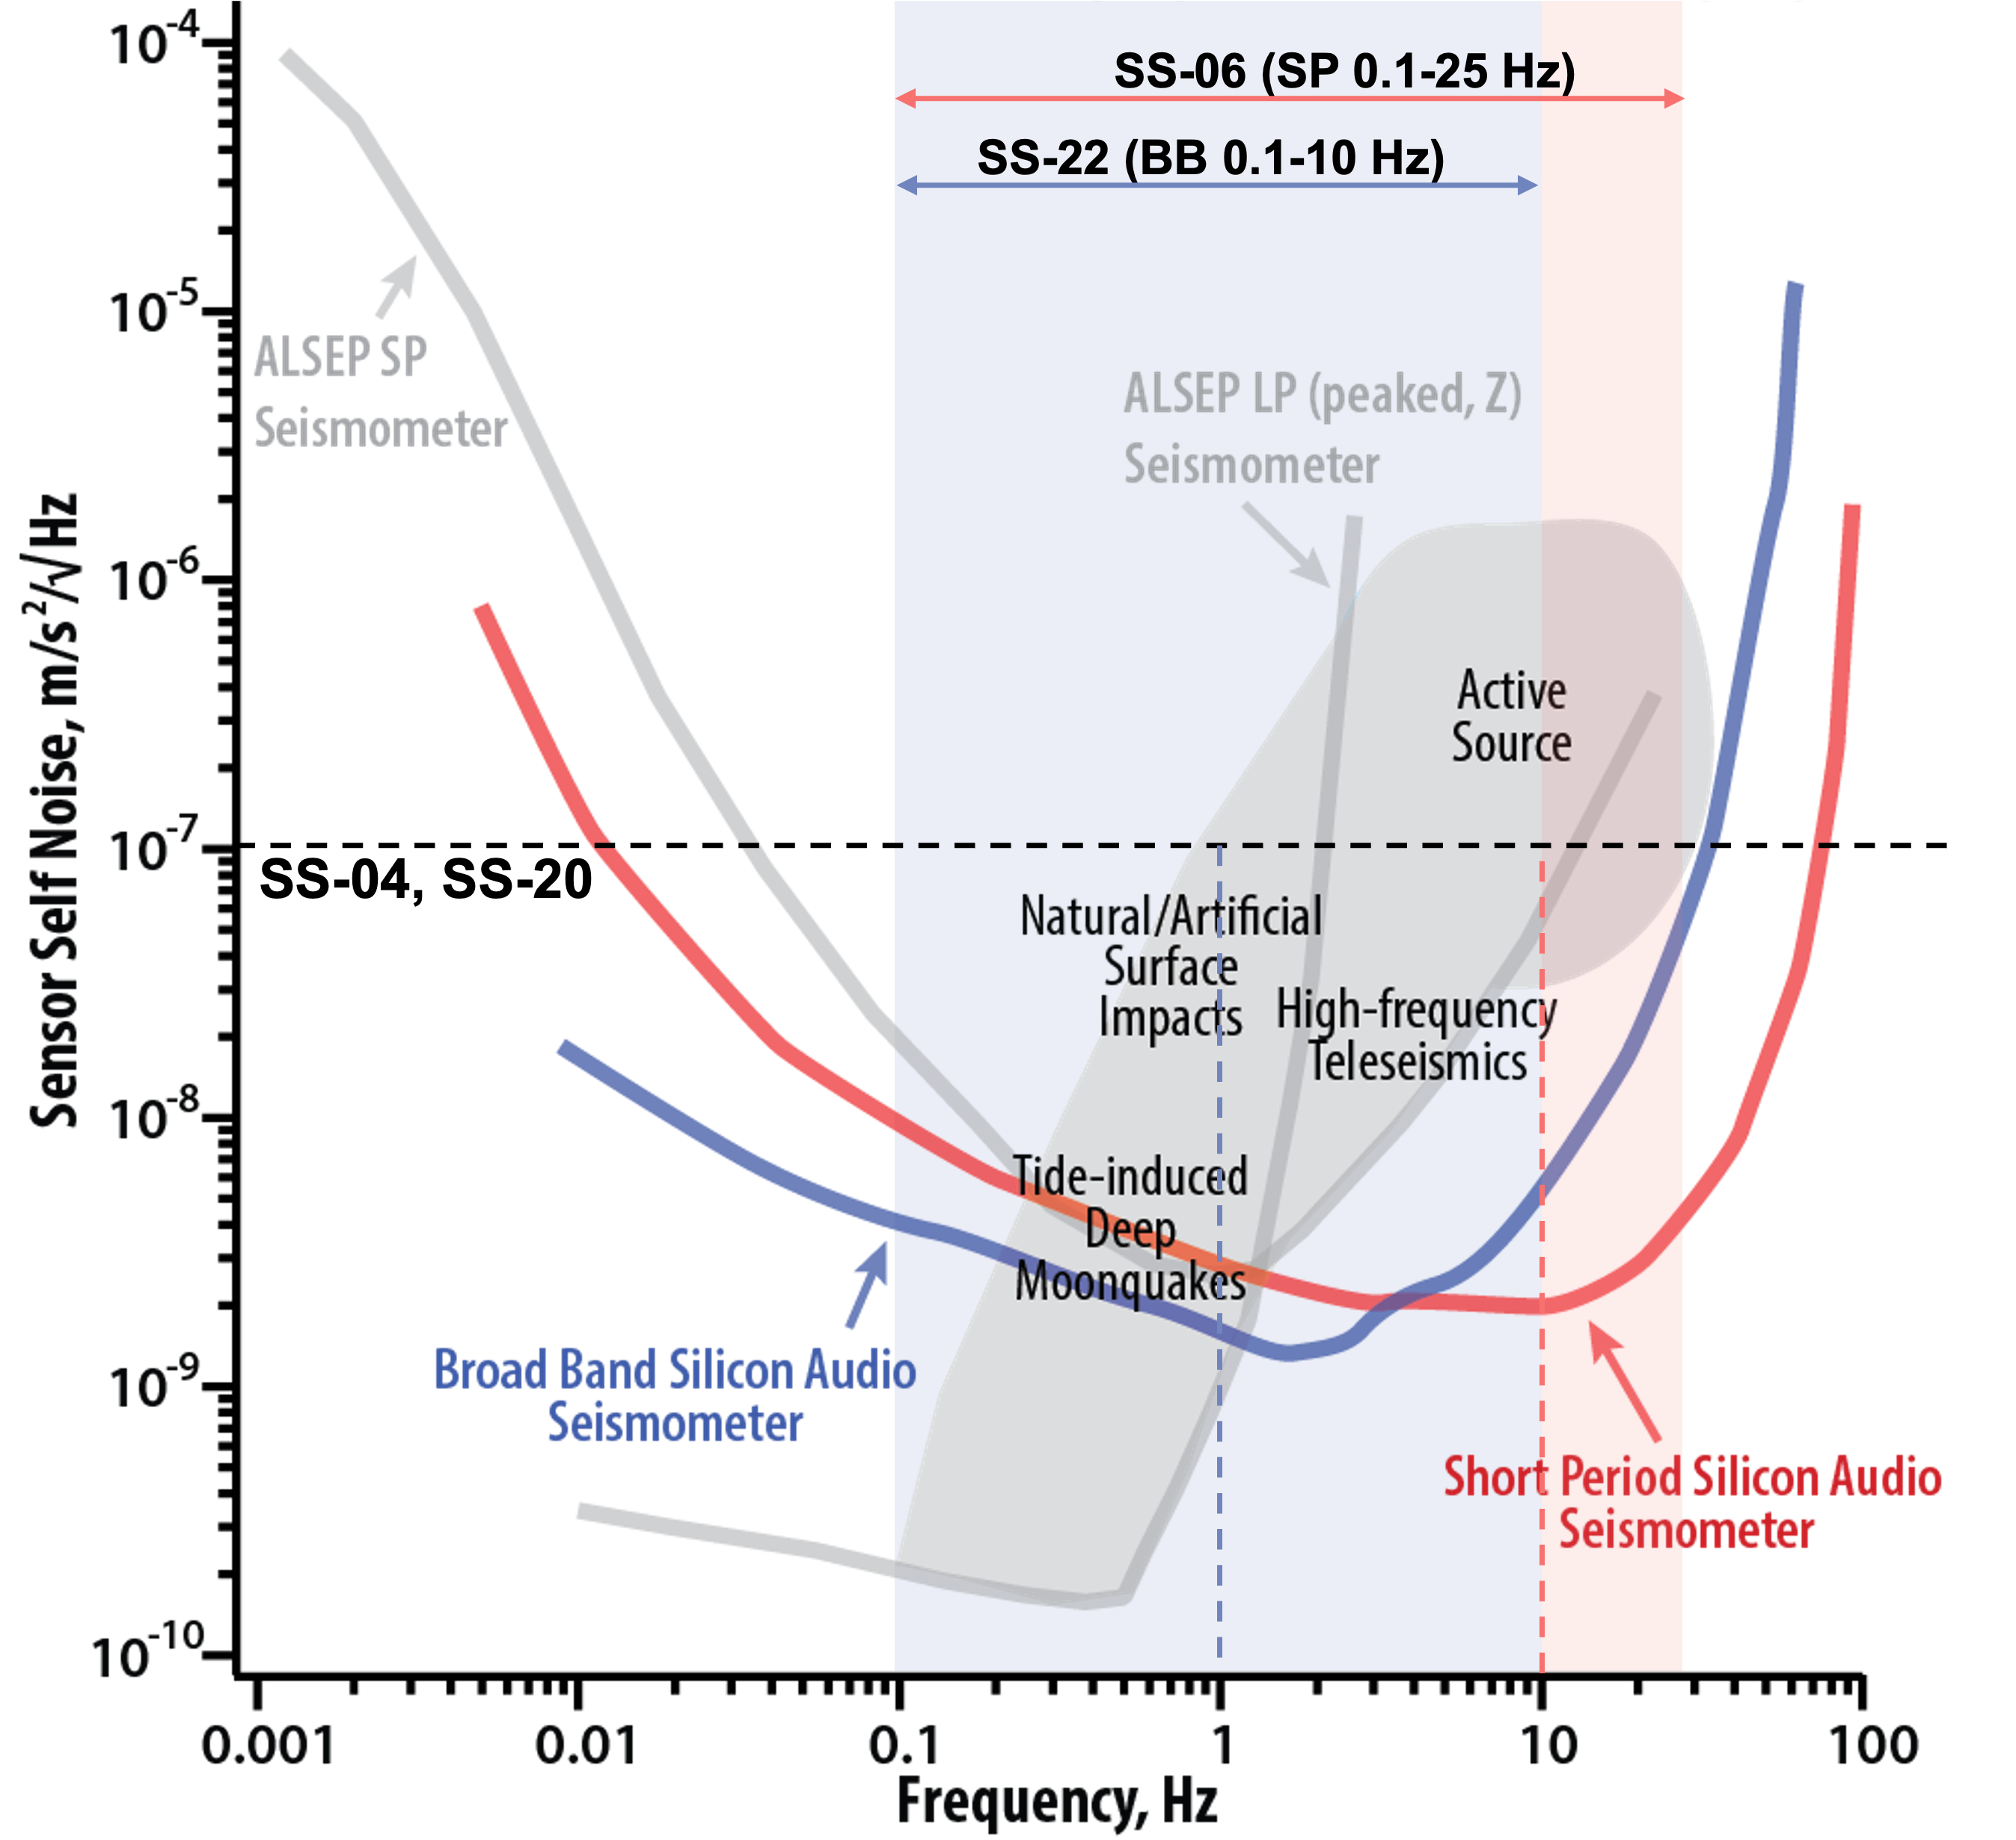
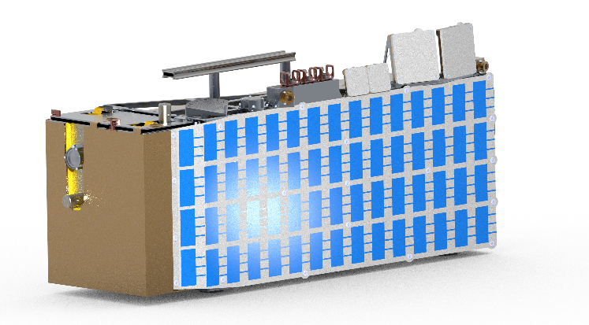
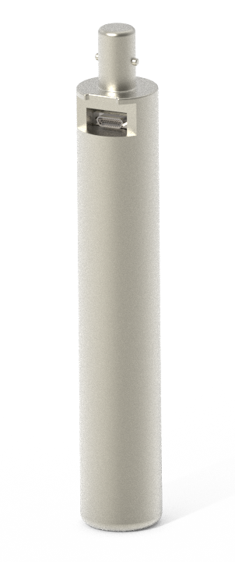
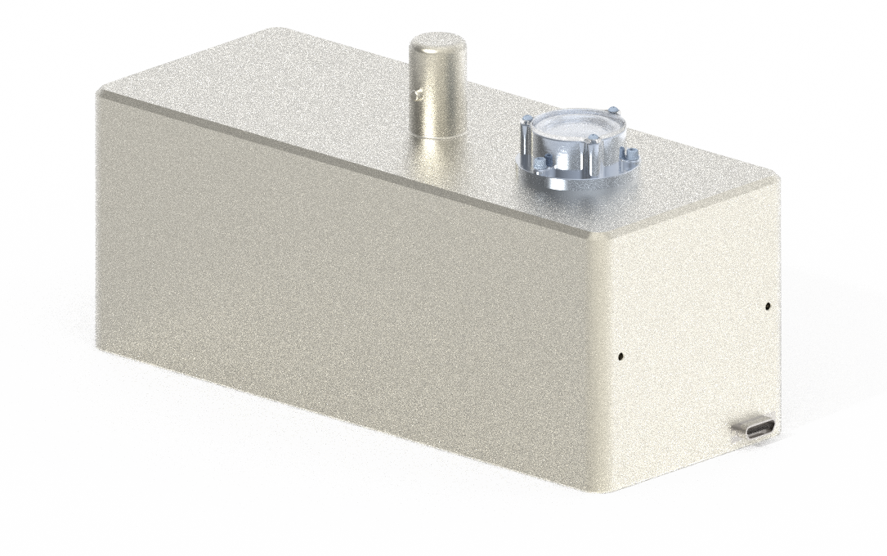
Mission Overview
LEMS-A3 is an autonomous, survive and operate in the lunar night instrument package that enables long-term, in-situ monitoring of lunar seismic activity for two-years on the Moon’s surface
LEMS-A3 project development has 18-month schedule beginning July, 2024 where it progresses from a Technology Readiness Level of 6 (TRL-6) to flight delivery
The seismometers will expand on Apollo in-situ seismometry to measure deep moonquakes, thermal moonquakes, surface impacts, and active sources.

Slide 3
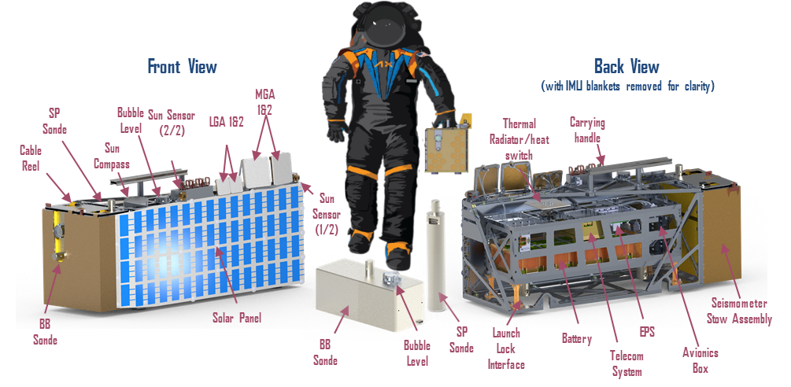
System Architecture

Slide 4


Driving Thermal Requirements
Maintain operational and survival temperature limits of all components during launch, cruise, deployment, and surface operations
Consume less than the allocated bus battery energy (640 W-h) during nighttime (354 h / 14.75 Earth days)
Mitigate environmental degradations from astronaut, solar, and dust exposure

Slide 5
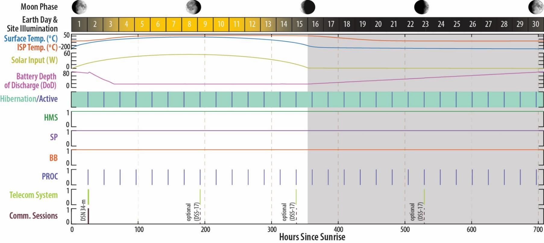
Concept of Operations
asdf

Slide 6
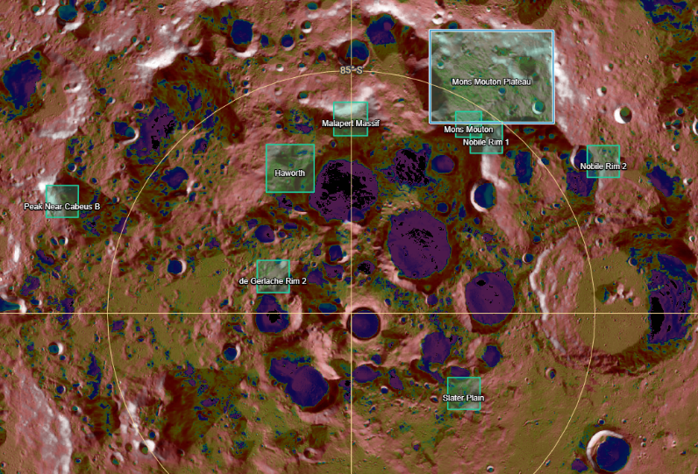
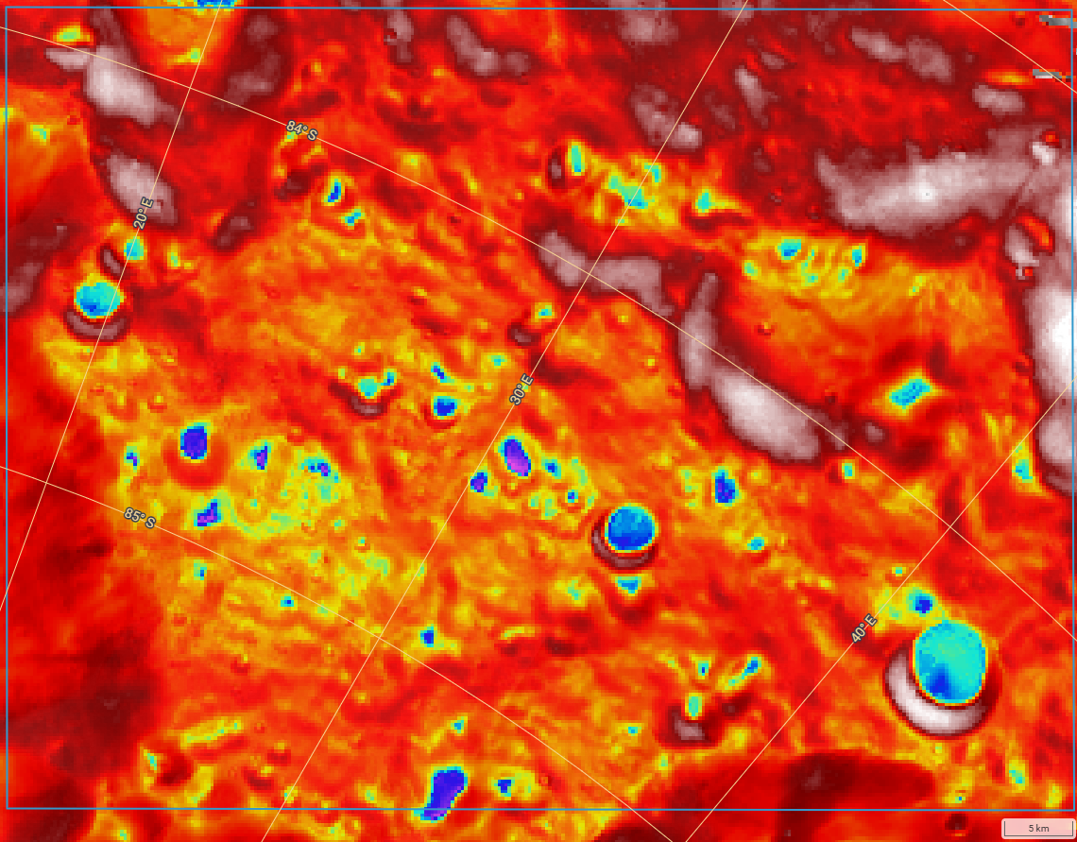

Lunar Surface Thermal Environment
South Pole Regions
Summer Max
Lunar regolith thermophysical properties taken from:
Cross Program Design Specification for Natural Environments (DSNE 3.4.6.2-1)
Lunar Surface Thermal Analysis Guidebook (HLS-UG-001)
Candidate regions comprise ~8000 km2 requiring simplifying assumptions
Site specific analysis to be completed upon site selection
Candidate regions surveyed for min/max surface temperature (-203°C to +10°C) and models correlated to results
Mons Mouton Plateau
Name | Centerpoint Latitude | Area [km2] | Perimeter [km]
Nobile Rim 2 | -83.9 | 397.8 | 79.8
Mons Mouton | -85.4 | 255.2 | 63.9
Malapert Massif | -86.0 | 439.9 | 83.9
de Gerlache Rim 2 | -88.2 | 399.8 | 80.0
Mons Mouton Plateau | -84.2 | 4428.4 | 268.9
Slater Plain | -87.1 | 399.3 | 79.9
Peak Near Cabeus B | -83.6 | 397.3 | 79.7
Nobile Rim 1 | -85.4 | 398.7 | 79.9
Haworth | -86.7 | 886.6 | 119.1
Total |  | 8003.0
5
10
20 Kilometers
"Lunar QuickMap“, https://quickmap.lroc.asu.edu/

Slide 7
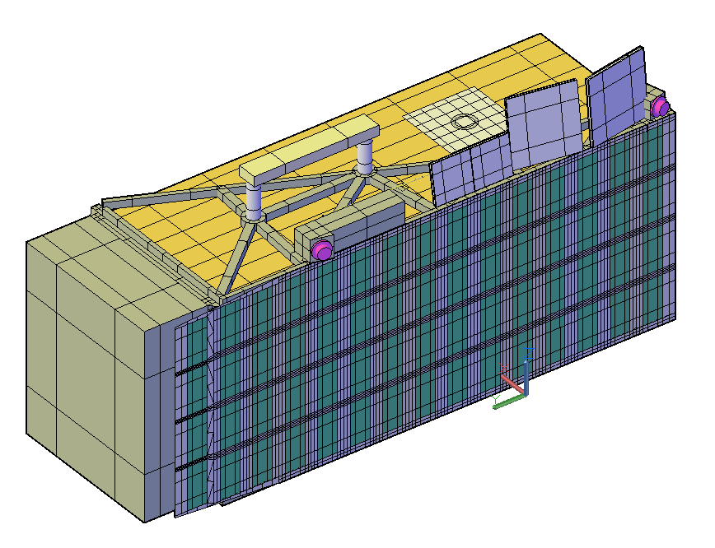
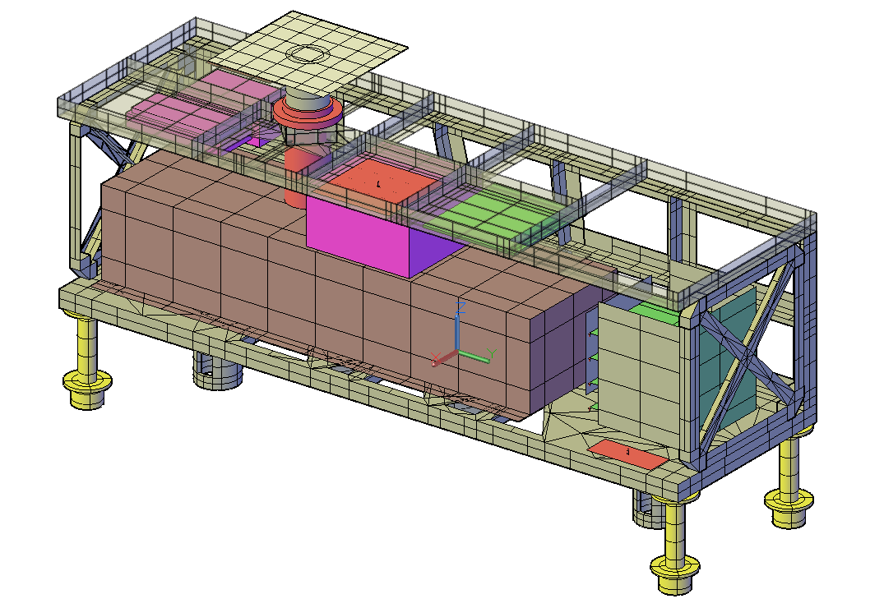
Thermal Control System
Passive Thermal Control
Low estar (e*<0.003) IMLI blanket w/ ballistic protection
Variable conductance heat switch + Z93C55 radiator
SLI or MLI for passthroughs (SAPP, launch lock)
Optimized materials and run length for SAPP
Low thermal conductivity ULTEM legs for surface ops
Titanium mechanical launch legs decoupled from regolith
Heater Control
Heaters to maintain bus temps in cold env.
4 x HMS software-controlled heaters
Bus heater
Heat switch heater
SEIS-SP heater
SEIS-BB heater
1 x EPS software-controlled heater for comms preheat
Temperature Telemetry
Hibernation Management System
32+ channels to continuously monitor internal and external components
CDH Processor Card (PROC)
T-sensors digitized by other processors outside of the Avionics Box
EPS
Additional monitoring of SA and battery
SEIS SP/BB
On-board analog + digital sensor for monitoring and heater control
Bus radiator
Antennae
IRIS Radio
Solar array
EPS
Avionics Box
Heat Load Summary (CBE Watts)
Location | Op Hibernation | Op Comms
Avionics Box | 0.99 | 3.37
EPS | 0.17 | 1.40
Battery | 0.07 | 1.84
IRIS SSPA | 0.00 | 12.70
IRIS LNA | 0.00 | 0.51
IRIS Transponder | 0.00 | 14.79
Inside Power | 1.23 | 34.61
BB Seismometer | 0.15 | 0.15
SP Seismometer | 0.15 | 0.15
IRIS RF Transmitted | 0.00 | 3.80
External Power | 0.3 | 4.1
Total Power | 1.53 | 38.71
Course Sun Sensor (CSS x 2)
Battery
LL Mechanical post
Seismometer Stow Assembly
(SSA)
LL Thermal Leg

Slide 8
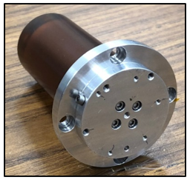
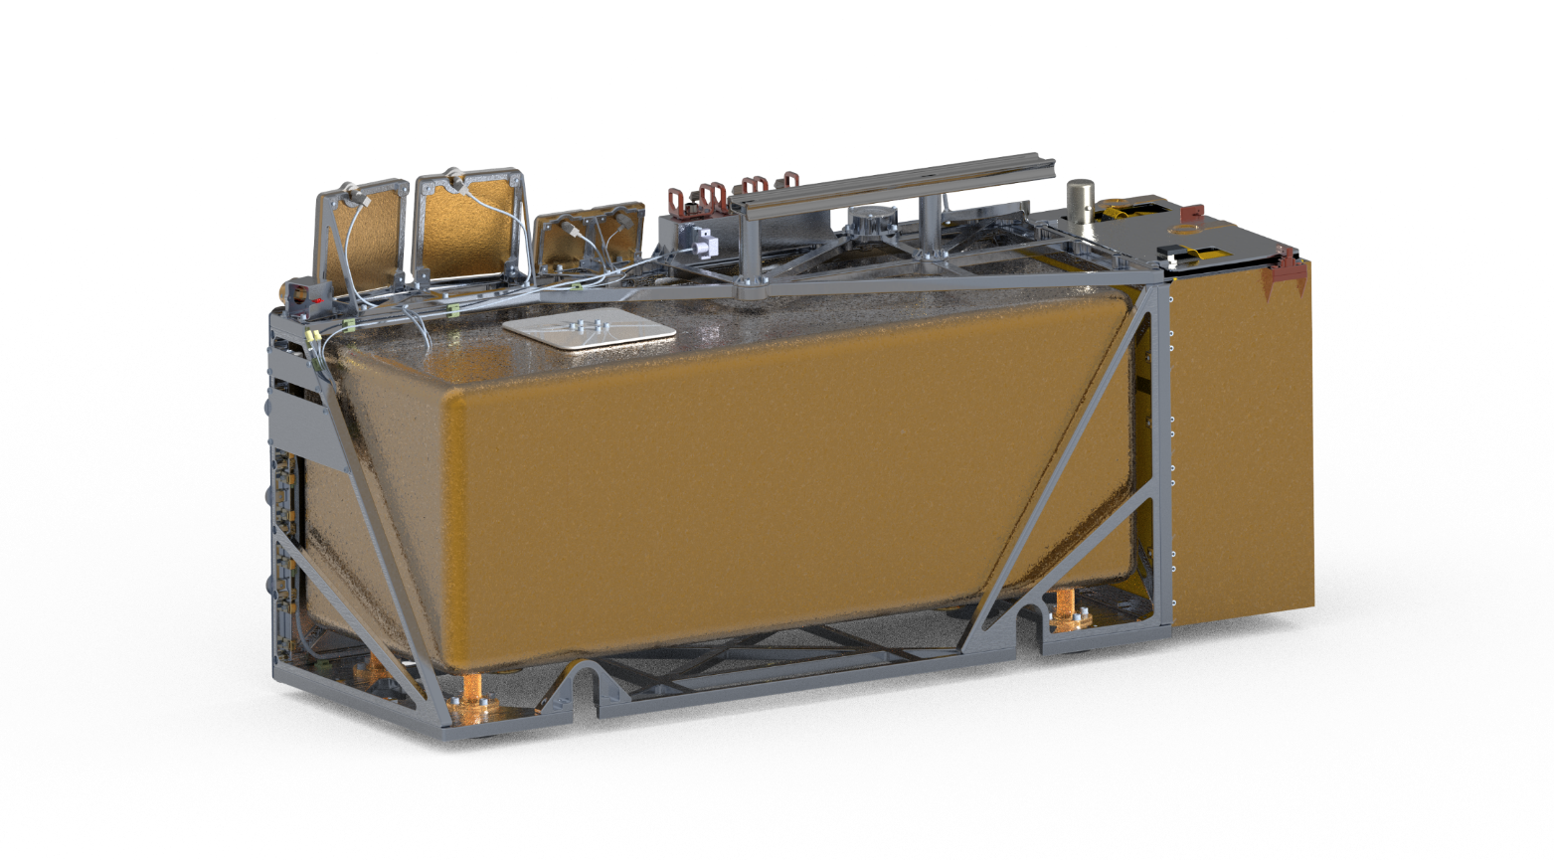
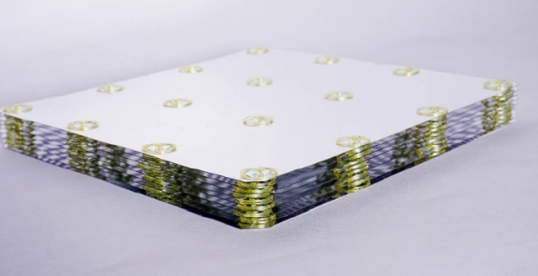
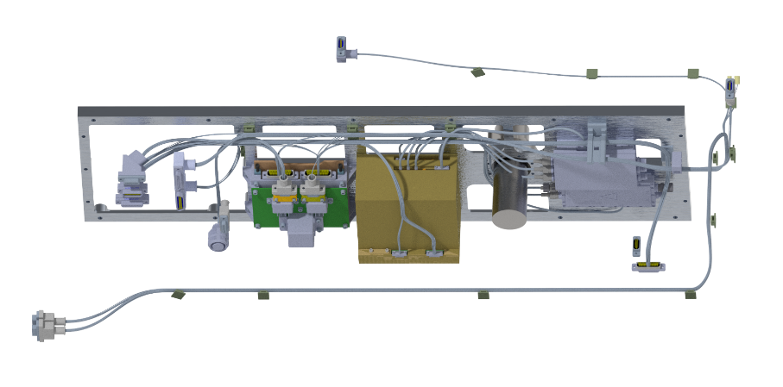
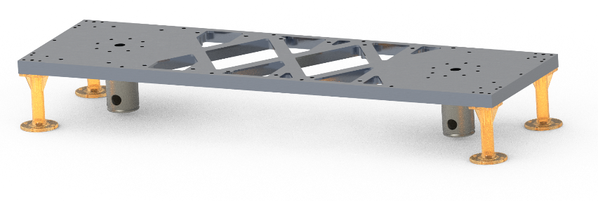
Surviving the Lunar Night Heat Leak Management
Heat Switch
Integrated Multi-Layer Insulation
(IMLI)
Variable conductance interface
G_on = 3.0 W/K
G_off = 0.002 W/K
High performance insulation using discrete standoffs
Signal and Power Passthrough
(SAPP)
Launch Lock (LL)
Post-deployment low conductance regolith contact
Low-k wire materials, Ultem clickbonds standoffs, and MLI
LL Thermal Leg qty. 4
(Ultem 1000 / VDA tape)
LL Mechanical Post qty. 2
(Ti6Al4V / Gold plated)
Notes:
Get updated central image, with IMLI semi-transparent so bus structure can be seen

Slide 9
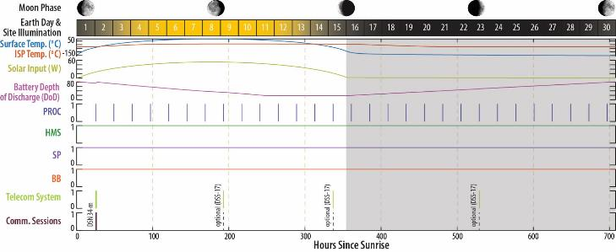
Transient Heat Loads
Transient cases combine heat loads
CBE Hibernation mode at night
MEV Solar Array charging during the day
CBE/MEV 10 min. data download from HMS to PROC every 24 hours ,
3 hour comms once a lunation
Additional comms events are optional and not shown
3
10
Night
Day
Night
6
3-hr Comms
12
11
6
11
Daytime PROC Session
12
Nighttime PROC Session
10
Daytime Hibernation + EPS
3
Nighttime Hibernation

Slide 10
Analysis Case Sets
Steady-state and transient cases are used for system analysis and trade studies
Lunar surface conditions change slowly relative to LEMS thermal constant so steady state analysis is appropriate
Human Landing System (HLS) trunk temperatures vary -40 C to +45 C during all transit phases
LEMS-A3 will be non-operational in the trunk so temperatures are validated by limits
EOL properties have 20% dust coverage (a = 0.53) as weighted average with coating optical properties
(a’ = a_coating*(80%) + a_dust*(20%))
Radiator size is reduced in the hot cases to account for potential near-field terrain
Case Name |  | Steady State Cold Op | Steady State Hot Op | Transient Cold Op | Transient Hot Op
Power State | Op Mode | 3 | 3 | Transient | Transient
 | Biasing | CBE | MEV
Coatings BOL/EOL Biasing |  | BOL | EOL + dust | BOL | EOL + dust
Environment | Local Lunar Time | 5:30 | 12:00 | One Lunation | One Lunation
 | Solar Heat Flux | 1310 | 1426 | 1310 | 1426
 | Lunar IR emiss | 0.95 | 0.98 | 0.95 | 0.98
 | Lunar Albedo | N/A | 0.47 | 0.53 | 0.47
Spacecraft Attitude | Latitude | 90S | 83.5S | 90S | 83.5S
 | Moon Abberation | 0 | 1.543 | 0 | 1.543
 | Surface Inclination | 0.0 | 10.0 | 0.0 | 10.0
 | Spacecraft Inclindation | 0.0 | -5.0 | -5.0 | -5.0
 | Effective Spacecraft Beta Angle | 0 | 13.053 | 0 | 13.053
Bus Radiator Terrain Derate* |  | 100% | 85% | 100% | 85%

Slide 11
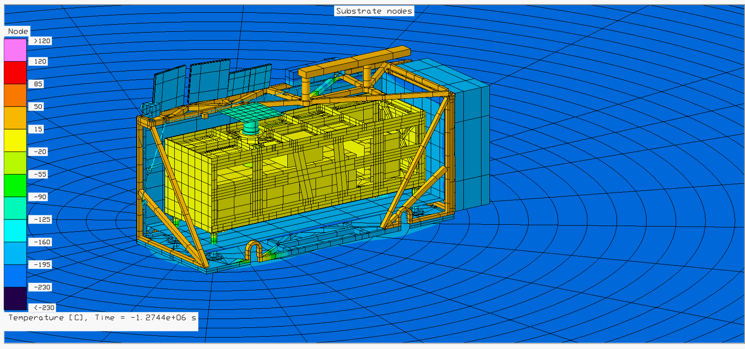
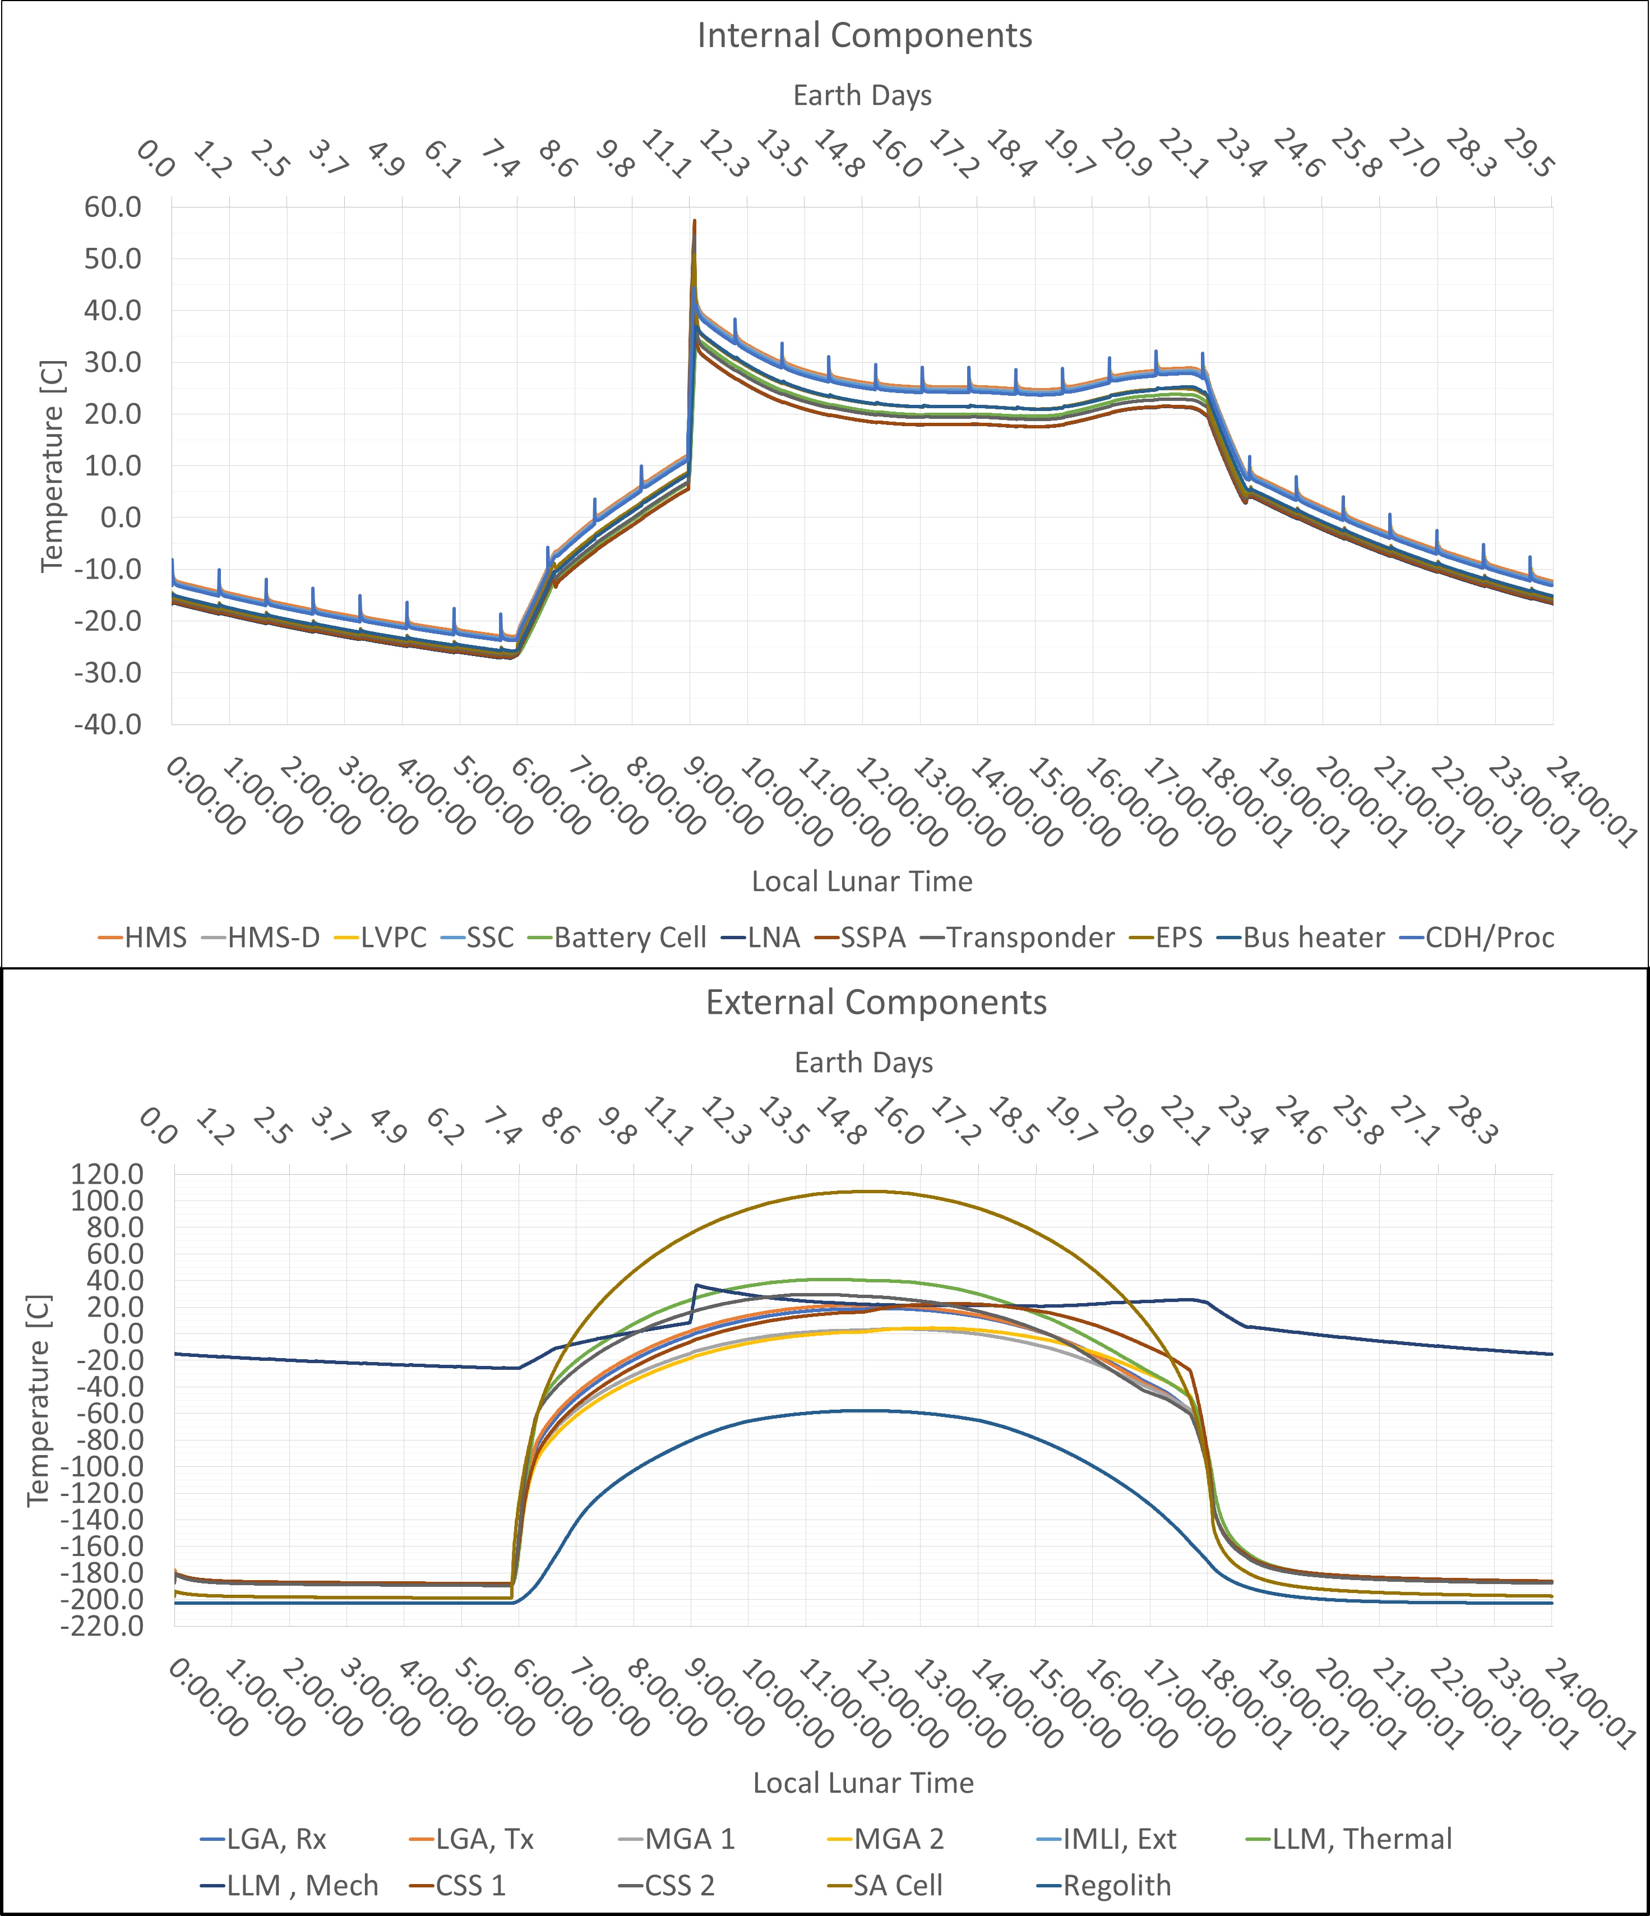
Hot Operational Thermal Transient

Slide 12
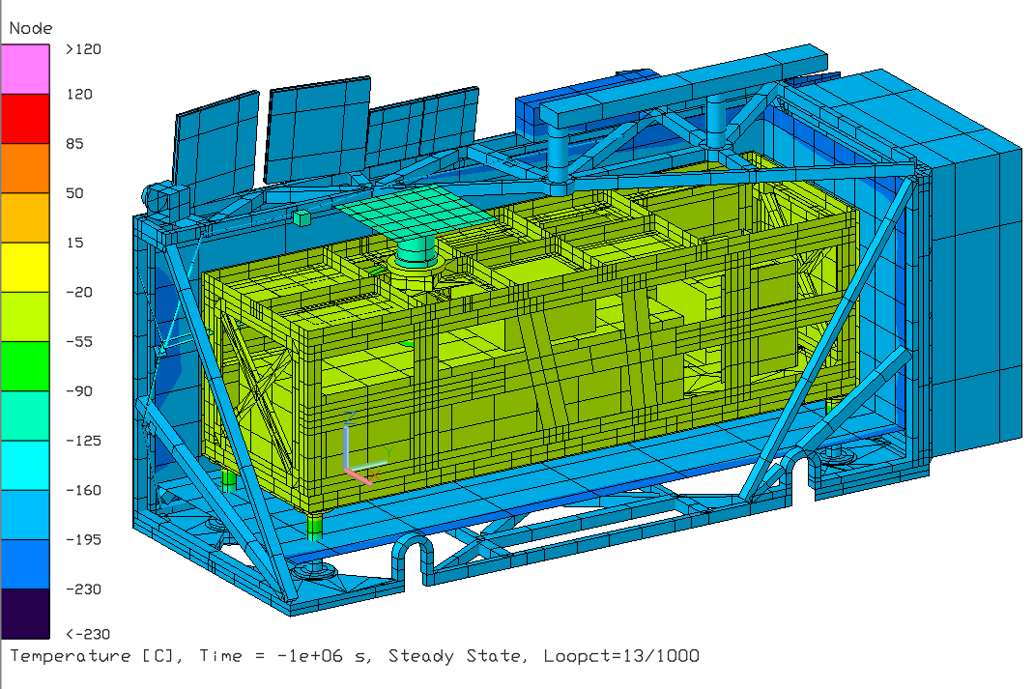
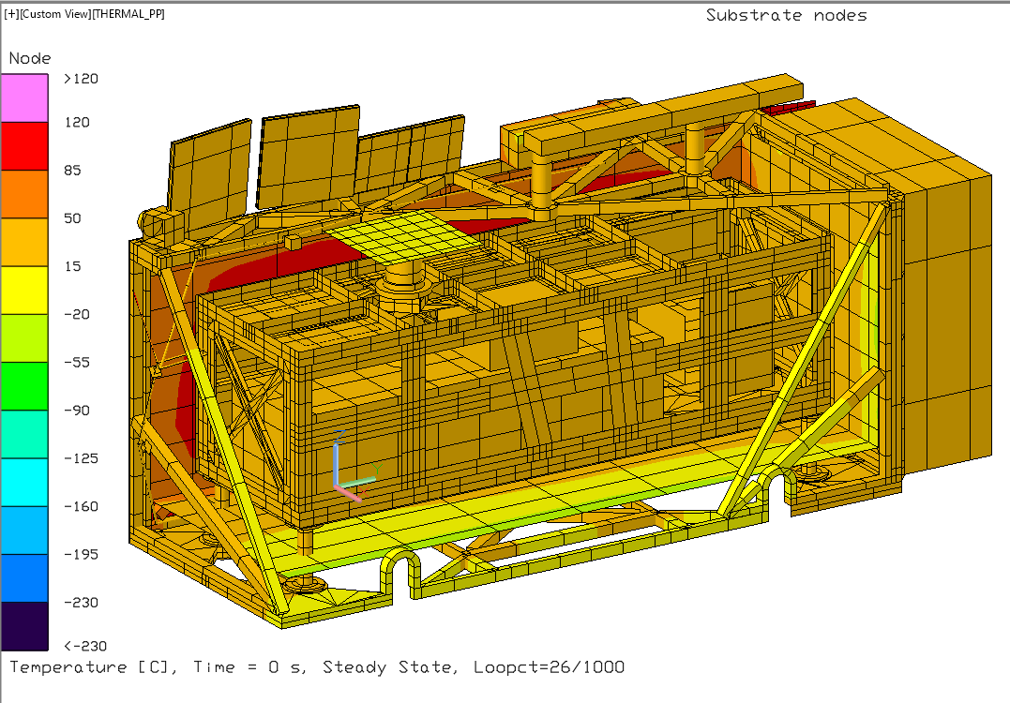
Steady State Results
Steady state predicts are conservative compared to transient predicts
Hot Op does not include comms session
Solar array limit violation is being addressed via testing and with the vendor
Description | Op Limits |  | Cold Op SS |  | Hot Op SS
 |  |  | Predict | Margin | Predict | Margin
 | Min | Max | [°C] | Min | [°C] | Max
Avionics, PROC | -35 | 60 | -24.8 | 10.2 | 35.2 | 24.8
Avionics, HMS | -35 | 60 | -24.0 | 11.0 | 36.3 | 23.7
Avionics, HMS-D | -35 | 60 | -24.4 | 10.6 | 35.9 | 24.1
Avionics, LVPC | -35 | 60 | -24.6 | 10.4 | 35.4 | 24.6
Avionics, Special Services | -35 | 60 | -24.4 | 10.6 | 35.6 | 24.4
Battery | -35 | 50 | -27.2 | 7.8 | 31.4 | 18.6
LGA RX | -210 | 70 | -189.9 | 20.1 | 34.0 | 36.0
LGA TX | -210 | 70 | -190.1 | 19.9 | 36.9 | 33.1
IRIS LNA | -30 | 60 | -27.6 | 2.4 | 29.0 | 31.0
MGA 1 | -210 | 70 | -189.5 | 20.5 | 17.9 | 52.1
MGA 2 | -210 | 70 | -189.4 | 20.6 | 17.0 | 53.0
IRIS SSPA | -30 | 60 | -27.5 | 2.5 | 29.0 | 31.0
IRIS Transponder | -30 | 60 | -27.3 | 2.7 | 30.4 | 29.6
EPS | -30 | 60 | -27.0 | 3.0 | 32.5 | 27.5
CSS 1 | -200 | 80 | -189.2 | 10.8 | 31.9 | 48.1
CSS 2 | -200 | 80 | -190.7 | 9.3 | 47.6 | 32.4
Bus Radiator | No Limit |  | -115.9 | No Limit | 13.1 | No Limit
Bus Heat Switch | -200 | 50 | -27.7 | -172.3 | 27.2 | 23.8
Solar Array | -200 | 110 | -199.5 | 0.5 | 115.6 | -5.6
Regolith, Sunside | No Limit |  | -198.5 | No Limit | 105.6 | No Limit
Regolith, Undisturbed | No Limit |  | -202.7 | No Limit | 28.9 | No Limit
Cold Op (↑)
Hot Op (↓)
Steady State Case | Description | Design |  | Predicts
 |  | Min Power [W] | Max Duty Cycle | Predict [W] | Duty Cycle
Cold Surv | Bus Op Heater | 5.00 | 70% | 1.41 | 28%
 | Heat Switch Heater | 1.00 | 70% | 0.00 | 0%
Cold Op | Bus Op Heater | 5.00 | 70% | 0.19 | 4%
 | Heat Switch Heater | 1.00 | 70% | 0.64 | 64%
Hot Op | Bus Op Heater | 5.00 | 70% | 0.00 | 0%
 | Heat Switch Heater | 1.00 | 70% | 0.00 | 0%
Notes:
Make model pictures bigger (print out to plotter). Make video of temperature changing
IRIS radio limits expected to be updated and expanded pending review of SDL TVAC data
Comments for Ethan:
The idea to use -200C as a limit to check against is questionable. I would suggest we keep it TBD, and instead highlight the Cold Op predict for these components that are running at that extreme cold temperature. With that we can talk about where things are expected to get
There are some inconsistencies between the TAR. The avionics card interface Op limit is +50C
Add bullets pointing out violations and areas of concern

Slide 13
Lunar night survivability and heater power
The Thermal Control System will maintain temperatures longer than the battery can power electronics
Bus predicted heat leak reduced from 3.980 W (TRL-6) to 1.528 W
Description | Heat Balance [W]
Launch Lock (thermal & mechanical) | -0.353
IMLI (e*=0.0028) | -0.303
Signal and Power Passthrough (SAPP) | -0.398
Heat Switch | -0.474
Total Heat Loss | -1.528
Internal Electronics CBE Heat | 1.231
Heater Power | 0.297
Total Bus Internal Electronics Power | 1.528
Nighttime Thermal Energy Balance (354 hrs) [W-h] | -541
Allocated Battery Energy (LA3-L4-TH-01 & 03) [W-h] | 640
Battery Thermal Energy Margin [W-h] | 99
 | (15%)
Time until Energy Allocation Limit [Earth Days] | 17.7
Notes:
Remove seismometer from thermal energy balance
How to spend it:
Larger radiator = faster cool down and lower temperature spike 3 hr comms
Higher nighttime op temp: stay above IRIS radio cold start temp, reduced battery degradation
Relax SAPP material and mounting requirements
Carry as margin for expanded site selection
Thicker thermal legs (requested by mechanical)
Relax test req.
Reduce blanket layers
Heater power to seismometer

Slide 14
Conclusions
All bus components shown to be within temperature limits during surface operations
Solar array limit violation addressed by increasing max allowable temperature per vendor
Bus heat leak reduced from 3.980 W at TRL-6 to 1.528 W at CDR
Expected energy consumption is 541 W-h with 99 W-h margin against the 640 W-h allocation
LEMS should be able to operate >17 Earth days before depleting the battery
LEMS-A3 has proceeded to integration and test for delivery Q1 2026
Lessons Learned
Passively operating in the cold Lunar night is very challenging
Count the milliwatts!
Defend heat leaks against mechanical, electrical, comms, science, systems, project management…

Slide 16
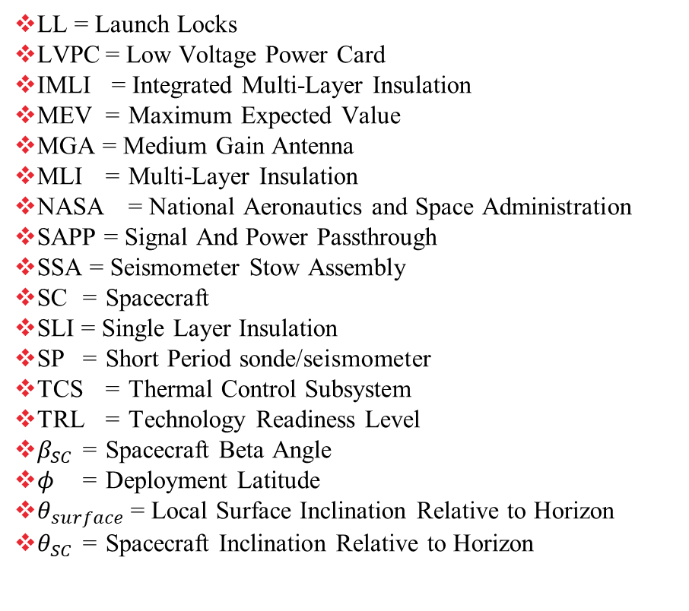
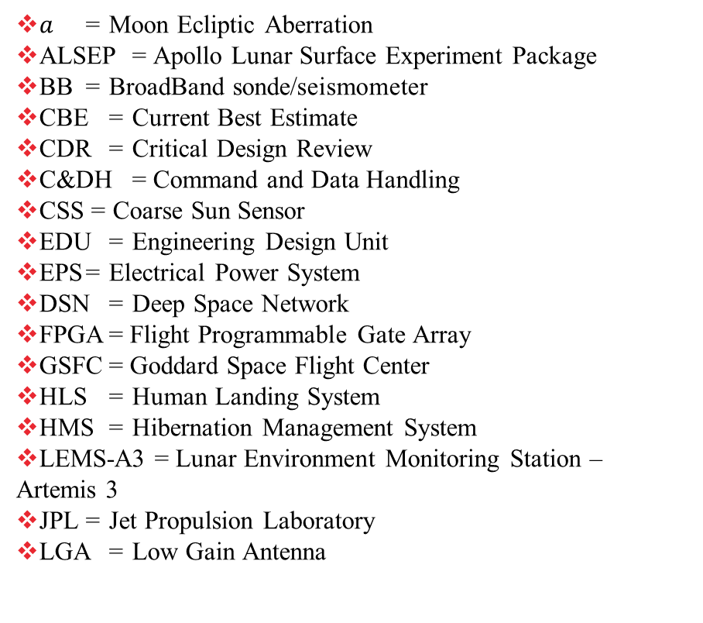
Acronym List
$a$ = Moon Ecliptic Aberration
ALSEP = Apollo Lunar Surface Experiment Package
BB = BroadBand sonde/seismometer
CBE = Current Best Estimate
CDR = Critical Design Review
C&DH = Command and Data Handling
CSS = Coarse Sun Sensor
EDU = Engineering Design Unit
EPS = Electrical Power System
DSN = Deep Space Network
FPGA = Flight Programmable Gate Array
GSFC = Goddard Space Flight Center
HLS = Human Landing System
HMS = Hibernation Management System
LEMS-A3 = Lunar Environment Monitoring Station – Artemis 3
JPL = Jet Propulsion Laboratory
LGA = Low Gain Antenna
LL = Launch Locks
LVPC = Low Voltage Power Card
IMLI = Integrated Multi-Layer Insulation
MEV = Maximum Expected Value
MGA = Medium Gain Antenna
MLI = Multi-Layer Insulation
NASA = National Aeronautics and Space Administration
SAPP = Signal And Power Passthrough
SSA = Seismometer Stow Assembly
SC = Spacecraft
SLI = Single Layer Insulation
SP = Short Period sonde/seismometer
TCS = Thermal Control Subsystem
TRL = Technology Readiness Level
$β_{SC}$ = Spacecraft Beta Angle
$φ$ = Deployment Latitude
$θ_{surface}$ = Local Surface Inclination Relative to Horizon
$θ_{SC}$ = Spacecraft Inclination Relative to Horizon

