Slide 1
The LEAF Thermal Control System
Kaitlyn Baba (Lead Author and Presenter), Adam Escobar
Space Lab Technologies, LLC, Boulder, CO, 80301
James Nabity
Ann and H. J. Smead Aerospace Engineering Sciences, University Colorado at Boulder, CO, 80303

Slide 2
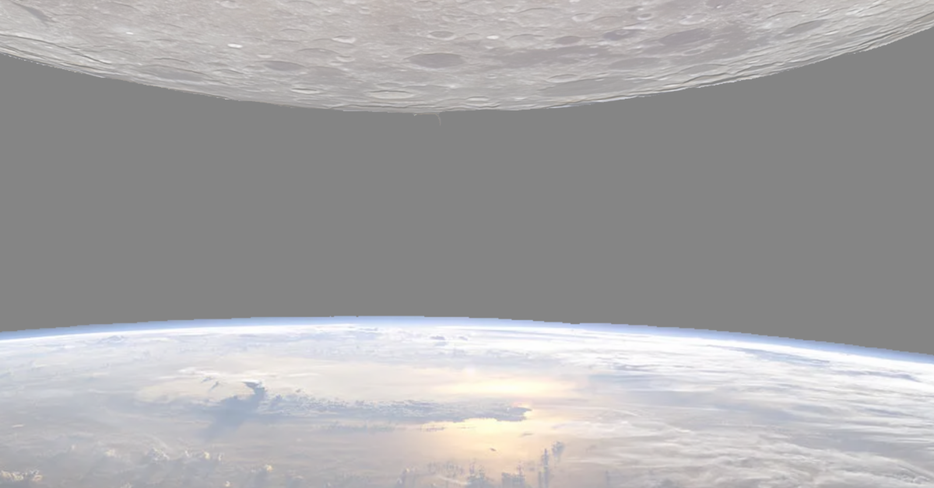
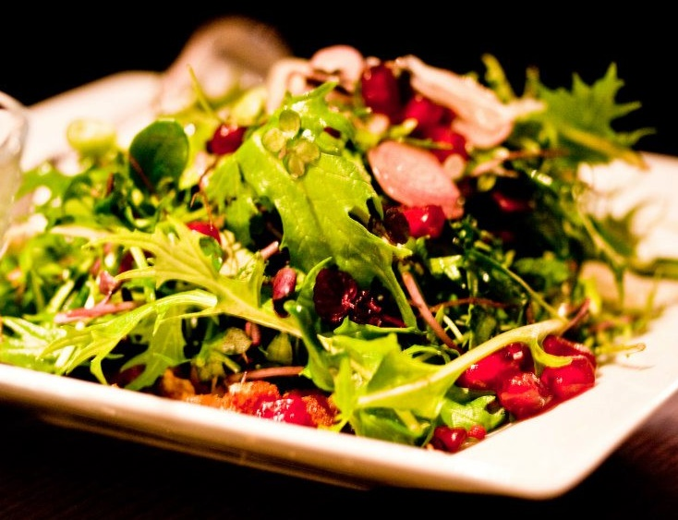
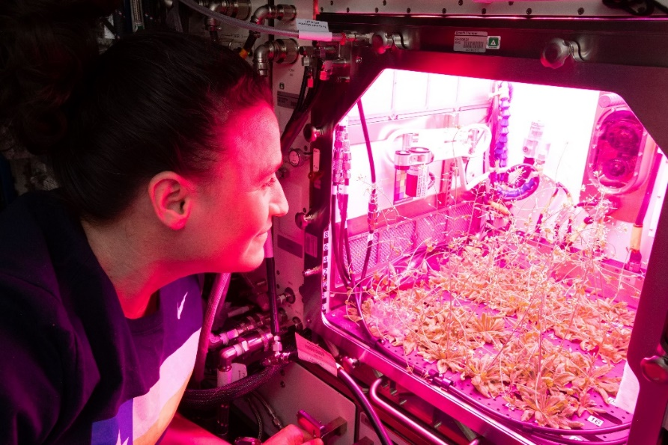
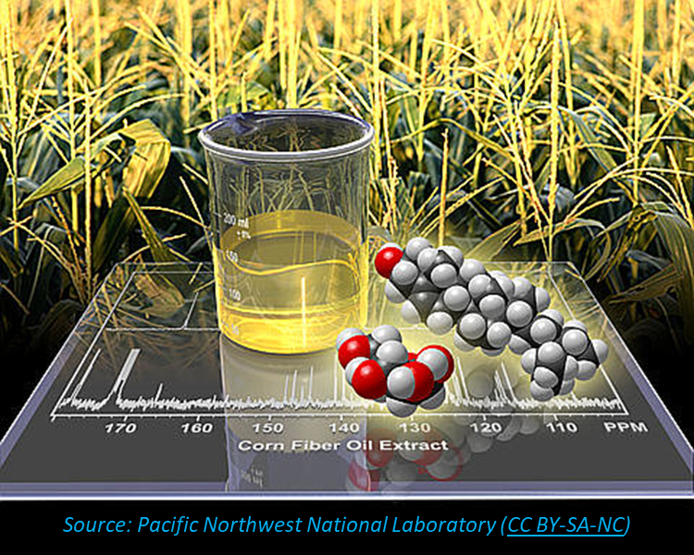

Enabling Sustained Exploration of the Moon and Beyond
Plants in Space
Psychological Well Being
Regenerative Food for Decreased Mass & Nutrition
Bioproducts: Medicine, Biofuel, Fibers, Polymers
Life Support:
Air & Water Revitalization
Lunar Effects on Agricultural Flora (LEAF β) will provide the first, comprehensive assessment of organism-wide effects of the Lunar environment on model space
crops, reducing risks for sustainable off-planet food production and life support.

Slide 3
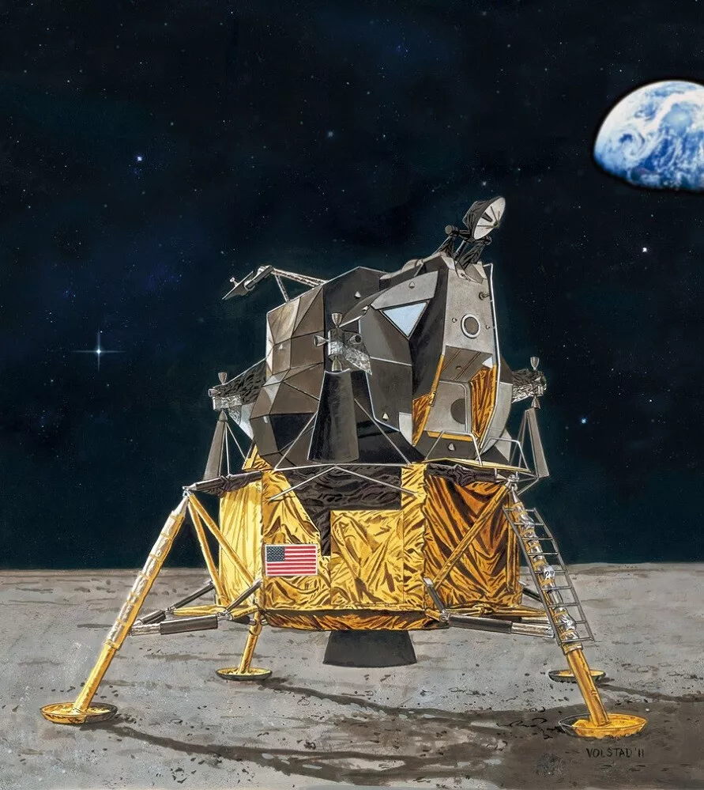
Sources of Thermal Heat Loads
Radiative Heat Q_{R}
Incident Solar Flux q_{s}
Albedo q_{α}
θ
Absorbed
HLS Heat Load Q_{HLS}
Q_{R} = Q_{s} + Q_{α} + Q_{IR} + Q_{HLS}
solar
albedo
IR
HLS heat loads
Lunar Surface IR q_{IR}

Slide 4
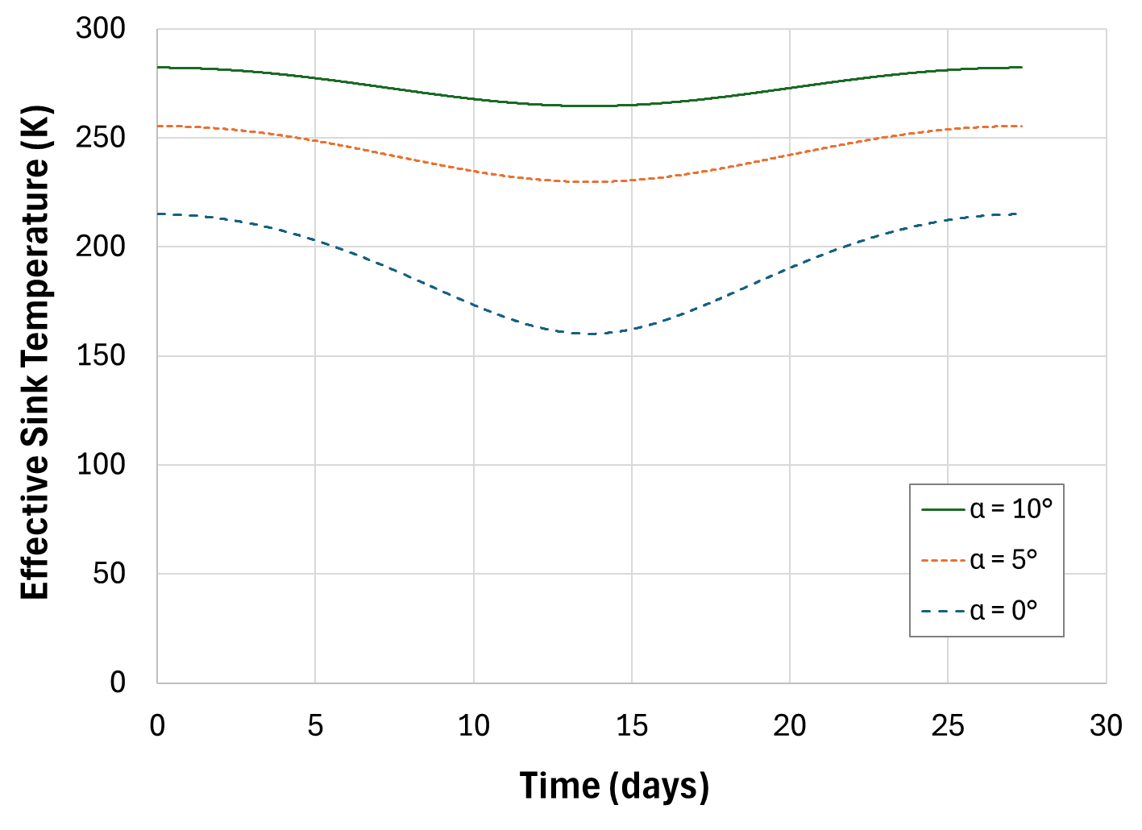
Lunar Environment
θ
θ
θ

Slide 5
Thermal System Functions and Features
Function | Implemented By
Maintain aerial zone temperature of growth bed chambers between 18°C and 28°C (23°C nominal) | Blower Condensing heat exchanger STR Heat Exchanger Plate Carbon fiber heat strap Variable conductance heat pipes Ducting for air mixing Radiator with AZ-93 paint Aerothreads MLI on all 6 sides of payload structure Radiator Cover with Crew Carry Handle Vaisala RH/Temp Sensor Resistance Temperature Detectors
Monitor aerial zone temperature hourly
Maintain aerial zone relative humidity between 20% and non-condensing levels (nominally between 40-75%)
Monitor aerial zone relative humidity hourly

Slide 6
LEAF Thermal System – Full Overview

Slide 7
Main Thermal Control Components - Overview

Slide 8
Secondary Thermal Control Components - Overview

Slide 9
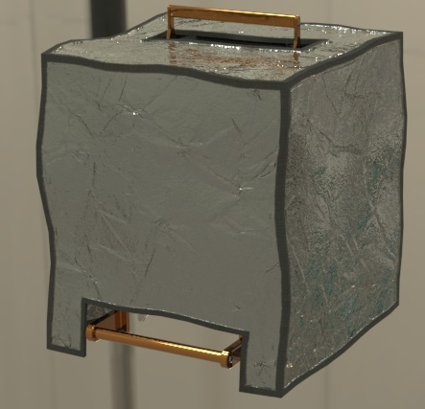
LEAF Thermal System – Multi-Layer Insulation
Prior to deployment, all surfaces of LEAF, aside from the handles, will be covered in an MLI blanket to
Materials
  First Surface Mirror Layer: Silverized Teflon
  Mesh spacers between layers
  4-layer MLI blanket
  Space Lab will work with Aerothreads to develop this MLI blanket.
Because overheating is of concern for LEAF once powered on, the multilayer insulation is designed to be removable by attaching it to the payload via SJ4580 reclosable fasteners.
LEAF in MLI bag

Slide 10
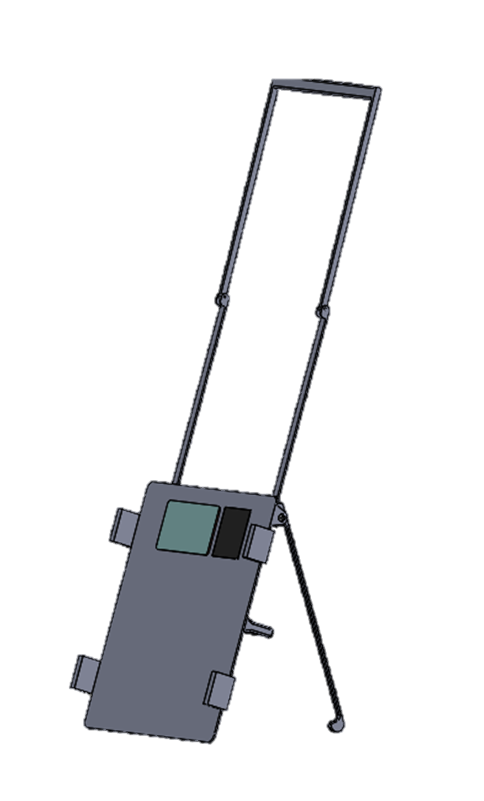
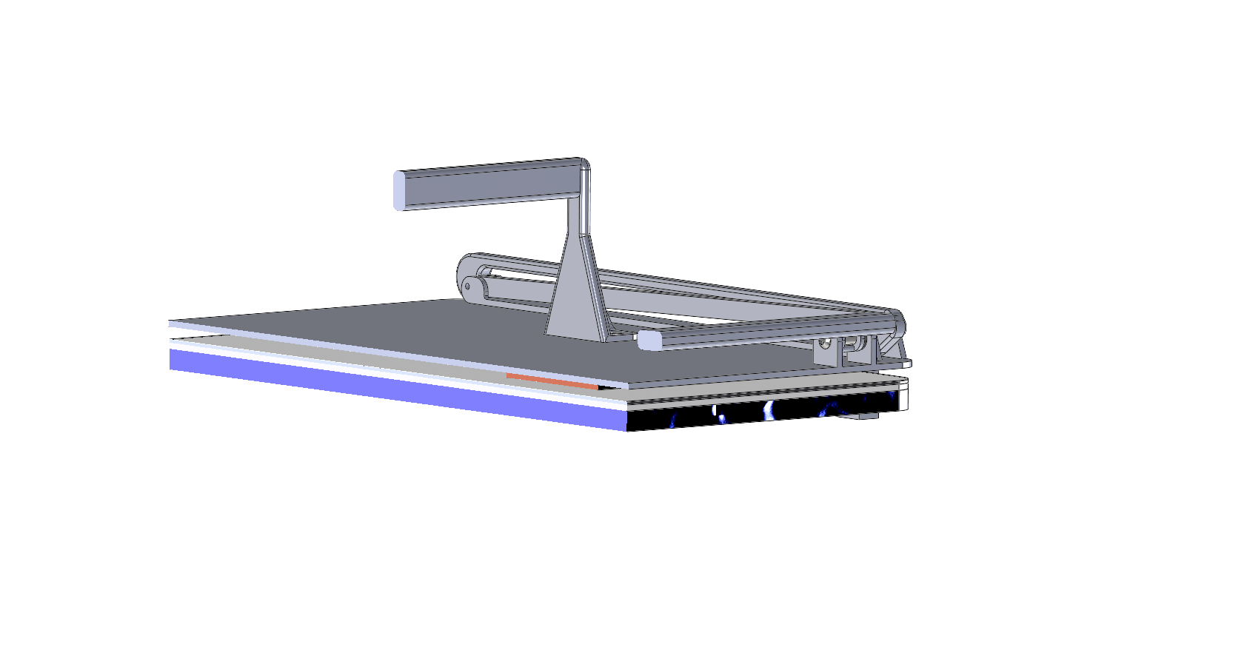
LEAF Thermal System – Radiator Cover
Primary Functionality:
  Protect radiator from damage during deployment
Secondary Functionality:
  House antenna components
Radiator:
  Mounted directly to heat generating components
  Perpendicular to lunar surface
  AZ-93 coated
  Solid aluminum plate
Radiator Cover
Undeployed Cover
Deployed Cover
Deployed Cover

Slide 11
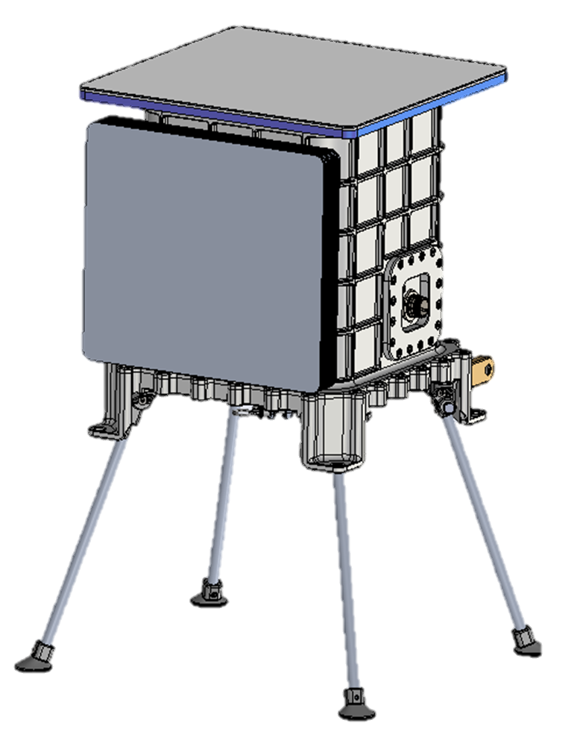
LEAF Thermal System – Radiator
Mounted to the zenith face of the payload via thermally insulating standoffs
Integrated with the rest of the thermal system by three graphite composite heat straps mounted between a cold plate on the top of the payload enclosure and the bottom of the radiator.
Materials:
  Solid aluminum plate
  AZ-93 coated
  0.145 m²
Radiator
Radiator and Radiator Cover Assembly
Full Payload

Slide 12
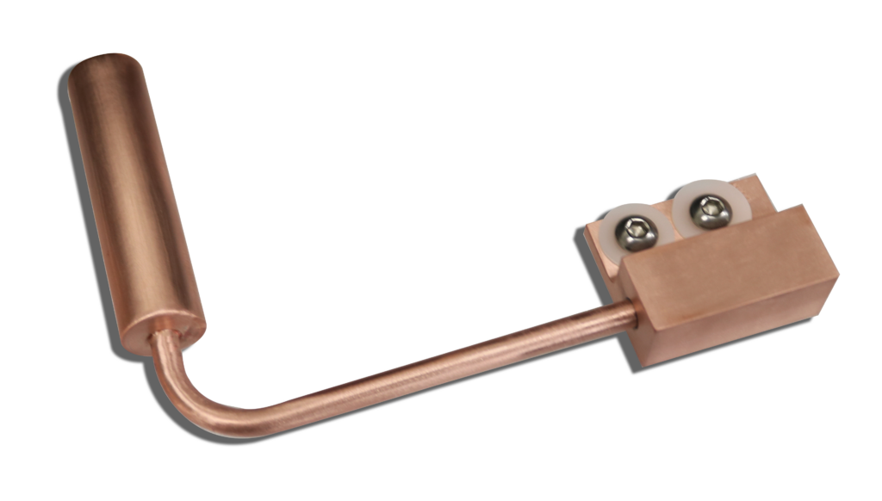
LEAF Thermal System – Variable Conductance Heat Pipes
Given the wide range of lunar environmental temperatures and variable heat load, variable conductance heat pipes will be used to integrate the CHX with the rest of the system due to freezing risk
Heat pipes will route directly from the condensing surface to the cold plate
Space Lab Technologies will work with Advanced Cooling Technologies to develop the heat pipe system

Slide 13
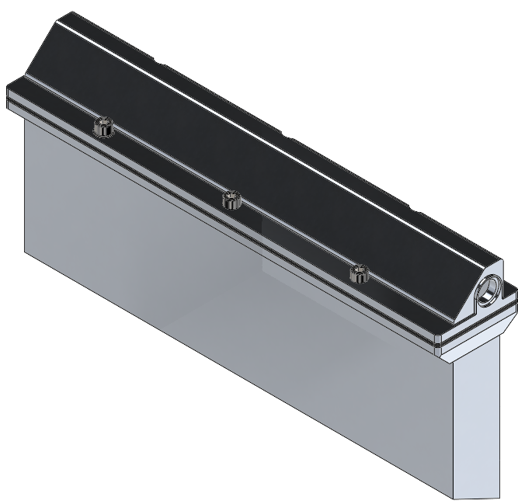
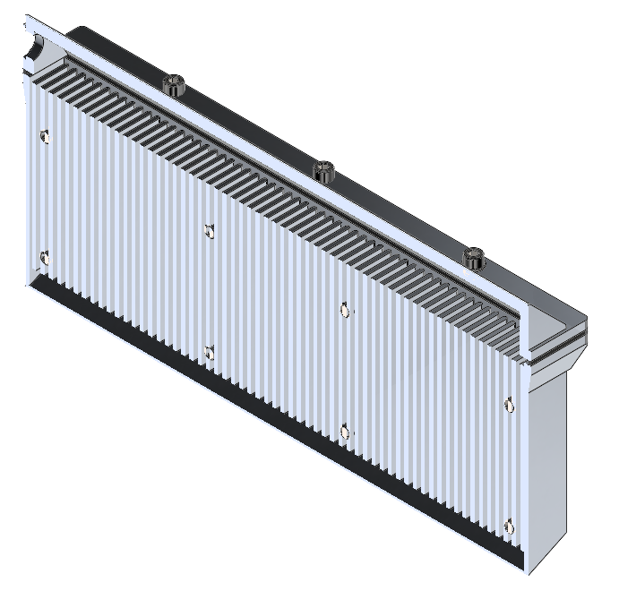
LEAF Thermal System – Condensing Heat Exchanger
Capability to move max heat load of 41.4W
Minimum condensing area of 0.0736 m²
Surface temperature of 11°C
Connection port in back to heat pipes
Condensate is routed directly into the growth beds below
Housing and inlet manifold material: Hardened anodized aluminum
9.37 cm
19.41 cm
Labelled view of CHX
3.71 cm
Section View of CHX

Slide 14
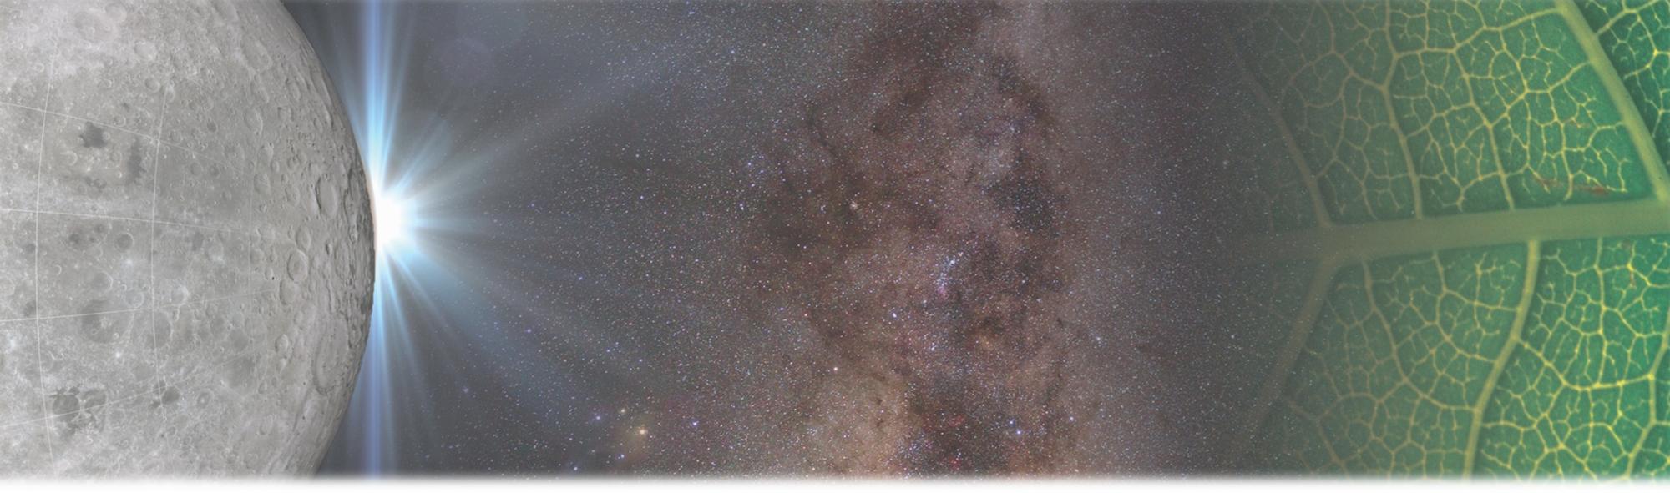


LEAF
Lunar Effects on Agricultural Flora
Credit: www.victorygardenoftomorrow.com
Notes:
We are so excited to embark on his amazing 3 year journey and can’t wait to share with you our results.
15s
22:45 total

Slide 15
Thank you kaitlyn@spacelabtech.com

