Slide 1
Thermochromic Variable Emissivity Material Thermal Modeling and Test Correlation Session No. Thermal Control & Protection 12 / Paper No. TC&P XII - 01
Authors
Redwire: Dr. Derek Hengeveld (presenter)
AFRL: Isaac J. Foster, Trevor J. Bird, Daniel Lockwood, and Jonathan Allison

Slide 2
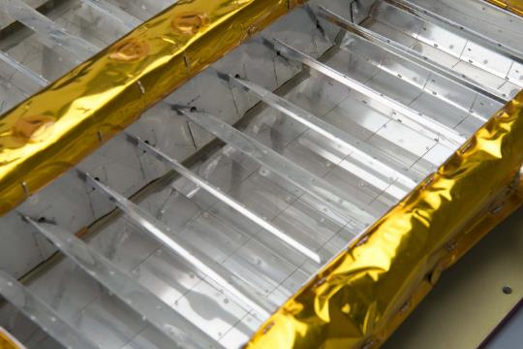
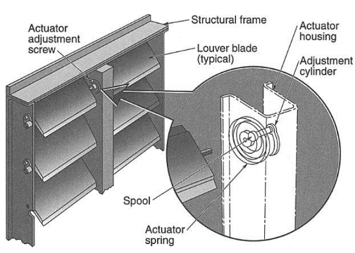
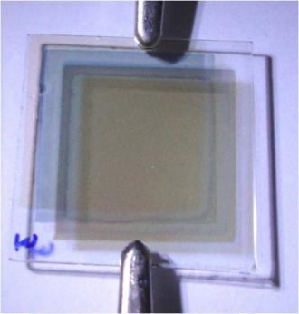
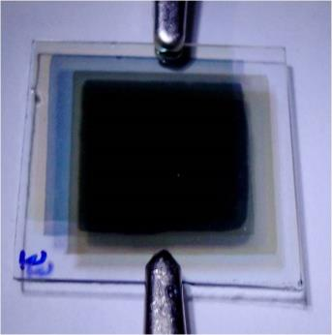
Variable Heat Rejection Surfaces
INTRODUCTION
Alter view factors, adjust heat conduction path near surface, change emissive properties of surface
Provide adaptable heat rejection and temperature regulation for spacecraft thermal engineers
Examples
Macro-louvers
Micro-electro-mechanical systems (MEMS)
Electrostatic switched radiators (ESRs)
Electrochromic devices (ECDs)
Thermochromic Variable Emissivity Materials (VEMs)
Orbital Sciences louver assembly
ESA’s Rosetta macro louvers
Electrochromic in bleached/colored states
MEMS
Notes:
https://www.esa.int/ESA_Multimedia/Images/2015/08/Rosetta_thermal_louvres
https://en.wikipedia.org/wiki/Electrochromic_device

Slide 3

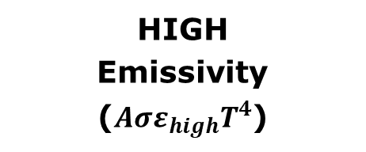
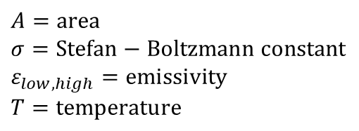
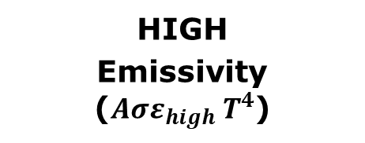
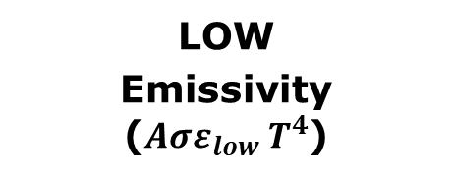
VEMs
VEM
Traditional
HIGH
Emissivity
($Aσε_{high}T^{4}$)
High ε is critical for heat rejection
LOW
Emissivity ($Aσε_{low}{ T}^{4}$)
HIGH
Emissivity ($Aσε_{high}{ T}^{4}$)
INTRODUCTION
Albedo
S/C
S/C
S/C
Eclipse
Direct
Solar
Earth
IR
Earth
IR
Internal Heat
Reduced heater requirements
Increased heater requirements
$$A=area$$
$$σ=Stefan−Boltzmann constant$$
$$ε_{low,high}=emissivity$$
$$T=temperature$$

Slide 4
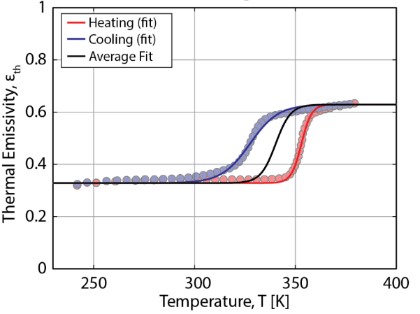
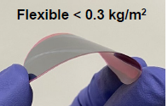
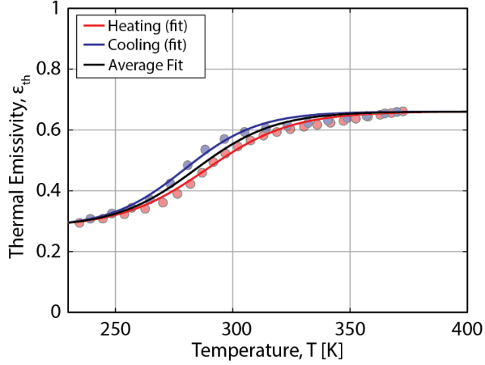
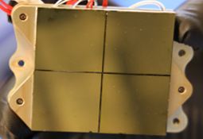
VEM Advantages
INTRODUCTION
Temperature dependent, passive, variable emissivity modulation
Commonly Vanadium dioxide (VO2) thin film; with a solid-solid phase transition at 67°C (340 K). Transition is customizable (Barako).
Provides passive regulation of variable thermal loads
Provides reduced size and weight (<1 kg/m² areal density)
No moving parts; low complexity
Provides reliable, passive, and adaptable heat rejection and temperature regulation for spacecraft thermal engineers
Example VEM (Lawdensky)
VEMs integrated onto test sites (Foster)
Undoped (top) and doped (bottom) VO2 VEMs
Notes:
Metrics and images taken from Air Force Research Laboratory Tech Roadmap, Dr. Valerie Lawdensky, Spacecraft Thermal Control Workshop, 2023.
Image taken from Air Force Research Laboratory Tech Roadmap, Isaac Foster, Spacecraft Thermal Control Workshop, 2025.

Slide 5
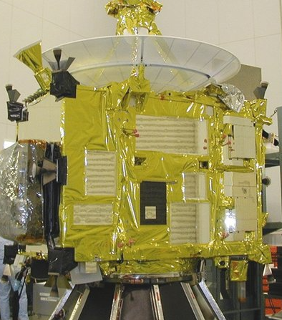
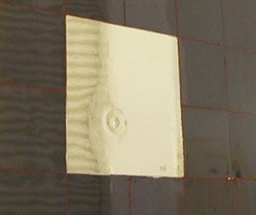
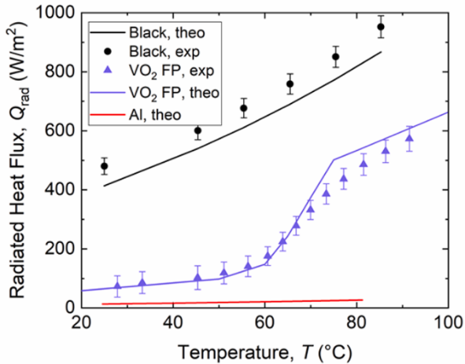
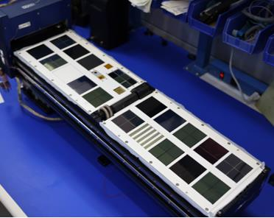
VEM Development History
INTRODUCTION
Fabrication and demonstration
Early work in 1990s characterized properties on thin-film VO2
Commercial and academic work ensured: MPB Communications, Thales Alenia Space, Arizona State University, Chinese Academy of Sciences, University of Southampton, University of the District of Columbia
VEM Flight Heritage (in literature)
JAXA Hayabusa (2003) and REIMEI (2005)
Kepler Communications CubeSat (planned 2020)
SPIRRAL (November 4, 2024)
SRD mounted on HAYABUSA
Arizona State University measured results
SPIRRAL (Foster)
Notes:
https://www.researchgate.net/publication/360096894_Advanced_Passive_Thermal_Control_Materials_and_Devices_for_Spacecraft_A_Review/figures?lo=1&utm_source=bing&utm_medium=organic
Image taken from Air Force Research Laboratory Tech Roadmap, Isaac Foster, Spacecraft Thermal Control Workshop, 2025.

Slide 6
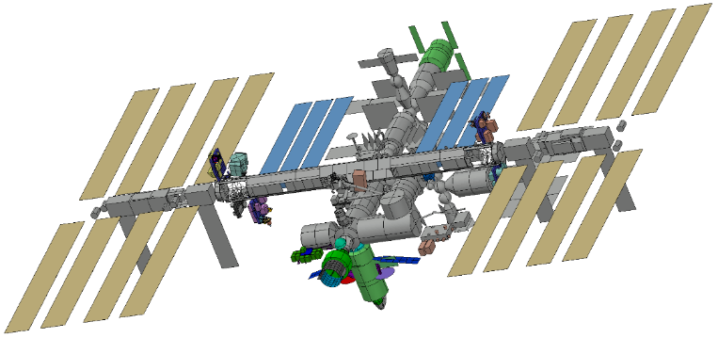
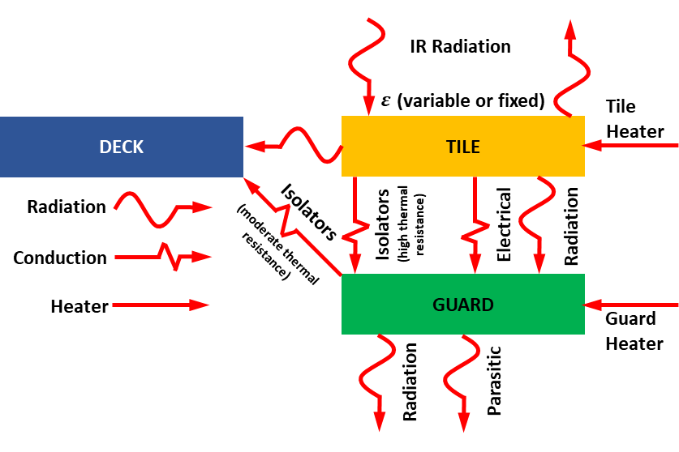
SPIRRAL
ISS Thermal Model showing SPIRRAL location
Rendering of ISS SPIRRAL Experiment
Controls 5 total
INTRODUCTION
Space Power InfraRed Regulation and Analysis of Lifetime (SPIRRAL)
Measures VEM IR emissivity (ε) and solar absorptivity (α) throughout 1 yr ISS mission to determine space effects on VEMs
SPIRRAL consists of:
13 VEM sites; 5 control sites (MLS-85-SB, AZ-2100, Zebra, SSMs)
Plus, space effects sensors and passive area
SPIRRAL sites
Calorimetric experiment containing tile and guard
Thermal isolation and power/temperature-controlled heaters to minimize heat leak. Power and temperature measurements
VEMs
13 total
UV/AO
sensors
Edit
SPIRRAL site with heat flows

Slide 7
VEM Modeling

Slide 8
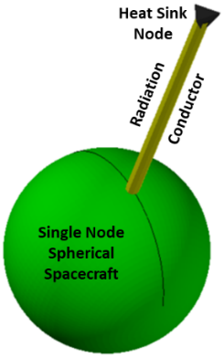
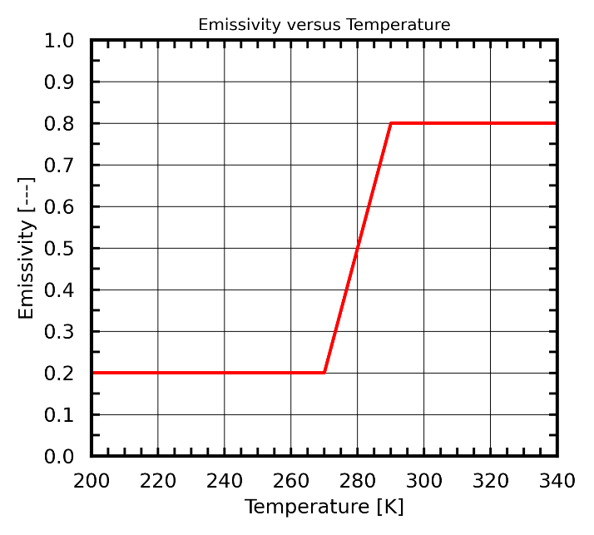
VEM Thermal Modeling
Radiation conductor
VEM MODELING
Traditional thermal modeling tools (Thermal Desktop®) assume fixed optical properties (ε = constant).
How to handle VEMs; ε = f(T)?
Three methods developed to handle VEMs
Radiation conductor (with and without Dynamic SINDA)
Node-to-surface conductor with temperature dependent optical property. Inexpensive and simple but limited.
Radiation Database
Pre-run radiation jobs across temperature bands. Not as versatile but less expensive than Dynamic SINDA.
Do all the computationally expensive ray tracing ahead of time. Requires additional logic/code.
Radiation Database Bands
2023 ICES/TFAWS – Hengeveld and Allison - Novel Methods for Modeling Thermochromic Variable Emissivity Surfaces

Slide 9
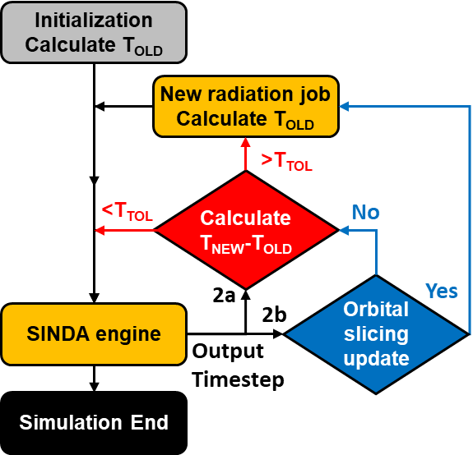
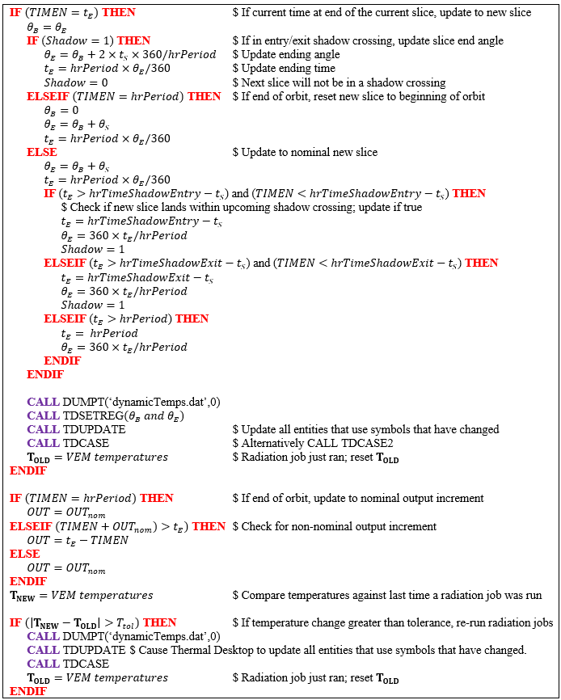
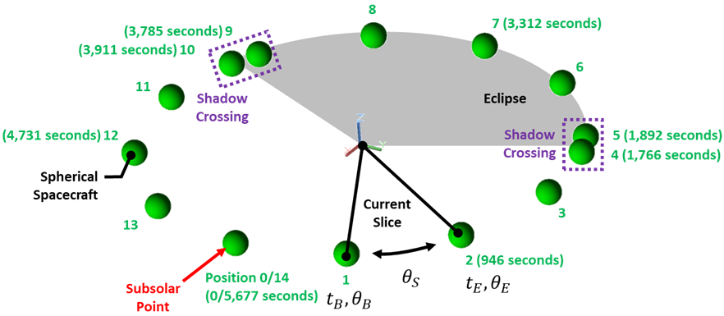
VEM Thermal Modeling
Dynamic SINDA
Method
VEM MODELING
Pseudocode
Dynamic SINDA (with and without orbital slicing)
Leverages Dynamic SINDA
Temperature-dependent optical property
Periodically pause current SINDA solution, update radiation jobs (e.g., Radk and Heating Rates), then resume
Based on VEM temperatures
Most versatile method but can be computationally expensive

Slide 10
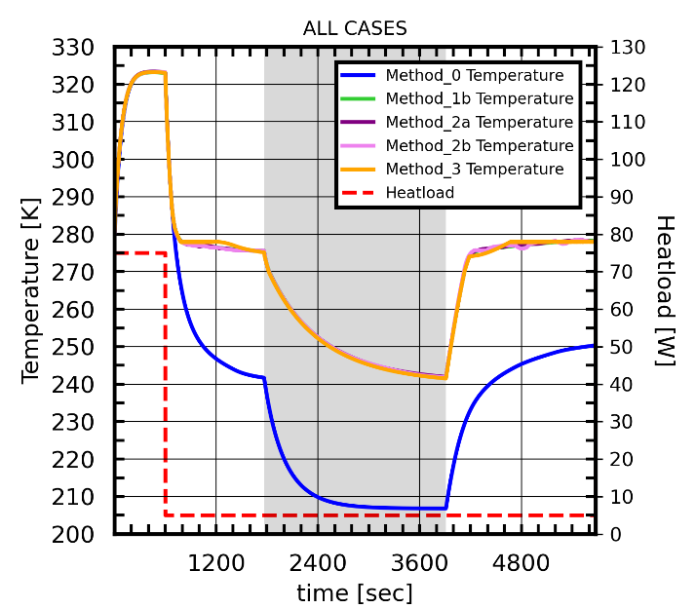
VEM Thermal Modeling
VEM MODELING
All methods were compared
Good agreement with one another; +/-1.5°C
Some differences. Likely a result of temperature band resolution and differences in orbital positions
Dynamic SINDA
Used to evaluate to applications; CubeSat and ThinSat
Method | Description | Application | Computational Cost
1a | Radiation Conductor (without Dynamic SINDA) | Single VEM surface without spacecraft IR (emissivity-dependent) environmental heating | Low (10 seconds)
1b | Radiation Conductor (with Dynamic SINDA every 2 seconds) | Single VEM surface with spacecraft IR (emissivity-dependent) environmental heating | Extremely High (2,196 seconds)
2a | Dynamic SINDA (without orbital slicing) | Any number of VEM surfaces; any heating environment | High (162 seconds)
2b | Dynamic SINDA (with orbital slicing) | Any number of VEM surfaces; any heating environment | Medium-High (146 seconds)
3 | Radiation Database | Single VEM surface with emissivity-dependent environmental heating | Medium-Low (20 seconds)

Slide 11
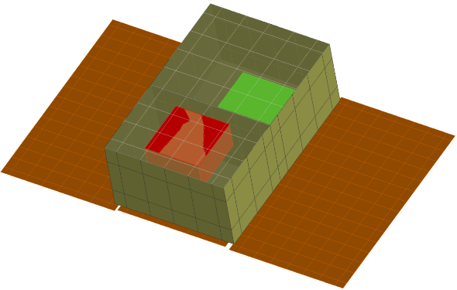
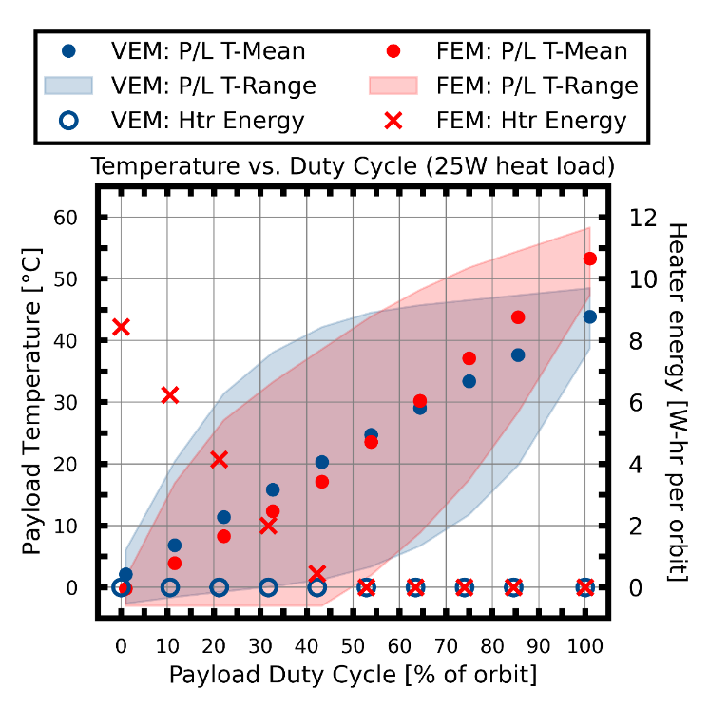
VEM Thermal Modeling: CubeSat Application
6U CubeSat Thermal
Desktop Model
Payload
ε = VEM/FEM
α = 0.2
Solar
Panel
VEM MODELING
6U CubeSat
500 km, β= 0°, circular orbit, sun-pointing solar array
Payload (P/L) Heat Load: Off and 25W max
Exterior surfaces coated with either FEM or VEM
VEM is 5 surfaces; FEM is 3 surfaces (to reduce heater energy requirements)
VEMs provide reduction in required heater energy at low duty cycles
~9 W-hr per orbit (FEM) vs. 0 W-hr per orbit (VEM) at 0% duty cycle (off)
VEM payload runs cooler at higher duty cycles
Result of high ε radiator surface and more radiating area
VEMs provide a one-size-fits-most approach
Plot of payload temperature versus duty cycle for VEM/FEM designs

Slide 12
SPIRRAL Thermal Model Correlation

Slide 13
Model Correlation
Thermal model correlation criteria used in industry (Welch)
SPIRRAL Thermal Model Correlation
Thermal model correlation improves thermal model to better predict in-situ performance
TVac tests generate experimental data at various thermal conditions
Correlation finds a thermal model input parameter set that generates the best fit to the test data
Fit evaluated via temperature residuals (measured – modeled)
Some thermal model correlation criteria used in industry are provided
SPIRRAL success: >90% of the temperature sensors are within +/-4°C when comparing modeled results against measured results.
Organization | Thermal Model Correlation Criteria
U.S. Air Force | within ±3°C (provide explanation for any exceedances)
NASA Goddard | Compute ±1°C and a standard deviation of ±2.5°C (provide explanation for those outside 5°C). Percentage errors computed for < 3°C and <5°C
NASA Marshall | Within ±5°C
NASA Jet Propulsion Laboratory | Within ±5°C
Contractor | 90% within ±5°C
European Space Agency | Typical: <5°C for internal units and <10°C for external units. Mean deviation within ±2°C, standard deviation <3°C
JAXA | Typically <5°C, but not standard

Slide 14
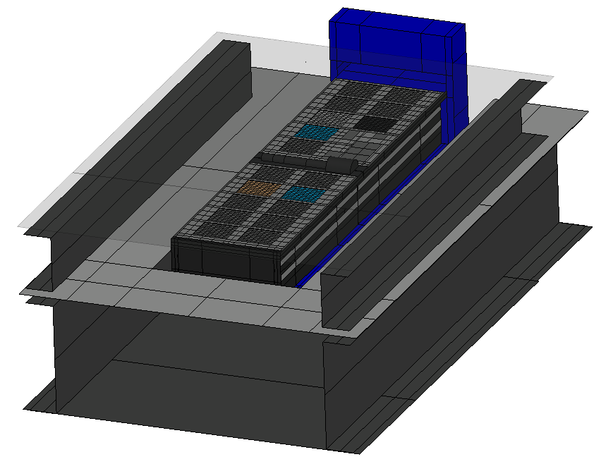
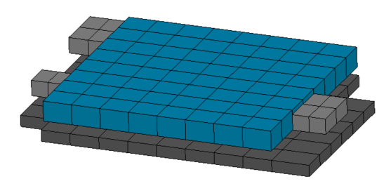
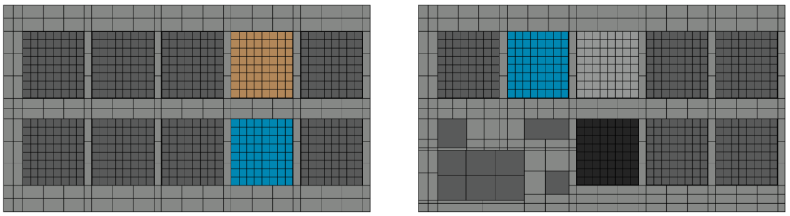
Test Setup and Sequence
SPIRRAL Thermal Vacuum Thermal Model
SPIRRAL Thermal Model Correlation
SPIRRAL Site Thermal Model
Thermal Vacuum Testing
Thermal workmanship and model correlation
1.3⁻⁶ hPa (10⁻⁶ Torr); cooling via LN2 cooled panels (-140°C to 150°C; -40°C nominal)
Test sequence
10 initial power-controlled tests; exercised tile and guard heaters
Constant tile power (1.0 or 2.0 W) to generate large tile-to-guard ΔT to better understand heat leaks
Constant guard power (0.5, 1.0, or 2.0 W) to generate tile-to-deck ΔT
40 subsequent site-specific tests
One initial power-controlled test followed by 3 increasing temperature-controlled tests
Similar tile and guard temperatures to minimize heat leaks
1,800 correlation points (360 initial; 1,440 subsequent)
SPIRRAL Thermal Model (decks and sites)

Slide 15
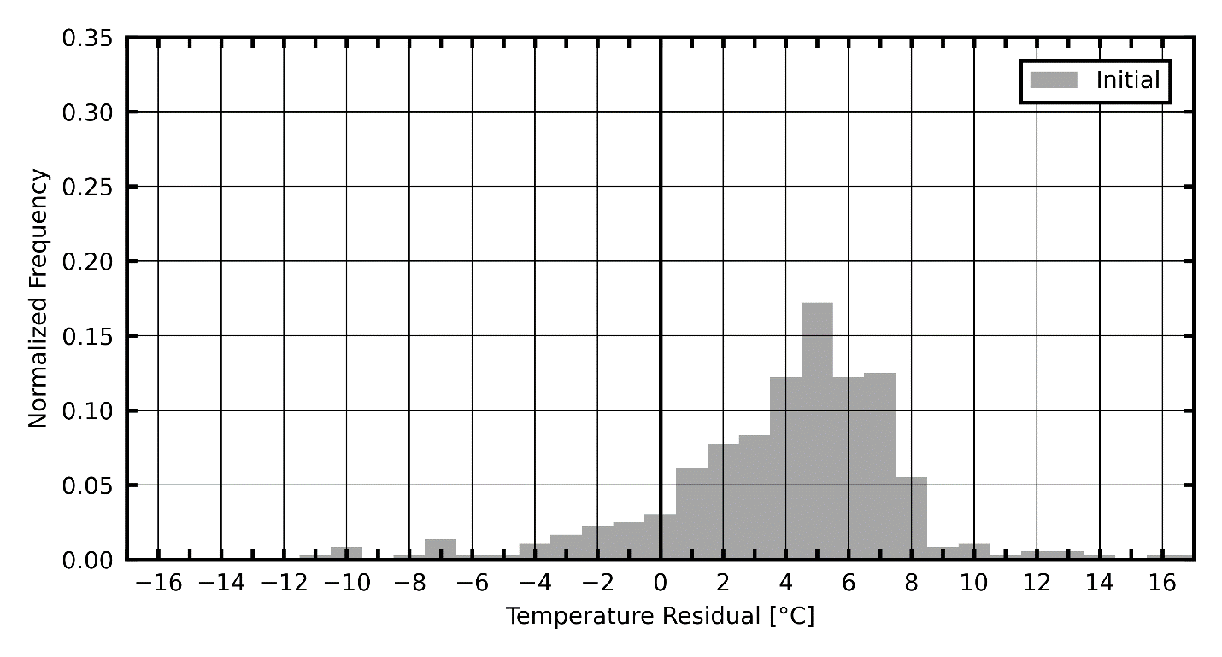
Correlation Results
Temperature Residual Statistical Measures
Data Set | Number of Observations | Arithmetic Mean | Standard Deviation | Skewness | Kurtosis | Within ±3°C | Within ±4°C | Within ±5°C
[---] | [---] | [°C] | [°C] | [°C] | [---] | [%] | [%] | [%]
Initial | 360 | 3.90 | 3.80 | -0.87 | 2.54 | 26.4 | 38.1 | 54.4
Intermediate | 360 | 1.91 | 3.02 | 1.28 | 4.49 | 70.3 | 85.0 | 89.7
Final | 1,800 | -0.17 | 1.73 | 1.25 | 14.45 | 94.7 | 96.7 | 97.8
Initial Correlation
Temperature Residual Histogram
SPIRRAL Thermal Model Correlation
Initial Correlation
10 unique correlation tests
Power-controlled tests at multiple simultaneous sites
Each test run to 10,200 seconds
15-minute data averaging (max σ = ~0.25°C)
360 temperature correlation points measured on tile and guard
Results
Model underpredicts measured by ~5°C
Broad range of residuals -12°C up to 16°C
Only 38% within +/-4°C

Slide 16
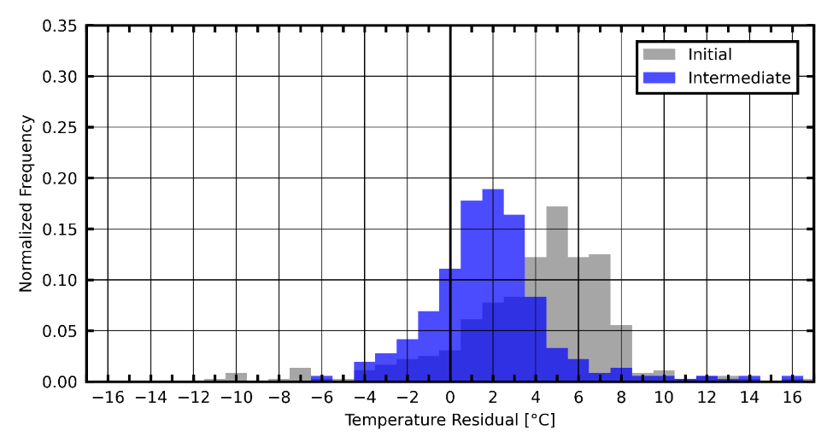
Correlation Results
Temperature Residual Statistical Measures
Data Set | Number of Observations | Arithmetic Mean | Standard Deviation | Skewness | Kurtosis | Within ±3°C | Within ±4°C | Within ±5°C
[---] | [---] | [°C] | [°C] | [°C] | [---] | [%] | [%] | [%]
Initial | 360 | 3.90 | 3.80 | -0.87 | 2.54 | 26.4 | 38.1 | 54.4
Intermediate | 360 | 1.91 | 3.02 | 1.28 | 4.49 | 70.3 | 85.0 | 89.7
Final | 1,800 | -0.17 | 1.73 | 1.25 | 14.45 | 94.7 | 96.7 | 97.8
Intermediate Correlation
Temperature Residual Histogram
SPIRRAL Thermal Model Correlation
Intermediate Correlation
Model initially set to steady-state solution routine; led to overprediction of temperatures; changed to transient solution with temperature initialization from previous test.
Internal heat loads more carefully evaluated; 32% increase in experiment heat loads. Led to increase to increase in modeled deck temperatures (reduction in temperature residual).
System-level conductances updated to more accurate reflect actual performance.
Results
Shift in residuals towards zero
85% within +/-4°C

Slide 17
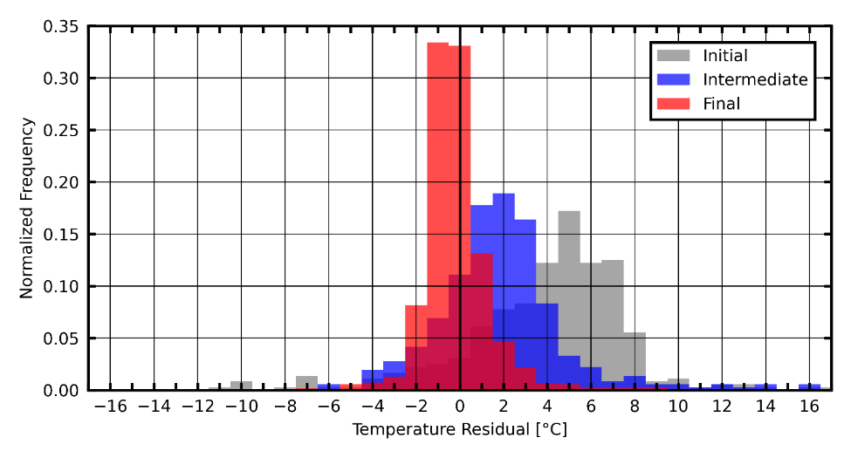
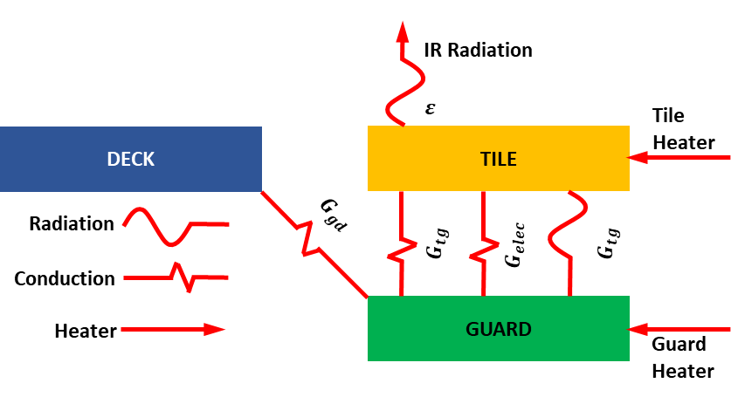
Correlation Results
Temperature Residual Statistical Measures
Data Set | Number of Observations | Arithmetic Mean | Standard Deviation | Skewness | Kurtosis | Within ±3°C | Within ±4°C | Within ±5°C
[---] | [---] | [°C] | [°C] | [°C] | [---] | [%] | [%] | [%]
Initial | 360 | 3.90 | 3.80 | -0.87 | 2.54 | 26.4 | 38.1 | 54.4
Intermediate | 360 | 1.91 | 3.02 | 1.28 | 4.49 | 70.3 | 85.0 | 89.7
Final | 1,800 | -0.17 | 1.73 | 1.25 | 14.45 | 94.7 | 96.7 | 97.8
Final Correlation
Temperature Residual Histogram
SPIRRAL Thermal Model Correlation
Final Correlation
Additional 40 test cases (1,800 total observations)
Site specific
Initially focused on five control sites (constant optical properties)
1-D model built (thermal resistance network). Examined G_tg and G_gd to minimize residuals. Compared to test and applied to VEMs.
Switched from average-fit to heating-specific VEM curves
Results
More correlation points; better results
Shift in residuals towards zero
97% within +/-4°C
Some outliers (hence large kurtosis) due to a few sites with measured performance with more associated uncertainty.
Edit

Slide 18
Conclusions
SPIRRAL Thermal Model Correlation
SPIRRAL success: >90% of the temperature sensors are within +/-4°C when comparing modeled results against measured results
VEM Correlation Suggestions:
During thermal balance tests, allow VEMs to be operated in a regime of nearly constant emissivity (i.e., not their transition region).
Accurate measurements of VEM performance prior to correlation is critical. (e.g., calorimetric tests and/or spectroscopic measurements).
In the future, it is expected that VEM manufacturers will provide this information.
Devise the testing such that either heating or cooling curves could be applied instead of average fit curves.
In the future, it is anticipated that modeling methods could capture VEM hysteresis.
If possible, ensure that known emissivity surfaces (i.e., controls) are near VEMs. These control surfaces will help uncover modeling issues without also contending with emissivity changes.

Slide 19
Acknowledgments and References
This work is in support of the Space Power InfraRed Regulation and Analysis of Lifetime (SPIRRAL) experiment by the Air Force Research Laboratory, Space Vehicles Directorate, Kirtland AFB, NM (AFRL/RV). The views expressed are those of the authors and do not reflect the official guidance or position of the United States Government, the Department of Defense or of the United States Air Force. The appearance of external hyperlinks does not constitute endorsement by the United States Department of Defense (DoD) of the linked websites, or the information, products, or services contained therein. The DoD does not exercise any editorial, security, or other control over the information you may find at these locations.
Select references
Lawdensky, Air Force Research Laboratory Tech Roadmap, presented at 2023 Spacecraft Thermal Control Workshop
Foster, Air Force Research Laboratory Tech Roadmap, presented at 2025 Spacecraft Thermal Control Workshop
2023 ICES/TFAWS - Hengeveld and Allison - Novel Methods for Modeling Thermochromic Variable Emissivity Surfaces
Welch, J. Assessment of thermal balance test criteria requirements for test objectives and thermal design. 2016. 46th International Conference on Environmental Systems

Slide 20
Thermochromic Variable Emissivity Material Thermal Modeling and Test Correlation
Authors
Redwire: Dr. Derek Hengeveld
AFRL: Isaac J. Foster, Trevor J. Bird, Daniel Lockwood, and Jonathan Allison

Slide 21
Backup

Slide 22


Defining Thermochromic Characteristics
2025 STCW – Foster- AFRL Thermal Tech Roadmap
Thermal Emissivity Vs. Temperature Curve for Thermochromic VEM
“Cooling Transition” T*_{C}
“Transition Temperature”
T*
“Heating Transition” T*_{H}
“Cold State Onset” T_{C}
“Hot State Onset” T_{H}
$$ε\left(T\right)= ε_{L}+\frac{ε_{H}−ε_{L}}{1+e^{−k(T −T^{∗})}}$$
“Hot State Emissivity”
ε_{H}
Δε/2
“Growth Parameter” $k$
“Transition”
“Emissivity Contrast”
Δε (= ε_{H} - ε_{C})
Δε/2
“Cold State Emissivity”
ε_{C}
“Transition Crispness” or “Transition Width
ΔT_{Trans} (= T_{H} – T_{C})
“Hysteresis”
ΔT_{Hyst} (= T*_{H} – T*_{C})
Notes:
From ‘20250411 Distro A AFRL Thermal Roadmap FINAL CLEARED.pptx’

