Slide 1

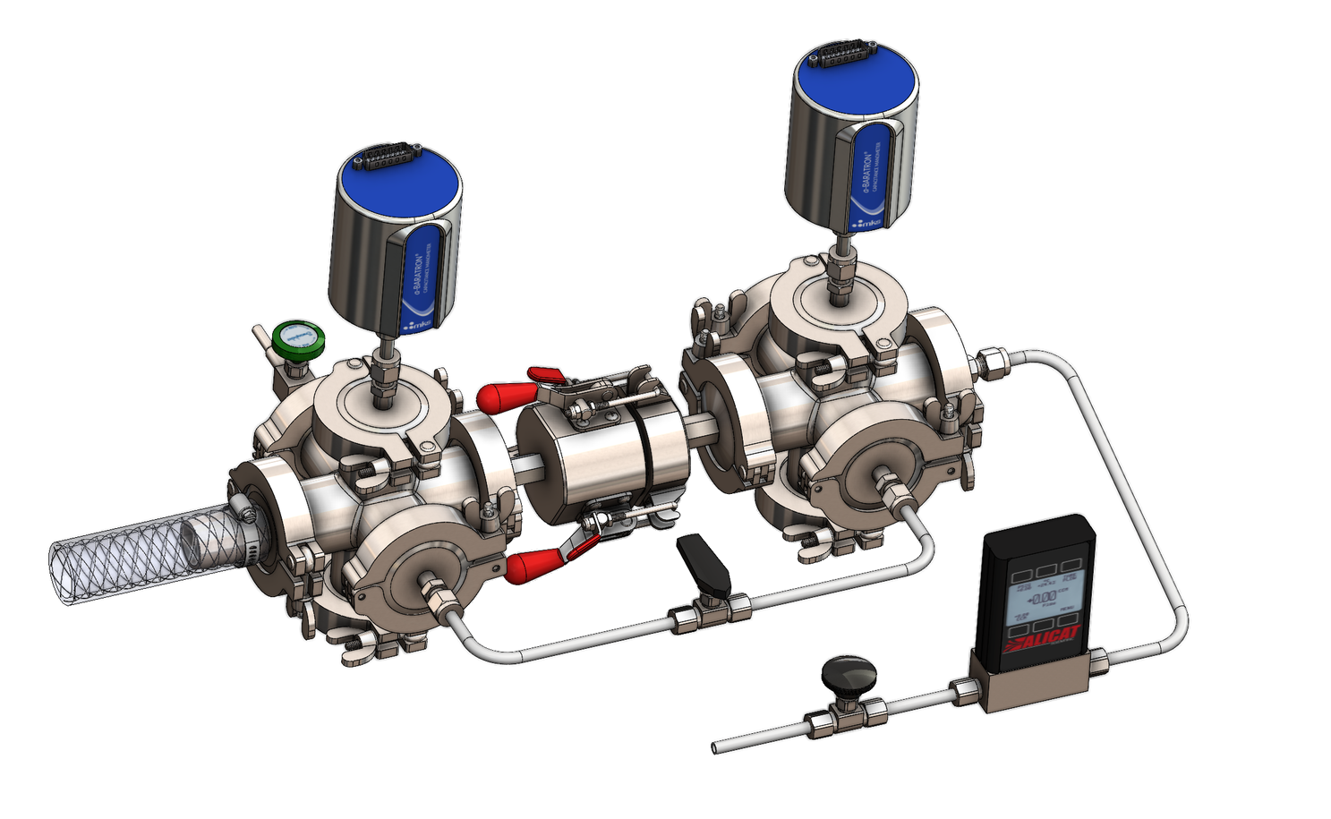
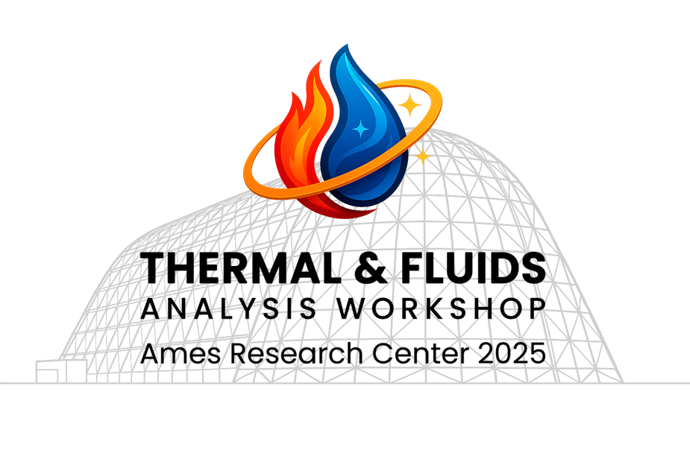
Unsteady Measurements of Ultra-Low Permeability in Thermal Protection Systems Materials
Michael W. Renfro and Michael L. McKinney
Department of Mechanical and Aerospace Engineering
Stanley and Karen Pigman College of Engineering
University of Kentucky
Thermal & Fluids Analysis Workshop 2025
NASA Ames Research Center
San Jose, CA
August 4-7, 2025

Slide 2
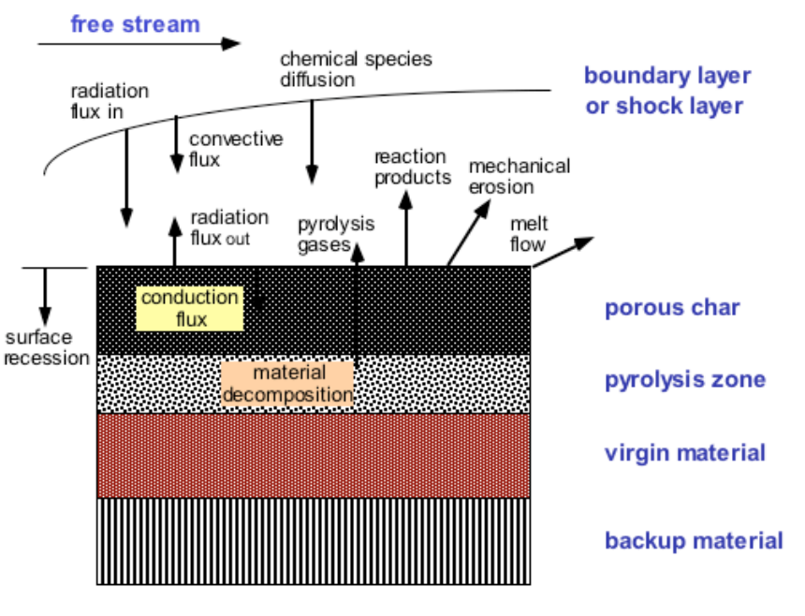

Background
Pyrolysis gas generated during heating of ablative TPS materials must flow back through charred/partially charred regions
Pressure in the pyrolysis zone:
Increases with gas generation rate, viscosity and temperature
Decreases with larger effective permeability,
High p (low k₀) leads to high material stress and potential fracture
Permeability of lightly charred material is rate limiting
$$k_{0}\left(P_{avg}+b\right)$$

Slide 3
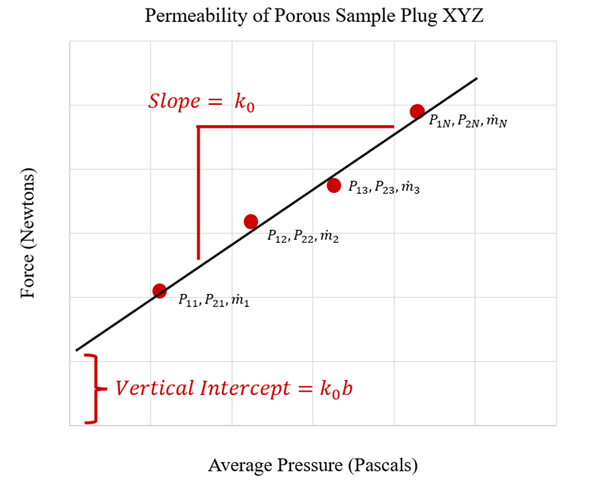



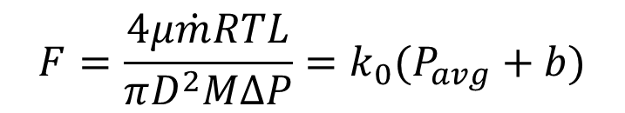

Prior Steady Permeability Measurements
Permeability, k₀, and Klinkenberg slip factor, b, can be measured with controlled, steady state gas flows of known molar mass and temperature (e.g., Panerai, 2016)
$$F=\frac{4μ\dot{m}RTL}{πD^{2}MΔP}=k_{0}(P_{avg}+b)$$
Constant pressure drop $∆P$
$$P_{1}$$
$$P_{2}$$
Constant mass flow rate $\dot{m}$

Slide 4
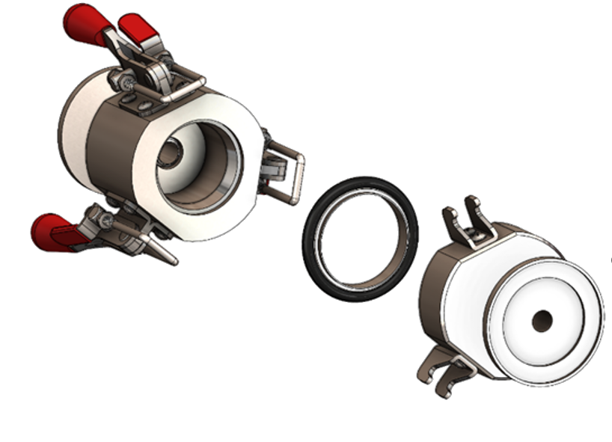
UK Experimental Apparatus
Stainless steel clamshell holder accepts modular sample cups of various design
Toggle clamps allow easy and repeatable installation
Charred samples with irregular shapes cast into resin molds

Slide 5
Materials tested
Asterm, Norcoat Liege, and Zuram tested as a function of mass loss by char (also PICA, Avcoat and FiberForm)
Virgin samples charred in UK furnace as function of maximum temperature and hold time
Low char % of high interest
 | Asterm | Norcoat | Zuram
Virgin | 15 | 1 | 5
N2 Char | 23 | 9 | 9
Atm. Char | 8 | 4 | 0
Destroyed | 2 | 27 | 0

Slide 6
Example of Data Collection
Each data point is a different mass flow rate which must reach steady state prior to reading pressures
Linear fit yields one permeability measurements

Slide 7
Zuram Results versus Char
To develop permeability versus char requires ~150 measurements

Slide 8
Challenges Addressed by This Research
Time scale for reaching steady state scales inversely with k_{o}
For low permeability materials (10⁻¹⁵ m²), time is hours per data point, one-two days per char state, two-three weeks for a char curve
FiberForm (10⁻¹⁰ m²) is less than 1 second per data point
Ultra-low permeability materials expected to be ~ 10⁻¹⁷ m²
Residual leaks become dominant at very long measurement times
Other applications could also benefit from fast measurement of flow state
In-situ measurements during char
Tortuosity measurements of gas diffusivity

Slide 9
Unsteady Approach
Demonstrated in geological measurements but not at pressures relevant to TPS where rarified gas effects can be important
Same hardware utilized except with more accurate dynamic pressure transducers
Method: Pull vacuum on low side and provide initial high p on the upstream side. Stop mass flow rate and measure pressure versus t.

Slide 10
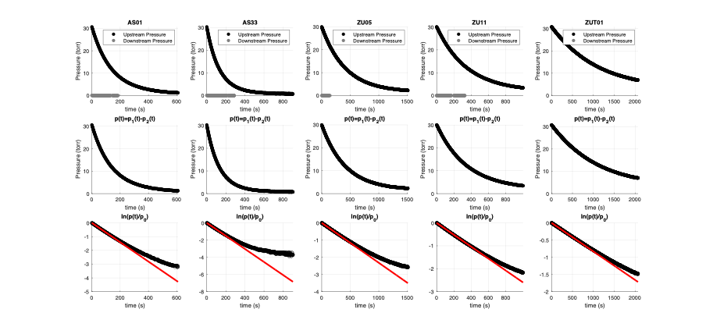
Preliminary Results
NOTE: Single run recovers permeability versus ~10 steady state measurements. Zuram (10⁻¹⁵ m²) measured in <5 mins versus 2 days

Slide 11
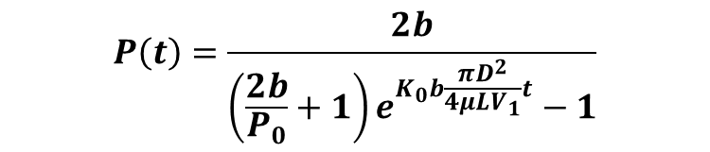
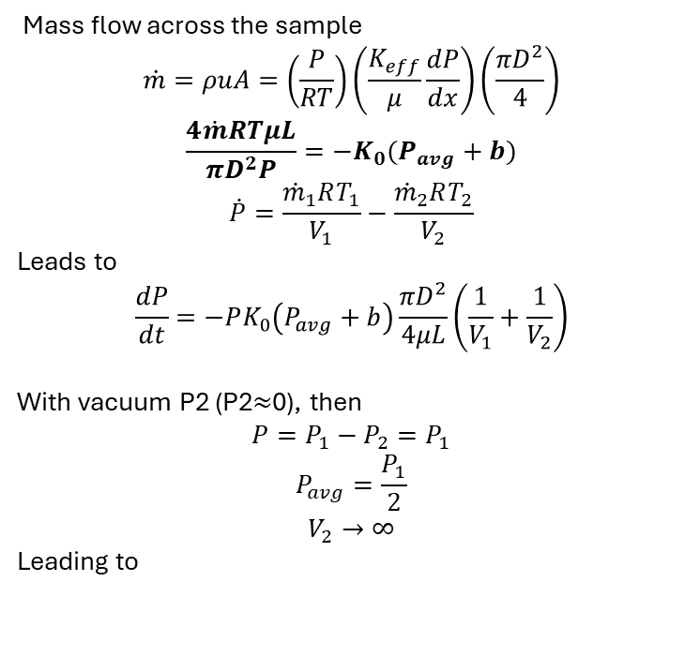
Unsteady Model
Mass flow across the sample
$$\dot{m}=ρuA=\left(\frac{P}{RT}\right)\left(\frac{K_{eff}}{μ}\frac{dP}{dx}\right)\left(\frac{πD^{2}}{4}\right)$$
$$\frac{4\dot{m}RTμL}{πD^{2}P}=−K_{0}(P_{avg}+b)$$
$$\dot{P}=\frac{{\dot{m}}_{1}RT_{1}}{V_{1}}−\frac{{\dot{m}}_{2}RT_{2}}{V_{2}}$$
Leads to
$$\frac{dP}{dt}=−PK_{0}\left(P_{avg}+b\right)\frac{πD^{2}}{4μL}\left(\frac{1}{V_{1}}+\frac{1}{V_{2}}\right)$$
With vacuum P2 (P2$≈$0), then
$$P=P_{1}−P_{2}=P_{1}$$
$$P_{avg}=\frac{P_{1}}{2}$$
$$V_{2}→∞$$
Leading to
$$P\left(t\right)=\frac{2b}{\left(\frac{2b}{P_{0}}+1\right)e^{K_{0}b\frac{πD^{2}}{4μLV_{1}}t}−1}$$

Slide 12
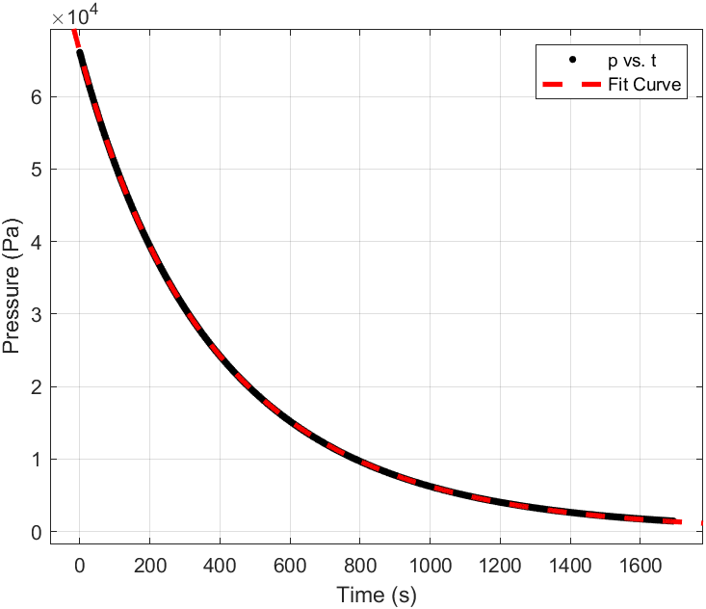
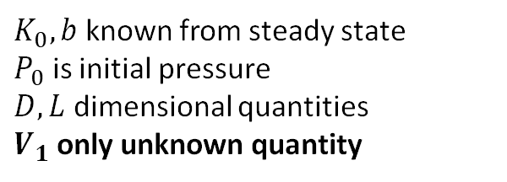
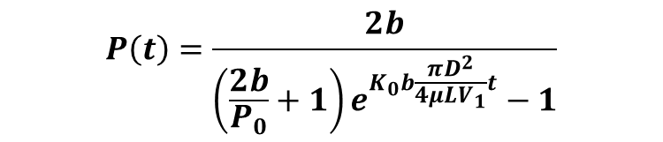
Experimental Calibration
$$P\left(t\right)=\frac{2b}{\left(\frac{2b}{P_{0}}+1\right)e^{K_{0}b\frac{πD^{2}}{4μLV_{1}}t}−1}$$
$K_{0}, b$ known from steady state
$P_{0}$ is initial pressure
$D, L$ dimensional quantities
$V_{1}$ only unknown quantity

Slide 13
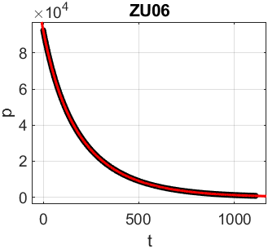
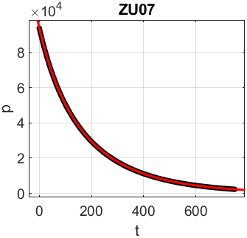
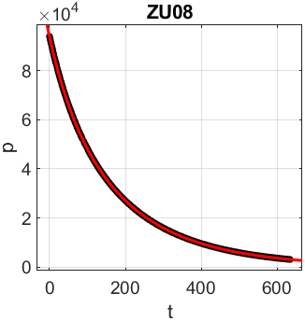
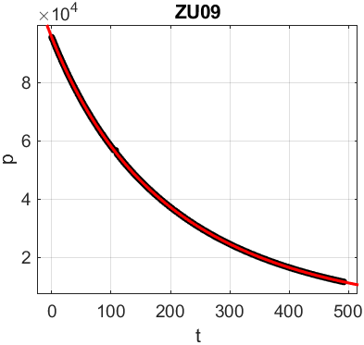
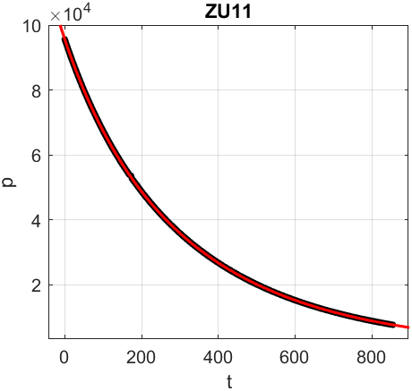
Zuram Permeability Results

Slide 14
Simultaneous K₀ & b Validation

Slide 15
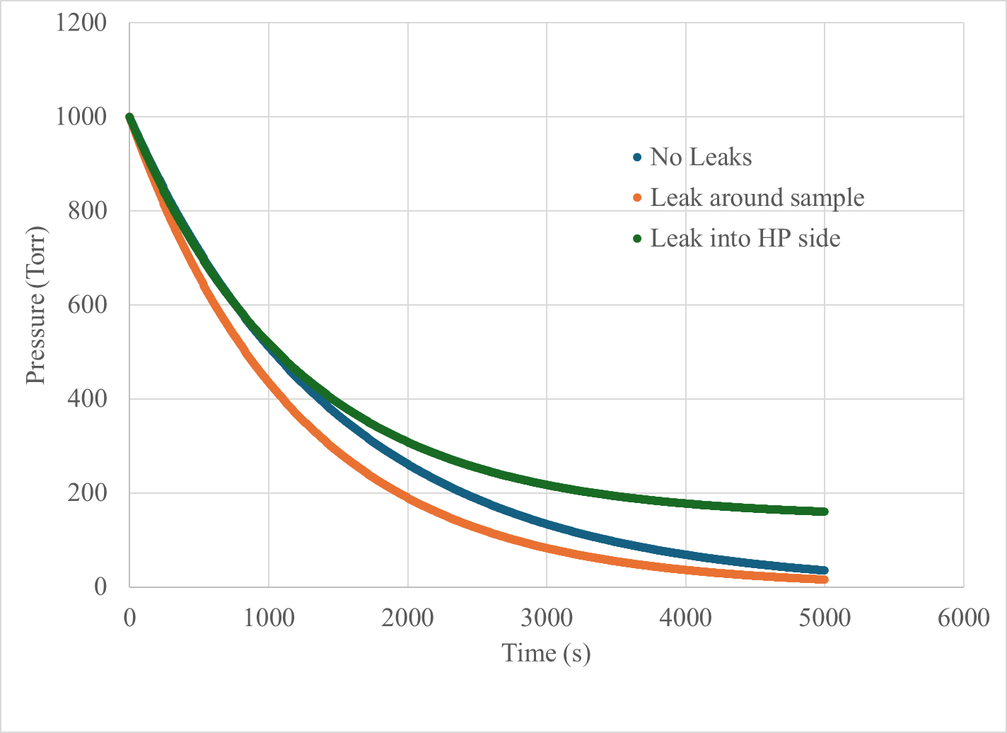
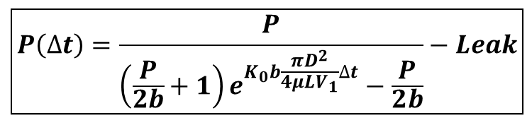
Impact of Leaks
Model leak as proportional to current pressure and ambient
$$\boxed{P\left(∆t\right)=\frac{P}{\left(\frac{P}{2b}+1\right)e^{K_{0}b\frac{πD^{2}}{4μLV_{1}}∆t}−\frac{P}{2b}}−Leak}$$

Slide 16
Upstream Leak Reduction
 | Leak Rate (mTorr/s)
Old | 5.27
New | 1.21

Slide 17
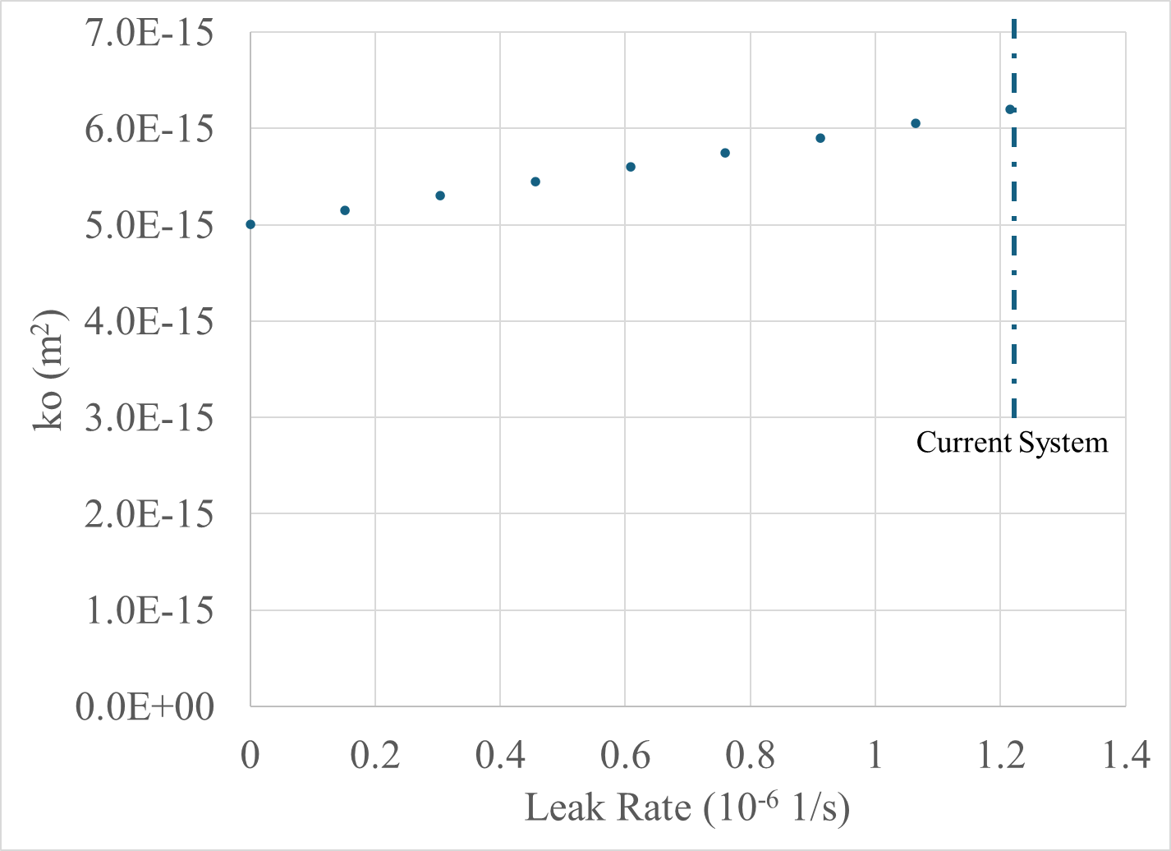
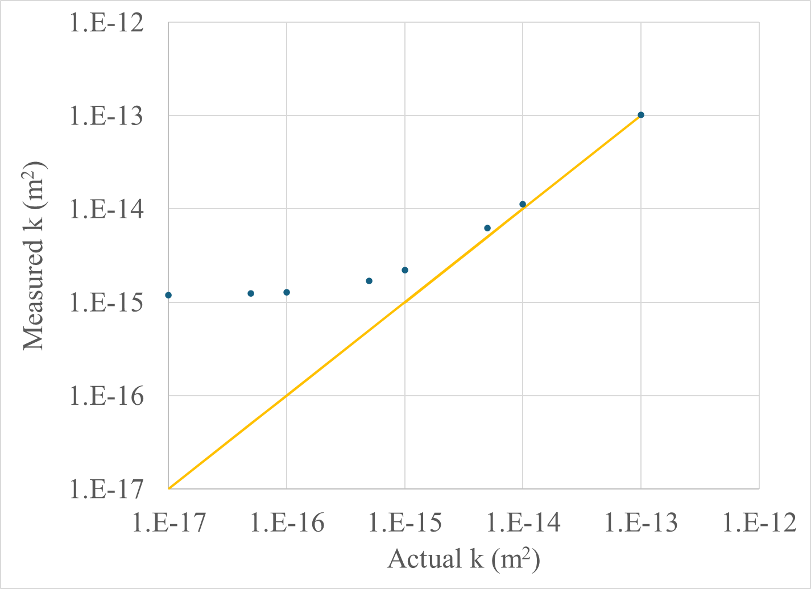
Effects of Leaks on Accuracy and Lower Limits
Leak rate of 1.2 mTorr/s (@ 1000 Torr) leads to 24% overestimation of permeability at k = 5x10⁻¹⁵ m²
Permeabilities below 10⁻¹⁵ m² dominated by leaks

Slide 18
Conclusions
Unsteady measurements of permeability reduce data collection time for a Zuram char curve from 3 weeks to under 1 hour – now limited by time to load samples
Unsteady measurements have improved repeatability compared to steady state measurements
Sample with 10⁻¹⁷ m² permeability would take ~50 hours of data collection
Measurement accuracy dominated by residual leaks (1.2 mTorr/s at full 1000 Torr pressure difference)
Current system limited to permeabilities greater than ~10⁻¹⁵ m²
Next steps: (1) update to sample holder seals, (2) reduce external leaks by operating both sides near 1 atm, (3) reduce impact of leaks by limiting curve fitting to regions with near equal pressures
Funding: NASA EPSCoR: R3 STMD RFA-067 (TM: Bruno Dias)

