Slide 1

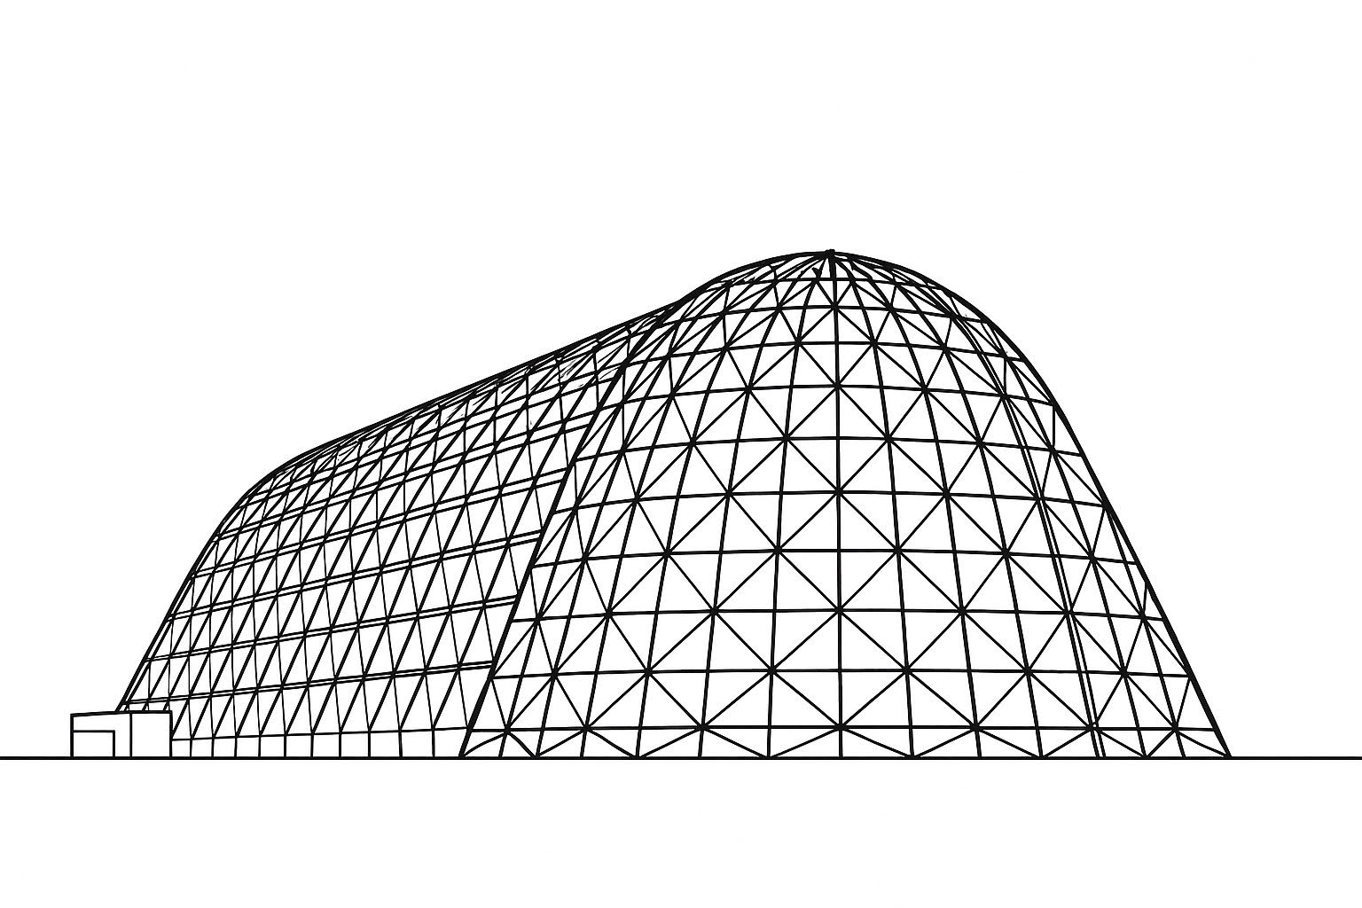

Mapping and Modeling the Effects of Lunar Dust on Thermally Sensitive Surfaces for Heat Rejection Analysis
TFAWS 2025 Passive Thermal Technical Session
Presented by: Brandon Hoffmann
Brandon Hoffmann
Amentum | Aerodyne
Bruno Miranda
Amentum | HX5
Thermal & Fluids Analysis Workshop 2025
NASA Ames Research Center
San Jose, CA
August 4-7, 2025

Slide 2
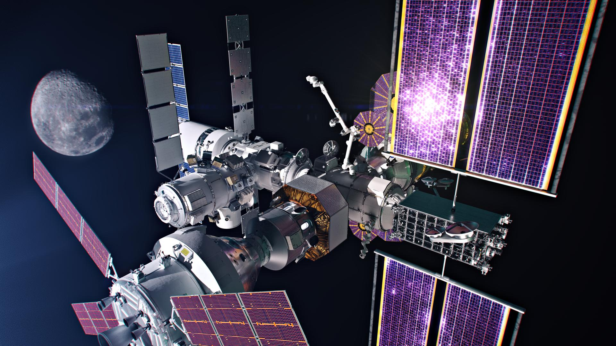
Introduction
Lunar dust acts as a significant obstacle to effective heat rejection when it lands on thermally sensitive surfaces. Dust increases absorptivity and decreases emissivity of radiators, making it a significant factor in optics degradation
During Gateway’s nominal operation, lunar dust may land on several thermally sensitive surfaces when visiting vehicles dock after landing on the lunar surface
Previous analysis strategy assumed a flat dust degradation for entire radiator panel sections. This allows dust dense sections to be overrepresented when determining the degradation of radiator panels, which have a wide range of varying dust densities across each surface.
The following method offers a discretized distribution of lunar dust and its degradative effects. This discretization allows consideration of an uneven distribution of dust, which aligns with current model predictions
Gateway (NASA)

Slide 3
Methodology
Methodology: Run a multiple step analysis from dust distribution to heat rejection capability output.
ATCS Fluids Model (AFM) in TD
Modified HALO AFM to map distribution
Simulate heat rejection capability (HRC) for worst case config with dust
Compare to baseline
Thermal Desktop (TD)
Data processed to TD format
Import to map dust distribution
Convert to optical degradation impact based on test data relationship
GOLDMAP dust map [1]
Gateway On-orbit Lunar Dust Modeling and Analysis Program
3D dust density distribution map on radiators
Data per one docking event

Slide 4
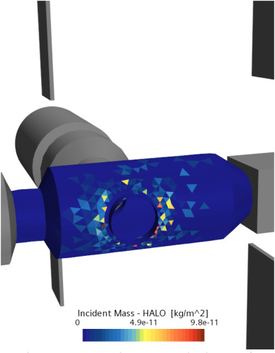
GOLDMAP Dust Distribution
To model how dust detaches from docking vehicles and lands on Gateway, the Gateway On-orbit Lunar Dust Modeling and Analysis Program (GOLDMAP) was developed [1]
This analysis uses a Monte Carlo simulation to distribute dust in 1000 cases, varying dust diameter, initial dust load, and dust injection location.
The results of this analysis create a ‘map’ of where dust lands on the vehicle, with each dust density associated with a coordinate.
GOLDMAP Dust distribution on HALO [1]

Slide 5
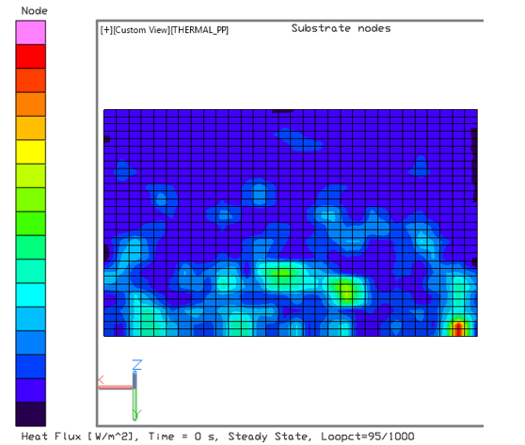
Applying Dust Distribution in Thermal Desktop
To map lunar dust in Thermal Desktop (TD), a random GOLDMAP case was imported using the boundary condition mapper. This uses the dust density coordinates to map the dust onto the radiators. To get TD to read the input file, we represented the dust density as heat flux
To ensure the dust location was accurately mapped, each radiators’ nodalization was increased to 30x30
Using MATLAB, the dust data from this case was trimmed to remove non radiator surfaces to increase accuracy
The modified file was reimported into the model and run
The result was a distribution of heat flux (dust density) for each node
Dust distribution on Radiator, shows as Heat Flux in TD

Slide 6
Optics Degradation Calculation
With the dust densities pulled per node, the absorptivity and effective emissivity of each node can be calculated.
Absorptivity
A fit curve generated from previous test data that examined absorptivity vs dust density was used, similar to the figure shown
The dust density of each node was pulled and plugged into the fit curve to get dust alpha degradation values for each node
Emissivity
Emissivity is assumed to be the effective emissivity based on previous test data in seen Ref [2]. This includes the dust insulative properties.
From this test data, a degradation curve was generated. Emissivity for each node was then calculated using linear interpolation along this curve
Plot of dust density vs alpha degradation for Z93C55

Slide 7
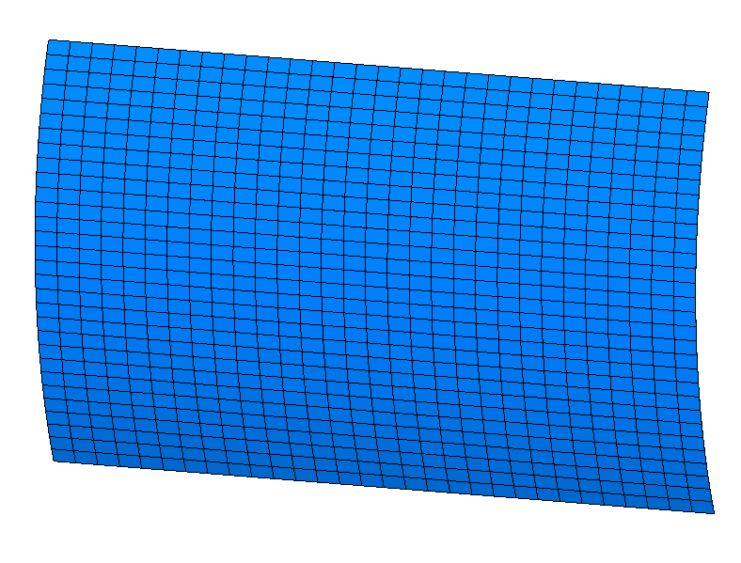
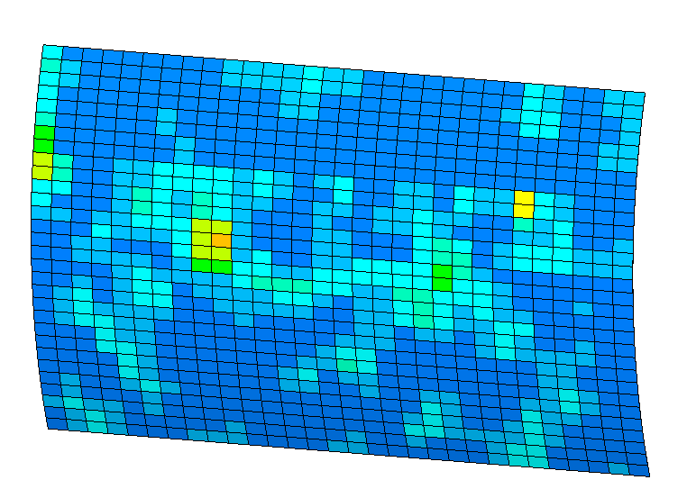
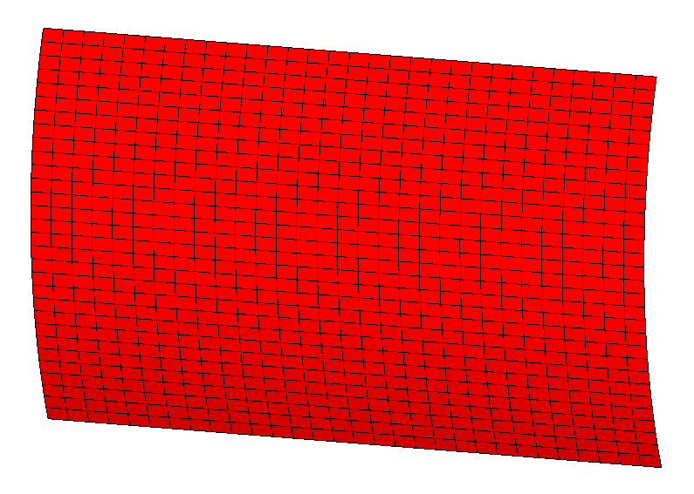
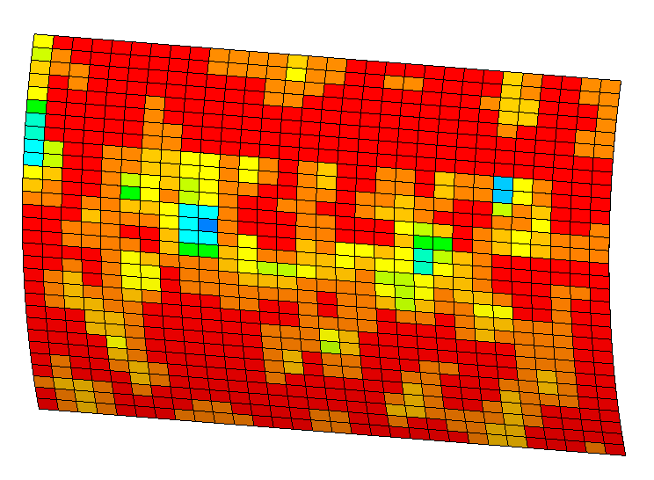
Implementing Calculated Dust Values
Using Thermal Desktop’s optical override feature, a list of every node and its corresponding absorptivity and emissivity values was input
The example radiator to the right is using generic white paint beginning of life values with a random dust distribution for example
With the newly applied dust optics, a heat rejection analysis was run to compare results
Figure: Before and after of absorptivity for a clean BOL radiator on the left vs dust applied radiator on the right
Figure: Before and after of emissivity for a clean BOL radiator on the left vs dust applied radiator on the right

Slide 8
Results
Example Case
Assumed generic white paint optics
BOL alpha of 0.16
BOL emissivity of 0.9
Used LHS1D simulant for dust degradation
Assumed a low dust density case
The table compares the percentage heat rejection decrease from undusted radiators for two different dust degradation calculation methods
Average dust values method assumes an average dust degradation for entire radiator panels
Discretized dust values uses the method discussed above, with each individual node having its own dust degraded optics based on a dust distribution map
Case | Average Dust Values [%] | Discretized Dust Values [%] | Difference
1 | 25.4 | 24.7 | 0.7
2 | 27.3 | 26.1 | 1.2
3 | 29.1 | 27.4 | 1.7
Table: Heat rejection percent decrease vs undusted radiators for two dust degradation methods

Slide 9
Conclusion and Pros and Cons
Conclusion
Using a combination of a dust distribution map, Thermal Desktop’s boundary condition mapper, dust degradation curves, and optics override, it was possible to create a discredited distribution of dust and models its effects on radiator heat rejection
Even in a low dust case and pristine BOL optics, there was a difference in heat rejection between the two methods
Pros and Cons
Pros
Provides a more accurate overall heat rejection value and optics table for surfaces
Prevents heavily dusted areas from skewing the overall dust density values
Allows non-dusted areas of radiators to have their full effectiveness, instead of being considered ‘degraded’ due to using dust density averages for the entire panel
Cons
More complicated to calculate optic values. Script required to calculate all absorptivity/emissivity values due to sheer number of values
May not be as relevant for lightly dusted surfaces
Requires highly nodalized model, increasing model complexity and run time

Slide 10
Questions?

Slide 11
References
Lee, R. G., Worthy, E. S., Willis, E. M., Brown, G. L., Cipriani, F., & Barker, D. C. (2023). Development of a comprehensive physics-based model for study of NASA gateway lunar dust contamination. Acta Astronautica, 210, 616–626. https://doi.org/10.1016/j.actaastro.2023.05.025
Hurlbert, K., et al. (2024). “Determination of Percent Area Coverage of Lunar Simulant on a Surface and Observations of Fairy Castle Structures,” NASA Technical Reports Server, URL: https://ntrs.nasa.gov/api/citations/20240007706/downloads/THE%202024%20ASCEND%20manuscript.pdf

