Slide 1

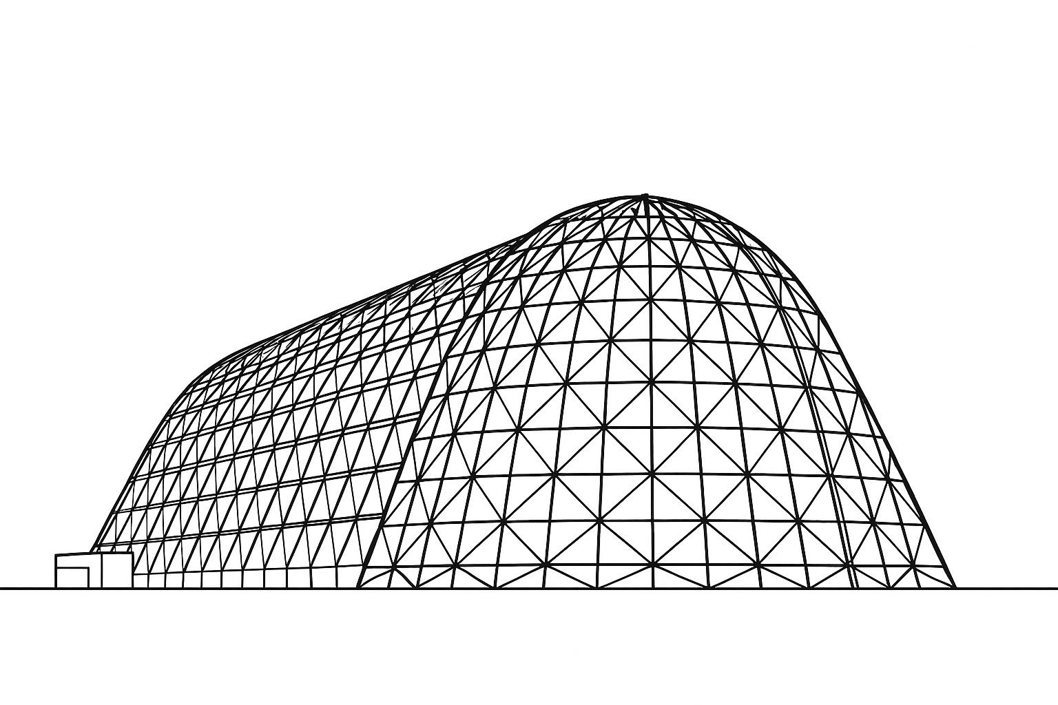


Injector Experiment Simulation and Experiment Design for Centrifugal Nuclear Thermal Rocket Engine
TFAWS 2025 Thermal Control & Protection Technical Session
Presented by: Timothy Blackman
Timothy Blackman, Doctoral Candidate.
Robert A. Frederick, Jr., PhD.
The University of Alabama in Huntsville
Thermal & Fluids Analysis Workshop 2025
NASA Ames Research Center
San Jose, CA
August 4-7, 2025

Slide 2
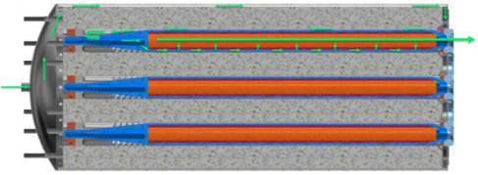
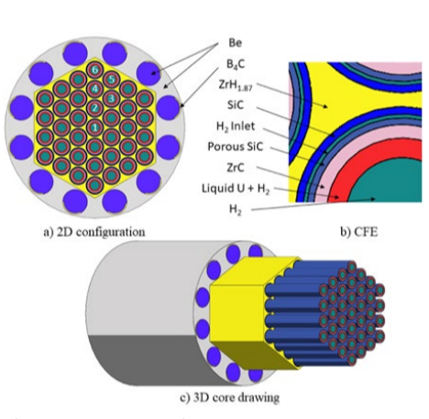
Background
Centrifugal Nuclear Thermal Propulsion (CNTP) has been researched since 1954 and is a liquid-core concept of a Nuclear Rocket Engine [1]
Liquid uranium is contained at 5500 K within multiple Centrifugal Fuel Elements (CFEs) [2]
Gaseous hydrogen propellant flows throughout the engine structure keeping temperatures below 800 K
The University of Alabama in Huntsville (UAH) research team has created a 37-core reference configuration which predicts a Specific Impulse of up to 1500 s
Propellant Flow Path [2]
UAH Reference Engine Design [3]

Slide 3
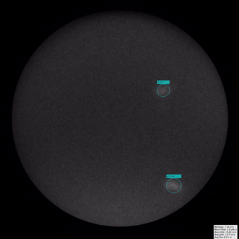
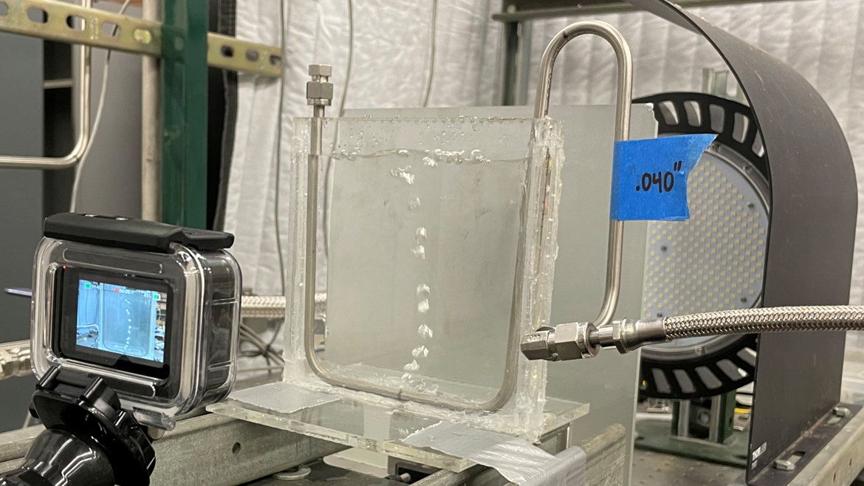
UAH Experiment Campaign
1D ANTFARM Experiment
Galinstan Experiment

Slide 4
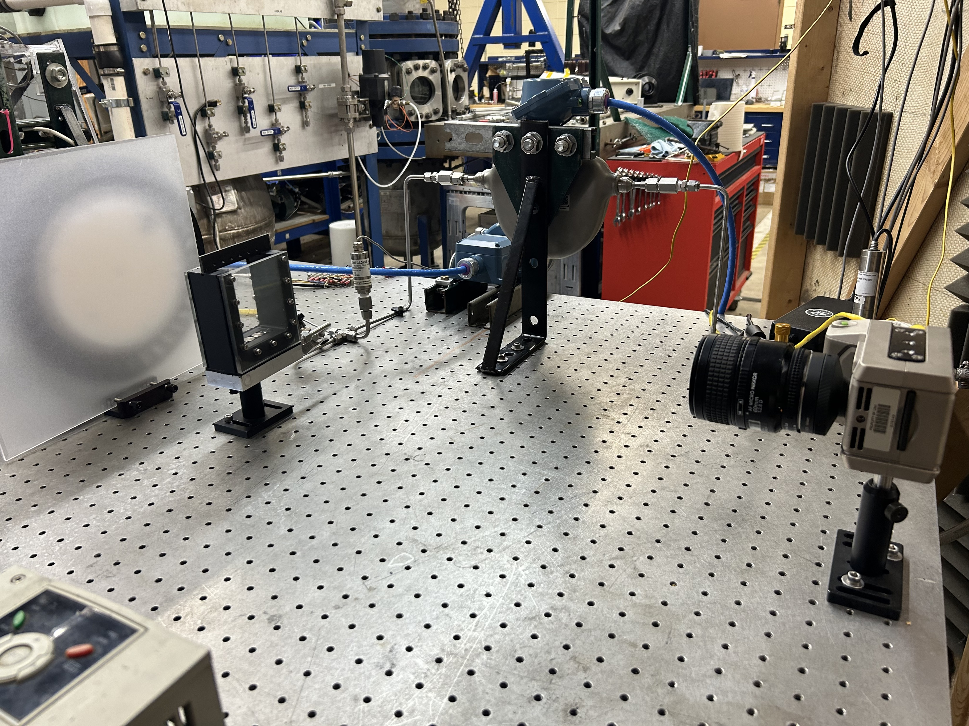
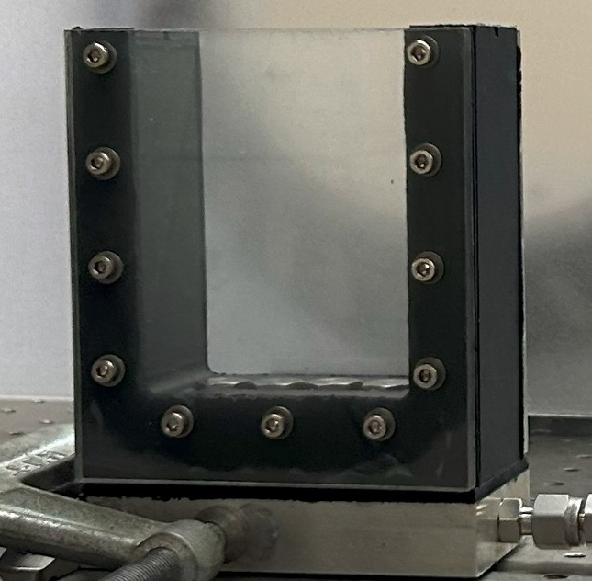
UAH Bubblina Apparatus
Bubblina Apparatus
Bubblina Experiment Set Up

Slide 5
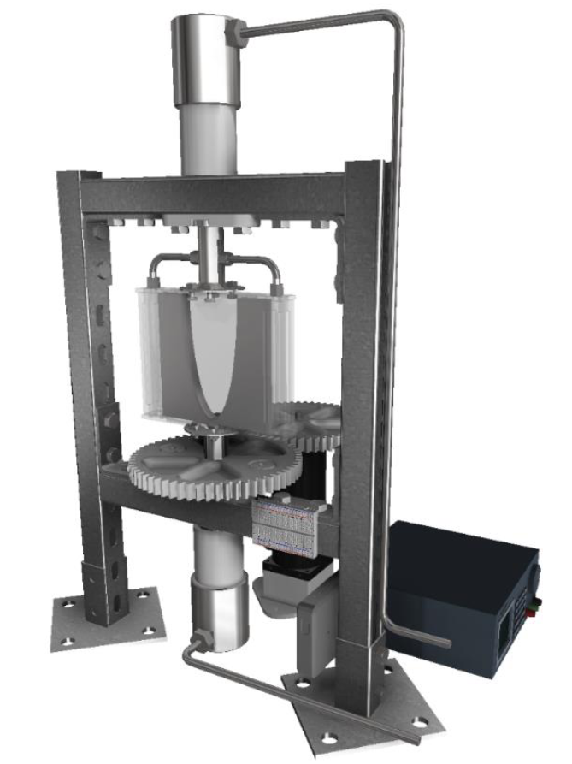
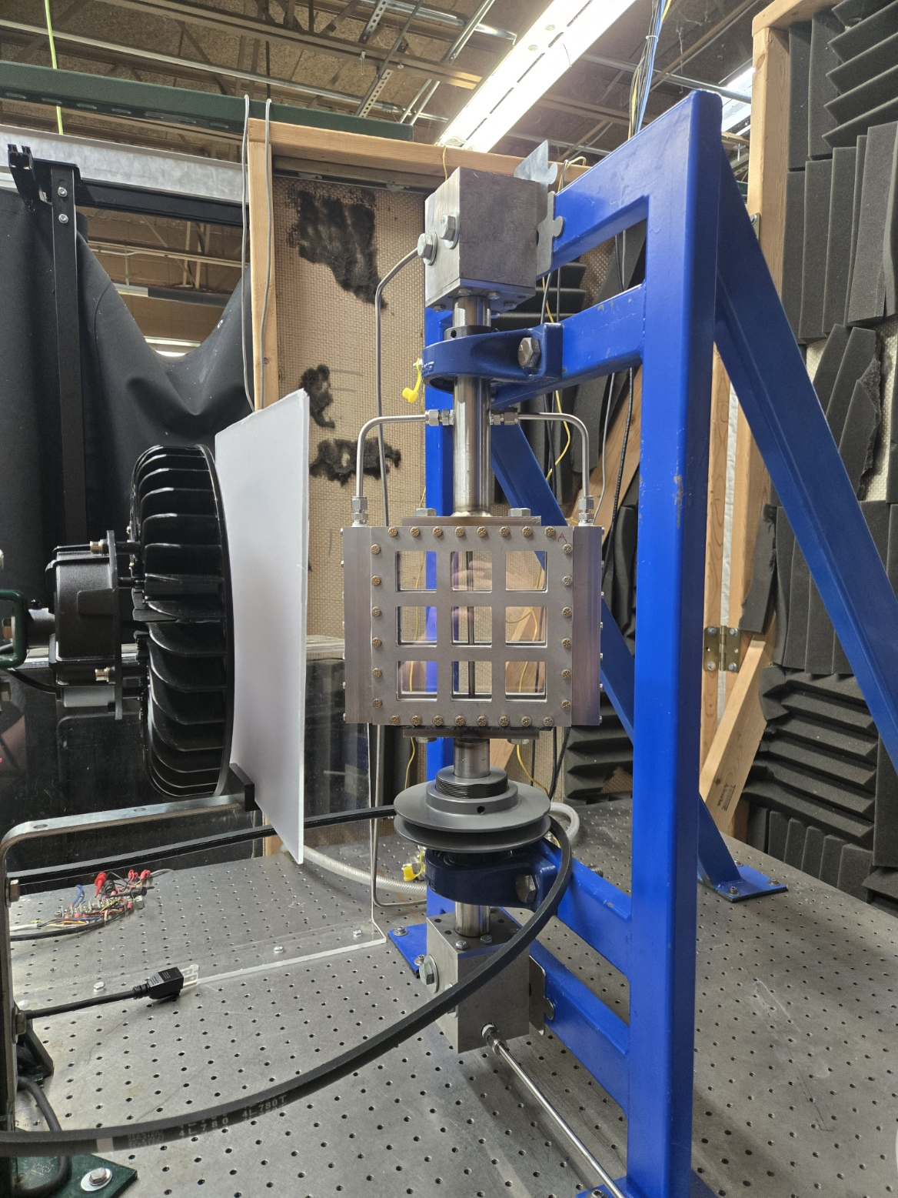
UAH BLENDER Apparatus
BLENDER I Apparatus
BLENDER II Apparatus

Slide 6
Updated BLENDER
BLENDER III Apparatus

Slide 7
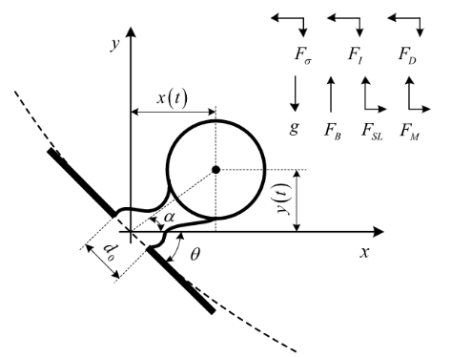
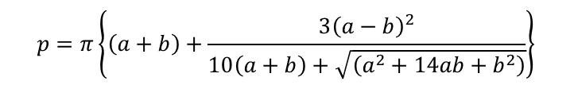
Bubble Dynamics
Bubbles within the CFE are formed via gas injection
Bubble formation can be described through balancing the forces acting on the bubble
Formation can be captured using a high-speed camera
An equivalent bubble size is determined using AI detection and the Ramanujan Ellipse Circumference Approximation
Forces Acting on a Forming Bubble [4]
$$F_{B}+F_{SL}+F_{M}=F_{D}+F_{I}+F_{σ}$$
Bubble Force Balance Equation
$$\begin{aligned}p=π\left\{\left(a+b\right)+\frac{3{\left(a−b\right)}^{2}}{10\left(a+b\right)+\sqrt{\left(a^{2}+14ab+b^{2}\right)}}\right\}\end{aligned}$$
Ramanujan Ellipse Circumference Approximation

Slide 8
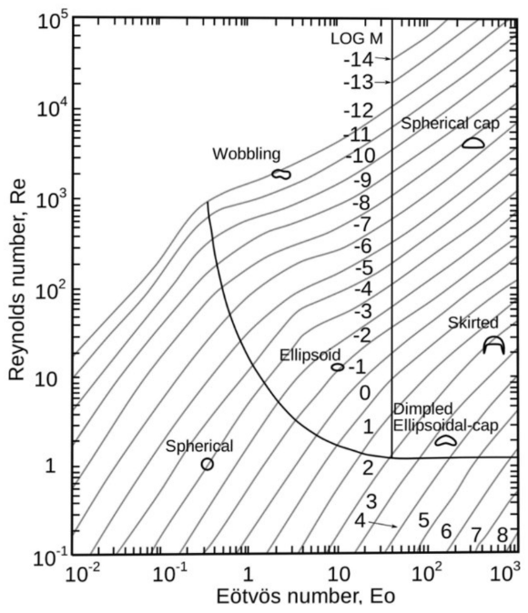


Bubble Dynamics
Bubble shape can be predicted using the Reynold’s and Bond (Eӧtӧs) numbers
$$Re=\frac{UDρ_{l}}{μ_{l}}$$
$$Eo=\frac{g\left(ρ_{l}−ρ_{b}\right)D^{2}}{σ}$$
µ_{l} = Liquid Viscosity
ρ_{l} = Liquid Density
ρ_{b} = Gas Density
σ = Surface Tension
D = Bubble Diameter
g = Gravitational Force
U = Bubble Velocity
Grace Diagram [5]

Slide 9
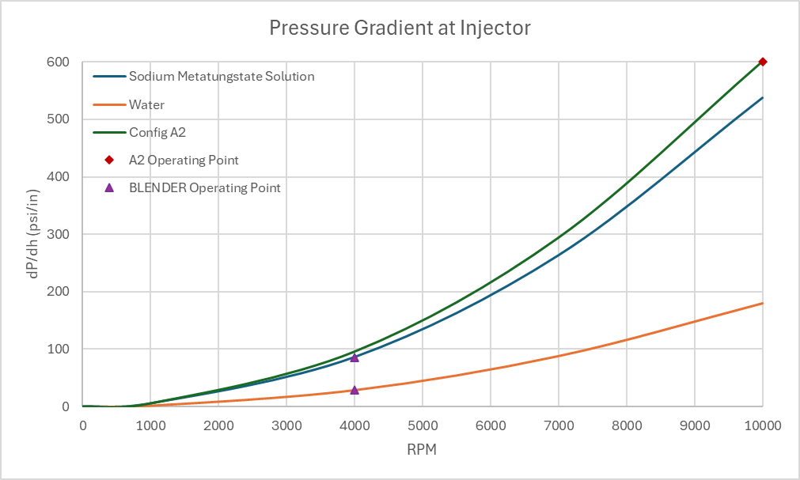
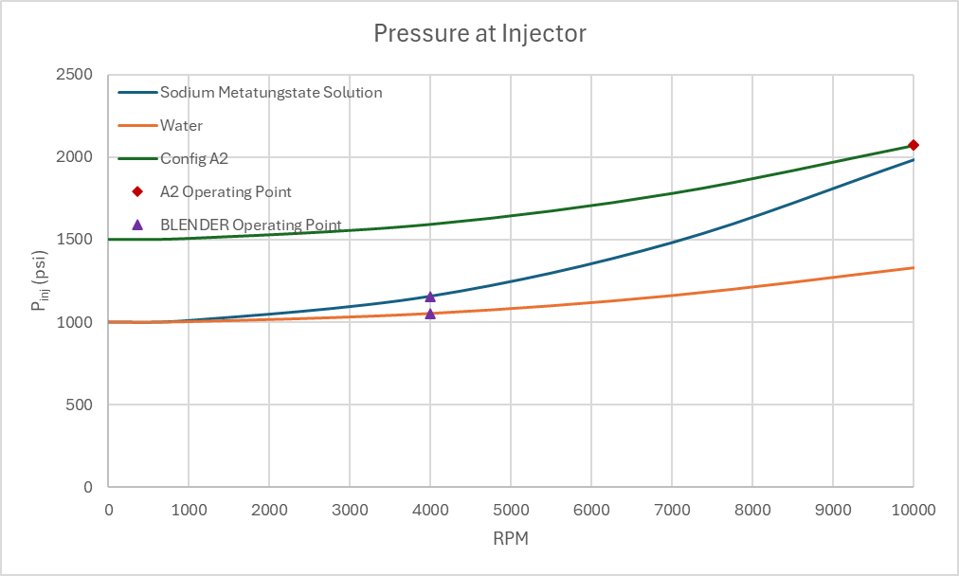
Experiment Design
UAH Baseline CFE configuration
Rotates at 10,000 RPM
Chamber Pressure = 1450 psi
Liquid Uranium Layer = 0.34 in
Pressure Gradient in Layer = 600 psi/in
BLENDER Configuration
Max Rotation = 4,000 RPM
Max Chamber Pressure = 500 psi
Liquid Layer = 1.75 in
Pressure Gradient at Injector
Pressure at Injector

Slide 10
Experiment Design
Chamber Pressures
0 psi
250 psi
500 psi
Chamber Size
Outside Radius: 2.75 in
Inside Radius: 1 in
Pressure Gradients
0.45, 7.18, 28.72 psi/in
1.35, 21.54, 86.15 psi/in
Liquids
Water
Sodium Polytungstate Solution (SPT-3)
Rotations
500 RPM
2000 RPM
4000 RPM
Injectors
Number per side: 1-4
Orifice Diameter: 0.04”
Orifice Sizes
Upstream: 0.05”
Downstream: Variable Needle Valve

Slide 11
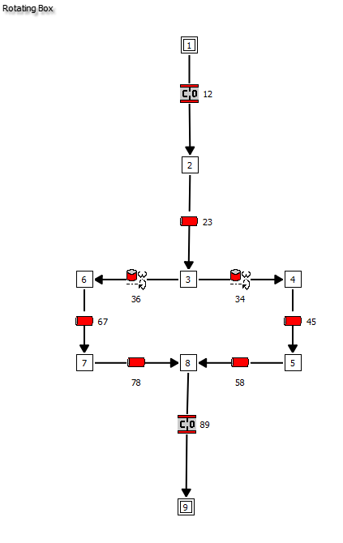
Injector Experiment Simulation Using GFSSP
NASA’s Generalized Fluid System Simulation Program (GFSSP) is used to inform the test matrices
Forces modeled on the bubble:
Pressure
Drag
Centrifugal
Buoyancy
Pipes 58 and 78 model the liquid and bubbles using a FORTRAN subroutine
Assumes one, unchanging bubble with static drag coefficient
Currently, flow is controlled at the injectors
GFSSP Model

Slide 12
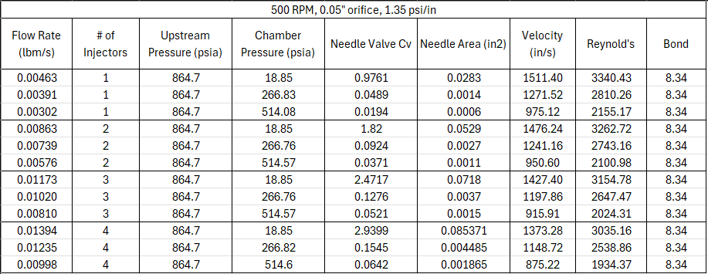
Example SPT3 Test Matrix

Slide 13
Grace Diagram Testing Box

Slide 14
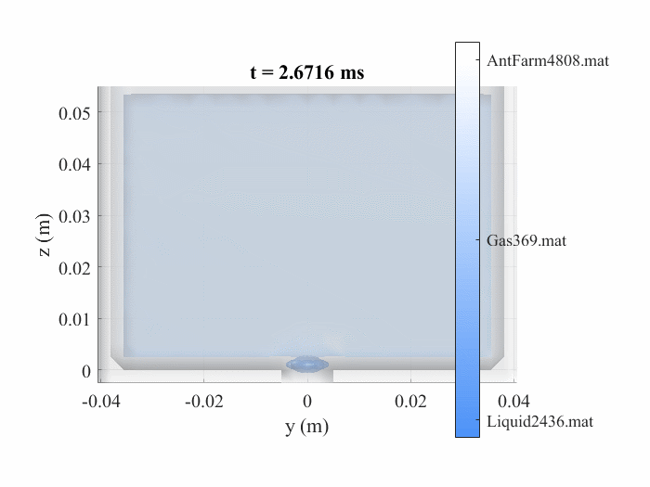
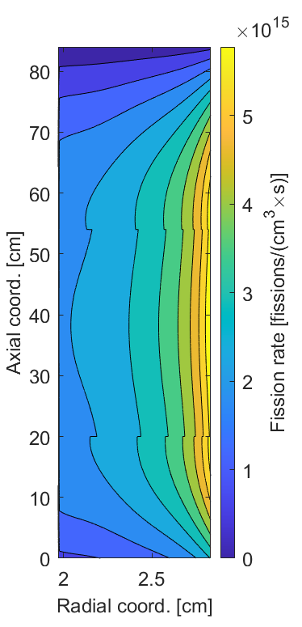
Results/Future Work
Data collected from these runs will be used as validation for the CFD engine modelers of the research team
Tangible bubble formation data will be used to improve heat and mass transfer calculations and thus overall engine performance
Bubble data will also be useful for other disciplines that use centrifuges
CFD of ANTFARM [6]
CFE Fission Rate [7]

Slide 15
Thank You
Timothy Blackman
University of Alabama in Huntsville
timothy.blackman@uah.edu
This work was supported by NASA’s Space Technology Mission Directorate (STMD) through the Space Nuclear Propulsion (SNP) project

Slide 16
Questions?

Slide 17
Sources
[1] McCarthy, J., “Nuclear Reactors for Rockets,” 1954.
[2] Houts, M., Patterson, M., Heidet, F., Foster, J., Johns, M., Smith, N., and Allen, J., “Overview of High-Performance Centrifugal Nuclear Thermal Rocket Propulsion System,” presented at the 2020 ANS Virtual Winter Meeting, 2020. https://doi.org/10.13182/T123-33578
[3] Thomas, D., Houts, M., Wang, D., Hollingsworth, K., Frederick, R., and Cassibry, J., “Addressing Challenges to Engineering Feasibility of the Centrifugal Nuclear Thermal Rocket,” International Astronautical Congress, 2024.
[4] Zhang, J., Xia, Z., Huang, L., and Ma, L., “Experimental and Numerical Parametric Studies on Two-Phase Underwater Ramjet,” Journal of Propulsion and Power, Vol. 34, No. 1, 2018, pp. 161–169. https://doi.org/10.2514/1.B36533
[5] Haas, T., Schubert, C., Eickhoff, M., and Pfeifer, H., “A Review of Bubble Dynamics in Liquid Metals,” Metals, Vol. 11, No. 4, 2021, p. 664. https://doi.org/10.3390/met11040664
[6] Ayuthya, P. D. N., and Cassibry, D. J., “Mitigating Liquid Over-Compressibility in Liquid-Gas Models for Centrifugal Nuclear Thermal Propulsion Systems,” presented at the Nuclear and Emerging Technologies for Space 2025, Huntsville, AL, 2025. https://doi.org/doi.org/10.13182/NETS25-47460
[7] Schroll, M., Frederick, R., Thomas, L. D., "Characterization of Engine Cooldown for a Centrifugal Nuclear Thermal Rocket," 75th International Astronautical Congress, Milan, Italy, Oct. 2.024

Slide 18
Back Up Slides

Slide 19
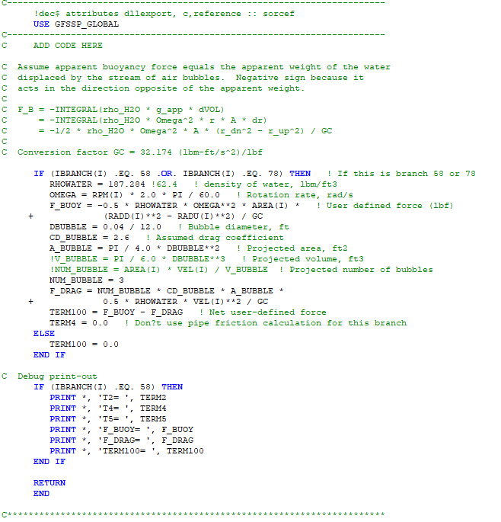
FORTRAN Subroutine

Slide 20
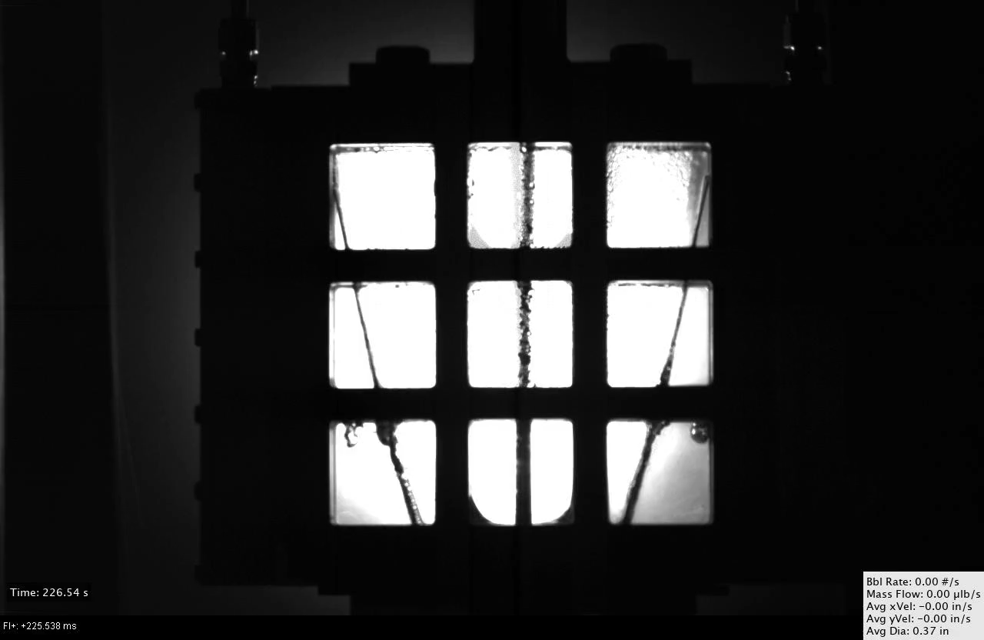
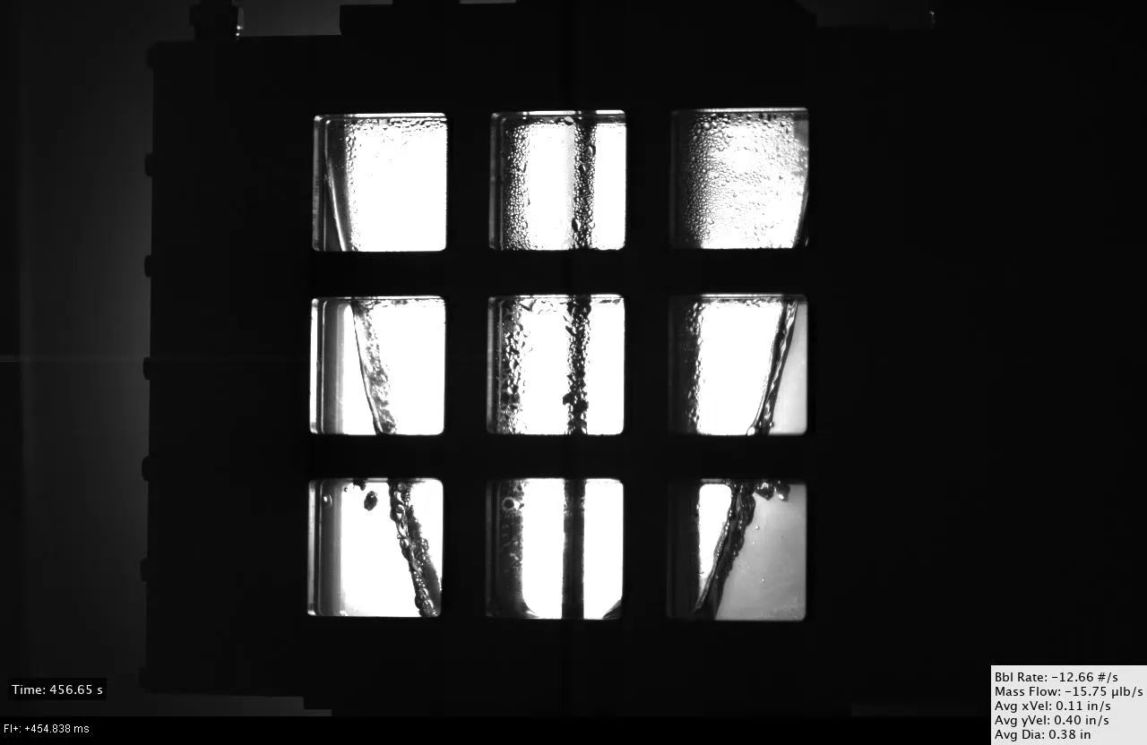
Previous Spinning Experiments
70 psi at 300 RPM (Still)
70 psi at 300 RPM (Burst)

Slide 21
Motivation for AI-Based Bubble Detection
AI Objective: Improve reliability of bubble detection & tracking under dynamic conditions
Traditional image processing methods struggled with:
Background variation
Lighting changes
Motion blur in spinning mode
Enables accurate measurement of:
Bubble diameter
Position
Velocity

Slide 22
AI Architecture Overview
Image
Mask R-CNN
CNN Classifier
Kalman
Two-Stage Pipeline:
Mask R-CNN (Detectron2) → generates candidate pixel masks
CNN Classifier (PyTorch) → confirms if candidate is a bubble
Tracking:
Kalman filter algorithm for frame-to-frame consistency
TFAWS 2025 – August 4-7, 2025

Slide 23
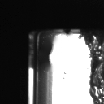
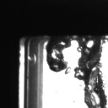
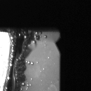
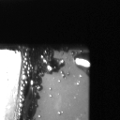

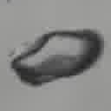
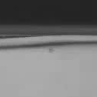
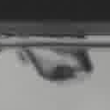
Data Curation Process
Negative
Positive
Positive Samples:
Pixel masks labeled using Matlab’s Image Labeler
Centroids extracted → patches cropped (128×128) to include border reflection
Negative Samples:
Centroids extracted on blank images → patches cropped (128×128) to include border reflection
Apply inpainting to known mask regions
Fill in removed areas using neighboring pixels or Gaussian noise
Mask Generation:
Binary .png masks saved from segmentation tools
Converted to COCO JSON using utility scripts
CNN Negative and Positive Training Data
TFAWS 2025 – August 4-7, 2025

Slide 24
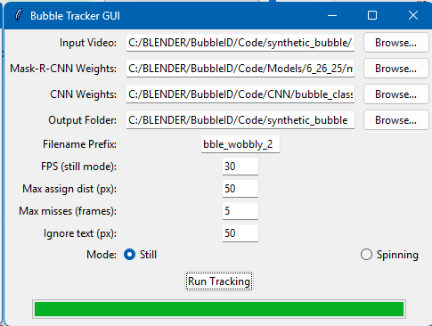
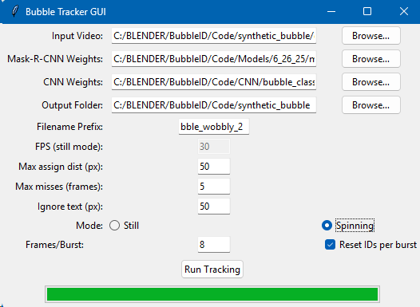
App Integration (GUI Tool)
GUI allows user to load:
Video
Mask R-CNN model (.pth)
CNN classifier (.pth)
Performs:
Mask inference
CNN filtering
Kalman filter tracking
Output:
Tracked .avi videos
Per-frame CSV and summary velocity CSV
GUI for Still Option
GUI for Spinning Option
TFAWS 2025 – August 4-7, 2025

Slide 25
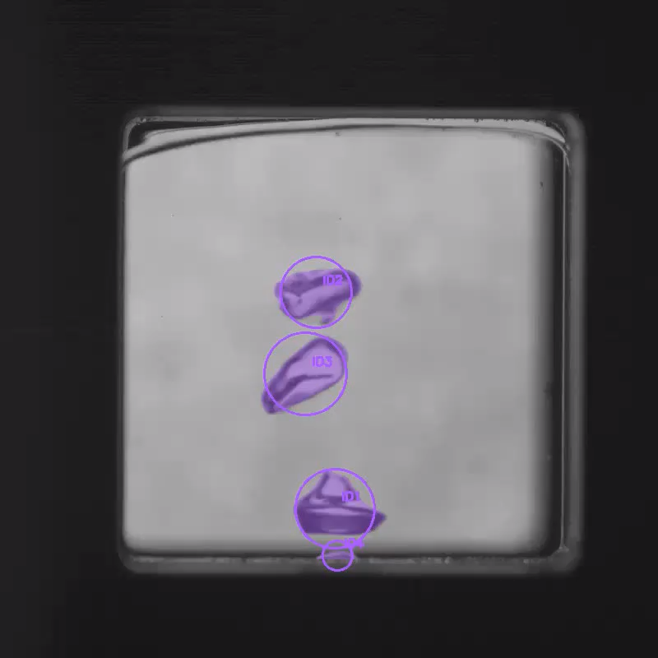
Outputs and Visuals
Final Filtered Still Video
TFAWS 2025 – August 4-7, 2025

Slide 26
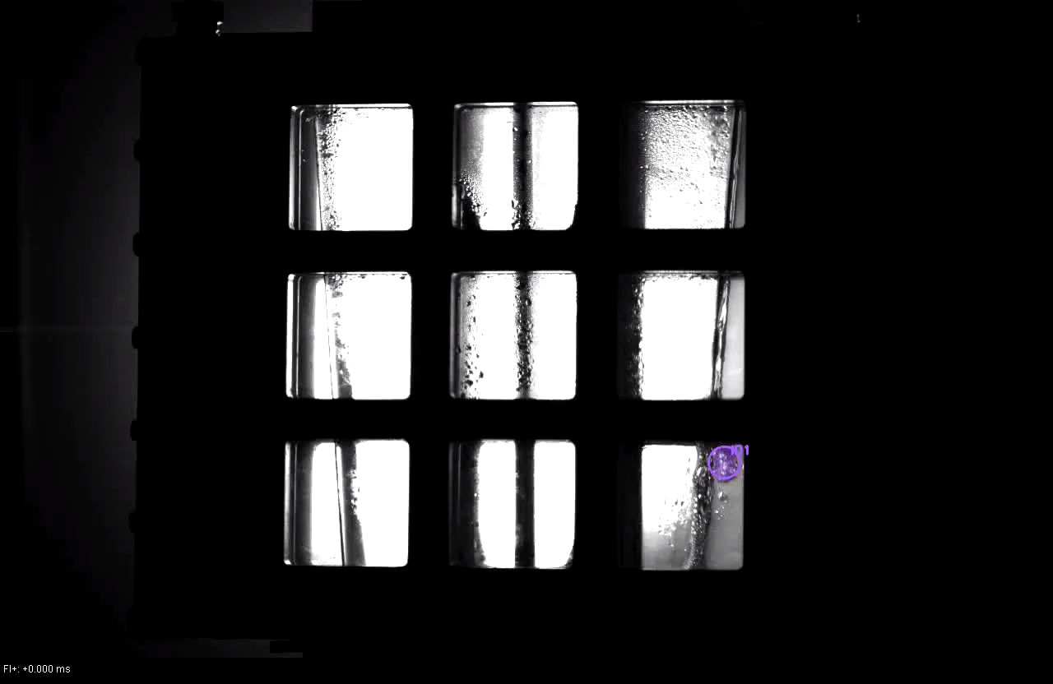
Outputs and Visuals
Final Filtered Spinning Video
TFAWS 2025 – August 4-7, 2025

