Slide 1

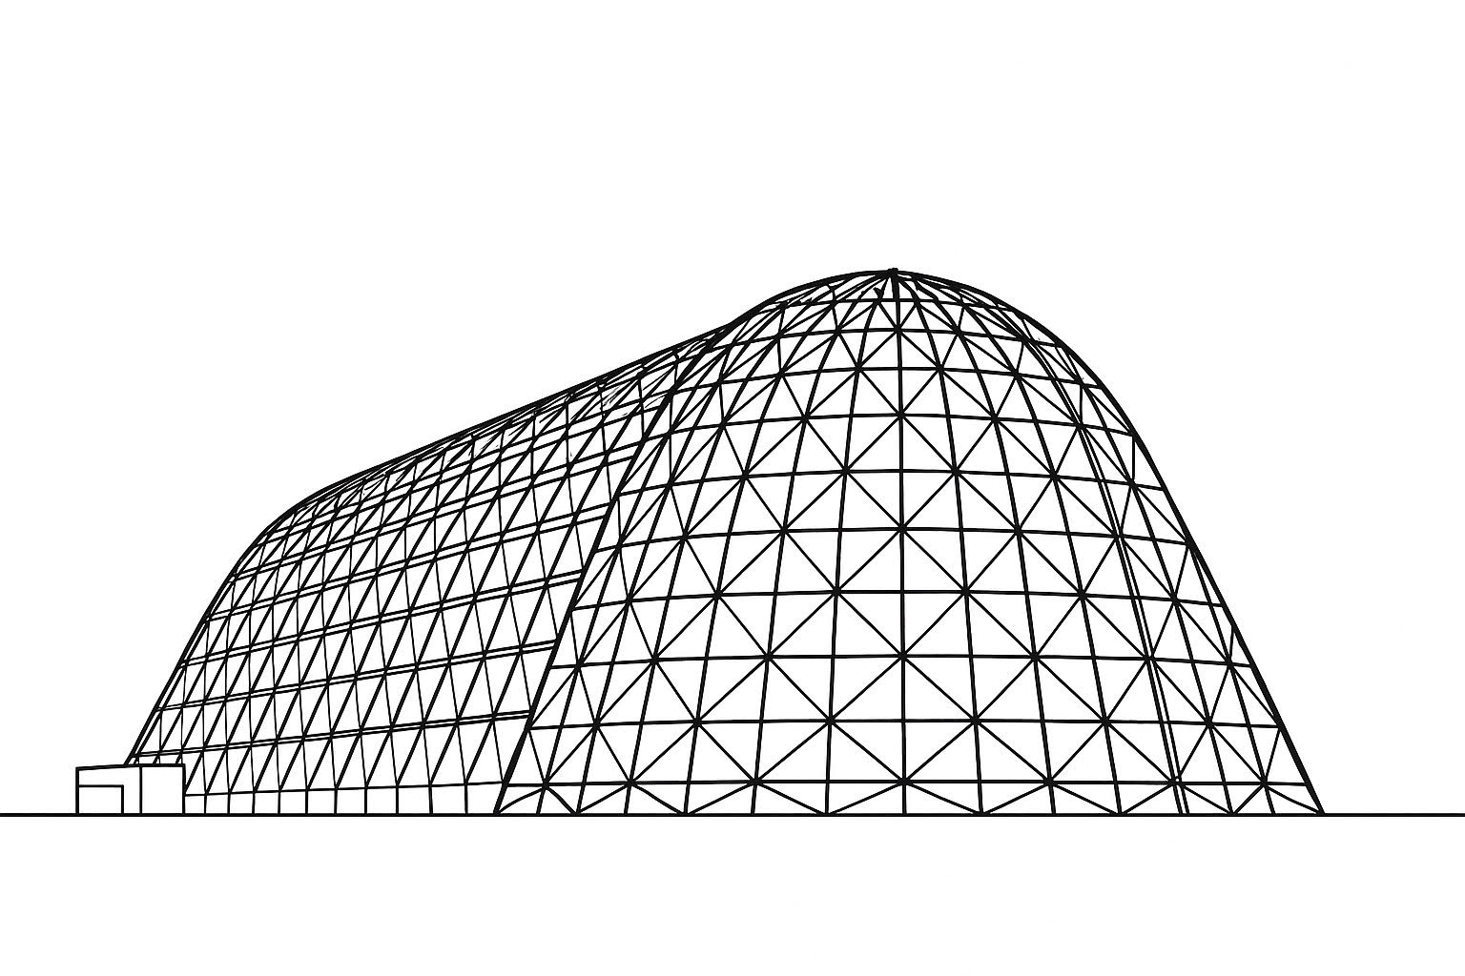

A Mathcad model to perform orbital vehicle ascent venting analysis to determine the vent sizes to maintain the differential pressure loads within required limits
TFAWS 2025 Passive Thermal Technical Session
Presented by: Siraj Jalali
Siraj Jalali, Ph.D.
James Galbraith
Oceaneering Space Systems
NASA Johnson Space Center
Thermal & Fluids Analysis Workshop 2025
NASA Ames Research Center
San Jose, CA
August 4-7, 2025

Slide 2
Venting Analysis Math Model Description
A Mathcad model to size the vent for enclosed gas during the launch to escape or inflate without causing over the limit pressure load on the system.
The flight environment conditions are applied in the model along with enclosed gas conditions.
The differential pressure causing by enclosed gas are manipulated by changing the vent size to maintain it within required limits.
The math model applies the choked and unchoked conditions to determine the mass flow across the vent and subsequently determine the enclosed mass conditions.
Any number of flight data can be applied in the model by assigning their indexes, and by changing the vent size resulting enclosed gas differential pressure can be attained within the pressure load requirements.

Slide 3
Venting analysis math modeling applicability
In flight environment the pressure and temperature variations develop differential pressure across the thermal protection system (TPS).
This differential pressure overloads the fasteners, subsequent attachments, components, and the TPS itself, that could cause failure of not just the fasteners and TPS but also failure of the mission itself.
To mitigate the overloading problem and failure of the components, vent holes are introduced in the assembly to maintain the differential pressure within allowable limits.
The math model developed inputs flight pressure and temperature profiles and set of orifice data such as its CD and hole diameter along with number of orifices to be drilled in the structure for air to move in and out of the structure.
Different sets of orifice data are applied to determine the variation of the differential pressure across the TPS. The number of holes in the structure can be drilled to maintain required differential pressure across the TPS to maintain the loads on the fasteners and structures as well as on TPS itself.

Slide 4
Venting analysis math modeling assumptions and notes
The math model was developed using Mathcad Prime 7.0. For venting model development some assumptions were made.
The enclosed gas volume was assumed as constant, and gas was interacting with the AL structure. The shape of AL structure confining the gas was assumed to be spherical being the least surface area to volume ratio, hence having minimum amount of heat transfer between structure and enclosed gas.
AL spherical structural outer surface is assumed insulated.
The flight pressure and temperature the enclosed gas interacting with are applied as boundary conditions, i.e. those are not changing due to mass of gas flowing in and out of the confined volume.
The enclosed gas was assumed as air, its properties vary as function of its pressure and temperature.
The convection between AL structure and enclosed gas is assumed as natural with air velocity of 1 m/s.
For AL structure to enclosed gas heat transfer coefficient calculation turbulent flow was assumed, following Nusselt number expression was used:
Nu = 0.023*Re^{0.8}*Pr^{0.4}
Energy balance was performed for venting analysis based upon the mass flow in and out of the enclosed volume, the energy associated with the position of the system (PE) was ignored.
The flow through the orifice was modeled considering the choke or unchoke flow condition.
The orifices have two-way flow and assumed CD of 0.6 and 0.4 to cover extreme flow cases.

Slide 5
Venting analysis math modeling Nomenclatures
CD Coefficient of discharge
CPR Critical pressure ratio
C_wall AL structure specific heat
D_inner Enclosed air volume equivalent sphere diameter
dM Mass flow in and out of enclosed volume
Dorif Orifice equivalent diameter
DPA Absolute differential pressure across the TPS
DPR Actual differential pressure across the TPS
hair Air heat transfer coefficient
IMASS Initial enclosed mass of air
M mass flow rate in and out of enclosed volume
M_wall Mass of AL structure
MT Total enclosed mass at any time
MTD Total enclosed mass after air flows out
MTI Total enclosed mass after air flows in
NOH Number of orifice holes
Nu Nusselt number
PD Total enclosed air pressure after air flows out
PI Total enclosed air pressure after air flows in
Pblnk Enclosed air pressure
Penv Flight environment pressure
Pr Prandtl number
Qair Convection heat transfer between air and AL structure
Re Reynolds number
SA_inner Enclosed volume equivalent sphere inner surface area
SOA Single orifice area
Tblnk Enclosed air temperature
Tenv Flight environment temperature
THA Total hole (orifice) area
time Total data accumulation time
tsphere Enclosed volume equivalent sphere AL structure thickness
Twall Enclosed air equivalent sphere volume structure thickness
Vair Velocity of air
Vblnk Enclosed air volume

Slide 6
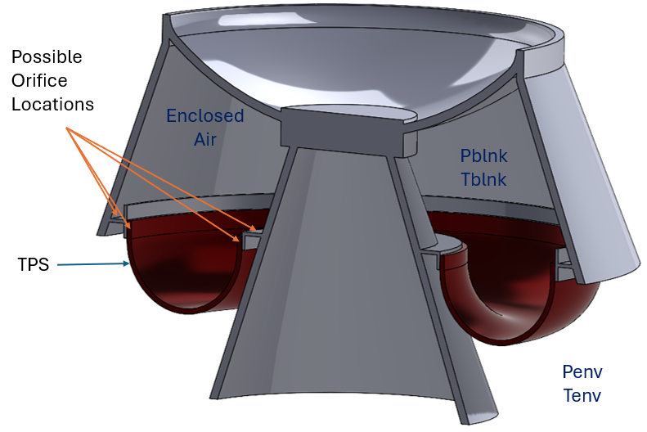
The enclosed air above the thermal protection blanket
All Avionics and actuators are located above the TPS in enclosed air area.
Orifices are drilled in the flange to move the air in and out of the enclosed volume to keep the differential pressure under the required limits.
Over the limit differential pressure would cause excessive loads on the Avionics, plunger, and all the fasteners and joints resulting failure of the flight.

Slide 7
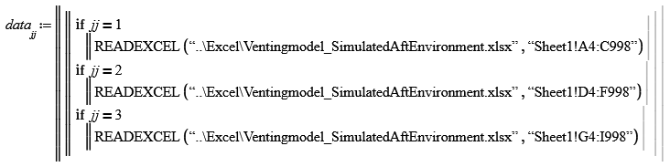
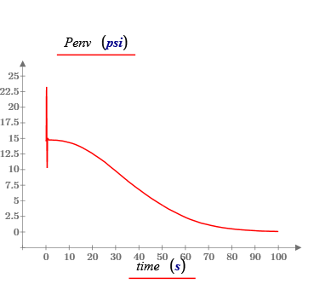
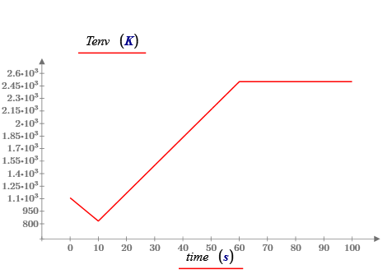
The flight environment input to the model
The flight “artificial ascent data” is prepared as Excel table and read in the model as follows:
Any numbers of data can be input in spreadsheet and read by setting the index ‘jj’ value. The flight or environment data read were as follows:

Slide 8
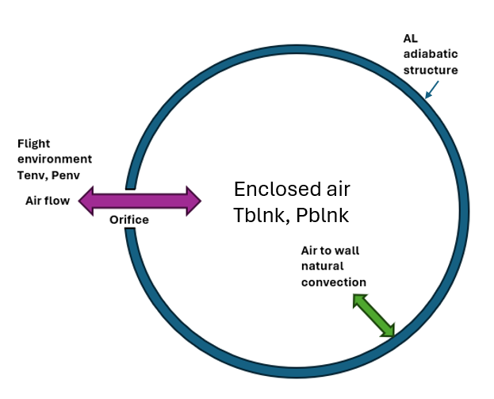
Enclosed Air Structure
The structure above the blanket was assumed as spherical to have lowest surface area to volume ratio so that enclosed air imparts minimum heat interaction with the wall inner surfaces. The graphical representation of air flow through orifices is depicted below:
The enclosed air inputs were assumed as follows:
Volume of enclosed air = V_{blnk} = 1308 L
Orifice CD = 0.6, for worst flow CD = 0.4 was assumed also
Total number of holes (orifices) = NOH = 13
Orifice diameter = D_{orif} = 0.25 inch

Slide 9
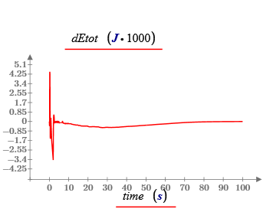
Energy balance for venting analysis
The energy balance of an open system at any instance was calculated as follows:
dEtot = dQconv + dU + dWflow + dKE + dComp + dPE
2. Convection energy added to air if Twall > Tblnk:
dQconv = hair * SA_inner * (Twall – Tblnk)
3. Internal energy dU of air:
dU = dM * Cv_air (Twall - Tblnk)
where dM = mass flow rate in and out of the controlled volume
4. The energy due pressure and volume:
dWflow = if (Pblnk > Penv, Pblnk, Penv) * dM / r_{air}
5. The kinetic energy of the system:
dKE = ½ * dM * Vair²
where Vair was velocity of air in and out of the system
6. The energy due to air compression / expansion
dComp = d(Pblnk * MT/rair)
7. dPE = 0, energy change due to position was ignored

Slide 10
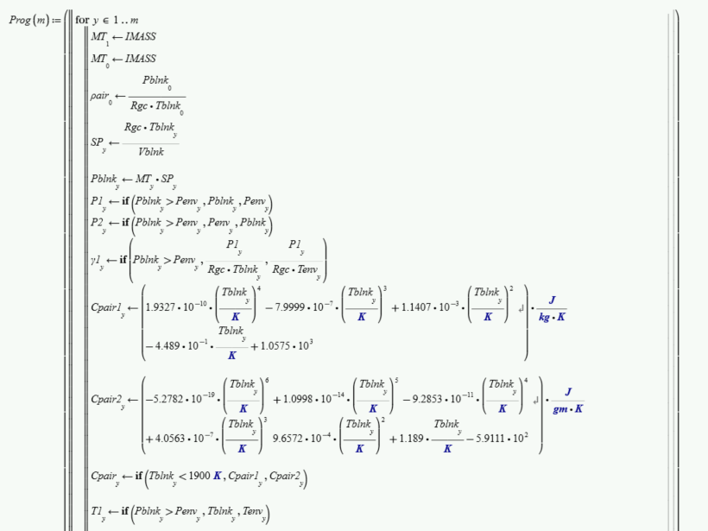
Mathcad Venting Model

Slide 11
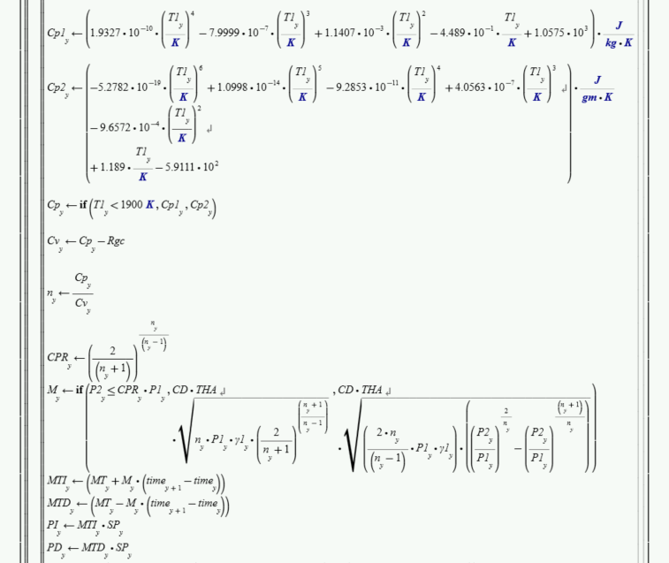
Mathcad Venting Model

Slide 12
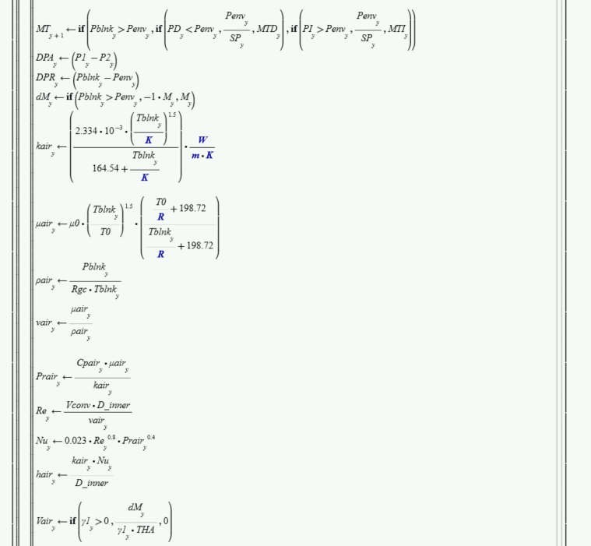
Mathcad Venting Model

Slide 13
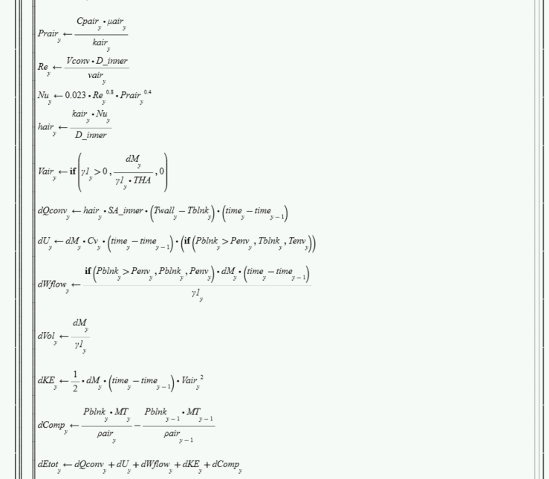
Mathcad Venting Model

Slide 14
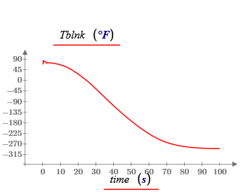
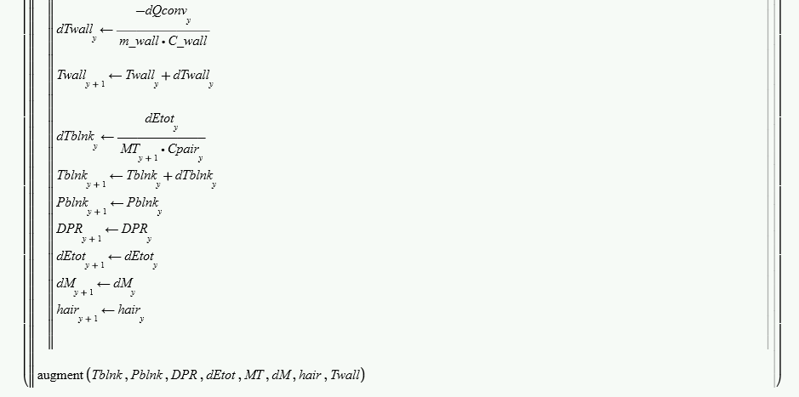
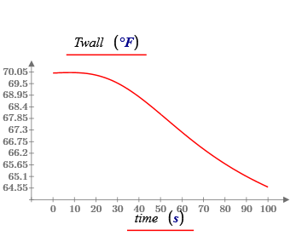
Mathcad Venting Model

Slide 15
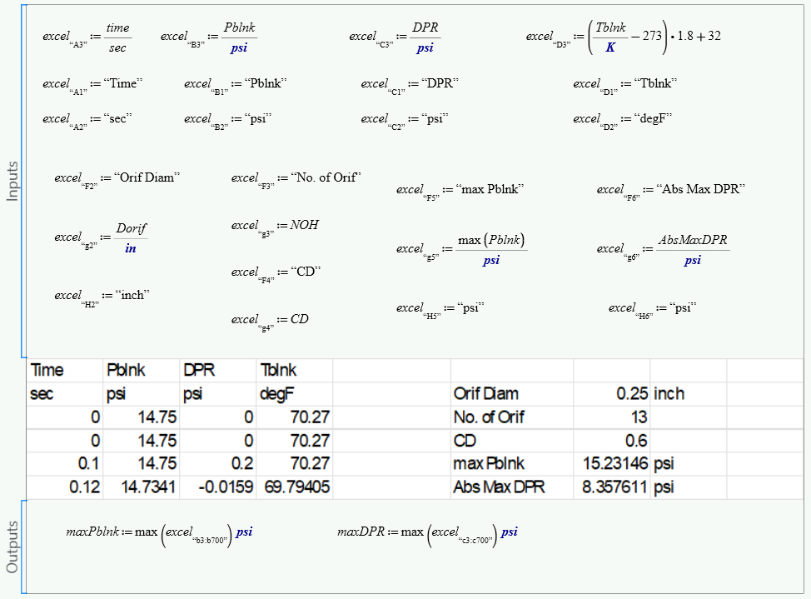
Mathcad Venting Model Output

Slide 16
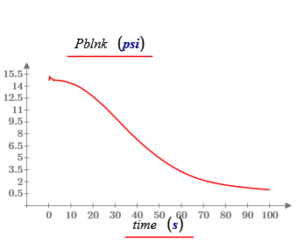
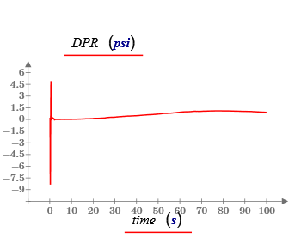
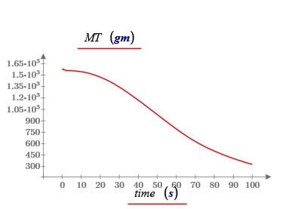
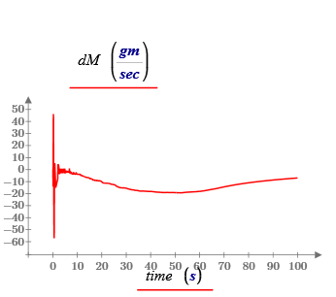
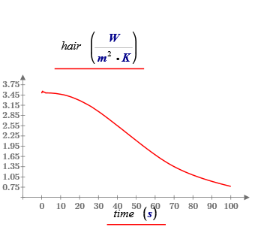
Mathcad Venting Model Charts

Slide 17
Conclusions
The math model can provide the enclosed air differential pressure control for a given fight environment
For gases other than air, the gas constant and properties expressions for specific heat, thermal conductivity, and dynamic viscosity will require to be changed per the gas being used.
Several sets of orifice diameter, CD, and number of orifices can be applied to attain corresponding differential pressures to satisfy the load requirements.
Several sets of input environment data can be applied to attain corresponding differential pressure loading on the fasteners and TPS back-face components.

